Slide 1
SSC 2030: Energy Systems & Sustainability
4. Coal
4.1: Coal: an introduction
4.2: Fuel of the industrial revolution
4.3 : Formation & composition
4.4: Modern extraction & current uses
4.5: Coal deposits, reserves & production
4.6: Global coal resources & reserves
4.7: Coal combustion & emissions
4.8: Alternative uses of coal
4.9: Carbon sequestration & clean coal

Slide 2
4. Coal
4.9: Carbon sequestration & clean coal

Slide 3
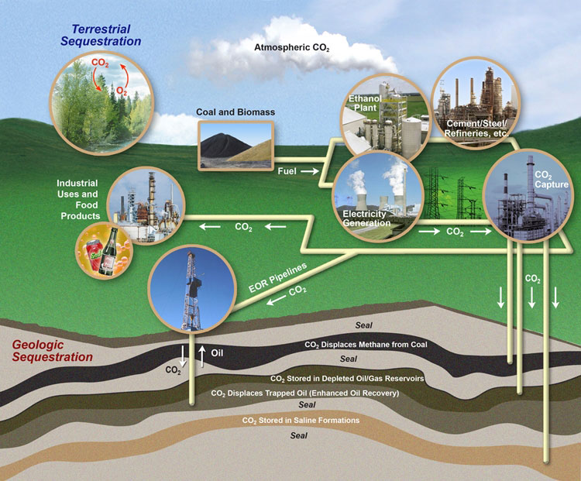
Carbon sequestration
Sequestration ties up carbon to keep it out of the atmosphere.
Biological sequestration is natural.
Can we engineer sequestration?
Wyoming Public Media
A Watt double-acting steam engine (1859)
Energy Systems & Sustainability, 2/e, Chapter 5; US Carbon Sequestration Program, US DOE

Slide 4
Dirty coal, clean future (Fallows)
Wyoming Public Media
A Watt double-acting steam engine (1859)
https://www.theatlantic.com/magazine/archive/2010/12/dirty-coal-clean-future/308307/

