Slide 1

SSC 2030: Energy Systems & Sustainability
4. Coal
4.1: Coal: an introduction
4.2: Fuel of the industrial revolution
4.3 : Formation & composition
4.4: Modern extraction & current uses
4.5: Coal deposits, reserves & production
4.6: Global coal resources & reserves
4.7: Coal combustion & emissions
4.8: Alternative uses of coal
4.9: Carbon sequestration & clean coal

Slide 2
4. Coal
  4.1: Introduction to coal

Slide 3
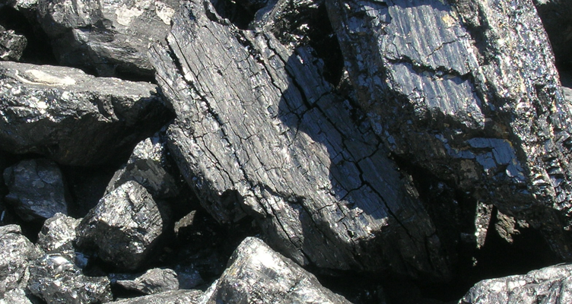
Comparing coal, oil & NG
How does coal compare to oil and natural gas?
Abundant: huge, globally distributed reserves;
Extraction has large environmental impacts (stip-mining);
  And is a health hazard;
More difficult to transport (less dense);
Produces twice as much carbon dioxide;
Produces large amounts of ash when burned;
  Ash can leach sulfuric acid & arsenic into ground water;
  Coal ash ponds and floods; &
Produces SOx and NOx in flue gasses.
For these reasons, coal is sometimes called the ‘ignoble’ fuel.
Yet coal production is up 4-fold from 1920 – 2009;
Even as its contribution to energy production is down from 60 – 25%
Energy Systems & Sustainability, 2/e, Chapter 5

Slide 4
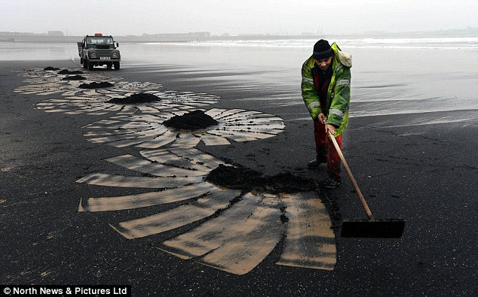
History of coal use
Wood was man’s first fuel and has been used for 3000 – 4000 years.
Charcoal is partially combusted (pyrolysis) wood that is more energy dense than wood.
Coal has been used for 2000 years in China & the Middle East.
‘Sea coal’ washes ashore from underwater deposits and was traditionally collected as a highly valued fuel along the coasts.
Hampton Court (1500s)
Mining started in the Roman era.
Brick chimneys allowed wood and
coal to be combusted indoors & withstood the corrosive flue gases.
  By 1680 1400 ships were used to transport coal in Britain.
Sea coal on the beaches of Scotland
Energy Systems & Sustainability, 2/e, Chapter 5; Daily Mail

Slide 5
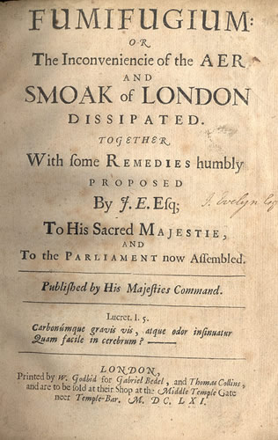
Air quality problems arose quickly
Air quality suffered as use of coal boomed. In this era British coal was ‘brown’ and high in sulfur. Air emissions resulted in huge amounts what we now call ‘smog’.
By 1661, London was cloaked in:
"Such a cloud of sea-coal, as if there be a resemblence of hell upon earth, it is in this volcano in a foggy day: this pestilent smoak, which corrodes the very yron [iron], and spoils all the moveables, leaving a soot on all things that it lights: and so fatally seizing on the lungs of the inhabitants, that cough and consumption spare no man."
- John Evelyn petitioning Charles II for zoning to move industry out of the city and improve air quality
Energy Systems & Sustainability, 2/e, Chapter 5; wikipedia

Slide 6
4. Coal
  4.2: Fuel of the Industrial Revolution

Slide 7
Industrial revolution: coal, iron & steel
The industrial revolution was made possible by coal, and one of its products, steel.
Iron ore is actually iron oxide.
Iron is purified by the process of smelting, that removes oxygen.
iron ore
coke
iron
flue gases
Fe₂O₃, Fe₃O₄ + C → Fe + CO₂ + CO
Coke: created by pyrolysis (combustion in limited oxygen) of coal at high temperatures (2000°F).
Nearly pure carbon as most impurities (O, S) are ‘driven off’
Coking works at night
Energy Systems & Sustainability, 2/e, Chapter 5

Slide 8
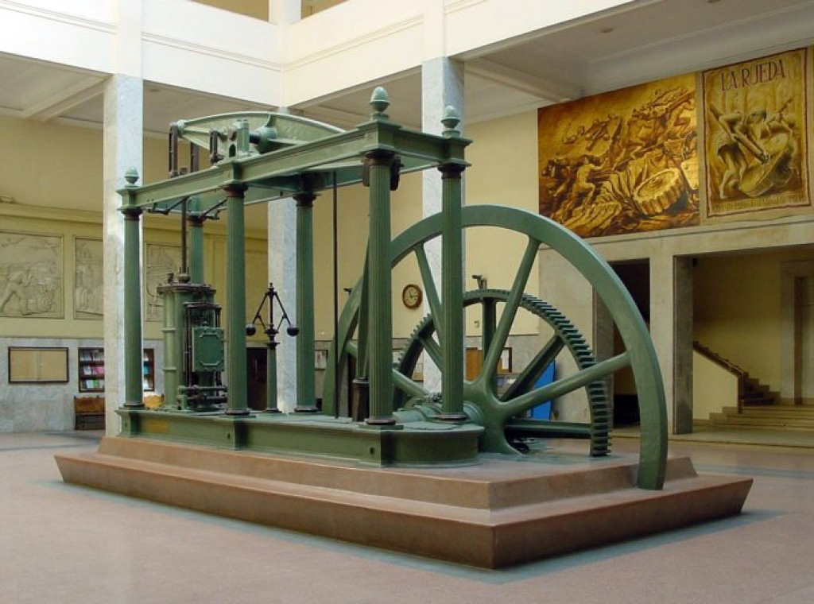
Industrial revolution: coal, iron & steel
James Watt’s steam engine (1769) converted the energy of coal to heat (steam) and then mechanical work.
Heralded the true start of England’s industrial revolution.
Made possible by coal and steel.
Steel: an alloy of iron & other elements, mainly carbon
Harder and stronger than iron
Carbon provided by adding coke
A Watt double-acting steam engine (1859)
Energy Systems & Sustainability, 2/e, Chapter 5; wikipedia

Slide 9
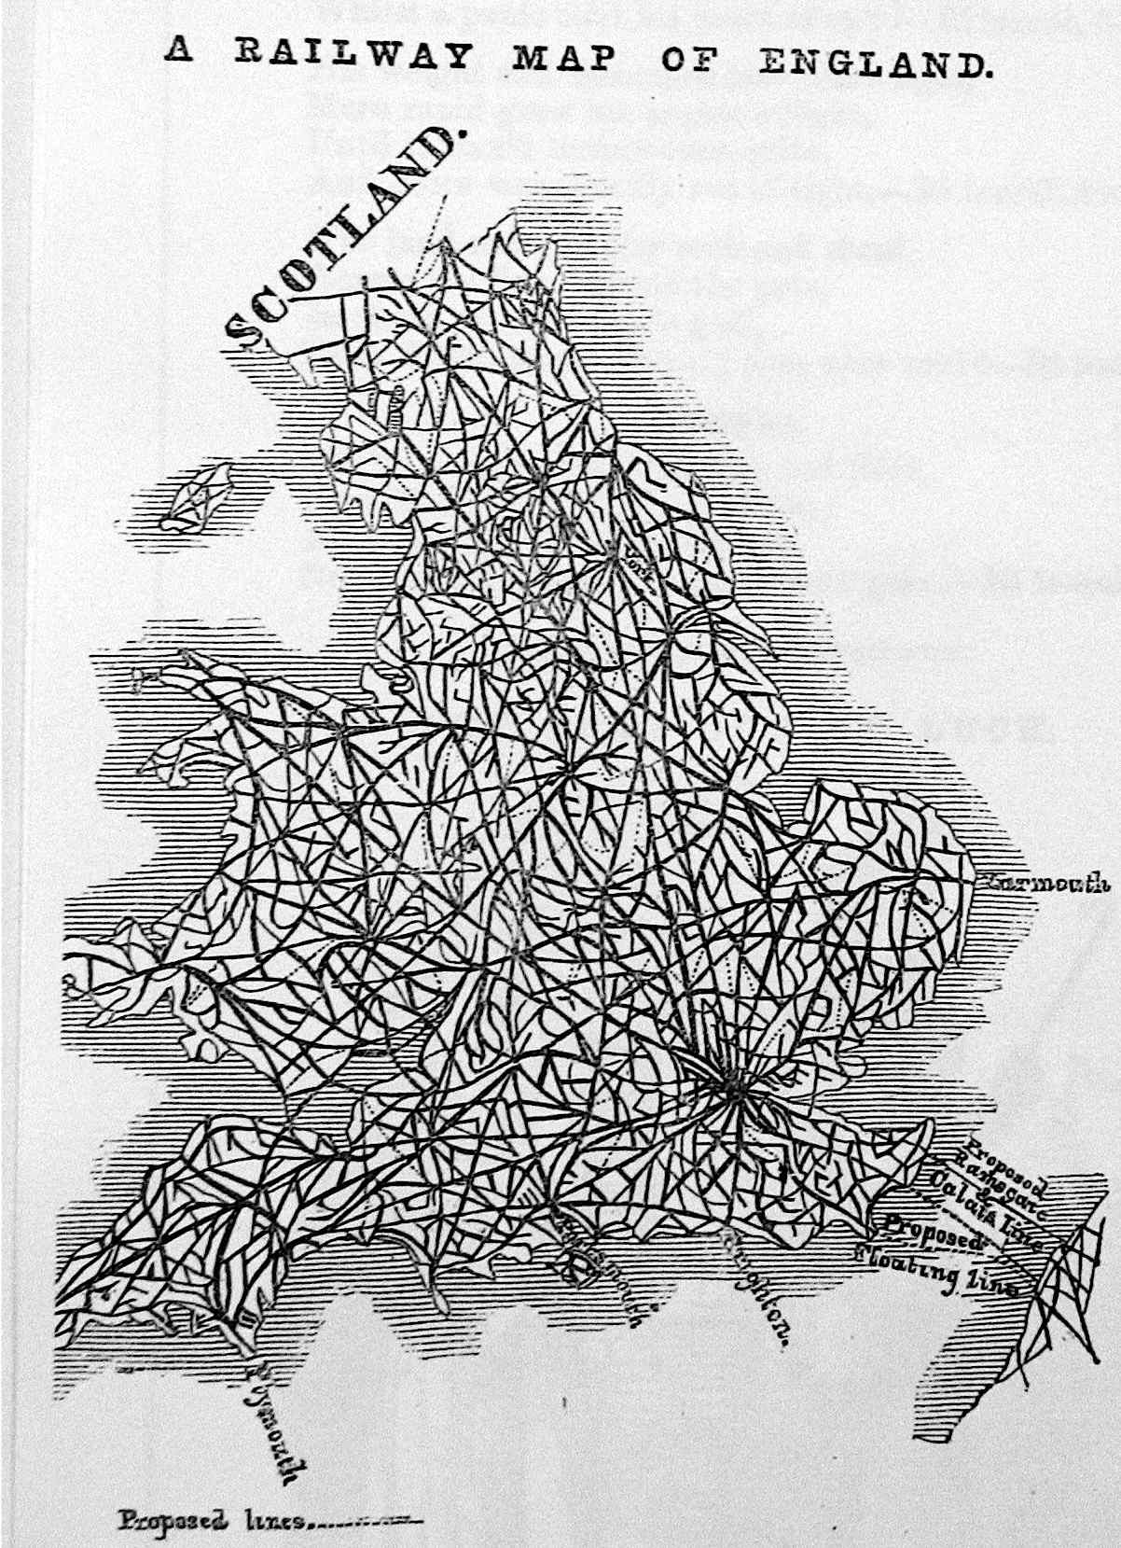
By 1800, coal was essential
By the 1800s coal was an essential commodity in England.
Coal powered mills;
Was essential for smelting & ironworks;
Was used in domestic heating.
1845
Over the next 100 years coal’s role
expanded to include:
Powering ships;
Driving railways;
Lighting cities; and
Providing feedstock for synthetic
fertilizer and chemical production
Energy Systems & Sustainability, 2/e, Chapter 5
https://ragpickinghistory.co.uk/2012/10/04/meta-ornament-railway-tracks/

Slide 10
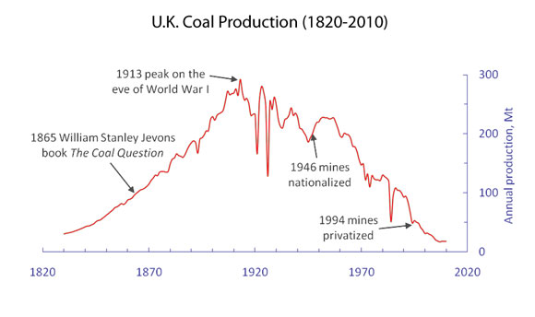
Coal production in England
1/3 exported
1900
UK & US: 300 Mtonnes
Germany: 100 Mtonnes
Global: 1 billion tonnes
https://blogs-images.forbes.com/williampentland/files/2011/09/UK-Coal-History2.jpg

Slide 11
4. Coal
  4.3: Formation & composition

Slide 12
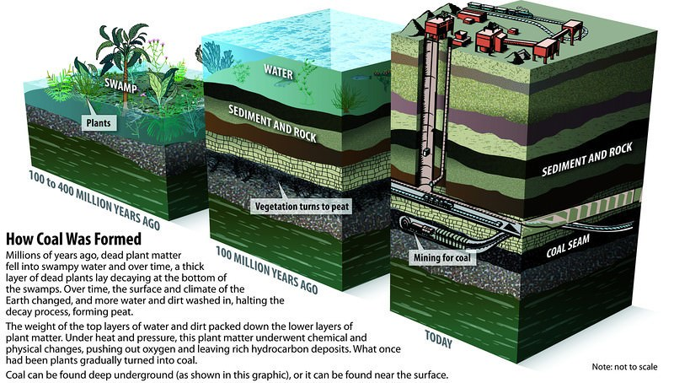
Chemical composition of coal
organics
partially
decompose
peat
heat, pressure
& time
coal
(older is better)
Energy Systems & Sustainability, 2/e, Chapter 5; pmfias.com

Slide 13
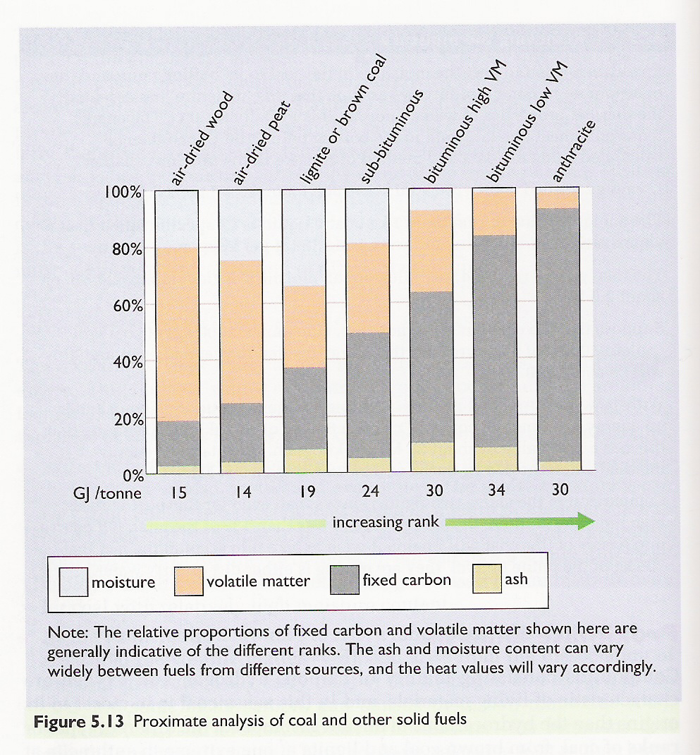
Chemical composition of coal
Proximate analysis: Quality of coal increases with increasing carbon content.
smokeless fuel
coke / steam
coke
steam
Elements:
C
H
N
S
O
Energy Systems & Sustainability, 2/e, Chapter 5

Slide 14
Combustion of coal
Ash remains: silicates & oxides of iron & aluminum.
Fixed carbon (coke) combines with oxygen to produce carbon dioxide flue gases (emissions) and heat.
smokeless fuel
coke / steam
coke
increasing temperature
Volatile matter (hydrocarbons) are boiled off into gases: H₂, CO, CH₄, C₂H₄, C₂H₂.
The gases combust, releasing heat.
steam
Water is heated & evaporated using a tiny fraction of coal’s energy.
Energy Systems & Sustainability, 2/e, Chapter 5

Slide 15
Why does coal produce more CO₂?
Coal is often referred to as a dirty fuel because of its emissions.
And it’s said to produce more carbon dioxide than other fossil fuels. Why?
The higher the C:H ratio of fuels, the more carbon dioxide they produce.
fuel | C:H ratio | Energy (MJ/kg) | CO₂ (mol/MJ)
coal | 1:1 | 39.3 | 2.0
oil | 2:1 | 43.6 | 1.6
ethanol | 3:1 | 27.3 | 1.6
natural gas | 4:1 | 51.6 | 1.2
hydrogen gas | 100% H | 120.0 | 0
smokeless fuel
coke / steam
coke
increasing temperature
steam
https://www.wou.edu/las/physci/GS361/Energy_From_Fossil_Fuels.htm

Slide 16
4. Coal
  4.4: Coal deposits, reserves & production

Slide 17
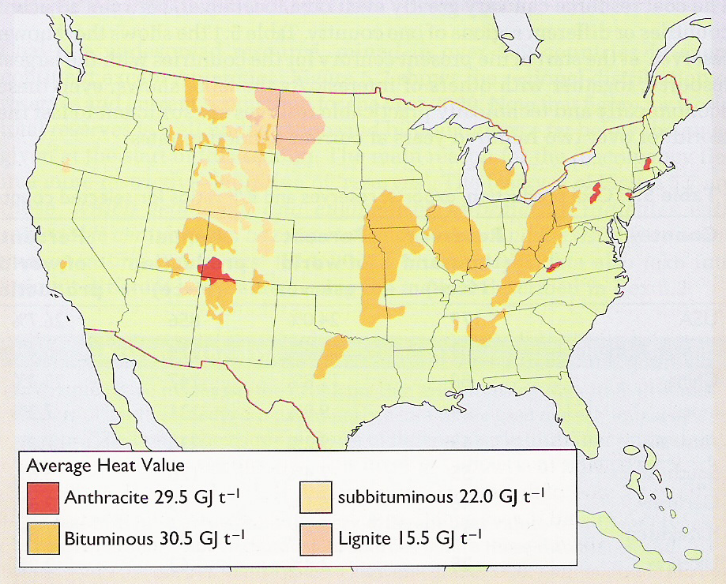
US coal deposits
Higher grade:
Hard coal
Black coal
Anthracite
Bituminous
Lower grade:
Brown coal
Lignite
Sub-bituminous
Energy Systems & Sustainability, 2/e, Chapter 5

Slide 18
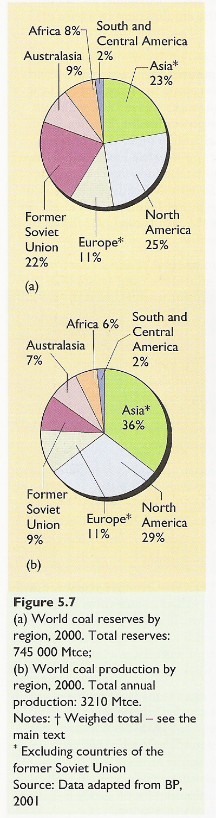
Global coal reserves & production
Reserves
Production
Energy Systems & Sustainability, 2/e, Chapter 5

Slide 19
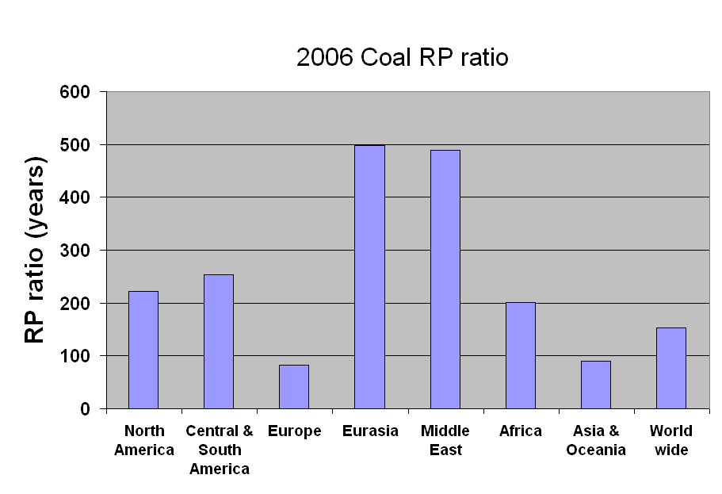
Global coal R/P ratios (2006)
Australia exporting
Russia: coal displaced by NG
India importing
UK mines down from 3000 to 13
China’s R/P 38 y
Energy Systems & Sustainability, 2/e, Chapter 5

Slide 20
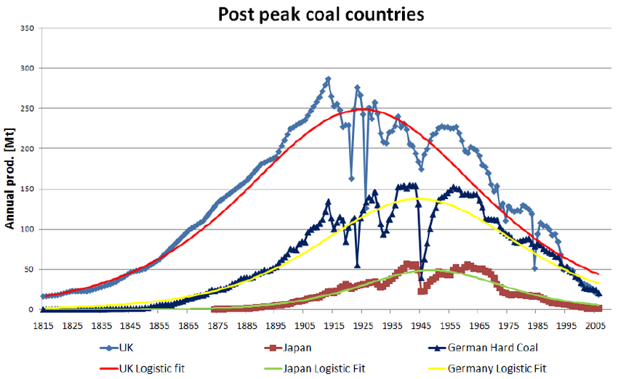
Some countries are well past peak
In fact, some have nearly null R/P ratios.
Figure 5.4
A Watt double-acting steam engine (1859)
https://www.researchgate.net/profile/Kjell_Aleklett/publication/228838239/figure/fig1/AS:300666963677184@1448695998872/Figure-1-The-peaking-of-several-countries-with-a-long-history-of-coal-mining-The-two.png

Slide 21
4. Coal
  4.5: Modern coal extraction methods & current uses

Slide 22
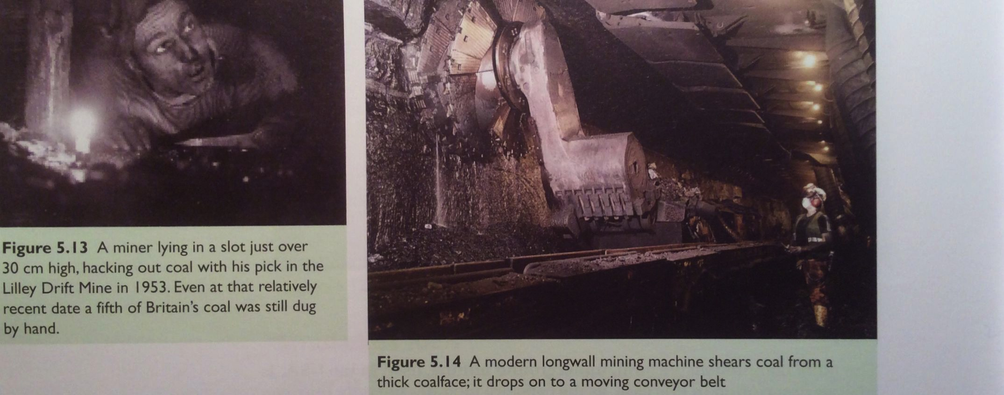
Mining automation: pit mines
Automation has changed pit mining dramatically over the past 70 years.
Fewer workers.
More production.
UK, 1953
Washington DNR
Today’s pit mine
Energy Systems & Sustainability, 2/e, Chapter 5

Slide 23
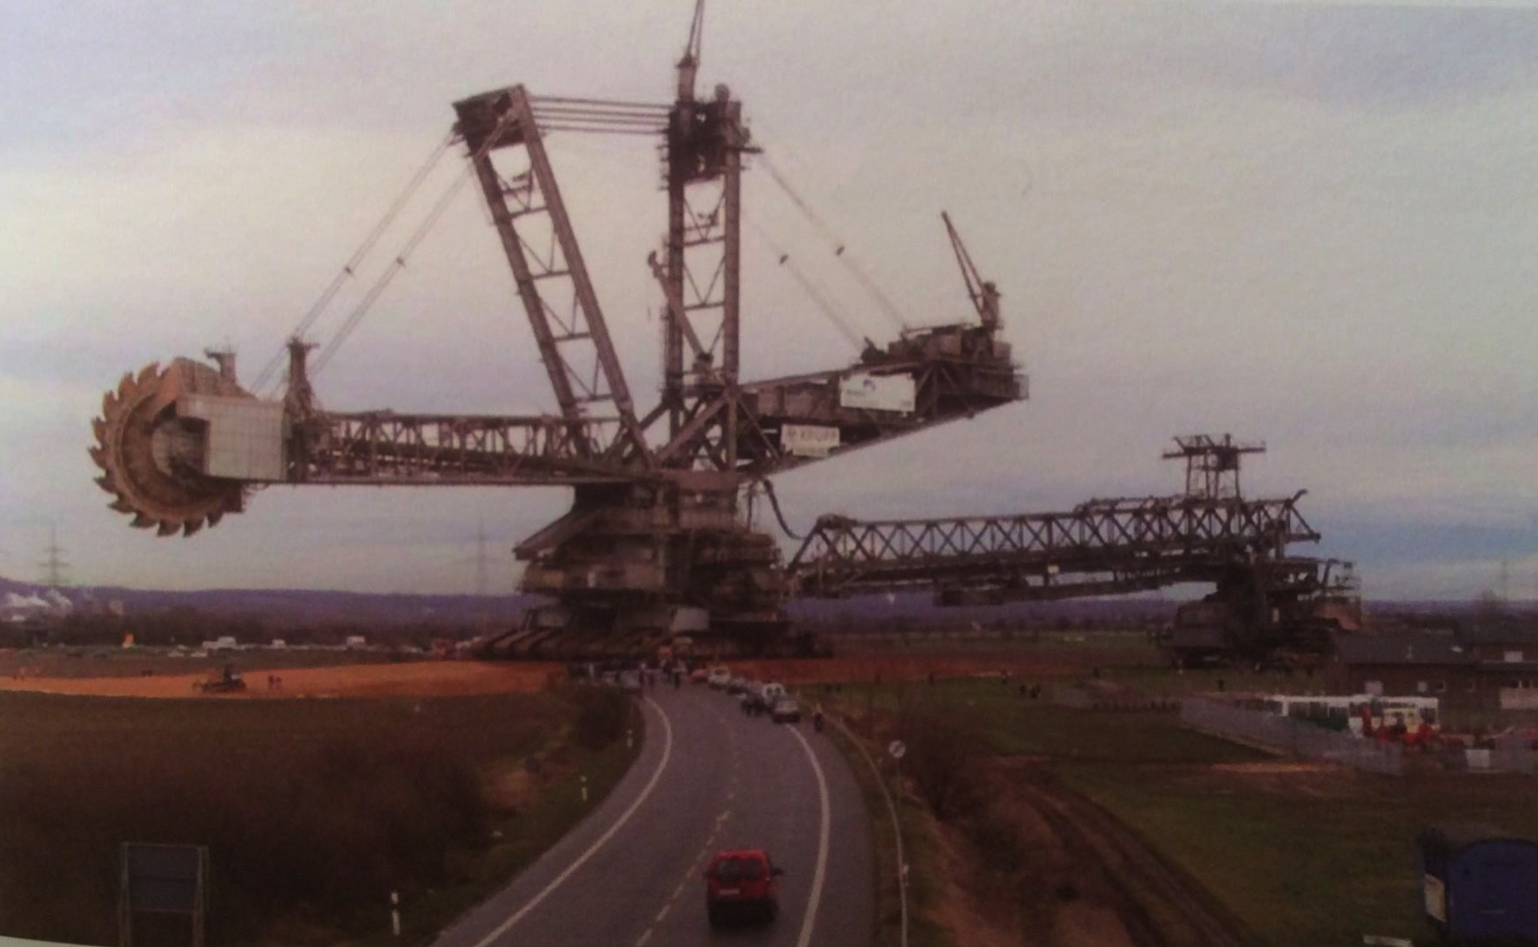
Mining automation: open mines
Bagger 288 bucketwheel excavator is used to remove overburden.
Weighs 13,500 tonnes
Moves 240,000 cubic meters per day
Washington DNR
A Watt double-acting steam engine (1859)
Energy Systems & Sustainability, 2/e, Chapter 5

Slide 24

Deep mining
Deep (aka underground) mines, use shafts & tunnels up to 1000 m deep.
The longwall method is still used, exposing a long, horizontal surface of a coal seam.
Now very mechanized, using huge cutting loaders and long conveyer belts to carry the coal for transport out of the mine.
Advantages & disadvantages?
Able to access deep deposits of coal.
Environmental impacts:
  land subsidence;
  Toxic tailing piles & sludge;
Health impacts:
  Black lung; &
  Accidents (Today in the US 1/50 lifetime risk for miners)
Washington DNR
msha.gov
A Watt double-acting steam engine (1859)
Energy Systems & Sustainability, 2/e, Chapter 5

Slide 25
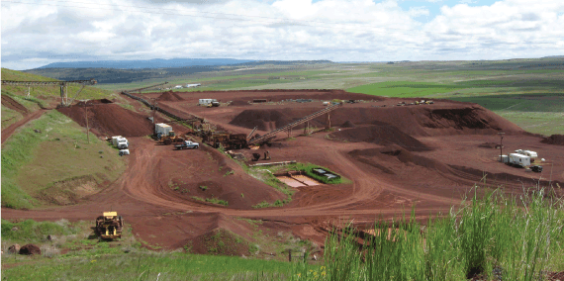
Surface (strip) mining
Surface mines, aka open cast mines, aka strip mining
The surface (aka ‘overburden’) is removed first to get to the coal beneath it. Explosives & mechanical methods are used.
Mountain top removal is an extreme form of strip mining.
In 2008-9, 70% of US coal &
60% of UK coal was strip-mined.
Advantages & disadvantages?
Relative to deep mining:
  Simpler;
  Less expensive, so more efficient;
  Safer for miners.
However, the environmental effects of surface mining are extreme.
  Laws sometimes require rehabilitation of closed mines, but are not always completely enforced.
Washington DNR
A Watt double-acting steam engine (1859)
Energy Systems & Sustainability, 2/e, Chapter 5

Slide 26
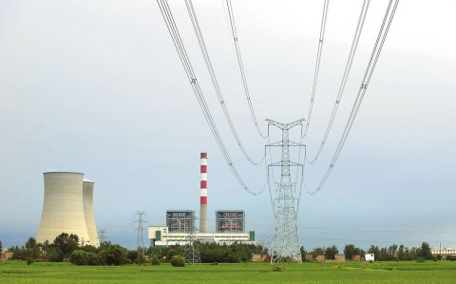
Current uses of coal
As of 2008, two-thirds of global coal was used for producing electricity.
In the UK, 80%.
To avoid transporting bulky coal from mines to distant population centers, electric generating plants are often located near mines and electricity is transmitted to urban centers: ‘coal by wire’.
2-6% losses.
As of 2017, coal is used to produce <31% of electricity.
Coke is still used for smelting and steel production.
Global coke use was 800 million tonnes in 2009.
Nearly half of coke was used in China.
A Watt double-acting steam engine (1859)
Energy Systems & Sustainability, 2/e, Chapter 5

Slide 27
4. Coal
  4.6: Global coal resources & reserves

Slide 28
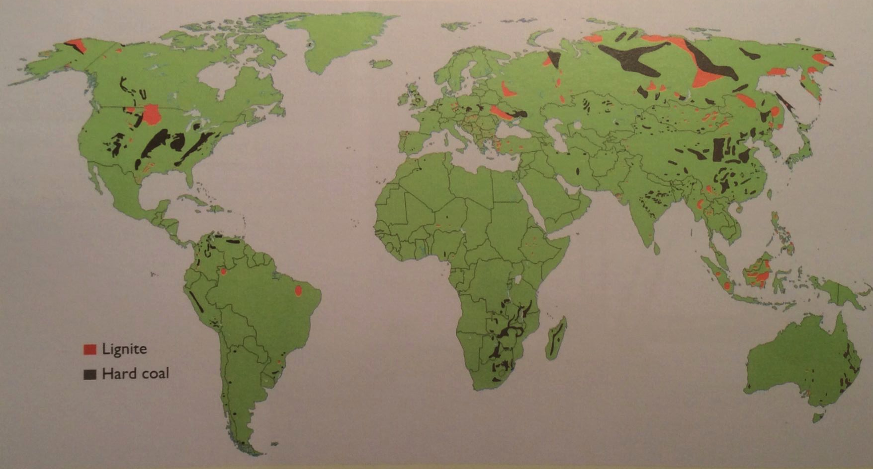
Global coal deposits (2009)
Coal is found on every continent except Antarctica.
Hard coal has 1.5 times as much energy as lignite.
A Watt double-acting steam engine (1859)
Energy Systems & Sustainability, 2/e, Chapter 5

Slide 29
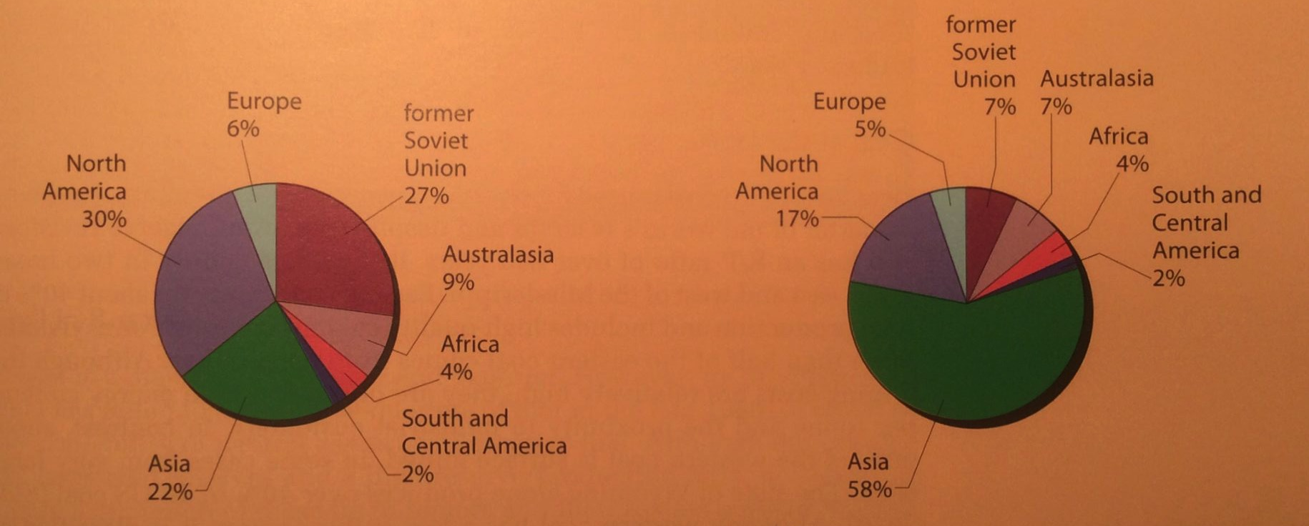
Global reserves & deposits (2010)
Note that areas of highest production are not the areas with the largest reserves.
Coal reserves
Coal production
A Watt double-acting steam engine (1859)
Energy Systems & Sustainability, 2/e, Chapter 5

Slide 30
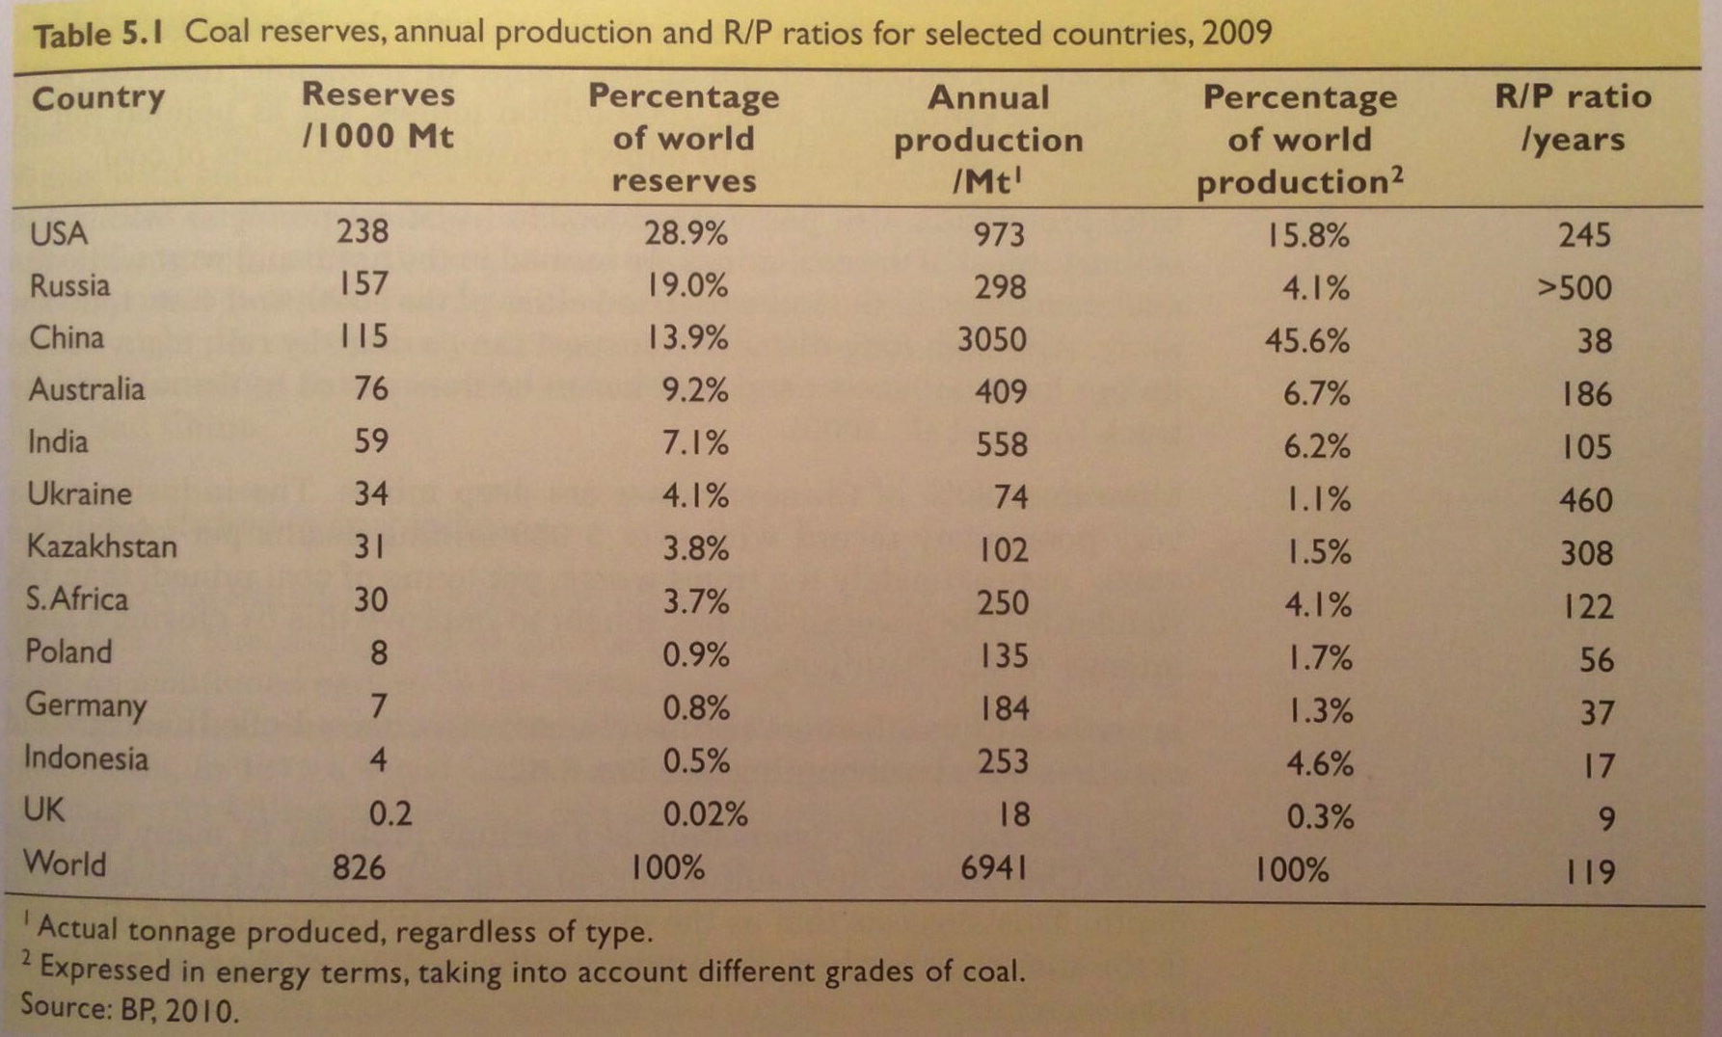
Global reserves & R/P ratios (2009)
A Watt double-acting steam engine (1859)
Energy Systems & Sustainability, 2/e, Chapter 5

Slide 31
Coal in the US
The US has 25% of global coal reserves.
R/P of 245 years
Eastern coal
  Deep pits
  High-quality coking coal
Western coal
  Surface mined
  Sub-bituminous, so low heat content
  Must be transported to areas with high need, increasing cost
A Watt double-acting steam engine (1859)
Energy Systems & Sustainability, 2/e, Chapter 5

Slide 32
Coal in China
Use of coal in China has been expanding rapidly, but…
R/P of 38 years
Coal is found in the north & west, but need is in the south & east.
  Transported by truck and rail
Nearly all mines are deep pits.
  Poor safety: 5,00o deaths in the 1990s
  10X worse than the UK
  Uncontrolled underground mine fires occur.
Chinese coal has > 5% sulfur.
  Acid rain is a problem in many cities
A Watt double-acting steam engine (1859)
Energy Systems & Sustainability, 2/e, Chapter 5

Slide 33
Coal elsewhere
Russia
R/P of >500 years
But production has fallen because of abundant NG
  Coal in Siberia can be considered a conditional reserve.
India
4th largest reserves
R/P of 105 years
Poor quality: low heat content & high ash
  Imports high-quality coal from Australia
Australia
Less than 10% of global reserves
R/P of 186 years
Surface mines are located near railways to cities of need.
Australia’s largest export:
  40% to Japan
  Coking coal to Europe
  Middle East, Asia (India, China)
A Watt double-acting steam engine (1859)
Energy Systems & Sustainability, 2/e, Chapter 5

Slide 34
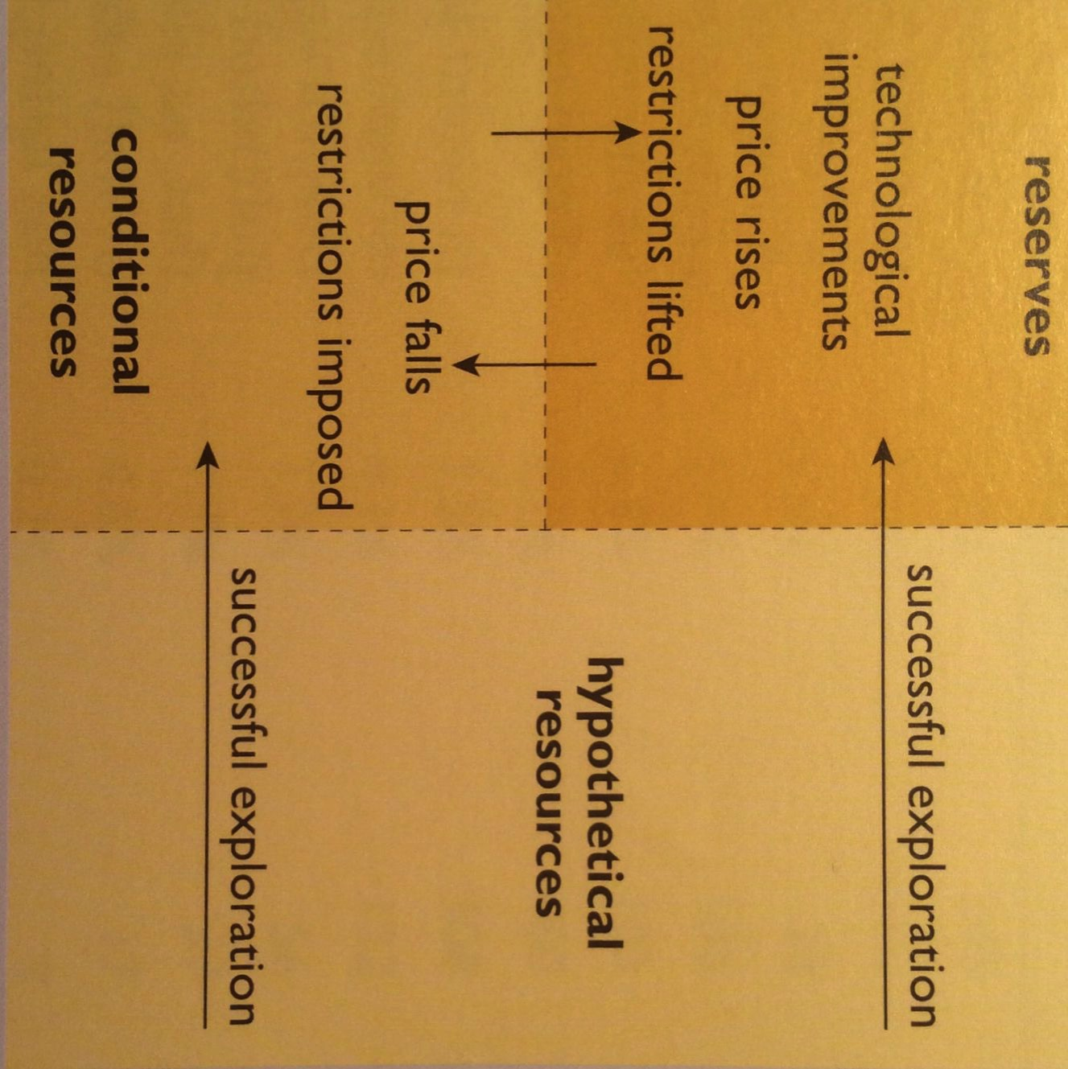
Reserves & R/P ratios can change…
…as technology and economic conditions change.
previously unknown
Resources: deposits likely to exist
Conditional resources: deposits that are not now reserves because their extraction isn’t economically or politically feasible now
Reserves: deposits that can be economically extracted now
McKelvey diagram
A Watt double-acting steam engine (1859)
Energy Systems & Sustainability, 2/e, Chapter 5

Slide 35
4. Coal
  4.7: Combustion of coal & emissions

Slide 36
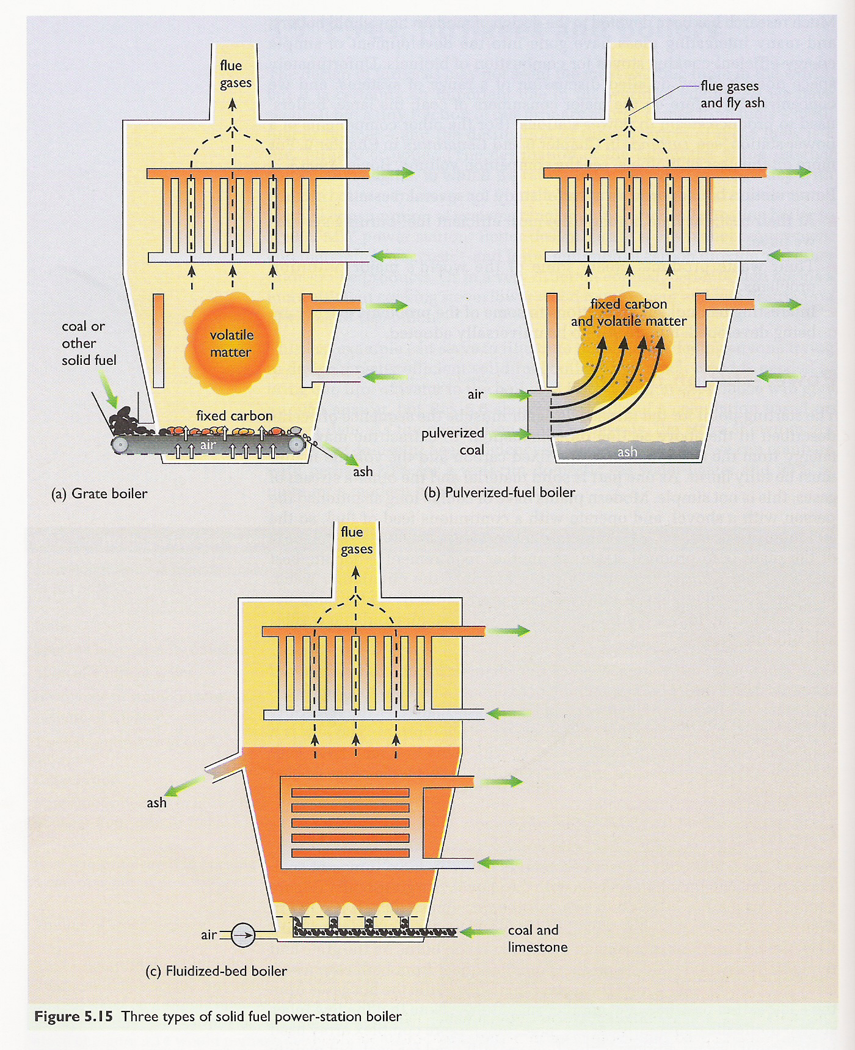
Combustion
Moisture evaporates in the first stages of combustion.
Volatile matter is turned to gas like CO, CH₄ and other hydrocarbons.
These gases combust to create heat.
Fixed carbon combines with oxygen gas to produce carbon dioxide flue gas.
Ash is any material that remains.
Best quality coal has ~10% ash.
Lower quality may produce 15-30%.
A Watt double-acting steam engine (1859)
Energy Systems & Sustainability, 2/e, Chapter 5

Slide 37
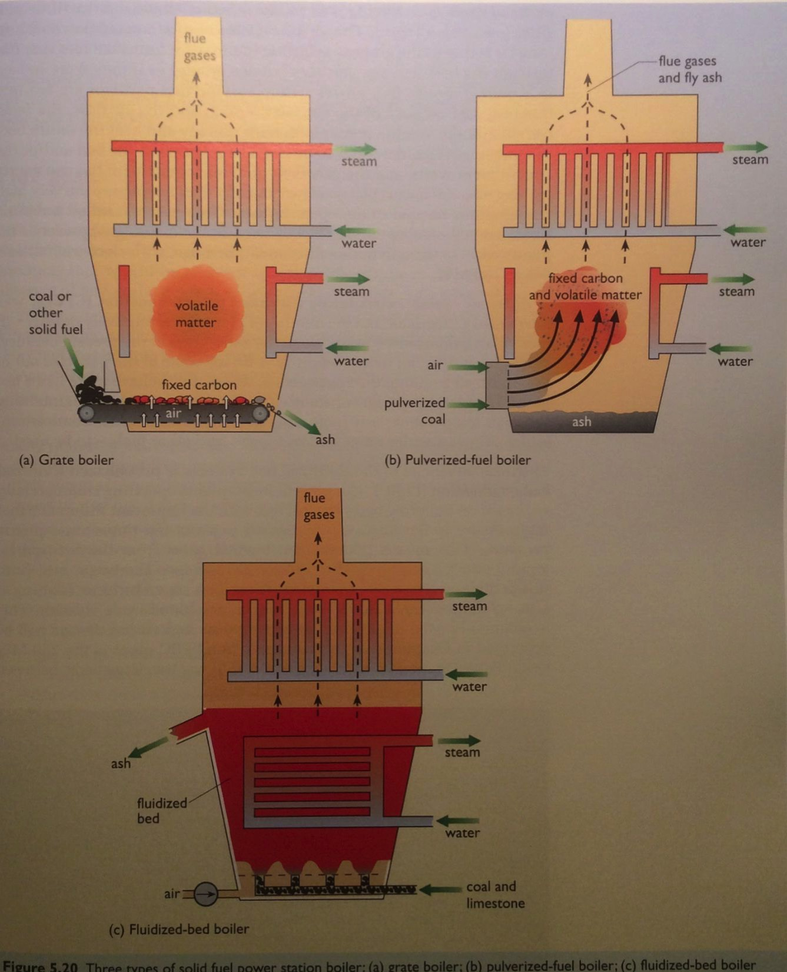
Combustion: newer technologies
Pulverized fuel boilers create a fine carbon powder that is blown into the combustion chamber with air.
90% efficient
Problem: fine fly ash in flue gases.
Fluidized bed boilers combust small coal particles in a bed of sand. ‘Bubbles’ of coal and air heat the entire bed.
Very efficient
Lower combustion temps, so less NOx
A Watt double-acting steam engine (1859)
Energy Systems & Sustainability, 2/e, Chapter 5

Slide 38
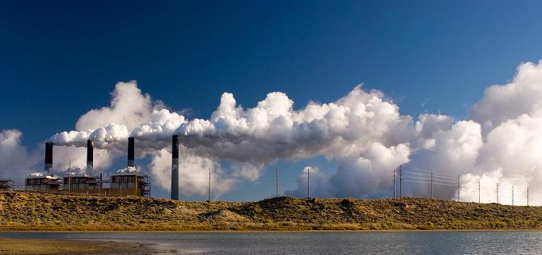
Combustion flue gases
Emissions: NOx, CO₂, H₂O, SOx, fly ash & particulates
Coal’s challenges?
Hot, dirty & corrosive
Volume: 3000 tonnes/hour!
Very high levels of:
  Moisture
  SOx; &
  Particulates
Wyoming Public Media
A Watt double-acting steam engine (1859)
Energy Systems & Sustainability, 2/e, Chapter 5

Slide 39
Making emissions real
Let’s look at some numbers to bring home the scale of emissions from coal-fired power plants.
A power plant burns 250 tonnes of coal per hour to produce 500 MW.
Emission | tonnes | problem?
N₂ (from air for combustion) | 2000 | little harm
CO₂ | 650 | GHG !
Steam (H₂O) | 150 | harmless (energy loss)
NOx | 1 | acid-rain, health
SOx | 1 - 20 | acid-rain, health
Fly ash | 20 | health
Mercury vapor | 30 g | health
A Watt double-acting steam engine (1859)
Energy Systems & Sustainability, 2/e, Chapter 5

Slide 40
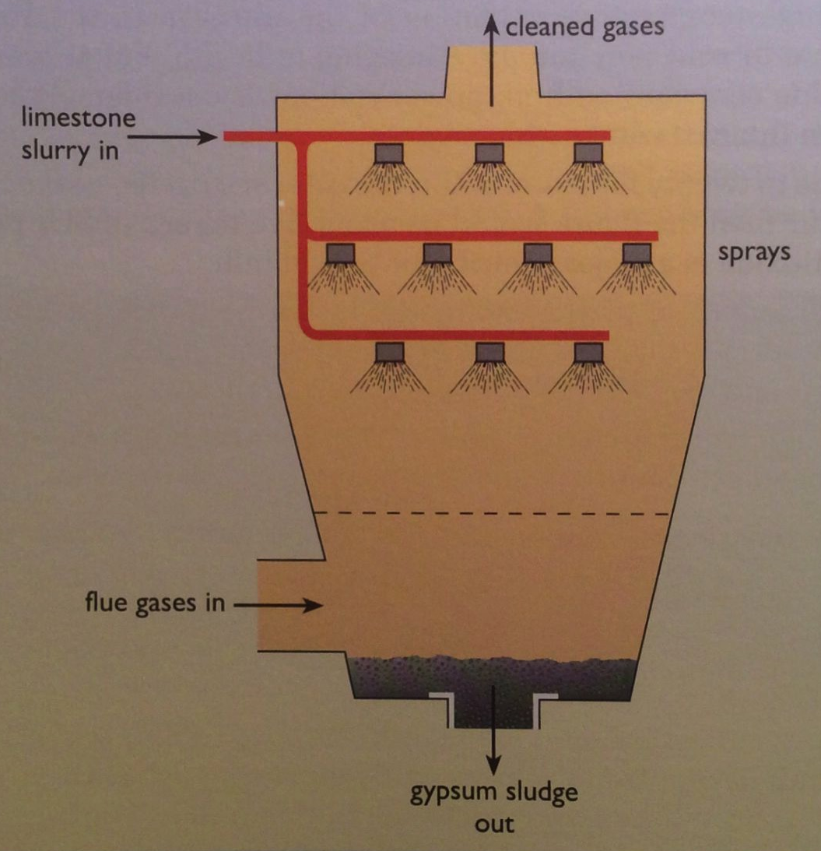
Lowering SOx
SOx can be reduced by using limestone (CaCO₃) or seawater to precipitate the 90-95% of sulfur out of the flue gases.
CaCO₃ + SO₂ → CaSO_{3/4} ⬇+ CO₂
Energy Systems & Sustainability, 2/e, Ch 5

Slide 41
Lowering NOx
NOx can be reduced by:
Decreasing combustion temperatures (a la fluidized bed);
Selective catalytic reduction (removal of O from N); or
Gas reburn via added natural gas to remove oxygen.
4NH₃ + 6NO → 5N₂ + 6H₂O
W (tungsten) or V (vanadium) catalyst
A Watt double-acting steam engine (1859)
Energy Systems & Sustainability, 2/e, Chapter 5

Slide 42
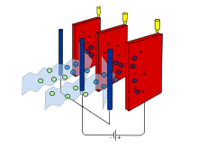
Lowering particulates and ash
Particulates and ash can be reduced using:
Cyclone;
Bag filter; or
Electrostatic precipitator:
Particles are ionized (charged) & then
attracted to charged filters / plates.
Disposing of the ash?
Ash is toxic because of metal contaminants.
Landfill; or
Use as a ‘filler’ in concrete where toxins are fixed.
A Watt double-acting steam engine (1859)
Energy Systems & Sustainability, 2/e, Chapter 5; wikipedia

Slide 43
4. Coal
  4.8: Alternative uses of coal

Slide 44
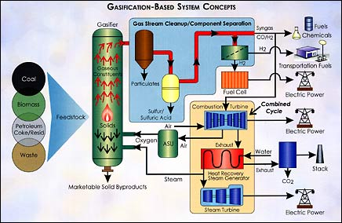
Gasification to syngas
Gasification converts hydrocarbons like coal into gases using heat, pressure and steam. Oxygen levels are controlled to prevent combustion.
Syngas:
CO & H₂
Wyoming Public Media
A Watt double-acting steam engine (1859)
Energy.gov

Slide 45
Gasification to syngas
Integrated gasification combined-cycle:
Cleaned syngas is combusted to drive a combustion turbine that drives a generator;
Exhaust heat is used to create steam, to drive a second steam turbine-generator.
Combined turbines generate electricity very efficiently: 40%
Compatible with carbon capture & storage
If oxygen is used in place of air, carbon dioxide is produced in a concentrated stream that is easier to capture and sequester.
Other uses of syngas?
Chemical building blocks for the chemical industries
Fuel for fuel-cell systems
Source of hydrogen
Wyoming Public Media
A Watt double-acting steam engine (1859)
Energy.gov

Slide 46
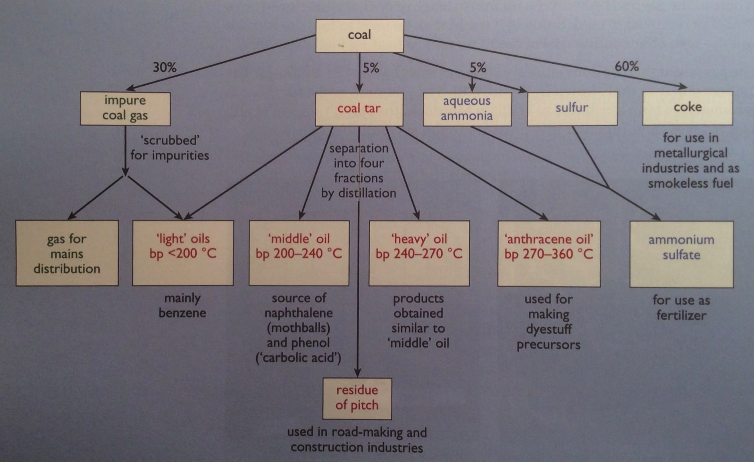
Gasification products & co-products
Wyoming Public Media
A Watt double-acting steam engine (1859)
Energy Systems & Sustainability, 2/e, Chapter 5

Slide 47
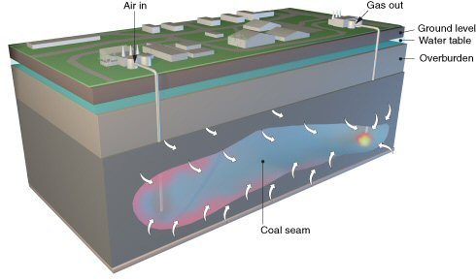
Underground coal gasification
Uses conventional gasification technology, put performed underground.
Air & water are injected into the coal seam;
Ignited under low-oxygen conditions to partially oxidize coal into:
  H₂, CO, CO₂, CH₄, H₂S
  Gases piped to the surface for combustion.
The UK will not
use this
technology
because its CO₂
emissions
are significantly higher
than those from NG.
Wyoming Public Media
Energy Systems & Sustainability, 2/e, Chapter 5

Slide 48
4. Coal
  4.9: Carbon sequestration & clean coal

Slide 49
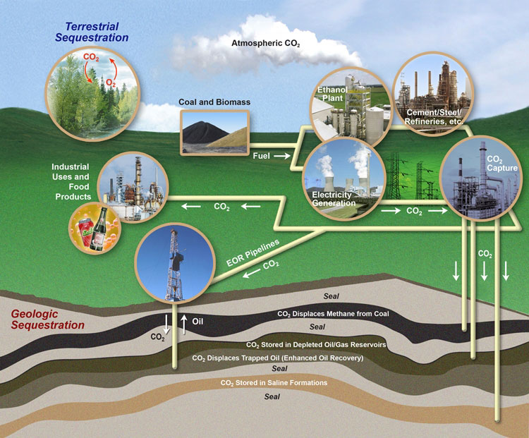
Carbon sequestration
Sequestration ties up carbon to keep it out of the atmosphere.
Biological sequestration is natural.
Can we engineer sequestration?
Wyoming Public Media
A Watt double-acting steam engine (1859)
Energy Systems & Sustainability, 2/e, Chapter 5; US Carbon Sequestration Program, US DOE

Slide 50
Dirty coal, clean future (Fallows)
Wyoming Public Media
A Watt double-acting steam engine (1859)
https://www.theatlantic.com/magazine/archive/2010/12/dirty-coal-clean-future/308307/

