Slide 1

SSC 2030: Energy Systems and Sustainability
4. Coal
4.1: What is coal? Origins and composition
4.2: Early uses and the industrial revolution
4.3: Coal deposits, reserves and production
4.4: Modern extraction methods
4.5: Coal combustion and emissions
4.6: Current global uses of coal
4.7: Alternative uses of coal
4.8: Carbon sequestration (CCS) and ‘clean coal’
4.9: Business cycles, LCOE, EROEI, COVID lessons, and early retirement

Slide 2
Module 4. Coal
  4.1: What is coal?
    Formation of coal
    Composition of coal

Slide 3
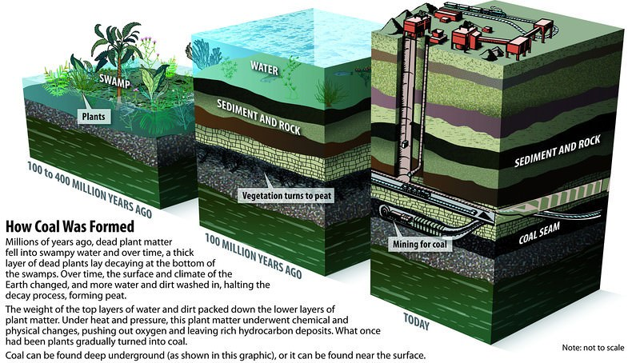
Chemical composition of coal
organics
partially
decompose
peat
heat, pressure and time
coal
(older is better)
Energy Systems and Sustainability, 2/e, Chapter 5; pmfias.com

Slide 4
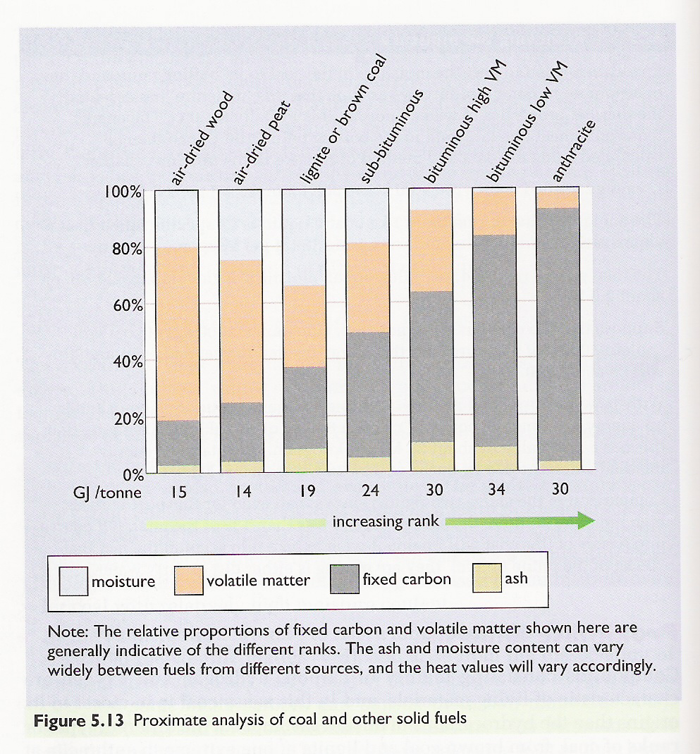
Chemical composition of coal
Proximate analysis:
Coal quality increases with increasing carbon content.
smokeless fuel
coke / steam
coke
steam
Elements:
C
H
N
S
O
Energy Systems and Sustainability, 2/e, Chapter 5

Slide 5
Combustion of coal
Toxic ash remains: silicates and oxides of iron and aluminum.
Fixed carbon (coke) combines with oxygen to produce carbon dioxide flue gases (emissions) and heat.
smokeless fuel
coke / steam
coke
increasing temperature
Volatile hydrocarbons are boiled off into gases: H₂, CO, CH₄, C₂H₄, C₂H₂.
These gases combust, releasing heat.
steam
Water is heated and evaporated using a tiny fraction of coal’s energy.
Energy Systems and Sustainability, 2/e, Chapter 5

Slide 6
Why does coal produce more CO₂?
Coal is often referred to as a dirty fuel because of its emissions.
And it’s said to produce more carbon dioxide than other fossil fuels. Why?
The higher the C:H ratio of fuels, the more carbon dioxide they produce.
fuel | C:H ratio | energy (MJ/kg) | CO₂ (mol/MJ)
coal | 1:1 | 39.3 | 2.0
oil | 2:1 | 43.6 | 1.6
ethanol | 3:1 | 27.3 | 1.6
natural gas | 4:1 | 51.6 | 1.2
hydrogen gas | 100% H | 120.0 | 0
smokeless fuel
coke / steam
coke
steam
https://www.wou.edu/las/physci/GS361/Energy_From_Fossil_Fuels.htm

Slide 7
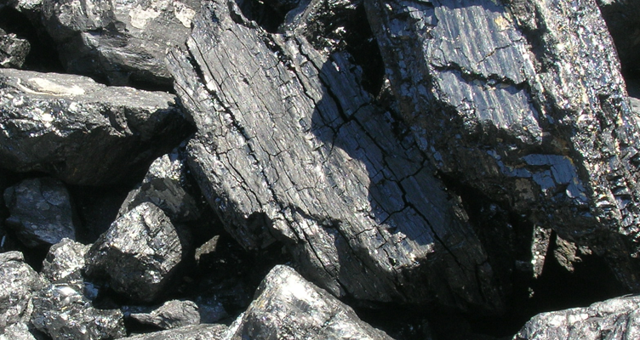
Comparing coal, oil and natural gas (NG)
How does coal compare to oil and natural gas?
Abundant: huge, globally distributed reserves;
Extraction has large environmental impacts (strip-mining);
  And is a health hazard;
More difficult to transport (less dense);
Produces twice as much carbon dioxide;
Produces large amounts of ash when burned;
  Ash can leach sulfuric acid and arsenic into ground water;
  Coal ash ponds and floods; and
Produces SOx and NOx emissions in flue gasses.
For these reasons, coal is sometimes called the ‘ignoble’ fuel.
Energy Systems and Sustainability, 2/e, Chapter 5

Slide 8
Module 4. Coal
  4.2: Early uses and the Industrial Revolution
    Ancient China
    Tutor England
    Fuel of the Industrial Revolution
    Now played out in the UK

Slide 9
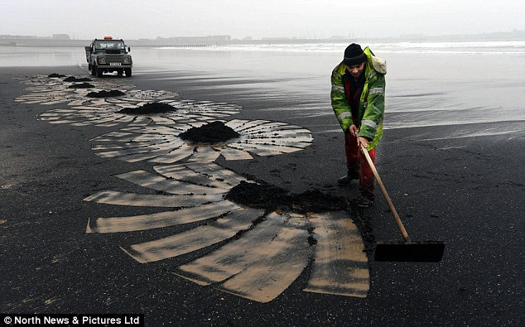
History of coal use
Wood was man’s first fuel; has been used for 3000 – 4000 years.
Charcoal is partially combusted (pyrolysis) wood that is more energy dense than wood.
Coal has been used for 2000 years in China and the Middle East.
‘Sea coal’ washes ashore from underwater deposits and was traditionally collected as a highly valued fuel along the coasts.
Mining started in the Roman era.
Hampton Court (1500s)
Brick chimneys allowed wood and coal to be combusted indoors and withstood the corrosive flue gases.
  Sign of great wealth!
By 1680 1400 ships were used to transport coal in Britain.
Sea coal on the beaches of Scotland
Energy Systems and Sustainability, 2/e, Chapter 5; Daily Mail

Slide 10

Air quality problems arose quickly
Air quality suffered as use of coal boomed.
In this era British coal was ‘brown’ and high in sulfur.
Air emissions resulted in huge amounts what we now call ‘smog’.
By 1661, London was cloaked in:
"Such a cloud of sea-coal, as if there be a resemblence of hell upon earth, it is in this volcano in a foggy day: this pestilent smoak, which corrodes the very yron [iron], and spoils all the moveables, leaving a soot on all things that it lights: and so fatally seizing on the lungs of the inhabitants, that cough and consumption spare no man."
John Evelyn
petitioning Charles II for zoning to move industry and improve air quality
Energy Systems and Sustainability, 2/e, Chapter 5; wikipedia

Slide 11
Industrial revolution: coal, iron and steel
The industrial revolution was made possible by coal, and one of its products, steel.
Iron ore is actually iron oxide.
Iron is purified by the process of smelting, which removes oxygen leaving ‘purified’ Fe.
iron ore
coke
iron
flue gases
Fe₂O₃, Fe₃O₄ + C → Fe + CO₂ + CO
Coke: created by pyrolysis (combustion in limited oxygen) of coal at high temperatures (2000°F).
Nearly pure carbon as most impurities (O, S) are ‘driven off’
Coking works at night
Energy Systems and Sustainability, 2/e, Chapter 5

Slide 12
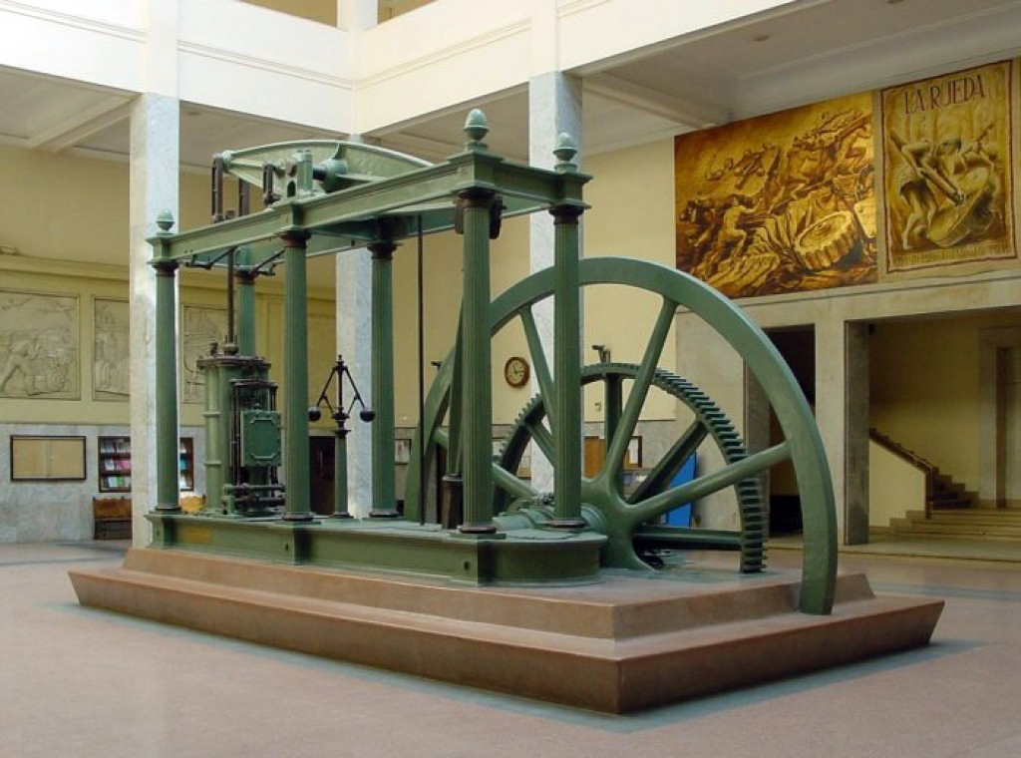
Industrial revolution: coal, iron and steel
James Watt’s steam engine (1769) converted the energy of coal to heat (steam) and then mechanical work.
Heralded the true start of England’s industrial revolution.
Made possible by coal and steel.
Steel: an alloy of iron and other elements, mainly carbon
Harder and stronger than iron
Carbon provided by adding coke
Energy Systems and Sustainability, 2/e, Chapter 5; wikipedia
A Watt double-acting steam engine (1859)

Slide 13
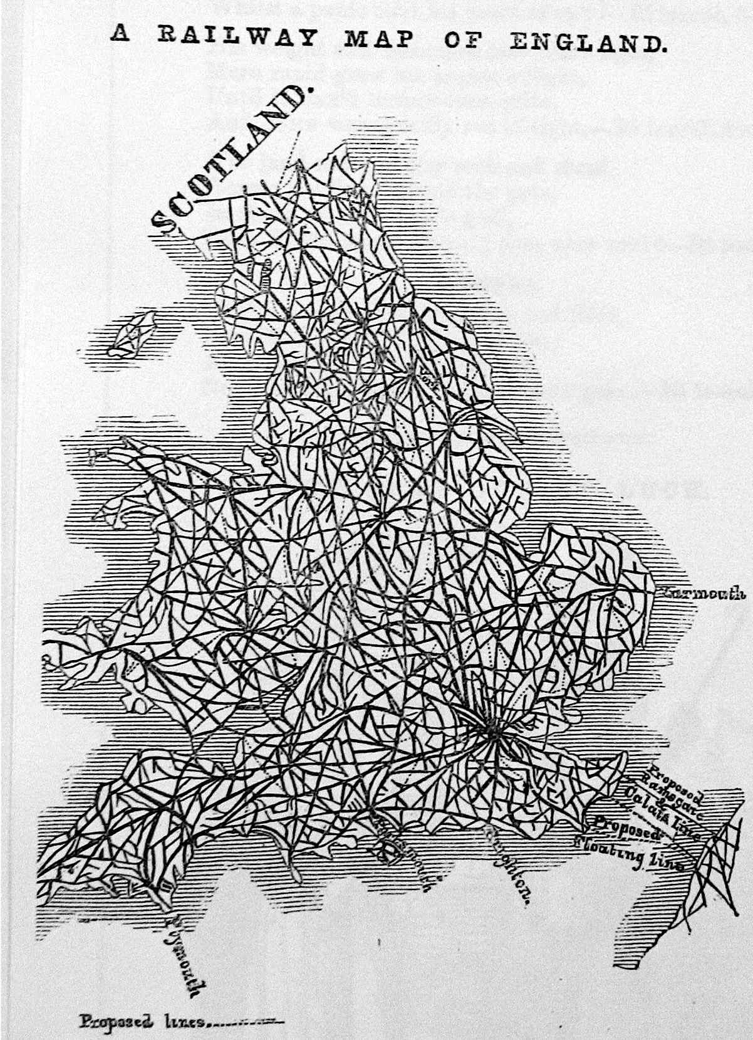
1800s: coal was essential across England’s economy
By the 1800s coal was an essential commodity in England.
Coal powered mills;
Was essential for smelting and ironworks;
Was used in domestic heating.
Over the next 100 years coal’s role expanded to include:
Powering ships;
Driving railways;
Lighting cities; and
Providing feedstock for synthetic
fertilizer and chemical production
Energy Systems and Sustainability, 2/e, Chapter 5
https://ragpickinghistory.co.uk/2012/10/04/meta-ornament-railway-tracks/
1845

Slide 14
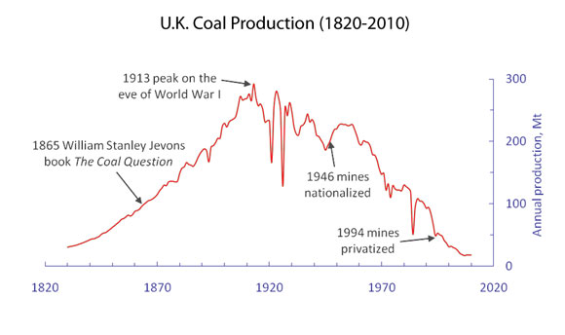
Coal production in England
1/3 exported
1900
UK and US: 300 Mtonnes
Germany: 100 Mtonnes
Global: 1 billion tonnes
https://blogs-images.forbes.com/williampentland/files/2011/09/UK-Coal-History2.jpg

Slide 15
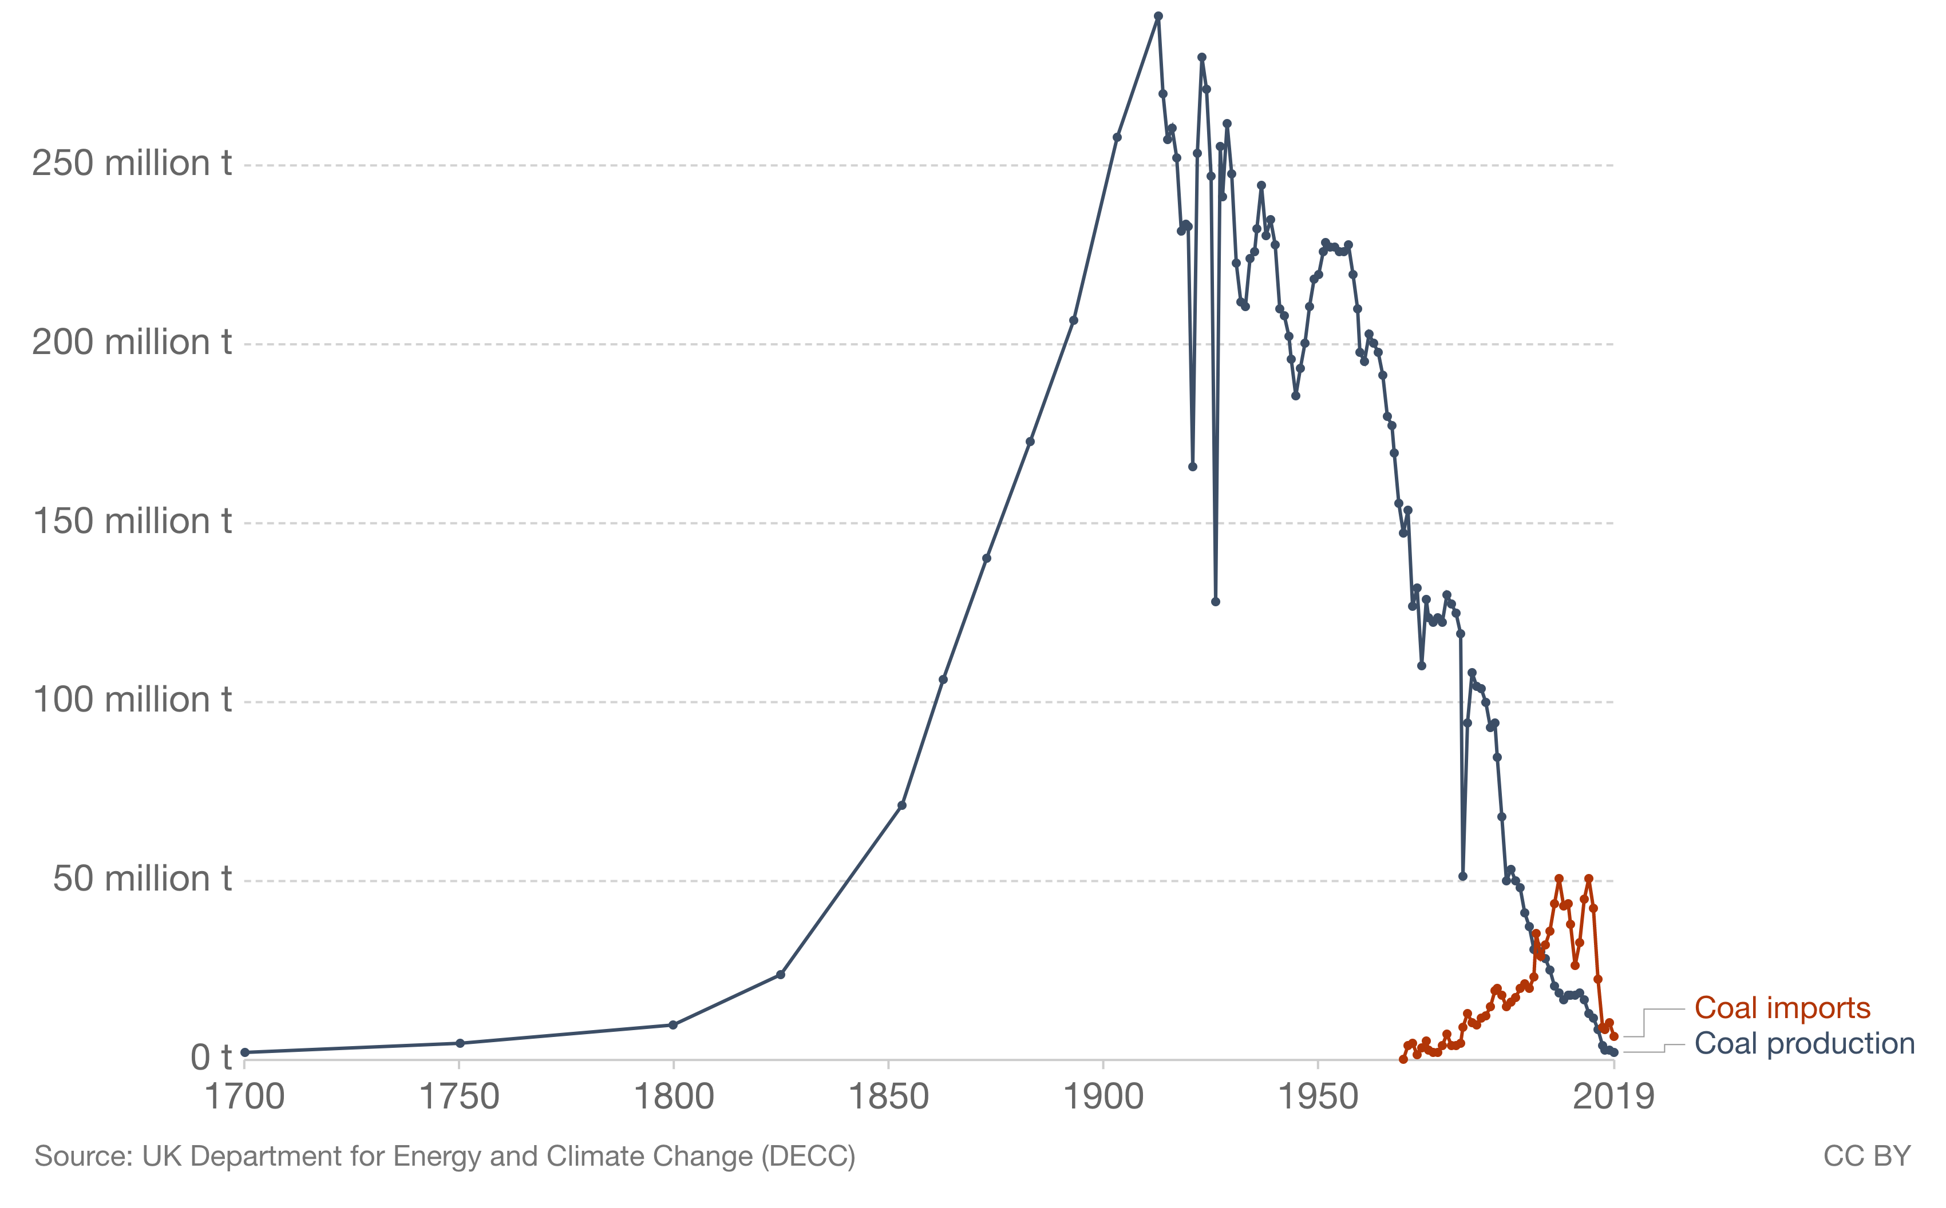
UK moved to coal importation
Notice that all coal use in the UK is now down to 3% as regulations seek to mitigate GCC.
A Watt double-acting steam engine (1859)
https://ourworldindata.org/death-uk-coal

Slide 16
Module 4. Coal
  4.3: Coal deposits, reserves and production
    Global
    US
    China
    Russia
    India
    Australia
    R/P ratios
    Past peak

Slide 17
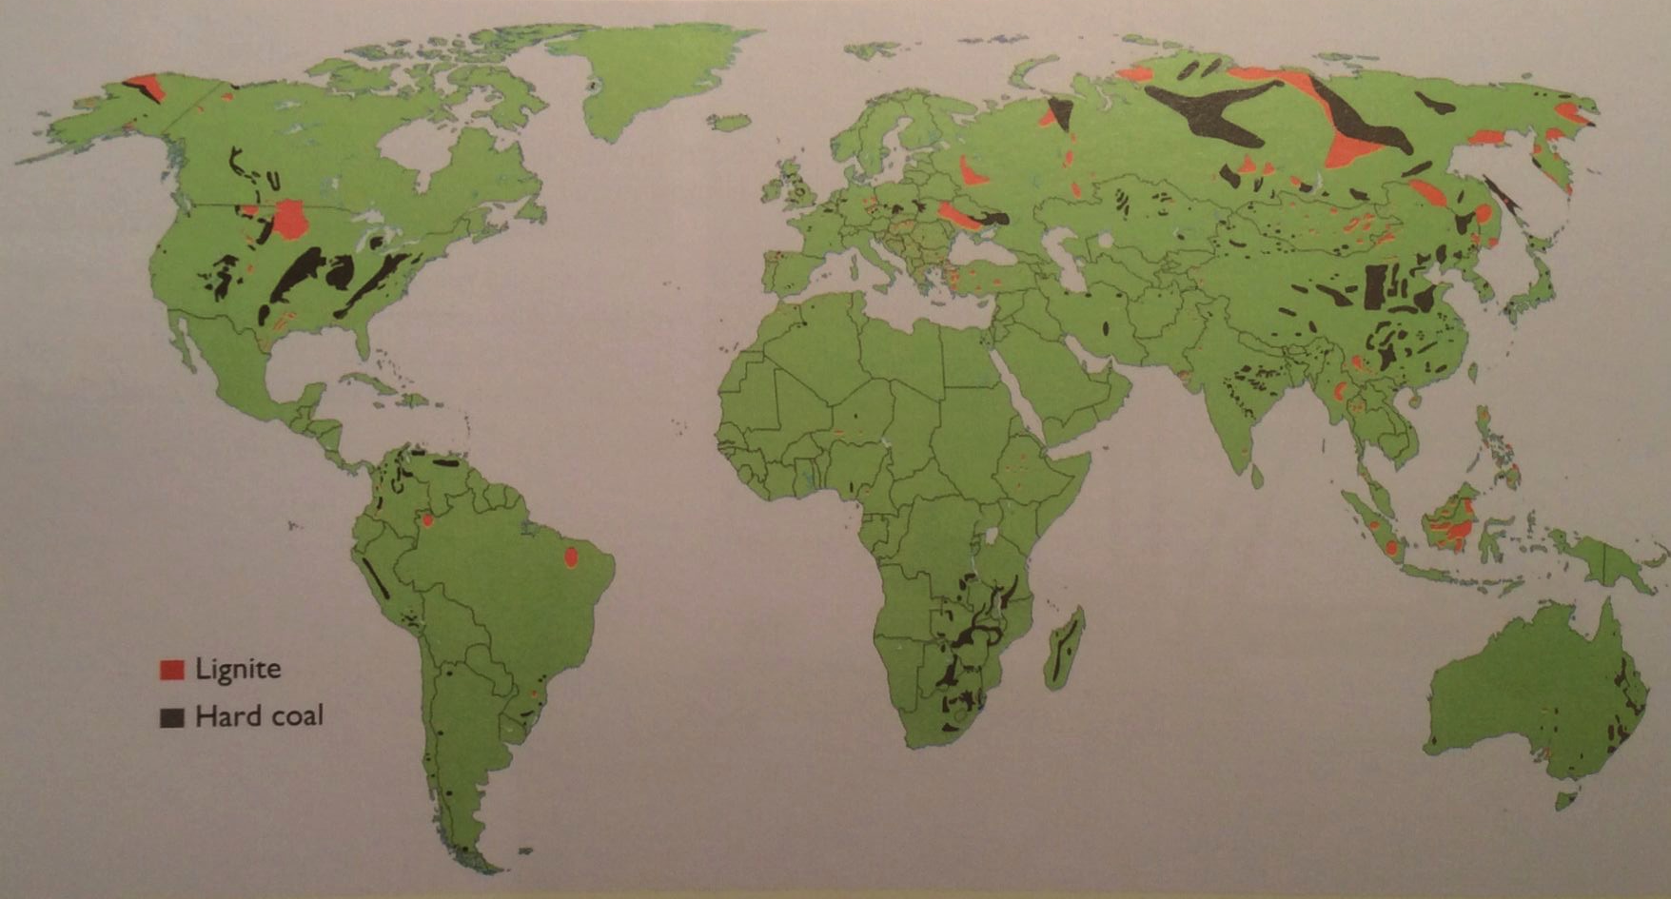
Global coal deposits (2009)
Coal is found on every continent except Antarctica.
Energy Systems and Sustainability, 2/e, Chapter 5
A Watt double-acting steam engine (1859)
Hard coal has 1.5 times as much energy as lignite.

Slide 18
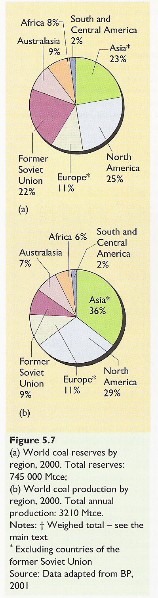
Global coal reserves and production (2010)
Reserves
Production
Energy Systems and Sustainability, 2/e, Chapter 5

Slide 19
Coal in the US
The US has 25% of global coal reserves.
R/P of 245 years
Eastern coal
  Deep pits
  High-quality coking coal
Western coal
  Surface mined
  Sub-bituminous, so low heat content
  Must be transported to areas with high need, increasing cost
A Watt double-acting steam engine (1859)
Energy Systems and Sustainability, 2/e, Chapter 5

Slide 20
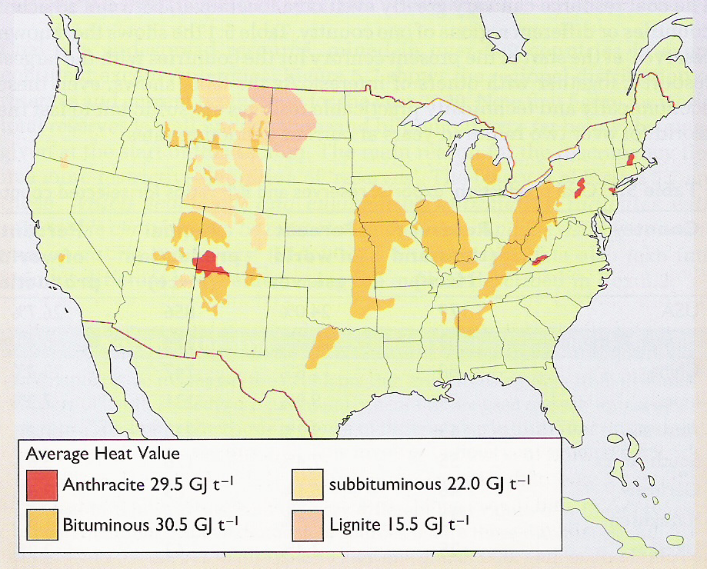
US coal deposits
Higher grade:
Hard coal
Black coal
Anthracite
Bituminous
Lower grade:
Brown coal
Lignite
Sub-bituminous
Energy Systems and Sustainability, 2/e, Chapter 5

Slide 21
Coal in China
Use of coal in China has been expanding rapidly, but…
R/P of 38 years
Coal is found in the north and west, but need is in the south & east.
  Transported by truck and rail.
Nearly all mines are deep pits.
  Poor safety: 5,00o deaths in the 1990s
  10X worse than the UK
  Uncontrolled underground mine fires occur.
Chinese coal has > 5% sulfur.
  Acid rain is a problem in many cities
A Watt double-acting steam engine (1859)
Energy Systems & Sustainability, 2/e, Chapter 5

Slide 22
Coal elsewhere
Russia
R/P of >500 years
But production has fallen because of abundant NG
  Coal in Siberia can be considered a conditional reserve.
India
4th largest reserves
R/P of 105 years
Poor quality: low heat content & high ash
  Imports high-quality coal from Australia
Australia
Less than 10% of global reserves
R/P of 186 years
Surface mines are located near railways to cities of need.
Australia’s largest export:
  40% to Japan
  Coking coal to Europe
  Middle East, Asia (India, China)
Energy Systems and Sustainability, 2/e, Chapter 5

Slide 23
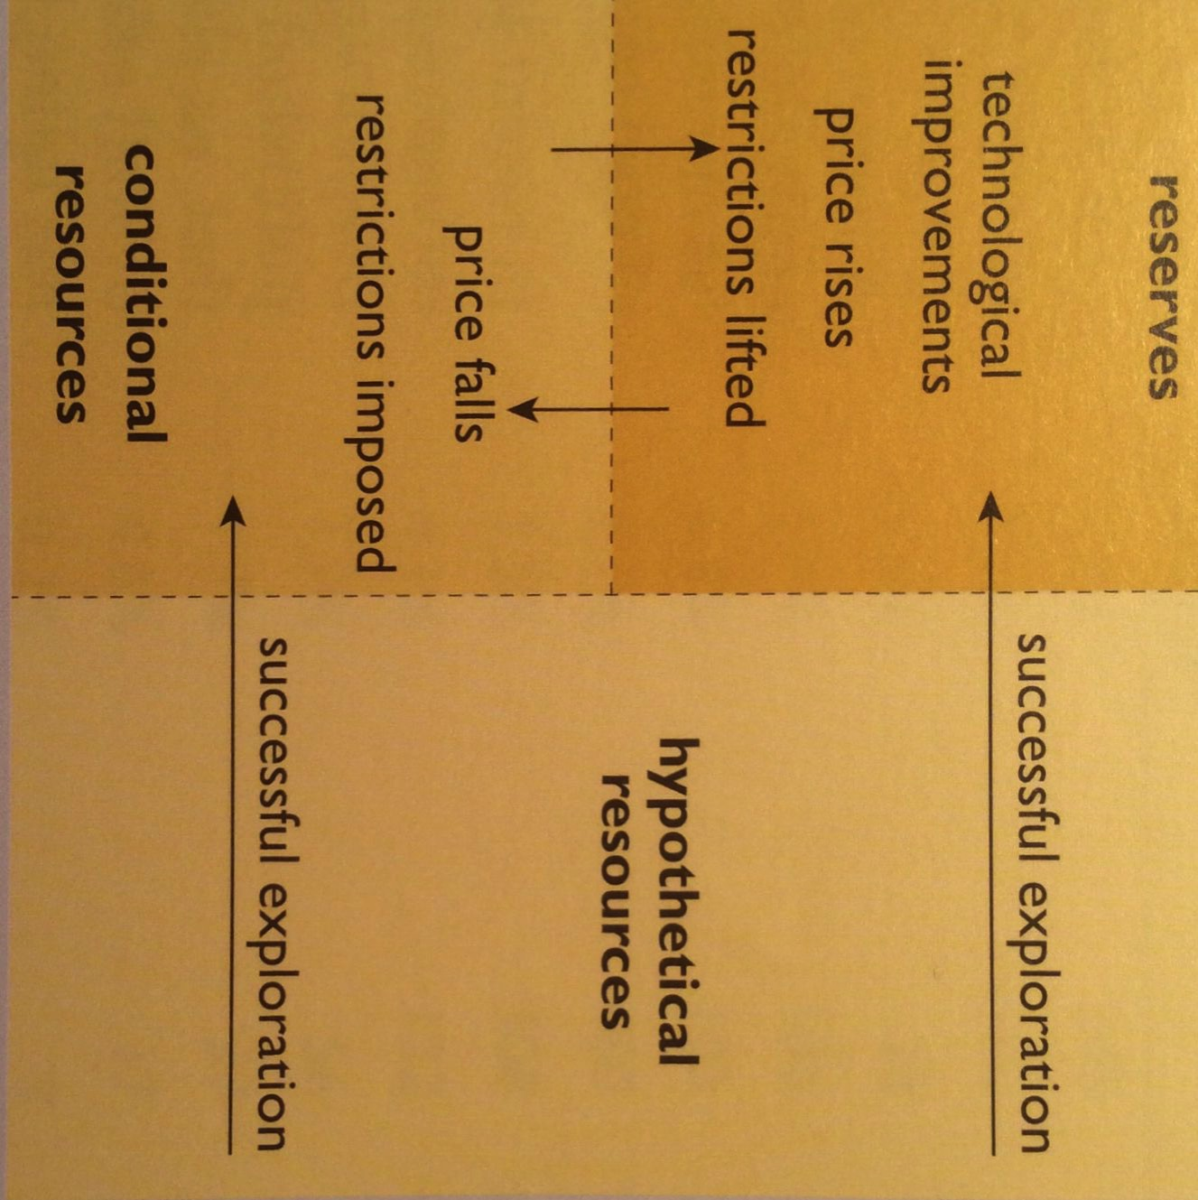
Reserves and R/P ratios can change…
…as technology and economic conditions change.
previously unknown
Resources: deposits likely to exist
Conditional resources: deposits that are not now reserves because their extraction isn’t economically or politically feasible now
Reserves: deposits that can be economically extracted now
McKelvey diagram
A Watt double-acting steam engine (1859)
Energy Systems and Sustainability, 2/e, Chapter 5

Slide 24
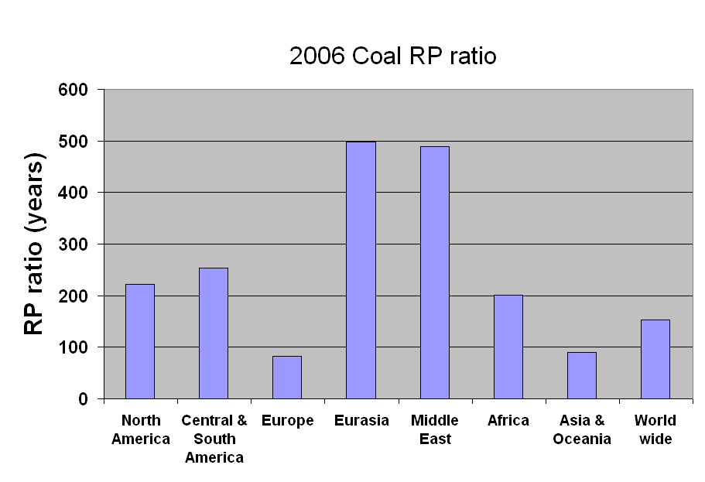
Global coal R/P ratios (2006)
Russia: coal displaced by NG
Australia exporting
India importing
UK mines down from 3000 to 13
China’s R/P 38 y
Energy Systems and Sustainability, 2/e, Chapter 5

Slide 25
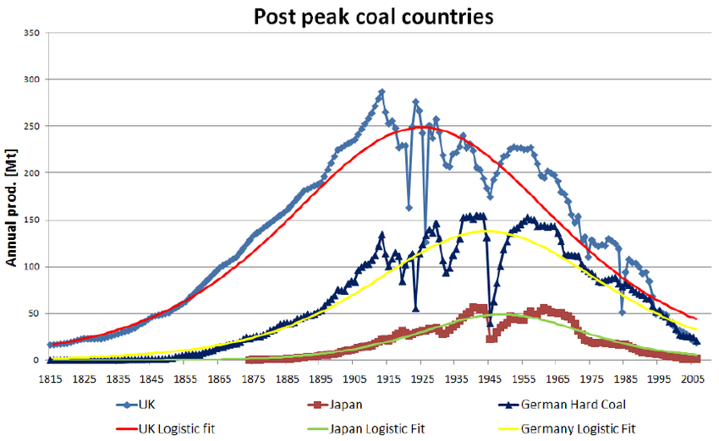
Some countries are well past peak
In fact, some have nearly null R/P ratios.
Figure 5.4
https://www.researchgate.net/profile/Kjell_Aleklett/publication/228838239/figure/fig1/AS:300666963677184@1448695998872/Figure-1-The-peaking-of-several-countries-with-a-long-history-of-coal-mining-The-two.png
A Watt double-acting steam engine (1859)

Slide 26
Module 4. Coal
  4.4: Modern coal extraction methods
    Automation
    Deep mining
    Surface (strip) mining

Slide 27
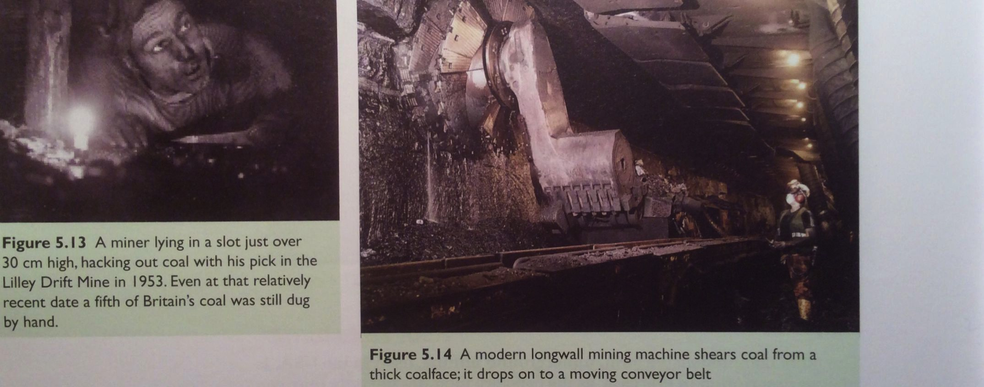
Mining automation: pit mines
Automation has changed pit mining dramatically over the past 70 years.
Fewer workers.
More production.
Washington DNR
UK, 1953
Today’s pit mine
Energy Systems and Sustainability, 2/e, Chapter 5

Slide 28

Mining automation: open mines
Bagger 288 bucketwheel excavator is used to remove overburden.
Weighs 13,500 tonnes
Moves 240,000 cubic meters per day
Washington DNR
A Watt double-acting steam engine (1859)
Energy Systems and Sustainability, 2/e, Chapter 5

Slide 29

Deep mining
Deep (aka underground) mines, use shafts & tunnels up to 1000 m deep.
The longwall method is still used, exposing a long, horizontal surface of a coal seam.
Now very mechanized, using huge cutting loaders and long conveyer belts to carry the coal for transport out of the mine.
Advantages & disadvantages?
Able to access deep deposits of coal.
Environmental impacts:
  land subsidence;
  Toxic tailing piles and sludge;
Health impacts:
  Black lung; and
  Accidents (Today in the US 1/50 lifetime risk for miners)
Washington DNR
msha.gov
A Watt double-acting steam engine (1859)
Energy Systems and Sustainability, 2/e, Chapter 5

Slide 30
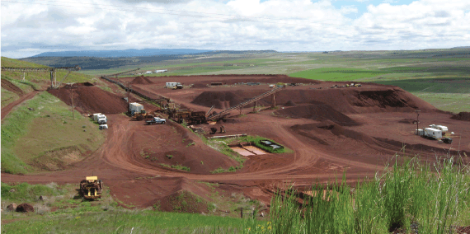
Surface (strip) mining
Surface mines (aka open cast mines or strip mining)
The surface (aka ‘overburden’) is removed first to get to the coal beneath it. Explosives & mechanical methods are used.
Mountain top removal is an extreme form of strip mining.
In 2008-9, 70% of US coal and
60% of UK coal was strip-mined.
Advantages & disadvantages?
Relative to deep mining:
  Simpler;
  Less expensive, more efficient;
  Safer for miners.
However, the environmental effects of surface mining are extreme.
  Laws sometimes require rehabilitation of closed mines, but are not always completely enforced.
Washington DNR
A Watt double-acting steam engine (1859)
Energy Systems & Sustainability, 2/e, Chapter 5

Slide 31
Module 4. Coal
  4.5: Combustion of coal and emissions
    Stages of combustion
    Boiler designs
    Flue gases
    Emissions controls

Slide 32
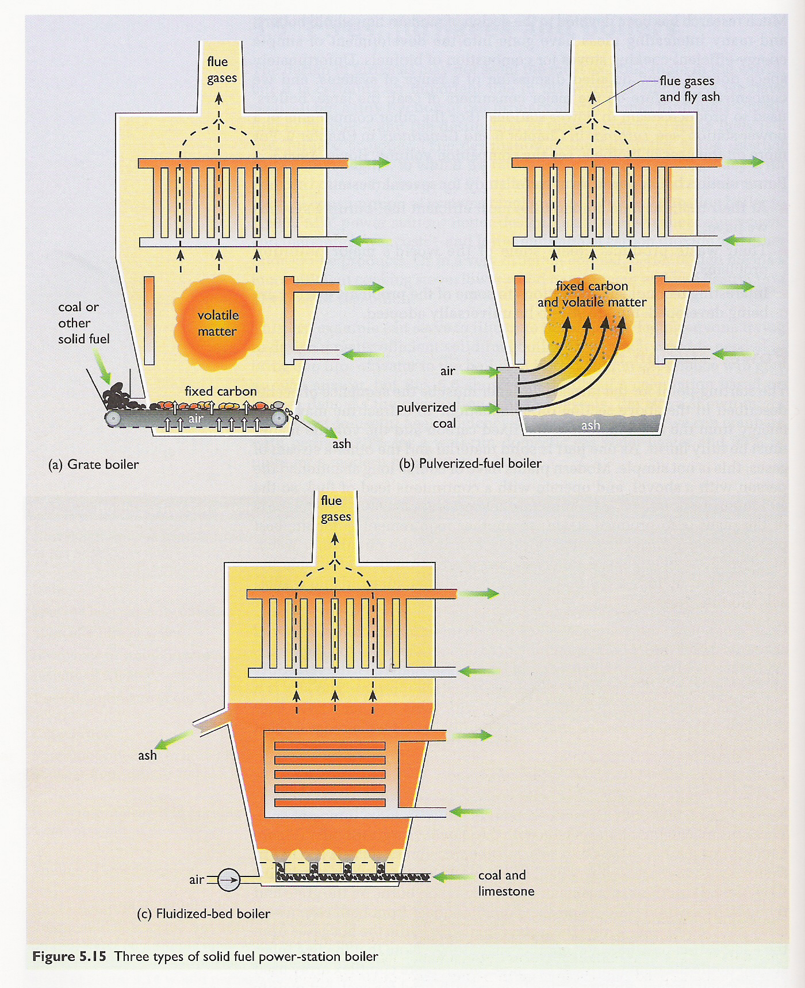
Combustion
Moisture evaporates in the first stages of combustion.
Volatile matter is turned to gas like CO, CH₄ and other hydrocarbons.
These gases combust to create heat.
Fixed carbon combines with oxygen gas to produce carbon dioxide flue gas.
Ash is any material that remains.
Best quality coal has ~10% ash.
Lower quality may produce 15-30%.
Often disposed of in ponds, lakes and landfills
Pollutes water supplies
A Watt double-acting steam engine (1859)
Energy Systems and Sustainability, 2/e, Chapter 5

Slide 33
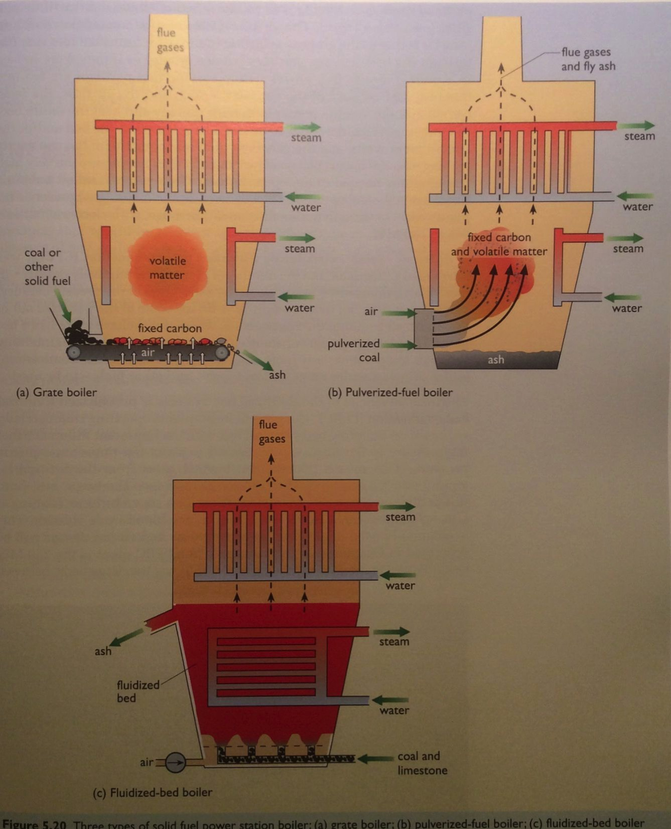
Combustion: newer technologies
Pulverized fuel boilers create a fine carbon powder that is blown into the combustion chamber with air.
90% efficient
Problem: fine fly ash in flue gases.
Fluidized bed boilers combust small coal particles in a bed of sand. ‘Bubbles’ of coal and air heat the entire bed.
Very efficient
Lower combustion temps, so less NOx
A Watt double-acting steam engine (1859)
Energy Systems and Sustainability, 2/e, Chapter 5

Slide 34
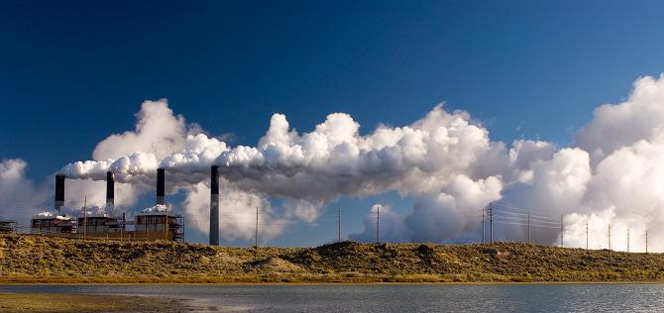
Combustion flue gases
Emissions: NOx, CO₂, H₂O, SOx, fly ash and particulates
Coal’s challenges?
Hot, dirty and corrosive
Volume: 3000 tonnes/hour!
Very high levels of:
  Moisture
  SOx; and
  Particulates
A Watt double-acting steam engine (1859)
Wyoming Public Media
Energy Systems and Sustainability, 2/e, Chapter 5

Slide 35
Making emissions real
Let’s look at some numbers to bring home the scale of emissions from coal-fired power plants.
A power plant burns 250 tonnes of coal per hour to produce 500 MW.
emission | tonnes | problem?
N₂ (from air for combustion) | 2000 | little harm
CO₂ | 650 | GHG !
steam (H₂O) | 150 | harmless (energy loss)
NOx | 1 | acid-rain, health
SOx | 1 - 20 | acid-rain, health
fly ash | 20 | health
mercury vapor | 30 g | health
A Watt double-acting steam engine (1859)
Energy Systems and Sustainability, 2/e, Chapter 5

Slide 36
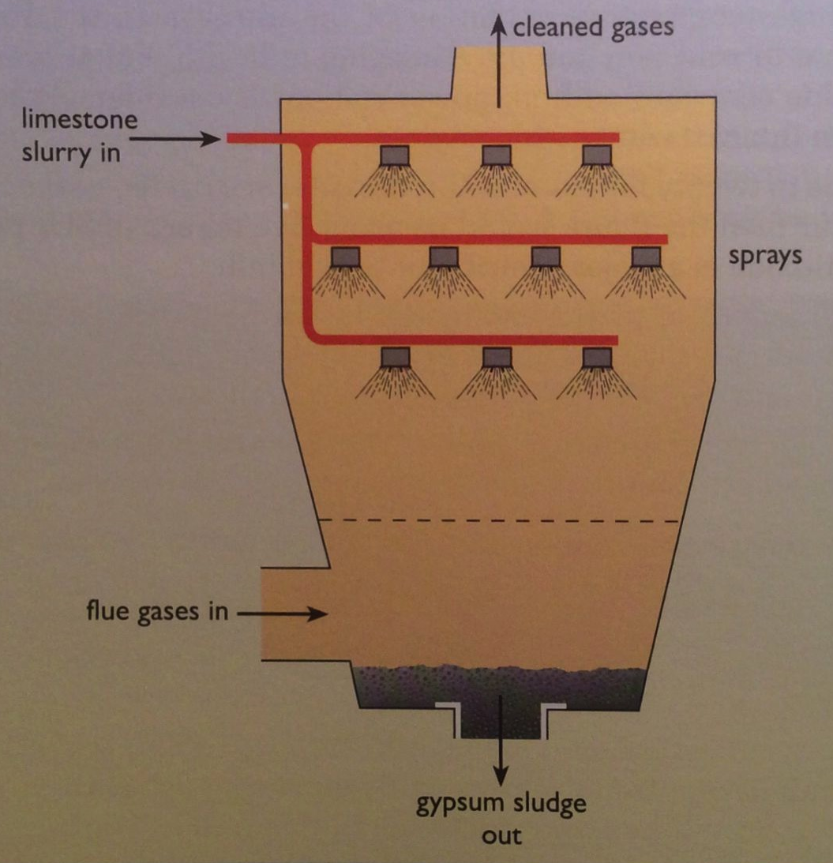
Lowering SOx
SOx can be reduced by using limestone (CaCO₃) or seawater to precipitate the 90-95% of sulfur out of the flue gases.
CaCO₃ + SO₂ → CaSO_{3/4} ⬇+ CO₂
gypsum
Energy Systems and Sustainability, 2/e, Ch 5

Slide 37
Lowering NOx
NOx can be reduced by:
Decreasing combustion temperatures (a la fluidized bed);
Selective catalytic reduction (removal of O from N); or
Gas reburn via added natural gas to remove oxygen.
4NH₃ + 6NO → 5N₂ + 6H₂O
W (tungsten) or V (vanadium) catalyst
A Watt double-acting steam engine (1859)
Energy Systems and Sustainability, 2/e, Chapter 5

Slide 38
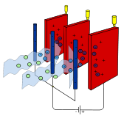
Lowering particulates and ash
Particulates and ash can be reduced using:
Cyclone;
Bag filter; or
Electrostatic precipitator:
Particles are ionized (charged) and then
attracted to charged filters / plates.
Disposing of the ash?
Ash is toxic because of metal contaminants.
Landfill; or
Use as a ‘filler’ in concrete where toxins are fixed.
A Watt double-acting steam engine (1859)
Energy Systems and Sustainability, 2/e, Chapter 5; wikipedia

Slide 39
Module 4. Coal
  4.6: Current global use of coal
    US
    Europe
    China
    India
    Market forces and export

Slide 40
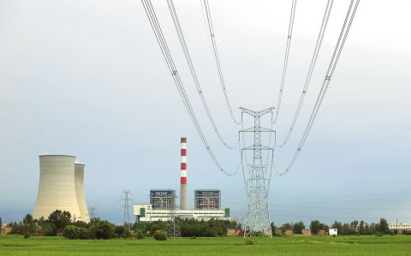
Current uses of coal
As of 2008, two-thirds of global coal was used for producing electricity.
In the UK, 80%.
As of 2020, coal is used to produce only 23.5% of electricity.
To avoid transporting bulky coal from mines to distant population centers, electric generating plants are often located near mines and electricity is transmitted to urban centers: ‘coal by wire’.
2-6% losses.
Coke is still used for smelting, steel and cement production.
Global coke use was 800 million tonnes in 2009.
Nearly half of coke was used in China.
A Watt double-acting steam engine (1859)
Energy Systems and Sustainability, 2/e, Chapter 5; US EIA

Slide 41
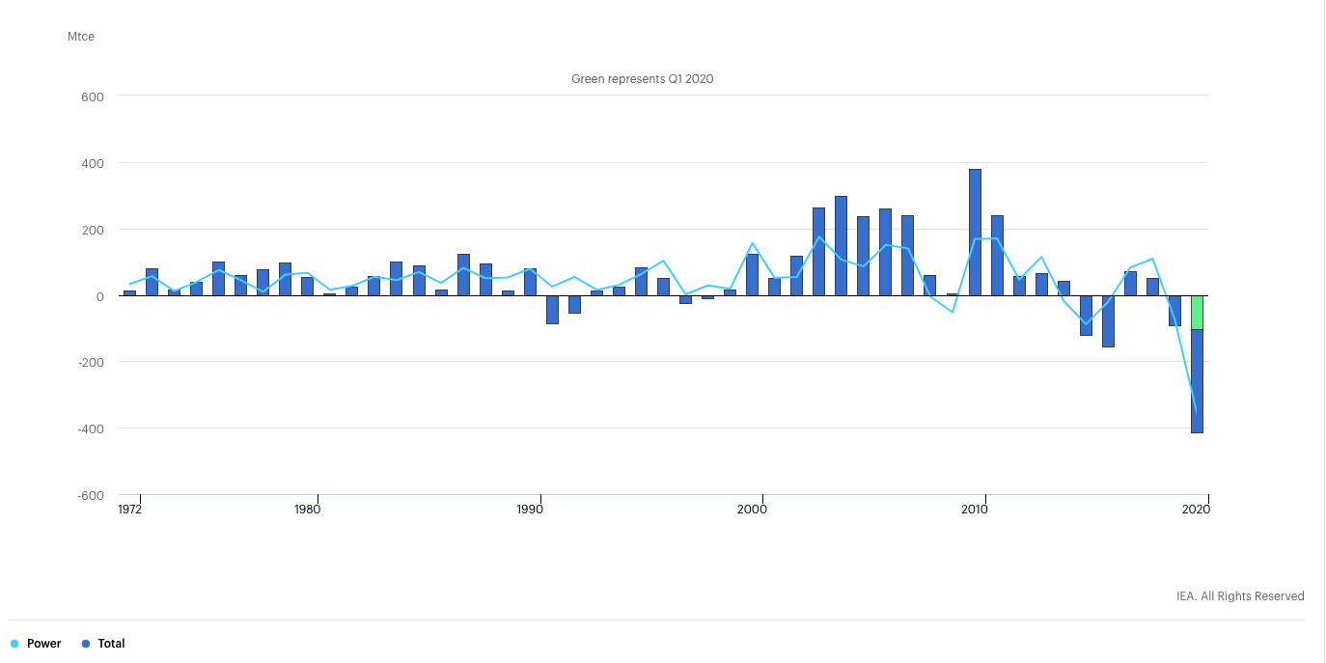
Annual global changes in coal demand, 1971 – 2020
https://www.iea.org/reports/global-energy-review-2020/coal

Slide 42
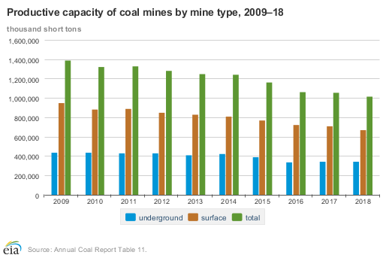
Coal production and consumption is down in the US

Slide 43
Coal production is also falling in Europe
https://ec.europa.eu/eurostat/statistics-explained/images/7/7a/Production_of_hard_coal_trend_line.jpg

Slide 44
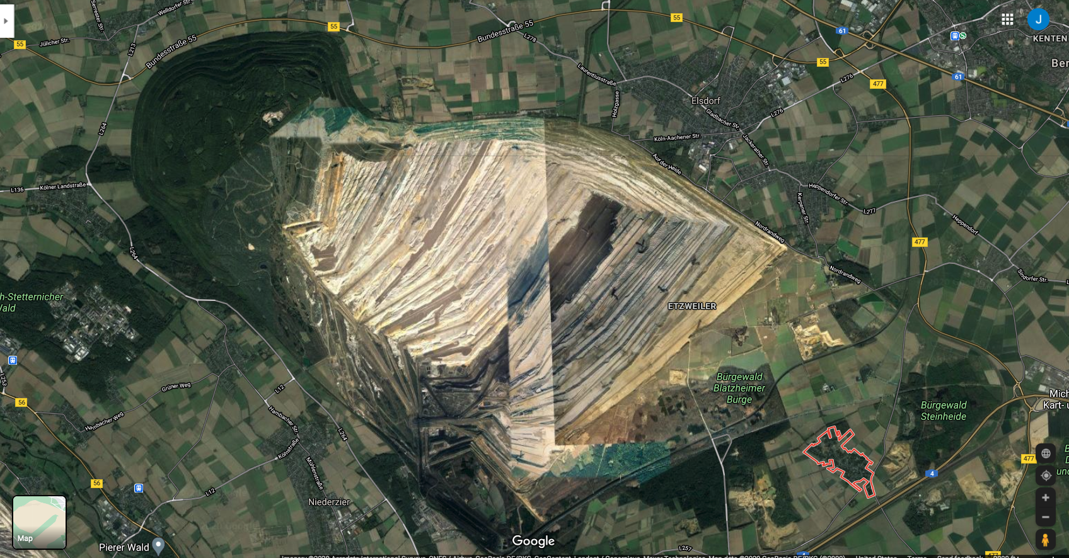
The cost of the last coal resources is very high
After the 2011 Fukushima nuclear accident Germany decided to shut down its nuclear energy. While building replacement renewable capacity Germany had to turn back to coal.
The costs?
Village of Manheim
The ancient Hambach forest

Slide 45
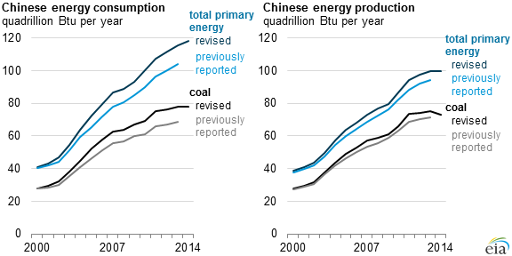
China: coal has risen but may have plateaued
https://www.eia.gov/todayinenergy/detail.php?id=22952

Slide 46
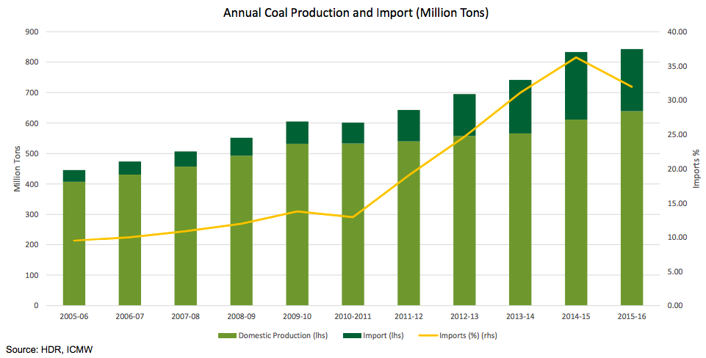
India: coal production is rising, despite plans
https://www.eia.gov/conference/2016/pdf/presentations/roychoudhury.pdf

Slide 47
Forces reducing US coal production and use?
“Power companies continue to shutter their coal-fired plants because, as one utility executive told me, “our customers don’t want it.” Ten years ago, coal generated more than half of America’s electricity; today, coal accounts for about one-fifth — and falling. The fastest-growing electricity source is wind.
How are large coal companies doing?
1. Peabody: largest US coal company
  2016: Filed for bankruptcy
  2018: Reorganized and opened at $47.00/share
  2020: Stock has dropped to $3.50/share
2. Arch coal has lost 60% of value from 2016 - 2020
3. Cloud Peak Energy is in bankruptcy
4. Murray Energy is in bankruptcy
5. Alliance Resource Partners
  2014 stock at $50/share
  2020 stock at $4/share
https://www.washingtonpost.com/opinions/trump-pledged-to-bring-back-coal-like-everything-under-him-it-collapsed-instead/2020/06/12/1fa8bed6-accd-11ea-9063-e69bd6520940_story.html

Slide 48
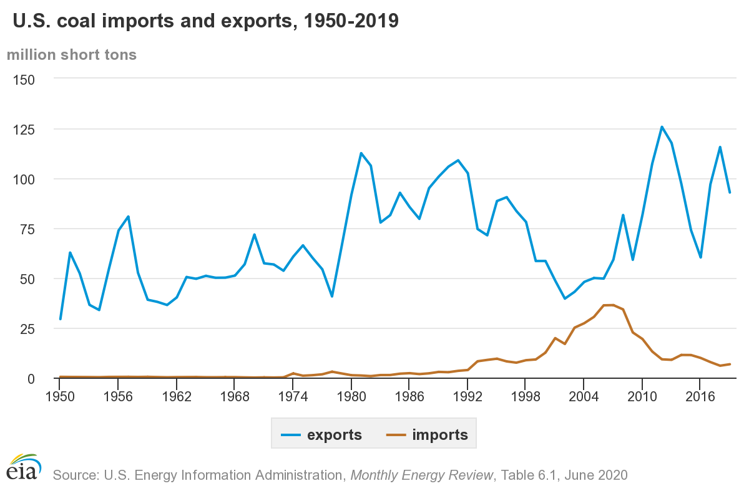
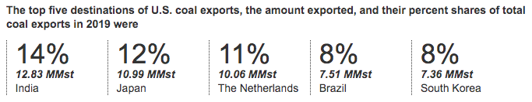
Will we export our coal to others?

Slide 49
Are increased coal exports a good thing?
Jobs?
A few, though mechanization was causing job loss before coal production slowed.
GCC?
Not good news as CO₂ emissions don’t know national borders?
The US economy?
  “But it’s not such great news for U.S. steelmakers, who are watching global rivals gobble up American coal to feed their steel mills — and who then turn around and export millions of tons of steel to the United States, prompting the Trump administration to levy tariffs on lots of imported steel.”
https://foreignpolicy.com/2018/04/04/trump-makes-american-coal-great-again-overseas/

Slide 50
Module 4. Coal
  4.7: Alternative uses of coal
    Gasification to ‘syngas’

Slide 51
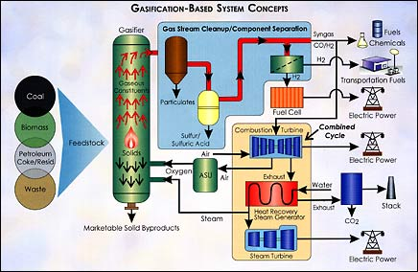
Gasification to syngas
Gasification converts hydrocarbons like coal into gases using heat, pressure and steam. Oxygen levels are controlled to prevent combustion.
Syngas:
CO and H₂
Wyoming Public Media
A Watt double-acting steam engine (1859)
Energy.gov

Slide 52
Gasification to syngas
Integrated gasification combined-cycle:
Cleaned syngas is combusted to drive a combustion turbine that drives a generator;
Exhaust heat is used to create steam, to drive a second steam turbine-generator.
Combined turbines generate electricity very efficiently: 40%
This efficiency can be achieved with H2 fuel from non fossil-fuel sources too.
CCGT technology is more critical than rather than fuel.
Compatible with carbon capture and storage
If oxygen is used in place of air, carbon dioxide is produced in a concentrated stream that is easier to capture and sequester.
Wyoming Public Media
Other uses of syngas?
Chemical building blocks for the chemical industries
Fuel for fuel-cell systems
Source of hydrogen
A Watt double-acting steam engine (1859)
Energy.gov

Slide 53
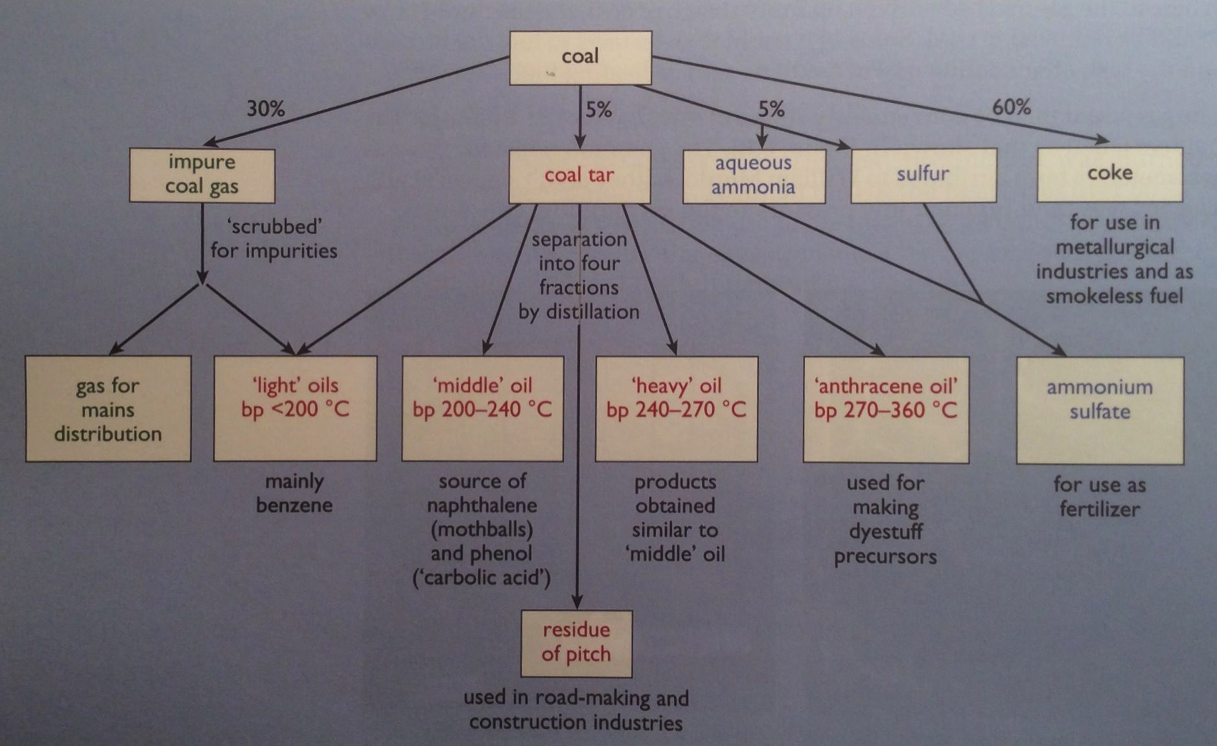
Gasification products and co-products
Wyoming Public Media
A Watt double-acting steam engine (1859)
Energy Systems and Sustainability, 2/e, Chapter 5

Slide 54
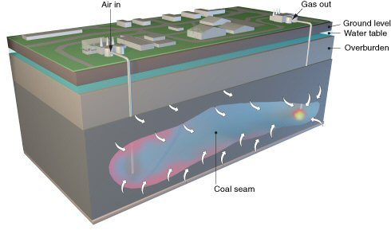
Underground coal gasification
Uses conventional gasification technology, put performed underground.
Air and water are injected into the coal seam;
Ignited under low-oxygen conditions to partially oxidize coal into:
  H₂, CO, CO₂, CH₄, H₂S
  Gases piped to the surface for combustion.
The UK will not use this
technology because its CO₂
emissions are significantly higher than those from NG.
Wyoming Public Media
Energy Systems and Sustainability, 2/e, Chapter 5

Slide 55
Module 4. Coal
  4.8: Carbon sequestration and ‘clean coal’
    Biological and artificial carbon sequestration
    ’Clean coal’ and its economic viability
    More efficient coal combustion

Slide 56
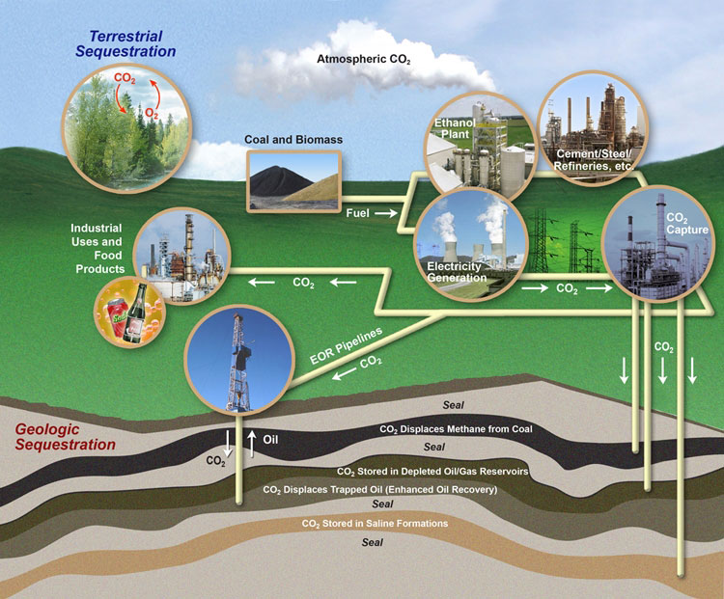
Carbon sequestration
Sequestration: ties up carbon to keep it out of the atmosphere.
Biological sequestration is natural.
Engineered sequestration?
Aka CCS
carbon capture and storage
CCU
  Carbon capture and use
Wyoming Public Media
Energy Systems and Sustainability, 2/e, Chapter 5; US Carbon Sequestration Program, US DOE
A Watt double-acting steam engine (1859)

Slide 57
What is ‘clean coal’?
“The term “clean coal” was popularized in 2008 by coal industry groups, at a time when Congress was contemplating climate change legislation. While the term is deliberately vague, it is often understood to mean coal plants that capture the carbon dioxide emitted from smokestacks and bury it underground as a way of limiting global warming.”
Commonly called CCS (carbon capture and storage)
Ohio researchers are developing a chemical looping combustion process that would allow easier capture of carbon emitted by burning coal.
Still in development
Will it scale up?
Would it be cost competitive?
Wyoming Public Media
A Watt double-acting steam engine (1859)
https://www.nytimes.com/2017/08/23/climate/what-clean-coal-is-and-isnt.html
https://news.osu.edu/a-fossil-fuel-technology-that-doesnt-pollute/

Slide 58
Clean coal in 2020?
July 2020: US DOE rolls out a ‘Clean Coal’ game plan
Enhance tax credits and extending them to 2030
By 2030, retrofit a critical mass of coal power plants with carbon capture and efficiency technologies.
By 2035, establish a network of carbon dioxide storage sites and pipelines five times the size of today’s.
By 2040, develop a range of new coal plant technologies.
The plan admits that CCS is still in R&D.
Wyoming Public Media
A Watt double-acting steam engine (1859)
https://county17.com/2020/07/17/doe-panel-rolls-out-clean-coal-game-plan/

Slide 59
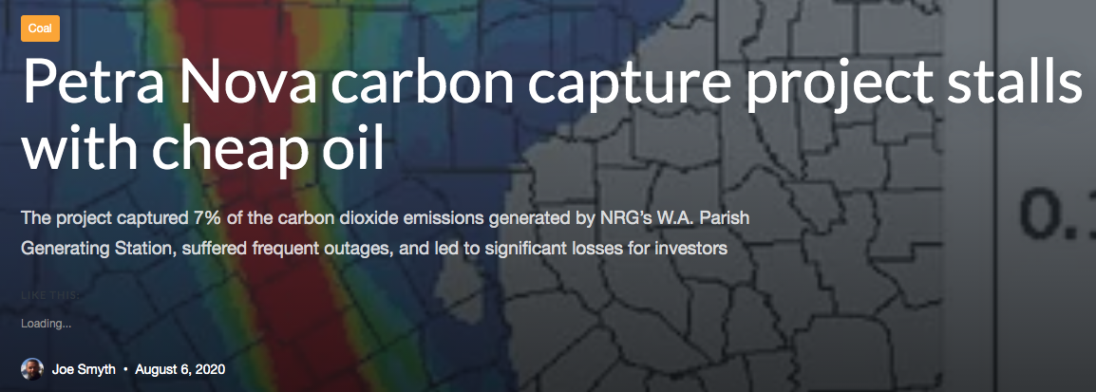
CCS isn’t commercially viable in the US in 2020
“The [$1 b] Petra Nova carbon capture project has stopped operating because low oil prices have made it uneconomic to sell carbon dioxide to boost oil drilling operations.”
“…the project actually experienced so many outages that it wasn’t operating for one of out every three days over the last three years.”
Wyoming Public Media
A Watt double-acting steam engine (1859)
https://www.energyandpolicy.org/petra-nova/

Slide 60
Would clean coal be competitive with RE?
“Avoiding climate destabilization caused by greenhouse gas (GHG) emissions, requires climate-neutral electricity sources. It has been proposed that the GHG emissions from coal-fired power plants can be offset by carbon capture and sequestration or bio-sequestration. However, solar photovoltaic (PV) technology has recently declined so far in costs it now offers both technical and economic potential to offset all of coal-fired electricity use. PV only emits GHGs during fabrication and not during use. To determine which technical solution to climate-neutral electricity generation should be preferred, this study aggregates and synthesizes life cycle analysis studies for exergy, GHG emissions and land transformation for climate-neutral electricity. The results show that because of lower exergy efficiencies coal plants emit 13–18 times more GHG and transform 5–13 times more land than PV. Optimal bio-sequestration of coal-fired GHG requires 62% of U.S. arable land or 89% of all U.S land with average forest cover. Carbon capture and storage and enhanced oil recovery can improve coal performance, but for all cases the results clearly show that PV is a far more effective use of land. Overall, for the first time this study found climate-neutral photovoltaic farms are a preferred solution to climate-neutral coal fired electricity generation.”
A Watt double-acting steam engine (1859)
https://www.nature.com/articles/s41598-018-31505-3

Slide 61
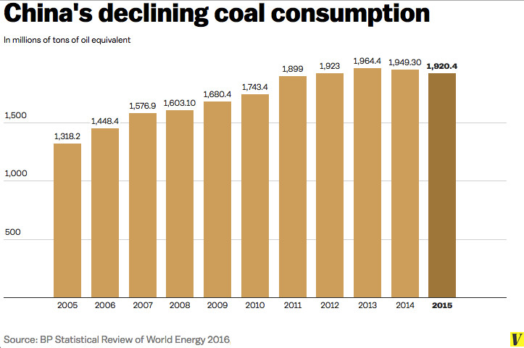
China’s recent affair with coal… ending?
2000: China creates a massive economic push to lift millions our of poverty
  powered by coal
2010: China’s use of coal slows
  Move away from manufacturing and towards service
  Rapid expansion of renewables
  Motivation?
  Pollution of air and water had
  become intolerably high.
The US moved from coal to NG, but China doesn’t have NG.
China’s plan?
Use coal as well as possible…
… while jumping right to renewables.
Wyoming Public Media
A Watt double-acting steam engine (1859)
https://www.vox.com/energy-and-environment/2017/5/15/15634538/china-coal-cleaner

Slide 62
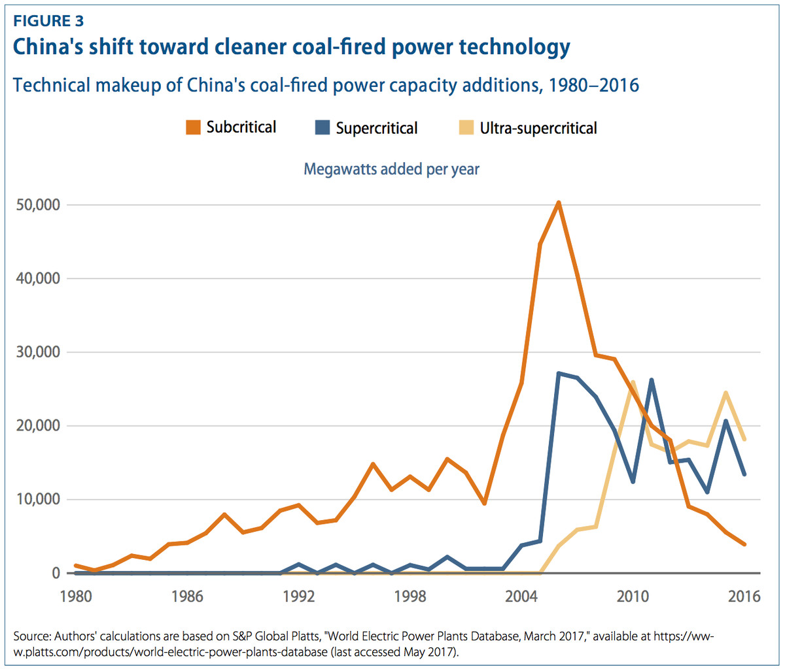
China’s ‘cleaner’ (less dirty) coal
Subcritical: < water’s critical point
Supercritical: above water’s critical point
Ultra-supercritical: far above
power
pollution
$$$
Wyoming Public Media
A Watt double-acting steam engine (1859)
https://www.vox.com/energy-and-environment/2017/5/15/15634538/china-coal-cleaner

Slide 63
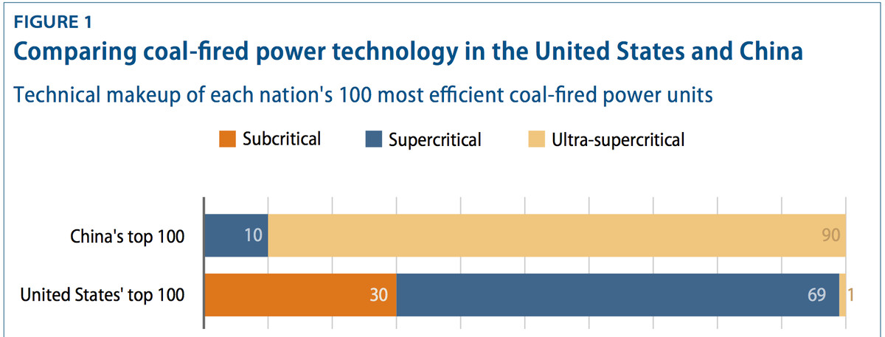
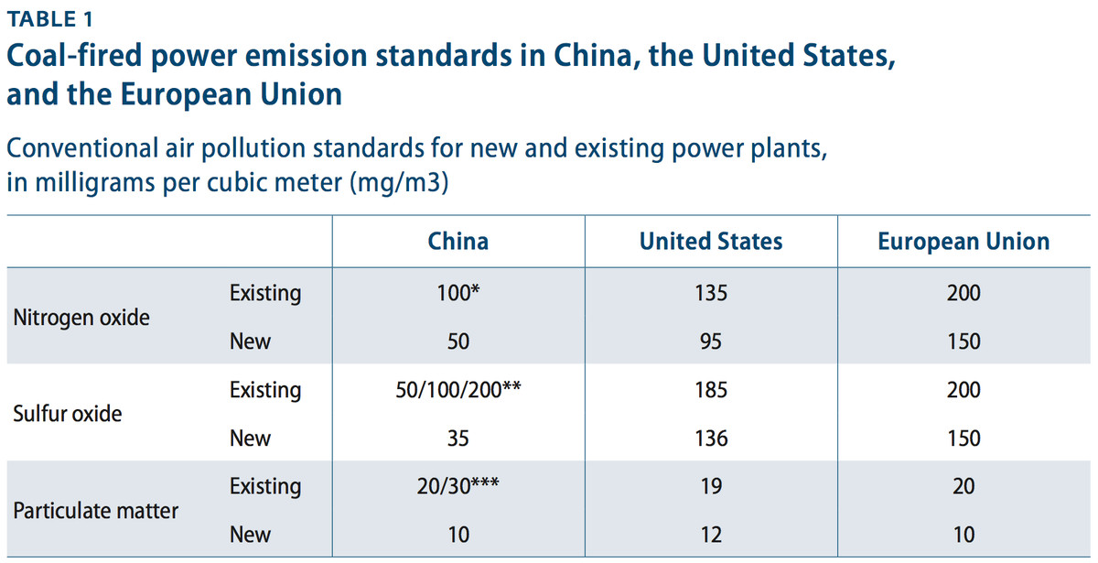
Coal plant standards in China vs. US and Europe?
Wyoming Public Media
A Watt double-acting steam engine (1859)
https://www.vox.com/energy-and-environment/2017/5/15/15634538/china-coal-cleaner

Slide 64
Module 4. Coal
  4.9: Coal’s future?
    Business cycles
    LCOE and EROEI
    COVID lessons and opportunities
    Early retirement?

Slide 65
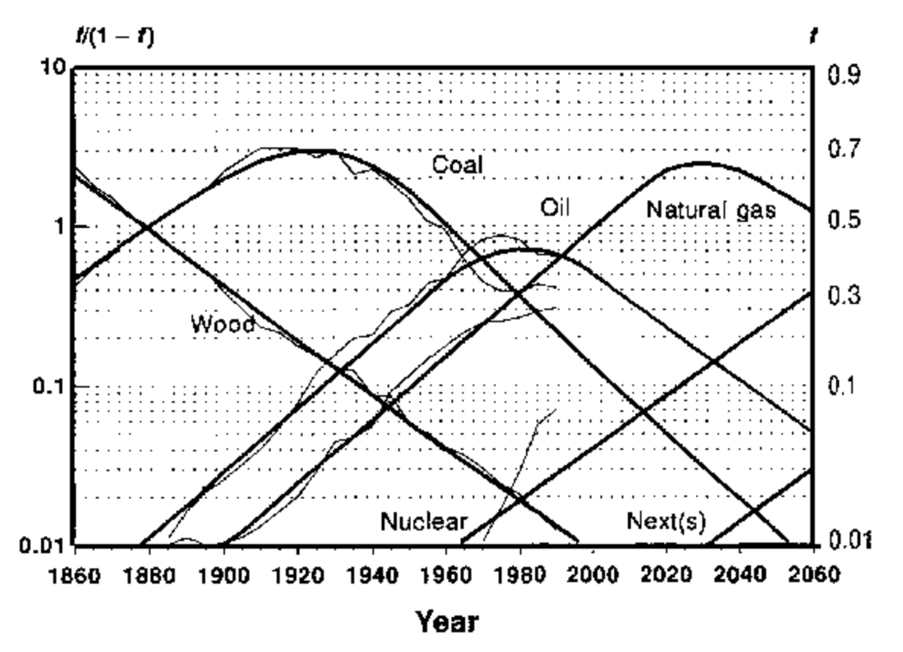


Energy cycles are business cycles
Adapted from Marchetti and Nakicenovic (1979)

Slide 66
LCOE (levelized cost of energy)
Levelized cost of electricity: represents the average revenue per unit of electricity generated that would be required to recover the costs of building and operating a generating plant during an assumed financial life and duty cycle.
LCOE is often cited as a convenient summary measure of the overall competiveness of different generating technologies.
Key inputs:
capital costs
fuel costs
fixed and variable operations and maintenance (O&M) costs
fuel costs
financing costs
assumed utilization rate for each plant
Incentives, including state or federal tax credits also affect the calculation of LCOE.
Knock: LCOE fails to address the time value of money correctly. This ongoing error has the unfortunate consequence of slowing the deployment of renewable energy.
https://www.eia.gov/outlooks/aeo/pdf/electricity_generation.pdf
https://www.utilitydive.com/news/lcoe-is-not-the-metric-you-think-it-is/578360/

Slide 67
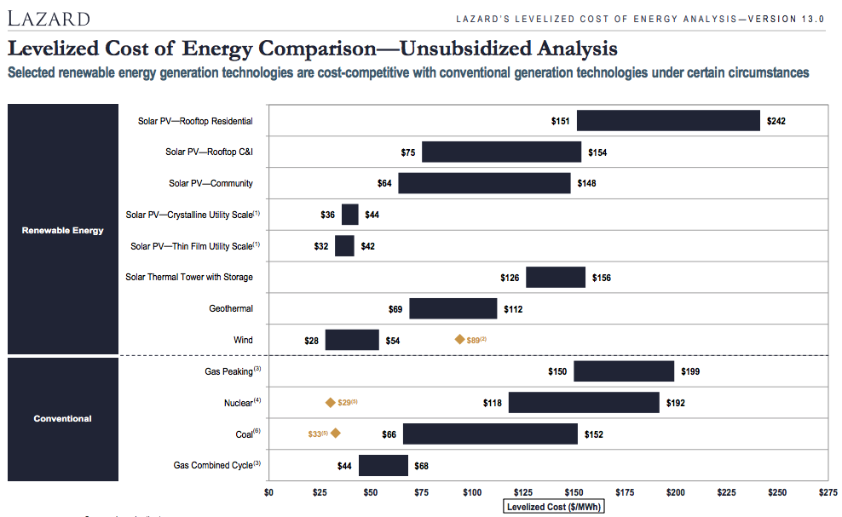
Lazard’s 2019 LCOE
https://www.lazard.com/media/451086/lazards-levelized-cost-of-energy-version-130-vf.pdf

Slide 68
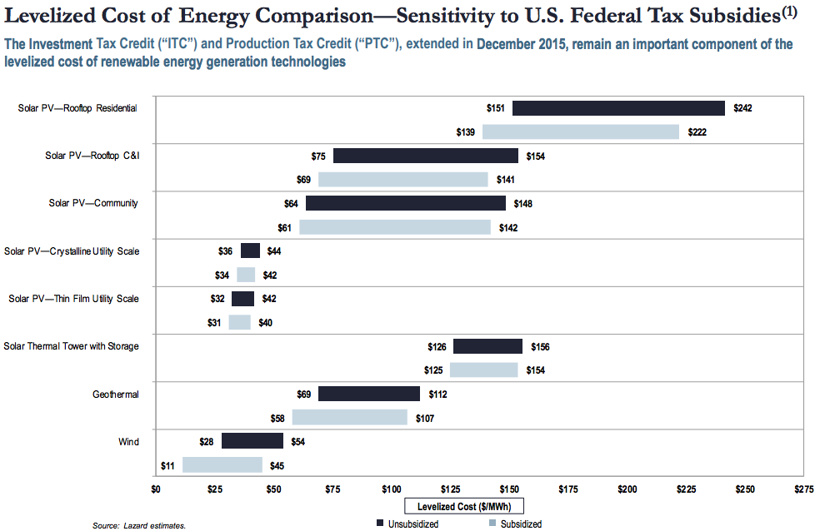
LCOE: sensitivity to subsidy
https://www.lazard.com/media/451086/lazards-levelized-cost-of-energy-version-130-vf.pdf

Slide 69
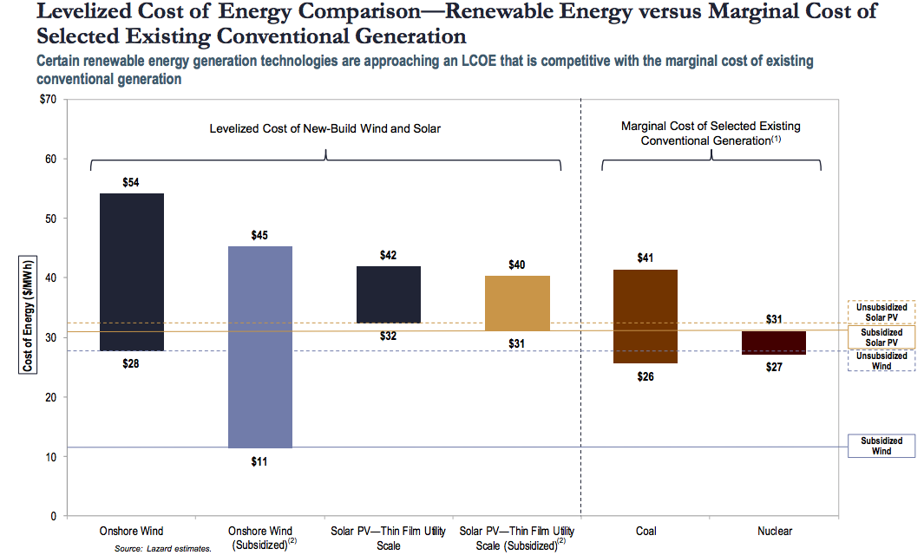
LCOE: marginal costs
Marginal cost: the cost added by producing one additional unit of a product or service.
https://www.lazard.com/media/451086/lazards-levelized-cost-of-energy-version-130-vf.pdf

Slide 70
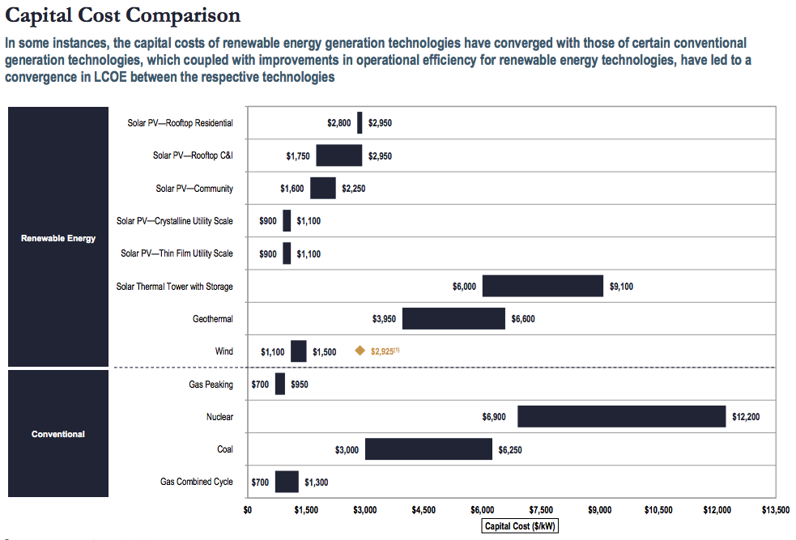
LCOE: capital costs
https://www.lazard.com/media/451086/lazards-levelized-cost-of-energy-version-130-vf.pdf

Slide 71
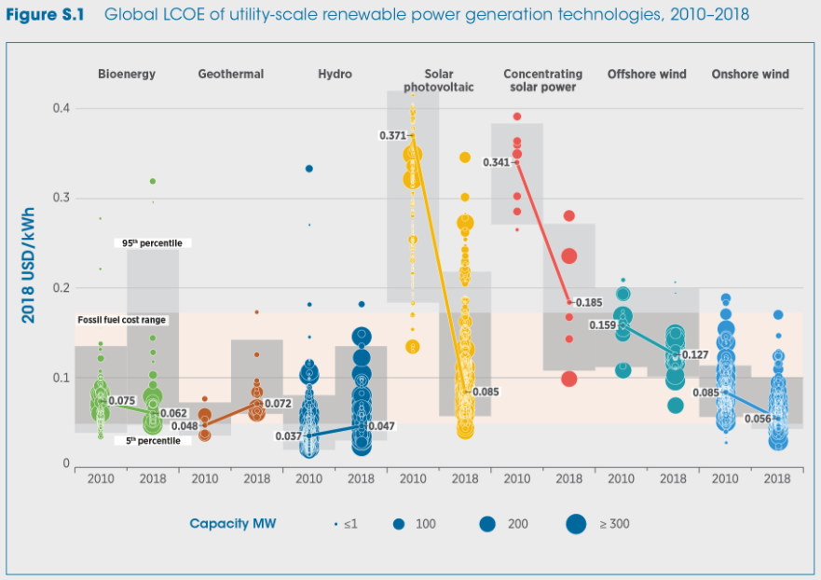
Global LCOE’s confirm that coal is losing the cost race
fossil fuels
https://energypost.eu/cheaper-than-coal-irenas-comprehensive-report-on-cost-declines-all-renewables-categories/

Slide 72
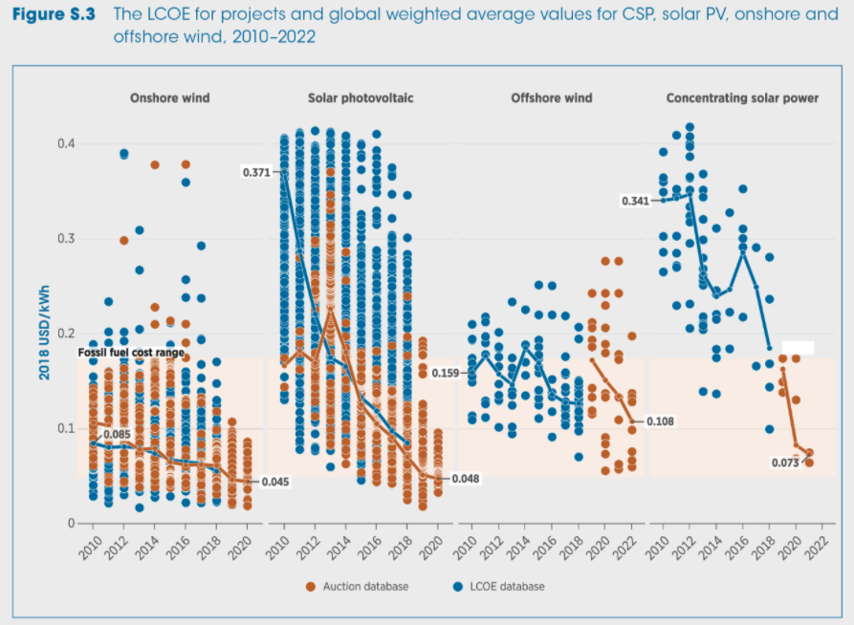
Global LCOE’s weighted averages for RE vs. FF
https://energypost.eu/cheaper-than-coal-irenas-comprehensive-report-on-cost-declines-all-renewables-categories/
fossil fuels

Slide 73
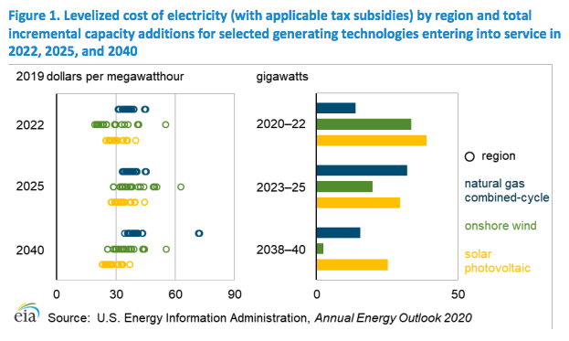
LCOE: US projections
https://www.eia.gov/outlooks/aeo/pdf/electricity_generation.pdf

Slide 74
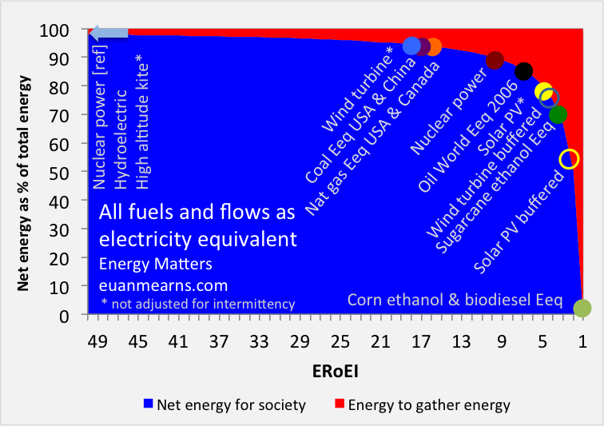
EROEI = energy return on energy investment
ERoEI = energy gathered
energy invested
The higher the EROEI, the more efficient the energy source or technology
A recent analysis suggests that the EROEI of fossil fuels has been overestimated for years and that they are much closer to RE than previously thought.
http://euanmearns.com/eroei-for-beginners/
https://www.sciencedaily.com/releases/2019/07/190711114846.htm
fossil fuels

Slide 75
Rethinking – or recalculating - EROEI
“A new study, co-authored by scientists from the Sustainability Research Institute at the University of Leeds, has calculated the EROI for fossil fuels over a 16 year period and found that at the finished fuel stage, the ratios are much closer to those of renewable energy sources -- roughly 6:1, and potentially as low as 3:1 in the case of electricity.
The study, undertaken as part of the UK Energy Research Centre programme and published today in Nature Energy, warns that the increasing energy costs of extracting fossil fuels will cause the ratios to continue to decline, pushing energy resources towards a "net energy cliff." This is when net energy available to society declines rapidly due to the increasing amounts of "parasitical" energy required in the energy production.
The researchers emphasise that these findings make a strong case for rapidly stepping up investment in renewable energy sources …”
https://www.sciencedaily.com/releases/2019/07/190711114846.htm

Slide 76
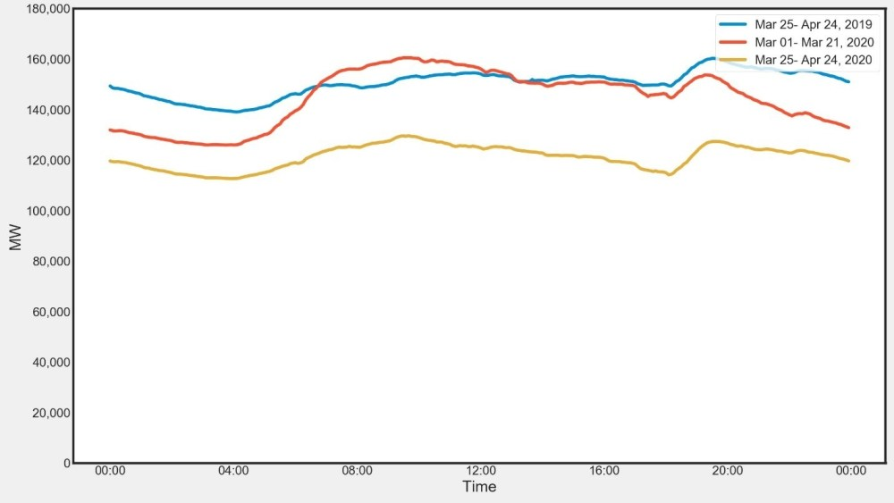
The opportunity presented by COVID?
In India, COVID cut electrical consumption significantly.
Response?
Most coal plants were taken offline.
Renewables were left online.
Hydropower was used to balance grid demand and meet instantaneous need.
Wyoming Public Media
https://www.brookings.edu/blog/up-front/2020/06/15/is-covid-19-an-opportunity-to-clean-up-indias-coal-power-plants-faster/
A Watt double-acting steam engine (1859)

Slide 77
COVID opportunities: lessons and planning needed
Lessons:
The RE system worked when demand was lowered and it could work when demand increases if it is expanded.
Hydropower played an essential role in allowing the supply of intermittent power sources (RE) to meet demand. So hydropower (or another baseload power source like nuclear is likely an essential part of
Planning ahead to allow best use of crises
India will need coal-fired electricity for a while as they transform their energy system.
Today, many of those plants are inefficient and dirty.
While the plants are down during COVID-like crises, it would be wise to use that time to make improvements including systems that:
  Desulfurize flue gas
  Remove particulates (electrostatic precipitator)
  Remove NOx and SOx
This requires capital and planning ahead.
Wyoming Public Media
A Watt double-acting steam engine (1859)
https://www.brookings.edu/blog/up-front/2020/06/15/is-covid-19-an-opportunity-to-clean-up-indias-coal-power-plants-faster/

Slide 78
Post-COVID energy predictions for 2020
Five energy experts shared their energy predictions for 2020.
Solar boom
Solar development will continue to boom but could be more effective with better policy. Solar should produce 20% of US electricity by 2030 and offset 35% of energy emissions. Prices will fall and solar employment will rise.
2. Private investment in the energy sector is critical
Investment needs to double to keep us on path with the Paris accord. The grid needs to be updated to enable effective change across the board. Government incentives would drive private investment.
3. Use of coal is crashing and NG is stalling and targeted
2020 may end the long era of coal in the US. Fracked NG is under pressure and isn’t paying when compared to renewables, storage and efficiency.
Wyoming Public Media
4. As regulations are slashed and GCC becomes evident, the public will mobilize
As it becomes clear that GCC is affecting all of us, and that low-carbon energy can work, the public will continue to react and demand change.
A Watt double-acting steam engine (1859)
https://www.forbes.com/sites/energyinnovation/2020/01/13/five-2020-energy-predictions-solar-surge-coal-crash-gas-exorcism-clean-energy-incentives-public-mobilization/#4d2451fc1ece

Slide 79
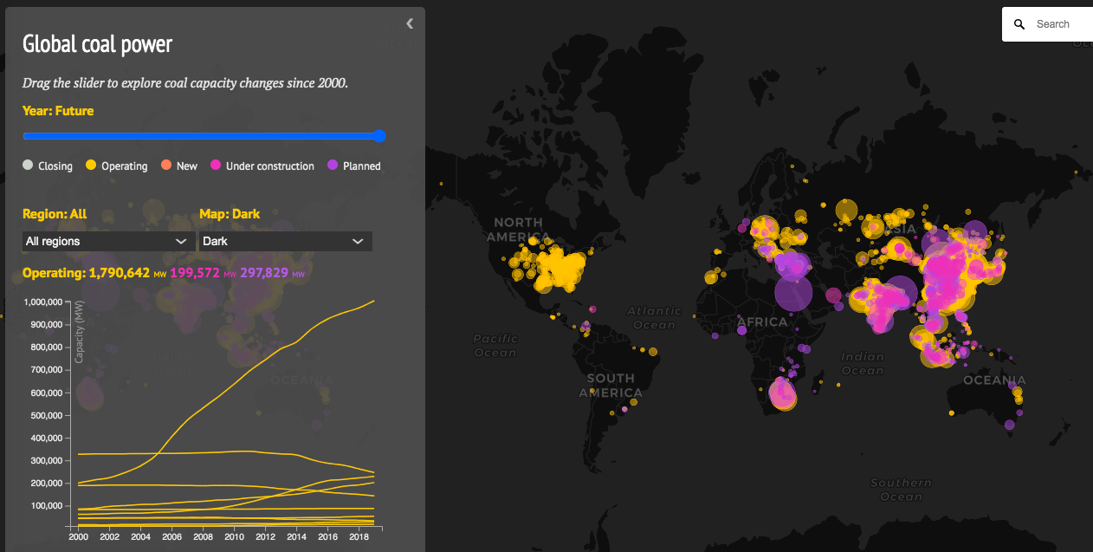
Global coal power changes 2000 – 2019 and on
Five energy experts shared their energy predictions for 2020.
In 2020, US utilities announced that they would close 13 plants over the next several years.
https://www.carbonbrief.org/mapped-worlds-coal-power-plants

Slide 80
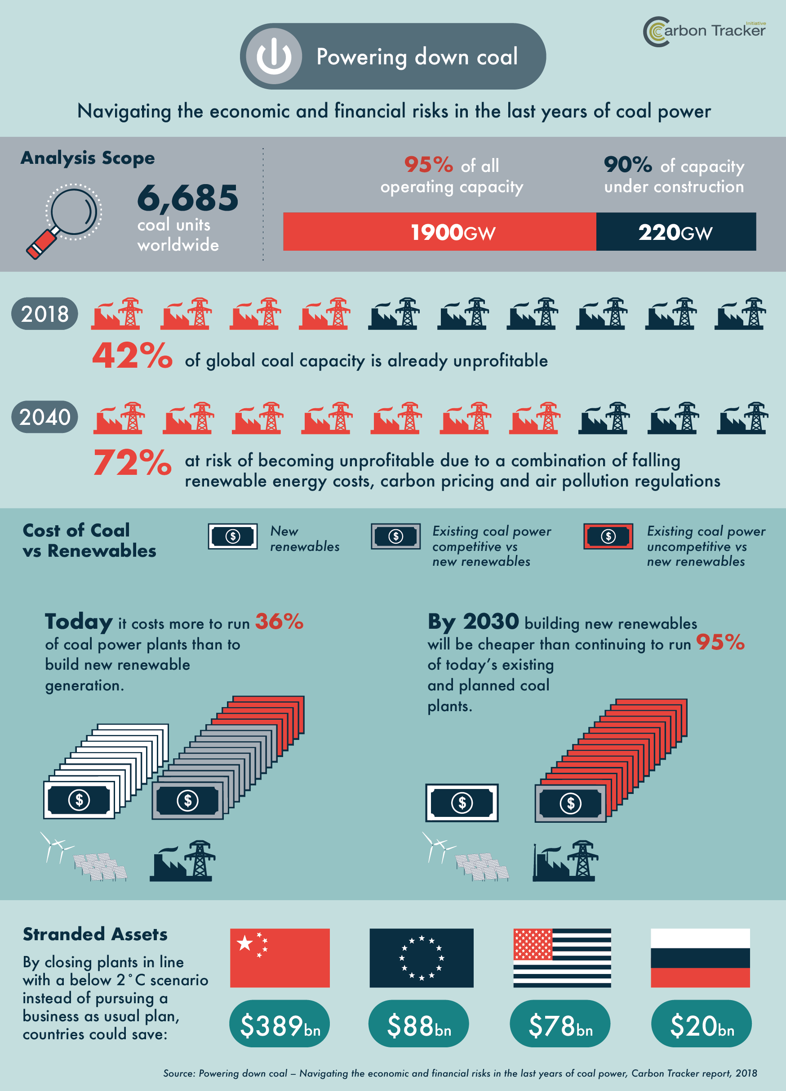
Powering down coal
https://carbontracker.org/wp-content/uploads/2018/11/Coal-economics-infographic-6-01.png

Slide 81

Should coal take early retirement?
As of 2020, it’s cheaper for utilities to build new renewable energy capacity than to keep operating 39% of existing global coal-fired electricity plants.
↑ to 60% by 2022
↑ to 73% by 2025
Replacing the entire global coal fleet with clean energy can be done at a net savings to society as early as 2022.
Wyoming Public Media
https://carbontracker.org/reports/how-to-retire-early/
A Watt double-acting steam engine (1859)

Slide 82
Buy-outs could hasten the move away from coal
During 2020, a trend has been noted in Europe: governments are paying coal companies to shut down coal-fired power plants.
May 2020: Dutch government paying €52.5 million to energy company Vattenfall to close a coal-fired power plant 5 years earlier than planned.
Vattenfall (a Swedish company) is now investing heavily in renewable energy.
Hollandse Kust Zuid 1-4, the world’s largest wind farm built without subsidies, with a total installed capacity of 1,500MW.
2020/2021: German government will hold auctions in which 5.5 GW of coal-fired plants can bid for closure buy-outs. The lowest bid wins and closes the plant.
      However, one more new plant Datteln 4 will be allowed to go online.
2018 - 2020: In Spain, coal mines and coal-fired plants are closing due to economic down-turns and COVID. The government has set aside €250 million for compensation to displaced workers, training and environmental restoration.
Wyoming Public Media
A Watt double-acting steam engine (1859)
https://www.power-technology.com/features/closing-coal-should-we-be-compensating-the-fossil-fuel-industry-for-early-closures/

