Slide 1

SSC 2030: Energy Systems and Sustainability
5. Oil and natural gas
5.1: Origins and geology of petroleum and its industry
5.2: Case study - rise and fall of North Sea oil and gas
5.3: Why are oil and gas so special?
5.4: Finding and producing petroleum
5.5: Petroleum refining and products
5.6: Oil consumption and production today
5.7: Natural gas
5.8: Methane leaks and GCC
5.9: Unconventional oil and gas
5.10: Methyl hydrates (clathrates)
5.11: Petroleum’s future?

Slide 2
Module 5. Oil and gas
  5.1: Origins and geology of petroleum
  and today’s oil and gas industry

Slide 3
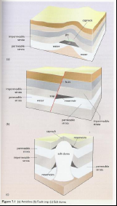
Introduction to oil and gas
Petroleum: all hydrocarbons deposited in the Earth’s crust
Crude oil (liquid)
Natural gas (gaseous)
Bitumens (coal; solids)
Formed by decomposition of marine organics followed by time, heat and pressure. (Coal + more time and pressure?)
Abundant where marine strata accumulated.
Traps: geologic formations where hydrocarbons accumulate
Geologic traps: porous, permeable reservoir rock; high pressure
Structural traps: anticline, fault trap, salt dome
Energy Systems and Sustainability, 2/e, Chapter 7

Slide 4
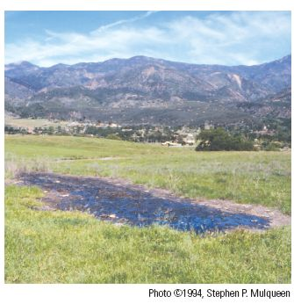
Use of ‘surface’ petroleum is ancient
Early use of petroleum depended on easy access:
Surface seepage; or
Topographical features allowing easy access.
Petroleum’s many ancient uses
From the Babylonians onward, surface petroleum was used as a lamp fuel, an adhesive, for caulking boats, medicines and … myriad other uses
Oil seep in CA after Northridge
earthquake (USGS)
Energy Systems and Sustainability, 2/e, Chapter 7

Slide 5
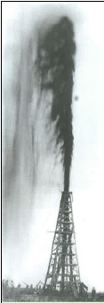
Modern use started with lighting
coal
In the 1800s, coal gas was used to light cities, but was
not available outside of cities.
In 1850, Scottish chemist James ‘Paraffin’ Young patented the distillation of coal oil and paraffin wax from coal.
Coal oil became a popular lighting and lubricating oil.
oil
In 1859, Edwin Drake ‘hit’ oil in Titusville PA.
Early uses focused on distillation of lighting oil.
Within 40 years, uses were soon found for all fractions produced by distillation of crude oil.
Energy Systems and Sustainability, 2/e, Chapter 7

Slide 6
... And quickly dominated transportation
The energy density and liquid state of heavy and light fractions of petroleum made it an attractive alternative to coal for transportation.
1890: The Diesel engine developed for peanut oil, but was able to use petroleum.
1903: The Wright brothers’ first flight was fueled with gasoline.
1908: British navy used oil-fired steam turbines for its lightest and fastest ships.
1930: Half of all global shipping was powered by oil.
After 1950: Diesel engines replace steam turbines in shipping.
1970s: international conflicts increase price and decrease global supply of petroleum.
Nonetheless, the world becomes firmly addicted to petroleum
Energy Systems and Sustainability, 2/e, Chapter 7

Slide 7
The natural gas industry
Natural gas can be found associated with oil or non-associated
The latter may have developed from fresh-water plant material.
Natural gas is often contaminated with water, condensate or natural gas liquids.
Condensate is a light oil (C₅H₁₂).
Natural gas liquids are lighter hydrocarbons like propane (C₃H₈) & butane (C₄H₁₀).
  Liquified using high pressure and sold as liquid petroleum gas (LPG).
Until recently, NG was flared (burned off) as a waste.
1920s: NG used in US as heating and power station fuel.
Post-WWII Europe: transformed energy economies came to rely on NG
Russia supplies Europe by with NG by pipeline.
Energy Systems and Sustainability, 2/e, Chapter 7
https://www.bp.com/content/dam/bp/business-sites/en/global/corporate/pdfs/energy-economics/statistical-review/bp-stats-review-2019-full-report.pdf
2020: NG = 23.8% of global primary energy
    40% of UK primary energy

Slide 8
Module 5. Oil and gas
5. Oil & gas
  5.2: Case study - North Sea oil and gas

Slide 9
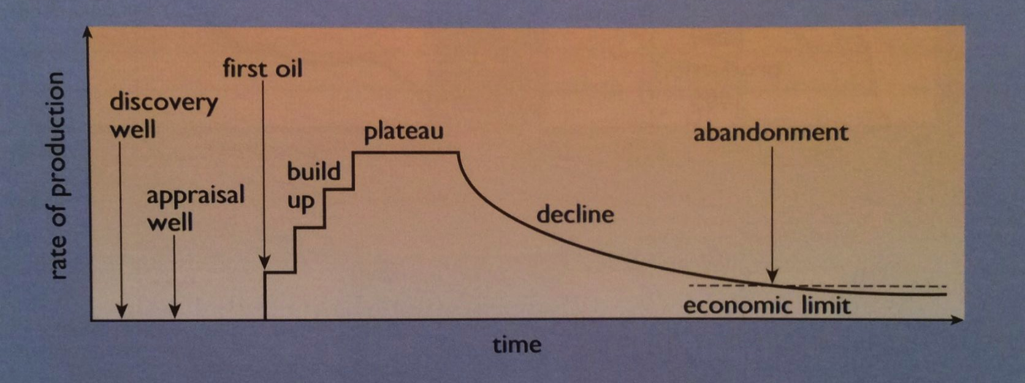
Oil and gas are finite
North Sea oil and gas have benefitted the UK, Norway, Denmark and the Netherlands.
But the benefit won’t last…
1969
1975
2000
Energy Systems and Sustainability, 2/e, Chapter 7

Slide 10
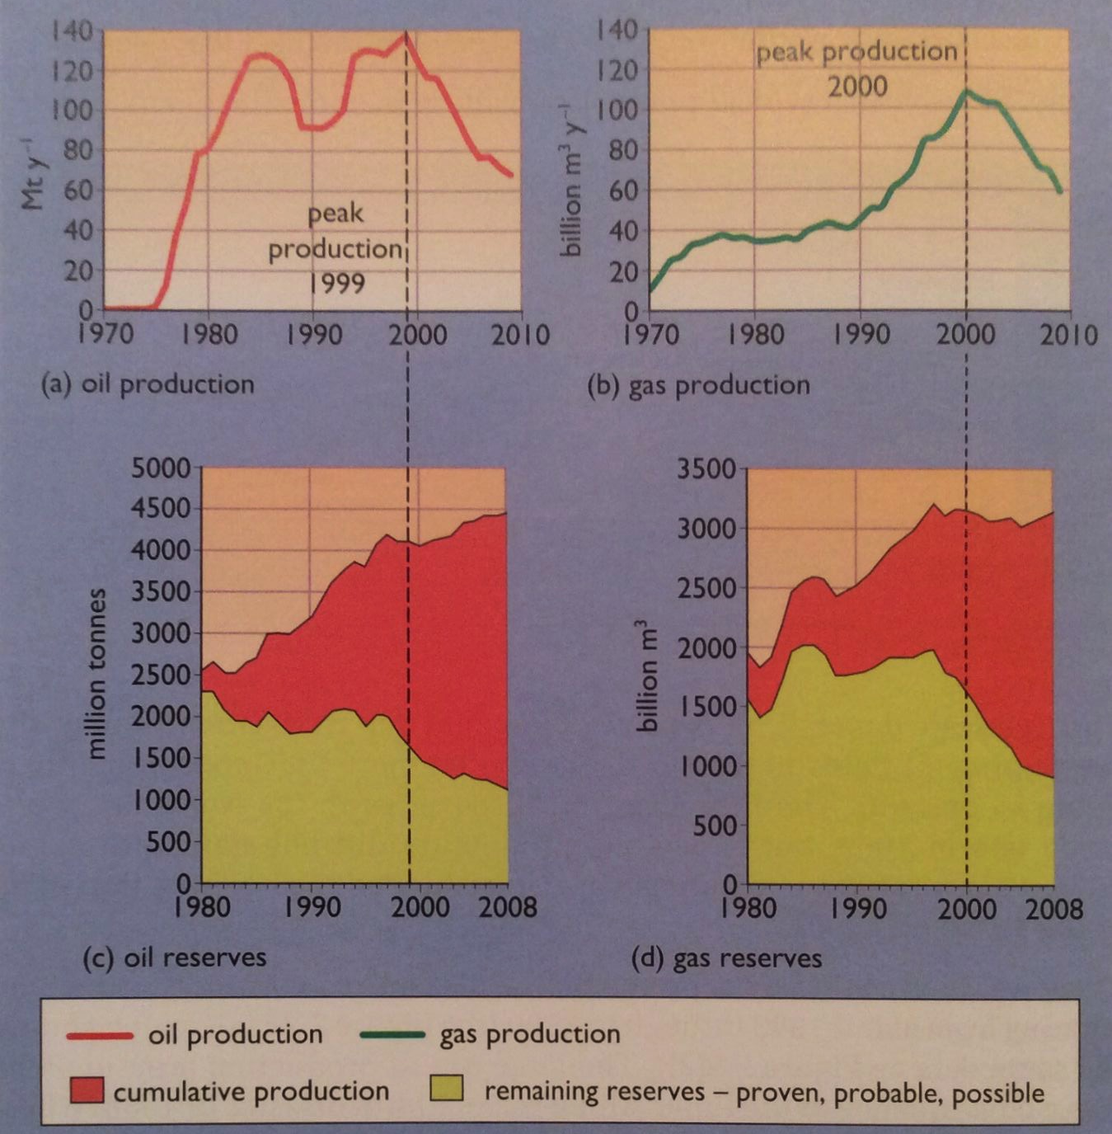
Timeline of UK production
Piper Alpha
167 dead
Large-scale production began in 1975 and provided a cushion from oil crisis of 1970s.
Plateau 1983 – 2000
Piper Alpha 167 dead
Production is now declining at a rate of 7% per year.
Energy Systems and Sustainability, 2/e, Chapter 7

Slide 11
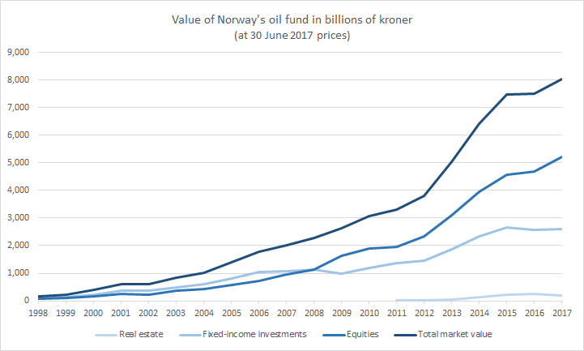
Norway’s approach to a finite resource
The UK aggressively produced North Sea oil and gas. UK governments used the revenue to keep non-oil taxes down, arguing that this would grow the UK economy.
Norway’s approach was different. Oil changed Norway’s economy radically; oil was a relatively larger boon to Norway. But Norway called it ‘Oljeeventyr’, the oil fairy tale, and saw it as a fleeting source of wealth.
In 1974, Norway decided to use oil money to develop a "qualitatively better society”.
Domestic control of oil;
Oil revenue invested in a sovereign wealth fund now worth >$1 billion;
Only 4% of surplus from this investment is spent for the public good.
Energy Systems & Sustainability, 2/e, Chapter 7;
https://en.wikipedia.org/wiki/Government_Pension_Fund_of_Norway#/media/File:Norway_Oil_Fund.png

Slide 12
Module 5. Oil and gas
  5.3: Why are oil and gas so special?

Slide 13
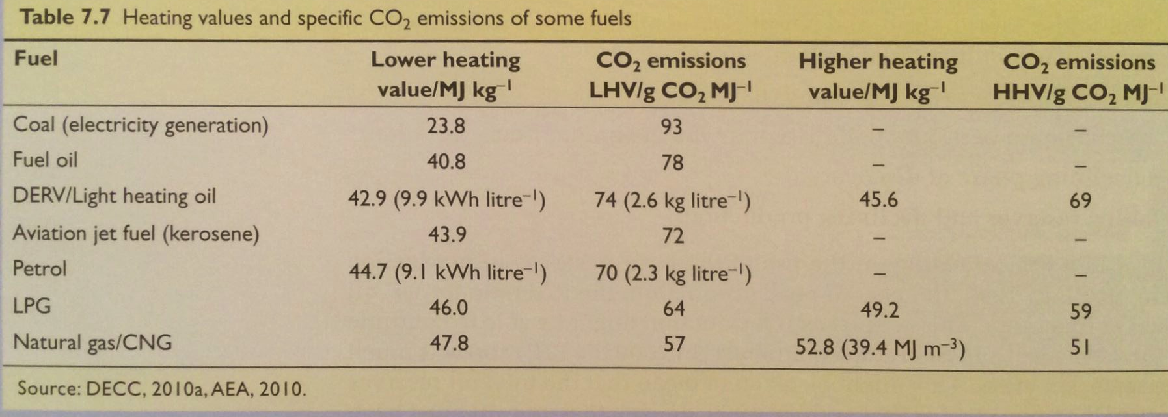
High energy density and a ‘clean’ burn
Why have oil and gas become such dominant forms of primary energy?
High energy density
Cleaner burning than coal (less CO₂/energy unit)
Ease of transport and use (universal infrastructure)
Abundant and cheap
Energy Systems and Sustainability, 2/e, Chapter 7

Slide 14
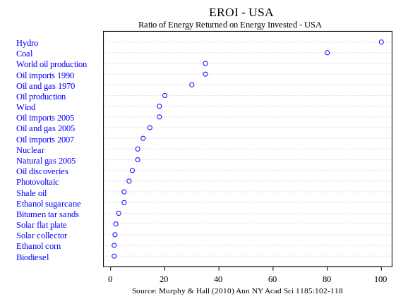
EROEI
Energy return on energy investment (EROEI): a measure of how much energy a fuel will produce vs the amount of energy it took to create that fuel, from harvest through processing (and sometimes distribution)
EROEI = __________energy delivered________
energy required to deliver the energy
fossil fuel | EROEI | EROEI 2020*
coal | 80 | 6 - 8
oil | 12 - 35
NG | 10
shale oil | 5
tar sands | 3
Energy Systems & Sustainability, 2/e, Chapter 7; https://en.wikipedia.org/wiki/Energy_returned_on_energy_invested

Slide 15
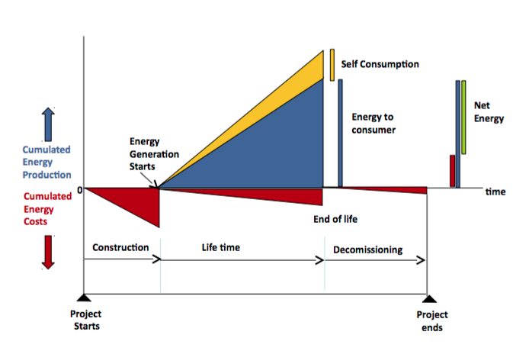
Factors affecting EROEI
In essence, EROEI balances the cost of producing energy with its benefits.
Energy Systems and Sustainability, 2/e, Chapter 7; http://euanmearns.com/eroei-for-beginners/; Prieto and Hall

Slide 16
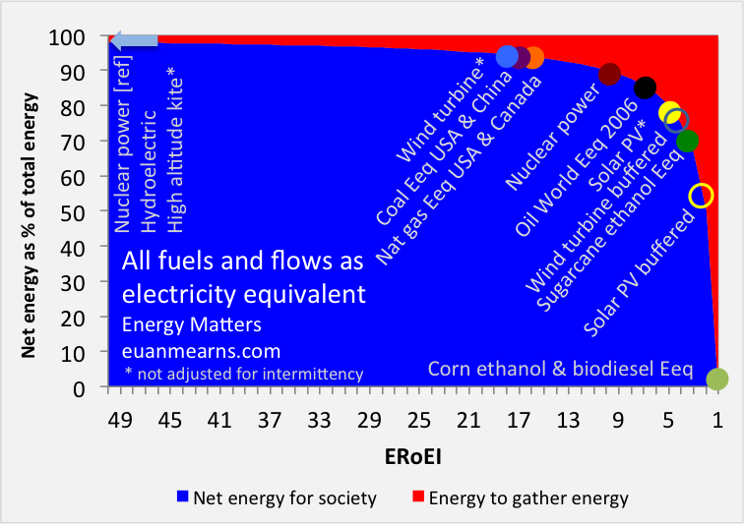
Will we fall off the energy cliff?
Energy Systems and Sustainability, 2/e, Chapter 7; http://euanmearns.com/eroei-for-beginners/

Slide 17
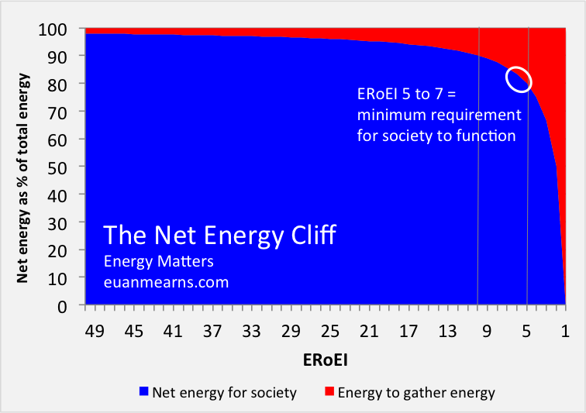
EROEI energy cliff?
Net energy cliff hypothesis contends that when EROEI falls too low, energy costs too much relative to the benefits it provides society.
Energy Systems and Sustainability, 2/e, Chapter 7; http://euanmearns.com/eroei-for-beginners/

Slide 18
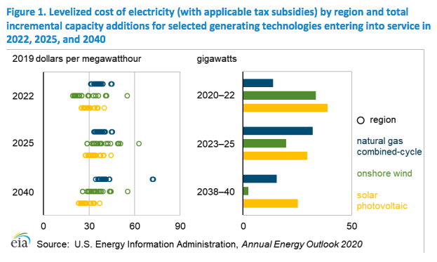
LCOE: US projections
https://www.eia.gov/outlooks/aeo/pdf/electricity_generation.pdf

Slide 19
Module 5. Oil and gas
  5.4: Finding and producing petroleum

Slide 20
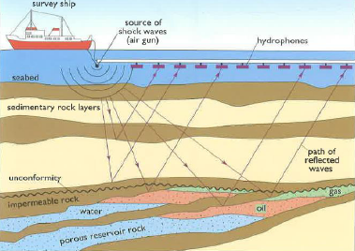
Oil prospecting
Modern survey methods make drilling the last step.
Gravimetric survey:
oil-bearing rock is less dense than most rock
Geomagnetic survey:
looks for variation in magnetic field.
Sedimentary rock is iron-poor and not magnetic.
Seismic survey:
reflection and refraction of waves may reveal pockets of oil
Energy Systems and Sustainability, 2/e, Chapter 7

Slide 21
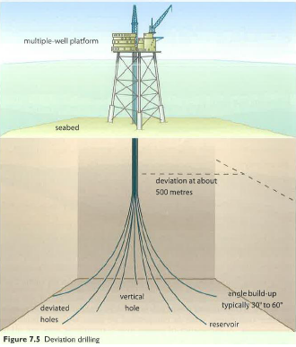
Oil wells
Wells as deep as 4500 m are possible depending on geology.
If the initial well finds oil, more
appraisal wells are drilled to assess the size and shape of the deposit or oil field.
Deviation wells can be drilled from a single platform to extract oil from a larger area.
Used in the North Sea
Finally, production wells are drilled used to extract maximum amounts of oil.
Energy Systems and Sustainability, 2/e, Chapter 7

Slide 22
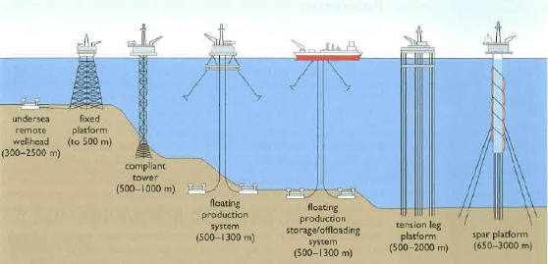
Offshore oil well technology
After depleting easily harvested oil, we’ve developed technology that allows us to drill for oil in more challenging conditions.
“Necessity is the mother of invention.”
Energy Systems and Sustainability, 2/e, Chapter 7

Slide 23
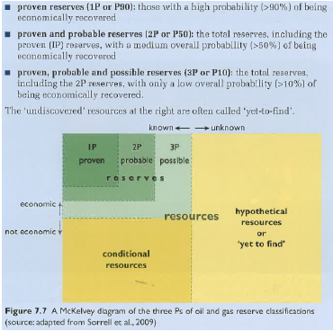
The three ‘Ps’ of the oil and gas industry
Oil and gas exploration is a form of informed gambling.
How lucky to you feel?
1P = 90%
2P = 50%
3P = 10%
Energy Systems and Sustainability, 2/e, Chapter 7

Slide 24

Oil production
Primary recovery: pumping oil from freshly drilled and capped wells
Initial high well pressure makes this simple.
30 – 50%
recovery
Secondary recovery: becomes necessary after well pressure falls
Pressure is increased by pumping in NG or water.
Secondary recovery may be very slow.
Saudi Arabia pumps seawater across the desert.
Tertiary recovery (aka enhanced oil recovery): more extreme
Injecting steam
Injecting CO₂ or N₂
Energy intensive & slow
5 – 15%
recovery
Energy Systems and Sustainability, 2/e, Chapter 7

Slide 25
Module 5. Oil and gas
  5.5: Oil refining and products

Slide 26
What is crude oil?
Crude oil: a mixture of hydrocarbon molecules, of varying carbon number (chain length) and structure
hydrocarbon | average % | range %
alkanes | 30 | 15 - 60
naphthenes | 49 | 30 - 60
aromatics | 15 | 3 - 30
asphaltics | 6 | remainder
element | % by mass
C | 83 - 85
H | 10 - 14
N | 0.1 - 2
O | 0.05 – 1.5
S | 0.05 - 6
metals | <0.1
Properties like color, density, viscosity, heat value vary greatly depending on composition.
S content may be regulated by governments because it leads to pollution.
Energy Systems and Sustainability, 2/e, Chapter 7; https://en.wikipedia.org/wiki/Petroleum

Slide 27
Products of crude oil
alkane | formula | boiling point (°C) | heat value (MJ/kg)
methane | CH₄ | -162 | 55.5
ethane | C₂H₆ | -89 | 51.9
propane | C₃H₈ | -42 | 50.4
butane | C₄H₁₀ | -0.5 | 49.5
octane | C₈H₁₈ | 125 | 47.1
distilled fraction | boiling range (°C)
liquid petroleum gas | - 40
butane | - 12 - -1
Gasoline (octane) | -1 - 110
jet fuel | 150 - 205
kerosene | 205 - 260
fuel oil | 205 - 290
diesel fuel | 260 - 315
Useful products can be created from crude oil by separating and transforming oil molecules by the process of fractional distillation, based on boiling points.
Light: crude with large amounts of light molecules (gases)
Sweet: low levels of sulfur
Energy Systems & Sustainability, 2/e, Chapter 7; https://en.wikipedia.org/wiki/Petroleum
Energy Systems & Sustainability, 2/e, Chapter 7

Slide 28
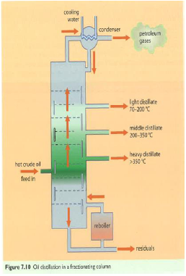
Oil refining: fractional distillation
Fractionation (aka cracking): a process that breaks long hydrocarbon chains down into smaller chains that are then separated by fractional distillation.
The process uses:
Heat;
steam; and/or
catalysts.
Lighter molecules separate at lower temperatures.
Light: gas; jet fuel; kerosene
Middle: diesel; heating oil
Heavy: semi-solid; heavy diesel
Energy Systems and Sustainability, 2/e, Chapter 7

Slide 29
The many uses of oil
natural gas and energy gases
aviation fuel
vehicle fuel
petrochemical feedstock
industrial solvent
paint thinner
dry cleaner
lamps
heating stoves
ship’s fuel
power station fuel
lubricating oil
waxes
bitumen
petroleum coke for graphite
transportation
electricity
Energy Systems and Sustainability, 2/e, Chapter 7

Slide 30
Module 5. Oil and gas
  5.6: Oil consumption and production today

Slide 31
Quick review of units of oil production
1 metric tonne = 7.3 barrels = 42 GJ
1 million barrels per day (bpd) = 0.365 billion barrels / year
= 50 million tonne / year
= 2.1 EJ / year
= 2 quads / year
Global oil use in 2019: 100 million barrels per day
Energy Systems and Sustainability, 2/e, Chapter 7

Slide 32
Geographical distribution of petroleum resources

Slide 33
Geographical distribution of petroleum resources

Slide 34
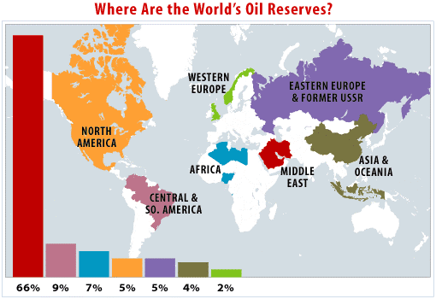
Geographical distribution of petroleum reserves

Slide 35
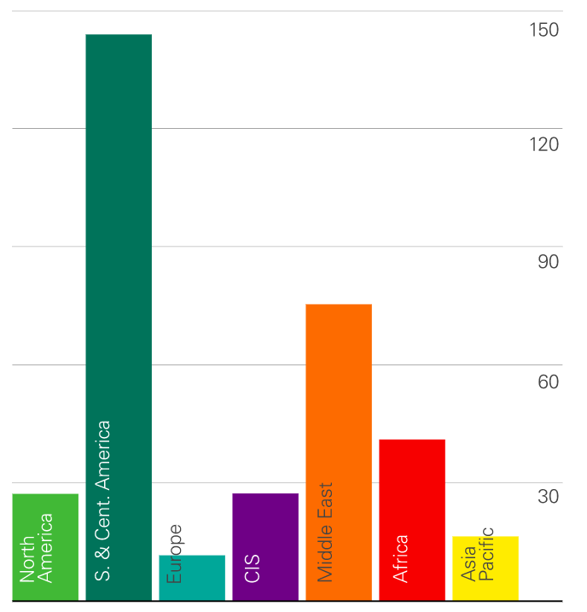
R/P ratios for oil
Even with up-to-date data, R/P ratios for oil are low in North America, Europe and Asia.
years
https://www.bp.com/en/global/corporate/energy-economics/statistical-review-of-world-energy/natural-gas.html

Slide 36
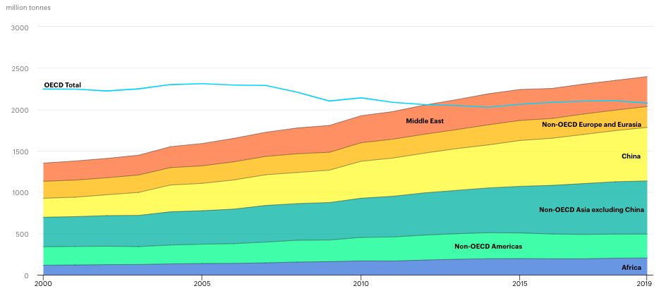
Global oil demand (consumption)
https://www.iea.org/reports/oil-information-overview

Slide 37
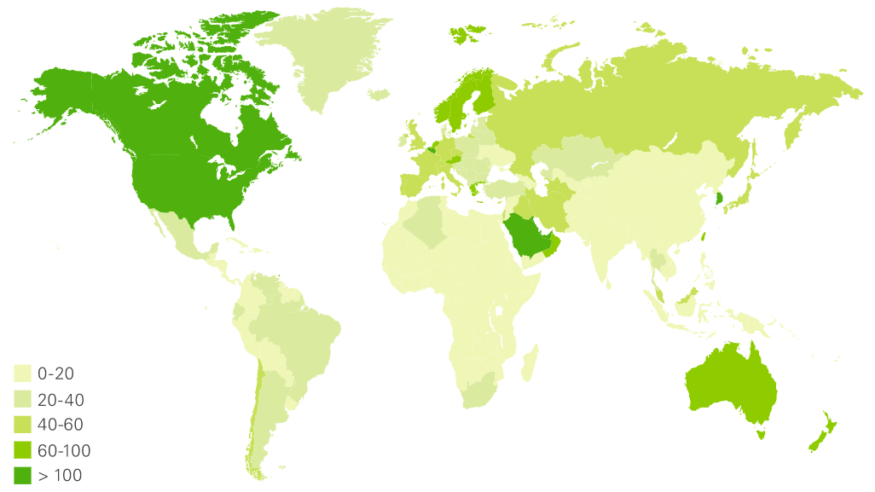
Global oil consumption (GJ/capita)
https://www.bp.com/en/global/corporate/energy-economics/statistical-review-of-world-energy/natural-gas.html

Slide 38
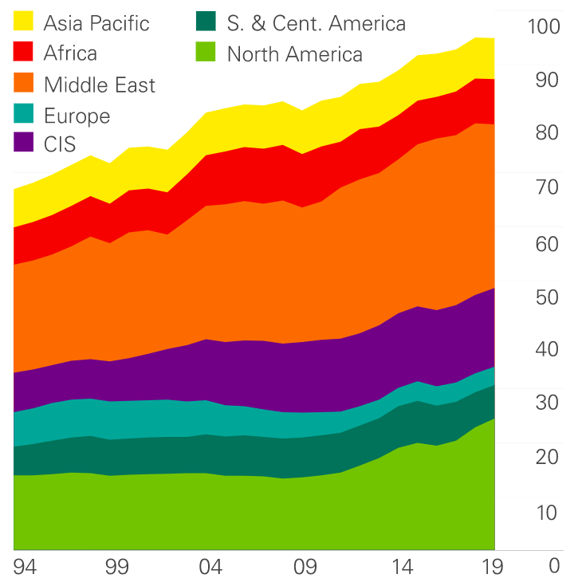
Global oil production
Note the apparent leveling off of production even before COVID.
Sanctions
OPEC slowdowns to prevent price declines
million barrels/day
https://www.bp.com/en/global/corporate/energy-economics/statistical-review-of-world-energy/natural-gas.html

Slide 39
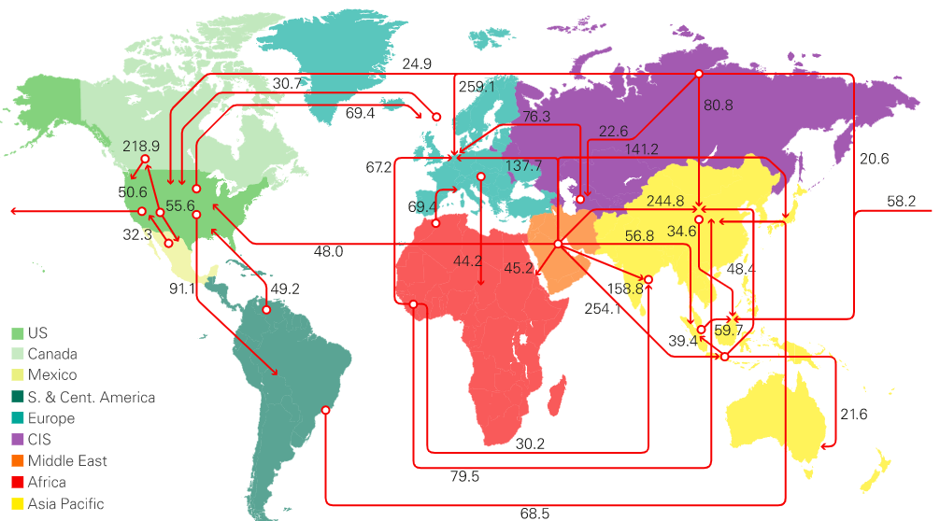
Global oil trading
https://www.bp.com/en/global/corporate/energy-economics/statistical-review-of-world-energy/natural-gas.html
million barrels/day

Slide 40
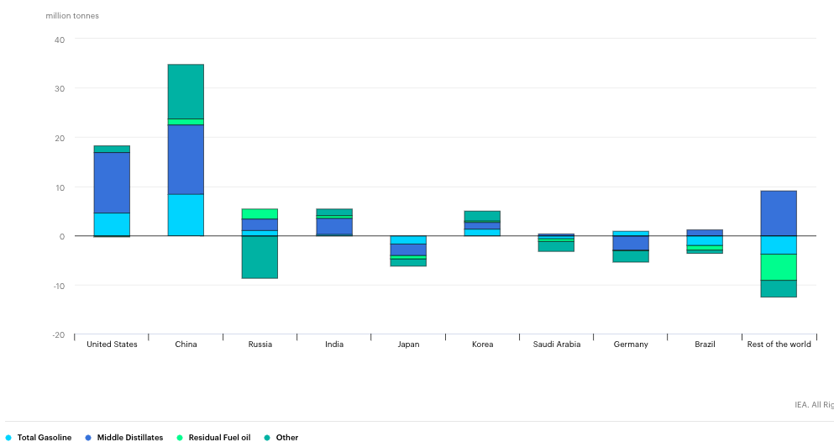
Refinery output growth
https://www.iea.org/reports/oil-information-overview

Slide 41
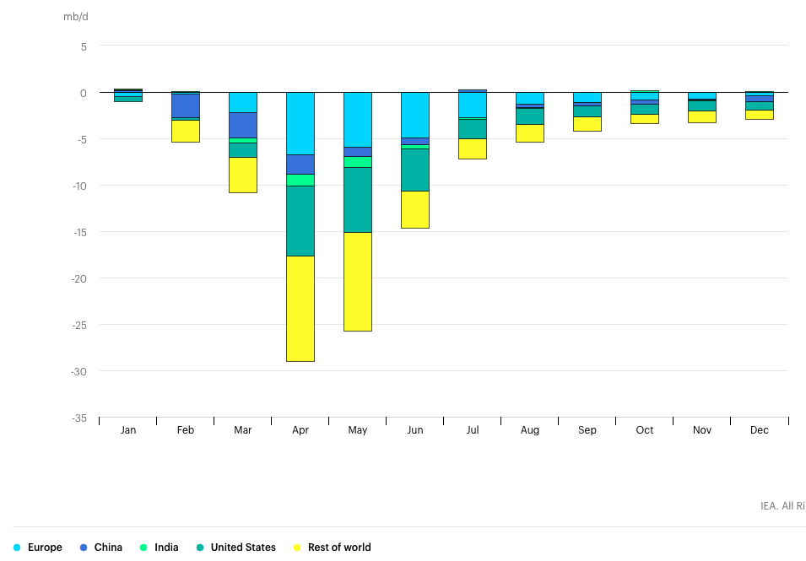
Impacts of COVID? Demand in 2020 relative to 2019
https://www.iea.org/data-and-statistics/charts/change-in-monthly-oil-demand-in-selected-countries-2020-relative-to-2019

Slide 42
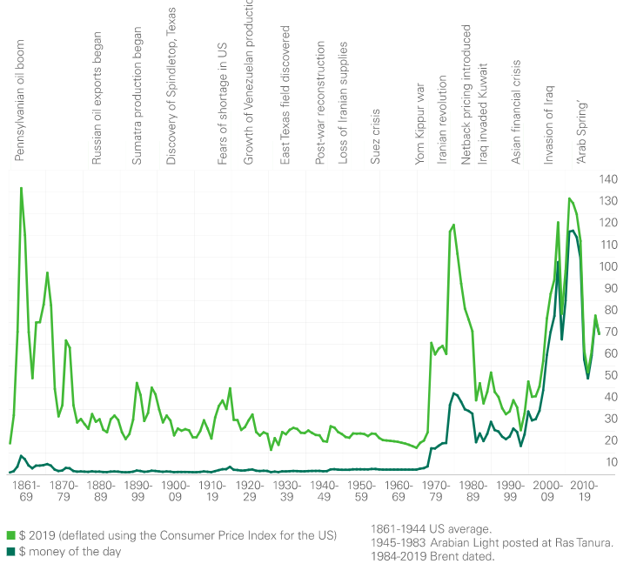
Oil prices: recently volatile
https://www.iea.org/data-and-statistics/charts/change-in-monthly-oil-demand-in-selected-countries-2020-relative-to-2019

Slide 43
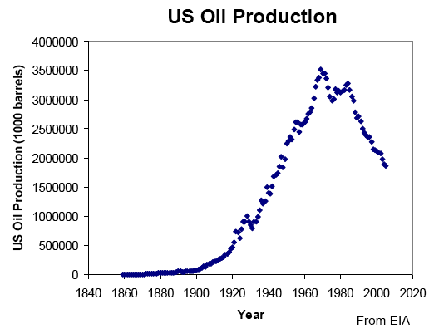
US oil production: driven by technology
Development of automobiles and planes spurred early growth.
Energy Systems and Sustainability, 2/e, Chapter 7

Slide 44
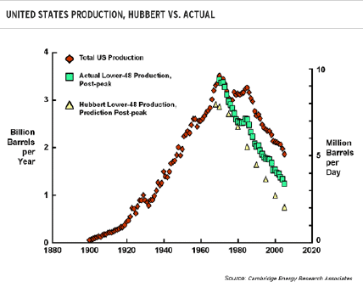
Peak oil will occur but is delayed
Note that US production figures support Hubbert’s hypothesis.
Why is peak delayed?
Technology
Policy
Growth
Inertia
Energy Systems and Sustainability, 2/e, Chapter 7

Slide 45
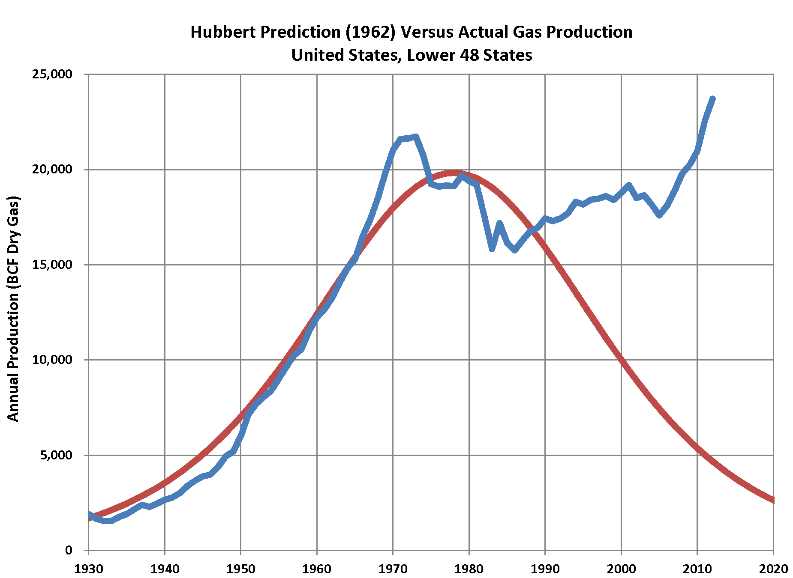
US production appears to be defying peak?
Many have noted that US oil production appears to be defying peak predictions.
While we can probably shift the timing of the peak extraction and conversion won’t make a finite resource endless.
Energy Systems and Sustainability, 2/e, Chapter 7

Slide 46
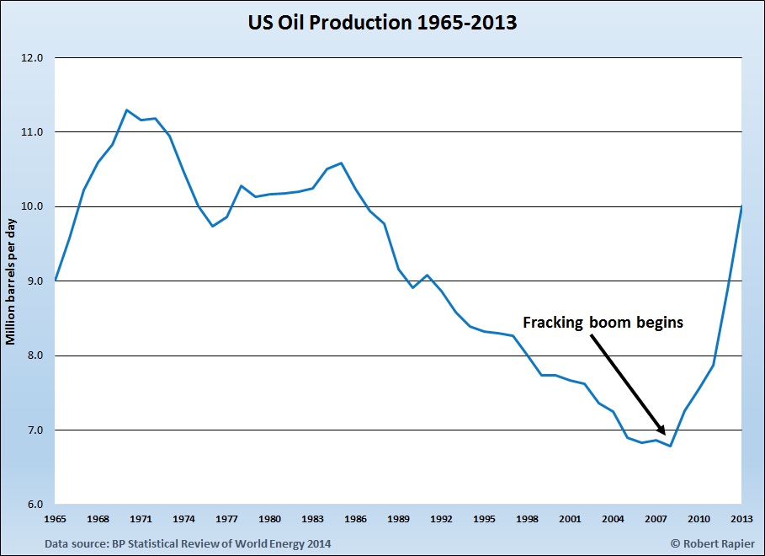
Example? Fracking boosted US oil production

Slide 47
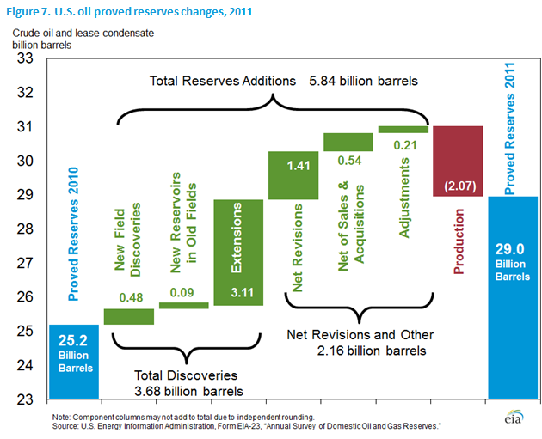
Revised fossil fuel reserves
While reserves figures are revised upwards, only a tiny fraction is new discoveries.
Because fossil fuel reserves and revenues are critical to the stability of many governments, fossil fuels ‘data’ may be subject to political influence or revision.
Reserves
= political stability
Energy Systems and Sustainability, 2/e, Chapter 7

Slide 48
Planning to move away from oil
By 2017, several European countries have pledged to either:
Stop producing and selling petro fueled cars…
  India
  France
  Britain
  Norway
…or are planning to increase to percentage of electric cars in their fleet.
  Austria
  China
  Denmark
  Germany
  Ireland
  Japan
  the Netherlands
  Portugal
  Korea
  Spain
http://money.cnn.com/2017/07/26/autos/countries-that-are-banning-gas-cars-for-electric/index.html

Slide 49
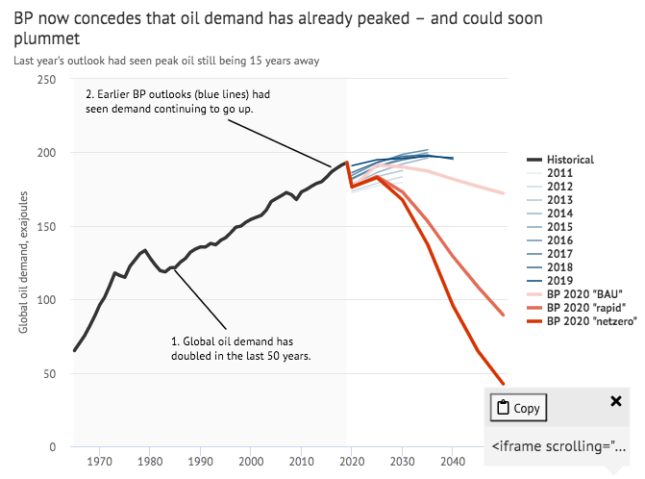
Has peak use already passed?

Slide 50
Module 5. Oil and gas
  5.7: Natural gas

Slide 51
NG units
UK units:
1 therm = 100,000 BTU = 29.3 kWh = 105.5 MJ = 2.7 m³ NG
US units:
1 MMBTU = 1,000,000 BTU = 293 kWh = 1.055 GJ = 27 m³ = 1E3 ft³ NG
International:
1000 m³ NG = 39 GJ = 10.8 MWh = 0.93 tonnes of oil
‘Roundly’:
1000 m³ NG = 40 GJ = 10 MWh = 1 tonnes of oil
Energy Systems and Sustainability, 2/e, Chapter 7

Slide 52
Processing NG: ‘scrubbing’ by-products
Natural gas (CH₄) is contaminated with other gases:
Ethane (C₂H₆)
He
H₂S
CO₂
plastics manufacturing
medical uses; superconducting magnets
These gases are ‘scrubbed’ out of NG using amine chemistry.
S used in fertilizers
re-injected to flush more NG out of wells
NG with low levels of contaminants is called ‘sweet’.
Energy Systems and Sustainability, 2/e, Chapter 7

Slide 53
Natural gas: ‘cleaner’ than oil and coal
Natural gas is mostly methane (CH₄) but contains small amounts of other hydrocarbon gases when extracted: ethane (2 carbons); propane (3 carbons); and butane (4 carbons).
CH₄ + 2O₂ → CO₂ + 2H₂O
CO₂ = 44 = 2.75
fuel 16
mass 16 64 44 36
Propane is (C₃H₈) and is separated from natural gas during processing.
C₃H₈ + 5O₂ → 3CO₂ + 4H₂O
CO₂ = 132 = 3.0
fuel 44
mass 44 160 132 72
It is often said that NG is a ‘cleaner’ fuel than oil or coal and produces less CO₂.
Why & how?
Hydrogen ‘burns’ without producing CO₂. The more hydrogen a fuel has, the less CO₂ it produces.
So, to identify ‘clean’ fuels look for a high H:C ratio.
Energy Systems and Sustainability, 2/e, Chapter 7

Slide 54
NG: lower CO₂ emissions
Natural gas has lower carbon dioxide emissions because of its high H:C ratio
fossil fuel | H:C ratio | pounds CO₂ / MBtu
coal (anthracite) | 0 – 0.3:1 | 228.6
coal (bituminous) | 0.8:1 | 205.7
coal (lignite) | 1:1 | 215.4
diesel fuel / heating fuel | 2.27:1 | 161.3
gasoline (no ethanol) | 2.25:1 | 157.2
propane | 2.67: 1 | 139.0
natural gas | 4:1 | 117.0
Energy Systems and Sustainability, 2/e, Chapter 7; https://www.eia.gov/tools/faqs/faq.php?id=73&t=11

Slide 55
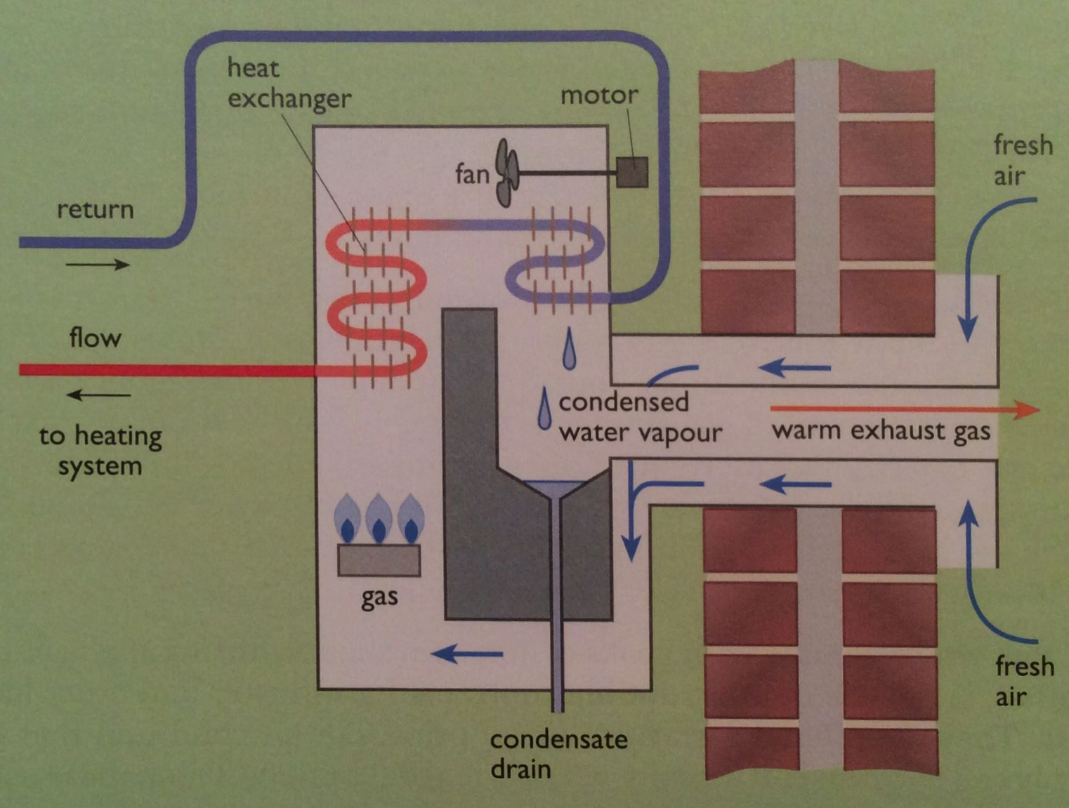
Domestic condensing gas boilers
Because NG burn cleanly, water vapor produced by combustion can be condensed allowing recovery of the latent heat of vaporization.
40°C return water cools flue gases below 50°C, increasing recovery of heat from the flue gases by 11%, the difference between HHV and LHV.
Increases boiler efficiency to >90%.
Energy Systems and Sustainability, 2/e, Chapter 7

Slide 56
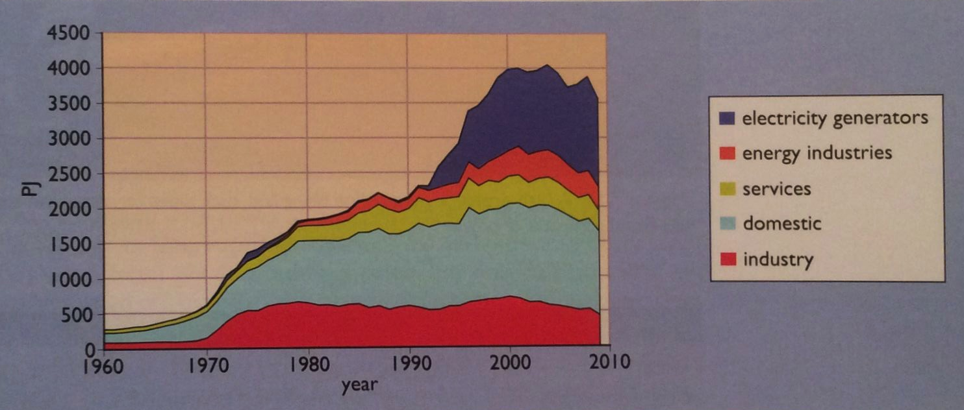
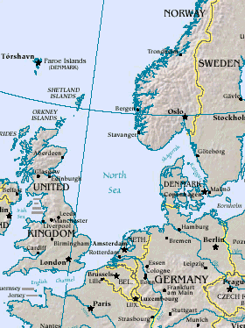
Natural gas: a ‘recent’ fossil fuel
While the US started using NG in the 1920s, European countries did not.
In 1959, a huge non-associated NG field was discovered in the Netherlands; later, off-shore NG fields in the North Sea.
In the UK, conversion from coal gas to NG took a decade and cost £564 m.
Pricing lower than coal gas incentivized customers to switch.
Energy Systems & Sustainability, 2/e, Chapter 7; https://en.wikipedia.org/wiki/North_Sea#/media/File:Nseamap.gif

Slide 57
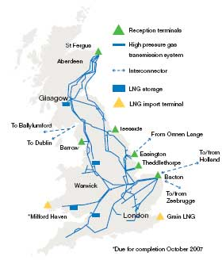
Lessons learned while switching fuels
In the UK, conversion from coal gas to NG took a decade and cost £564 m.
NG has 2X the energy content of coal gas; retrofitting was needed.
  13 m customers
  40 m appliances
Pricing NG lower than coal gas incentivized the switch.
2007: 92% of homes have central heat
  75% are heated with NG
2000: 40% of electricity from NG
  Generated with CCGTs
To meet peak winter demands,
3% of annual NG demand is stored by
injection into depleted offshore wells
  Some large users have interruptible
  contracts and have secondary energy
Energy Systems and Sustainability, 2/e, Chapter 7;
http://www2.nationalgrid.com/uploadedImages/Resources/Image_library/Maps/UK%20Transmission%20maps.jpg

Slide 58
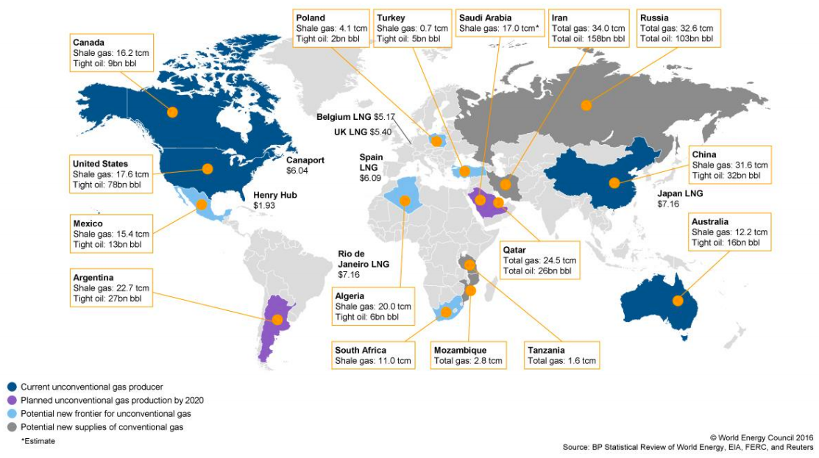
Global geographical distribution of NG
https://www.worldenergy.org/assets/images/imported/2016/10/World-Energy-Resources-Full-report-2016.10.03.pdf

Slide 59
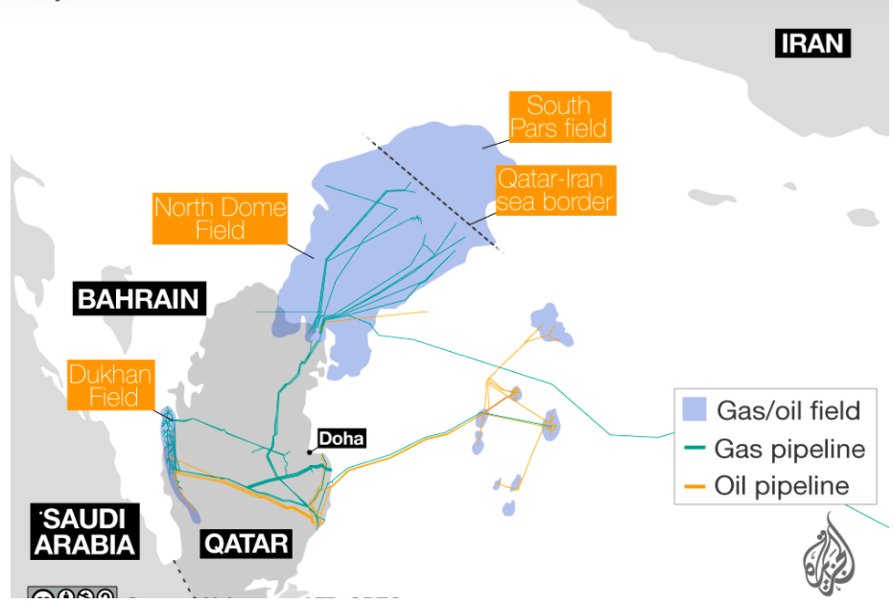
NG reserves: a point of friction for Qatar and Iran
”The Qatar-Iran Gas Field Behind the Diplomatic War in the Middle East.”
Qatargas, the world's largest exporter of liquefied natural gas, reassures Japan, the world's largest importer, that Gulf state rift will not effect supply…”
https://www.aljazeera.com/indepth/interactive/2017/06/qatar-north-dome-iran-south-pars-glance-lng-gas-field-170614131849685.html
https://www.haaretz.com/middle-east-news/the-qatar-iran-gas-field-behind-the-diplomatic-war-in-the-middle-east-1.5480343

Slide 60
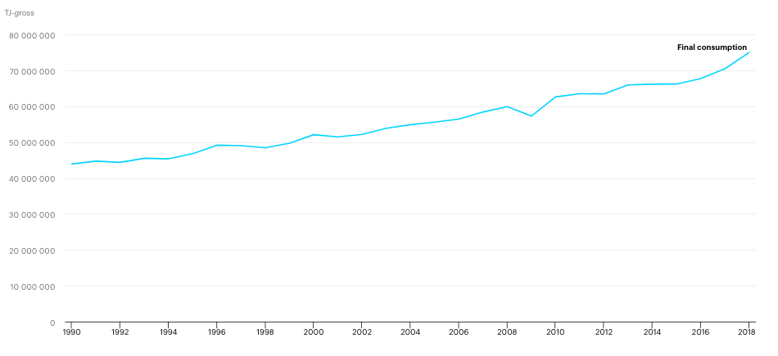
Global NG consumption
https://www.iea.org/fuels-and-technologies/gas

Slide 61
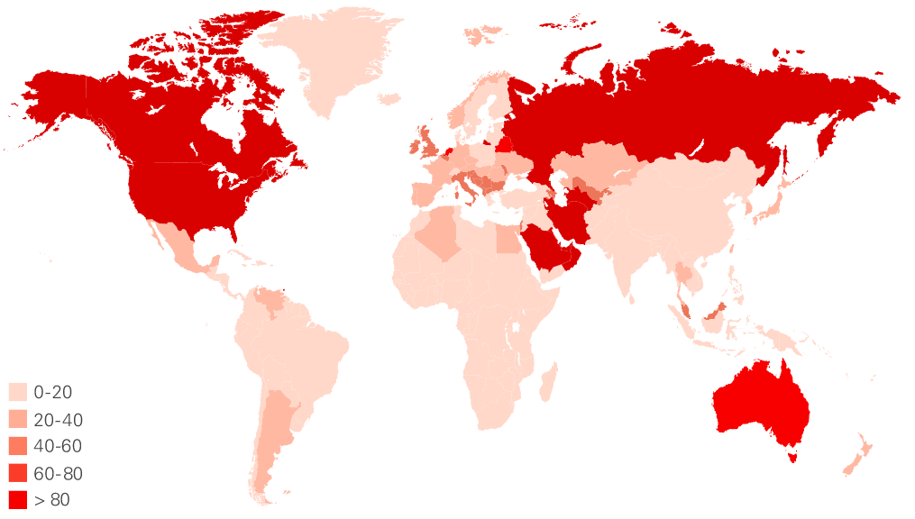
Global NG consumption (GJ/capita)
https://www.bp.com/en/global/corporate/energy-economics/statistical-review-of-world-energy/natural-gas.html

Slide 62
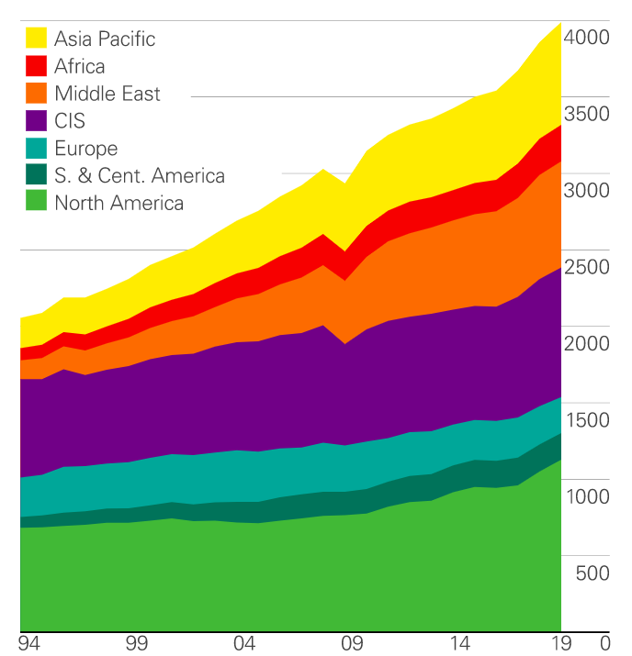
Global NG production
Production is up.
US
Asia
  Australia
  China
  Middle East
billion m³
https://www.bp.com/en/global/corporate/energy-economics/statistical-review-of-world-energy/natural-gas.html

Slide 63
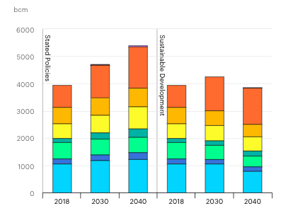
2018 was a record year for NG – forecast?
forecast
Sustainable planning
NG use increased 4.6% in 2018
½ of new energy demand
US: fracking
China: economic growth
Middle East: diversification
https://www.iea.org/fuels-and-technologies/gas

Slide 64
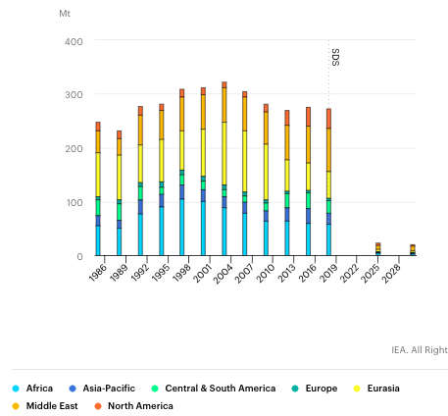
While valuable, much NG is flared and wasted
Why flare it?
Difficult (ie expensive) to:
  capture
  Store
  Transport
Technology fix needed
No penalty
But GCC requires a fix
Flaring and waste drop here in sustainable development scenarios
https://www.iea.org/fuels-and-technologies/gas

Slide 65
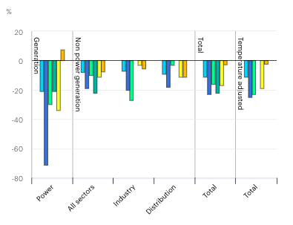
COVID dramatically decreased NG use
https://www.iea.org/fuels-and-technologies/gas

Slide 66
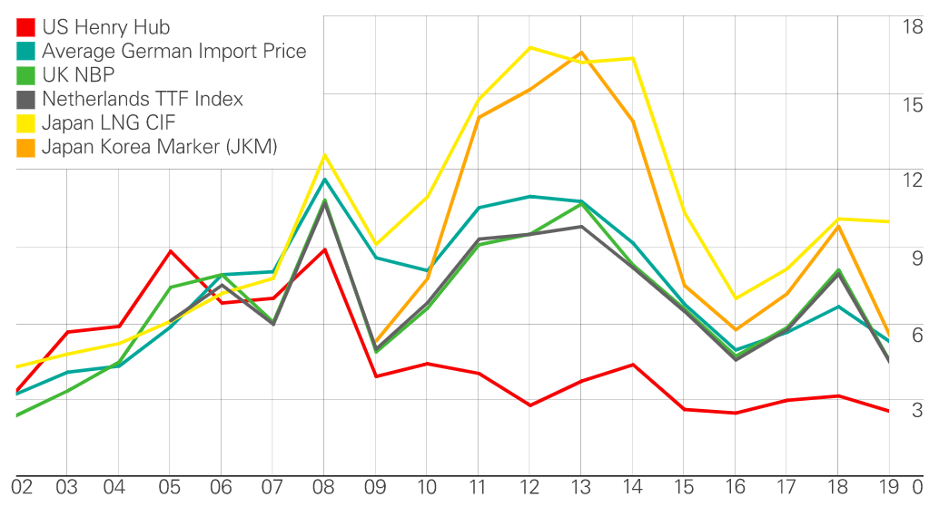
US NG prices have fallen: recession and supply
https://www.bp.com/en/global/corporate/energy-economics/statistical-review-of-world-energy/natural-gas.html
$/MMBtu

Slide 67
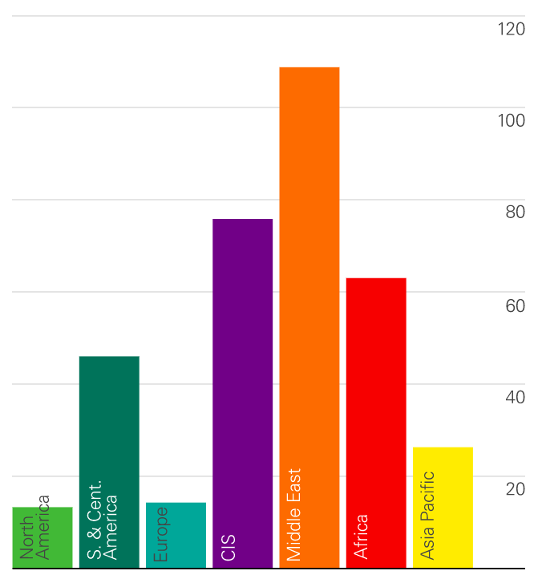
R/P ratios for NG
https://www.bp.com/en/global/corporate/energy-economics/statistical-review-of-world-energy/natural-gas.html

Slide 68
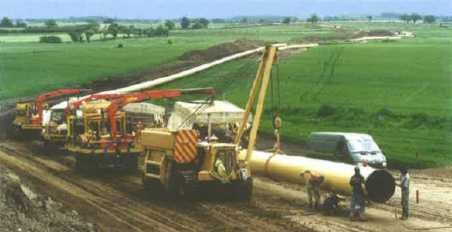
Transporting NG? Pipelines
High-pressure pipeline transports natural gas from NG storage depots to communities and industries.
Pipelines can transport the equivalent of gigawatts of power.
Energy Systems and Sustaiability, 2/e, Chapter 7

Slide 69
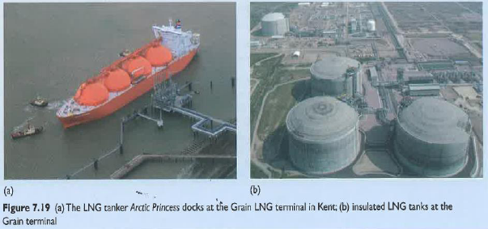
Transporting NG? LNG
LNG, liquified natural gas, is produced by compressing natural gas. Increased energy density allows economical long-distance transportation.
Energy Systems and Sustainability, 2/e, Chapter 7

Slide 70
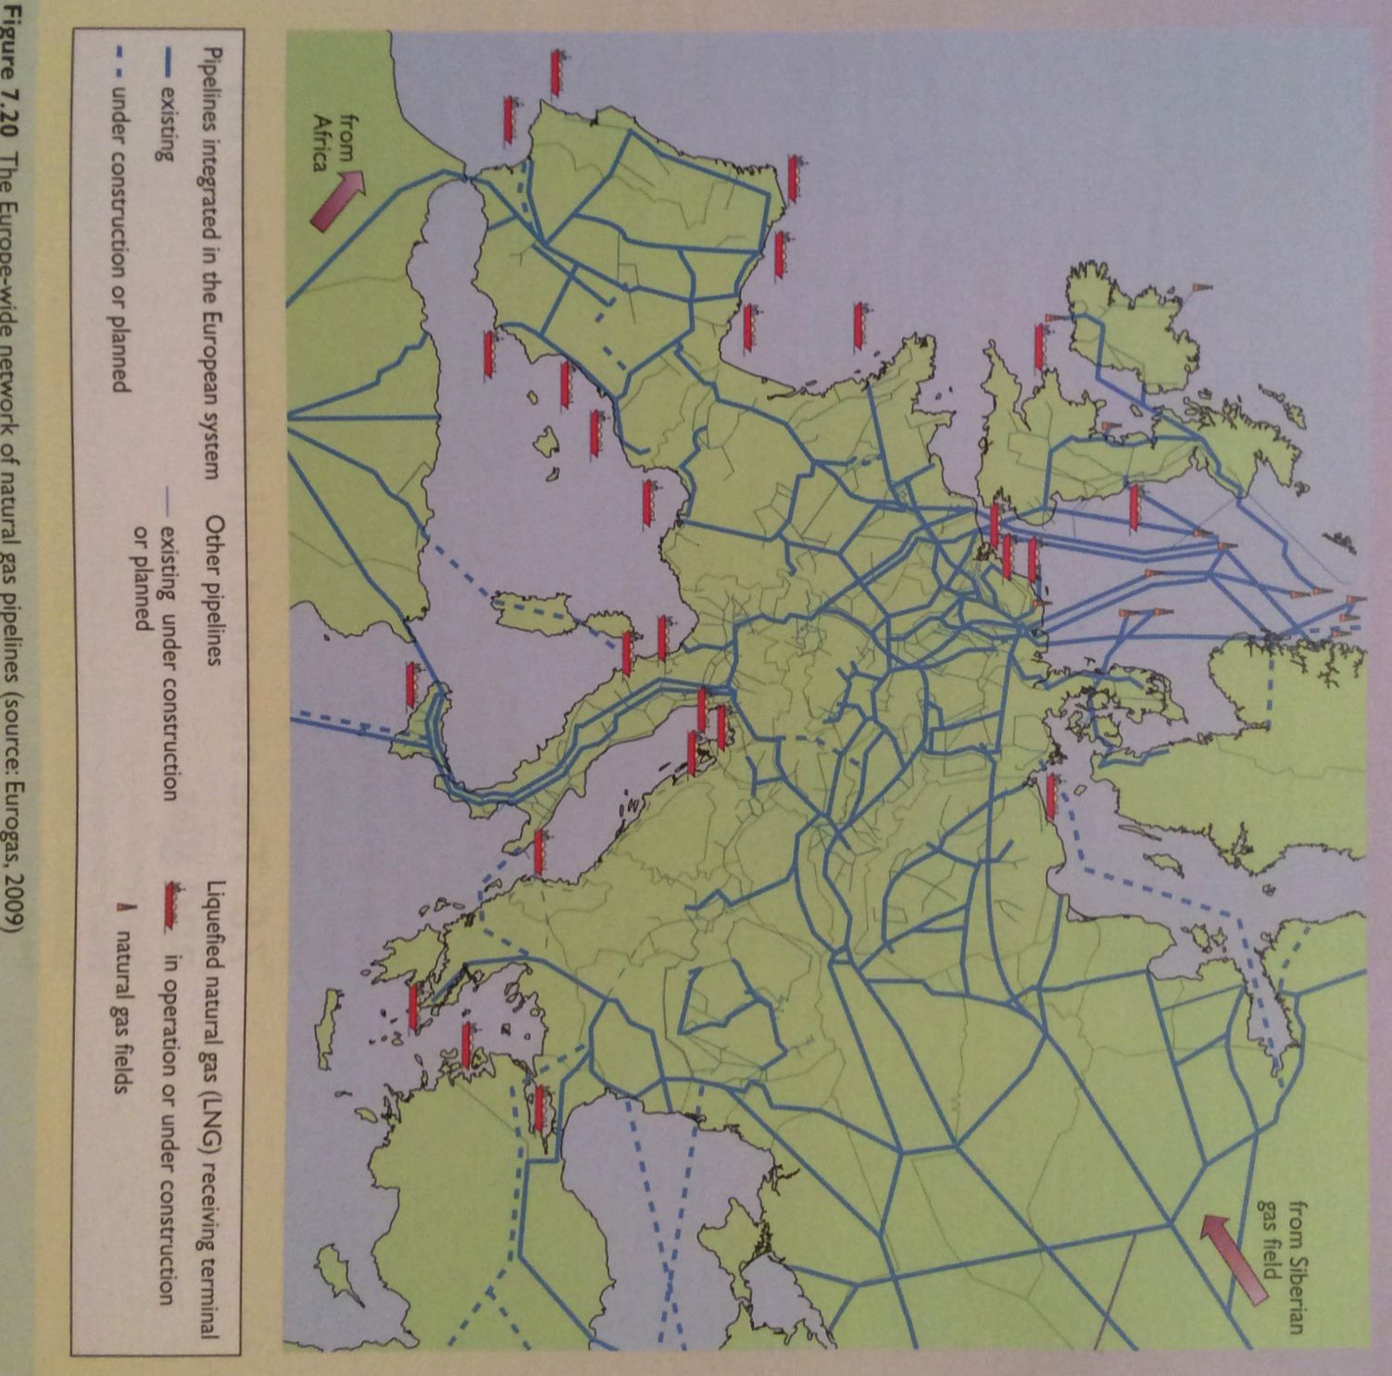
Europe is now dependent on NG
Russia exports NG to Europe from Siberia through long pipelines.
Pipeline pressure is boosted by in-pipe gas turbines powered by adding O₂.
Europe’s energy security is not boosted.
Note that NG from Russia
must cross Ukraine & Belarus.
Energy Systems and Sustainability, 2/e, Chapter 7

Slide 71
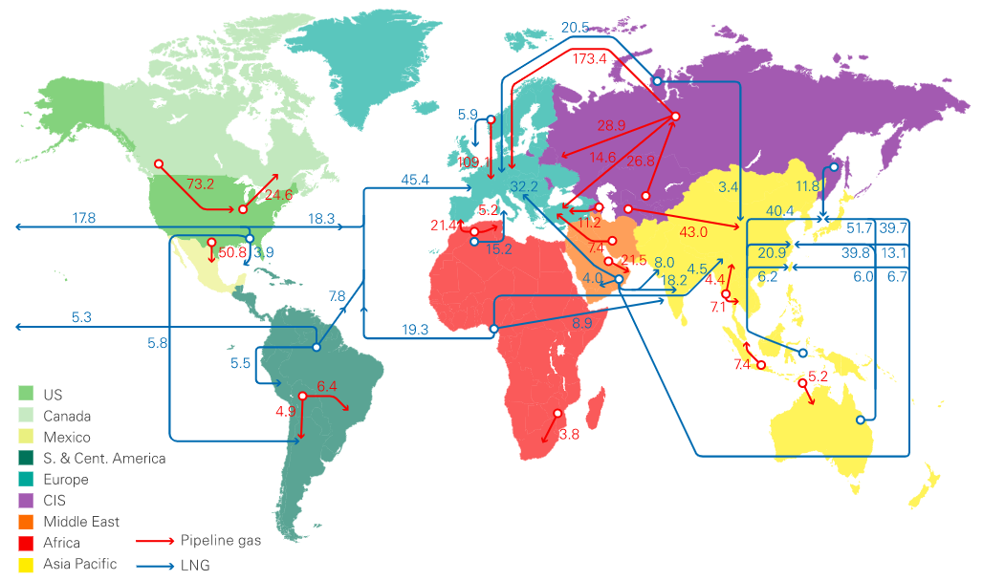
And NG trade is global
https://www.bp.com/en/global/corporate/energy-economics/statistical-review-of-world-energy/natural-gas.html

Slide 72
Module 5. Oil and gas
  5.8: Methane leaks and GCC

Slide 73
Methane’s global warming potential
A number of atmospheric gases have global warming potentials (GWP): can hold heat in the earth’s atmosphere. GWP values are measured relative carbon dioxide (CO₂), given an arbitrary GWP of one.
  CO₂ has an atmospheric lifetime of thousands of years.
Methane (CH₄; natural gas) has a much higher GWP than CO₂.
CH₄ has a shorter atmospheric lifespan, about 10 years.
But CH₄ absorbs much more energy than CO₂.
And methane is converted into ozone, also a GHG.
Over a 100-year period, methane’s GWP is 28 - 36
20-year 84 - 87
https://www.epa.gov/ghgemissions/understanding-global-warming-potentials#Learn%20why

Slide 74
Perspective: methane as a GWP
Methane is a significant contributor to annual global carbon emissions.

Slide 75
Methane emissions rising even as CO₂ may peak
“Global emissions of methane, a potent greenhouse gas, soared to a record high in 2017”, our most recent data
Methane emissions are driven by fossil fuel leaks and agriculture.
Global methane emissions are up 9 percent from the early 2000s
  Human activity is responsible for >50% those emissions.
“There’s a hint that we might be able to reach peak carbon dioxide emissions very soon. But we don’t appear to be even close to peak methane,” said Rob Jackson, an earth scientist at Stanford University who heads the Global Carbon Project, which conducted the research. “It isn’t going down in agriculture it isn’t going down with fossil fuel use.”
https://www.nytimes.com/2020/07/14/climate/methane-emissions-record.html?auth=login-email&login=email

Slide 76

Satellite detection of methane emissions
Harvesting fossil fuels releases methane into the atmosphere as leaks.
Satellite imaging is essential for finding and resolving leaks.
The four-corners CH₄ hotspot is due to poor recovery of coal-seam methane.
2,500 mi²
½ CT
released 0.59 tonne/year
https://www.nasa.gov/feature/jpl/nasa-led-study-solves-a-methane-puzzle
https://www.nasa.gov/press/2014/october/satellite-data-shows-us-methane-hot-spot-bigger-than-expected

Slide 77

Methane storage leaks
Methane leak from underground NG storage facility in southern CA.
https://earthobservatory.nasa.gov/images/88245/imaging-a-methane-leak-from-space

Slide 78
Methane storage leaks
https://www.nytimes.com/interactive/2019/12/12/climate/texas-methane-super-emitters.html?action=click&module=RelatedLinks&pgtype=Article

Slide 79

Methane fracking leaks
Road monitoring of methane levels finds leaks from the ground.
NG compressor station
NG wells
https://news.psu.edu/photo/338850/2014/12/17/methanemapbarkley

Slide 80


Ocean methane hydrates melting?
Methane hydrates lie frozen deep in the oceans.
But as the ocean’s warm hydrates seem to be melting and releasing methane; correlation with warming temperatures!
http://arctic-news.blogspot.com/2012/05/striking-increase-of-methane-in-arctic.html

Slide 81


Permafrost methane … also leaking
The permafrost is a thick subsurface layer of soil that remains frozen throughout the year, occurring chiefly in polar regions.
It’s estimated that the permafrost contains twice the carbon now in the atmosphere.
Warming temperatures could cause permafrost to release 15-33% of current carbon emissions.
https://www.nytimes.com/2011/12/17/science/earth/warming-arctic-permafrost-fuels-climate-change-worries.html

Slide 82

Undersea methane leaks
A July 2020 study has found cracks in huge craters under the Barents sea ‘gushing’ methane into sea water. This is an old fault system.
Study raises many questions:
Destabilized by drilling?
Will large amounts of methane be released to the atmosphere?
Effects on GCC?
https://www.nature.com/articles/s41598-020-65018-9

Slide 83
5. Oil & gas
Module 5. Oil and gas
  5.9: Unconventional oil and gas

Slide 84

Heavy and extra-heavy oil
Oil that is so thick and viscous that it will not flow to the surface without injection of steam into the well to heat the oil and add enough pressure to force it to the surface.
Venezuela’s Orinoco basin has 500 billion barrels of reserve of heavy oil, more oil than Saudi Arabia.
High levels of S.
Difficult to harvest and refine.
Energy Systems and Sustainability, 2/e, Chapter 7;
https://en.wikipedia.org/wiki/Orinoco_Belt#/media/File:Orinoco_USGS.jpg

Slide 85

Shale oil
Shale oil: an ‘immature’ hydrocarbon trapped or embedded in rock as a waxy substance called kerogen.
Energy content of raw shale oil = 5 – 15 GJ/tonne (like poor lignite).
Shale oil was produced commercially in Scotland (1880 – 1940), Estonia (1920s – present), China and Brazil.
Concerns?
Environmental: the extraction process expands the volume of the rock, creating huge ‘bings’.
EROI is poor: 2.5 - > 10
Energy Systems and Sustainability, 2/e, Chapter 7;
https://slowair.wordpress.com/category/experiments-research/
Shale oil ‘bings’ (Scotland)

Slide 86

Oil sands or tar sands
Oil sands (aka tar sands): mature bitumens binding together loose rock
Easier recovery than shale oil.
Huge reserves of 27 billion tonnes in the Athabasca (northern Alberta)
  16 billion tonnes can be surface mined.
  2007 production was 75 million tonnes.
Energy Systems & Sustainability, 2/e, Chapter 7;
https://infograph.venngage.com/p/232326/oil-sands

Slide 87

Tar sands extraction
Up to 90% recovery of bitumen
Energy Systems & Sustainability, 2/e, Chapter 7;
https://infograph.venngage.com/p/232326/oil-sands

Slide 88

Tar sands challenges and costs
Tar sands extraction has significant challenges and costs.
Huge requirement for clean water use:
~ 500 – 1000 gallons / tonne of bitumen
High energy inputs of heat and steam the remove bitumen from the rock:
Energy input: 1 – 1.25 GJ / barrel of bitumen
Energy return: 6.12 GJ / barrel of bitumen
Mainly from NG
EROI ~ 5-6
Low cost of oil (2017)
Exxon ‘delisted’ 3.5 billion barrels of tar sands oil in Canada in 2017.
Environmental destruction
Energy Systems & Sustainability, 2/e, Chapter 7;
https://en.wikipedia.org/wiki/Oil_sands
https://insideclimatenews.org/news/22022017/exxon-mobil-tar-sands-alberta-canada-climate-change-oil-prices

Slide 89

Tar sands: environmental changes
Much of the Athabasca land mined for tar sands was a complex, boreal forest or peatland fens ecosystem (50% of land area) that sequestered a great deal of CO₂.
At 54,000 square miles mining could release 11.4 – 47.3 million tonnes of CO₂.
Following tar sands extraction, reclamation must create ecosystems on stripped lands. As of 2014, reclamation focused on ecosystems that could cope with the salts, metals and acids released by tar sands operations.
Shrub land marshes
Upland forests
These reclaimed ecosystems are less
complex and sequester less.
- 7.2 million tonnes CO₂ / year
Biodiversity has been reduced.
Massive use of Athbasca River water and
contamination with tar sands chemicals.
Energy Systems & Sustainability, 2/e, Chapter 7;
http://e360.yale.edu/features/on_ravaged_tar_sands_lands_big_challenges_for_reclamation

Slide 90

Hydraulic fracturing – now conventional
Fracking allows production of tight gas trapped in sandstone and shale gas trapped in shale formations.
Energy Systems and Sustainability, 2/e, Chapter 7

Slide 91
Costs of fracking?
In order to pressurize fracking wells and force out gas, fracking fluids are pumped into the wells at high pressure.
Scientists at Yale analyzed over 1000 chemicals found in fracking fluid.
  Good data on 240 showed that 157 are associated with developmental or reproductive toxicity.
    67 were already chemicals of concern.
    Included: arsenic, benzene, cadmium, lead, formaldehyde, chlorine, and mercury
Fracking chemicals often enter groundwater when fractures extend from gas wells into water-bearing rock.
This contaminates drinking water supplies.
Earthquakes are caused by:
The fracking process itself; and
Injection of fracking fluid waste into deep wells.
Energy Systems & Sustainability, 2/e, Chapter 7
https://news.yale.edu/2016/01/06/toxins-found-fracking-fluids-and-wastewater-study-shows
http://www.pbs.org/newshour/rundown/earthquakes-triggered-by-fracking/

Slide 92
Some have banned fracking
A number of countries and states have banned fracking:
Scotland
Ireland
France
The Netherlands
Germany
Tunisia
Vermont
New York
Maryland
Quebec
Energy Systems and Sustainability, 2/e, Chapter 7

Slide 93

Fracking (et al.) will extend oil production
Fracking technology is allowing us to extract oil not previously seen as reserves.
Redefining resources vs. reserves.
Energy Systems and Sustainability, 2/e, Chapter 7

Slide 94

The impact of fracking is huge
Energy Systems and Sustainability, 2/e, Chapter 7

Slide 95

US NG reserves and production are up
Energy Systems and Sustainability, 2/e, Chapter 7

Slide 96


US NG export is booming
…to Canada & Mexico
Energy Systems and Sustainability, 2/e, Chapter 7

Slide 97
Are unconventional sources the answer?
Let’s look at some numbers:
Canadian oil sands: 4.6 million barrels per day
Venezuelan extra heavy oil: 2.3 million barrels per day
World shale oil: 0.5 million barrels per day
11% current world oil production
Unconventional sources of petro-fuels appear to be extending – or postponing – peak oil, but these sources are also finite.
Energy Systems and Sustainability, 2/e, Chapter 7

Slide 98

Reserves of unconventional fossil fuels
Increasingly, our reserves of petro-fuels will trend ‘unconventional’.
Energy Systems and Sustainability, 2/e, Chapter 7

Slide 99
Summary: oil and gas
Upsides:
Relatively inexpensive and readily available;
Convenient and easy use – existing infrastructure supports oil and gas;
‘Cleaner’ than coal;
Easy to distribute, store and transport;
High density:
  40 MJ/L;
  125,000 Btu/gallon
Downsides:
Extraction also has environmental impacts;
Carbon dioxide emissions and GCC;
Petroleum is a finite resources.
Energy Systems and Sustainability, 2/e, Chapter 7

Slide 100
Are unconventional sources the answer?
Let’s look at some numbers:
Canadian oil sands: 4.6 million barrels per day
Venezuelan extra heavy oil: 2.3 million barrels per day
World shale oil: 0.5 million barrels per day
11% current world oil production
Unconventional sources of petro-fuels appear to be extending – or postponing – peak oil, but these sources are also finite.
Energy Systems and Sustainability, 2/e, Chapter 7

Slide 101
Reserves of unconventional fossil fuels
Increasingly, our reserves of petro-fuels will trend ‘unconventional’.
Energy Systems and Sustainability, 2/e, Chapter 7

Slide 102
Summary: oil and gas
Upsides:
Relatively inexpensive and readily available;
Convenient and easy use – existing infrastructure supports oil and gas;
‘Cleaner’ than coal;
Easy to distribute, store and transport;
High density:
  40 MJ/L;
  125,000 Btu/gallon
Downsides:
Extraction also has environmental impacts;
Carbon dioxide emissions and GCC;
Petroleum is a finite resources.
Energy Systems and Sustainability, 2/e, Chapter 7

Slide 103
5. Oil & gas
Module 5. Oil and gas
  5.10: Methyl hydrates (or clathrates)
  The last fossil fuel frontier?

Slide 104

Methane hydrates: what are they?
Methane hydrates form at the high pressures (hundreds of atm) and cold temperatures (1-2°C) below the sea floor at 300 – 500 m depth.
4 CH₄ + 23 H₂O → 4CH₄•23H₂O (methyl hydrate)
Ice-like crystalline compound of methane trapped in a cage of ice
Energy Systems & Sustainability, 2/e, Chapter 7; https://en.wikipedia.org/wiki/Methane_clathrate

Slide 105

Methane hydrates: Where are they?
Methyl hydrates are found in coastal waters off of most continents.
And in (melting) permafrost.
Brings FF resources to nations that don’t have any other FF.
Most are withing national control.
Attractive resources for energy security.
Energy Systems & Sustainability, 2/e, Chapter 7; https://en.wikipedia.org/wiki/Methane_clathrate

Slide 106
Methane hydrates: How big a resource?
The earth’s estimated methane hydrates (aka gas hydrates) dwarf the amount of fossil fuels and allows us to continue using fossil fuels and avoid some fundamental changes to our energy system.
However, combusting this additional source of fossil fuels will accelerate GCC.
http://priceofoil.org/2013/03/13/the-madness-of-exploiting-methane-hydrates/

Slide 107
Methane hydrates: What’s the potential?
“Depending on economics and technology, they could potentially supply the world with more than 1 million exajoules of energy, equivalent to thousands of years of current global energy demand.”
“And they are nearing commercial production, with some ventures looking to be only half a decade away. That’s why it is time now to think about how to govern their use.”
Biggest concerns:
Who owns them or the rights to them? offshore/international waters
Huge disruption of existing global FF economics
Potential for big leaks during extraction/production
Impact on ocean shelf fisheries
A new source of huge GHG emissions when used
South China Sea
Artic region
“If methane hydrates are to be extracted responsibly, the world needs to create strong regulations to protect the marine environment and the atmosphere.”
https://foreignpolicy.com/2020/01/09/fracking-oceanic-methane-hydrates-global-energy-landscape-bonanza/

Slide 108

Creating a carbon storage loop while harvesting?
In a 2019 lab study, scientists were able to use hot CO₂—rich flue gases to displace (release and harvest) the methane in methyl hydrates in frozen permafrost.
The CO₂-rich gases replace the CH₄, are frozen and stored as CO₂-hydrates.
Question?
How do you get hot flue gases to the methyl hydrate sites?
https://www.nature.com/articles/s41598-019-52745-x

Slide 109
China reports successful harvest of methyl hydrates
In February of 2020 China said it extracted a record amount of flammable ice during its second trial exploration in the South China Sea, with about 28,700 cubic meters collected per day for a total of 861,400 m³.
1,225 m depth
Horizontal drilling method
Environmental surveillance system developed; no leaks detected
“…one cubic meter of methane hydrate releases about 164 cubic meters of gas at standard conditions－making it a potential energy resource,"
https://global.chinadaily.com.cn/a/202003/27/WS5e7d4499a310128217282599.html
https://www.chinausfocus.com/peace-security/methane-hydrates-chinas-real-south-china-sea-goal

Slide 110
Module 5. Oil and gas
  5.11: Petroleum’s future?

Slide 111
Finite, but not quite down for the count
While all fossil fuels, coal, oil, NG, etc., are finite resources human ingenuity will probably allow us to keep finding and exploiting ‘new’ reserves of fossil fuels for decades if not hundreds of years.
So, whether to keep using fossil fuels or switch to alternatives is choice people, governments and corporations will make.
What will we choose to do and why?
https://www.nature.com/articles/s41598-020-65018-9

Slide 112

Much petroleum ‘is unburnable’ for a 2C GCC limit
Wyoming Public Media
https://www.carbonbrief.org/media/366129/percentage-usable2.png
A Watt double-acting steam engine (1859)

Slide 113
There are signs of change
February 2020
“The British oil giant BP set the most ambitious climate change goal of any major oil company on Wednesday, saying that it aimed to eliminate or offset by 2050 all of the planet-warming emissions from its operations — as well as the emissions caused by the burning of the oil and gas it pumps out of the ground.”
“We are aiming to earn back the trust of society,” said Bernard Looney, BP’s chief executive, at a news conference in London. “We have got to change, and change profoundly.”
Other members of Europe’s “Big Oil” fraternity have made similar pledges.
BP offered few details about how it fulfill this pledge.
  BP’s direct emissions: 55 m tons GHG/year
  BP’ emissions from fossil fuels it sells: 360 m tons GHG/year
  BP sells fossil fuels from others: 77 m tons GHG/year (cut those in ½ by 2050)
  CA (for context): 424 m tons GHG in 2017
BP still expects to be producing and selling petroleum in 2050.
https://www.nytimes.com/2020/02/12/climate/bp-greenhouse-gas-emissions.html?searchResultPosition=6

Slide 114

BP’s current ”strategy”
https://www.bp.com/en/global/corporate/what-we-do/our-strategy.html

Slide 115
First hints of BP’s plan
August 2020
Cut oil and gas output by 40% by 2030.
No new petro exploration in countries it isn’t yet operating in.
Increase low-carbon investment from $500 m/year in 2019 to $5 b/year in 2030.
To $3 – 4 b/year by 2025
Note that BP’s capital expenditures were $12 b in 2020
Create / invest in 50 GW of RE by 2030.
← Similar to French EDF’s RE goal.
From 2.5 GW in 2020 to 20 GW by 2025.
BP has cut its shareholder dividend in half.
Stock price rose by 8% when this news was released.
https://www.greentechmedia.com/articles/read/bp-to-invest-5b-a-year-on-low-carbon-and-cut-fossil-fuel-output-by-40-percent-by-2030

Slide 116
What about government subsidies to big petro?
G7 nations:
US
Canada
UK
France
Germany
Italy
Japan
2019: The G7 gave the fossil fuel industry $100 b/year in subsidies.
2009: The G20 pledged to end fossil fuel subsidies within 10 years.
2016: The G7 pledged to end fossil fuel subsidies by 2025.
2014 - 2016: EU gave the fossil fuel industry €55.5 b/year in subsidies.
2017: EU + Norway earned €400 b/year from the fossil fuel revenues.
2018: France adds a modest fuel tax and the response is months of very serious ‘yellow vest’ protest
The EU has repeatedly promised to end fossil fuel subsidies. But what actions?
2019: Draft plans show that 8 / 27 countries plan to end coal subsidies by 2030.
2019: 5 / 27 countries plan modest increases in FF subsides as ‘low-carbon transition support.
https://www.euractiv.com/section/climate-environment/news/eu-countries-have-no-concrete-plans-to-phase-out-fossil-fuel-subsidies-report/

Slide 117
COVID, lower demand and revenue may be a push
EU Energy Commissioner Kadri Simson wants to make a Green Deal part of the pandemic recovery plan.
“Getting rid of fossil fuel subsidies while lowering taxes on electricity can nudge us in the right direction, without putting too much pressure on the consumers.”
"At the same time, the crisis has given us a snapshot of the future: in many countries, the penetration of renewables has significantly increased and this will become more and more common," Simson said. "Many investors are turning their interest away from fossil fuels and into renewable energies, where they see higher long-term returns. That's why I believe the recovery plan is an opportunity to accelerate support for renewable energy."
While the EU has yet to lower its €200 b/year subsidies to fossil fuels, the EU Parliament is said to be taking another look.
https://www.bloomberg.com/news/articles/2020-04-29/oil-slump-spurs-talk-of-ending-eu-subsidies-for-polluting-fuels

Slide 118

Plastics?
https://www.vox.com/energy-and-environment/21419505/oil-gas-price-plastics-peak-climate-change

Slide 119

Plastics are a petroleum product
95% of growth
And a great deal of energy must be used to convert oil to plastic.
https://www.vox.com/energy-and-environment/21419505/oil-gas-price-plastics-peak-climate-change

Slide 120
But plastics may not be the answer for big oil
1. Plastics cause carbon emissions at a time when the issue has become critical.
  5 tons CO2 / ton of plastic
  That’s doubles the carbon yield of oil.
  And if the plastic is burned for disposal (much is) the emissions from no to 2050 would equal 56 Gtons, >50X annual emissions of all US coal-fired power plants.
2. Plastics’ external costs are nearly equal to its market value.
  Mainly emissions, sorting, pollution, microplastics; estimated ~ $1,000 / ton
3. Plastics is a wasteful industry.
  36% single-use
  40% mismanaged – ends up as pollution
  20% sent for recycling but only 5% is actually recycled
  Without design and production guidelines, little can be recycled.
4. The public is becoming aware of the downsides of plastic and voting it off the island.
  Polls show that 70-80% want to reduce plastics, particularly single-use.
https://www.vox.com/energy-and-environment/21419505/oil-gas-price-plastics-peak-climate-change
https://www.npr.org/2019/07/09/735848489/plastic-has-a-big-carbon-footprint-but-that-isnt-the-whole-story

