Slide 1
SSC 2030: Energy Systems & Sustainability
5. Oil and natural gas
5.1: Origins & geology of petroleum
5.2: Origins of oil & gas industries
5.3: Finding & producing petroleum
5.4: Petroleum refining & products
5.5: Oil today
5.6: Natural gas
5.7: Rise & fall of North Sea oil & gas
5.8: Why are oil & gas so special?
5.9: Conversion technologies
5.10: Unconventional oil & gas
5.11: Methane leaks and GCC

Slide 2
5. Oil & gas
5.1: Origins & geology of petroleum

Slide 3
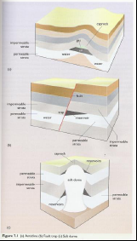
Introduction to oil & gas
Petroleum (rock oil): all hydrocarbons deposited in the Earth’s crust
Crude oil (liquid)
Natural gas (gaseous)
Bitumens (coal; solids)
Formed by decomposition of marine organics followed by time, heat & pressure.
Abundant where marine strata accumulated.
Traps: Where hydrocarbons accumulate:
Geologic traps: porous, permeable reservoir rock; high pressure
Structural traps: anticline, fault trap, salt dome
Energy Systems & Sustainability, 2/e, Chapter 7

Slide 4
Introduction to oil & gas
Anticline: formed by folds in the crust
Most common = 80%
Fault trap
Salt dome
Energy Systems & Sustainability, 2/e, Chapter 7

