Slide 1
SSC 2030: Energy Systems & Sustainability
5. Oil and natural gas
5.1: Origins & geology of petroleum
5.2: Origins of oil & gas industries
5.3: Finding & producing petroleum
5.4: Petroleum refining & products
5.5: Oil today
5.6: Natural gas
5.7: Rise & fall of North Sea oil & gas
5.8: Why are oil & gas so special?
5.9: Conversion technologies
5.10: Unconventional oil & gas
5.11: Methane leaks and GCC

Slide 2
5. Oil & gas
5.10: Unconventional oil & gas

Slide 3
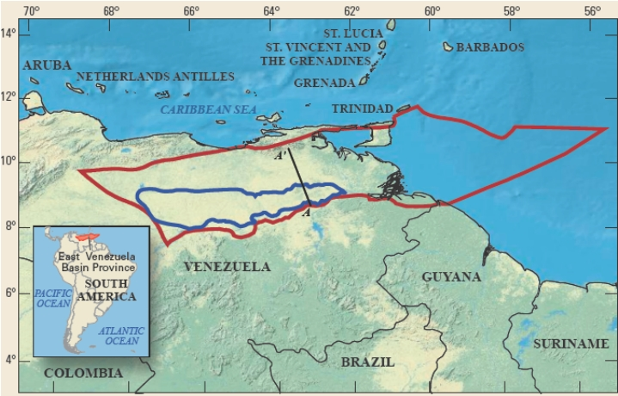
Heavy & extra-heavy oil
Oil that is so thick & viscous that it will not flow to the surface without injection of steam into the well to heat the oil and add enough pressure to force it to the surface.
Venezuela’s Orinoco basin has 500 billion barrels of reserve of heavy oil, more oil than Saudi Arabia.
High levels of S.
Difficult to harvest & refine.
Energy Systems & Sustainability, 2/e, Chapter 7; https://en.wikipedia.org/wiki/Orinoco_Belt#/media/File:Orinoco_USGS.jpg

Slide 4
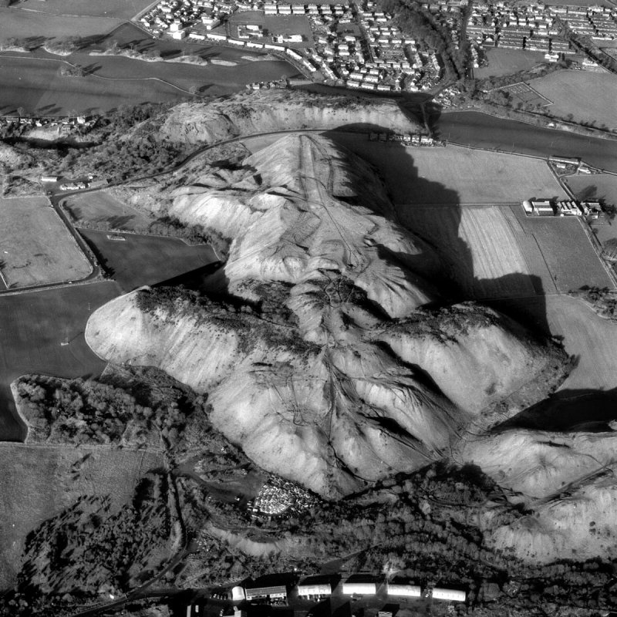
Shale oil
Shale oil is an ‘immature’ hydrocarbon trapped or embedded in rock as a waxy substance called kerogen.
Energy content of raw shale oil = 5 – 15 GJ/tonne (like poor lignite).
Shale oil was produced commercially in Scotland (1880 – 1940), Estonia (1920s – present), China & Brazil.
Concerns?
Environmental: the extraction process expands the volume of the rock, creating huge ‘bings’.
EROI is poor: 2.5 - > 10
Shale oil ‘bings’ (Scotland)
Energy Systems & Sustainability, 2/e, Chapter 7; https://slowair.wordpress.com/category/experiments-research/

Slide 5
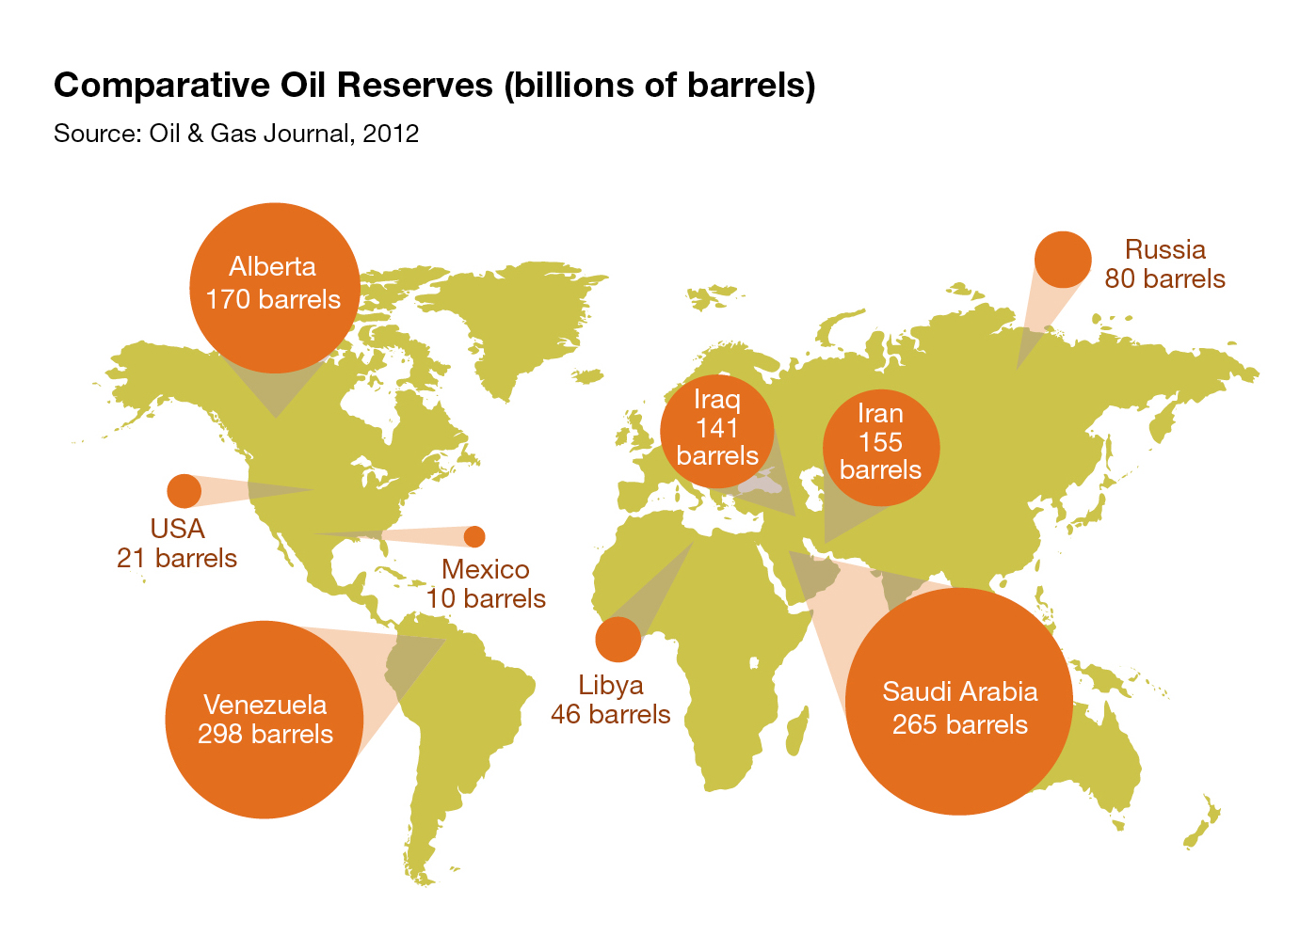
Oil sands or tar sands
Oil sands (aka tar sands) are mature bitumens binding together loose rock.
Easier recovery than shale oil.
Huge reserves of 27 billion tonnes in the Athabasca (northern Alberta)
16 billion tonnes can be surface mined.
2007 production was 75 million tonnes.
Energy Systems & Sustainability, 2/e, Chapter 7;
https://infograph.venngage.com/p/232326/oil-sands

Slide 6
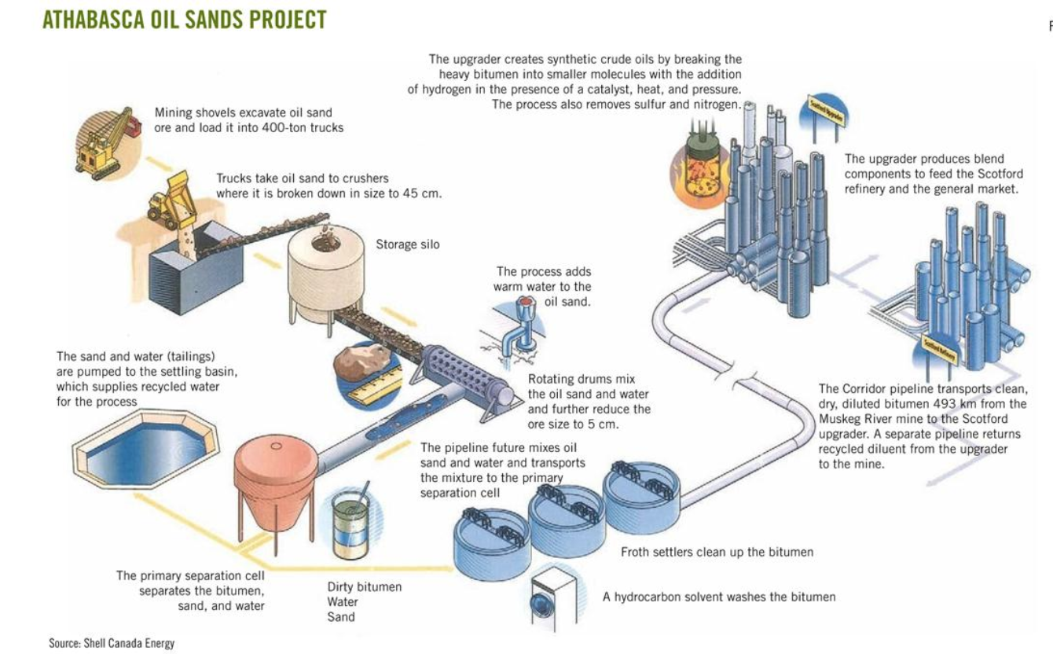
Tar sands extraction
Energy Systems & Sustainability, 2/e, Chapter 7;
https://infograph.venngage.com/p/232326/oil-sands
Up to 90% recovery of bitumen

Slide 7
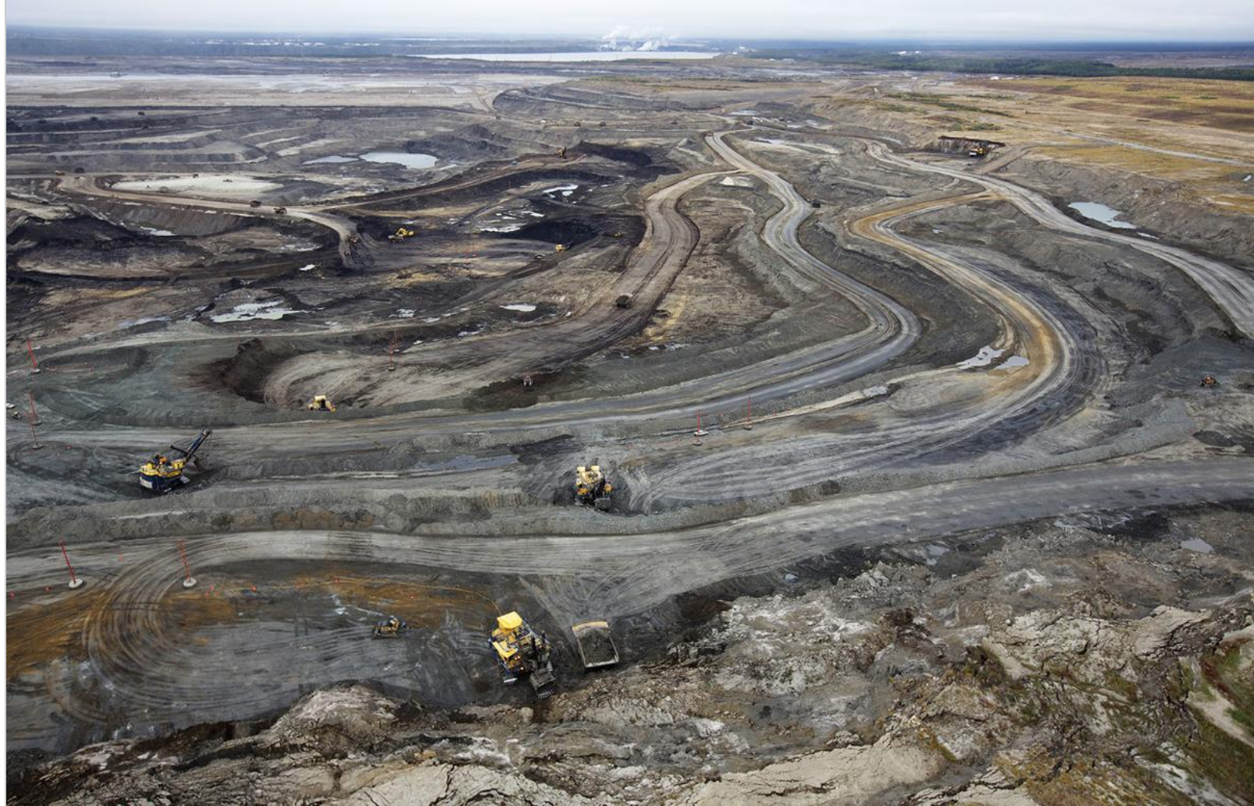
Tar sands challenges & costs
Tar sands extraction has significant challenges and costs:
Huge requirement for clean water use:
~ 500 – 1000 gallons / tonne of bitumen
High energy inputs to heat & steam the bitumen from the rock:
Energy input: 1 – 1.25 GJ / barrel of bitumen
Energy return: 6.12 GJ / barrel of bitumen
Mainly from NG
EROI ~ 5-6
Low cost of oil (2017)
Exxon ‘delisted’ 3.5 billion barrels of tar sands oil in Canada in 2017.
Environmental destruction
Energy Systems & Sustainability, 2/e, Chapter 7;
https://en.wikipedia.org/wiki/Oil_sands
https://insideclimatenews.org/news/22022017/exxon-mobil-tar-sands-alberta-canada-climate-change-oil-prices

Slide 8
Tar sands: environmental changes
Much of the Athabasca land mined for tar sands was a complex, boreal forest or peatland fens ecosystem (50% of land area) that sequestered a great deal of CO₂.
Total of 54,000 square miles.
Approved mining could release 11.4 – 47.3 million tonnes of CO₂.
Following tar sands extraction, reclamation must create ecosystems on stripped lands. As of 2014, reclamation focused on ecosystems that could cope with the salts, metals and acids released by tar sands operations.
Shrub land marshes
Upland forests
These reclaimed ecosystems are less complex & sequester less.
- 7.2 million tonnes CO₂ / year
Biodiversity has been reduced.
Massive use of Athbasca River water & contamination with tar sands chemicals.
Energy Systems & Sustainability, 2/e, Chapter 7;
http://e360.yale.edu/features/on_ravaged_tar_sands_lands_big_challenges_for_reclamation

Slide 9
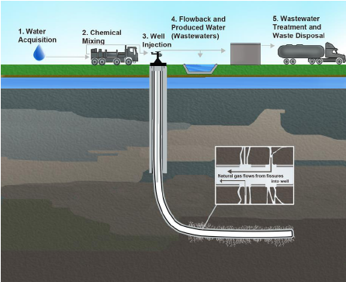
Hydraulic fracturing
Fracking allows production of tight gas trapped in sandstone and shale gas trapped in shale formations.
Energy Systems & Sustainability, 2/e, Chapter 7

Slide 10
Costs of fracking?
In order to pressurize fracking wells and force out gas, fracking fluids are pumped into the wells at high pressure.
Scientists at Yale analyzed over 1000 chemicals found in fracking fluid.
Good data on 240 showed that 157 are associated with developmental or reproductive toxicity.
67 were already chemicals of concern.
Included: arsenic, benzene, cadmium, lead, formaldehyde, chlorine, & mercury
Fracking chemicals often enter groundwater when fractures extend from gas wells into water-bearing rock.
This contaminates drinking water supplies.
Earthquakes are caused by:
The fracking process itself; and
Injection of fracking fluid waste into deep wells.
Energy Systems & Sustainability, 2/e, Chapter 7
https://news.yale.edu/2016/01/06/toxins-found-fracking-fluids-and-wastewater-study-shows
http://www.pbs.org/newshour/rundown/earthquakes-triggered-by-fracking/

Slide 11
Some have banned fracking
An number of countries and states have banned fracking:
Scotland
Ireland
France
The Netherlands
Germany
Tunisia
Vermont
New York
Maryland
Quebec
Energy Systems & Sustainability, 2/e, Chapter 7

Slide 12
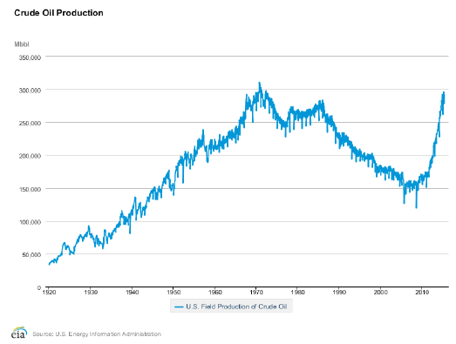
Fracking (et al.) will extend oil production
Fracking technology is allowing us to extract oil not previously seen as reserves.
Redefining resources vs. reserves.
Energy Systems & Sustainability, 2/e, Chapter 7

Slide 13
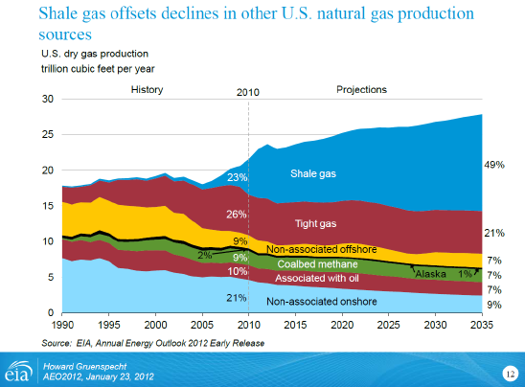
The impact of fracking is huge
Energy Systems & Sustainability, 2/e, Chapter 7

Slide 14
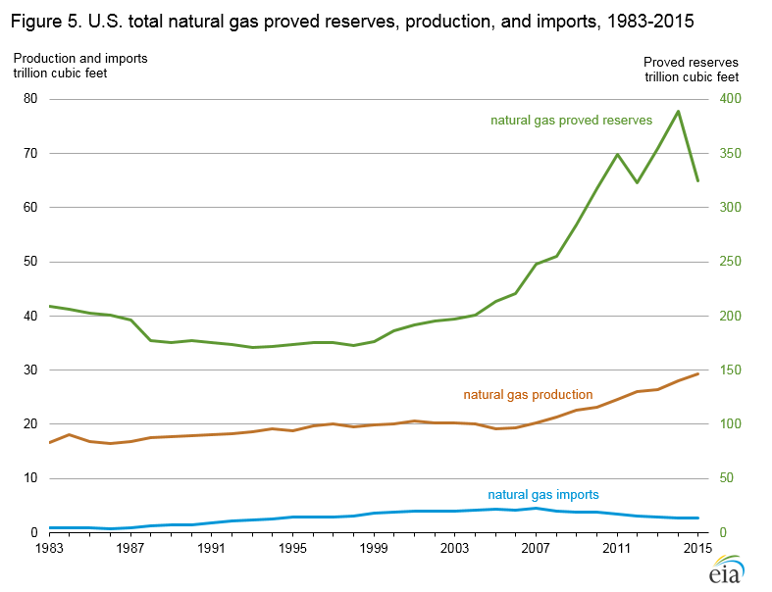
US NG reserves and production are up
Energy Systems & Sustainability, 2/e, Chapter 7

Slide 15
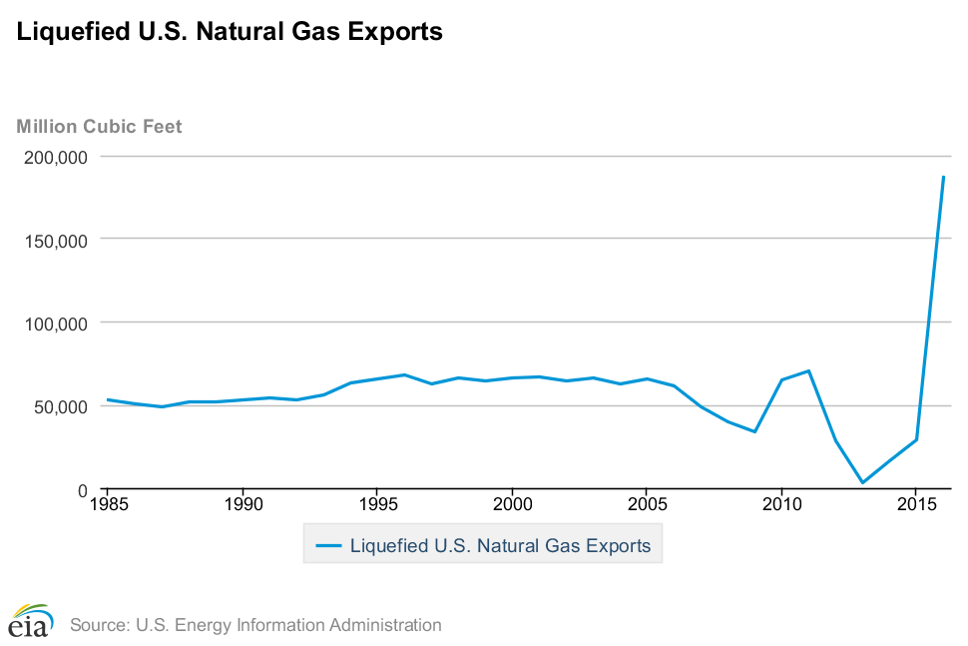
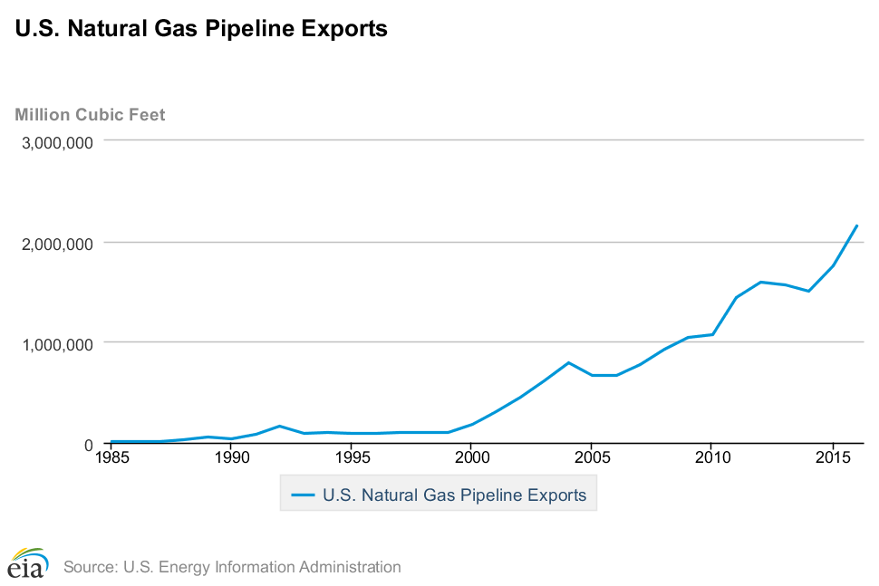
US NG export is booming
…to Canada & Mexico
Energy Systems & Sustainability, 2/e, Chapter 7

Slide 16
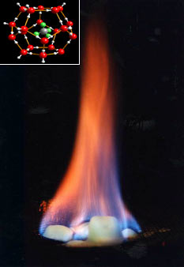
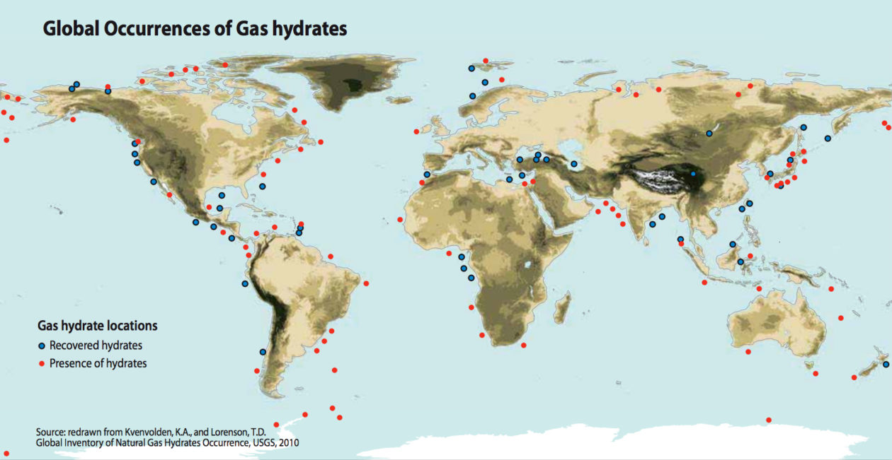
Methane hydrates: the last fossil fuel?
Methane hydrates form at the high pressures (hundreds of atm) & cold temperatures (1-2°C) below the sea floor at 300 – 500 m depth.
4 CH₄ + 23 H₂O → 4CH₄•23H₂O (methyl hydrate)
Ice-like crystalline compound
Global estimates of 1,000 – 5,000 trillion cubic meters of methane hydrate
Equivalent to all conventional NG reserves or more
Energy Systems & Sustainability, 2/e, Chapter 7; https://en.wikipedia.org/wiki/Methane_clathrate

Slide 17
Methane hydrates: promise or danger?
Can methane hydrates be harvested without accidental release of massive amounts of methane into the atmosphere?
Japan & China are experimenting with drilling & harvest now.
It’s possible to force methane out of methane hydrates by replacing the methane with carbon dioxide gas; sequestration.
Methane has 27-times the GHG potential of carbon dioxide.
Recently, ‘fountains’ of methane have been observed bubbling up from the Arctic seabed. Is the warming ocean melting methane hydrates?
Would the successful harvesting and combustion of methane hydrates cause a huge increase in global warming?
Using the huge volume of methane hydrates would certainly increase atmospheric CO₂ levels.
Should we harvest them to prevent global climate change from releasing them?
Energy Systems & Sustainability, 2/e, Chapter 7; https://en.wikipedia.org/wiki/Methane_clathrate

Slide 18
Are unconventional sources the answer?
Let’s look at some numbers:
Canadian oil sands: 4.6 million barrels per day
Venezuelan extra heavy oil: 2.3 million barrels per day
World shale oil: 0.5 million barrels per day
11% current world oil production
Unconventional sources of petro-fuels appear to be extending – or postponing – peak oil, but these sources are also finite.
Energy Systems & Sustainability, 2/e, Chapter 7

Slide 19
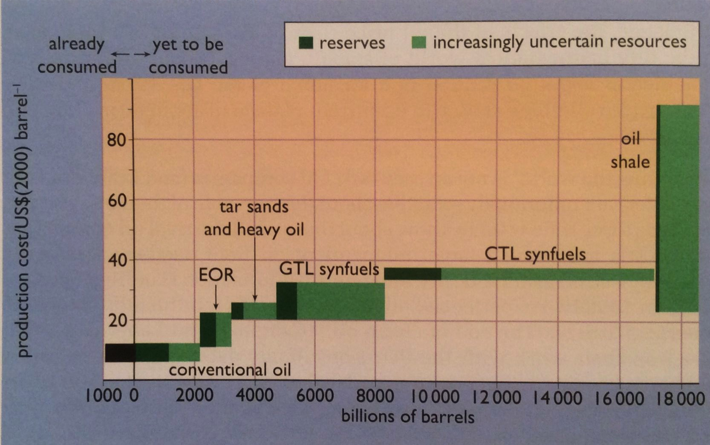
Reserves of unconventional fossil fuels
Increasingly, our reserves of petro-fuels will trend ‘unconventional.’
Energy Systems & Sustainability, 2/e, Chapter 7

Slide 20
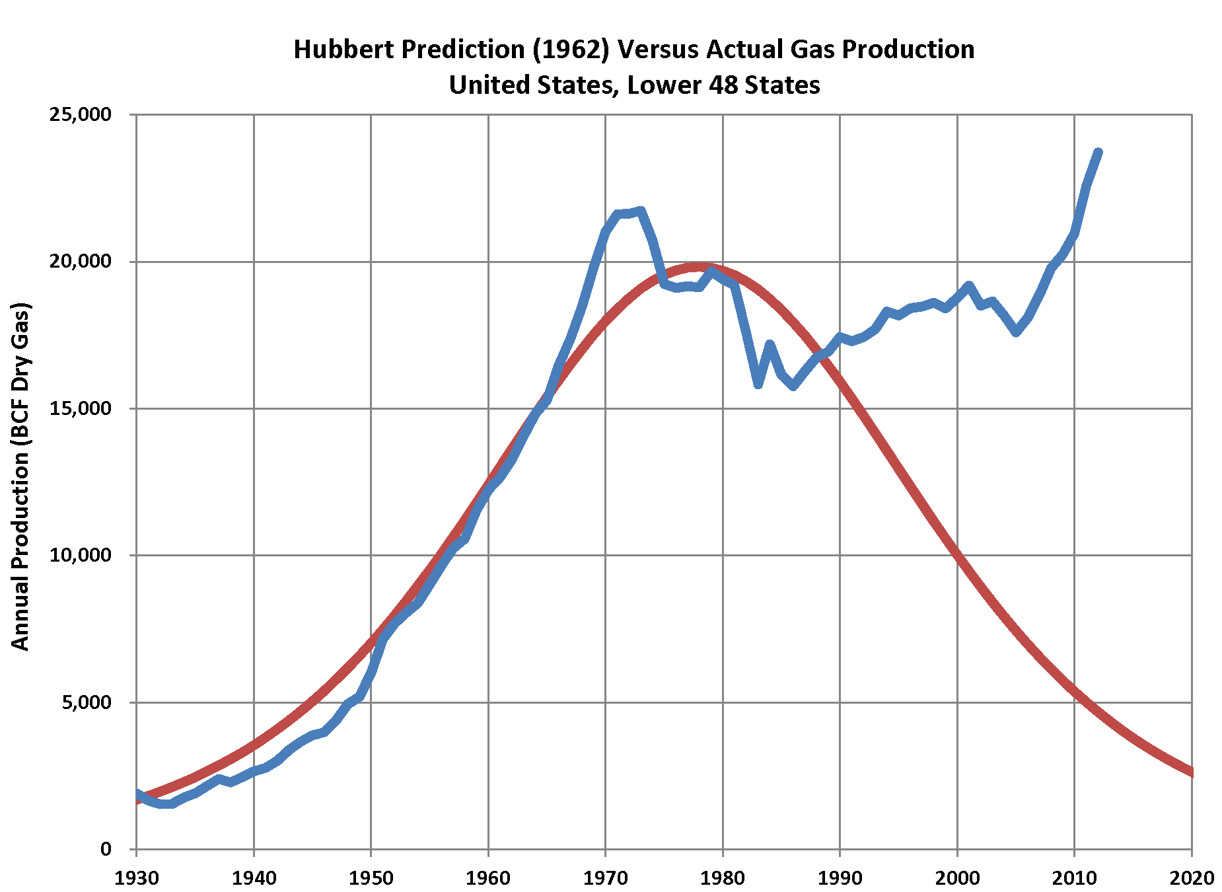
Peak oil?
Many have noted that US oil production appears to be defying peak predictions.
While we can probably shift the timing of the peak extraction & conversion won’t make a finite resource endless.
Energy Systems & Sustainability, 2/e, Chapter 7

Slide 21
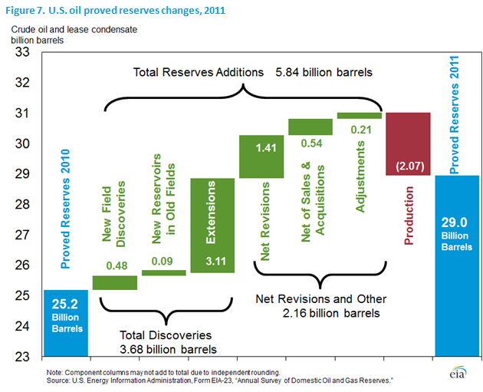
Revised fossil fuel reserves
While reserves figures are revised upwards, only a tiny fraction is new discoveries.
Because fossil fuel reserves & revenues are critical to the stability of many governments, fossil fuels ‘data’ may be subject to political influence or revision.
Reserves = political stability
Energy Systems & Sustainability, 2/e, Chapter 7

Slide 22
Summary: oil & gas
Oil & gas are:
Upsides:
Relatively inexpensive & readily available;
Convenient & easy use – existing infrastructure supports oil & gas;
‘Cleaner’ than coal;
Easy to distribute, store and transport;
High density:
40 MJ/L;
125,000 Btu/gallon
Downsides:
Extraction also has environmental impacts;
Carbon dioxide emissions & GCC;
Petroleum is a finite resources.
Energy Systems & Sustainability, 2/e, Chapter 7

