Slide 1

SSC 2030: Energy Systems & Sustainability
5. Oil and natural gas
5.1: Origins & geology of petroleum
5.2: Origins of oil & gas industries
5.3: Finding & producing petroleum
5.4: Petroleum refining & products
5.5: Oil today
5.6: Natural gas
5.7: Rise & fall of North Sea oil & gas
5.8: Why are oil & gas so special?
5.9: Conversion technologies
5.10: Unconventional oil & gas
5.11: Methane leaks and GCC

Slide 2
5. Oil & gas
  5.11: Methane leaks and GCC

Slide 3
Methane’s global warming potential
A number of atmospheric gases have global warming potentials (GWP): can hold heat in the earth’s atmosphere. GWP values are measured relative carbon dioxide (CO₂), given an arbitrary GWP of one.
  CO₂ has an atmospheric lifetime of thousands of years.
Methane (CH₄; natural gas) has a much higher GWP than CO₂.
CH₄ has a shorter atmospheric lifespan, about 10 years.
But CH₄ absorbs much more energy than CO₂.
And methane is converted into ozone, also a GHG.
Over a 100-year period, methane’s GWP is 28 - 36
20-year 84 - 87
https://www.epa.gov/ghgemissions/understanding-global-warming-potentials#Learn%20why

Slide 4
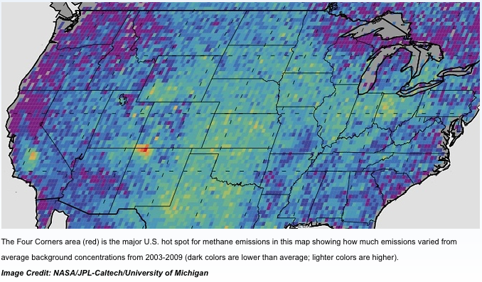
Global methane emissions are up
Harvesting fossil fuels releases methane into the atmosphere as leaks.
Satellite imaging is essential for finding and resolving leaks.
The four-corners CH₄ hotspot is due to poor recovery of coal-seam methane.
2,500 mi²
½ CT
released 0.59 tonne/year
https://www.nasa.gov/feature/jpl/nasa-led-study-solves-a-methane-puzzle
https://www.nasa.gov/press/2014/october/satellite-data-shows-us-methane-hot-spot-bigger-than-expected

Slide 5
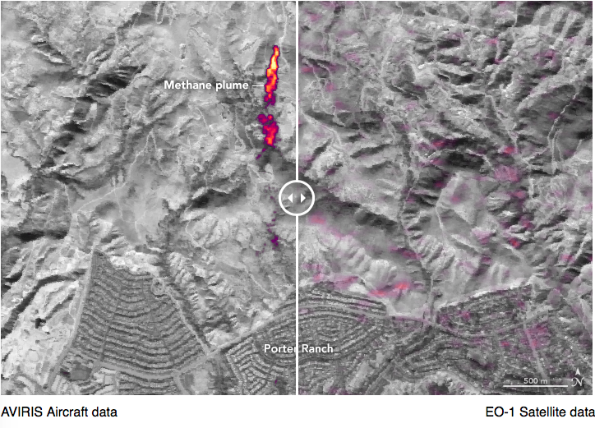
Methane storage leaks
Methane leak from underground NG storage facility in southern CA.
https://earthobservatory.nasa.gov/images/88245/imaging-a-methane-leak-from-space

Slide 6
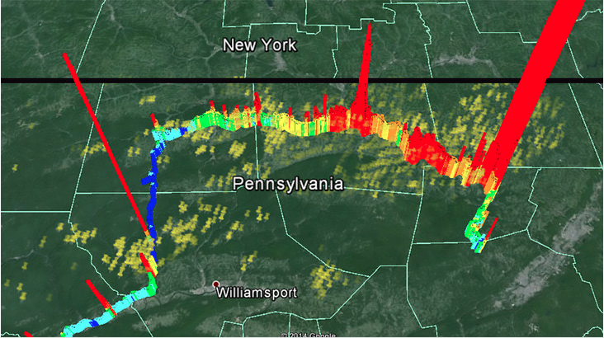
Methane fracking leaks
Road monitoring of methane levels finds leaks from the ground.
NG compressor station
NG wells
https://news.psu.edu/photo/338850/2014/12/17/methanemapbarkley

Slide 7
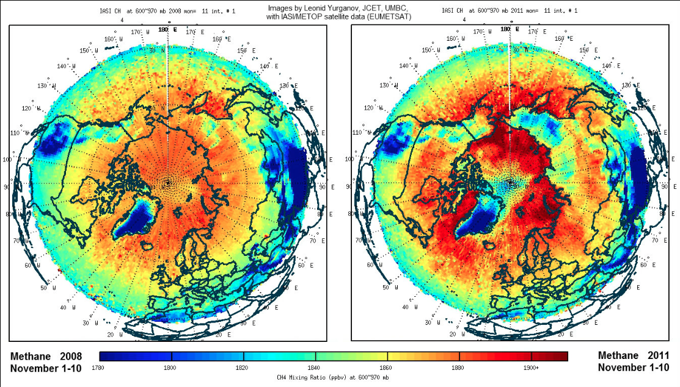
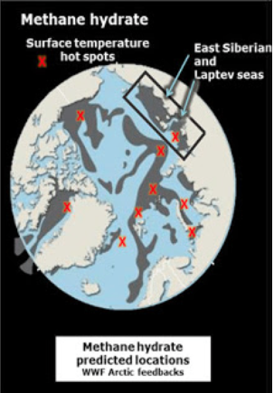
Ocean methane hydrates melting?
Methane hydrates lie frozen deep in the oceans and may be a future source of methane for energy.
But as the ocean’s warm hydrates seem to be melting and releasing methane; correlation with warming temperatures!
http://arctic-news.blogspot.com/2012/05/striking-increase-of-methane-in-arctic.html

Slide 8
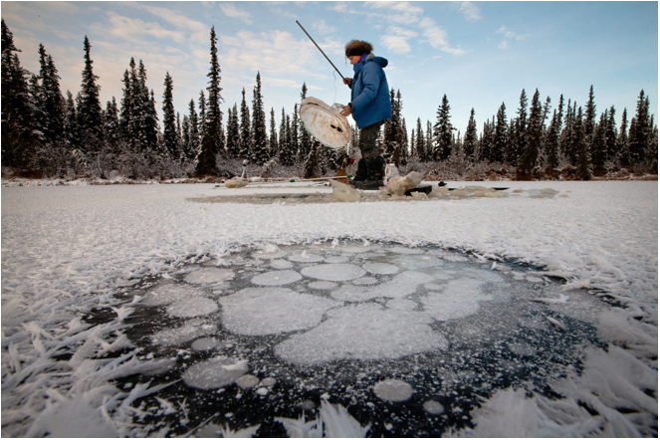
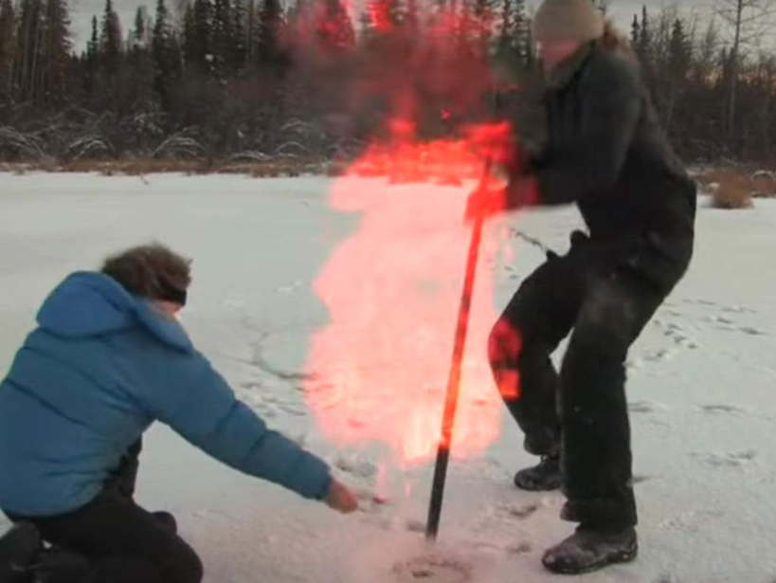
Permafrost methane … also leaking
The permafrost is a thick subsurface layer of soil that remains frozen throughout the year, occurring chiefly in polar regions.
It’s estimated that the permafrost contains twice as much carbon as is now in the atmosphere.
Warming temperatures could cause permafrost to release 15-33% of current carbon emissions.
https://www.nytimes.com/2011/12/17/science/earth/warming-arctic-permafrost-fuels-climate-change-worries.html

Slide 9
Perspective: methane as a GWP
Methane is a significant contributor to annual global carbon emissions.

Slide 10
Sources: atmospheric methane
EPA (n.d) “Understanding global warming potentials”
Retrieved from: https://www.epa.gov/ghgemissions/understanding-global-warming-potentials#Learn%20why
John Nelson, ed. (3 January 2018) “NASA-led study solves a methane puzzle”
Retrieved from: https://www.nasa.gov/feature/jpl/nasa-led-study-solves-a-methane-puzzle
Sam Carana (18 May 2012) “Striking increase of methane in the Arctic”, Arctic News
Retrieved from: http://arctic-news.blogspot.com/2012/05/striking-increase-of-methane-in-arctic.html
NASA (9 October 2014) “Satellite data shows U.S. methane ‘hot spot’ bigger than expected”, NASA News
Retrieved from: https://www.nasa.gov/press/2014/october/satellite-data-shows-us-methane-hot-spot-bigger-than-expected/
Justin Gillis (16 December 2011) “As permafrost thaws, scientists study the risks”, New York Times
Retrieved from: https://www.nytimes.com/2011/12/17/science/earth/warming-arctic-permafrost-fuels-climate-change-worries.html
Ian Johnston (19 July 2017) “Thawing permafrost poses even greater global warming threat than previously thought, study suggests”, The Independent
Retrieved from: https://www.independent.co.uk/news/science/thawing-permafrost-global-warming-climate-change-glaciers-antarctic-threat-mackenzie-delta-a7849211.html
Penn State News (18 July 2014) “Results of methane testing along state roads in north-central Pennsylvania”
Retrieved from: https://news.psu.edu/photo/338850/2014/12/17/methanemapbarkley

