Slide 1
SSC 2030: Energy Systems & Sustainability
5. Oil and natural gas
5.1: Origins & geology of petroleum
5.2: Origins of oil & gas industries
5.3: Finding & producing petroleum
5.4: Petroleum refining & products
5.5: Oil today
5.6: Natural gas
5.7: Rise & fall of North Sea oil & gas
5.8: Why are oil & gas so special?
5.9: Conversion technologies
5.10: Unconventional oil & gas
5.11: Methane leaks and GCC

Slide 2
5. Oil & gas
5.4: Oil refining & products

Slide 3
What is crude oil?
Crude oil is a mixture of hydrocarbon molecules, of varying carbon number (chain length) and structure mainly:
hydrocarbon | average % | range %
alkanes | 30 | 15 - 60
naphthenes | 49 | 30 - 60
aromatics | 15 | 3 - 30
asphaltics | 6 | remainder
element | % by mass
C | 83 - 85
H | 10 - 14
N | 0.1 - 2
O | 0.05 – 1.5
S | 0.05 - 6
metals | <0.1
Properties like color, density, viscosity, heat value vary greatly depending on this composition.
S content may be regulated.
Energy Systems & Sustainability, 2/e, Chapter 7; https://en.wikipedia.org/wiki/Petroleum

Slide 4
Products of crude oil
alkane | formula | boiling point (°C) | heat value (MJ/kg)
methane | CH₄ | -162 | 55.5
ethane | C₂H₆ | -89 | 51.9
propane | C₃H₈ | -42 | 50.4
butane | C₄H₁₀ | -0.5 | 49.5
octane | C₈H₁₈ | 125 | 47.1
Useful products can be created from crude oil by separating and transforming oil molecules by the process of fractional distillation, based on boiling points.
distilled fraction | boiling range (°C)
liquid petroleum gas | - 40
butane | - 12 - -1
Gasoline (octane) | -1 - 110
jet fuel | 150 - 205
kerosene | 205 - 260
fuel oil | 205 - 290
diesel fuel | 260 - 315
Light: crude with large amounts of light molecules (gases)
Sweet: low levels of sulfur
Energy Systems & Sustainability, 2/e, Chapter 7
Energy Systems & Sustainability, 2/e, Chapter 7; https://en.wikipedia.org/wiki/Petroleum

Slide 5
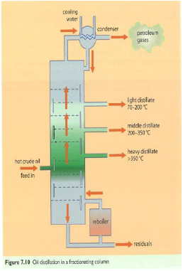
Oil refining: fractional distillation
Fractionation (aka cracking): a process that breaks long hydrocarbon chains down into smaller chains that are then separated by fractional distillation. The process uses:
heat;
steam; and/or
catalysts.
Lighter molecules (fractions) separate at lower temperatures.
Light: gas; jet fuel; kerosene
Middle: diesel; heating oil
Heavy: semi-solid; heavy diesel
Energy Systems & Sustainability, 2/e, Chapter 7

Slide 6
The many uses of oil (1)
Energy Systems & Sustainability, 2/e, Chapter 7

Slide 7
The many uses of oil (2)
Energy Systems & Sustainability, 2/e, Chapter 7

