Slide 1
SSC 2030: Energy Systems & Sustainability
5. Oil and natural gas
5.1: Origins & geology of petroleum
5.2: Origins of oil & gas industries
5.3: Finding & producing petroleum
5.4: Petroleum refining & products
5.5: Oil today
5.6: Natural gas
5.7: Rise & fall of North Sea oil & gas
5.8: Why are oil & gas so special?
5.9: Conversion technologies
5.10: Unconventional oil & gas
5.11: Methane leaks and GCC

Slide 2
5. Oil & gas
5.5: Oil today

Slide 3
Quick review of units of oil production
1 metric tonne = 7.3 barrels = 42 GJ
1 million barrels per day (bpd) = 0.365 billion barrels / year
= 50 million tonne / year
= 2.1 EJ / year
= 2 quads / year
Energy Systems & Sustainability, 2/e, Chapter 7

Slide 4
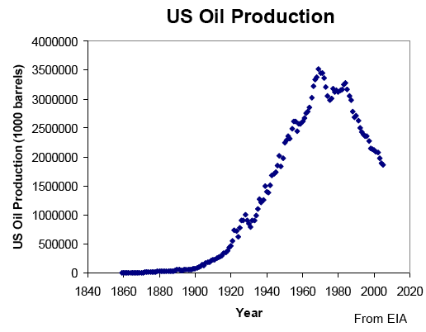
US oil production: driven by technology
Development of automobiles & planes spurred early growth.
Energy Systems & Sustainability, 2/e, Chapter 7

Slide 5
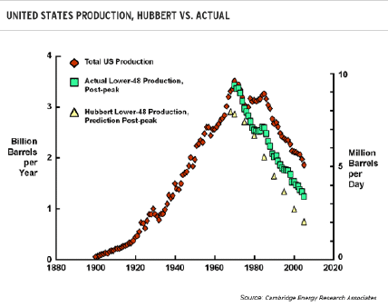
Peak oil?
Note that US production figures support Hubbert’s hypothesis.
Energy Systems & Sustainability, 2/e, Chapter 7

Slide 6
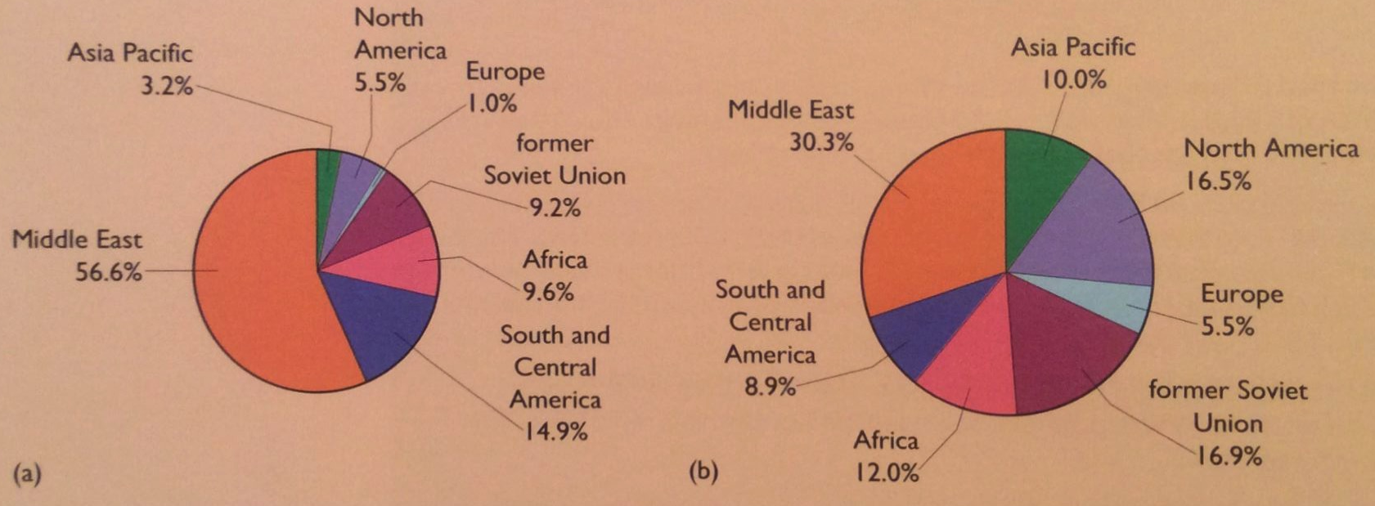
Oil reserves vs. production
As we’ve seen before, production doesn’t always align with reserves.
Middle East accounts for 30% of production & 35% of export.
Energy Systems & Sustainability, 2/e, Chapter 7

Slide 7
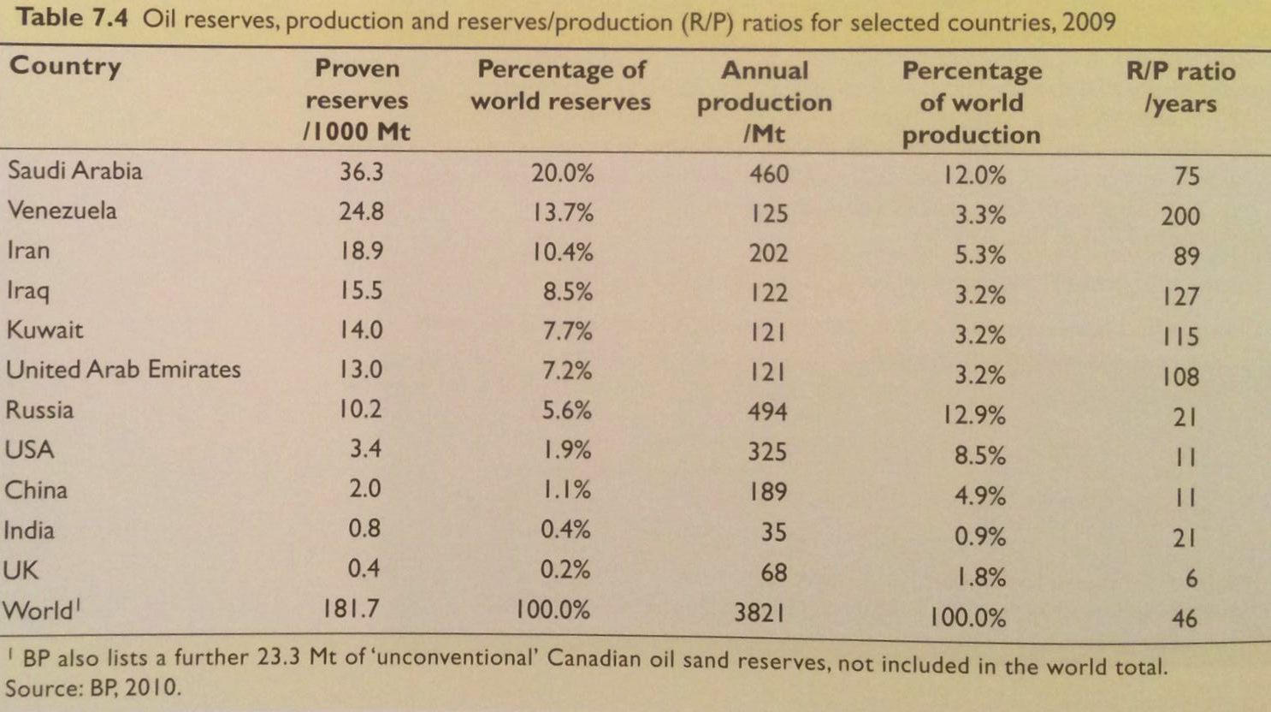
R/P ratios for oil
Global R/P ratios show that many industrialized countries have used most of their oil reserves.
Energy Systems & Sustainability, 2/e, Chapter 7

Slide 8
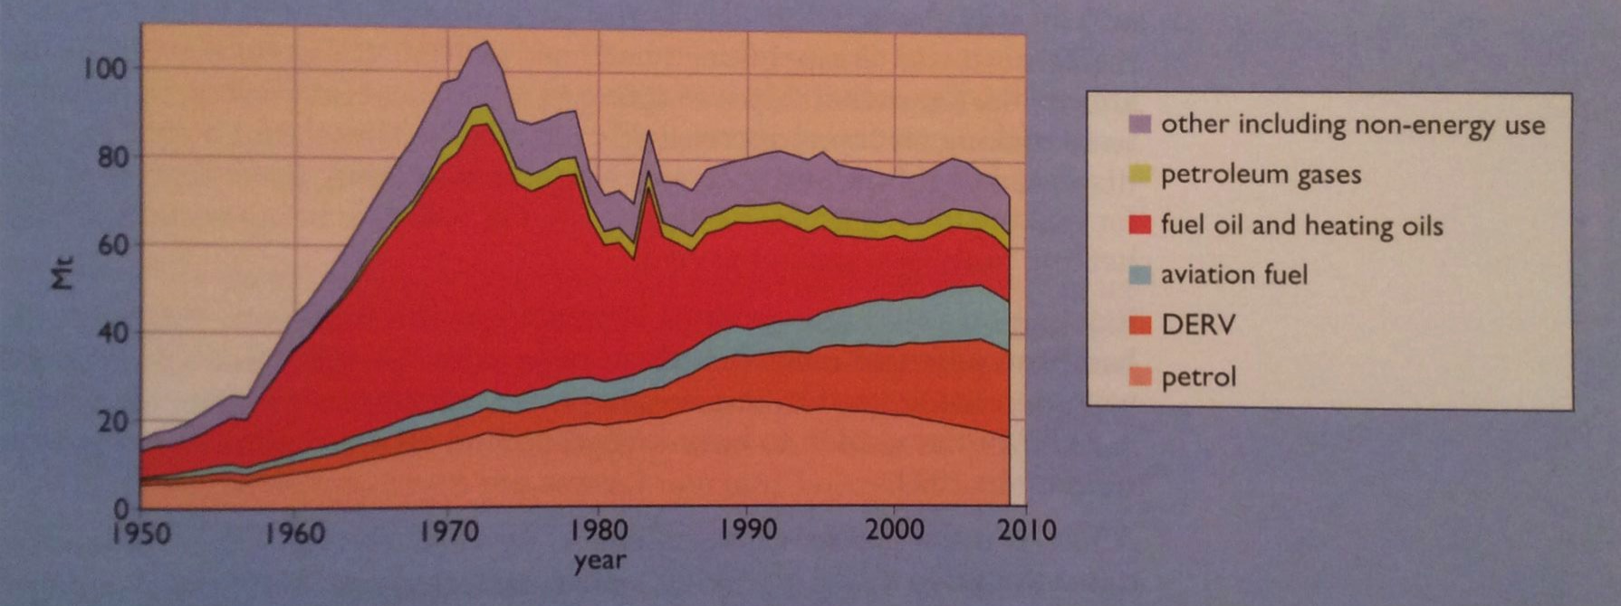
Changes in use of oil
The oil crisis of the 1970s did affect the way nations viewed oil dependence.
DERV = diesel
Energy Systems & Sustainability, 2/e, Chapter 7

Slide 9
Planning to move away from oil
This year (2017), several European countries have pledged to either:
Stop producing and selling petro fueled cars:
India
France
Britain
Norway
Across the globe, others plan to increase to percentage of electric cars:
Austria
China
Denmark
Germany
Ireland
Japan
the Netherlands
Portugal
Korea
Spain
http://money.cnn.com/2017/07/26/autos/countries-that-are-banning-gas-cars-for-electric/index.html

