Slide 1
SSC 2030: Energy Systems & Sustainability
5. Oil and natural gas
5.1: Origins & geology of petroleum
5.2: Origins of oil & gas industries
5.3: Finding & producing petroleum
5.4: Petroleum refining & products
5.5: Oil today
5.6: Natural gas
5.7: Rise & fall of North Sea oil & gas
5.8: Why are oil & gas so special?
5.9: Conversion technologies
5.10: Unconventional oil & gas
5.11: Methane leaks and GCC

Slide 2
5. Oil & gas
5.6: Natural gas

Slide 3
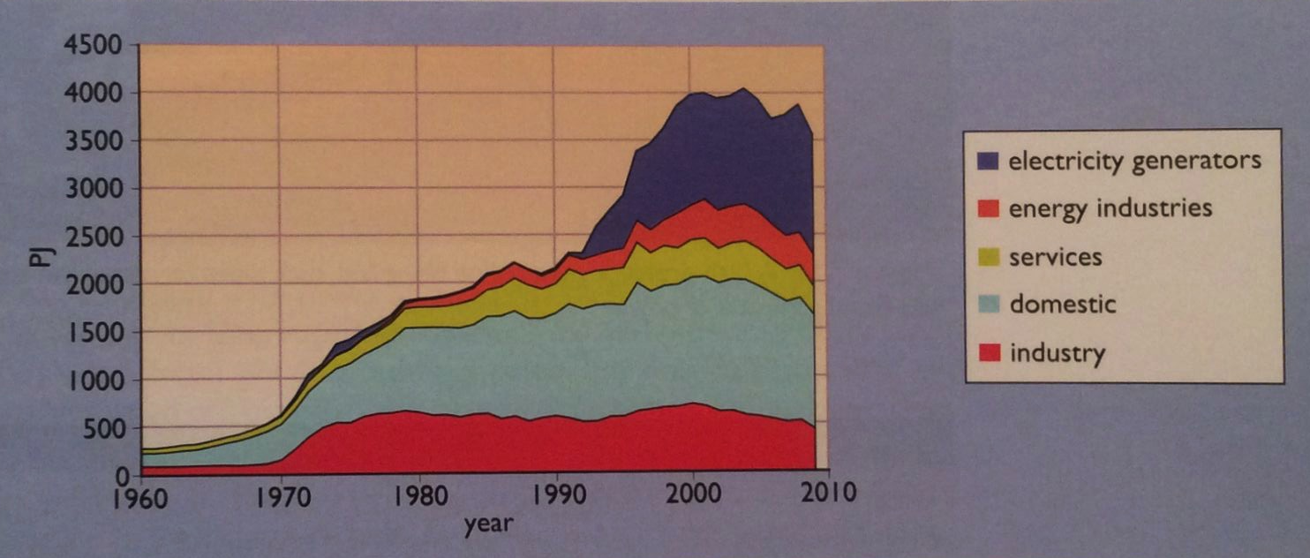
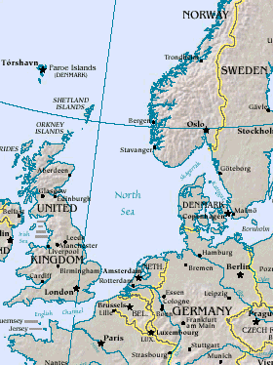
Natural gas: a ‘recent’ fossil fuel
While the US started using NG in the 1920s, European countries did not.
In 1959, a huge non-associated NG field was discovered in the Netherlands; later, off-shore NG fields in the North Sea.
In the UK, conversion from coal gas to NG took a decade & cost £564 m.
Pricing lower than coal gas incentivized the switch.
Energy Systems & Sustainability, 2/e, Chapter 7; https://en.wikipedia.org/wiki/North_Sea#/media/File:Nseamap.gif

Slide 4
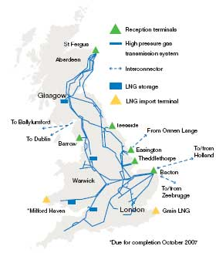
Lessons learned while switching fuels
In the UK, conversion from coal gas to NG took a decade & cost £564 m.
NG has 2X the energy content of coal gas; retrofitting was needed.
13 m customers
40 m appliances
Pricing lower than coal gas incentivized the switch.
2007: 92% of homes have central heat
75% are heated with NG
2000: 40% of electricity from NG
Generated with CCGTs
To meet peak winter demands, 3% of annual NG demand is stored by injection into depleted offshore wells
Some large users have interruptible contracts & have secondary energy
Energy Systems & Sustainability, 2/e, Chapter 7; http://www2.nationalgrid.com/uploadedImages/Resources/Image_library/Maps/UK%20Transmission%20maps.jpg

Slide 5
Processing NG: ‘scrubbing’ by-products
Natural gas (CH₄) is contaminated with other gases:
Ethane (C₂H₆)
He
H₂S
CO₂
plastics manufacturing
These gases are ‘scrubbed’ out of NG using amine chemistry.
medical uses; superconducting magnets
S used in fertilizers
re-injected to flush more NG out of wells
NG with low levels of contaminants is called ‘sweet’.
Energy Systems & Sustainability, 2/e, Chapter 7

Slide 6
Natural gas: ‘cleaner’ than oil & coal
Natural gas is mostly methane (CH₄) but contains small amounts of other hydrocarbon gases when extracted: ethane (2 carbons); propane (3 carbons); and butane (4 carbons).
CH₄ + 2O₂ → CO₂ + 2H₂O
CO₂ = 44 = 2.75
fuel 16
mass 16 64 44 36
Propane is (C₃H₈) and is separated from natural gas during processing.
C₃H₈ + 5O₂ → 3CO₂ + 4H₂O
CO₂ = 132 = 3.0
fuel 44
mass 44 160 132 72
It is often said that NG is a ‘cleaner’ fuel than oil or coal & produces less CO₂. Why & how?
Hydrogen ‘burns’ without producing CO₂. The more hydrogen a fuel has, the less CO₂ it produces.
So, to identify ‘clean’ fuels look for a high H:C ratio.
Energy Systems & Sustainability, 2/e, Chapter 7

Slide 7
NG: lower CO₂ emissions
Natural gas has lower carbon dioxide emissions because of its high H:C ratio
fossil fuel | H:C ratio | pounds CO₂ / MBtu
Coal (anthracite) | 0 – 0.3:1 | 228.6
Coal (bituminous) | 0.8:1 | 205.7
Coal (lignite) | 1:1 | 215.4
Diesel fuel / heating fuel | 2.27:1 | 161.3
Gasoline (no ethanol) | 2.25:1 | 157.2
Propane | 2.67: 1 | 139.0
Natural gas | 4:1 | 117.0
Energy Systems & Sustainability, 2/e, Chapter 7; https://www.eia.gov/tools/faqs/faq.php?id=73&t=11

Slide 8
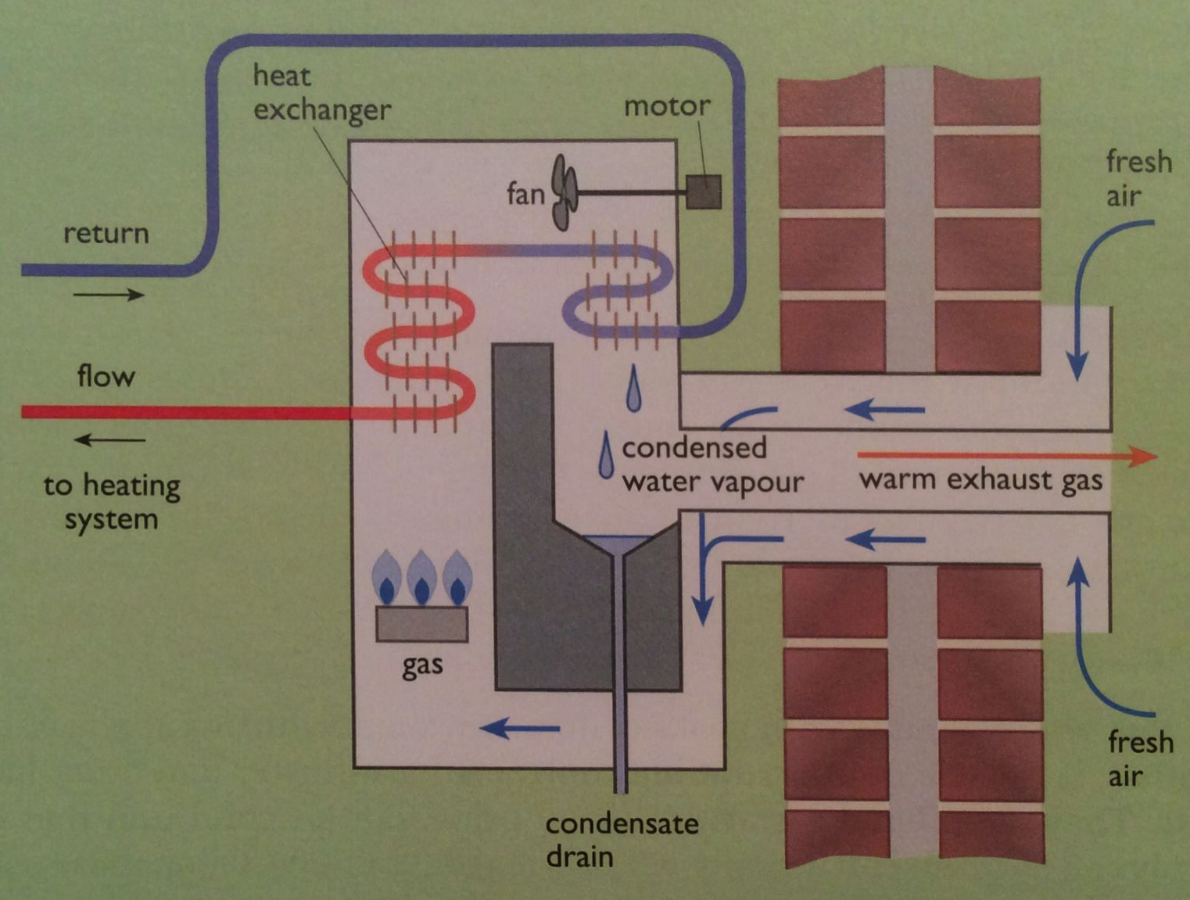
Domestic condensing gas boilers
Because NG burn cleanly, water vapor produced by combustion can be condensed allowing recovery of the latent heat of vaporization.
40°C return water cools flue gases below 50°C, increasing recovery of heat from the flue gases by 11%, the difference between HHV & LHV.
Increase boiler efficiency to >90%.
Energy Systems & Sustainability, 2/e, Chapter 7

Slide 9
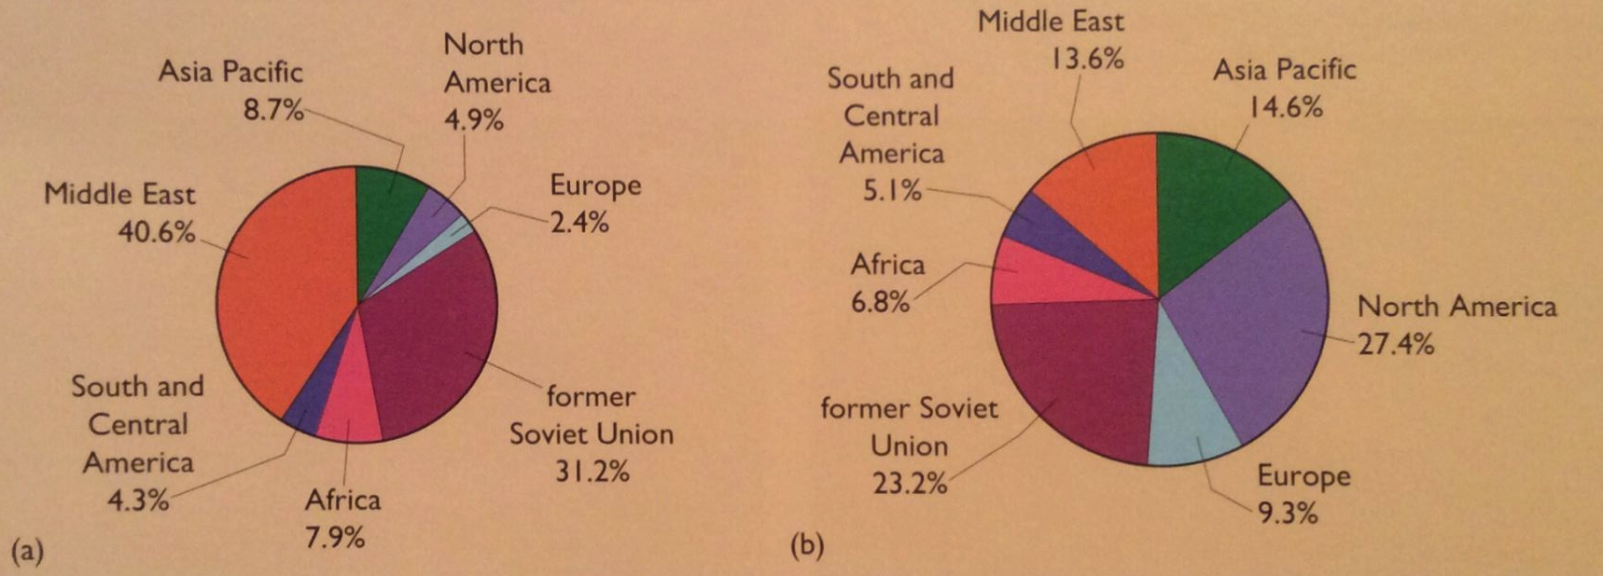
Global gas reserves & production
Once again, distribution doesn’t predict production.
reserves
production
40% of global NG reserves are in the Middle East, most in the Gulf between Qatar & Iran.
Qatar is a huge exporter of LNG.
Energy Systems & Sustainability, 2/e, Chapter 7

Slide 10
NG units
UK units:
1 therm = 100,000 BTU = 29.3 kWh = 105.5 MJ = 2.7 m³ NG
US units:
1 MMBTU = 1,000,000 BTU = 293 kWh = 1.055 GJ = 27 m³ = 1E3 ft³ NG
International:
1000 m³ NG = 39 GJ = 10.8 MWh = 0.93 tonnes of oil
‘Roundly’:
1000 m³ NG = 40 GJ = 10 MWh = 1 tonnes of oil
Energy Systems & Sustainability, 2/e, Chapter 7

Slide 11
R/P ratios for NG
Energy Systems & Sustainability, 2/e, Chapter 7

Slide 12
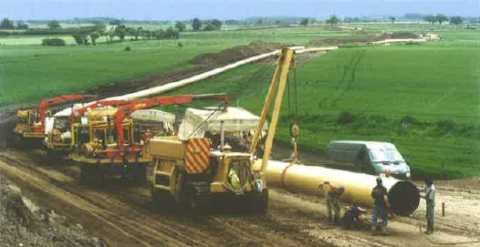
Transporting NG? Pipeline
High-pressure pipeline transports natural gas from NG storage depots to communities and industries.
Pipeline can transport the equivalent of gigawatts of power.
Energy Systems & Sustainability, 2/e, Chapter 7

Slide 13
Transporting NG? LNG
LNG, liquified natural gas, is produced by compressing natural gas. Increased energy density allows economical long-distance transportation.
Energy Systems & Sustainability, 2/e, Chapter 7

Slide 14
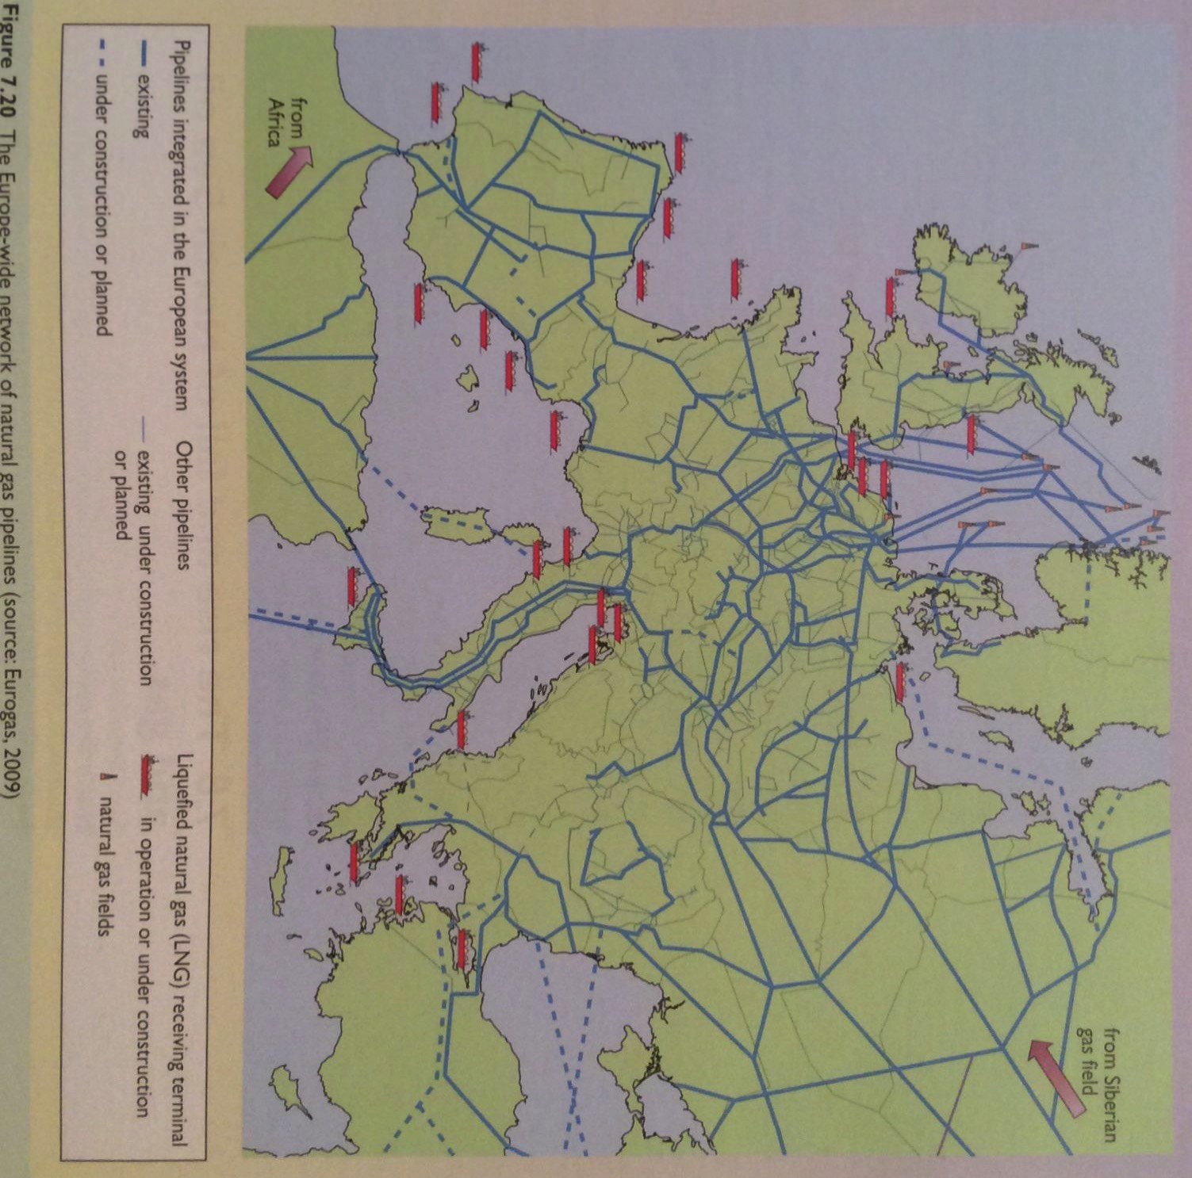
Europe is now dependent on NG
Russia exports NG to Europe from Siberia through long pipelines.
Note that NG from Russia must cross Ukraine & Belarus.
Pipeline pressure is boosted by in-pipe gas turbines powered by adding O₂.
Energy Systems & Sustainability, 2/e, Chapter 7
Europe’s energy security is not boosted.

