Slide 1
SSC 2030: Energy Systems & Sustainability
5. Oil and natural gas
5.1: Origins & geology of petroleum
5.2: Origins of oil & gas industries
5.3: Finding & producing petroleum
5.4: Petroleum refining & products
5.5: Oil today
5.6: Natural gas
5.7: Rise & fall of North Sea oil & gas
5.8: Why are oil & gas so special?
5.9: Conversion technologies
5.10: Unconventional oil & gas
5.11: Methane leaks and GCC

Slide 2
5. Oil & gas
5.7: Rise & fall of North Sea oil & gas

Slide 3
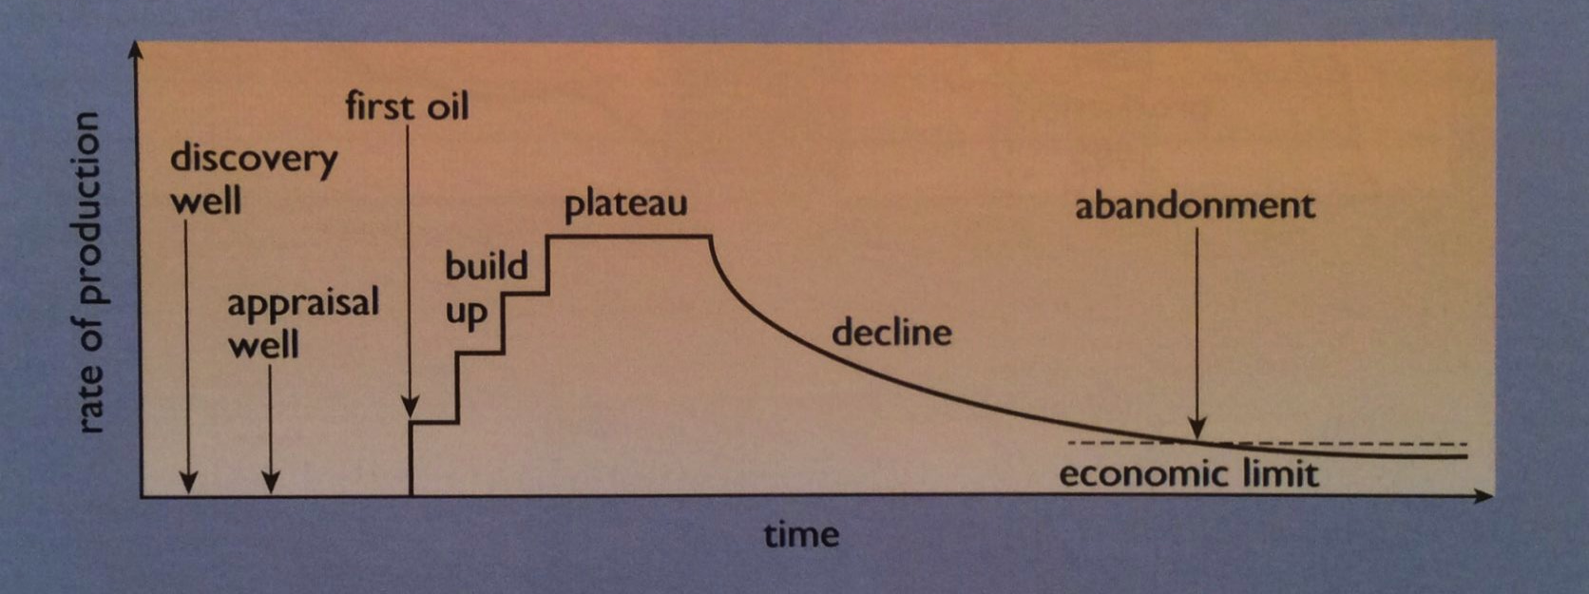
Oil & gas are finite
North Sea oil & gas have benefitted the UK, Norway, Denmark & the Netherlands.
But the benefit won’t last…
1975
1969
2000
Energy Systems & Sustainability, 2/e, Chapter 7

Slide 4
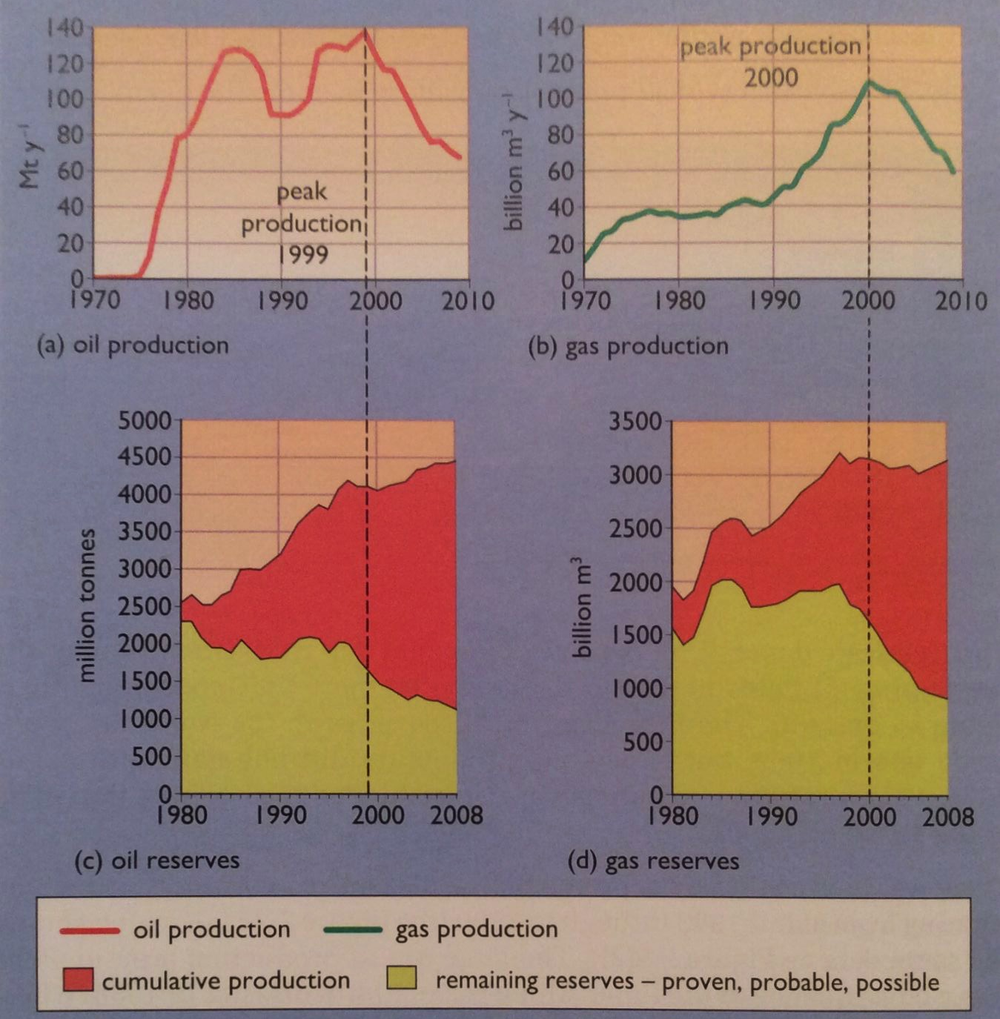
Timeline of UK production
Large-scale production began in 1975; cushion from oil crisis of 1970s.
Piper Alpha
167 dead
Plateau 1983 – 2000 .
Piper Alpha 167 dead.
Production now declining at a rate of 7% per year
Energy Systems & Sustainability, 2/e, Chapter 7

Slide 5
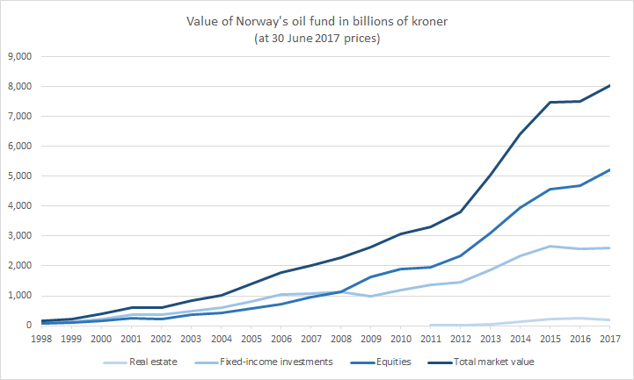
Norway’s approach to a finite resource
The UK aggressively produced North Sea oil & gas. UK governments used the revenue to keep non-oil taxes down, arguing that this would grow the UK economy.
Norway’s approach was different. Oil changed Norway’s economy radically; oil was a relatively larger boon to Norway. But Norway called it Oljeeventyr, the oil fairy tale, & saw it as a fleeting source of wealth.
In 1974, Norway decided to use oil money to develop a "qualitatively better society”.
Domestic control of oil;
Oil revenue invested in a sovereign wealth fund now worth >$1 billion;
Only 4% of surplus from this investment is spent for the public good.
Energy Systems & Sustainability, 2/e, Chapter 7; https://en.wikipedia.org/wiki/Government_Pension_Fund_of_Norway#/media/File:Norway_Oil_Fund.png

