Slide 1
SSC 2030: Energy Systems & Sustainability
5. Oil and natural gas
5.1: Origins & geology of petroleum
5.2: Origins of oil & gas industries
5.3: Finding & producing petroleum
5.4: Petroleum refining & products
5.5: Oil today
5.6: Natural gas
5.7: Rise & fall of North Sea oil & gas
5.8: Why are oil & gas so special?
5.9: Conversion technologies
5.10: Unconventional oil & gas
5.11: Methane leaks and GCC

Slide 2
5. Oil & gas
5.8: Why are oil & gas so special?

Slide 3
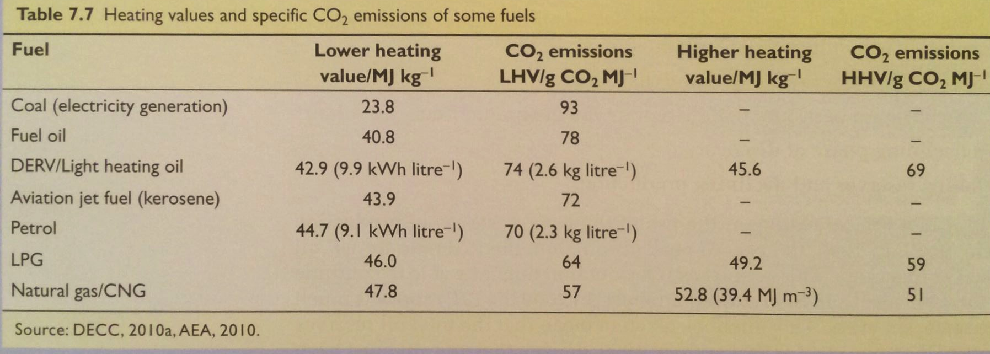
High energy density & a ‘clean’ burn
Why have oil and gas become such dominant forms of primary energy?
High energy density
Cleaner burning than coal (less CO₂/energy unit)
Ease of transport & use (universal infrastructure)
Abundant and cheap
Energy Systems & Sustainability, 2/e, Chapter 7

Slide 4
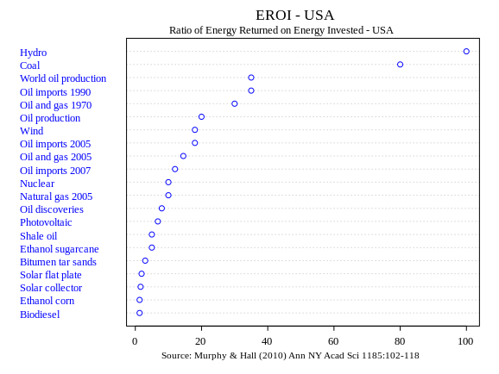
EROEI
Energy return on energy investment (EROEI) is a measure of how much energy a fuel will produce vs the amount of energy it took to create that fuel, from harvest through processing (and sometimes distribution.
EROEI = __________energy delivered________
energy required to deliver the energy
Fossil fuel | EROEI
Coal | 80
Oil | 12 - 35
NG | 10
Shale oil | 5
Tar sands | 3
Energy Systems & Sustainability, 2/e, Chapter 7; https://en.wikipedia.org/wiki/Energy_returned_on_energy_invested

Slide 5
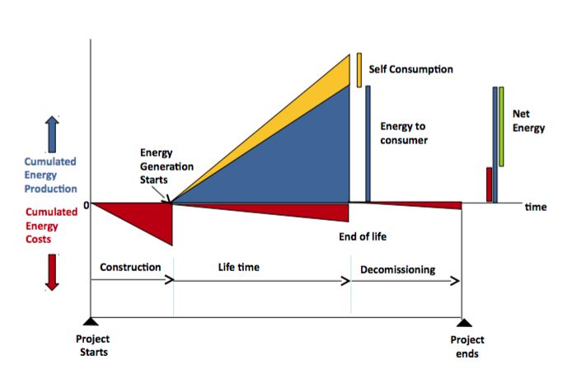
Factors affecting EROEI
In essence, EROEI balances the cost of producing energy with it’s benefits.
Energy Systems & Sustainability, 2/e, Chapter 7; http://euanmearns.com/eroei-for-beginners/; Prieto & Hall

Slide 6
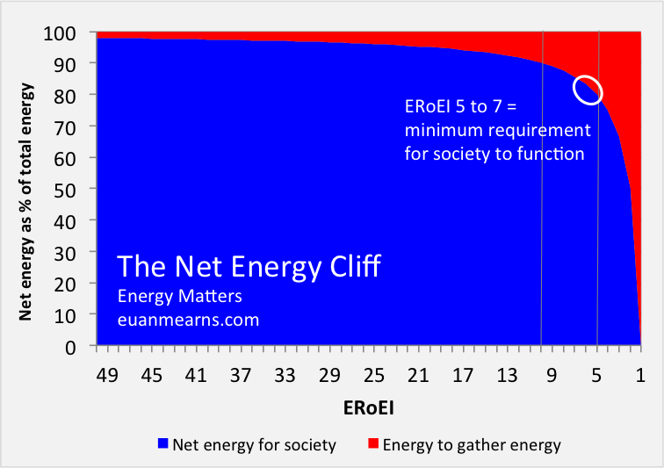
EROEI energy cliff?
Net energy cliff hypothesis contends that when EROEI falls too low, energy costs too much relative to the benefits it provides society.
Energy Systems & Sustainability, 2/e, Chapter 7; http://euanmearns.com/eroei-for-beginners/

Slide 7
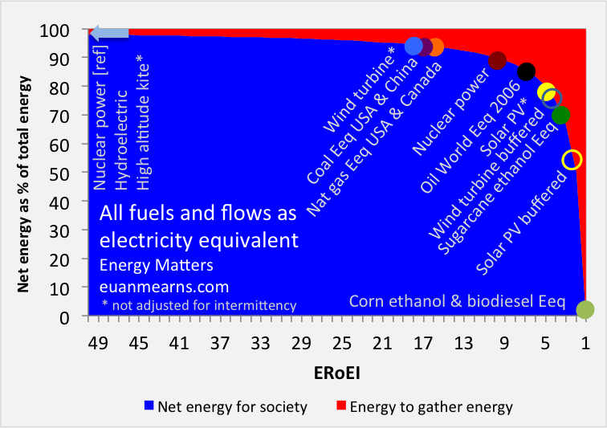
Will we fall off the energy cliff?
Energy Systems & Sustainability, 2/e, Chapter 7; http://euanmearns.com/eroei-for-beginners/

