Slide 1
SSC 2030: Energy Systems & Sustainability
5. Oil and natural gas
5.1: Origins & geology of petroleum
5.2: Origins of oil & gas industries
5.3: Finding & producing petroleum
5.4: Petroleum refining & products
5.5: Oil today
5.6: Natural gas
5.7: Rise & fall of North Sea oil & gas
5.8: Why are oil & gas so special?
5.9: Conversion technologies
5.10: Unconventional oil & gas
5.11: Methane leaks and GCC

Slide 2
5. Oil & gas
5.9: Conversion technologies

Slide 3
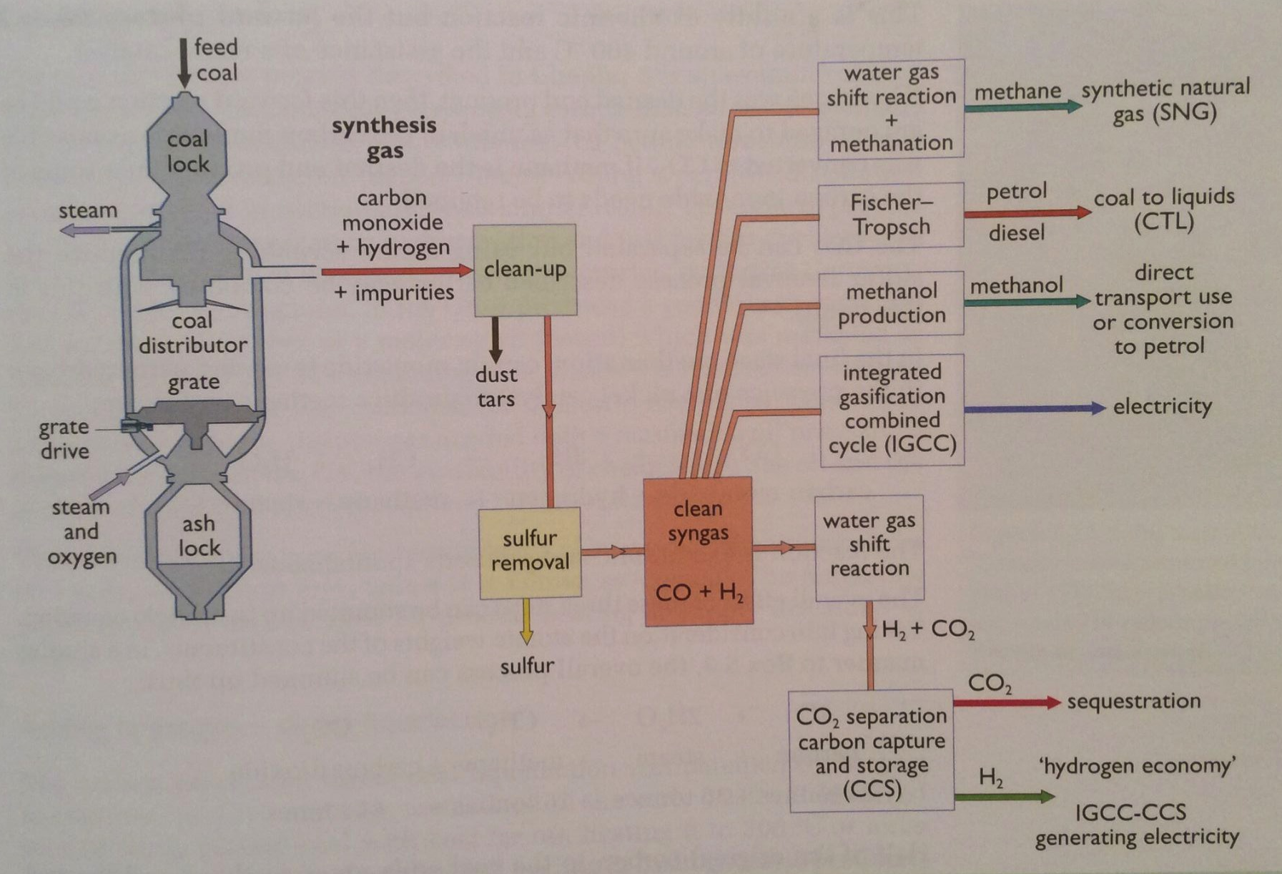
Should we convert coal to syngas?
CTL (coal to liquid) technology has a long history: 1930s to the present.
Used when coal is abundant but oil & gas are not.
Energy Systems & Sustainability, 2/e, Chapter 7

Slide 4
Conversion chemistry
Chemistry needed to convert coal (C) to methane (CH₄).
2C + O₂ → 2CO
C + H2O ←→ CO + H₂
CO + H₂O ←→ CO₂ + H₂
CO + 3H₂ → CH₄ + H₂O
2C + 2H₂O → CH₄ + CO₂
pyrolysis: combustion of coal with limiting O₂ (-ΔH)
water gas reaction (+ΔH)
water gas shift reaction (-ΔH)
methanization (+ΔH) requires Ni catalyst
overall syngas reaction
24 36 16 44 tonnes
32.8 55.5 MJ / kg
7.87 E5 8.88 E5 MJ
Not 100% efficient; process heat
Large amounts of water required.
Energy Systems & Sustainability, 2/e, Chapter 7

Slide 5
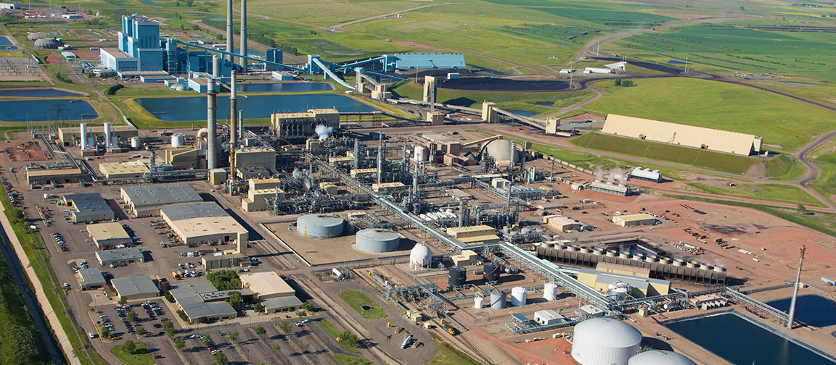
Syngas from coal in ND
The Great Plains Synfuels, ND: a pilot plant in operation since 1984
lignite → CH₄ (syngas = NG)
By-products:
(NH4)₂(SO₄) fertilizer, Kr gas, Xe gas, CO₂ for enhanced oil production in CA
Energy Systems & Sustainability, 2/e, Chapter 7

Slide 6
Coal to liquids
To convert coal to a liquid fuel, hydrogen must be added to increase the H:C ratio.
Steps:
Remove C from coal
Add H
Direct coal liquefaction (Germany, 1913) [EROI of 60-73%]
Mix finely ground coal with coal tar oil.
Add heat & pressure.
Add H2 gas with an iron catalyst.
Refine the synthetic crude oil.
Sasol process (Germany, 1930s) [EROI of 55%, but ‘sweet’]
Convert coal to NG.
Polymerize carbons via Fischer-Tropsch process.
Pass CO, H₂ mixture over iron catalyst at 20-30 atm, 200-350°C.
Lower temperatures produce paraffin & waxes; higher temperatures produce lighter products.
Energy Systems & Sustainability, 2/e, Chapter 7

Slide 7
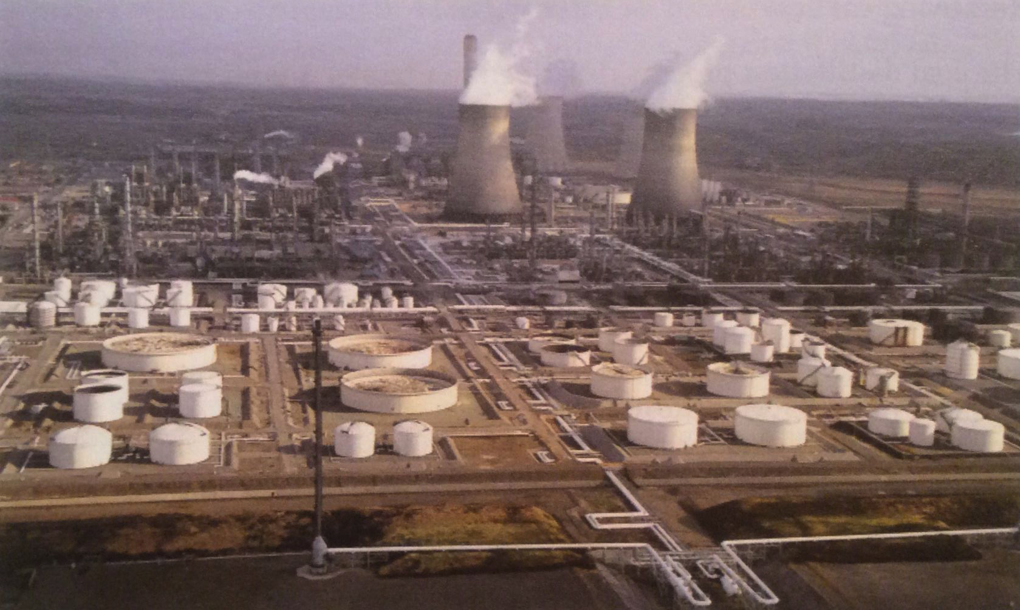
Commercial CTL in South Africa
South Africa has large coal reserves, but lacks liquid hydrocarbons.
Operates 3 Sasol plants that produce 6,000 – 30,000 barrels of oil products per day.
While the process isn’t very efficient, sulfur and nitrogen are removed, producing ‘clean’ fuels.
Energy Systems & Sustainability, 2/e, Chapter 7

Slide 8
Gas to liquid conversion
Because liquids are more easily transported, methane is sometimes converted into liquid hydrocarbons by reversing the chemistry we’ve just looked at:
CH₄ + H₂O → CO + 3H₂O
Methanol (CH₃OH) can be used as a liquid fuel or converted to ‘petrol’.
New Zealand used a methanol-to-gasoline plant to supply 10% of national need until NG reserves started running low.
Sasol process can also be used to build longer hydrocarbon fuels from methane.
Malaysia uses this technology in a middle distillate synthesis plant to produce 140,000 barrels of liquid fuel per day.
Massive amounts of water are required.
Energy Systems & Sustainability, 2/e, Chapter 7

Slide 9
Is CTL the answer to peak oil?
Economics?
2010 studies of CTL show that a break even price for the technology would be between $24 – 75/barrel of oil.
CO₂ emissions?
CTL produces twice the CO2 emissions than conventional oil.
GTL produces 1.5 times “ “
Carbon sequestration could mitigate these increases in CO₂.
Supplies of water and coal?
Two barrels of oil would require 1 tonnes of coal.
Water use might be the larger problem.
Energy Systems & Sustainability, 2/e, Chapter 7

