Slide 1
SSC 2030: Energy Systems & Sustainability
6. Nuclear power
6.1: Nuclear power: an introduction
6.2: Nuclei: a brief summary
6.3: Radioactivity
6.4: Nuclear fission
6.5: Thermal fission reactors
6.6: Types of thermal fission reactors
6.7: Nuclear fuel cycles
6.8: Fast neutron reactors
6.9: Newer nuclear reactor designs
6.10: Nuclear power in Vermont
6.11: Power from fusion

Slide 2
6. Nuclear power
6.1: Nuclear power introduction

Slide 3
Use of nuclear to generate electricity
2017: Nuclear power generation in:
30 countries
449 reactors
60 new plants under construction in 15 countries
Country | nuclear as % power
France | 72.3
Slovakia | 54.1
Ukraine | 52.3
Belgium | 51.7
Hungary | 51.3
Sweden | 40.0
Slovenia | 35.2
Bulgaria | 35.0
Switzerland | 34.4
Finland | 33.7
Armenia | 31.4
South Korea | 30.3
Czech Republic | 29.4
Total global nuclear generation:
2,476,671.2 GWh
Total US nuclear generation:
805,327.2 GWh
99 plants
19.7% of national generation
Nuclear Energy Institute; https://www.nei.org/Knowledge-Center/Nuclear-Statistics/World-Statistics

Slide 4
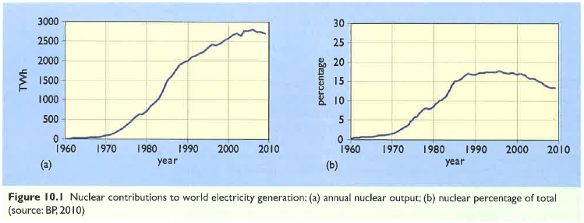
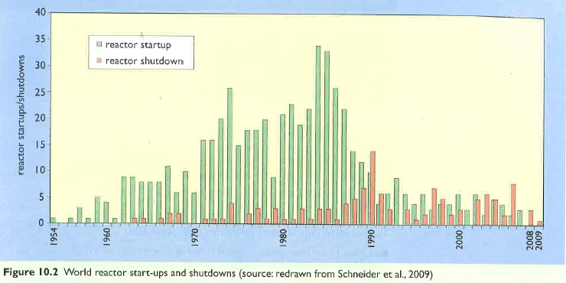
Time-line of nuclear power use
While the first nuclear plants were built in the 1950s, implementation really boomed in the 1960s & 1970s.
In the 1990s shutdown of aging (or problematic) nuclear plants outpaced construction.
Energy Systems & Sustainability, 2/e, Chapter 10

