Slide 1
SSC 2030: Energy Systems & Sustainability
6. Nuclear power
6.1: Nuclear power: an introduction
6.2: Nuclei: a brief summary
6.3: Radioactivity
6.4: Nuclear fission
6.5: Thermal fission reactors
6.6: Types of thermal fission reactors
6.7: Nuclear fuel cycles
6.8: Fast neutron reactors
6.9: Newer nuclear reactor designs
6.10: Nuclear power in Vermont
6.11: Power from fusion

Slide 2
6. Nuclear power
6.10: Nuclear power in Vermont

Slide 3
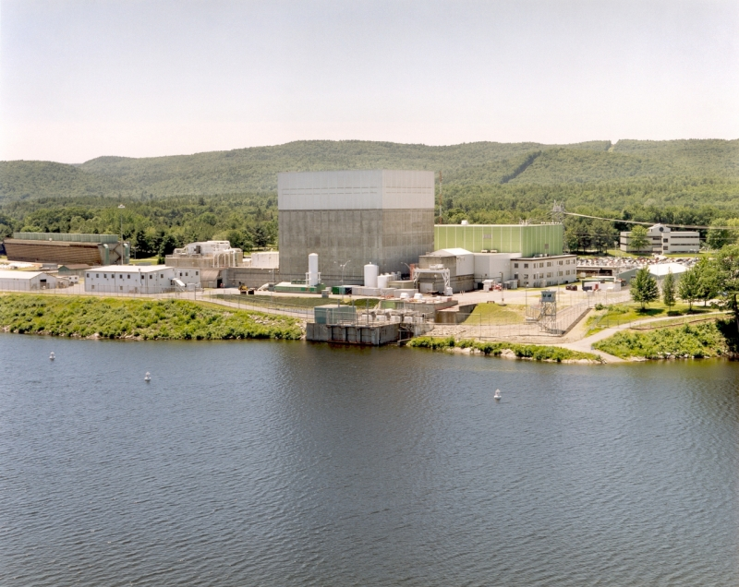
Vermont Yankee nuclear plant
Data
Location | Vernon, VT
Operator | Entergy
Start of commercial operation | February 28, 1973
Reactors
Reactor supplier | General Electric
Reactor type | BWR-4
Power
Capacity | 620 MW
Total power generation in 2007 | 4,703 GW·h
Average annual generation (last 5 yrs) | 4,436 GW·h
Energy Systems & Sustainability, 2/e, Chapter 10

Slide 4
Vermont Yankee nuclear plant
Vermont Yankee occupies a 125-acre site in Vernon, VT (Windham County)
September 2003: Entergy Nuclear Operations, the owner, submitted an application to the Nuclear Regulatory Commission (NRC) to increase the plant’s maximum power level by 20%.
There were questions and objections.
The plant was nearing the end of its licensing period.
And it needed to be refueled to increase power.
January 2007: Entergy applied for a 20-year license extension.
2014: Vermont Yankee closed… decomissioning dates uncertain
www.eia.doe.gov

Slide 5
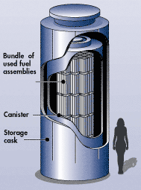
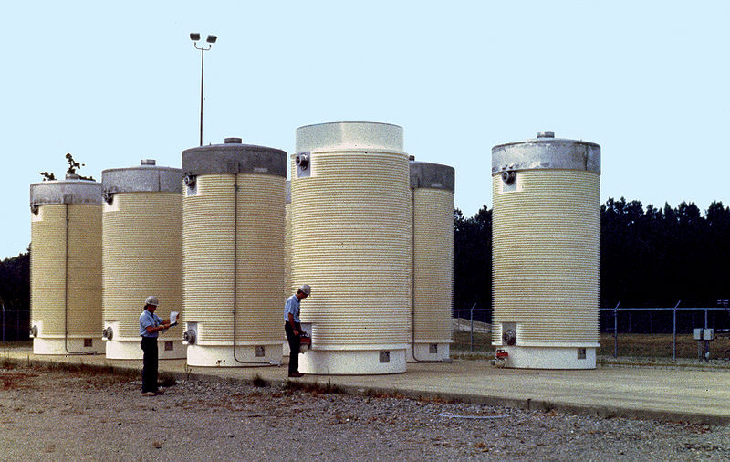
Dry cask storage of nuclear waste
Nuclear waste at Vermont Yankee is stored on site in ‘dry casks’.
Spent fuel is placed in a canister & flooded with inert gas.
The steel cylinder is bolted / welded shut.
Cylinders are surrounded by additional steel, concrete or other material to shield humans from radiation.
www.eia.doe.gov

