Slide 1
SSC 2030: Energy Systems & Sustainability
6. Nuclear power
6.1: Nuclear power: an introduction
6.2: Nuclei: a brief summary
6.3: Radioactivity
6.4: Nuclear fission
6.5: Thermal fission reactors
6.6: Types of thermal fission reactors
6.7: Nuclear fuel cycles
6.8: Fast neutron reactors
6.9: Newer nuclear reactor designs
6.10: Nuclear power in Vermont
6.11: Power from fusion

Slide 2
6. Nuclear power
6.2: Nuclei - a brief summary

Slide 3
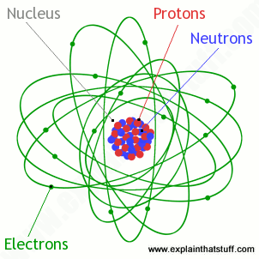
Atoms & nuclei
Atomic nuclei: dense, central conglomeration of protons & neutrons
Protons: heavy, positively charged particles [# is unique atomic identifier]
Neutrons: heavy, uncharged particles [# varies in isotopes]
Atomic mass: ~ sum of protons + neutrons
Strong atomic force: holds protons & neutrons together in nucleus
Energy Systems & Sustainability, 2/e, Chapter 10;
https://cdn4.explainthatstuff.com/atom.png

