Slide 1
SSC 2030: Energy Systems & Sustainability
6. Nuclear power
6.1: Nuclear power: an introduction
6.2: Nuclei: a brief summary
6.3: Radioactivity
6.4: Nuclear fission
6.5: Thermal fission reactors
6.6: Types of thermal fission reactors
6.7: Nuclear fuel cycles
6.8: Fast neutron reactors
6.9: Newer nuclear reactor designs
6.10: Nuclear power in Vermont
6.11: Power from fusion

Slide 2
6. Nuclear power
6.3: Radioactivity

Slide 3
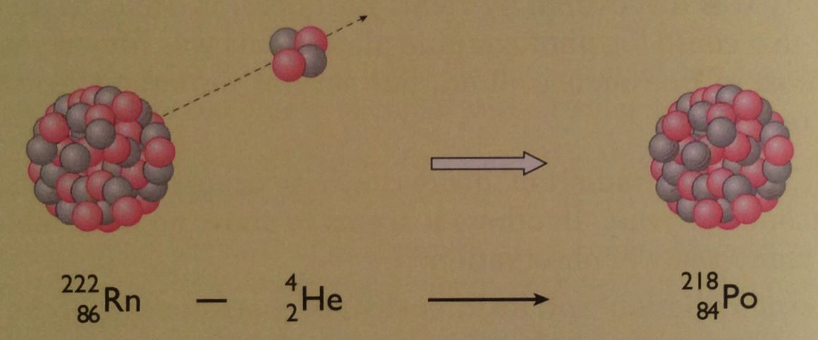
Heavy elements & radioactivity
The light elements in the upper four rows (or periods) of the periodic table have roughly equal numbers of protons & neutrons.
But heavier elements found in lower rows have far more neutrons than protons.
zB: Mercury (Hg) has 80 protons but 120 neutrons
The additional neutrons may add strong nuclear force needed to hold the large number of protons together (fighting repulsive force).
But beyond bismuth (Bi, 92) nuclei become unstable.
Elements beyond bismuth are radioactive: their nuclei emit high energy charged particles & thus become different elements
Energy Systems & Sustainability, 2/e, Chapter 10

Slide 4
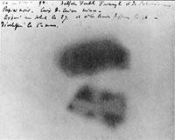
Radioactivity: caught on film
Henry Becquerel described radioactivity in 1896.
He found that uranium salts exposed a photographic plate (caused it to blacken) when the plate was completely protected from light.
The energy (radioactivity) given off by the uranium acted like light.
Uranium emits beta radiation.
Each element has its own characteristic type of radioactivity.
Physical & chemical changes to a radioactive element have no effect on its radioactivity.
Energy Systems & Sustainability, 2/e, Chapter 10

Slide 5
Radioactive elements
Marie & Pierre Curie found two more radioactive elements:
Polonium;
Radium
The Curies coined the term radioactivity and isolated large enough amounts of radioactive elements to allow detailed study.
Sadly, this extensive exposure to radioactivity for many years ultimately proved fatal.
The Nobel Prize was awarded to the Curies and Becquerel in 1903.
Energy Systems & Sustainability, 2/e, Chapter 10

Slide 6
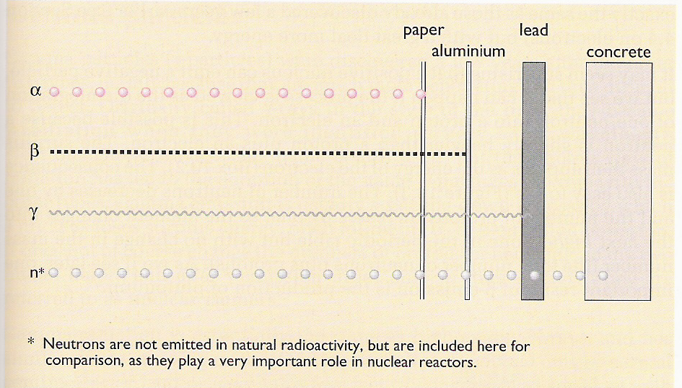
Types of radioactivity
Higher levels of activity allow radiation to penetrate more materials.
2+ nuclei
- electrons
energy w/o mass
neutrons
Energy Systems & Sustainability, 2/e, Chapter 10

Slide 7
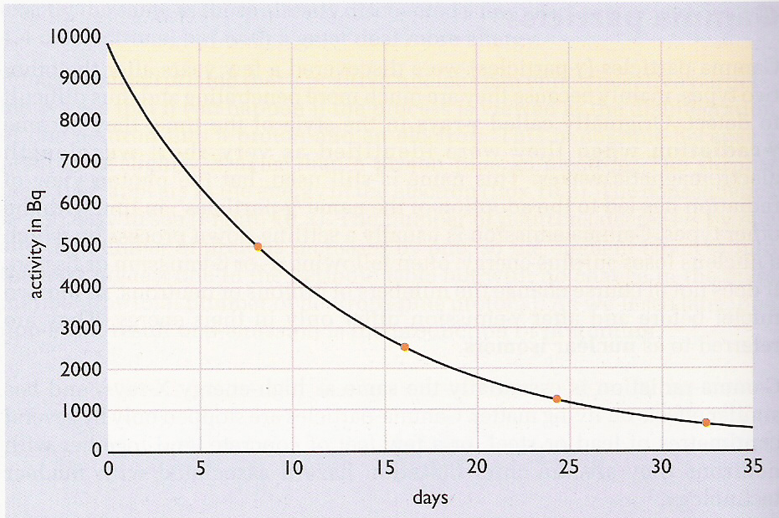
Radioactive decay
Rate of decay: rate at which the number of radioactive atoms decreases; proportional to the number present at any moment.
The half-life (time for half of the activity to decay) of elements involved in nuclear power and nuclear weapons is very long.
Energy Systems & Sustainability, 2/e, Chapter 10

Slide 8
Half-life
Half-life: the time required for half the sample to decay
Isotope | U-238 | U-235 | Pu-239 | Sr-90 | I-131
particle | α | α | Α | β | β
Half-life | 4.5 E9 years | 7.0 E8 years | 24,000 years | 28 years | 8.1 days
1 g | 12,000 Bq | 79,000 Bq | 2,300 MBq | 5.3 TBq | 4,600 TBq
10 kBq | 0.81 g | 0.13 g | 4.3 μg | 0.0019 μg | 2.2 pg
Energy Systems & Sustainability, 2/e, Chapter 10

