Slide 1
SSC 2030: Energy Systems & Sustainability
6. Nuclear power
6.1: Nuclear power: an introduction
6.2: Nuclei: a brief summary
6.3: Radioactivity
6.4: Nuclear fission
6.5: Thermal fission reactors
6.6: Types of thermal fission reactors
6.7: Nuclear fuel cycles
6.8: Fast neutron reactors
6.9: Newer nuclear reactor designs
6.10: Nuclear power in Vermont
6.11: Power from fusion

Slide 2
6. Nuclear power
6.4: Nuclear fission

Slide 3
Playing with radioactivity
Radioactivity became a tool that scientists could use to investigate atoms and atomic structure. Soon physicists were bombarding every known element with radioactive particles or neutrons.
Neutrons had the advantage of neutrality.
1930s: Enrico Fermi found that bombarding uranium with neutrons caused emission of β-particles as neutrons were changed into protons.
This creation of new protons created heavier elements, transuranic actinoids.
1938: Otto Hahn et al. found that Fermi’s bombardment of uranium had created a smaller element, barium.
Meitner realizes that the unstable uranium nucleus was split by the neutron’s impact: kernspaltung (nuclear fission).
Energy Systems & Sustainability, 2/e, Chapter 10

Slide 4
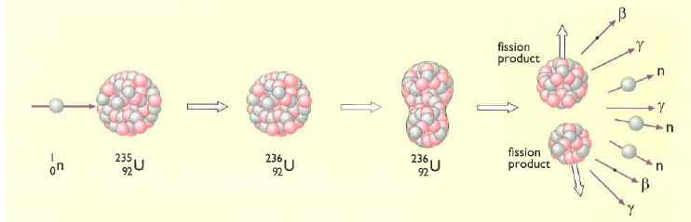
Kernspaltung
1939: (year that WWII began) Fermi realizes that fission will release free neutrons which will be able to split more atoms, releasing more neutrons → rinse, repeat
This is the nuclear chain reaction.
Slow neutron strikes U-235 & is absorbed to produce unstable U-236.
U-236 splits (=fission), due to instability & electrostatic repulsion.
Two new radioactive nuclei (& atoms) are produced, along with,
Energy!
More neutrons
Energy Systems & Sustainability, 2/e, Chapter 10

Slide 5
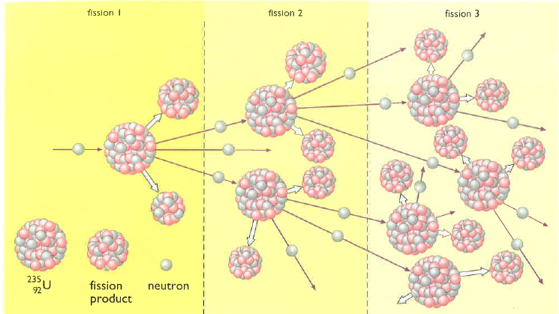
The fission chain reaction
Chain reaction: neutrons released by each fission event create new fission reactions.
Exponential amplification
Energy Systems & Sustainability, 2/e, Chapter 10

Slide 6
Fission products?
U-235 undergoes fission, producing two new nuclei.
If one is barium:
What is the other?
How many ‘surplus’ neutrons are produced?
Nucleus | # protons | # neutrons
U-235 | 92 | 143
Ba-138 | 56 | 82
Kr-86 | 36 | 50
Ba + Kr | 92 | 132
surplus |  | 11 + 1
However, the Ba & Kr produced are usually heavy isotopes, with more neutrons than average. This means that fewer of the surplus neutrons are actually free.
Generally 3-4 free neutrons are produced per fission event.
And the Ba & Kr are also radioactive, emitting β-particles.
Energy Systems & Sustainability, 2/e, Chapter 10

Slide 7
How much energy is released?
Calculations showed that, on average, fission of one atom of U-235 results in the loss of 0.21 amu.
E = (m)(amu)(931) = (1)(0.21 amu)(931) = 200 MeV [m = atoms]
E = 200 MeV = 3.2 E-11 J / atom
So how much energy would be released from fission of 1 kg of U-235?
Each atom has a mass of 235 amu.
One amu = 1.660 E-27 kg.
1 kg 1 amu 1 atom = 2.5 E24 atoms / kg U-235
1.660 E-27 kg 235 amu
(2.5 E24 atoms / kg U-235)(3.2 E-11 J / atom) = 80 E12 J / kg
= 80 TJ / kg U-235
Energy: 1 kg U-235 = 3000 tonnes of coal
Energy Systems & Sustainability, 2/e, Chapter 10

Slide 8
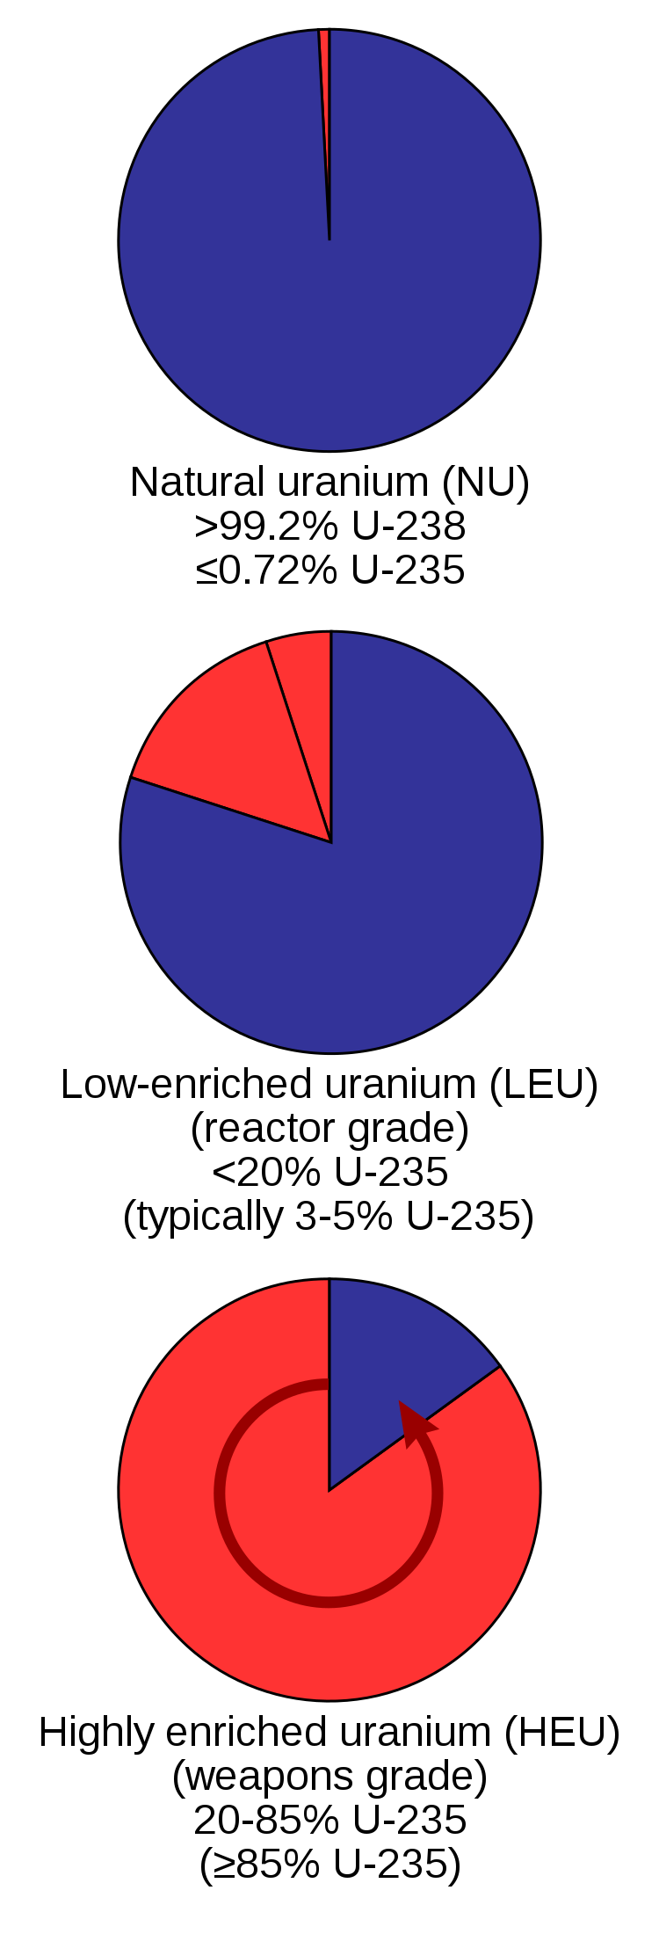
U-235 must be ‘enriched’
For every atom of U-235, uranium has 140 atoms of U-238.
If fission occurs in this unenriched uranium, U-238 will absorb most of the freed neutrons but will not undergo fission.
Chain fission won’t occur.
<1%
To make fission possible, uranium must be enriched for U-235.
Creating a critical mass of enriched uranium also helps fission to occur, as freed neutrons have a greater chance of causing another fission event when they travel through more uranium.
20%
Slowing the fast neutrons by colliding them with carbon (graphite) also increases the chance of more fusion events.
Graphite is a moderator of neutron speed.
85%
Energy Systems & Sustainability, 2/e, Chapter 10; https://en.wikipedia.org/wiki/Enriched_uranium

Slide 9
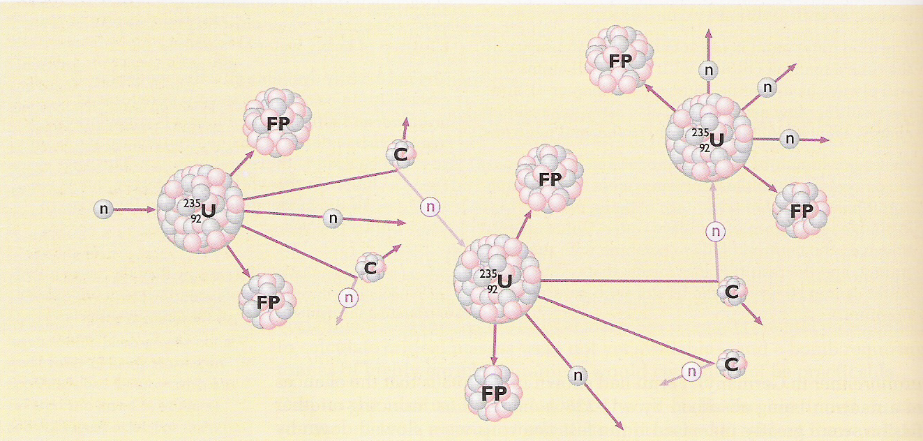
Controlling fission chain reactions
Graphite is added to the uranium; its carbon atoms don’t undergo fission.
When neutrons hit the carbon atoms they slow & the chain reaction occurs but is less amplified.
The slowed neutrons are warmed as kinetic energy is dissipated, so reactors that use moderators are called thermal fission reactors.
Energy Systems & Sustainability, 2/e, Chapter 10

Slide 10
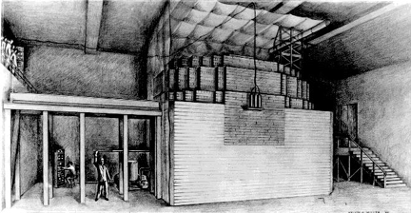
Fission, weapons & power
1941 Enrico Fermi develops a nuclear reactor (‘Fermi’s pile) at the University of Chicago
Oct 1941 US President Roosevelt commits huge resources to the development of an atomic bomb
Dec 1941 Japanese attack Pearl Harbor
1942 Fermi’s team demonstrates controlled chain reaction (fission)
1954 USSR claims the first nuclear power plant
Energy Systems & Sustainability, 2/e, Chapter 10;
http://static.newworldencyclopedia.org/c/c4/Atompile.gif
Fermi’s nuclear reactor

Slide 11
New elements produced by fission
Bombardment of natural uranium with neutrons caused β-emission converting either one or two neutrons into new protons & creating new elements:
93 neptunium
94 plutonium
the 2nd fissile element
U-239 & Np-239 have short half-lives, but Pu-239 has a longer half-life of 25,000 years & accumulates.
U-238 reactors that create Pu-239 are thus called breeder reactors.
Breeder reactors use fast (rather than slow) neutrons.
Energy Systems & Sustainability, 2/e, Chapter 10

Slide 12
Thorium breeding
Thorium (element 90) exists as the isotope Th-232:
Radioactive
Long half-life
fertile
β
β
Th-232
Pa-233
U-233
n
fissile
Energy Systems & Sustainability, 2/e, Chapter 10

Slide 13
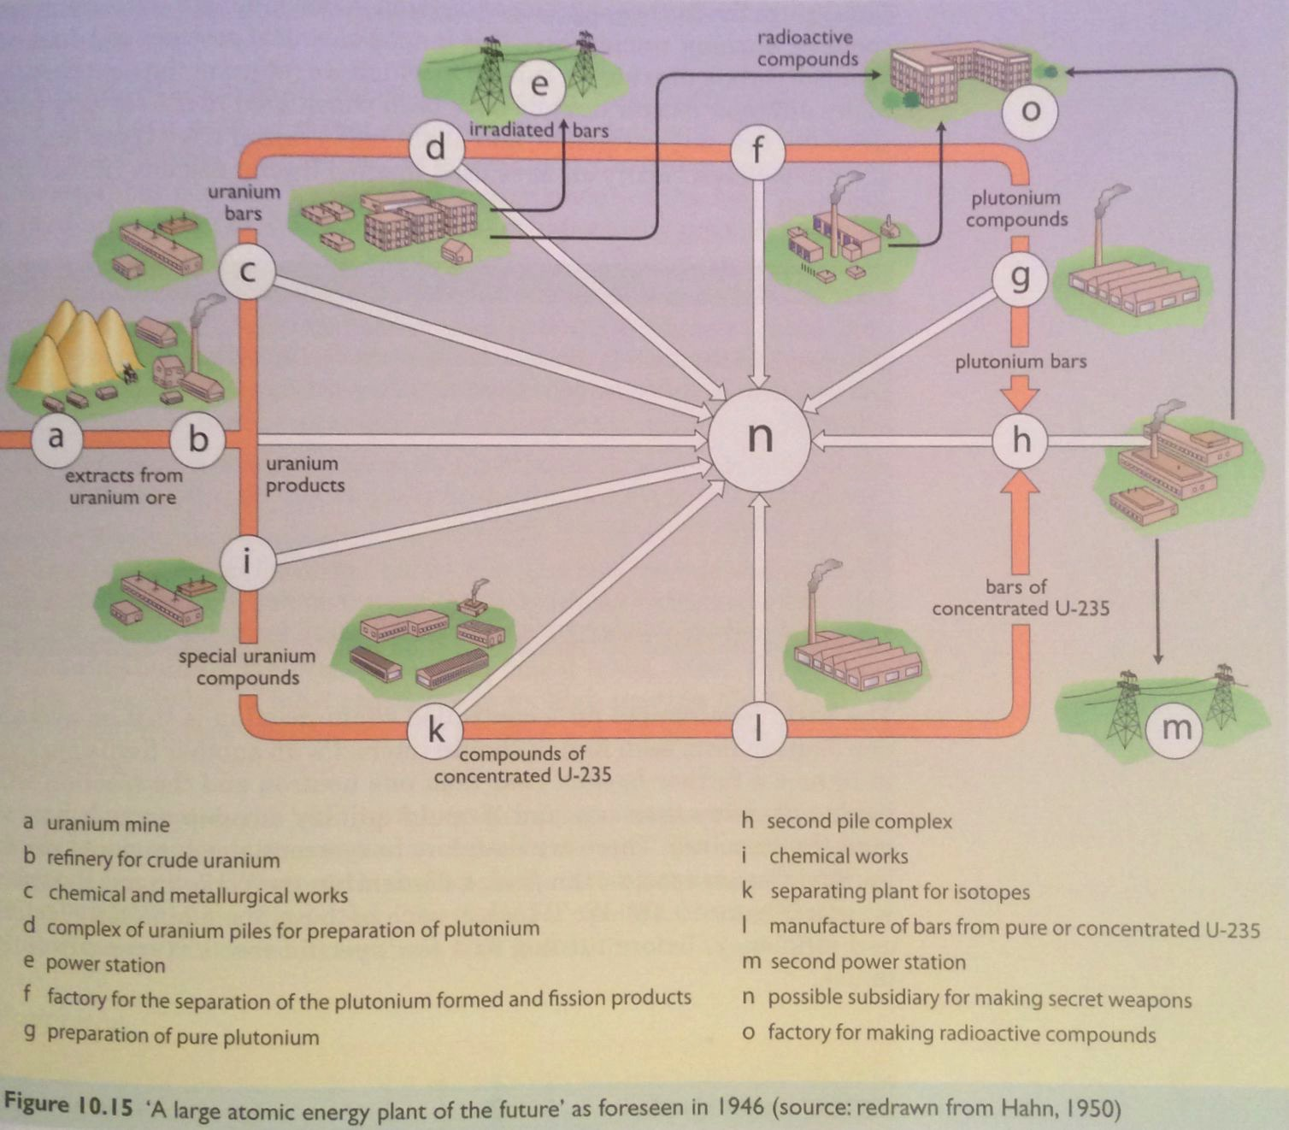
Nuclear power
All fission processes produce heat as a by-product. The heat can be used to create steam, drive stream turbines & generate electricity.
Russia: first reactor in 1954
Energy Systems & Sustainability, 2/e, Chapter 10

