Slide 1
SSC 2030: Energy Systems & Sustainability
6. Nuclear power
6.1: Nuclear power: an introduction
6.2: Nuclei: a brief summary
6.3: Radioactivity
6.4: Nuclear fission
6.5: Thermal fission reactors
6.6: Types of thermal fission reactors
6.7: Nuclear fuel cycles
6.8: Fast neutron reactors
6.9: Newer nuclear reactor designs
6.10: Nuclear power in Vermont
6.11: Power from fusion

Slide 2
6. Nuclear power
6.5: Thermal fission reactors

Slide 3
Thermal fission reactors?
Nuclear reactors don’t burn fuel, rather their uranium undergoes fission giving off heat in the process. That’s one type of thermal.
There are two basic types of nuclear reactors:
Thermal reactors use moderators like graphite to slow neutrons & allow controlled chain reactions
The slowed neutrons carry lost energy as heat.
Fast neutron reactors don’t need moderators so the neutrons aren’t ‘thermalized’.
Energy Systems & Sustainability, 2/e, Chapter 10

Slide 4
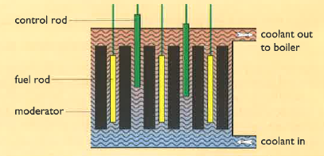
Thermal fission reactors: 4 essentials
Thermal fission reactors have four essential components:
Fuel = uranium;
Moderator, usually graphite;
Coolant to pick up and transfer heat; &
Control system.
Energy Systems & Sustainability, 2/e, Chapter 10

Slide 5
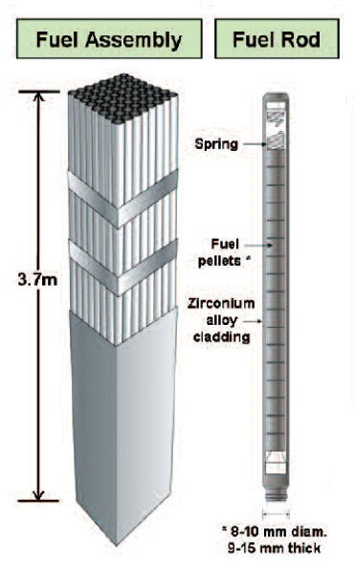
Fuel rods
Early nuclear plants used natural uranium, but recent plants use enriched uranium with 2-5% U-235.
Plutonium produced in breeder plants can be reprocessed & used as fuel.
Thorium can also be used as fuel.
Uranium oxide (UO₂) is a hard ceramic that can be formed into pellets.
Pellets are held in metal tubes.
The metal must not absorb neutrons.
Fuel rods are replaced every 12-18 months.
100 tonnes of fuel per reactor:
2-3 GW of heat
600 – 1000 MW of electricity
Energy Systems & Sustainability, 2/e, Chapter 10;
https://i.pinimg.com/originals/ae/a7/02/aea702d2b7bfdf48ae724853261c2456.jpg

Slide 6
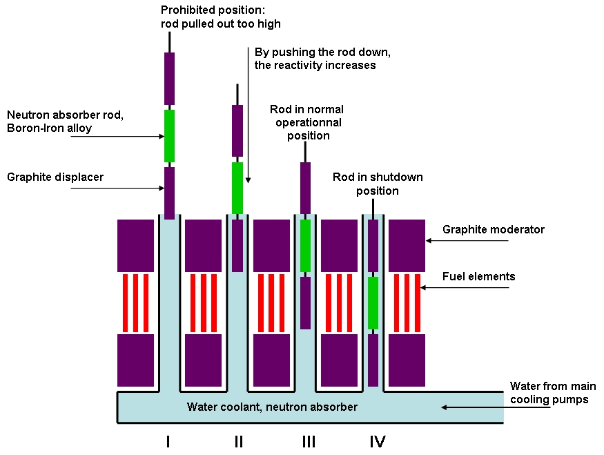
Moderator
Three types of moderator are common:
Light water (H₂O)
Heavy water (D2O)
Graphite (a form of carbon)
Remember that moderators are needed for fission to happen.
Energy Systems & Sustainability, 2/e, Chapter 10;
http://consumedland.com/images/Control%20Rods_en.jpg

Slide 7
Coolants & control systems
Coolants absorb heat released by decaying fuel pellets & carry the heat to the steam generator.
Liquid moderators like light & heavy water can also act as the coolant.
Gas coolants like carbon dioxide can also be used.
Control rods are made of material that absorbs freed neutrons & slow or stop fission from continuing.
Good neutron absorbers:
Cadmium
Boron
When control rods are inserted between fuel rods fission is dampened or stopped.
Energy Systems & Sustainability, 2/e, Chapter 10

Slide 8
Nuclear plant safety
Design of a nuclear plant must store & use fuel at the correct densities & must have a robust coolant system that will continue to function under the most adverse circumstances.
Lack of cooling can cause the fuel in the reactor core to meltdown.
Shielding is needed to protect operators from radiation in the core.
1E12 times the safe limit.
Safe distance without shielding would be 8 km.
Concrete & steel both absorb gamma radiation.
Containment is needed deal with high pressure & radioactive gases produced in the plant.
Energy Systems & Sustainability, 2/e, Chapter 10

Slide 9
Accidents
Most accidents result from loss of control of the nuclear chain reaction resulting in too much heat.
Water used as moderator or coolant can be turned to steam, react with the zirconium alloy fuel rods & produce explosive hydrogen gas.
Loss of cooling is a problem even if the fusion chain reaction is stopped because the fuel will continue to decay & produce heat. This can melt the fuel which can then escape containment.
Three Mile Island (1979, PA)
Fukushima (2011, Japan)
Loss of control would allow a runaway fission chain reaction.
Chernobyl (1986, Ukraine)
Passive response cause plants to safely shutdown if power or coolant systems failed.
Shutdown would be triggered without operator action.
Energy Systems & Sustainability, 2/e, Chapter 10

