Slide 1
SSC 2030: Energy Systems & Sustainability
6. Nuclear power
6.1: Nuclear power: an introduction
6.2: Nuclei: a brief summary
6.3: Radioactivity
6.4: Nuclear fission
6.5: Thermal fission reactors
6.6: Types of thermal fission reactors
6.7: Nuclear fuel cycles
6.8: Fast neutron reactors
6.9: Newer nuclear reactor designs
6.10: Nuclear power in Vermont
6.11: Power from fusion

Slide 2
6. Nuclear power
6.6: Types of thermal fission reactors

Slide 3
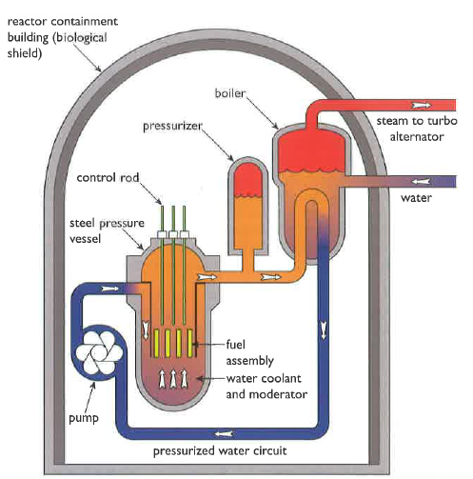
Light water pressurized water reactor
Most nuclear plants are pressurized water reactors (PWRs) developed in the US, or water-water-energy-reactors (VVER) from Russia.
Core:
100 fuel assemblies
Each 100s of UO₂ fuel rods
Water coolant/moderator flows through fuel at high pressure
Boiler:
Heated water (300°C) is pressurized to 100 atm to ensure that it remains liquid & can work as coolant.
Heat exchange in the boiler produces steam for electric generation.
Containment & safety:
Pressure vessel
Emergency coolant system
Energy Systems & Sustainability, 2/e, Chapter 10

Slide 4
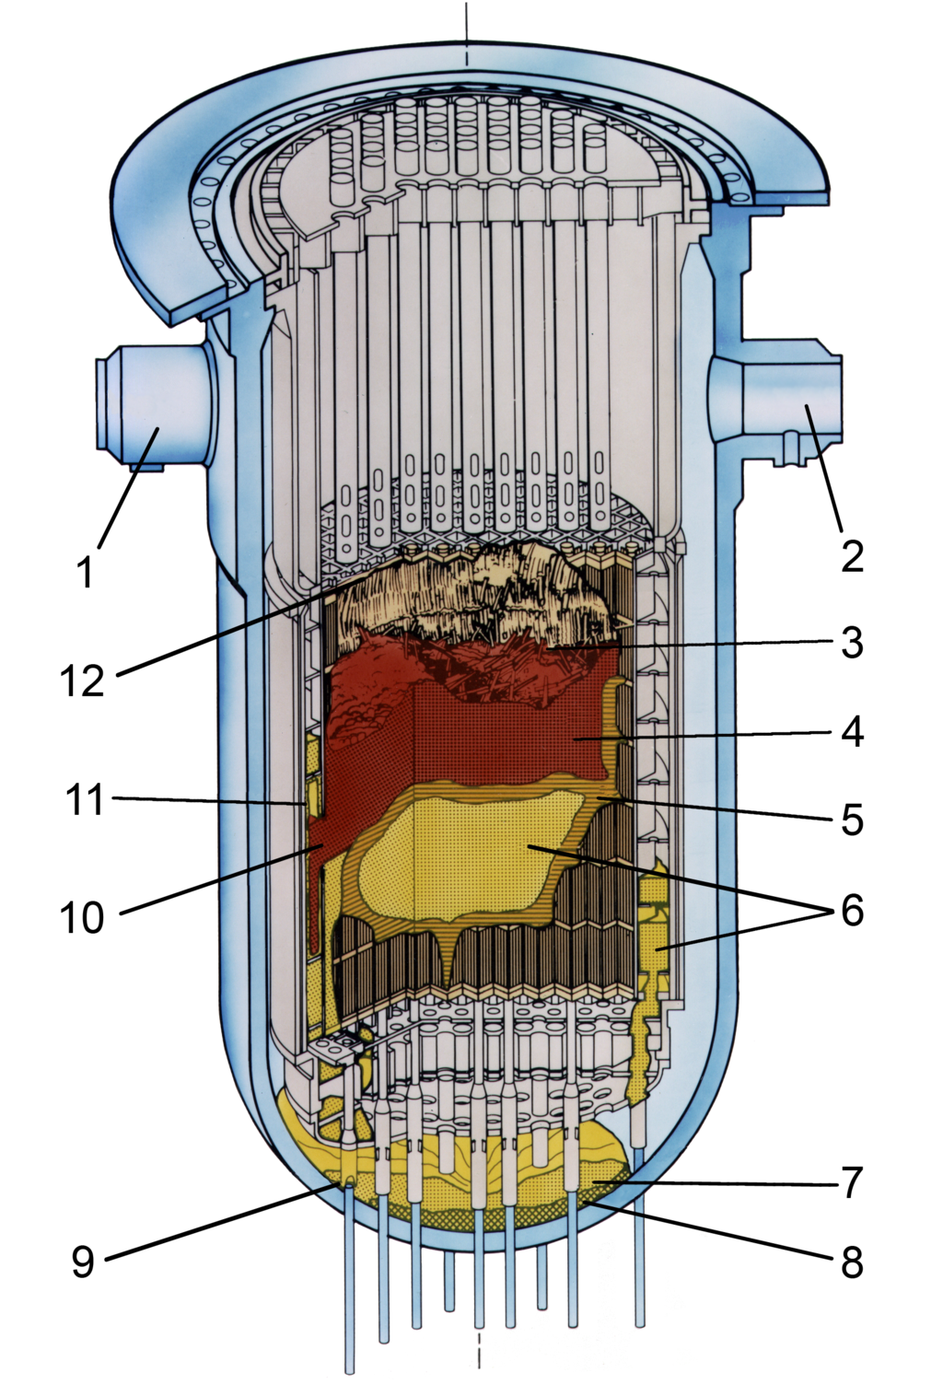
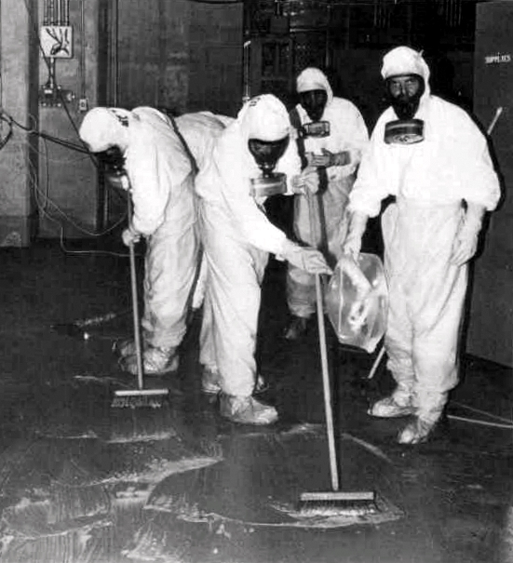
Failure: Three Mile Island (PA)
28 March 1979
A water pump in the cooling system failed (jammed valve) allowing coolant to escape. Operators were confused.
The reactor overheated.
A small amount of radioactive material was released into the atmosphere.
No immediate or anticipated health effects.
Small but not statistically signficant increase in cancer.
Energy Systems & Sustainability, 2/e, Chapter 10
https://en.wikipedia.org/wiki/Three_Mile_Island_accident

Slide 5
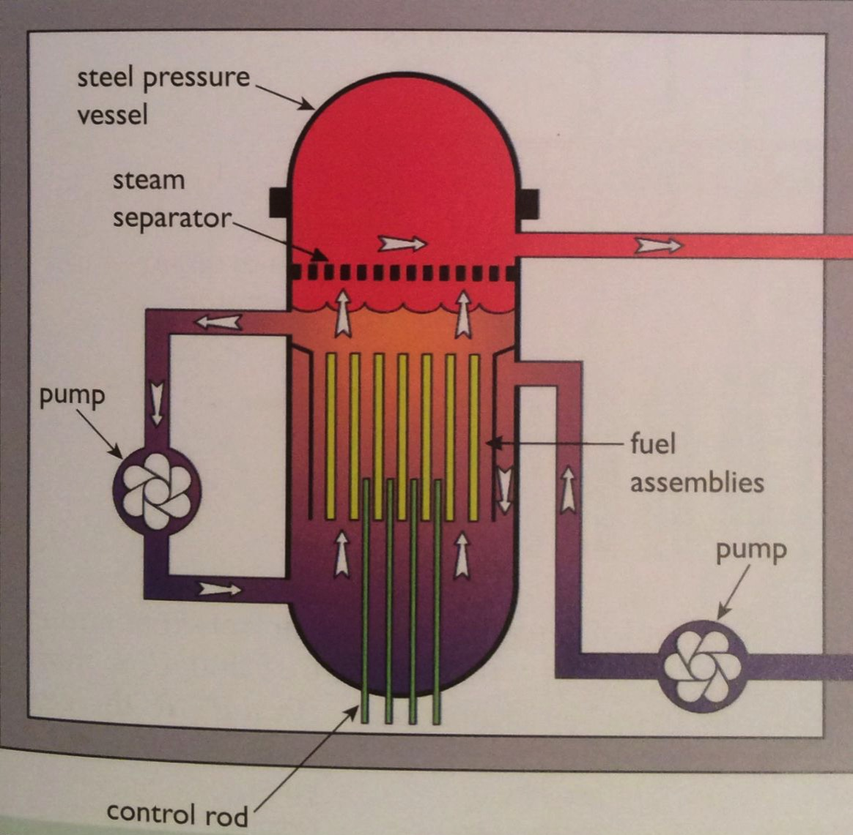
Light water boiling water reactor
Boiling water reactors (BWRs) developed in the US are next most common. Fukushima has BWRs.
Similar to PWR, except:
The water that flows through the fuel rods is allowed to boil to steam which is then used in the turbines.
Turbines are exposed to radioactivity.
Lower cost.
Energy Systems & Sustainability, 2/e, Chapter 10

Slide 6
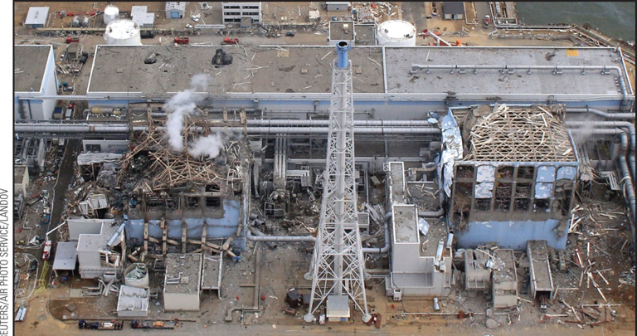
Failure: Fukushima (Japan)
11 March 2011
The plants electrical infrastructure was damaged by a tsunami.
Loss of coolant caused reactors to overheat, leading to explosions.
Radioactive material was released.
Estimated at 10-20% as much as at Chernobyl.
Long-term health effects have yet to be determined.
The site is closed.
Engineers are freezing ground- water to prevent it from running into the sea; not totally successful.
Energy Systems & Sustainability, 2/e, Chapter 10

Slide 7
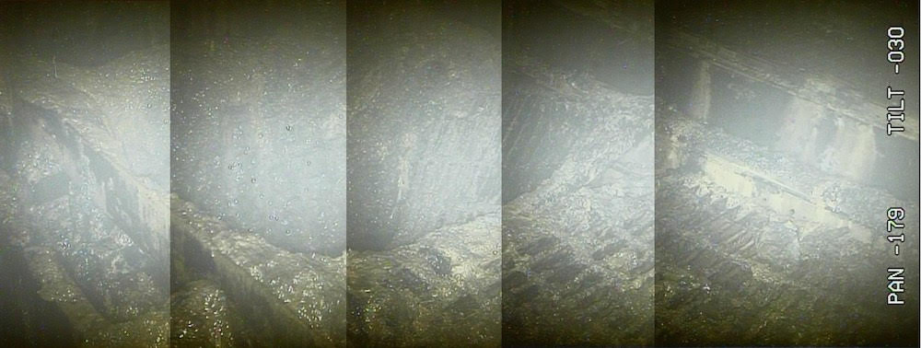
Failure: Fukushima (Japan)
Recently, TEPCO has sent robots into one of the Fukushima nuclear plants to assess damage and assess the possibility of cleanup.
High radiation levels have ‘fried’ the robots as quickly as 30’.
This image shows a hole in the floor of the reactor; may have been caused by meltdown of fuel.
Radiation levels are 210 SV/hour: fatal to humans within minutes.
Cleanup is expected to continue for at least 40 years.
https://voices.nationalgeographic.org/2017/02/22/after-alarmingly-high-radiation-levels-detected-what-are-the-facts-in-fukushima/

Slide 8
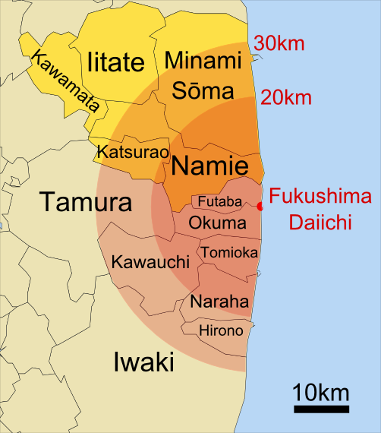
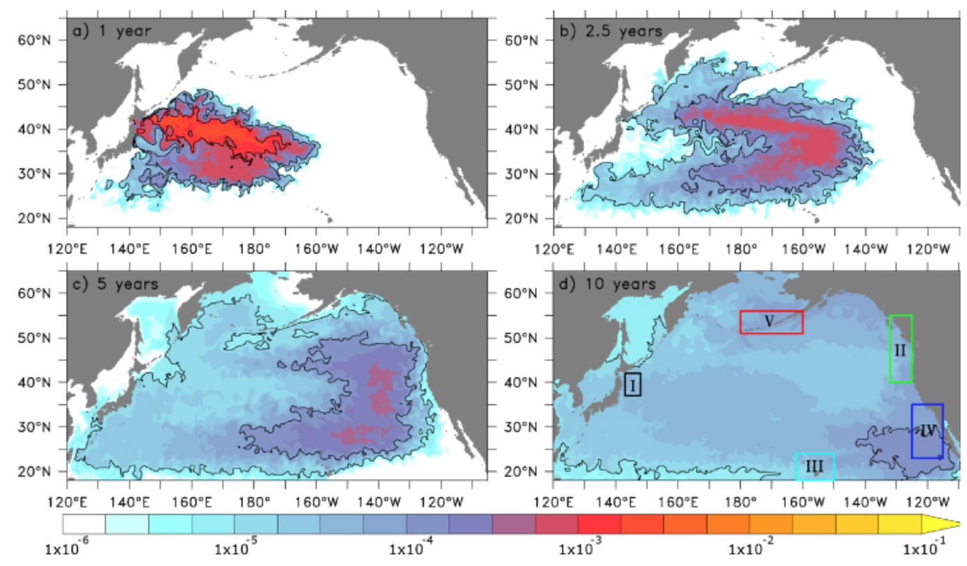
Extent of release
70,000 residents were evacuated
Most will be permanently resettled.
5-year modeling for movement of radio- active contamination.
Arrived WA, USA at end of 2016.
http://iopscience.iop.org/article/10.1088/1748-9326/7/3/034004; wikpedia

Slide 9
Gas-cooled reactors
Gas-cooled reactors were developed in the UK to use natural uranium.
Magnox reactors:
Graphite moderator
Carbon dioxide gas cooling
Magnesium alloy clad fuel rods
30% electric production efficiency
Core:
Solid graphite with vertical slots for fuel & control rods.
CO₂ coolant is pumped through the core at 40 atm.
Heat exchangers create steam for turbine.
Heavy concrete containment for cooling gas.
Energy Systems & Sustainability, 2/e, Chapter 10

Slide 10
Heavy water reactors
Canadian-deuterium-uranium (CANDU) reactors next most common (20).
Heavy water moderator & coolant at 300°C.
Coolant & moderator are separated.
Low thermal efficiency, but able to use a variety of fuels, including spent PWR fuels & surplus weapons-grade plutonium.
Now called pressurized heavy water reactors.
Energy Systems & Sustainability, 2/e, Chapter 10

Slide 11
RBMK reactors
High power channel-type reactor (RBMK) was developed in Russia.
Graphite moderator
Light water coolant.
Energy Systems & Sustainability, 2/e, Chapter 10
Chernobyl used this design.
None are being built but about a dozen are still operating.

Slide 12
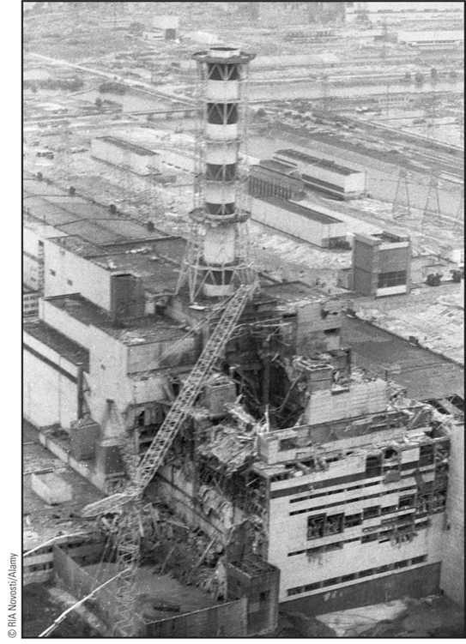
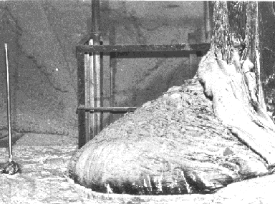
Failure: Chernobyl (Ukraine, USSR)
25 April 1986
The reactor became unstable as a result of tests run by the operators.
Overheating caused water to decompose, releasing hydrogen gas which then exploded.
The reactor core caught fire and melted.
Plumes of radioactivity spread across Europe.
The site 30 km in diameter is still closed & will be for 20,000 years.
https://en.wikipedia.org/wiki/Chernobyl_disaster

Slide 13
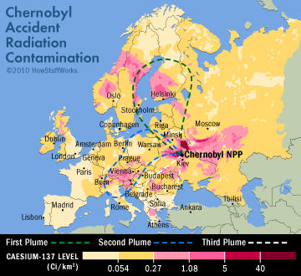
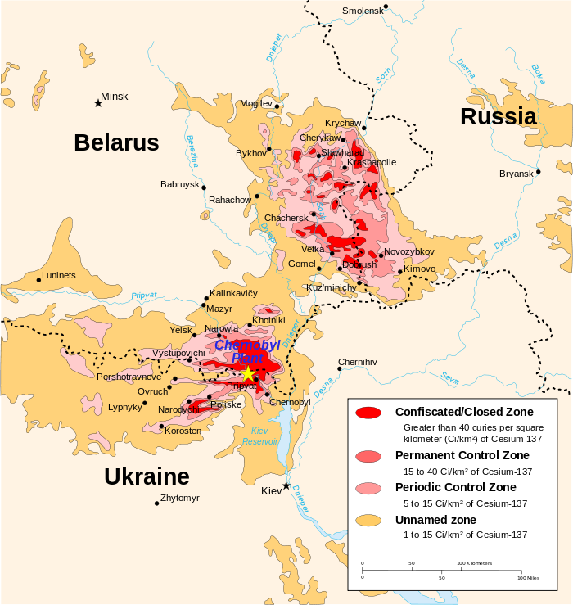
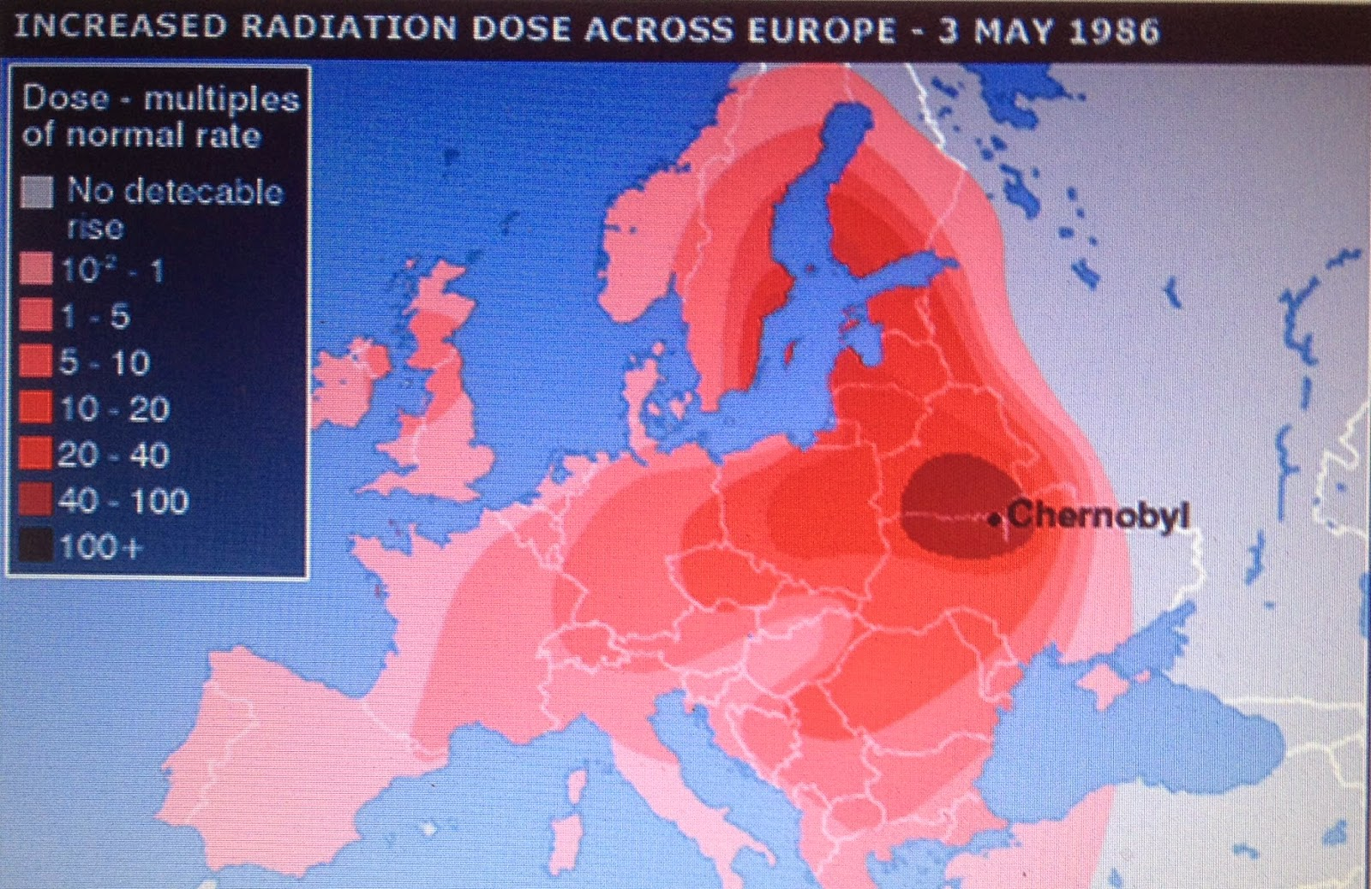
Extent of release
Wikipedia & BBC

