Slide 1
SSC 2030: Energy Systems & Sustainability
6. Nuclear power
6.1: Nuclear power: an introduction
6.2: Nuclei: a brief summary
6.3: Radioactivity
6.4: Nuclear fission
6.5: Thermal fission reactors
6.6: Types of thermal fission reactors
6.7: Nuclear fuel cycles
6.8: Fast neutron reactors
6.9: Newer nuclear reactor designs
6.10: Nuclear power in Vermont
6.11: Power from fusion

Slide 2
6. Nuclear power
6.7: Nuclear fuel cycles

Slide 3
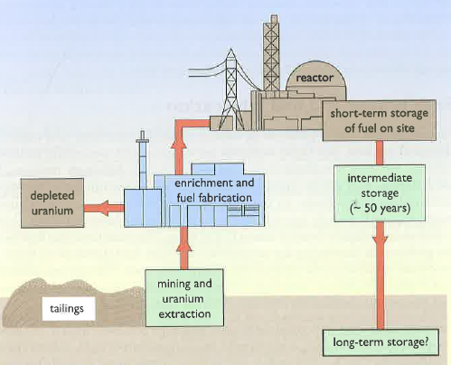
Nuclear fuel cycle
To assess nuclear power we must examine the entire nuclear fuel cycle.
Mining & extraction
Enrichment & fabrication
Reaction
Dealing with spent fuel.
Energy Systems & Sustainability, 2/e, Chapter 10

Slide 4
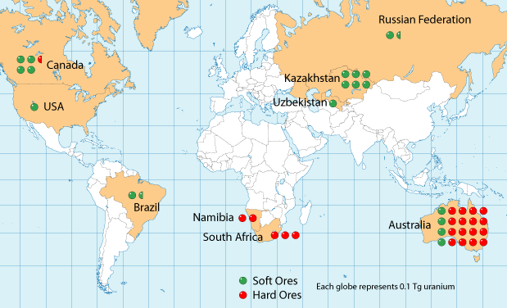
Uranium reserves
Global distribution of uranium reserves is pretty widespread.
Energy Systems & Sustainability, 2/e, Chapter 10;
watd.wuthering-heights.co.uk

Slide 5
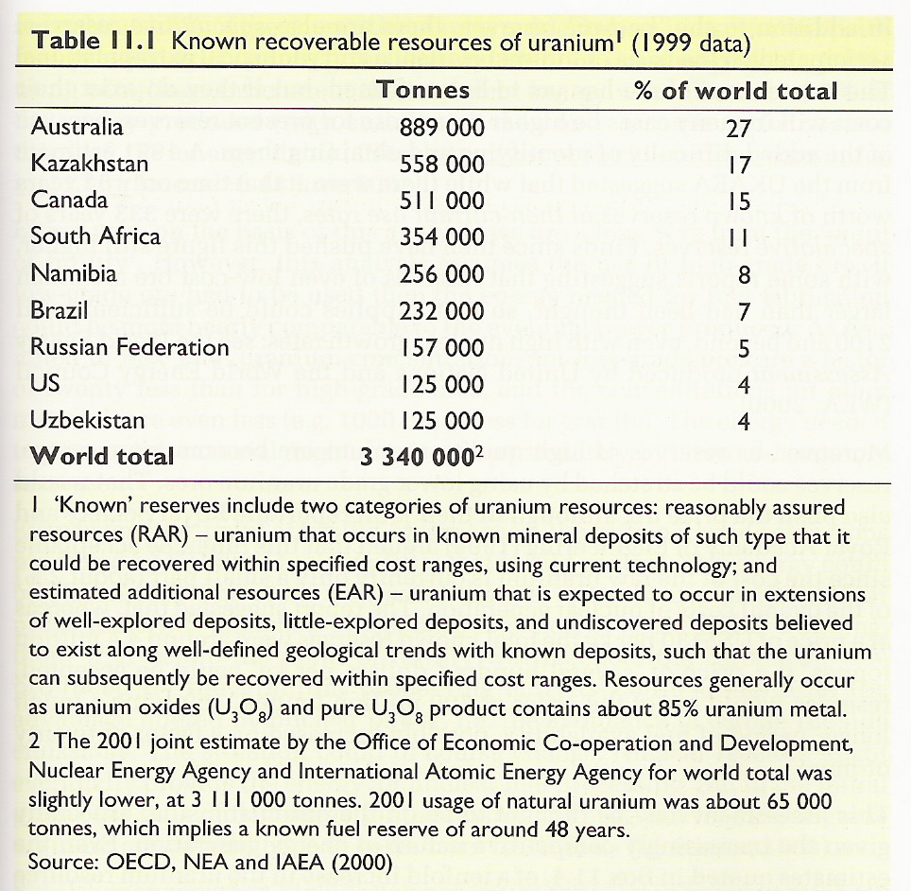
Uranium reserves quantified
Known global recoverable reserves.
Energy Systems & Sustainability, 2/e, Chapter 10

Slide 6
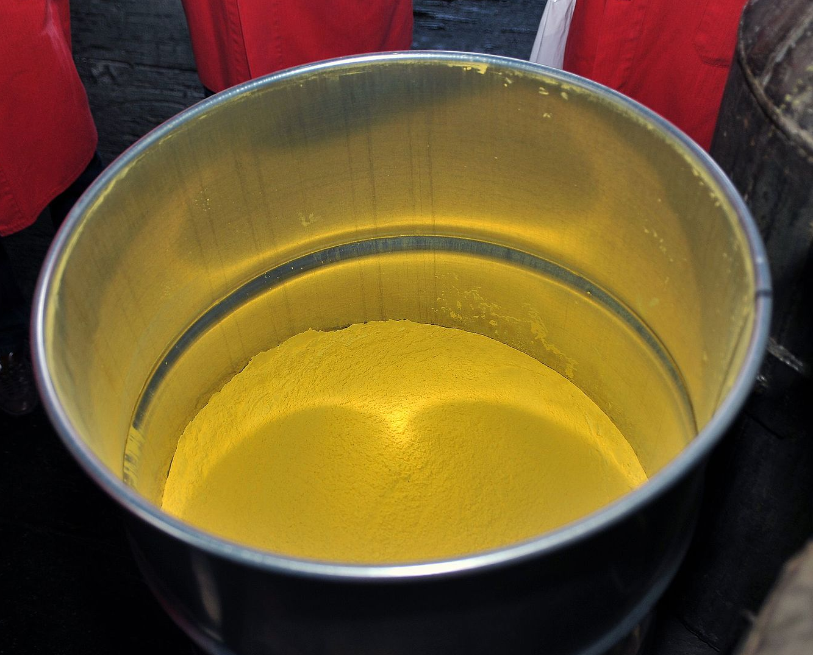
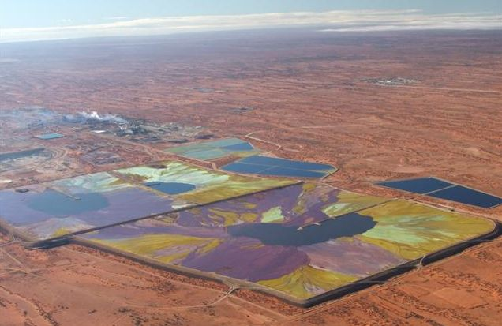
Uranium mining & extraction
Uranium ore is a mixture of uranium oxides, U₃O₈.
High-grad ore: a few percent
Low-grade ore: one part per thousand
Processed U₃O₈ is a yellow powder called yellowcake.
Yellowcake
Tailings, the material remaining after extraction of uranium from ore, is radioactive & must be stored to avoid impacting human health.
Uranium tailings ponds
Energy Systems & Sustainability, 2/e, Chapter 10

Slide 7
Uranium enrichment & fabrication
The only difference between the U-235 & U-238 isotopes is mass.
Gas diffusion:
Uranium oxide (U₃O₈) is converted to uranium hexafluoride (UF₆).
Becomes a gas when heated a bit.
Lighter isotope diffuses through a membrane faster.
1000X diffusion increases U-235 by 3-4%.
Gas centrifuge:
Uranium oxide (U₃O₈) is converted to uranium hexafluoride (UF₆).
Becomes a gas when heated a bit.
Spun at very high speed in gas centrifuges.
Multiple spins required to separate isotopes, but 50X more energy efficient than gas diffusion.
In either case, enrichment leaves large amounts (nearly all the starting material) that is depleted in U-235. This material is called depleted uranium and must be stored for future use. It’s still radioactive.
Its high density has caused some to be used in artillery.
Energy Systems & Sustainability, 2/e, Chapter 10

Slide 8
Nuclear fuel assembly
Pellets fill rods or pins.
Many pins create an assembly.
The core is a group of assemblies with space for coolant to circulate between them.
Energy Systems & Sustainability, 2/e, Chapter 10

Slide 9
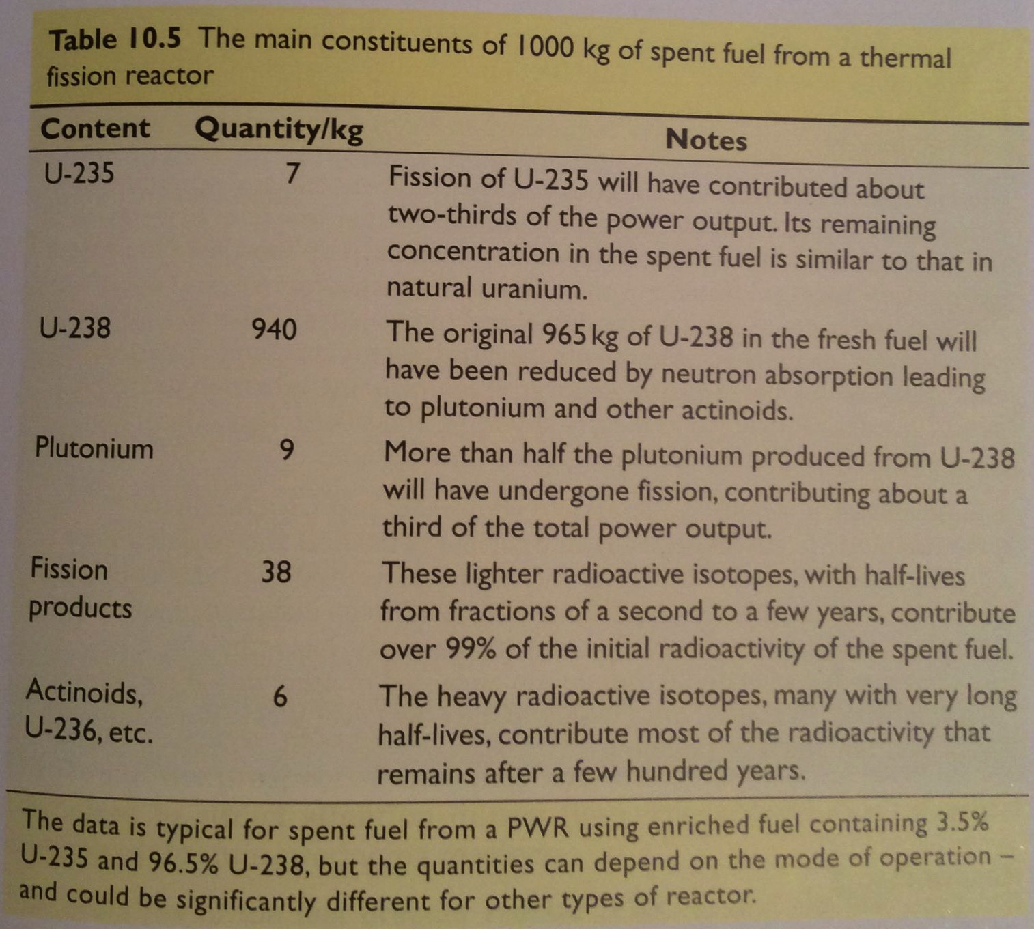
Spent fuel
As fission proceeds in fuel rods, fission products & actinoids build up & ‘poison’ the fuel because they lower heat output.
Typically, a fuel assembly functions for 3 years.
About 1/3 of assemblies are replaced each year.
Energy Systems & Sustainability, 2/e, Chapter 10

Slide 10
Spent fuel storage & disposal
Spent fuel is highly radioactive & is therefore stored in pools of water with active cooling systems for at least a year.
At Fukushima spent fuel cooling systems failed, causing fuel to heat, produce hydrogen gas, explode and burn.
Direct disposal: leaves spent fuel assemblies in pools for 40-50 years.
** Needs tens of thousands of years of stable, safe storage.**
Reprocessing: extracts remaining & new fissile elements for reuse.
5 years in cooling tanks.
Chemical separation of uranium, plutonium & waste.
Energy Systems & Sustainability, 2/e, Chapter 10

Slide 11
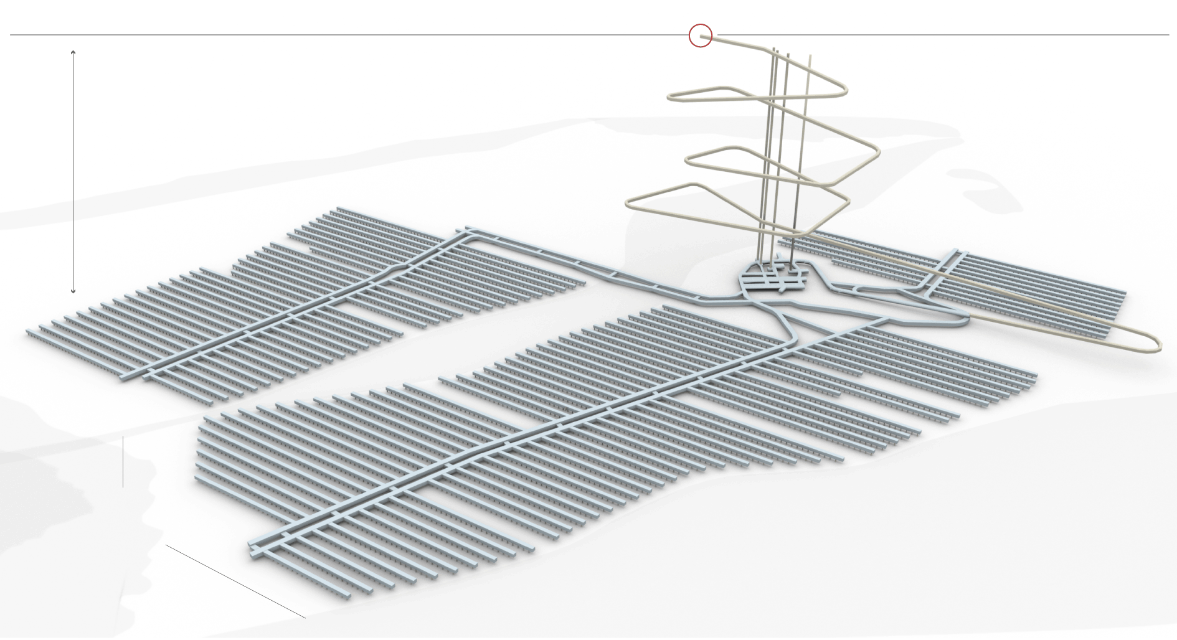
Finland: long-term nuclear storage leader
Finland is the world leader in long-term nuclear storage.
They have a plan & are in the 10-year construction phase; $3.9 b.
1,400-feet deep within granite bedrock, back-filled with clay.
Worked hard at community relations.
Energy Systems & Sustainability, 2/e, Chapter 10;
https://www.nytimes.com/2017/06/09/science/nuclear-reactor-waste-finland.html

Slide 12
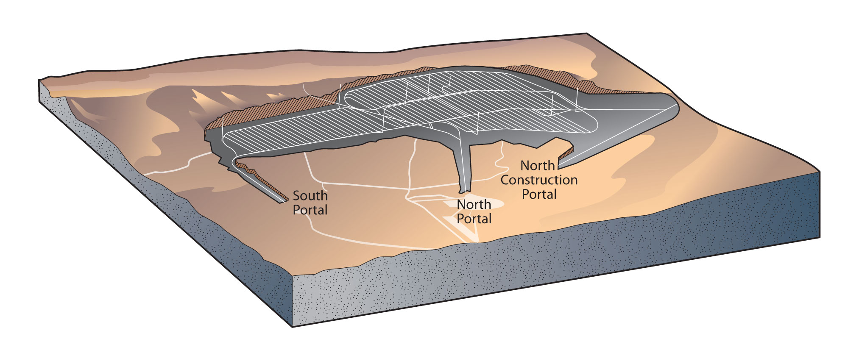
Yucca Mountain ?
The US has been debating plans to bury our nuclear waste below Yucca Mountain Nevada.
Funding for research about the site and planning ceased in 2011.
As of 2015, the US had 70,000 metric tonnes of waste to store.
Pros:
The US really needs a storage site.
Yucca Mountain is in a nuclear test area; already involved.
Yucca Mountain has been extensively studied by geologists.
Cons:
Yucca Mountain was formed by volcanic activity.
It’s volcanic tuff is fractured and sits above an aquifer.
Nevada has significant seismic activity; 4th in the US.
The Bow Ridge fault line is closer to Yucca Mountain than previously thought.
Energy Systems & Sustainability, 2/e, Chapter 10;
https://en.wikipedia.org/wiki/Yucca_Mountain_nuclear_waste_repository

Slide 13
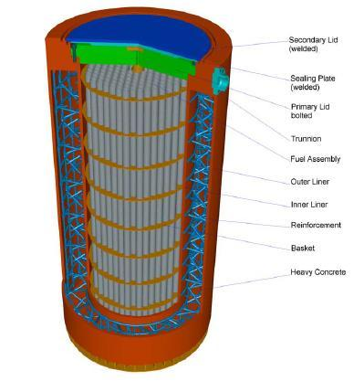
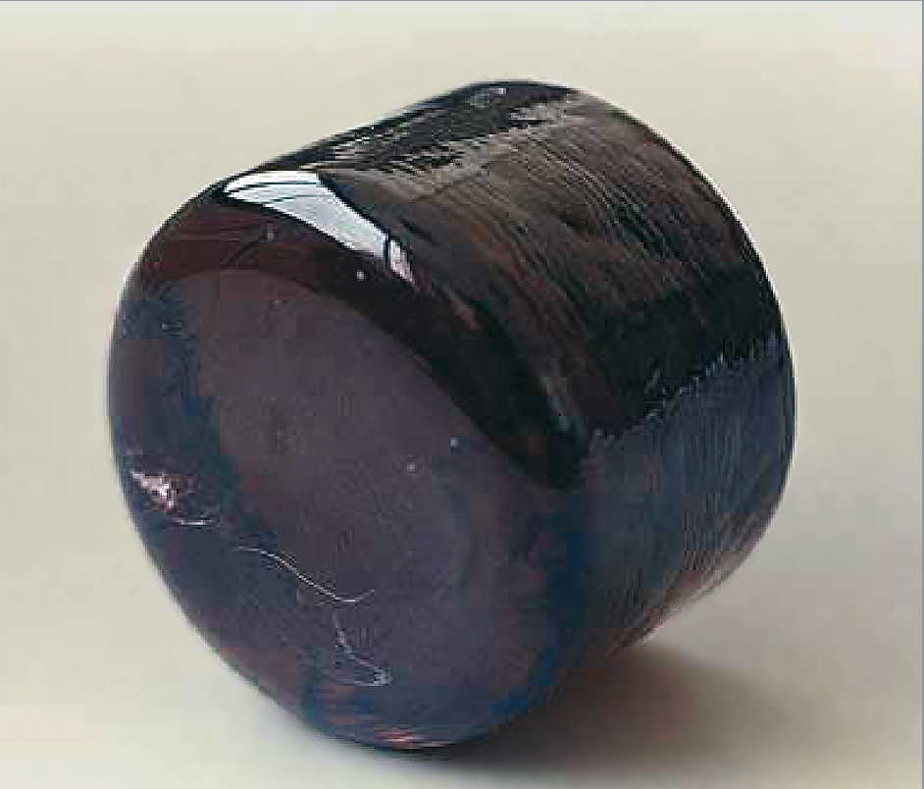
Current ‘long-term storage’ in the US
Without an underground storage facility – or the prospect of one in the near future – high level nuclear waste is stored in two ways.
Dry cask storage: sealed steel & concrete containers.
2009: 22% of US commercial waste.
1990s: repeated problems with bad welds
Vitrification: nuclear waste is melted with glass-forming chemicals to form a stable obsidian-like glass.
Stable & doesn’t leach.
Synroc: nuclear waste is mixed with elements to form a crystalline powder & compressed into a ceramic.
Energy Systems & Sustainability, 2/e, Chapter 10;
https://en.wikipedia.org/wiki/Yucca_Mountain_nuclear_waste_repository
https://en.wikipedia.org/wiki/Vitrification
https://en.wikipedia.org/wiki/Synroc

Slide 14
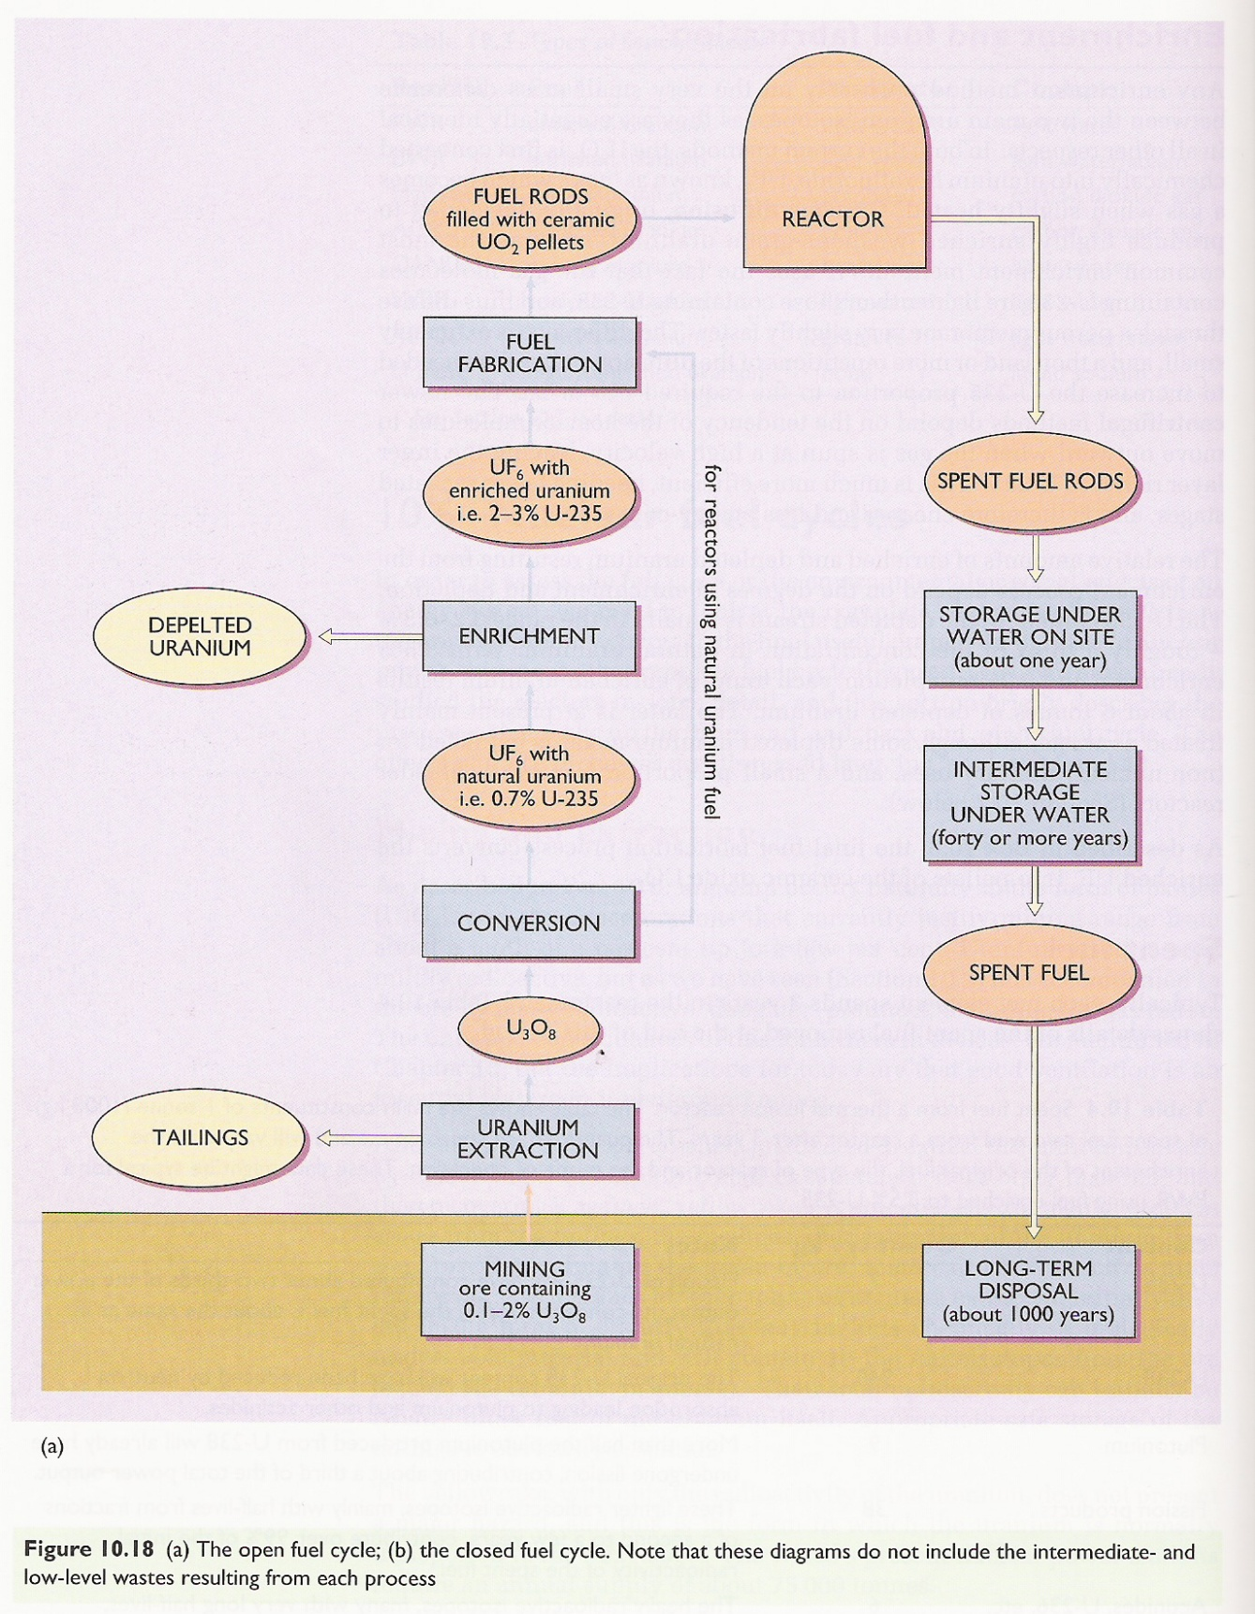
Summary of the nuclear fuel cycle
Energy Systems & Sustainability, 2/e, Chapter 10

