Slide 1
SSC 2030: Energy Systems & Sustainability
6. Nuclear power
6.1: Nuclear power: an introduction
6.2: Nuclei: a brief summary
6.3: Radioactivity
6.4: Nuclear fission
6.5: Thermal fission reactors
6.6: Types of thermal fission reactors
6.7: Nuclear fuel cycles
6.8: Fast neutron reactors
6.9: Newer nuclear reactor designs
6.10: Nuclear power in Vermont
6.11: Power from fusion

Slide 2
6. Nuclear power
6.8: Fast neutron reactor

Slide 3
Fast neutron reactors
Fast neutron reactors (FNR):
Don’t use moderators to slow down neutrons. But fast neutron are less efficient at causing fission reactions.
Therefore, FNRs must use fuel which has greater enrichment for fissile elements, 10 – 30% vs. 2 - 5%.
FNRs are much less common than reactors that use moderators.
Fast breeder reactors (FBR) are a form of FNR that are operated to create plutonium or other novel fissile elements.
Reactors designed to use up fissile elements are sometimes called burners.
Energy Systems & Sustainability, 2/e, Chapter 10

Slide 4
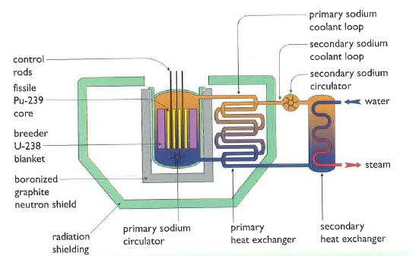
Liquid metal fast breeder reactors
All FBRs generate more heat, so cooling is a bigger concern.
The fission core of LMFB reactors is surrounded by a ‘blanket’ of U-238 in which ‘breeding’ occurs.
Liquid sodium coolant circulates through the system and transfers heat to create steam.
Sodium is neither a moderator nor an absorber.
Safety concerns?
Concentrated fuel could runaway.
Reprocessing is needed & is hazardous.
Pu can be used for weapons.
Energy Systems & Sustainability, 2/e, Chapter 10

