Slide 1
6. Nuclear power
6.X: Nuclear power in France

Slide 2
Nuclear power in France
The oil shocks (or oil crisis) of the early 1970s hit France especially hard because most of its electricity was generated with oil.
With no fossil fuel resources of their own, the French saw nuclear as their only way to energy independence.
Over the next 15 years France built 56 nuclear plants.
Electricity is now an export.
2017: 38 TWh exported
Consistency and scale:
All 56 plants are based on a Westinghouse design for pressureized water reactors.
Standard design lowered price of construction.
Lessons learned are applied across the fleet = ‘return of experience’.
http://www.pbs.org/wgbh//pages/frontline///////shows/reaction/readings/french.html

Slide 3
Why did France adopt nuclear power?
France is more reliant than any other country on nuclear power.
58 reactors supply 76% of electricity
Why?
A 1997 Frontline report by PBS identified four reasons:
1. "no oil, no gas, no coal, no choice."
2. Culture: large, centrally managed technological programs are the norm in France
High-speed trains
Supersonic jets (the Concorde)
3. Trust and respect for scientist, engineers and technical administrators
4. They sold it: PR, tours, jobs, pride, openness
The French do have nuclear fears, but the government has worked to overcome them.
http://www.pbs.org/wgbh//pages/frontline///////shows/reaction/readings/french.html

Slide 4
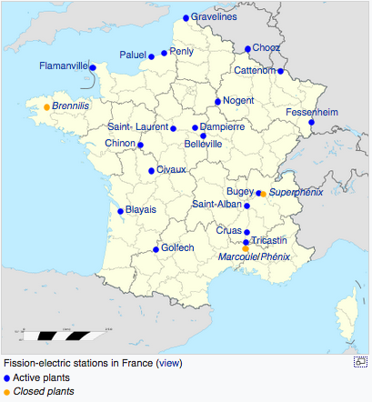
Nuclear plant locations
https://en.wikipedia.org/wiki/Nuclear_power_in_France

Slide 5
Government owned and managed
Messmer plan (1974) build a fleet of 80 nuclear plants by 1985, expanding to 170 plants by 2000.
No parliamentary or public approval
"In France, we do not have oil, but we have ideas."
Electricite de France (EDF) owns most shares and manages France‘s nuclear power system.
Typically in debt
Decommissioning is underfunded
French electricity is 12th least expensive in the EU (mid-level)
Baseload and peaking nuclear power:
Because nuclear supplies nearly all of France’s electricity some plants provide baseload power and others provide peaking power.
And France uses a great deal of electrical heating, so weather affects demand.
https://en.wikipedia.org/wiki/Nuclear_power_in_France

Slide 6
Reactor design
All French plants are now PWR (pressurized water reactors).
900 MWe
34 plants built in 1970s – 1980s
All given 10-year extension in 2002
1300 MWe
20 plants
1500 MWe
2 plants built 1984 - 1991
Heat loops rebuilt before operation 2000 - 2002
1650 MWe (EPR plants)
Planned new generation of plants designed in collaboration with others.
None completed yet. Significant cost overruns and redesigns
https://en.wikipedia.org/wiki/Nuclear_power_in_France

Slide 7
Cooling and GCC
Five plants are located on the ocean but the rest are cooled by river water.
Operational regulations set strict limits on acceptable water temperature.
Recent heat waves have shut down nuclear plants because water temperatures have risen above limits.
https://en.wikipedia.org/wiki/Nuclear_power_in_France

Slide 8
Fuel cycle
The French nuclear fleet recycles or reprocesses spent fuel while most other countries using nuclear power don’t.
France has also reprocessed fuel for the US and Japan.
France doesn’t mine uranium, but does control uranium resources in other countries like Canada, central Asia, Africa.
https://en.wikipedia.org/wiki/Nuclear_power_in_France

Slide 9
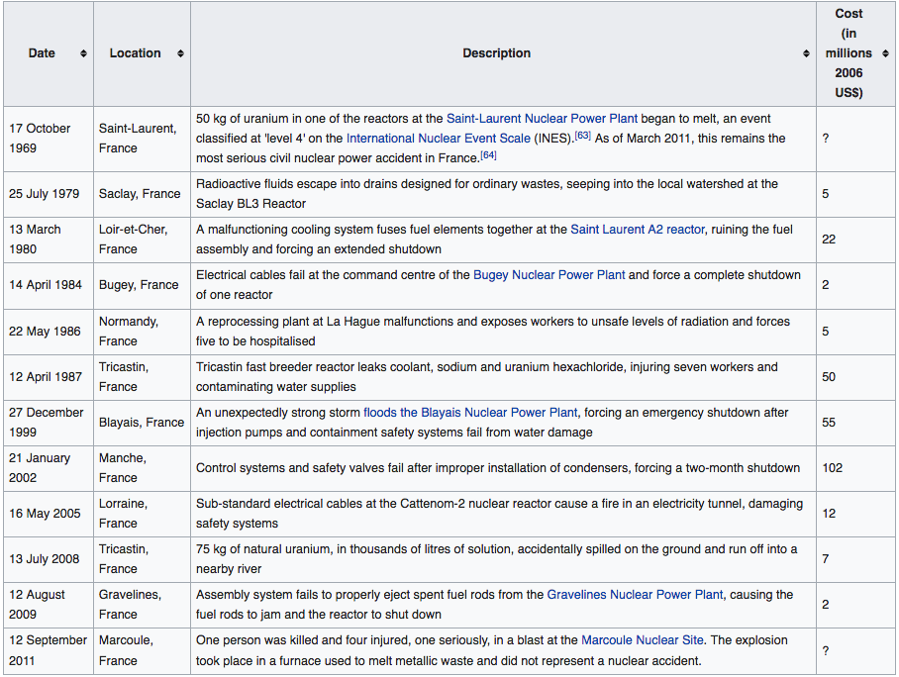
Accidents?
Yes! There have been a dozen accidents at nuclear power plants in France.
https://en.wikipedia.org/wiki/Nuclear_power_in_France

Slide 10
The problem of nuclear waste
When it came time to dispose of waste, the French public objected to burying it in their backyards.
In fact, French plants recycle much of their waste, excluding plutonium.
A change of approach to describe waste storage as ‘underground stocking’ of fuel and to propose establishment of labs dedicated to fuel recycling at four cites around France seems likely to be more successful.
However, the problem hasn’t been definitively solved.
The costs of decommissioning a fleet of plants within several decades will be massive and funding is thought to be insufficient.
http://www.pbs.org/wgbh//pages/frontline///////shows/reaction/readings/french.html

Slide 11
Fukushima?
2006: Autorité de sûreté nucléaire (ASN) was created as the independent French nuclear safety regulator.
2012: ASN report suggested safety and cooling upgrades at all French reactors.
Addition layers of safety to be built at all reactors
Elite deployment force to deal with accidents
Public opinion? Support for nuclear has dropped
30% in favor
40% hesitant
17% against
2012: Sarkozy extended the life of existing nuclear plants beyond 40
years
Upgrades planned
Electricity costs forecast to rise 10-30%
https://en.wikipedia.org/wiki/Nuclear_power_in_France

Slide 12
Future? Less nuclear in France
2015: National Assembly voted to reduce nuclear electricity to 50% by 2025
2017: Environment minister rolled this date back to 2030 - 2035
2016: Discovery that steel fittings created by Le Creusot Forge for nuclear plants across France had potential defects and weak
points
There had been a coverup
Checks shut down reactors in rolling waves
This problem may prevent plant life extension
2018: Macron rolled back the 50% date to 2035
14 of the 900 MWe reactors will close
2021: Decision about building new nuclear will be made
https://en.wikipedia.org/wiki/Nuclear_power_in_France

Slide 13
My nuclear power ‘take-homes’
Pros:
Hard to see how we will lower carbon emissions quickly without nuclear, particularly since asking people to change behavior is tough.
Overall safety record could be worse.
Cons:
Nuclear power is hard to disconnect from nuclear proliferation, nuclear weapons and dirty bombs.
And the world isn’t becoming safer or more stable. In fact, technologies are becoming accessible to even small, non-national groups.
Nuclear power is fairly safe, but when it goes wrong it goes very badly wrong. And we’ve not yet a full generation out from Chernobyl and Fukushima. All health effects aren’t yet apparent.
Settle on a few good designs and work their bugs out.
Nuclear is expensive though it has always been highly subsidized. It will take a carbon tax or even higher subsidizes to pay for new nuclear. See gilets jaunes protests in France.
Carbon footprint of electricity is already decreasing; transportation and industry are larger issues.

