Slide 1
SSC 2030: Energy Systems & Sustainability
Module 12. Geoengineering
12.1: Fossil fuel switching?
12.2: Efficiency: good, bad or essential?
12.3: Renewable energy’s role?
12.4: Hydrogen as a universal energy currency?
12.5: What is geoengineering?
12.6: Who decides? Governance and ethics

Slide 2
Module 12. Geoengineering
12.1: Fossil fuel switching?

Slide 3
Fuel switching concept: NG as a bridge
Advocates of ‘clean’ fossil fuels argue that switching to natural gas (NG) provides cleaner, yet still abundant fossil-fuel energy.
The global economy is already moving in this direction.
NG is still a finite resource.
And methane hydrates might be the next ‘clean’ fossil fuel.
‘In the context of an energy transition that may take decades the U.S. does not have 20 years for natural gas to kill coal and replace oil in power and transportation, respectively, followed by another 50 years needed to replace now-entrenched natural gas with renewables and/or nuclear power plants powering electric cars and trucks. The U.S. Environmental Protection Agency expects natural gas to be producing one-third of U.S. electricity in 2030 and technologies that might make natural gas near-zero carbon, like those that capture and store CO2, have yet to be tried or even tested on the gaseous fossil fuel.
For all these reasons, natural gas makes for a weak bridge to a zero-pollution future and truly clean power—one that cannot span more than a few decades. Still, a bridge made of gas is better than none at all.’
- Biello, Scientific American, 2015
https://www.scientificamerican.com/article/fact-or- fiction-natural-gas-will-reduce-global-warming-pollution/

Slide 4
Fuel switching reality
Changes in electric generation 2000 – 2020:
Coal 51% → 23%
NG 16% → 35%
RE 11% → 22%
Nuclear generation fell slightly
2018: Experts predicted that coal would still be critical for decades, but this seems unlikely in the US
But until we develop better/cheaper storage and electrify everything, NG will be important, perhaps for another 20 years.
Policies could change this.
https://www.forbes.com/sites/rrapier/2018/09/02/natural-gas-is-already-a-bridge-fuel/?sh=5081467d975f
https://www.eia.gov/outlooks/steo/report/electricity.php

Slide 5
Fuel switching reality
Changes in electric generation 2000 – 2020:
Coal 51% → 23%
NG 16% → 35%
RE 11% → 22%
Nuclear generation fell slightly
2018: Experts predicted that coal would still be critical for decades, but this seems unlikely in the US
But until we develop better/cheaper storage and electrify everything, NG will be important, perhaps for another 20 years.
Policies could change this.
https://www.forbes.com/sites/rrapier/2018/09/02/natural-gas-is-already-a-bridge-fuel/?sh=5081467d975f
https://www.eia.gov/outlooks/steo/report/electricity.php

Slide 6
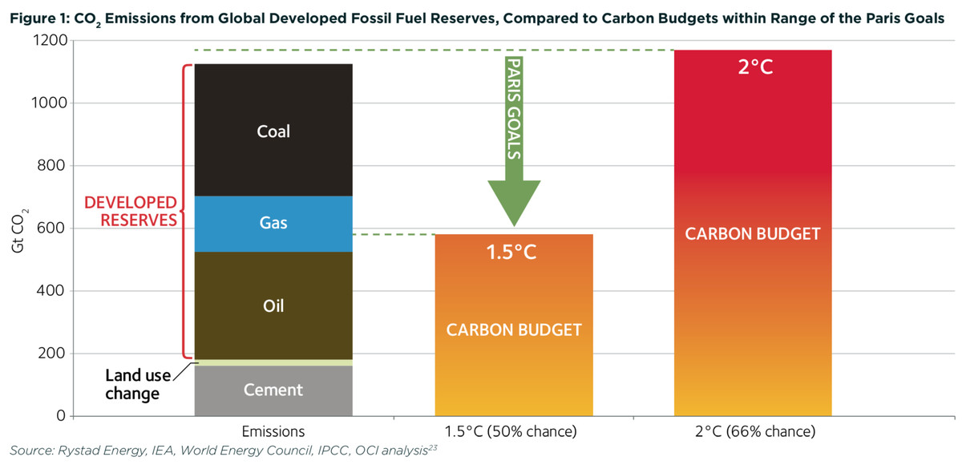
Is NG just a bridge to nowhere? (1)
Many believe that thinking of NG as a bridge is dangerous and will delay critical, rapid reductions in CO₂ emissions.
(1) NG breaks the C-budget
https://www.vox.com/energy-and-environment/2019/5/30/18643819/climate-change-natural-gas-middle-ground

Slide 7
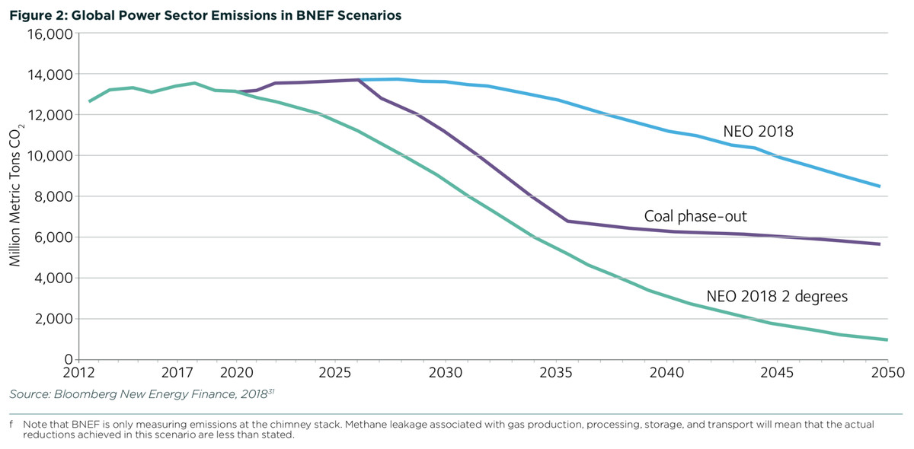
Is NG just a bridge to nowhere? (2)
(2) Coal-to-NG switching won’t get us where we need to go
w/o coal
coal-to-NG
To keep to 2C increase
https://www.vox.com/energy-and-environment/2019/5/30/18643819/climate-change-natural-gas-middle-ground

Slide 8
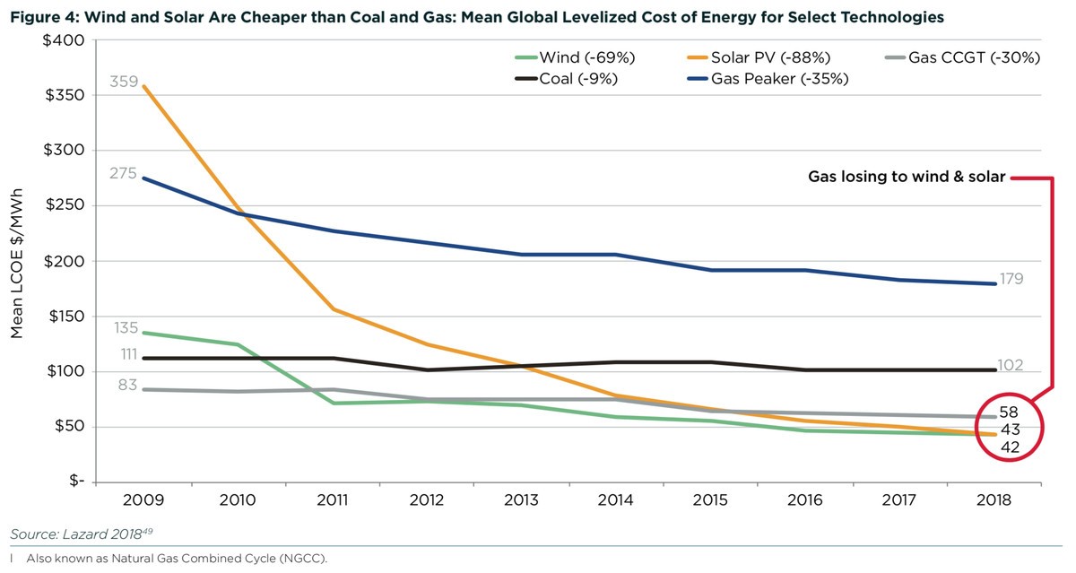
Is NG just a bridge to nowhere? (3)
(3) RE can replace both coal and NG in terms of cost
NG peaking
NG CCGT
coal
solar PV
wind
https://www.vox.com/energy-and-environment/2019/5/30/18643819/climate-change-natural-gas-middle-ground

Slide 9
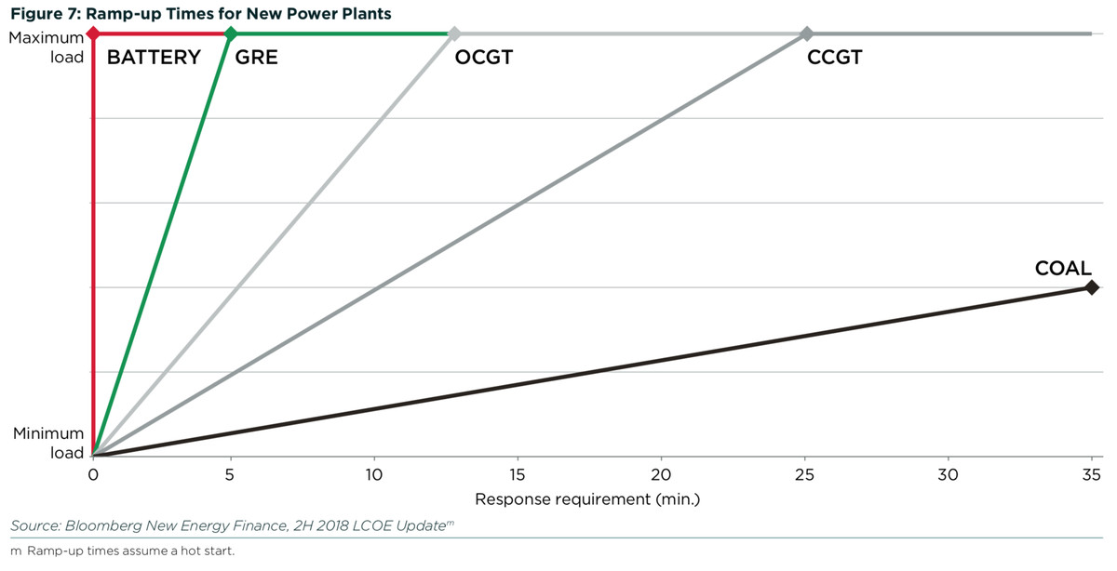
Is NG just a bridge to nowhere? (4)
NG gas reciprocating engines
(4) NG isn’t needed for a reliable grid
NG open-cycle gas turbines
Batteries are getting better and cheaper.
https://www.vox.com/energy-and-environment/2019/5/30/18643819/climate-change-natural-gas-middle-ground

Slide 10
Is NG just a bridge to nowhere? (5)
(5) New NG infrastructure will lock in carbon
existing NG pipeline
https://www.vox.com/energy-and-environment/2019/5/30/18643819/climate-change-natural-gas-middle-ground

Slide 11
What about CCS? Could that make NG feasible?
The US DOE estimated that use of CCS at NG plants would increase the cost of NG electricity by 50%.
Hard to implement CCS at all plants
Would likely slow move to RE.
Should CCS / CCU R&D continue?
Yes! But not to the detriment of making changes to RE now.
https://www.utilitydive.com/news/is-100-renewable-energy-for-the-us-possible-yes/547135/

Slide 12
Module 12. Geoengineering
12.2: Efficiency – good, bad or essential?

Slide 13
Efficiency: reducing demand
Increasing efficiency is essential to reducing energy use and carbon emissions.
Simple steps can have significant effects.
In Europe efficiency occurs more easily because inefficient products aren’t sold or are highly taxed.
Smaller… nearly everything
Efficient heating and cooling
Weatherization
Mass transportation
Electric transportation
Efficient lighting
Human behavior – the biggest challenge!
Renewable Energy, 2/e, Chapter 14

Slide 14
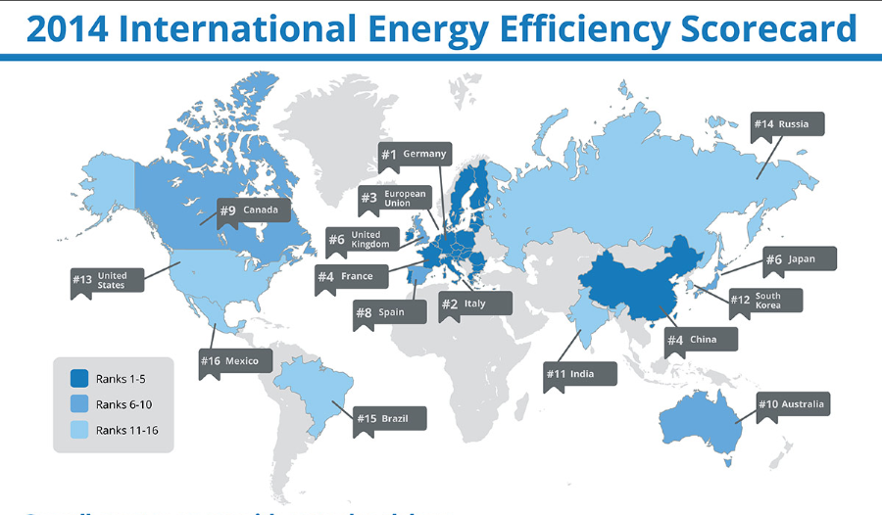
We can certainly do better
https://cleantechnica.com/2014/07/21/germany-1-world-energy-efficiency/

Slide 15
Would electrifying everything address efficiency?
Saul Griffith’s “Rewiring America” plan argues that typical efficiency measures won’t get us where we need to go and that their scarcity model will make people hesitant to change as change and diminished lifestyles are too much change at one time.
But, Griffith’s doesn’t argue against all efficiencies and they are a vital part of his plan.
Thermodynamic efficiency
Technologies that either produce less waste heat; or
Capture and use that waste heat
New technologies that are:
circular from the start; or
capture and/or reuse carbon as an integral part of their process
Renewable Energy, 2/e, Chapter 14

Slide 16
Module 12. Geoengineering
12.3: Role of renewable energy?

Slide 17
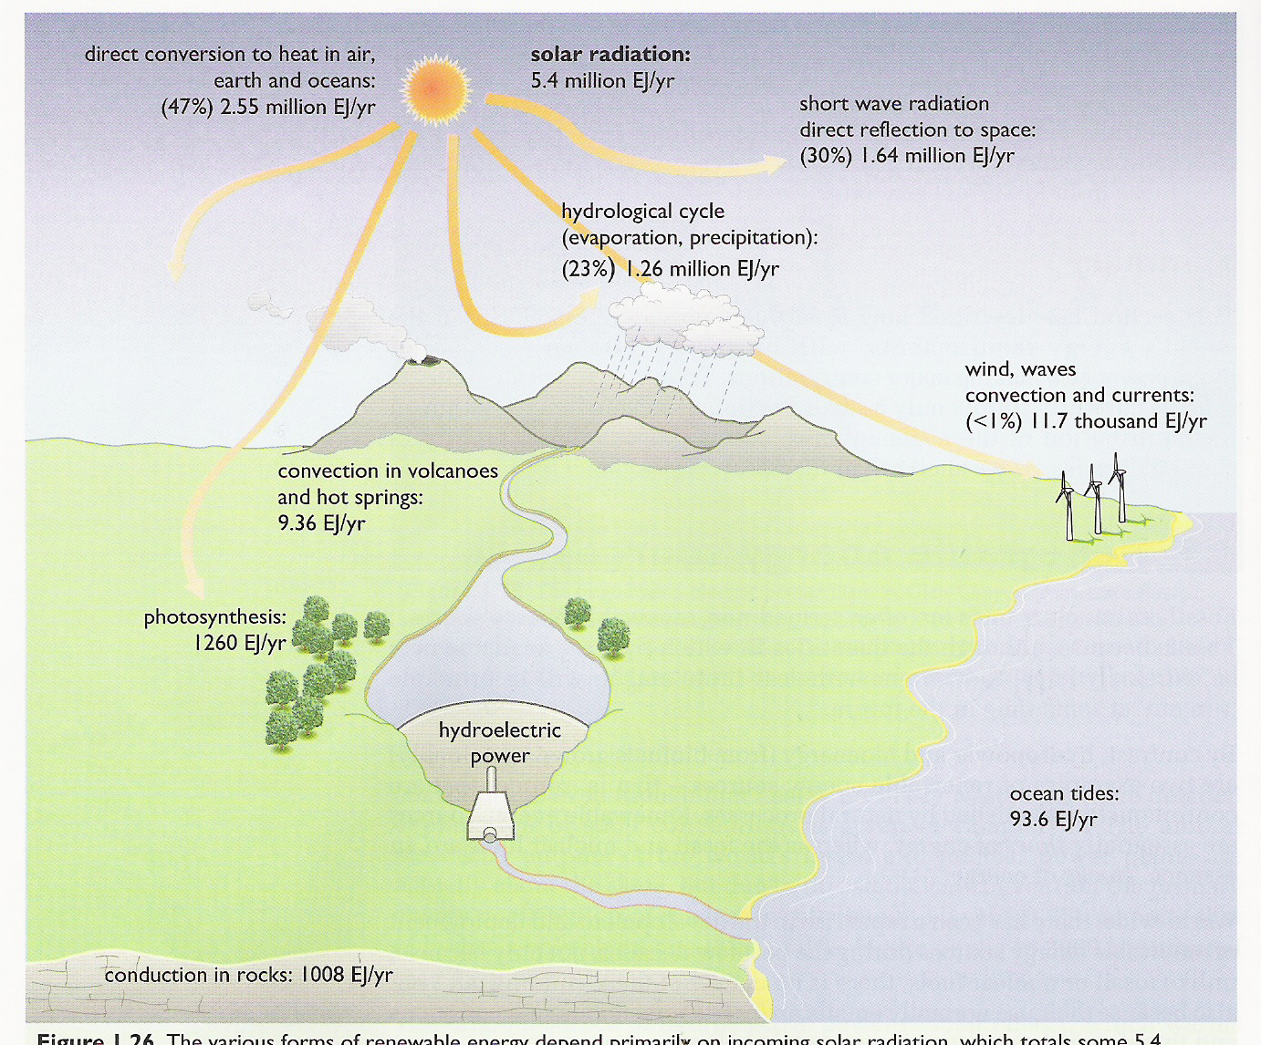
Renewable energy technologies
Solar energy
Solar thermal
Solar electricity: PV and thermal
Biomass
Traditional
Modern
Biofuels
Hydropower
Wind energy
Wave power
Tidal power
Geothermal
Renewable Energy, 2/e, Chapter 14

Slide 18
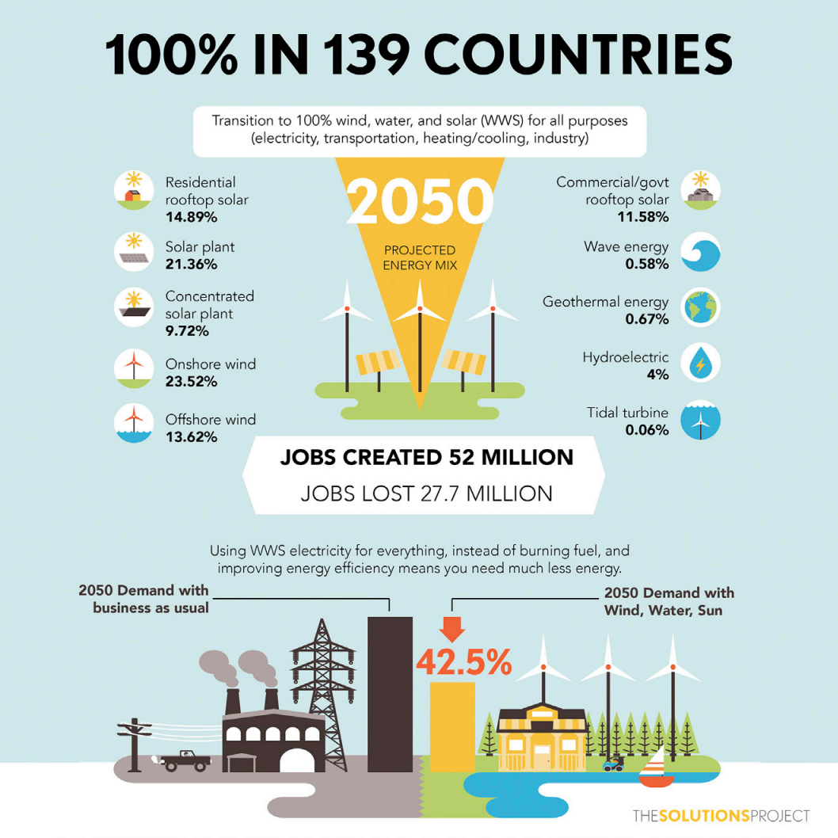
100% renewable energy as a global solution?
A 2015 paper by Jacobson et al., asserts that the world could be transitioned to 100% renewable energy by 2050.
https://web.stanford.edu/group/efmh/jacobson/Articles/I/CountriesWWS.pdf

Slide 19
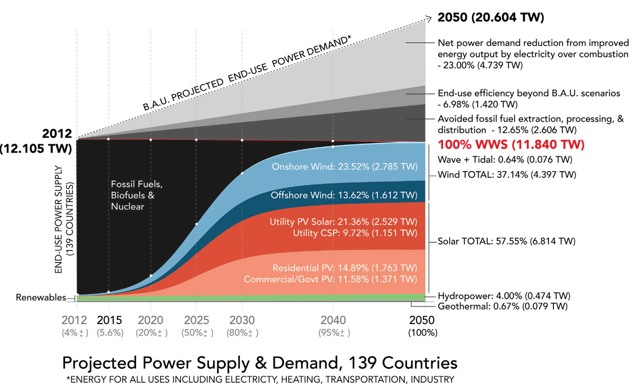
100% renewables energy specifics
https://web.stanford.edu/group/efmh/jacobson/Articles/I/CountriesWWS.pdf

Slide 20
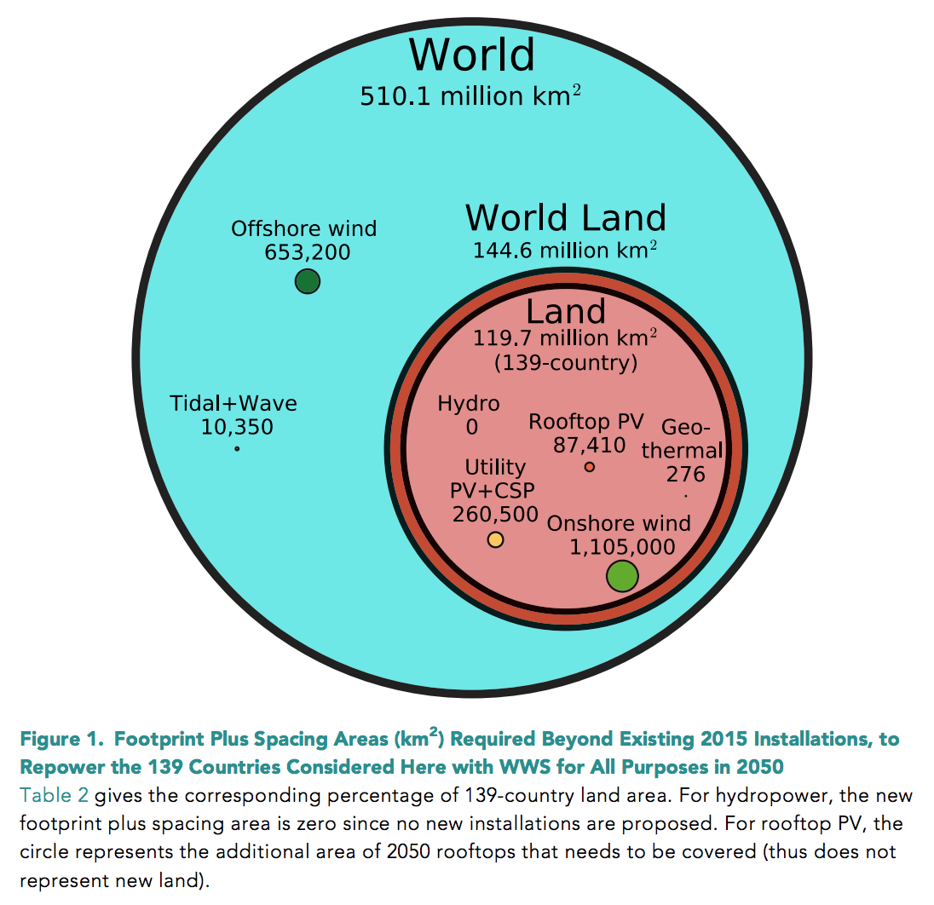
Land use for 100% renewable energy?
https://web.stanford.edu/group/efmh/jacobson/Articles/I/CountriesWWS.pdf

Slide 21
Criticism!
Jacobson’s assertion has come under a great deal of criticism from researchers who are proponents of sustainable energy.
The critics worry that overly optimistic expectations qhe policies will lead to disappointment & a backlash against renewable energy or climate change work in general.
“Other models, including Kammen’s, do show that the U.S. can transition to nearly 100 percent zero-emissions energy technologies. But the established view among energy researchers is that it would require making use of nearly every major technology available and that the transition, particularly getting the last 20 percent or so of the way there, would be prohibitively expensive using existing technologies. One of the key missing pieces is affordable grid-scale storage that can efficiently power vast areas for extended periods when wind and solar sources aren’t available.”
“The authors of [the] rebuttal were quick to stress that cutting emissions as quickly as possible is a crucial goal.”
https://www.technologyreview.com/s/608126/in-sharp-rebuttal-
scientists-squash-hopes-for-100-percent-renewables/

Slide 22
Further support for 100% RE
Following criticism a spate of publications argue that 100% RE is possible and affordable. A 2018 review of these publications concludes that:
More than enough wind, solar and hydropower: 30X more 2050 needs.
Technology to balance a grid powered by intermittent renewables exists.
The grid is shifting now and won’t need total redesign and rebuilding.
Cost of an RE powered system won’t be higher than FF-based systems and will be cleaner.
A number of nations are now (2018) significantly RE powered (electricity):
Norway 97%
Brazil 80%
Canada 65%
Demark 60%
Germany 46%
US 17%
https://www.sciencedirect.com/science/article/pii/S1364032118303307
https://en.wikipedia.org/wiki/List_of_countries_by_renewable_electricity_production

Slide 23
The global cost of 100% renewables?
A late 2019 study: global transition to 100% RE by 2050 would cost $73 trillion
7-year payback
28.6 million more jobs created than continuing with fossil fuels
This study made these assumptions:
Electrify everything
Increase energy efficiency
No nuclear
US?
$7.8 trillion upfront cost
288,000 x 6 MW wind turbines
16,000 x 100 MW solar farms
3.1 million more jobs than fossil fuels
Prevent 63,000 deaths annually
Reduce energy costs by $1.3 trillion
https://e360.yale.edu/digest/the-global-price-tag-for-100-percent-renewable-energy-73-trillion scientists-squash-hopes-for-100-percent-renewables/

Slide 24
Many corporations have signed onto 100% RE
RE100 is a global corporate RE initiative whose members have committed to moving to 100% RE.
RE100 has 264 members who meet criteria, set targets, report annual progress and share information about barriers and how to overcome them.
Apple
Bank of America
Facebook
General Motors
Microsoft
Walmart
more…
https://www.there100.org/

Slide 25
Module 12. Geoengineering
12.4: Hydrogen as a universal energy currency?

Slide 26
Fuel of the future?
What do you do when you run out of fossil fuel?
‘And what will they burn instead of coal?’
‘Water,’ replied Harding.
‘Water!’ cried Pencroft, ‘water as fuel for steamers and engines! Water to heat water!’
‘Yes, but water decomposed into its primitive elements.’ replied Cyrus Harding, ‘and decomposed doubtless, by electricity, which will then have become a powerful and manageable force, […] Yes, my friends, I believe that water will one day be employed as fuel, that hydrogen and oxygen which consisitute it, used singly or together, will furnish an inexhaustible source of heat and light, of an intensity of which coal is not capable. Some day the coalrooms of steamers and the tenders of locomotives will, instead of coal, be stored with those two condensed gases, which will burn in the furnaces with enormous calorific power.’
- Jules Verne, The Myterious Island, 1874

Slide 27
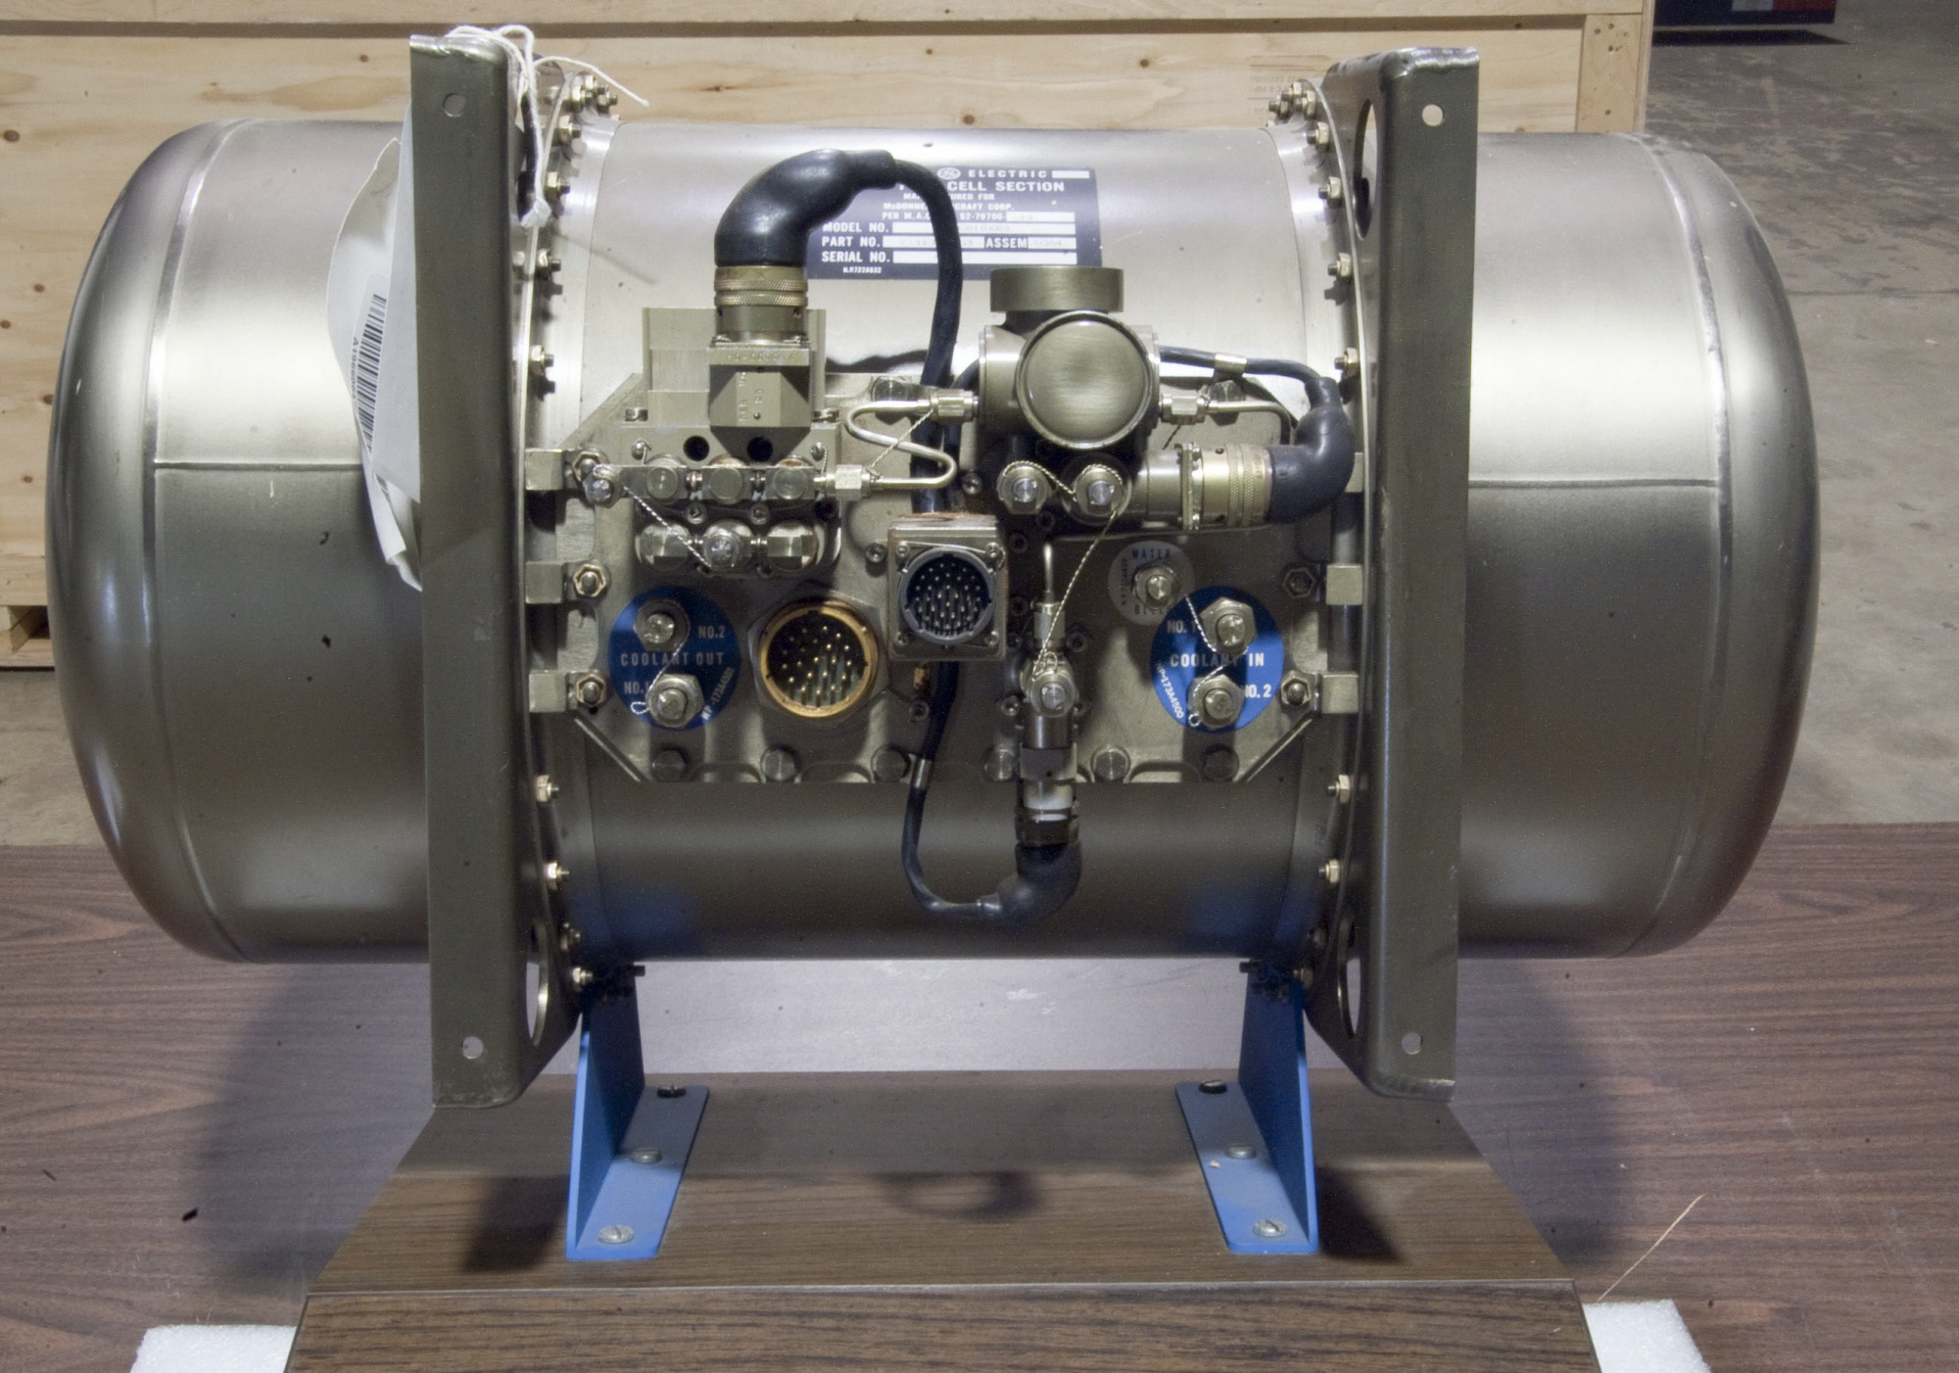
Hydrogen technology exists
The hydrogen fuel cell was invented by Grove in the 1840s.
In the 1950s, Bacon improved the hydrogen fuel cell.
First practical use on the Gemini and Apollo spacecraft where fuel cells were used to make electricity and water.
Renewable Energy, 2/e, Chapter 14;
https://airandspace.si.edu/collection-objects/fuel-cell-gemini-3

Slide 28
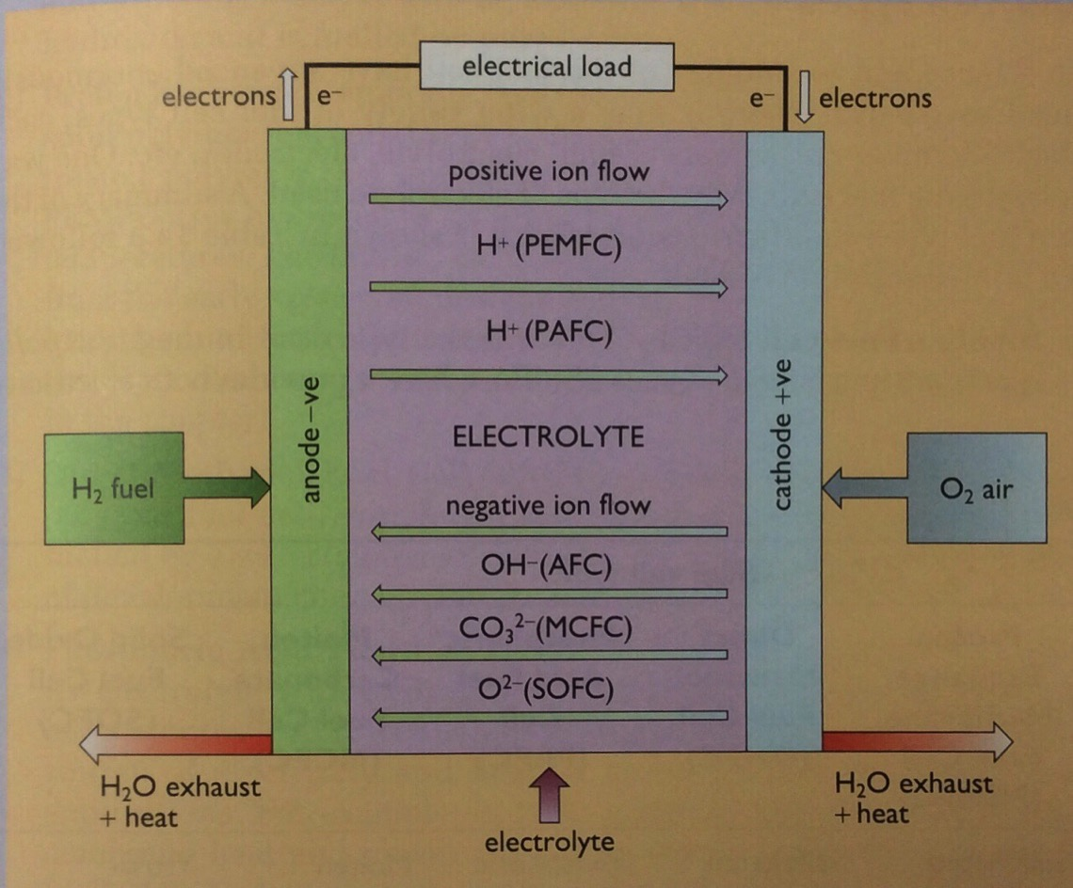
Hydrogen fuel cells
H₂ flows into the porous anode and O₂ flows into the porous cathode.
Catalyst splits H₂ into H⁺¹ ions and electrons.
Electrons flow towards the cathode through the electric load, providing electricity.
H⁺¹ ions flow through the electrolyte to the cathode.
At the cathode, H⁺¹ ions combine with O⁻² ions created when electrons flowing to the cathode reduce oxygen gas to O⁻².
Water and heat are co-products.
H₂ fuel must be pure.
Renewable Energy, 2/e, Chapter 14

Slide 29
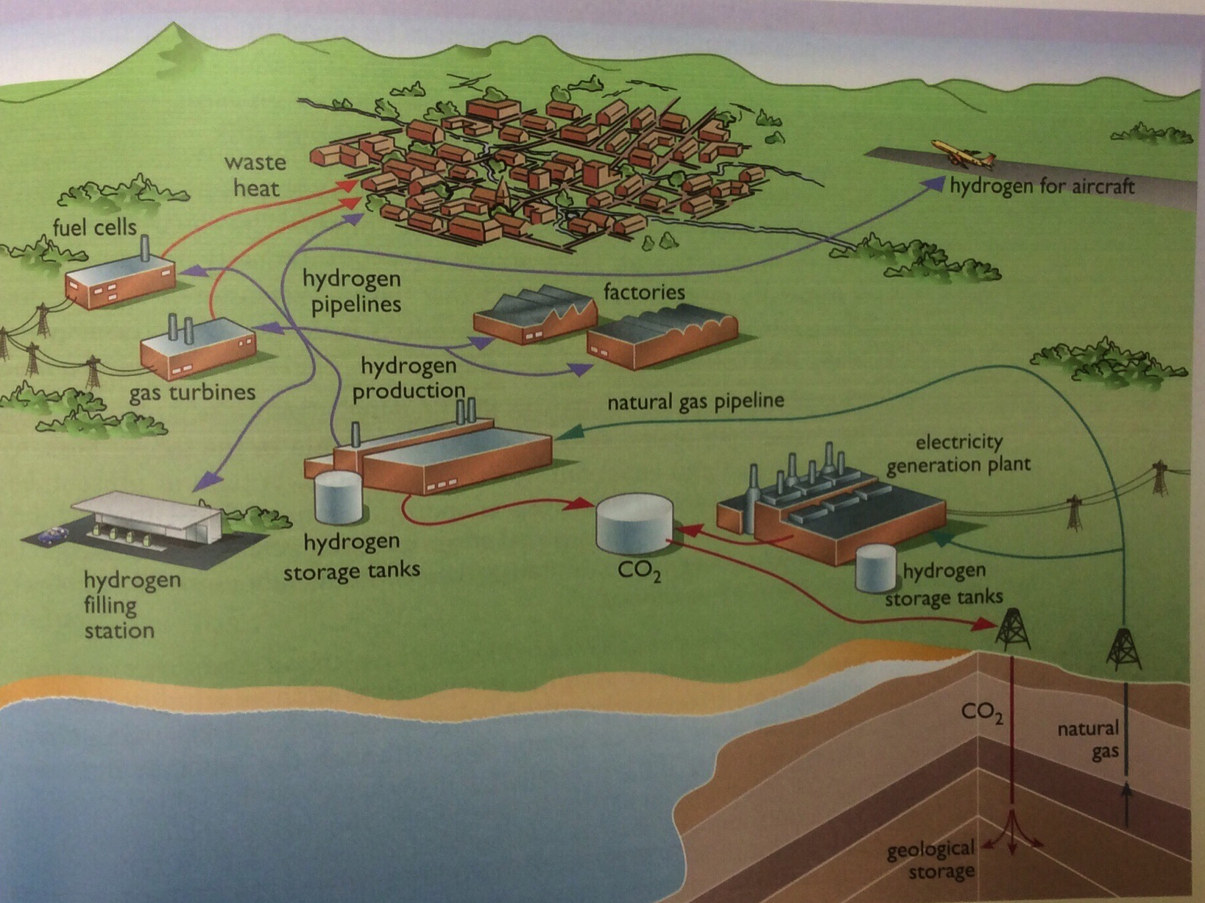
Hydrogen as common fuel
XXX
At one point, hydrogen was seen as the future universal fuel for global energy needs.
In the era of ‘electrify everything’ hydrogen can fill a critical, but secondary, role of plugging the energy gaps.
https://www.economist.com/science-and-technology/2020/07/04/after-many-false-starts-hydrogen-power-might-now-bear-fruit

Slide 30
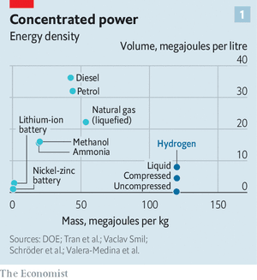
Hydrogen ‘plugging the gap’ economy?
What gaps would hydrogen plug? (15%)
Transportation alternative to electricity
Heating (replacing NG)
Storage of intermittent RE
Chemical feedstock
Replacing coke in smelting of iron and other high temperature processes
2020: Hyundai is marketing the Nexo and Toyota is updating the Mirai and is working with China to develop H-powered cars
Hyrdogen market is more likely for trucking and shipping
https://www.economist.com/science-and-technology/2020/07/04/after-many-false-starts-hydrogen-power-might-now-bear-fruit

Slide 31
Haven’t we seen this movie before?
Hydrogen has been touted as the fuel of future before, in the 1970s and 1990s.
What’s different now?
(1) The tremendous growth of RE has shown that fossil fuels can and will be replaced.
(2) Hydrogen has to be produced by from other energy sources:
Fossil fuels
Nuclear – maybe
RE (wind and solar) – yep, cheap and (sometimes) abundant
(3) The need to decarbonize is now obvious and urgent
RE can get us close, but another universal energy currency could push us it to 100%
(4) Electrolysis technology is making rapid advances
(5) Hydrogen can be integrated into existing NG distribution and use systems
Existing boilers can handle some H2 and H2-only boilers are close; 10-year replacement cycle
So we could use the gas grid while expanding the electric grid
https://www.economist.com/science-and-technology/2020/07/04/after-many-false-starts-hydrogen-power-might-now-bear-fruit

Slide 32
What color is your hydrogen?
Grey hydrogen: made by ‘reforming’ NG (CH₄) into H₂ and CO₂ which is released.
$1.50/kg
Blue hydrogen: made by ‘reforming’ NG (CH₄) into H₂ and CO₂ which is then buried.
$1.50 – 3.50/kg
renewable electricity in a clean disguise
Green hydrogen: made by electrolysis of water by RE.
$2.50 – 5.00/kg
Expected to fall with falling RE prices and scale-up
$0.70 - 1.60/ kg by 2050?
Factoring in externalities would make green hydrogen competitive.
https://e360.yale.edu/features/green-hydrogen-could-it-be-key-to-a-carbon-free-economy

Slide 33
Green hydrogen plant at Fukushima, Japan
https://e360.yale.edu/features/green-hydrogen-could-it-be-key-to-a-carbon-free-economy

Slide 34
Green hydrogen advocates
Saudi Arabia has been trying to diversify its economy and investing in wind and solar power.
Building new $500 billion city, Neom, powered by RE and green hydrogen.
World’s largest green hydrogen plant being built by US company Air Products and Chemicals.
Powered by 4 GW of wind and solar.
More green hydrogen plants planned.
Europe, now dependent on Russian NG, is investing in green hydrogen which could be produced domestically.
Germany: large of clean energy stimulus funding devoted to green hydrogen.
“It is the missing part of the puzzle to a fully decarbonized economy,” the European Commission wrote in a July strategy document.
https://e360.yale.edu/features/green-hydrogen-could-it-be-key-to-a-carbon-free-economy

Slide 35
Green hydrogen in the US? California!
California is aggressively pushing towards a zero-carbon energy system and plans to use green hydrogen.
LA Dept Water and Power is building a green hydrogen-fueled power plant in Utah to go online in 2025.
SGH2 is building a green hydrogen production plant in Southern CA to be fueled by waste gasification.
Lower cost projections.
Low-carbon fuel standard has spurred plans to use hydrogen to displace diesel fuel for heavy vehicles.
https://e360.yale.edu/features/green-hydrogen-could-it-be-key-to-a-carbon-free-economy
https://www.cpuc.ca.gov/uploadedFiles/CPUC_Website/Content/Utilities_and_Industries/Energy/Energy_Programs/Gas/Natural_Gas_Market/Nov13LADWP.pdf

Slide 36
Green hydrogen drawbacks?
Still very new so much hasn’t been worked out.
Energy is required to separate hydrogen from source: methane or water.
Needs (special) pipelines and tanks for storage.
Embrittles most metals so requires special materials.
Tiny size allows for easy escape of gaseous form; difficult to contain.
Liquification requires high pressure (700 X atm) and extreme cold (-240 C) (= energy).
Safety: highly flammable as a gas
https://e360.yale.edu/features/green-hydrogen-could-it-be-key-to-a-carbon-free-economy

Slide 37
Module 12. Geoengineering
12.5: What is geoengineering?

Slide 38
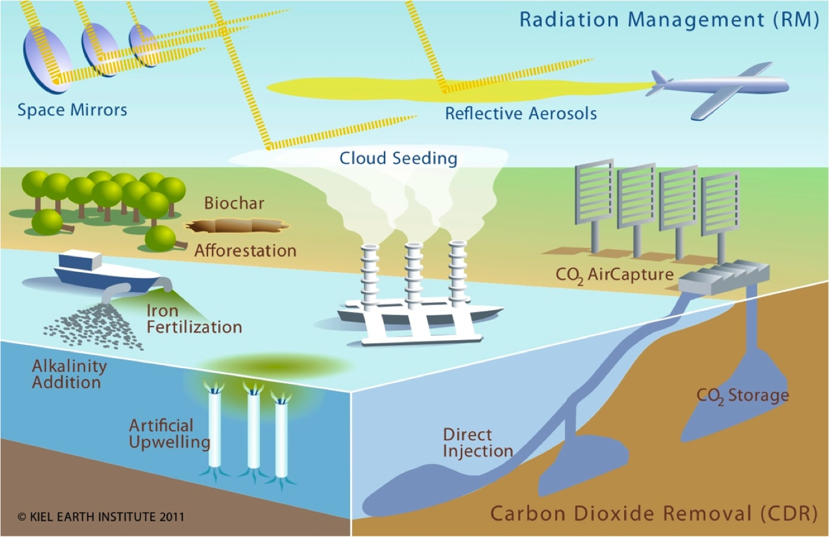
What is geoengineering?
Geoengineering (aka climate engineering or climate intervention) is is the deliberate and large-scale intervention in the Earth’s climatic system with the aim of affecting adverse global warming.
Two categories:
sequestering atmospheric carbon
SRM, solar radiation management
Renewable Energy, 2/e, Chapter 14
http://www.climate-engineering.eu/home-35.html

Slide 39
Geoengineering: not a new idea but untested
In 1965, President Lyndon Johnson’s Science Advisory Committee warned it might be necessary to increase the reflectivity of the Earth to offset rising greenhouse-gas emissions.
The committee went so far as to suggest sprinkling reflective particles across the oceans.
It’s revealing that in this, the first ever presidential report on the threat of climate change, the idea of cutting emissions didn’t seem worth mentioning.

Slide 40
NOVA: ‘Can we cool the planet?’
Direct air capture of CO₂ with storage in basalt (ClimeWorks)
Recycling CO₂, water into a solar methanol with concentrated solar power: C-neutral liquid fuel (Aldo Steinfeld)
Carbon upcycling: CO₂ into materials for our world (Carbon X Prize)
sequestering atmospheric carbon
Coal flyash activated to absorb CO₂, make cement
Increased forestation
Increased grasslands (doubling as food production)
Cloud whitening with superfine salt droplets
SRM: solar radiation management
Stratospheric particles to reflect sunlight

Slide 41
NOVA: ‘Can we cool the planet?’
https://www.pbs.org/video/can-we-cool-the-planet-m29pbj/

Slide 42
NOVA: ‘Can we cool the planet?’
“During production, each scientist we followed echoed more or less this sentiment: ‘There is no silver bullet to solving climate change, only silver buckshot.’ That sums up what we learned in 'Can We Cool The Planet?' While it’s natural to look to these fresh new ideas with hope and optimism, so many of them are still in their infancy. As every scientist in this film agrees, no technology on its own can fix the problem we face,” says filmmaker Ben Kalina.
“That said, as climate change ripples across the planet, the question has shifted from ‘should we research these unknown technologies’ to ‘which technology can scale up most quickly and be the least disruptive?’ adds filmmaker Jen Schneider. “We must be hopeful, but also cautious and data-focused as we think about stepping into this new era of climate risk management — and a geoengineered world.”
https://www.kpbs.org/news/2020/oct/22/nova-can-we-cool-planet/

Slide 43
Module 12. Geoengineering
12.6: Who decides? Governance and ethics

Slide 44
“A bad idea whose time has come”?
“Time is no longer on our side.”
- David King, former UK chief scientist
“It’s barking mad”
- Raymond Pierrehumbert, geophysicist, U. of Chicago
“Instead of forcing unworkable and costly government mandates on the American people, we should look to technology and innovation to lead the way to address climate change.”
- Lamar Alexander (R) US Senator, Tennessee
"If global warming were an extraterrestrial adversary, it would not have to fear a diplomatically unified Earth.”
- Parag Khanna and Michael Ferrari
“The technology’s potential to promote conflict… is likely to be substantial.”
- Steve Rayner, Oxford U. Geoengineering Project
“We are as gods and might as well get good at it.”
- Stewart Brand, 1968

Slide 45
Could geoengineering cause problems?
Sure. We’ve already seen that climate change on a global scale has consequences and some of them are hard to predict.
But we’d be fools not to anticipate some of these:
Moral hazard: geoengineering means we don’t have to change our energy system!
Once we start geoengineering, termination could cause huge, rapid climate swings.
Geopolitical conflict between nations that geoengineer and nations that suffer

Slide 46
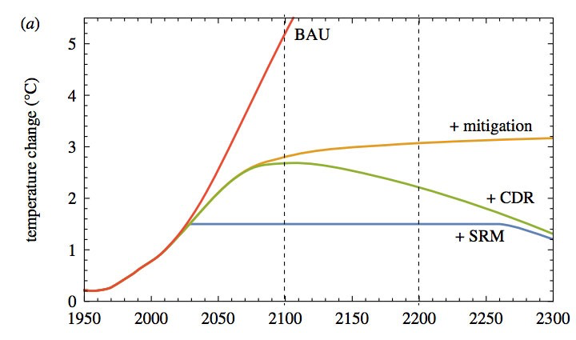
The moral hazard of geoengineering
In economics, moral hazard occurs when an entity has an incentive to increase its exposure to risk because it does not bear the full costs of that risk.
Would politicians (and the rest of us!) view geoengineering as a quick fix and avoid the difficult work of transitioning from fossil fuels?
If so, further build up of atmospheric CO₂ could cause problems not yet considered.
SRM should been seen as a supplement to reducing GHG and FF, not a quick fix
business as usual
cut CO₂ in half
+ CCS
cut CO₂ in half
cut CO₂ in half
+ CCS
+ SRM
https://en.wikipedia.org/wiki/Moral_hazard
https://www.carbonbrief.org/explainer-six-ideas-to-limit-global-warming-with-solar-geoengineering

Slide 47
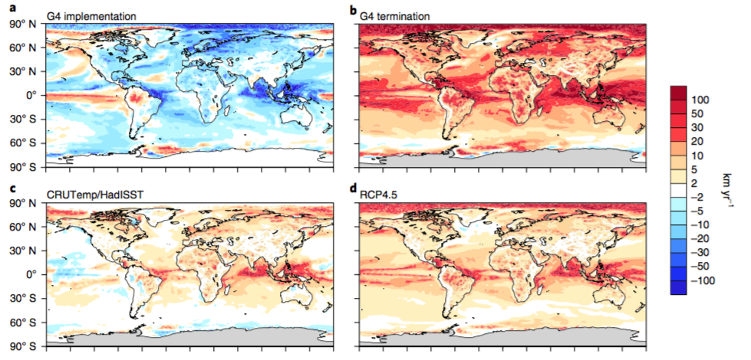
‘Termination shock’: SRM is suddenly stopped
with geoengineering
sudden stop
The speed of rebound wouldn’t allow species to move or adapt.
https://www.carbonbrief.org/geoengineering-carries-large-risks-for-natural-world-studies-show
today: change from 1960 - 2014
no geoengineering,
significant emissions cuts

Slide 48
Geopolitical conflict: GCC or geoengineering?
Climate change is expected to create political instability.
Some experts believe that climate change-induced drought, high food prices and migration to cities nudged Syria into civil war.
Would geoengineering be different?
Nation A embarked on a system-altering form of climate engineering.
An extreme whether event has huge impacts on nations B, C, D and E.
Who’s to blame?
Weather is usually seen as an act of God.
Would B, C, D and E blame God or nation A?
Scenario:
The government of China, faced with a catastrophic drought in the north of the country, decides its survival demanded rapid global cooling.
China deploys SRM and cools their territory.
The monsoon rains that irrigate India’s and Pakistan’s crops fail, bringing famine.
Three nuclear-armed nations would then be in conflict over weather patterns that affect the survival of millions of their citizens.
https://www.sciencefocus.com/planet-earth/could-geoengineering-cause-a-climate-war/

Slide 49
The Oxford Principles
“Research into geoengineering is at a very early stage, with no guarantee of success. The Principles are intended to guide the development of geoengineering techniques from early research to the point where they may be available for eventual deployment. The Principles also stipulate that any decision with respect to deployment only be taken with robust governance structures already in place in order to ensure social legitimacy.”
Principle 1: Geoengineering to be regulated as a public good
Principle 2: Public participation in geoengineering decision-making
Principle 3: Disclosure of geoengineering research and open publication of results
Principle 4: Independent assessment of impacts
Principle 5: Governance before deployment
http://www.geoengineering.ox.ac.uk/www.geoengineering.ox.ac.uk/oxford-principles/principles/index.html

Slide 50
How should geoengineering be governed?
Not governed – go for it!
Each country should be free to take action unilaterally.
Political and trade alliances should make the decisions.
Global, multinational governance is essential.
Nobody should try this; we’ve got other options.
Organizations advocating or governance:
Solar Radiation Management Governance Initiative (SRMGI) seeks to determine effects on developing nations (Southern Hemisphere).
Carnegie Climate Geoengineering Governance Initiative (C2G2) seeks to “encourage a broader, society-wide discussion about the risks, potential benefits…challenge…”
UN Environment Assembly
https://www.carbonbrief.org/explainer-six-ideas-to-limit-global-warming-with-solar-geoengineering

Slide 51
Geoengineering governance today?
2008:
After a number of ocean fertilization experiments (of which only 2 showed increased C sequestration), the UN Convention on Biological Diversity imposed a moratorium on more.
2019:
A multinational atmospheric geoengineering effort was rejected by the same UN body
A group of nations, led by the US and Saudi Arabia, "hamstrung" global efforts to scrutinize the risks and benefits (basically begin the process of regulating) geoengineering
“It is regrettable that efforts to strengthen existing UN governance on geoengineering met with resistance from a handful of high-emitting oil-producing countries,” - Lili Fuhr of the Heinrich Böll Foundation
https://www.wired.com/story/geoengineering-is-the-only-solution-to-our-climate-calamities/
https://www.theguardian.com/environment/2019/mar/18/us-and-saudi-arabia-blocking-regulation-of-geoengineering-sources-say

Slide 53
RE: reasons for optimism (Gore, TED 2016)
In 1980, AT&T was curious how many people would adopt “big, clunky” cell phones in upcoming decades, so they commissioned a McKinsey study to forecast cell phone use by the year 2000.
Their projection: 900,000 users.
“That did happen,” says Gore, “in first three days.”
They hugely underestimated because they didn’t account for the fact that the quality would improve and the cost would come down, both things happening with renewable energy.
https://blog.ted.com/why-al-gore-feels-optimistic-about-climate-change/

Slide 54
RE: reasons for optimism (1)
Al Gore, TED 2016
In 2000, the best projections said that the world would be able to install 30 GW of wind energy capacity by 2010.
“We beat that mark by 14 and a half times over,” says Gore.
As for solar power, projections 14 years ago said that we could install one GW per year by 2010.
“We beat that mark by 17 times over,” says Gore.
Last year, we beat it 58 times over. And this year, it looks like that will bump up to 68 times over.
The point: solar power is increasing exponentially.
https://blog.ted.com/why-al-gore-feels-optimistic-about-climate-change/

Slide 55
RE: reasons for optimism (2)
Al Gore, TED 2016
The cost of renewable energy has come down 10 percent per year for 30 years.
“We are close to reaching grid parity — that line, that threshold below which renewable is cheaper than electricity from burning fossil fuels,” he says.
“This is the biggest new investment opportunity in the history of the world.”
https://blog.ted.com/why-al-gore-feels-optimistic-about-climate-change/

Slide 56
RE: reasons for optimism (3)
Al Gore, TED 2016
On December 26, 2015, Germany got 81 percent of its energy from renewables, mainly solar and wind.
And then there’s the fact that on December 12, 2015, 195 governments came together in Paris, under the United Nations, and decided to intentionally change the course of the global economy in order to protect the earth, as described by Christiana Figueres.
The year before that 400,000 people marched in New York in support of climate change advocacy.
The US has now withdrawn, and is the only nation not to be a party to the Paris climate accord.
https://blog.ted.com/why-al-gore-feels-optimistic-about-climate-change/

Slide 57
RE: reasons for optimism (4)
Al Gore, TED 2016
“When any great moral challenge is ultimately resolved into a binary choice between what is right or what is wrong, the outcome is preordained because of who we are as human beings,” says Gore.
“The will to act itself is a renewable resource.”
https://blog.ted.com/why-al-gore-feels-optimistic-about-climate-change/

Slide 58
Hydrogen: energy carrier
Hydrogen gas could be energy storage or currency.
Sources?
Electrolysis of water by renewable electricity;
Conversion of fossil fuels to H₂ and CO₂; the CO₂ could be stored.
It’s easier to separate and capture the CO₂ before combustion.
Conversion of hydrogen to energy is more efficient and produces less pollution (and no CO₂).
Hydrogen can be used as transportation fuel.
So, a common hydrogen infrastructure could serve many energy purposes.
Production?
Worldwide production: 500 b cubic meters (6.5 EJ) in 2010.
Most made via reforming NG; less expensive than electrolysis.
Transportation?
Pipeline made of special steel alloys.
Renewable Energy, 2/e, Chapter 14

Slide 59
Safety?
There have been concerns about the safety of hydrogen gas since the destruction of the Hindenburg zeppelin in 1937.
Filled with hydrogen gas.
But the skin was painted with very flammable compounds.
Hydrogen is now transported safely.
While hydrogen burns hot, it also burns quickly.
Hydrogen is very light and dissipates quickly when it escapes.
Only explosive at greater than 4%.
Renewable Energy, 2/e, Chapter 14; https://en.wikipedia.org/wiki/Hindenburg_disaster

Slide 60
Geo-engineering strategies
Land-based:
Reforestation
Bioenergy with CCS
Biochar
Marine:
Fertilizing the oceans
Direct injection of CO₂ into the deep ocean
Solar radiation management:
Injection of sulfate into the atmosphere
Creation of cloud cover
Mirrors in space
Renewable Energy, 2/e, Chapter 14

Slide 61
CO₂ removal strategies (1)
Land-based methods:
Reforestation (technically, afforestation)
Growth of plant material, like trees, pulls CO₂ from the atmosphere.
Carbon is sequestered in plant growth as long as plant material is alive or not rotting.
IPCC estimates that afforestation could sequester 1.3 Gt of CO₂ per year at a 20007 cost of $20/tCO₂e.
This is only 4% of global CO₂ emissions.
It’s estimated that humans have removed 45% of the Earth’s original forest cover.
To date, reforestation has had mixed success. For example, China:
Restrictions on logging and farming have increased tree cover;
China now imports more wood, essentially off-shoring deforestation.
Renewable Energy, 2/e, Chapter 14
https://www.pri.org/stories/2016-06-27/what-chinas-successful-reforestation- program-means-rest-world

Slide 62
CO₂ removal strategies (2)
Land-based methods:
Bioenergy with carbon capture & storage (BECC):
Growth of plant material, like trees, pulls CO₂ from the atmosphere.
Carbon is sequestered in plant growth as long as plant material is alive or not rotting.
Using biomass to produce energy via the IGCC technology will be either:
Carbon neutral if biomass is grown at the same rate it is used; or
May be net carbon negative if used with CCS.
Critically, effective and sustainable use of biomass requires that new biomass is grown at a rate equal to, or great than, the rate with which biomass is used.
When growing trees, there is a significant time lag of 20-30 years or more.
Perennial grasses have a lower lag time.
Renewable Energy, 2/e, Chapter 14

Slide 63
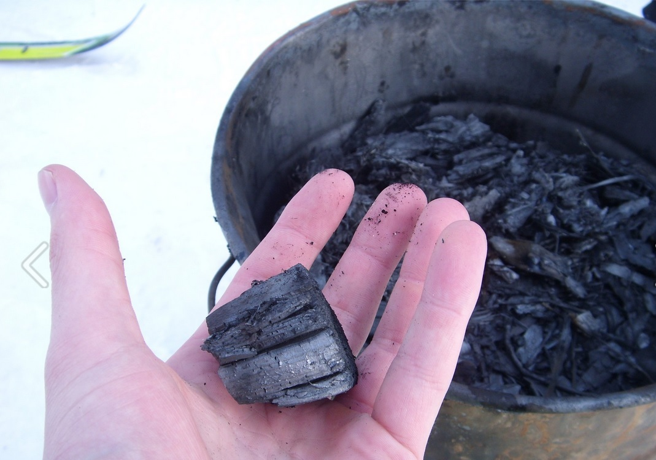
CO₂ removal strategies (3)
Land-based methods:
Biochar:
Biochar is a charcoal produced by incomplete pyrolysis (combustion in a low-oxygen atmosphere) of biological woody (cellulosic) materials.
Biochar is carbon.
Burying biochar may sequester its carbon.
Biochar holds water and nutrients in the soil and can improve the agricultural yield of poor soils.
The ability of biochar to sequester carbon is controversial.
Renewable Energy, 2/e, Chapter 14; https://en.wikipedia.org/wiki/Biochar;

Slide 64
CO₂ removal strategies (4)
Marine methods:
Fertilizing the oceans to increase biological carbon sequestration:
Microscopic organisms called phytoplankton grow at the surface of the oceans, fed by nutrients and sunlight and incorporating atmospheric CO₂.
Nutrients often limit growth; phytoplankton thrive near land.
When (uneaten, 30%) phytoplankton die, they drift to the bottom of the ocean where they remain for long periods of time before being converted back to CO₂ by deep-sea bacteria.
Fertilizing the ocean with nutrients (and iron) could encourage the growth of phytoplankton, sequestering CO₂.
Fertilizing the ocean could create new dead zones and may change ocean ecology in ways that we have not anticipated.
Renewable Energy, 2/e, Chapter 14

Slide 65
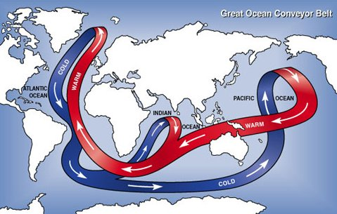
CO₂ removal strategies (5)
Marine methods:
Deep ocean injection of CO₂:
The deep oceans store massive amounts of CO₂: 37,000 Gt, or 50X atmospheric CO₂. The gas dissolves in surface water; currents move the water towards the poles where it cools; cold water sinks to the depths.
Thermohaline circulation (aka Great Ocean Conveyer Belt’)
1000 years later the deep waters rise & CO₂ is released.
Again, we don’t know the long-term ecological effects.
Renewable Energy, 2/e, Chapter 14
https://enviroliteracy.org/water/oceans/the-great-ocean-conveyer-belt/

Slide 66
Solar radiation mgt strategies (1)
Theory: If more solar radiation were reflected back out of the Earth’s atmosphere, global temperature could be reduced.
Reflecting 2% back would offset much warming…
... but is a massive project.
Sulfate aerosols:
SO₂ emissions form sulfate (SO₄)⁻² aerosols (fine mists) in the atmosphere to reflect sunlight back into space.
1991: the volcano at Mt. Pinatubo, Phillipines spewed 10 million tonnes of sulfur into the atmosphere. Global temperatures cooled by 0.5°C for several years.
Sulfate aerosols can also seed the formation of clouds.
We can spray sulfuric acid aerosol into the upper atmosphere to mimic this effect.
Potential downside: sulfate aerosols may combine with atmospheric water creating sulfuric acids (acid rain)
We are already seeing increased levels of atmospheric moisture due to increasing frequency of big storms.
Renewable Energy, 2/e, Chapter 14

Slide 67
Solar radiation mgt strategies (2)
Altering cloud cover:
Clouds, mainly water vapor, have multiple roles:
They shade earth’s surface &reflect sunlight into space; and
They insulate earth & prevent heat from radiating into space.
Marine cloud brightening:
Using remote control boats and fairly simple technology, a fine mist of sea water can be sent into the lower atmosphere where evaporation of water produces fine salt particles. Models show that albedo should increase, reflecting sunlight.
Seeding the atmosphere with dust or salts to create thinner clouds:
Could increase the particle size of ice in cirrus clouds causing thinner cloud cover allowing more heat to radiate into space.
Natural experiment? Huge dust storms can blow dust from central Asia east. Monitoring clouds and rain that result (or don’t) could provide data.
https://www.scientificamerican.com/article/salt-spray-may-prove-most-feasible-geoengineering/
https://www.technologyreview.com/s/511016/a-cheap-and-easy-plan-to-stop-global-warming/
Potential downsides: If theories are wrong, altering clouds could exacerbate warming rather than relieve it.

Slide 68
Solar radiation mgt strategies (3)
Physical shading from space:
Place a physical barrier between the sun and the earth to decrease the amount of sunlight reaching earth.
Most obvious means myriad tiny mirror or satellites.
Some have suggested that low-orbit solar PV parasols could provide ‘shade’ while beaming PV power to earth.
Potential downsides: Shading might even out global temperatures; tropics would be cooler and poles would be warmer.
http://www.bbc.com/future/story/20160425-how-a-giant-space-umbrella-could-stop-global-warming

