Slide 1
SSC2030: Energy Systems & Sustainability
Module 7B: Biomass
7.9: Introduction to bioenergy and its use
7.10: Bioenergy and feedstock materials
7.11: Bioenergy co-products
7.12: Drivers of bioenergy & the bioenergy debate
7.13: Cord wood heat
7.14: Wood chip energy
7.15: Wood pellet energy
7.16: Grass biomass energy
7:17: Carbon neutral?

Slide 2
7.9: Introduction and bioenergy use

Slide 3
What is bioenergy?
Bioenergy:
Renewable* energy produced from living (or recently living) biological material called biomass ¹
Useful renewable energy produced from organic matter – the conversion of complex carbohydrates in organic matter to energy ²
Energy from biofuels ³
*Renewable if the amount of biomass used is less than the amount of biomass that can be regrown.
1: Dahiya (2015)
2: U.S. DOE’s Oak Ridge National Laboratory’s (ORNL) Bioenergy Feedstock Network
3: Food & Agriculture Organization of the United Nations (FAO)

Slide 4
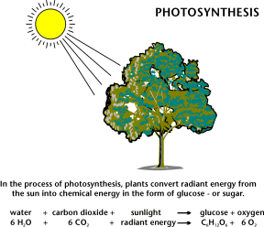
Sun power via photosynthesis
Bioenergy technologies are sun-powered.
The energy of sunlight is used to build carbon-based biomolecules from units of CO₂.
Carbon sequestration
Combustion / oxidation of fuels breaks those biomolecules down into CO₂, releasing bond energy.
Carbon cycling
The National Energy Education Project (Public Domain)

Slide 5
Focus of this course
Biofuels (and biogas):
Biomass converted to (solid), liquid or gaseous fuels like ethanol, methanol, methane and hydrogen
Biodiesel:
Renewable liquid fuel derived from vegetable oils or animal fats by transesterification; fatty acid esters
Biomass:
An energy source derived from organic matter, excluding fossil fuels
Generally refers to solid bioenergy
Dahiya (2015)

Slide 6
3 paths: biomass to bioenergy
Biofuels:
Biomass converted to (solid), liquid or gaseous fuels like ethanol, methanol, methane and hydrogen
Biodiesel:
Renewable liquid fuel derived from vegetable oils or animal fats by transesterification; fatty acid esters
Biomass:
An energy source derived from organic matter, excluding fossil fuels
Generally refers to solid bioenergy
Biomimicry: using (microbial) biology to convert (digest) biomass to biofuel
Chemistry: using simple organic chemistry to transform biomass into biofuel
Mechanical means: using simple mechanical processing;
Sometimes densifying biomass
Dahiya (2015)

Slide 7
Brief history of bioenergy
Bioenergy is a very old technology.
Was fire man’s first tool?
For centuries man lived with his animals; the original central heating.
Man has burned just about anything as fuel: wood, fiber, dried manure.
10th century BC: the Assyrians harnessed biogas for heating water
1908: Henry Ford’s model T was supposed to be fueled with ethanol
Ethanol was used throughout the 20th century
But ethanol use ramped up in 1970s
Nov 1975: Brazil created it’s National Alcohol Programme (ProAlchohol) using sugarcane as feedstock
Late 1970s: US moved towards creating 10/90 ethanol/gasoline blend
1992 Clean Energy Act
2007 Energy Independence & Security Act
The EU, China and India are also increasing production & use of biofuels
Rosillo-Calle & Johnson (2010)

Slide 8
Scale of bioenergy use
Bioenergy is used across a wide variety of scales:
Biofuel producers
Communities
Electrical or heating utilities
Cooperatives
Companies
Household cooking & heating
Dahiya (2015)

Slide 9
Bioenergy process overview
thermal conversion
thermochemical conversion
biochemical conversion
chemical conversion
lignocellulose
lignocellulose
lignocellulose
landfill & biogas
fats / oils / grease
sugars starches (crops)
densification
torrefication
fermentation
gasification
combustion
anaerobic digestion
trans-esterification
pyrolysis
charcoal
methanol
syngas
bio-oil
power heat
steam
bio-coal
syngas
ethanol
biogas or biomethane
biodiesel
BIOEN1

Slide 10
‘Generational’ categories
First generation biofuels:
Derived from oils, sugars and starches in food crops:
Corn ethanol, soy biodiesel, etc,.,
Second generation biofuels:
Derived from food crop waste and crop residues; leftovers:
Biodiesel from waste oil; &
Biogas from organic wastes.
Third generation biofuels:
Produced from algae, perennial grass & fast growing trees:
Energy crops; &
Algae for oil-based fuels.
Dahiya (2015)

Slide 11
Bioenergy vs. fossil fuels
Generally, bioenergy is seen as less advanced or less efficient than fossil fuels.
 | Bioenergy | Fossil fuels
advantages | Renewable May be carbon neutral Widely available (energy security) | Energy dense Supported by current energy infrastructure
disadvantages | Lower energy density May compete with food production Not supported by our current energy infrastructure (less universal) Require a variety of processing methods Can have substantial environmental impacts: loss of habitat. | Finite supply Increase atmospheric carbon The limited number of producers causes global inequity and leads to global tension & conflict. Accidental releases during extraction and transportation can have substantial environmental impacts. Fracking can degrade the quality of groundwater.

Slide 12
Relative energy densities
Energy density is an expression of the energy content of a type of fuel per volume.
Fuel | GJ/metric tonne
natural gas | 55
oil | 42
coal | 28
biogas | ~33
charcoal | 30
wood, dried | 15 - 18
paper | 17
bagasse | 17
MSW, commercial | 16
manure, dried | 16
straw | 15
MSW, residential | 9
wood, green | 6
grass, fresh | 4
fossil fuel
Fossil fuels convenience and widespread use can be attributed to their high energy densities and to the universal availability of fossil fuel-based energy infrastructure.
bioenergy
municipal solid waste
Boyle (2004) RE

Slide 13
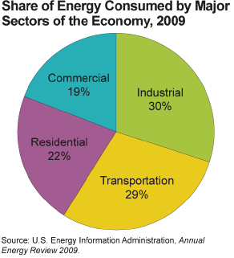
Current US energy use
US energy uses can generally be divided into rough thirds:
1/3 for industry & manufacturing;
1/3 for transportation; and
1/3 for commercial & residential use.
BIOEN1

Slide 14
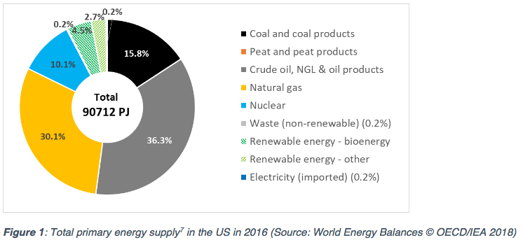
US primary energy sources
Recent changes (2011 – 2016) in US primary energy sources:
Coal down 6%
NG up 4%
RE up 1%
https://www.ieabioenergy.com/wp-content/uploads/2018/10/CountryReport2018_UnitedStates_final.pdf

Slide 15
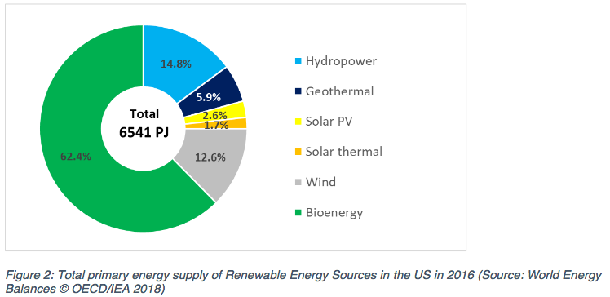
Most primary RE is bioenergy
Bioenergy overall only increased from 3.0 to 4.5% from 2005 to 2013 with little change since then.
https://www.ieabioenergy.com/wp-content/uploads/2018/10/CountryReport2018_UnitedStates_final.pdf

Slide 16
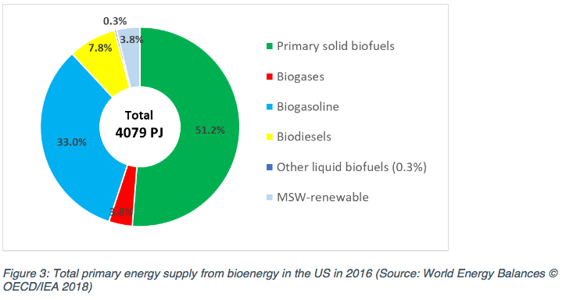
Primary bioenergy is ½ biomass
https://www.ieabioenergy.com/wp-content/uploads/2018/10/CountryReport2018_UnitedStates_final.pdf

Slide 17
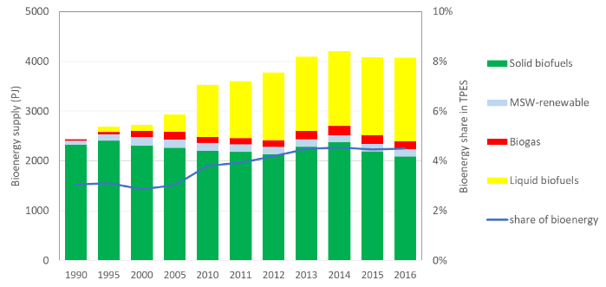
Gains due to liquid biofuel
Changes in forms of bioenergy with time: 1990 – 2016
Note that liquid biofuels account for all of the increase.
And that means bioethanol.
https://www.ieabioenergy.com/wp-content/uploads/2018/10/CountryReport2018_UnitedStates_final.pdf

Slide 18
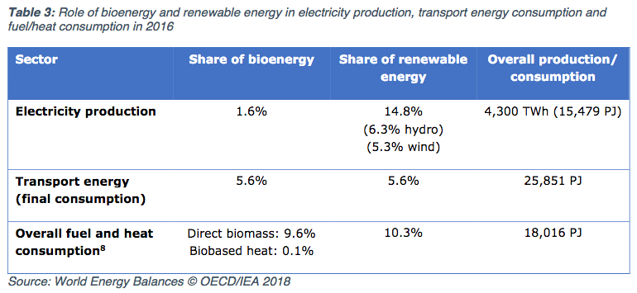
Heat ~ power > transport
RE power: 80% is hydro and wind; only 10% is biomass
Transportation energy: 5.6% is biofuel
Heating: about 10% from biomass
https://www.ieabioenergy.com/wp-content/uploads/2018/10/CountryReport2018_UnitedStates_final.pdf

Slide 19
Current global energy use
2007-2008, global energy use favored fossil fuels over biofuels, 10:1
Fossil fuel 500 EJ*
Biomass 50 – 54 EJ
Traditional use 35 – 43 EJ
Power generation 6.4 EJ
Transportation 2.6 EJ
What is bioenergy’s potential?
The World Bioenergy Association estimates that biofuels could produce:
1,135 – 1,548 EJ by 2050.
* What’s an EJ? Exajoule = one qunitillion = 10¹⁸ power
Rosillo-Calle & Johnson (2010)

Slide 20
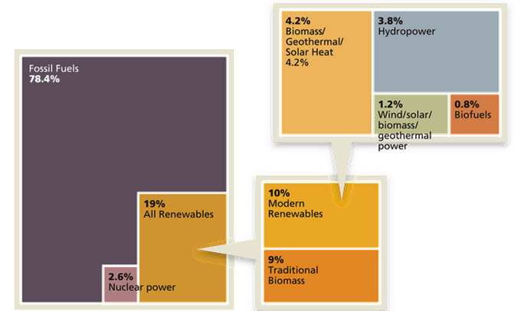
Current global energy use
Estimated RE Share of Global
Final Energy Consumption
http://www.renewableenergyworld.com/articles/2015/02/outlook-for-bioenergy-2015-whats-in-store-for-this- versatile-renewable-energy-feedstock.html

Slide 21
Breakdown of biomass use in US
In 2010, US biomass use looked like this:
46% was wood or wood-derived
43% was biofuel, mainly ethanol
11% was derived from municipal waste
BIOEN1
EIA @www.eia.doe.gov and www.repp.org/bioenergy/link6.htm;
www.extension.org/pages/Biomass_Feedstocks_and_Energy_Independence

Slide 22
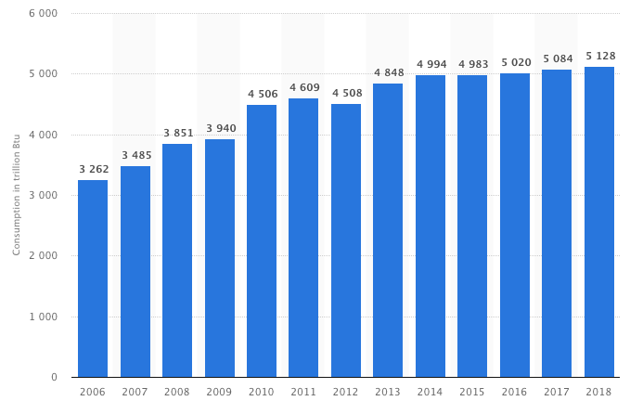
US biomass energy use static
From 2000 to 2018, electricity produced from biomass hasn’t increased.
https://www.statista.com/statistics/183429/biopower-generation-by-source-in-the-united-states-from-2000/

Slide 23
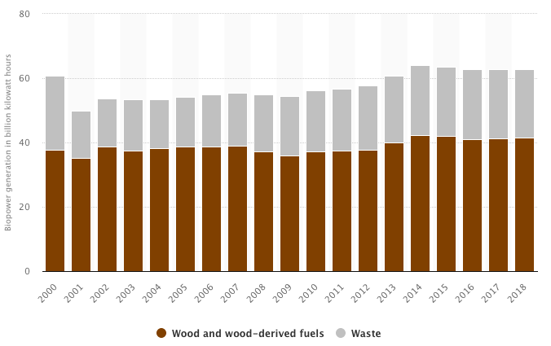
Biopower is static in the US
From 2000 to 2018, electricity produced from biomass hasn’t increased.
https://www.statista.com/statistics/183429/biopower-generation-by-source-in-the-united-states-from-2000/

Slide 24
How will US energy use change?
If recent changes to state & federal policies¹ hold, then by 2035:
Total energy use will increase;
Fossil fuel use will decrease from 84 to 78%; and
Renewable energy use will increase from 10 to 14%.
Natural gas use will increase as we exploit shale gas deposits via fracking.
NG prices are forecast to fall and stay low for some time.
Coal will continue to dominate electric generation, though new plants are not likely to be built.
Renewable energy targets have been set by 29 states and include wind, solar, hydropower and biomass (though biomass targets are very small).
BIOEN1
1 = CAFÉ standards, EISA, RFS, RFP, ARRA

Slide 25
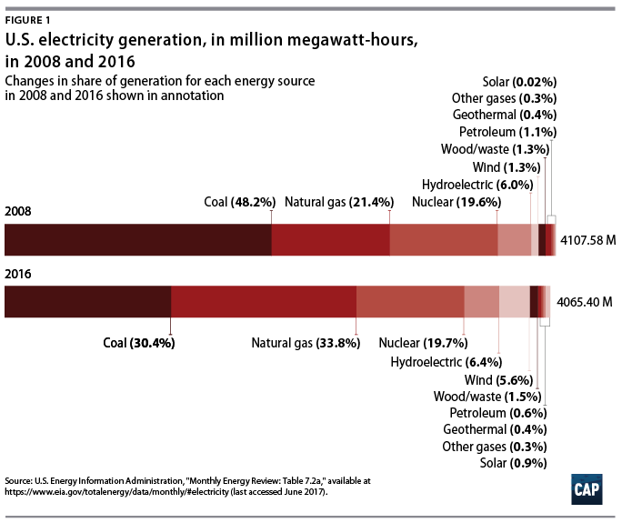
Obama administration?
Under the Obama administration, renewable energy and natural gas made great gains.
Biomass gains were more modest:
Renewable Fuel Standard (RFS)
Biomass Crop Assistance program
Biofuels Working Group
https://www.americanprogress.org/issues/green/reports/2017/06/29/435281/americas-clean-energy-success-numbers/
https://en.wikipedia.org/wiki/Energy_policy_of_the_Barack_Obama_administration

Slide 26
Trump administration?
August 2019: granted exemptions from the requirement for adding bioethanol to 31 of 40 small refineries.
“Iowa’s Republican Senator Chuck Grassley said the EPA had “screwed” the U.S. ethanol industry and farmers by granting the waivers.” - Reuters
December 2018: reauthorization of the Farm Bill, including Rural Energy for American Program (REAP) and Biomass Crop Assistance Program
- Established Interagency Biogas Opportunities Task Force
- But didn’t fund several of these programs as suggested
“The Trump administration endorsed burning trees and other biomass to produce energy on Thursday, vowing to promote a practice some scientists have declared more environmentally devastating than coal-fired power.” – Bloomberg News
April 2018: replaced Clean Power Plan, Affordable Clean Energy Rule
- Allows co-gen (addition of biomass to coal) to ‘reduce emissions’
http://biomassmagazine.com/articles/15838/trump-signs-2018-farm-bill

Slide 27
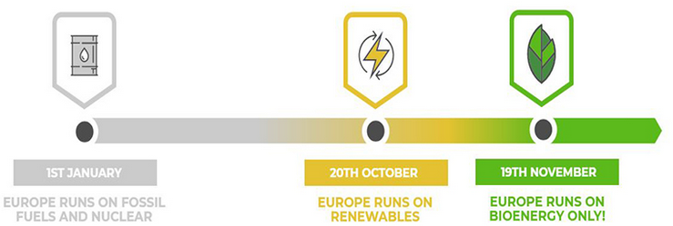
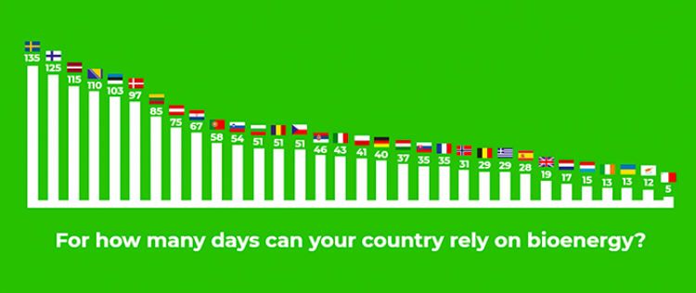
EU-28: annual days of bioenergy
43 days
U.S.
https://bioenergyinternational.com/opinion-commentary/poland-celebrates-national-bioenergy-day-2018
https://bioenergyinternational.com/markets-finance/biomass-can-heat-cool-power-and-transport-eu-28-for-43-days

Slide 28
7.10: Bioenergy feedstock materials

Slide 29
Feedstock & supply chain
Bioenergy feedstock: biomass-derived material that can be converted to energy using microbes, heat, chemicals or some combination thereof
Some amount of conversion (aka ‘refining’) is usually required to turn feedstock into use-ready biofuel.
Processing (refining) often involves densification (or aggregation) to make transport of feedstock easier and cheaper.
biomass
biofuel
energy for use
processing
refining
use
(often combustion)
supply chain / value chain
trees
cordwood, chips, pellets
heat, CHP, electricity
soybean plants
oil, biodiesel
heat, transportation fuel
Dahiya (2015)

Slide 30
Types of feedstock materials
woody
non-woody
lignocellulose
sugar
starch
cellulose/
lignocellulose
fats
Dahiya (2015)

Slide 31
Feedstock sources
forests
agriculture
waste
whole-tree chips
short-rotation woody crops
sawmill residues
perennial lignocellulosic crops
construction wastes
bole chips
municipal wastes
bark chips
lignocellulosic residues
oil / fat waste
sugars / starches
landfill gas
oils
municipal solid waste
Dahiya (2015)

Slide 32
Biomass feedstock availability
The 2005 report, ‘Biomass as Feedstock for a Bioenergy and Bioproducts Industry: the Technical Feasibility of a Billion-Ton Annual Supply’ prepared by DOE & USDA made these conclusions:
We have enough biomass to replace 30% of US petroleum use by 2030.
Biomass harvests could be increased from 2005’s 473 million to 1.1 billion dry tons annually with modest changes to land management practices.
2011 update decreased estimates of forest & crop residue resources, but increased the potential of energy crops.
Because biomass feedstock materials are not energy dense, transportation to processing plants affects the cost of feedstock and profitability of growing bioenergy feedstock.
Willingness to grow bioenergy crops may be limited by distance from processing plants.
Bioenergy Primer 1; BIOEN1

Slide 33
Ethanol feedstock availability
The 2008 report, ’90-Billion Gallon Biofuel Deployment Study’ prepared by Sandia National Lab and General Motors R&D Center looked at availability of feedstock for ethanol production.
hitectransportation.org/news/2009/Exec_Summary02-2009.pdf
90 billion gallons of biomass ethanol could be produced annually.
15 billion gallons from corn; and
75 billion gallons from cellulosic biomass, mainly perennial energy crops
Requiring 48 m acres of land now characterized as ‘idle, pasture of non-grazed forest’.
In order for cellulosic ethanol to become commercially viable:
Biomass producers will need consistent & reliable markets;
Production contracts to help ensure supply; &
Supportive policy to encourage development.
Bioenergy Primer 1; BIOEN1

Slide 34
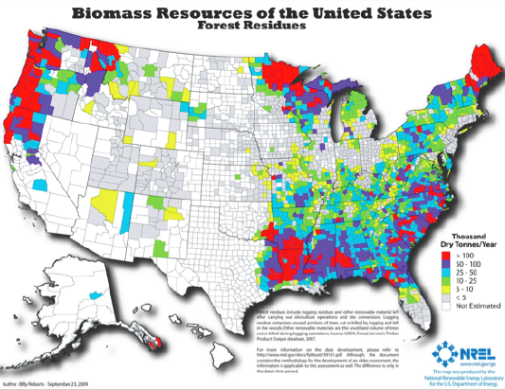
Forest-based feedstock sources
BIOEN1

Slide 35
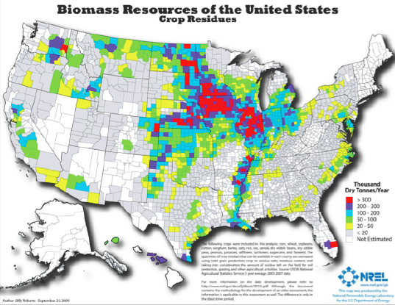
Agricultural residue sources
BIOEN1

Slide 36
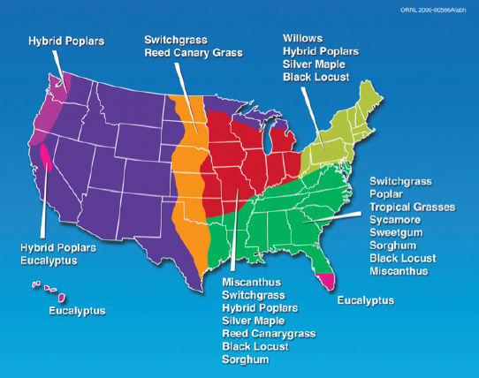
Agricultural perennial crops
BIOEN1

Slide 37
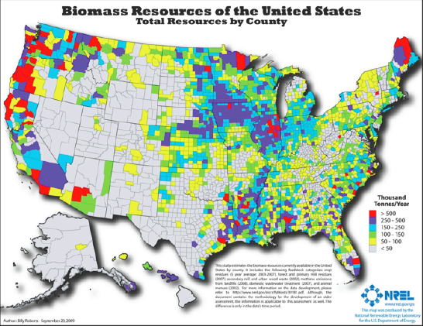
Total biomass sources
BIOEN1

Slide 38
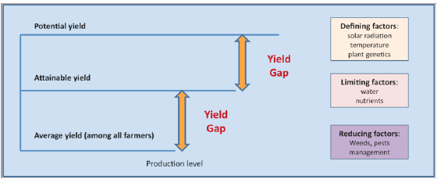
Biomass yields
Average yields are conservative estimates based on averages across producers and years. Attainable yields & potential yields can be obtained if all factors are optimized:
Nutrients (can be controlled to some extent)
Water
Weather
Pests & management
BIOEN1

Slide 39
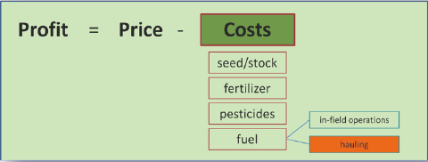
Biomass profits?
Typically, agricultural profits depend on the price paid for the crop and the combined cost of producing that crop.
Costs of hauling the crop to the buyer / processor must also be considered. So, producers will choose their crops, in part, on their distance from buyers or processing plants.
Biomass is an attractive crop to produce only when processing plants are close enough to limit the costs of hauling and allow profit.
BIOEN1

Slide 40
Biomass supply chain
source
biomass
processing
use / market
forests
tops & branches
small-diameter pulpwood
small understory trees
bark
power
heat
steam
biofuels
chemicals
annual crop residues
perennial energy crops
hybrid willow / poplar
densification
agriculture
all crop starches / sugar
construction materials
sawmill residue
cardboard & paper
waste
manure
food processing waste
food waste
BIOEN1

Slide 41
Feedstock by conversion process
thermal conversion
thermochemical conversion
biochemical conversion
chemical conversion
lignocellulose
lignocellulose
lignocellulose
organic wastes
fats / oils / grease
sugars starches (crops)
densification
torrefication
fermentation
gasification
combustion
anaerobic digestion
trans-esterification
pyrolysis
charcoal
methanol
syngas
bio-oil
power heat
steam
bio-coal
syngas
ethanol
biogas or biomethane
biodiesel
BIOEN1

Slide 42
7.11: Bioenergy co- & by-products

Slide 43
Bioenergy co-products
Co-products: non-energy products of bioenergy processing or use that have economic value
Distillers grains: grain after ethanol production
DDG (dry distillers grains) & WDG (wet distillers grains)
Produced by 60% of ethanol plants: dry-mill plants
Animal feed; AD feedstock
Bagasse: the fibrous material remaining when sugarcane is crushed
Combusted, cellulosic ethanol feedstock; AD feedstock
Glycerol (aka glycerin): high-energy liquid co-product of biodiesel
Used by cosmetic & food industries if purified
Combusted & used for AD feedstock
950,000 tons produced per year with surplus above market demand
Biochar: co-product of gasification or pyrolysis
Used as soil amendment: holds nutrients & sequesters carbon
BIOEN1

Slide 44
Bioenergy by-products
By-products: non-energy products of bioenergy processing or use that do not have significant economic value
Fly ash: fine particulate matter from solid fuel combustion; silica-rich
Air pollutant & health hazard regulated by EPA
Less than half of US fly ash is recycled as amendment to Portand cement
Waste water: water containing biomolecules
Regulated and cannot be dicharged into waterways without treatment
Liquid remainder from distillation of grains for ethanol
4-6 gallons of wastewater are produced per gallon of ethanol
Water used to ‘wash’ alcohol and glycerol from biodiesel
Can be treated via anaerobic digestion though it has a low energy content
Carbon dioxide: produced by combustion of biofuels
Will be regulated by EPA
We need to make CO₂ into a co-product!
BIOEN1

Slide 45
7.12: Drivers of bioenergy and the bioenergy debate

Slide 46
What drives use of bioenergy?
The current interest in expanding use of bioenergy is driven by:
Desire for energy independence or energy security.
Local energy sourcing can provide local economic development.
Renewable energy
Carbon neutrality (less impact on global climate change)
Recycling of nutrients – in biogas and to some extent biomass
Recent surge of interest seems to relate most strongly to:
The potential for sustainability!
The potential for disseminated global economic development &
local energy security
Dahiya (2015)

Slide 47
Policy influences bioenergy use
Since 1918, US governmental policy has provided the fossil fuel industry with substantial support in the form of subsidies and drilling rights. In comparison, support for renewable energy has been insignificant, and has become a political football.
Fossil fuels $446.96 b
Renewable energy $5.93 b
In 2011, worldwide, fossil fuel subsidies:
$480 b pre-tax
$1.9 t on a post-tax basis including externalities like carbon,
environmental impacts and public health
Eliminating the US’s 12 fossil fuel subsidies would save $41.4 b over a decade without increasing fuel prices, reducing unemployment or weakening energy security.
This would make a dent in energy transition costs.
www.energyfactcheck.org; bit.ly/N9lsin; bit.ly/1coLJmn; bit.ly/1h3mDhB

Slide 48
Recent bioenergy incentives
Ethanol production from corn has been supported by:
State & federal tax subsidies
Mandated use of ‘high oxygen’ gasoline
the Clean Air Act Amendments of 1990
2006: Advanced Energy Initiative: funding for biofuel processes
2007: “20-in-10” plan to reduce gasoline use by 20% in a decade
2007: Renewable Fuel Standard passed as part of the Energy
Independence & Security Act of 2007
36 b gallons of biofuel by 2022
Provisions for advanced biofuels
2008: Farm Bill - mandatory USDA funding for bioenergy activities.
August 2019: granted exemptions from the requirement for adding bioethanol to 31 of 40 small refineries.
“Iowa’s Republican Senator Chuck Grassley said the EPA had “screwed” the U.S. ethanol industry and farmers by granting the waivers.” - Reuters
Dahiya (2015); www.energyfactcheck.org/

Slide 49
Biofuel development ‘Roadmaps’
US DOE (EERE), UDSA, EPA have released ‘roadmaps’ for bioenergy:
A vision backed up by information;
A promise to look for and provide some funding; and
An attempt to shake market inertia.
August 2014 Biogas Opportunities Roadmap
www.usda.gov/oce/reports/energyBiogas_Opportunities_Roadmap_8-1-14.pdf
Advocates for increasing the number of US AD facilities from 240 to 11,000 over the next decade.
Urges voluntary action
Leverages $10 million of funding
2010 National Algal Biofuels Technology Roadmap
www1.eere.energy.gov/biomass/pdfs/algal_biofuels_roadmap.pdf
2011 IEA Biofuels for Transport Roadmap www.iea.org/publications/freepublications/publication/biofuels_roadmap_web.pdf
Biofuel could power 27% of the transport sector by 2050
Bioenergy Primer 1

Slide 50
Bioenergy debate: major issues
While there is disagreement about whether specific and overall impacts of bioenergy will be positive or negative, there is no doubt about the issues of being discussed and debated.
Social & economic development
Energy independence
Land use / sustainable practices
Ecology: environmental quality; biodiversity; habitat conservation
Energy balance
Greenhouse gas (GHG) emissions
Subsidies
Food prices
BIOEN1; Rosillo-Calle & Johnson (2010)

Slide 51
Biofuels are controversial
PRO
There is sufficient land to produce both needed food & a significant amount of biofuel.
Food insecure countries don’t have access to fossil fuels, but could produce biofuels.
More than 2.5 billion people don’t have access to modern energy systems. Bioenergy can be developed as rural countries also develop food production.
These countries already have multi-functional agricultural systems that can be developed to provide more food and fuel.
The social & economic benefits of biofuels can outweigh the costs if good management is applied to food and biofuel production.
ANTI
Biofuel production will lead to worldwide food insecurity.
Increasing food prices will disproportionately affect the poorer people in less developed countries.
Land competition will increase as competing demands for food and energy production grow….
…resulting in deforestation, ecosystem disruption or destruction & loss of biodiversity.
Social & economic benefits of biofuels are not proven.
Large scale biofuel production will increase soil erosion, deplete water resources and stress other ecosystem services.
Rosillo-Calle & Johnson (2010)

Slide 52
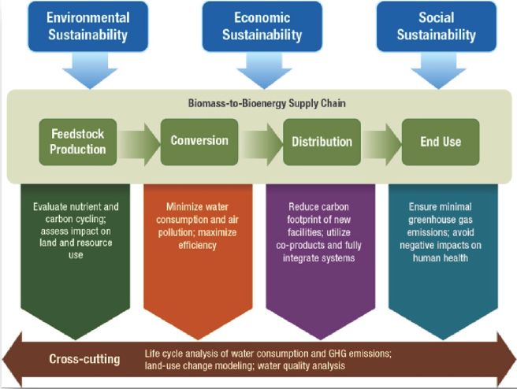
Critical thinking about bioenergy
How do we rationally assess the value and potential downsides of bioenergy?
BIOEN1

Slide 53
Life cycle analysis
Life cycle analysis or assessment (LCA): an approach to evaluating the direct & indirect effects associated with a product or process on human health and the environment in a ‘cradle-to-grave’ (or better yet, ‘cradle-to-cradle) analysis of the benefits and costs of a process or product.
LCA can be used to measure the effects of bioenergy production and use across the supply chain.
LCA allows for comparison of different products and processes.
LCA is a systems analysis; it examines a series of components, the processes that link those components, and the interactive effects of those processes on one another.
LCA analysis of bioenergy technologies is far from complete, but this approach is promising and essential.
For more on LCA, see BIOEN2: http://blogs.extension.org/bioen2/
BIOEN1

Slide 54
Concerns & solutions?
Concerns about the sustainability of bioenergy include:
Water use;
Impacts on soil;
Loss of biodiversity as more land is used to grow or harvest feedstock; &
Reductions in food production or food prices.
Guidelines and best management practices (BMPs) are needed, though few have been issued:
Forest Biomass Retention & Harvesting Guidelines for the Northeast
There are some third-party verifiers for sustainable forestry.
WI (& only that state) has guidelines for sustainable harvest & production of non-forest biomass.
Conclusion?
Bioenergy can be part of a sustainable approach to energy production if it is done well. That will require widespread, clear guidelines and follow through.
BIOEN1

Slide 55
Energy balance
Energy balance (or energy return on investment, EROI) is a measure of the ratio of energy produced to energy invested:
EROI = ______energy produced .
energy invested to produce energy
Traditionally the energy balance of first generation biofuels, like American biodiesel, has not been impressive.
However, continuous refinement & other technological improvements have improved energy balance.
Brazilian biofuel has improved five-fold in the last 20 years.
Rosillo-Calle & Johnson (2010)

Slide 56
Energy balance (EROI) values
EROI values aren’t easy to come by, but here are a few examples.
Fossil fuel | EROI
coal | 80
nuclear | 10 - 75
oil | 20 - 35
natural gas | 10
tar sands | 3
Bioenergy fuel | EROI
hydropower | 100
geothermal | 10 - 32
wind | 18
PV | 6.8
tar sands | 3
ethanol | 1.3 – 5.0
biogas | 2
biodiesel | 1.3
Rosillo-Calle & Johnson (2010)

Slide 57
EROI values: biomass
Biomass EROI values are generally below those of fossil fuels.
Fuel | EROI
domestic oil (1930) | 100:1
coal (2005) | 80:1
hydroelectric | 40:1
Imported oil (1970) | 38:1
domestic oil (1970) | 37:1
firewood | 30:1
Imported oil (2005) | 30:1
wind | 28:1
natural gas | 16:1
nuclear energy | 16:1
domestic oil (2000) | 9:1
solar photovoltaic | 6:1
tar sands | 6:1
biodiesel and bioethanol | 2:1
Energy return on investment (EROI) of different wood products, Pandur et al.

Slide 58
Wood fuel comparisons
How do values for wood stack up?
Less processing allows greater EROEI values.
Fuel | Price | Thermal efficiency | $/Mbtu* | EROEI
cord wood | $200-300/cord | 50 - 60% | $15.15 | 50:1
wood chips | $80/ton | 30% |  | 18:1
wood pellets | $260/ton | 80 - 85% | $15.15 | 15:1
co-op wood pellets | $120/ton | 80 - 85% | $9.09 | 15:1
fuel oil | $2.81/gallon | 70% | $41.20 | 9:1
natural gas | $17.07/TCF | 80% | $54.74 | 16:1
* $/million Btu
EROEI = energy return on energy investment: EROEI depends on distance transported & system efficiency
Other studies find higher whole-tree wood chip EROI values of ~27:1
Vermont sustainable heating initiative (2012)
Residential wood heat: a non-commercial service in support of responsible home heating with wood (2016)

Slide 59
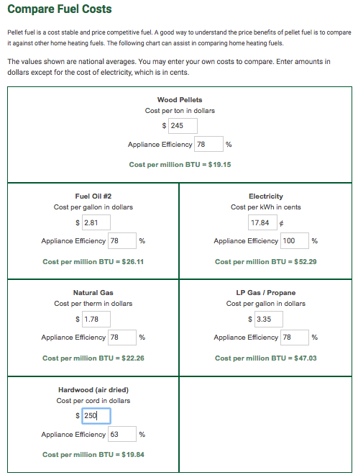
Cost calculators
A number of websites provide comparison tools.
This screenshot uses approximate Vermont costs in September of 2019.
https://www.pelletheat.org/compare-fuel-costs

Slide 60
7.13: Cord wood

Slide 61
Vermont residential heating
Statistics from the US Energy Information Agency (EIA) don’t include wood as a residential heating fuel.
However, 16% of Vermont households have wood stoves (2012)
This is the highest per capital use of wood stoves in the US.
In Canada, 20% of households use some wood heat.
VT residential heating fuel | 2012 (%) | 2019 (%)
fuel oil | 59 | 60
propane | 14
natural gas | 12 | 20
electricity | 5
other | 10
wood |  | 14
Total | 100 | 94
have wood stove? | 16
In 2008, the average Vermont household used 4.3 cords of wood.
Vermont sustainable heating initiative (2012)
https://www.eia.gov/state/print.php?sid=VT

Slide 62
When is cordwood a good option?
Cordwood systems are generally less expensive than woodchip or pellet systems and are good options when:
Heat, but not electricity, is sought;
The cordwood is produced locally; &
The space to be heated is relatively small, making chip or pellet systems to expensive.
Target heating load for cordwood systems?
100,000 – 900,000 Btu/hour
Replacing systems that require 2,500 – 30,000 gallons of oil per year
Cordwood energy systems for community heating in Alaska: an overview, USDA (2009)

Slide 63
More efficient cordwood systems?
Cordwood heating systems, particularly small residential systems, are often inefficient and produce high levels of air emissions:
However, more efficient cordwood systems are available with:
Efficient combustion (> 70%);
Heating loads of 350,000 – 950,000 Btu/hour;
Refractory-lined combustion chambers;
Better use of fans; all leading to lower levels of particulate emissions.
Fed manually;
Also: larger water heat storage units with 1,500 – 4,400 gallon capacities.
Such systems generally need to be stoked (loaded with cordwood) several times a day.
Cost of a good cordwood system? <$100,000 for system that displaces 2,500 – 30,000 gallons of oil per year.
Cordwood energy systems for community heating in Alaska: an overview, USDA (2009)

Slide 64
Residential cord wood gasifier
Tarm offers the Austrian Fröling FHG wood boiler that uses wood gasification combustion technology for residential heating.
91% overall efficiency when combined with a 500 – 1000-gallon water storage tank
Down-draft gasification is used for hot & fast combustion.
Water stores the heat provided by intermittent but hot combustion at maximum efficiency.
Thermal storage allows most homes to heat with one firing per day.
Clean double-burn with very little smoke and creosote
Primary combustion produces wood gases; &
Secondary burn adds oxygen & combusts the gases at 1800 - 2000°F.
Operating features:
Smokeless addition of wood;
Periodic ash removal
www.revisionheat.com/home-cord-wood-boilers/

Slide 65
Gasification case study
NY stone home built in 1948.
3 levels
3,000 square feet
Original oil-fired hot air furnace inefficient ($1,400/month for 55°F)
Renovations weatherized the building & added radiant floor heating.
Fröling FHG-L wood gasification boiler was chosen for primary heating.
2 combustion chambers w/ final combustion temps of 1800 - 2000°F
Microprocessor control via oxygen & temperature sensors
Three pressurized 220-gallon thermal storage tanks set at 100°F
A domestic hot water tank stores at 140°F
Six zone radiant floor system
Backup heating system is an efficient propane-fired boiler.
Performance?
‘We only have to put in wood maybe twice a day on very cold days…then you put two pieces of paper in, and light it. It’s the easiest thing. We clean it out maybe once every two weeks.’
Old stone home uses modern heating technology, Radiant Living (2012)

Slide 66
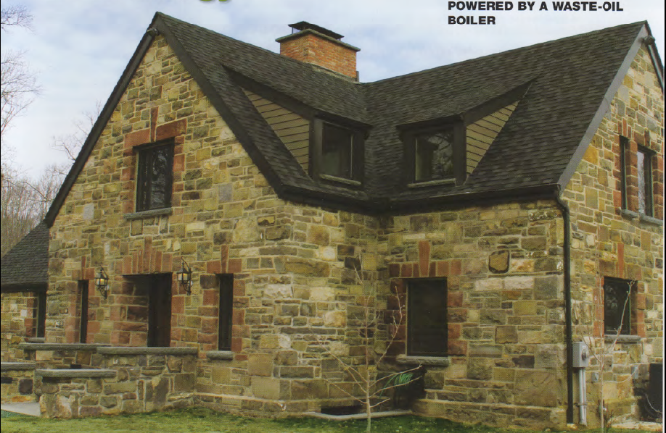
Cord wood gasification case study
Old stone home uses modern heating technology, Radiant Living (2012)

Slide 67
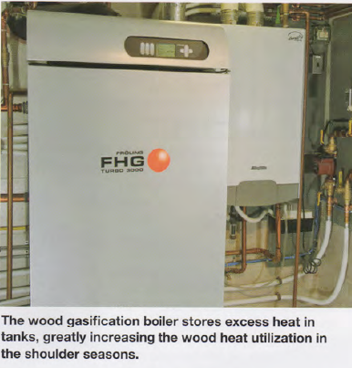
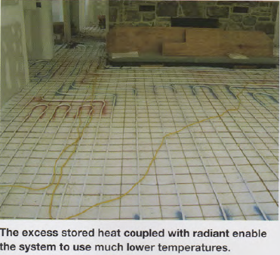
Radiant heat is more efficient
Old stone home uses modern heating technology, Radiant Living (2012)

Slide 68
7.14: Wood chip energy

Slide 69
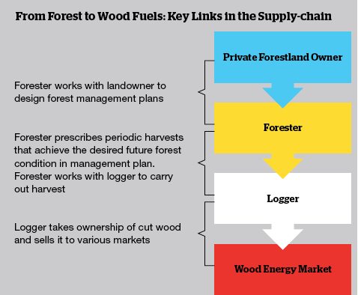
Where do woodchips come from?
Traditionally, woodchips are produced as a co-product by sawmills and wood processors. But sawmills have declined in the Northeast.
Today, most chips are produced by harvesters and chipping contractors.
Low-quality wood used for chips is usually harvested only as the better timber is cut. Cutting only low-quality wood is not as economically feasible.
A buyer’s guide to sourcing wood heating fuel in the northeastern US, BERC (2014)

Slide 70
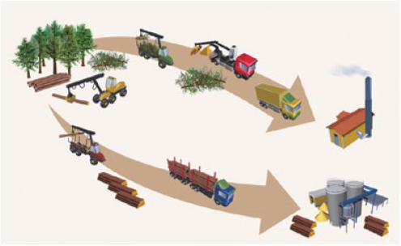
What type of wood is chipped?
Chips can be made from many tree species and tree components.
Bole chips made by chipping stems of low-quality trees now produces most wood chips used for heating. Often chipped in yards
Tops and limbs are often chipped in the woods.
Whole trees can be chipped in the woods.
A buyer’s guide to sourcing wood heating fuel in the northeastern US, BERC (2014)

Slide 71
Cost and reliability?
Chips cost less than fossil fuels, typically 30% less.
In 2014, chips for heating cost $45 - $65 per green ton.
Chip prices are less volatile than fossil fuel prices.
In Vermont, prices have increased 2% since 2000.
Factors that impact cost:
Wood source & production costs.
Strength of the saw log market.
Regional balance of supply & demand for low-quality wood. Other uses:
Pulp mills (paper mills);
Power plants; and
Pellet mills.
Trucking distances
Demand and demand seasonality
Woodchip quality
Lower demand frees up low-quality
wood for energy
A buyer’s guide to sourcing wood heating fuel in the northeastern US, BERC (2014)

Slide 72
Tracking the origin of chips?
If you buy chips directly from the forest harvest location documenting the source of the chips is fairly simple.
However, in practice tracking chip origin is rarely simple.
Wood is often aggregated from several logging jobs prior to chipping;
And chips aren’t usually segregated by origin.
Buying chips from specific management processes is possible but costs more.
Verification is required.
1st-party verification: the logger self-verifies
2nd-party verification: the consumer verifies by assessing the supplier’s records
3rd-party verification: sourcing is verified by someone with a vested interest who is not the producer or consumer. Considered the most rigorous.
A buyer’s guide to sourcing wood heating fuel in the northeastern US, BERC (2014)

Slide 73
National Life case study
National Life (Montpelier) heats their HQ with wood chips.
Bids for long-term supply asked about price, quality, reputation and source.
Limlaw Pulpwood & Chipping (Topsham VT) has the contract.
Wood comes from a 50-mile radius.
Sourced from 50 small suppliers.
Most is cut by under the guidance of a forester;
But only a small fraction is 3rd-party certified by FSC, SFI or Tree Farm
National Life would like to buy more certified material but it just isn’t available.
A buyer’s guide to sourcing wood heating fuel in the northeastern US, BERC (2014)

Slide 74
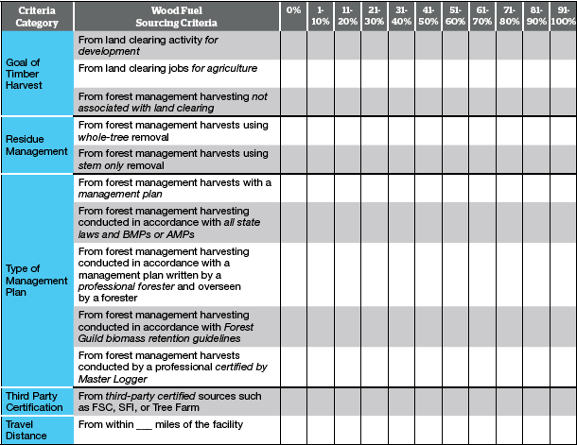
Wood sourcing template (BERC)

Slide 75
When to use chips?
Woodchip systems are cost-effective where:
Conventional (fossil) fuels are expensive;
In larger facilities;
Financed for 10 years or more; and / or
There are state funds to subsidize installation.
Wood-chip heating systems: a guide for institutional and commercial biomass installations, BERC (2004)

Slide 76
Wood combustion FAQs
Q: Doesn’t this require a lot of labor?
A: Depends on the degree of automation. Systems loaded with a tractor
require an extra 30’ a day from the operator.
Q: Isn’t wood fuel a fire hazard?
A: Green chips are 50% water and won’t ignite outside of the furnace.
Q: Won’t the system increase truck traffic?
A: Depends: may be several times a week or once every few months.
Q: Won’t the wood smoke be a health hazard?
A: Large institutional systems are designed to meet air quality standards.
Q: Won’t the wood smoke cause acid rain?
A: No, wood fuel doesn’t produce SOx.
Q: Isn’t wood ash toxic?
A: No, wood ash is used as an agricultural fertilizer.
Q: Is there enough wood in the region to increase use of wood fuel?
A: Yes, the Northeast has underutilized stocks of low-grade wood.
Q: Is wood heat cheaper than gas or oil heat?
A: It has been over the last twenty years, but may not be right now.
Wood-chip heating systems: a guide for institutional and commercial biomass installations, BERC (2004)

Slide 77
Backup systems
Many commercial & institutional biomass plants have oil or gas backup using additional boilers for those fossil fuels.
Backup systems might be used when:
The heating load is too small for the biomass system’s scale;
When the biomass system is being serviced;
If the woodchip bin is empty;
If the woodchip system malfunctions;
When the heating load exceeds the biomass system’s capacity both systems can be used.
Activation of backup systems can be manual or automatic.
Wood-chip heating systems: a guide for institutional and commercial biomass installations, BERC (2004)

Slide 78
Emissions control
Institutional & commercial biomass systems usually have very low stack emissions and meet state air quality standards.
Air quality regulations are usually triggered by the size of the boiler and heat exchanger.
Small systems may not trigger regulations.
Particles can be removed from stack exhaust using cyclone separators or multi-cyclones.
Mounted between the heat exchanger and chimney.
Larger institutional systems may used newer ‘core separators’ that are particularly effective at removing fine particles.
Very large plants may have additional equipment to clean gases:
Char re-injectors;
Wet scrubbers; and
Bag houses.
Wood-chip heating systems: a guide for institutional and commercial biomass installations, BERC (2004)

Slide 79
When are woodchips effective?
Generally, woodchip systems are most cost-effective when:
Space-heating electricity and oil prices are high;
Energy consumption is high;
The competing fuel is electricity rather than oil or gas;
A new system is being installed rather than an old system being replaced;
A hydronic (hot water or steam) heat distribution system is already in place.
Wood-chip heating systems: a guide for institutional and commercial biomass installations, BERC (2004)

Slide 80
7.15: Wood pellet energy

Slide 81
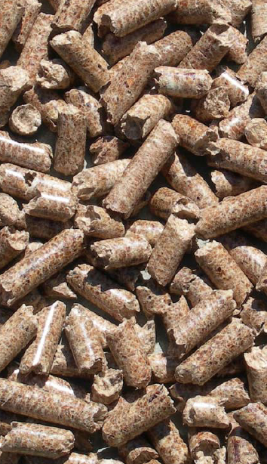
What are wood pellets?
Pellets are compressed wood:
Sometimes by-products, sometimes de novo products
Uniformly sized: ¼ - 5/16” in diameter and 1 – 1 ½ inches long;
Easy to store; &
Easy to use.
Because the moisture content of wood must be lowered before pellets can be made, the energy content of pellets is higher than other forms of wood biomass.
6% moisture
7,750 Btu per pound
Grades classified by amount of ash produced:
Premium: <1% ash
Standard: 1-2% ash
Industrial: > 3% ash
Wood pellet heating: a reference on wood pellet fuels & technology for small commercial & institutional systems

Slide 82
Use of wood pellet heating
As of 2007, 800,000 US homes used wood pellet stoves or furnaces for heating.
And use of pellet heat for larger buildings is increasing in Europe, and more slowly in the US:
Municipal or federal buildings;
Schools & colleges;
Housing complexes;
Office buildings, etc.,; &
Greenhouses.
In these larger settings pellets are delivered and stored in bulk for use by large boiler systems.
Wood pellet heating: a reference on wood pellet fuels & technology for small commercial & institutional systems

Slide 83
Candidates for wood pellets
Buildings:
between 10,000 – 50,000 square feet;
use electricity or fossil fuel for space heating and hot water;
or are new construction;
with heating loads of 0.25 – 1.5 million Btu per hour.
Buildings should have:
Centralized hot water heat distribution;
Space for bulk wood pellets near the boiler; &
Access for delivery to the silo.
Ideally, pellet users should be no more than 50 miles from the supplier to control delivery charges.
Wood pellet heating: a reference on wood pellet fuels & technology for small commercial & institutional systems

Slide 84
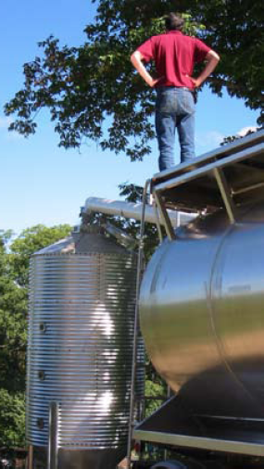
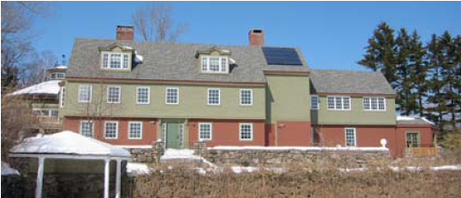
Case study: Harris Center (NH)
The Harris Center for Conservation Education provides educational programs and serves as a local land trust.
10,000 SF heated space
Nine-ton silo
Annual use of 10 – 15 tons
75 minutes per week
45% fuel cost savings (2007)
Wood pellet heating: a reference on wood pellet fuels & technology for small commercial & institutional systems

Slide 85
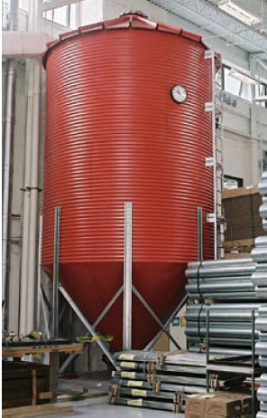
Case study: NRG Systems (VT)
NRG Systems makes wind-measurement equipment for the wind power industry.
Note that the building is so efficient that its heating load is smaller than expected for a building of this size.
46,000 SF heated space
30-ton silo (just 30-tons per year)
Fuels two residential scale 140,000 Btu/hour boilers
15 minutes per day
Offset 4,735 gallons of propane annually
Wood pellet heating: a reference on wood pellet fuels & technology for small commercial & institutional systems

Slide 86
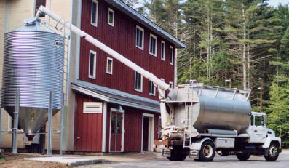
Bulk delivery considerations
Bulk delivery is very convenient for the user as most storage systems automatically feed pellets to the stove or boiler and require little work by the users.
However, bulk delivery and storage require a reliable supplier. When finding a supplier consider the following issues:
Delivery distance: less than 50 miles optimally;
Commitment to the bulk market;
Guarantee of a reliable supply;
Quality of pellets: avoid pellets produced from construction & demolition waste and be sure that pellet quality is compatible with the heating equipment you choose.
Wood pellet heating: a reference on wood pellet fuels & technology for small commercial & institutional systems

Slide 87
More than one building?
Wood pellet boilers can be used to heat small district systems: several buildings located close to one another.
The boiler is located in the most central building.
Buried hot water distribution pipes connect to the other buildings.
Creation of small districts tend to maximize cost savings as a single boiler system needs to be purchased, installed and maintained.
Wood pellet heating: a reference on wood pellet fuels & technology for small commercial & institutional systems

Slide 88
Air emissions?
Like all fuels, wood produces a variety of air emissions:
Particulate matter (PM);
Carbon monoxide (CO);
Nitrogen oxides (NOx); &
Sulfur oxides (SOx)
← Increased with wood vs. fossil fuel
← Decreased with wood vs. fossil fuel
Partial emissions data for wood pellets from a Danish study.
lb / million Btu | PM10 | CO | NOx | SOx
wood pellet boiler | NA | 0.51 | 0.272 | NA
wood chip boiler | 0.1 | 0.73 | 0.165 | 0.0082
oil boiler | 0.014 | 0.035 | 0.143 | 0.5
propane boiler | 0.004 | 0.021 | 0.154 | 0.016
natural gas boiler | 0.007 | 0.08 | 0.09 | 0.0005
Wood pellet heating: a reference on wood pellet fuels & technology for small commercial & institutional systems

Slide 89
Heating fuel equivalencies
One ton of wood pellets equals:
120 gallons of heating oil;
170 gallons of propane;
16,000 cubic feet of natural gas; or
4,775 kWh of electricity.
A price of $200/ton for pellets is the equivalent of these fuel prices:
$1.67 per gallon for heating oil;
$1.18 per gallon for propane;
$12.50 per 1000 cubic feet for natural gas; or
$0.04 per kWh for electricity.
Over the last 20 years, only natural gas has been competitive with wood pellets.
Wood pellet heating: a reference on wood pellet fuels & technology for small commercial & institutional systems

Slide 90
Calculating fuel cost savings
Step 1: Calculate total fuel use and costs.
(total fuel units used annually)(fuel price) = current annual fuel bill
(5,000 gallons of heating oil)($2.03/gallon) = $10,150
Step 2: Calculate tons of pellets required to replace current fuel.
total fuel units used annually = tons * $price = $ annual pellet cost
fuel units per ton year ton
5,000 gallons of heating oil = (41.67 tons)($260/ton) = $10,833.33
120 gallons/ton
Step 3: Calculate potential fuel savings
Potential cost savings = $ annual pellet cost - $ current annual fuel bill
$10,150 - $10,833 = - $683
Wood pellet heating: a reference on wood pellet fuels & technology for small commercial & institutional systems

Slide 91
Economic analysis
When are pellet boilers cost effective? Life cycle cost (LCC) or analysis incudes fuel costs, inflation rates, projected costs and calculates the net present value (NPV) of savings over the life of the pellet boiler system.
Spreadsheet-based LCC analysis tools are available from:
BERC
National Resources Canada (RETScreen)
Universities of Wisconsin and Alaska
Select architects & engineers
Wood pellet heating: a reference on wood pellet fuels & technology for small commercial & institutional systems

Slide 92
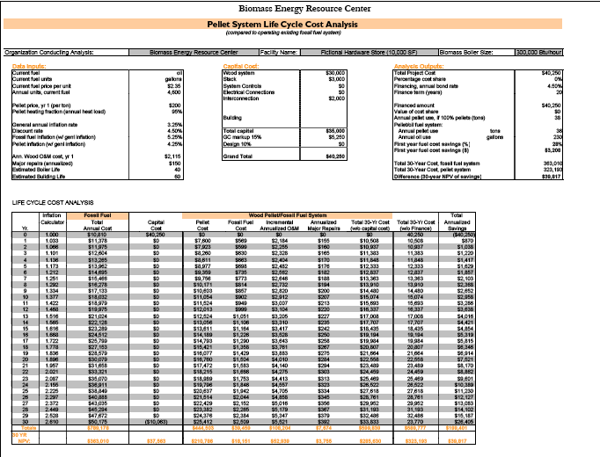
BERC LCC
Wood pellet heating: a reference on wood pellet fuels & technology for small commercial & institutional systems

Slide 93
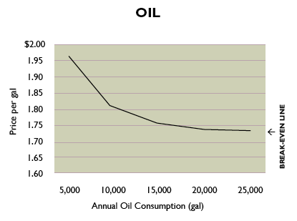
LCC of wood vs. alternate fuel
The line on the graph represents the break-even point: where the wood pellet system costs as much as it saves over the 30-year life of the system.
wood pellets are cost effective
wood pellets are not cost effective
Wood pellet heating: a reference on wood pellet fuels & technology for small commercial & institutional systems

Slide 94
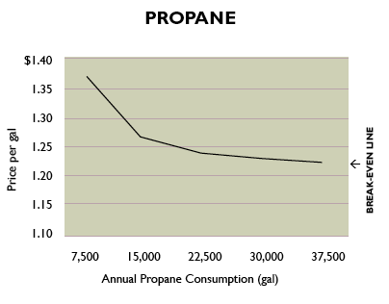
LCC of wood vs. alternate fuel
The line on the graph represents the break-even point: where the wood pellet system costs as much as it saves over the 30-year life of the system.
wood pellets are cost effective
wood pellets are not cost effective
Wood pellet heating: a reference on wood pellet fuels & technology for small commercial & institutional systems

Slide 95
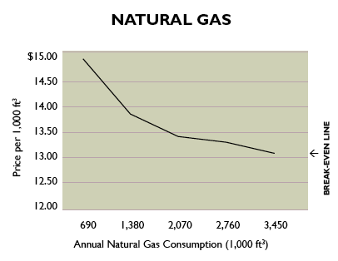
LCC of wood vs. alternate fuel
The line on the graph represents the break-even point: where the wood pellet system costs as much as it saves over the 30-year life of the system.
wood pellets are cost effective
wood pellets are not cost effective
Wood pellet heating: a reference on wood pellet fuels & technology for small commercial & institutional systems

Slide 96
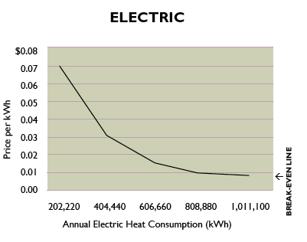
LCC of wood vs. alternate fuel
The line on the graph represents the break-even point: where the wood pellet system costs as much as it saves over the 30-year life of the system.
wood pellets are cost effective
wood pellets are not cost effective
Wood pellet heating: a reference on wood pellet fuels & technology for small commercial & institutional systems

Slide 97
Detailed LCC analysis?
Wood pellet systems typically cost $75,000 – 100,000 per million Btu.
Includes:
System equipment & installation;
Fuel storage & handling system & installation;
Construction;
Site costs;
Chimney equipment & installation;
Emissions permit or control equipment;
Professional fees (like engineering); and
Connection of controls & piping to existing heat distribution system.
LCC analysis should include O&M costs:
30’ per day for the staff who operates the system; &
Routine parts and or service.
Wood pellet heating: a reference on wood pellet fuels & technology for small commercial & institutional systems

Slide 98
Fictional LCC: hardware store
A hardware store is located within 50 miles of a wood pellet distribution center. The store is roughly 10,000 SF and uses 4,600 gallons of heating oil per year at an average cost of $2.35 per gallon. This is an annual heating cost of $10,810. The cost of pellets is $200 per ton, delivery charges included.
LCC calculates the total project cost, including fuel, at $39,817 and shows that the store would save $3,208 (28%) during the first year of operation.
This translates to $45,000 over 30 years.
This LCC analysis suggests going forward with installation.
Wood pellet heating: a reference on wood pellet fuels & technology for small commercial & institutional systems

Slide 99
Fictional LCC: Town Hall
The Town Hall is a municipal building located within 50 miles of a wood pellet distribution center. The building houses a variety of town offices within its 30,000 SF. The space is heated by one central boiler. The price of oil is $2.35 per gallon. Pellets would cost $200 per ton.
LCC shows that the Town Hall would require 110 tons of pellets per year and that a pellet system would cost $124,200.
First-year fuel savings would be 28 percent.
This translates to $211,722 over 30 years.
This LCC analysis suggests going forward with installation.
Wood pellet heating: a reference on wood pellet fuels & technology for small commercial & institutional systems

Slide 100
7.16: Grass biomass energy

Slide 101
Grass biomass conversion
Direct combustion with or without co-fire
Simplest with lowest cost
Does not require huge supply or high-capital processing
Synthetic fuel production via thermal or biochemical conversion
Requires very large supplies of biomass feedstock
And capital intensive processing plants
Most feasible in the Mid-West and South
Dahiya (2015)

Slide 102
Solid fuel for combustion
Direct combustion is the most energy efficient use of grass as a fuel.
Grass is generally harvested at 10 – 12% moisture content as long hay or chopped grass.
Harvested dry grass can be burned with or without additional densification:
Whole bales;
Briquettes or cubes; or
Pellets
Increasing processing / production costs
Densification:
Increase production costs; but
Decreases storage costs of the finished fuel product.
Dahiya (2015)

Slide 103
Grass energy combustion
There are four models for combusting grasses for energy.
Closed loop, no processing (aka whole bale burning)
Works for high thermal load;
Campuses with district heating, hospitals, office complexes, large facilities.
← Easiest to implement
2. Small scale on-farm processing uses a small stationary or
mobile pelletizer or densifier.
Used on-farm or sold to local users.
← most challenging
3. Regional processing at a central plant using locally grown grass.
Densified fuel delivered to local & regional commercial users.
Users be directed to appropriate furnaces / boilers.
4. Consumer pellet market using a central pelletizing plant fed by
local and regional biomass producers.
Goal: producing standardized pellets.
Users would be directed to appropriate furnaces / boilers.
← Hard to compete with wood unless demand increases.
Grass Energy in Vermont and the Northeast, Wilson Engineering for VSJF (2014)

Slide 104
Whole bale burners
Whole bale burners are fairly common in Europe, particularly Scandinavia.
Plants are large (district or region);
150 – 1,000 kW = 0.5 – 3.5 MM Btu / hour
Storage costs for bales are higher;
Boilers have moving grates to cope with clinkers; a
Automated ash handling systems;
Large thermal storage, usually water, to allow a constant burn rate.
Dahiya (2015)
Grass Energy in Vermont and the Northeast, Wilson Engineering for VSJF (2014)

Slide 105
Grass densification
Densification of grass involves a number of processing steps.
Hay bales are fed into a tub grinder that creates small lengths.
This material is fed to a grinder or hammer mill. Briquettes can be formed at this step.
Hammer milling must create particles of 3.5 mm or less.
Particles are passed through a cyclone to remove air.
Particles are pushed through a heated die where pressure and heat soften and crush the particles together into pellets.
Pellets are cooled and screened to remove fines.
densification | production cost ($/ton)
briquette | $130
cubes | $128
pellet | $173
Dahiya (2015)
Grass Energy in Vermont and the Northeast, Wilson Engineering for VSJF (2014)

Slide 106
Vermont study of grass biofuel
The Vermont Grass Energy Partnership conducted a study to learn more about:
Growing & harvesting perennial grasses;
Pre-processing & densifying the grasses;
Combustion of densified grass, and grass-wood blends; &
Air emissions from the combustion.
Three perennial hay grasses were studied:
Switchgrass (Panicum vigratum) A promising biomass grass not typically grown in Vermont
Reed Canarygrass (Phalaris arundinacea) Common in Vermont & adapted to many conditions including wet, marginal soil
Mulch hay Hay that is too poor in quality to serve as livestock feed
Technical assessment of grass pellets as boiler fuel in Vermont, BERC (2011)

Slide 107
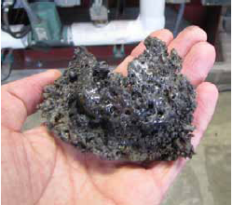
Energy, clinkers & emissions
The energy content of grass pellets was quite comparable to that of wood pellets.
Energy content
wood | 100%
switchgrass | 102%
Reed canarygrass | 90%
mulch hay | 92%
However, fused minerals (aka clinkers) formed during test combustion of the grass pellets.
Grasses had higher concentrations of N, S and Cl than wood, creating more potential emissions:
NOx
SOx
Corrosive chlorine-containing gases.
Stack emission tests confirmed higher Nox & ash (particulate) emissions.
Technical assessment of grass pellets as boiler fuel in Vermont, BERC (2011)

Slide 108
Cost & markets
A 2014 study of growing, harvesting and pelletizing switchgrass at Wood Crest Farm in PA found that the barebones cost of producing and pelletizing switchgrass was $89 per ton without including the cost of labor, equipment purchase or land rental.
While the intended market for switchgrass is energy a grower should be aware of alternate markets. In PA, a switchgrass grower has found these markets:
Ground switchgrass is used as a landscaping mulch and sold to landscapers or hardware and gardening stores;
Animal bedding for cows and chickens; &
Absorbent and erosion control.
On-farm production of biomass grass pellets, Penn State Extension, (2014)

Slide 109
Modeling economics of grass
The return on energy grasses isn’t high so keeping the costs of production down is essential.
Fortunately grasses require very few inputs once established.
Switchgrass cost of production for five yield scenarios
Establishment cost ($/acre): $350 - 400
Annual maintenance & harvest cost ($/acre): $170 - 270
Scenario | 1 |  | 2 | 3 | 4 | 5
Biomass yield (tons/acre)
Establishment year | 0 |  | 0 | 1.5 | 1.5 | 1.5
Year 2 | 2.0 |  | 2.0 | 2.5 | 2.5 | 2.6
Years 3 - 10 | 4.0 |  | 5.0 | 4.0 | 5.0 | 6.0
Total yield (10 years) | 34 |  | 42 | 36 | 44 | 52
Average yield/year | 3.4 |  | 4.2 | 3.6 | 4.4 | 5.2
Annual average cost
$/acre | 261 | 261 |  | 261 | 261 | 286
$/ton | 77 | 62 |  | 73 | 59 | 55
Costs of establishing stands?
From seed: $400 – 500/acre
From rhizomes: $1500 – 2000/acre
N added & economics improved
Dahiya (2015)

Slide 110
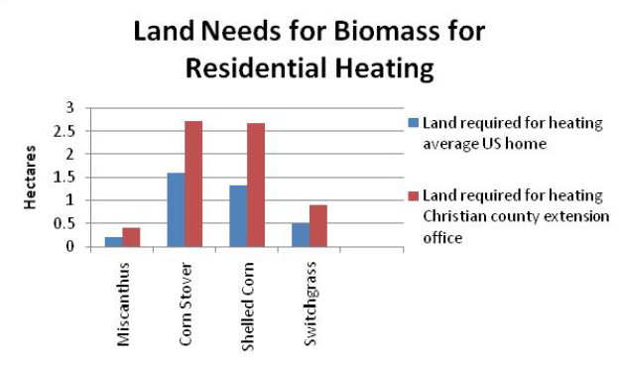
Land use for residential heating?
How much land would be needed to grow enough biomass to heat a residence?
Economics of using biomass for residential heating, U Ill, Urbana-Champaign

Slide 111
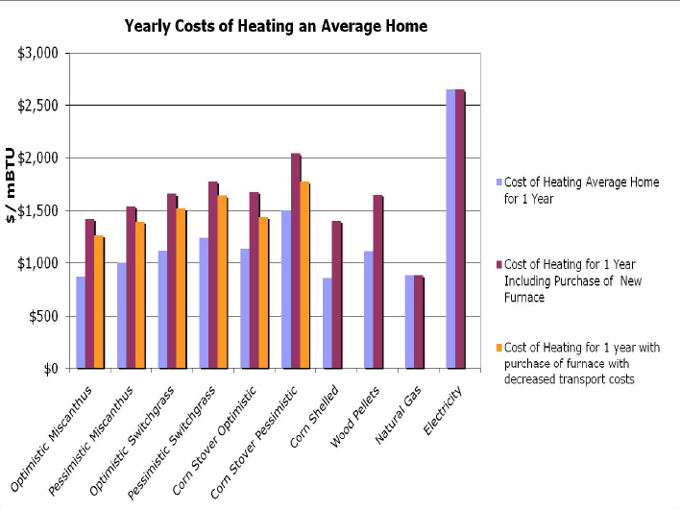
Annual cost of heating?
How much would it cost to heat a home with biomass vs. fossil fuels?
Economics of using biomass for residential heating, U Ill, Urbana-Champaign

Slide 112
7.17: Carbon neutral?

Slide 113
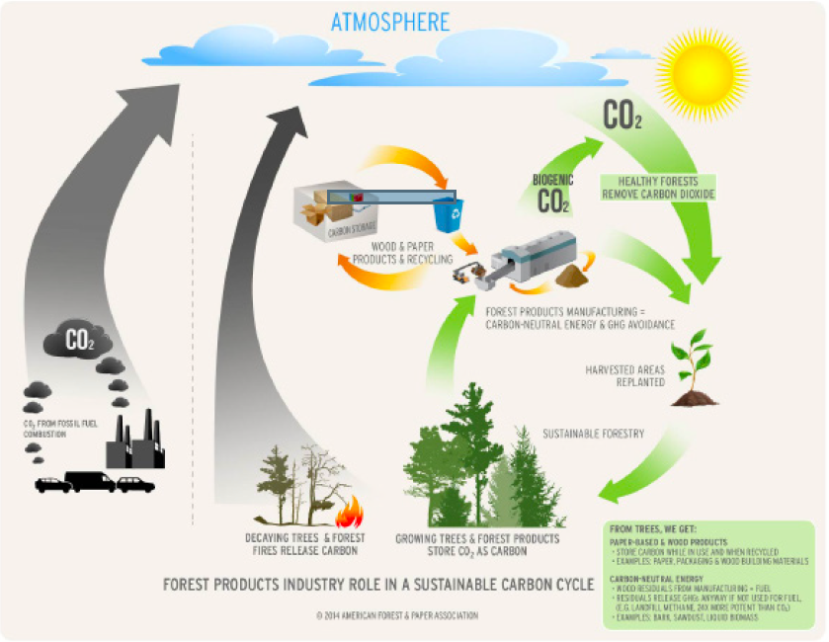
Biomass carbon cycling
Remember that biomass has the potential to be carbon neutral or negative.
Growth rate
Harvest rate
Best practices
https://www.afandpa.org/issues/issues-group/carbon-neutrality-of-biomass

Slide 114
Lifecycle analysis
Lifecycle analysis must be used to truly evaluate the impact of any technology, biomass included, on carbon emissions.
Complication?
LCA models differ and come to different conclusions.
Let’s take a quick look at Sedjo’s comparison of three biomass LCAs.
Manomet study
Canadian Forest study
TSM study
Sedjo (2013) Comparative Life Cycle Assessments: Carbon Neutrality and Wood Biomass Energy

Slide 115
Manomet study
Parameters:
One-time harvest for energy
100-year regrowth vs. 100-year carbon emissions?
So, in the short term this will worsen GCC.
In the long term, GHG would be lower than use of fossil fuels. Reharvest?
Sedjo (2013) Comparative Life Cycle Assessments: Carbon Neutrality and Wood Biomass Energy

Slide 116
Canadian forest study
Parameters:
Large 13 m-acre forest area studied
Fixed area and fixed market
Harvested at a constant rate thought to be sustainable in the long-term
Takes 100 years to reach a steady state (harvest = growth)
Examines a number of scenarios for use of forest products.
Conclusions:
In most scenarios:
Early C emissions are higher than fossil fuels.
Longer-term C emissions are lower than fossil fuels.
Often lower within the 100-year period before steady state.
100-year forest holds less C, but emissions are still lower.
Use matters.
Differs from Manomet in that it looks at the effect of periodic harvest throughout a large forest system.
Sedjo (2013) Comparative Life Cycle Assessments: Carbon Neutrality and Wood Biomass Energy

Slide 117
TSM study
Parameters:
A dynamic optimization forest-management model
Considers that market conditions with change, influencing demand and supply.
Allows the amount of forested land to grow or shrink with market demand.
Conclusions:
The demand for forest products, including wood energy, will rise and also increase:
Harvest rates
Investment in new forests
Rates of C sequestration
If demand for forest products falls, so will C sequestration
Sedjo (2013) Comparative Life Cycle Assessments: Carbon Neutrality and Wood Biomass Energy

Slide 118
TSM study (1)
Increasing demand increases biomass price
Sedjo (2013) Comparative Life Cycle Assessments: Carbon Neutrality and Wood Biomass Energy

Slide 119
TSM study (2)
Increasing demand increases C sequestration
Sedjo (2013) Comparative Life Cycle Assessments: Carbon Neutrality and Wood Biomass Energy

Slide 120
TSM study (3)
Increasing demand increases forest area
Sedjo (2013) Comparative Life Cycle Assessments: Carbon Neutrality and Wood Biomass Energy

Slide 121
TSM study (4)
Increasing demand increases harvest
Sedjo (2013) Comparative Life Cycle Assessments: Carbon Neutrality and Wood Biomass Energy

Slide 122
Take away?
In the long-term, as we turn away from fossil fuels and increase the value of biomass energy and carbon sequestration its likely that we will use more biomass energy with some version of best practices.
Long-term biomass energy use will help sequester carbon and be neutral or better unless it is practiced in an atrocious manner.
In the near future, biomass energy could increase carbon emissions relative to fossil fuel use. So, we must:
Use best practices including accurate carbon accounting.
Learn far more about how forestry practices affect carbon sequestration.
Focus on biomass with short lag times and rapid regeneration.
Grass?
Short-term wood crops
Sedjo (2013) Comparative Life Cycle Assessments: Carbon Neutrality and Wood Biomass Energy

Slide 123
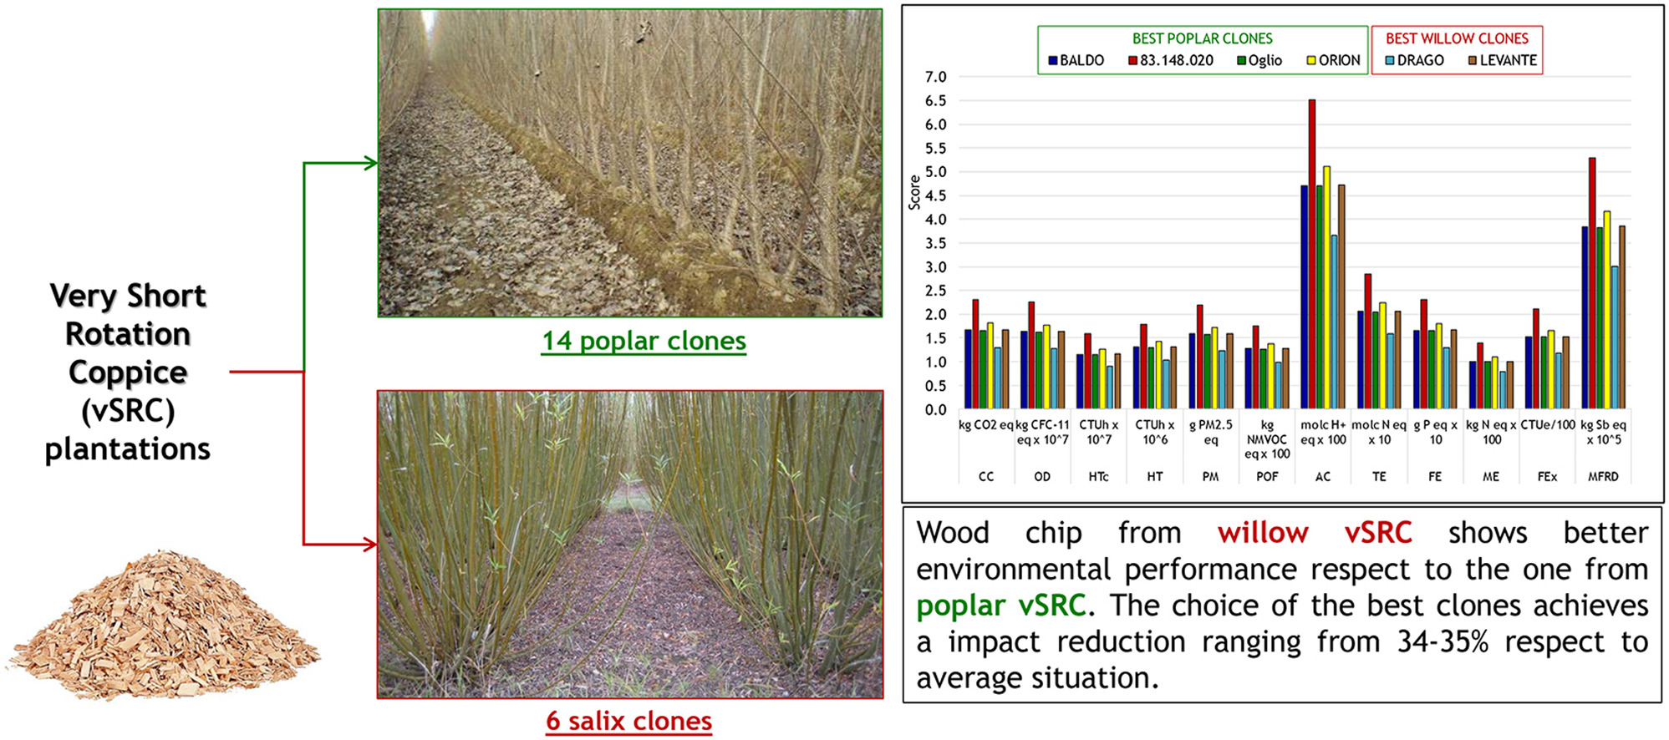
Short-rotation wood crops
An Italian study of coppiced wood crops found that willow and poplar were both productive and that the highest growth clones decreased environmental impact by 35%.
Irrigation with waste-water / nutrient wastes can accelerate growth.
https://www.sciencedirect.com/science/article/pii/S0961953416302926

