Slide 1

SSC2030: Energy Systems & Sustainability
8. Solar energy
8.1: Introduction - types of solar energy
8.2: Nature & availability of solar radiation
8.3: History of our use of solar energy
8.4: Low-temperature solar thermal applications
8.5: Active solar heating
8.6: Passive solar heating
8.7: Daylighting
8.8: Solar thermal engines & electric generation
8.9: Silicon doping & how PV works
8.10: Types of PV
8.11: Off-grid (remote) vs. grid-tied solar PV
8.12: PV stats & integration
Main source: Boyle, Godfrey (ed) (2004) Renewable Energy: Power for a Sustainable Future, 2/e,
Oxford University Press, UK

Slide 2
8. Solar energy
  8.1: Introduction: types of solar energy
Renewable Energy, 2/e, Chapter 2

Slide 3
Types of solar energy
Active solar heating: uses a solar collector and produces low-temperature hot water for domestic hot water
Solar thermal engines: more complex solar collectors that produce high-temperature heat that can produce steam and thus electricity
Passive solar heating:
Space heating via a hot air collector or solar porch
Integrated while building design that optimizes solar energy use & minimizes the use of fossil fuels
Daylighting: making best use of natural lighting (sunlight) at all seasons
Photovoltaic (PV) electric generation: the conversion of solar energy directly into electricity using a solid-state device
Renewable Energy, 2/e, Chapter 2

Slide 4
8. Solar energy
  8.2: Nature & availability
  of solar radiation
Renewable Energy, 2/e, Chapter 2

Slide 5
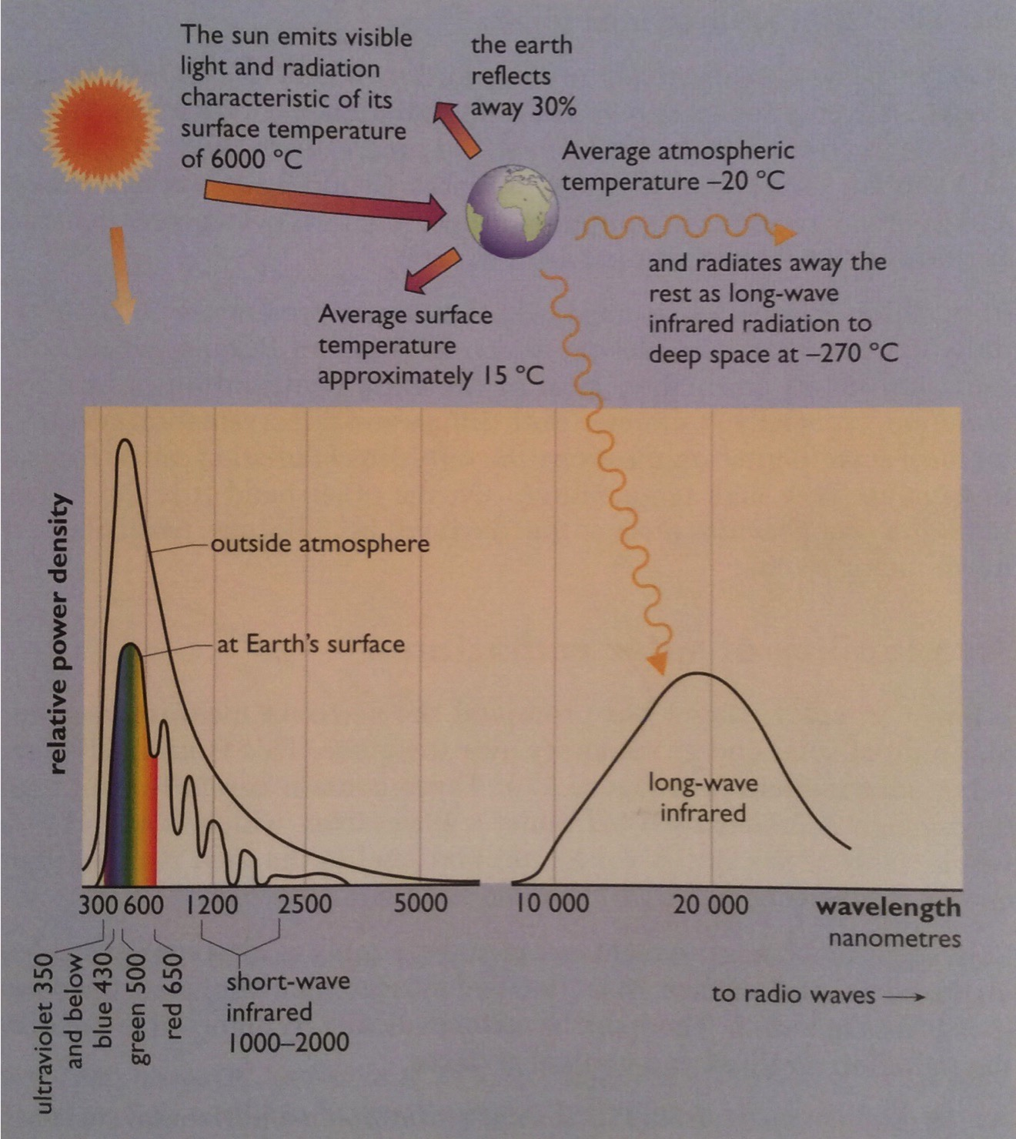
Wavelengths of solar radiation
The sun is a fission reactor that converts H to He at 4 million tonnes/second.
The earth receives solar radiation & re-radiates half back out to space.
Sunlight has a wide range of wavelengths.
PV: 380- 750 nm
heat: long-wave infrared
Renewable Energy, 2/e, Chapter 2

Slide 6
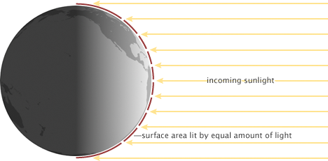
Insolation: more intense at equator
Insolation, and thus the potential for solar energy, is highest at the equator because the density of light is highest there.
The density of sunlight falls at higher latitudes.
Earthobservatory.nasa.gov

Slide 7
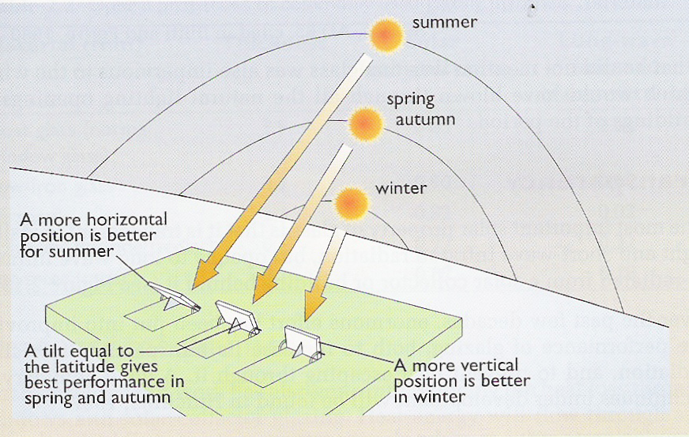
Seasonal angles of insolation
The angle of the earth’s axis is constant,
but the tilt of the earth relative to the
sun changes with the seasons.
Renewable Energy, 2/e, Chapter 2

Slide 8
Effect of angle of tilt
While tilt makes a difference, imperfect angles still produce significant & useful levels of power.
Tilt (°) | Annual total radiation (kWh/m²) | June total radiation (kWh/m²) | December total radiation (kWh/m²)
0° | 944 | 153 | 16
30° | 1,068 | 153 | 25
45° | 1,053 | 143 | 29
60° | 990 | 126 | 30
90° | 745 | 82 | 29
*Data from London England (Achard & Gicquel, 1986)
Likewise, south-east to south-west orientation to the sun, while imperfect can be used for effective solar power.
Renewable Energy, 2/e, Chapter 2

Slide 9
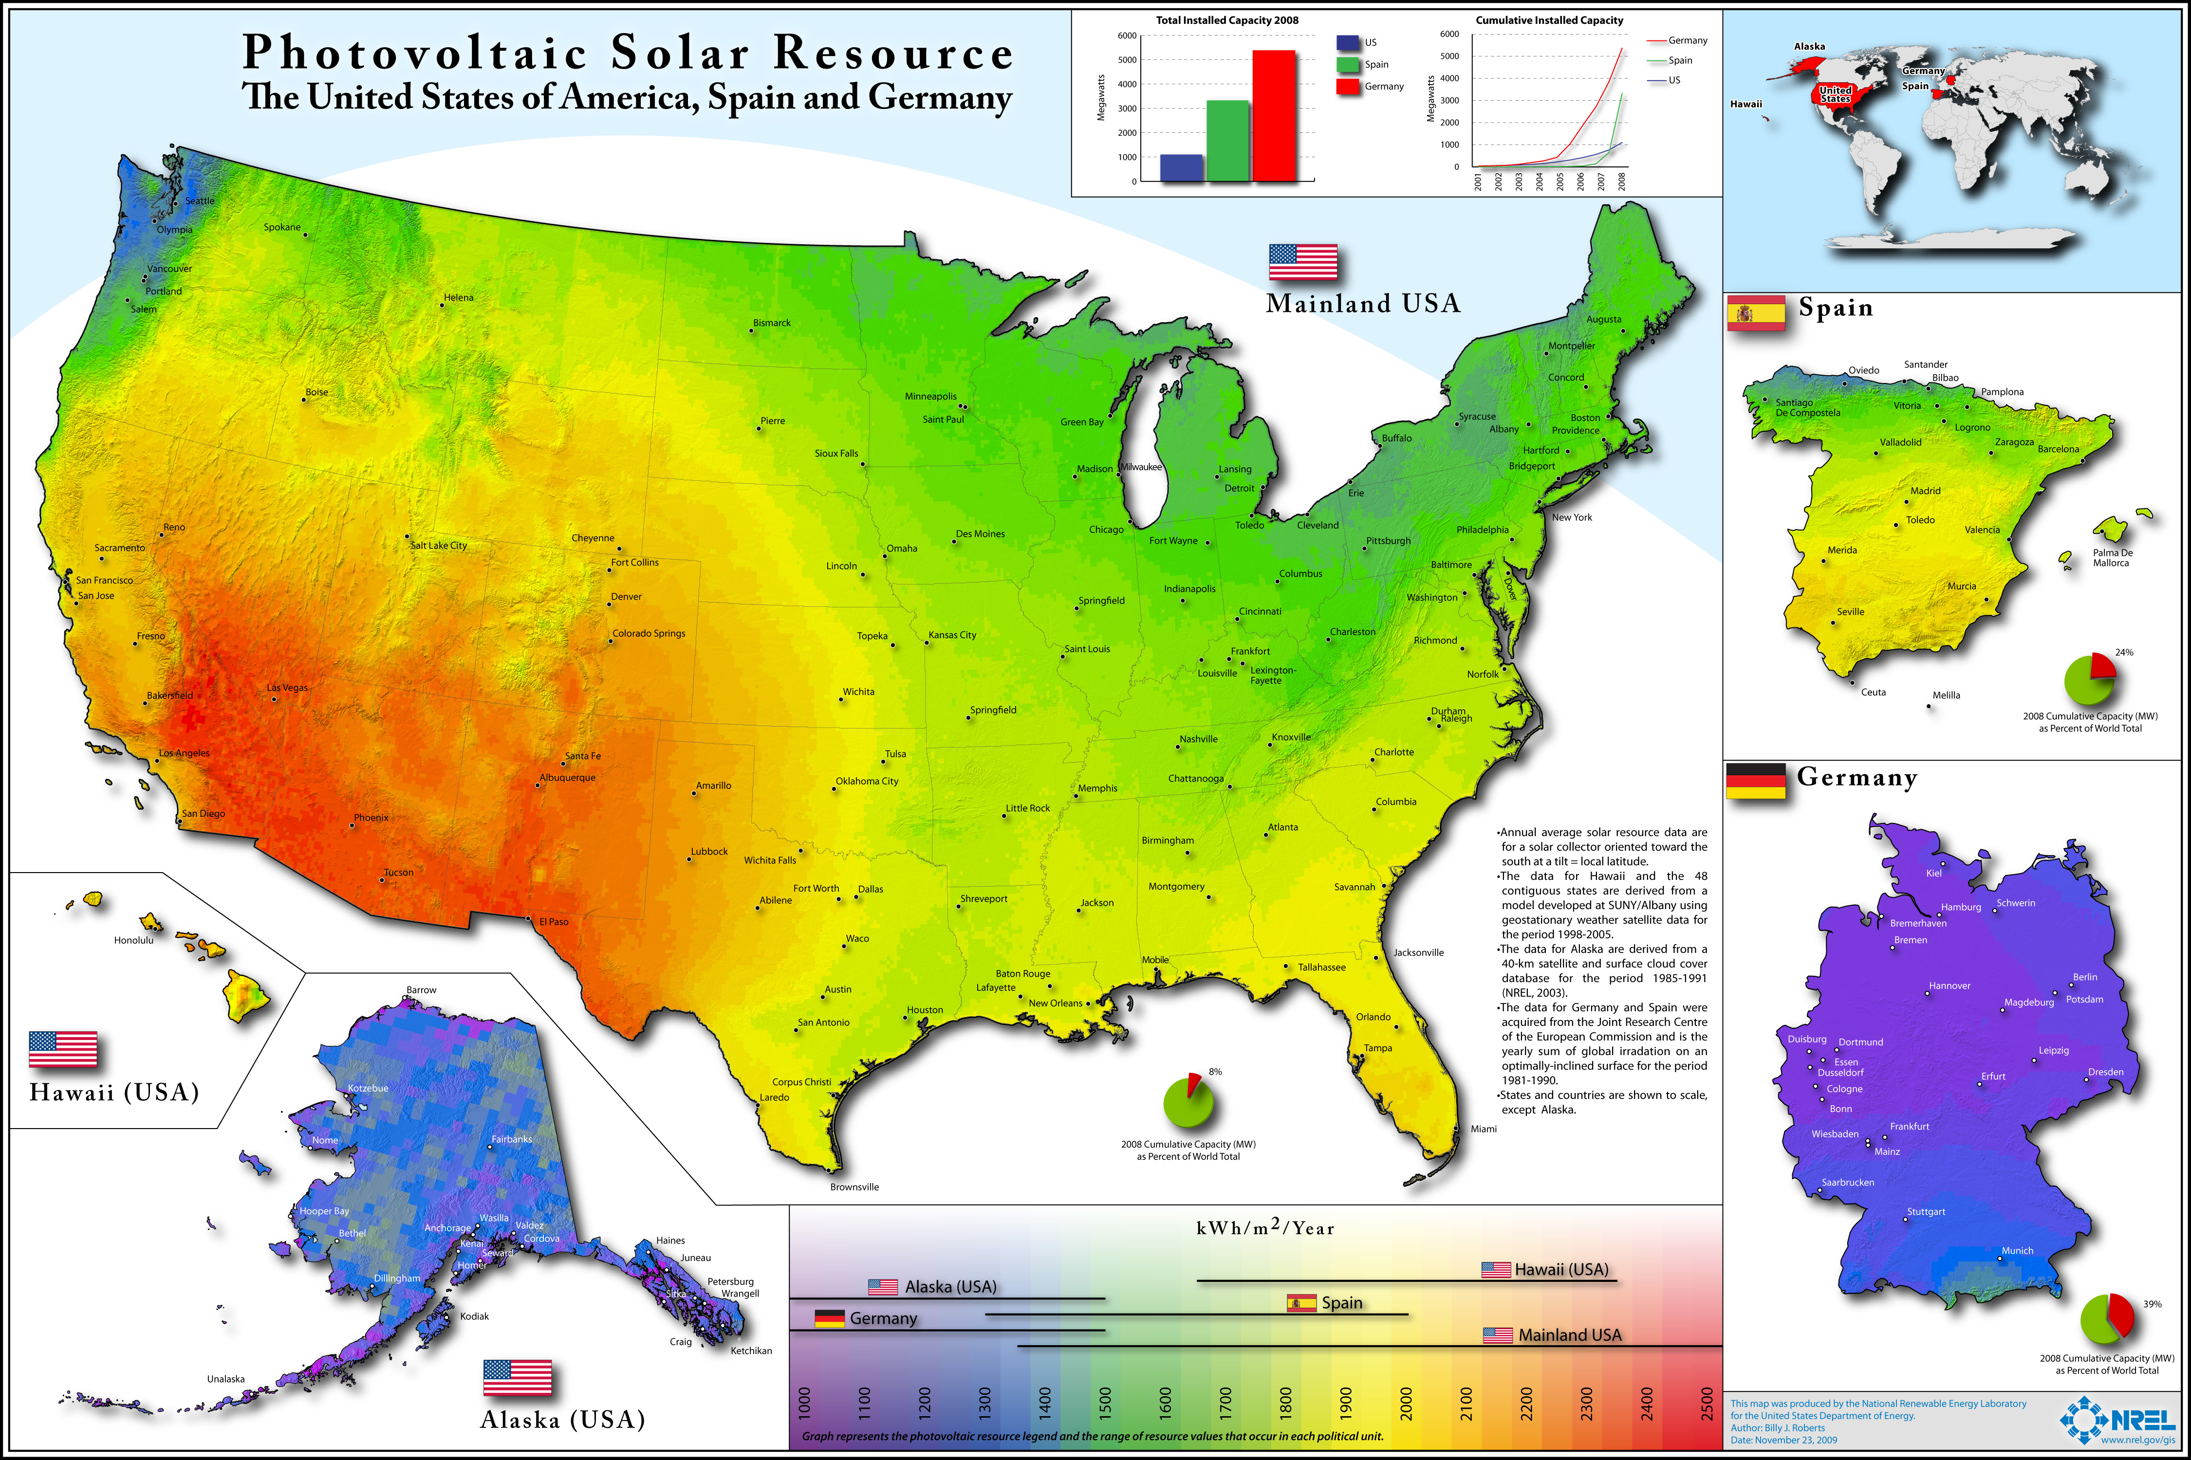
Insolation varies with location

Slide 10
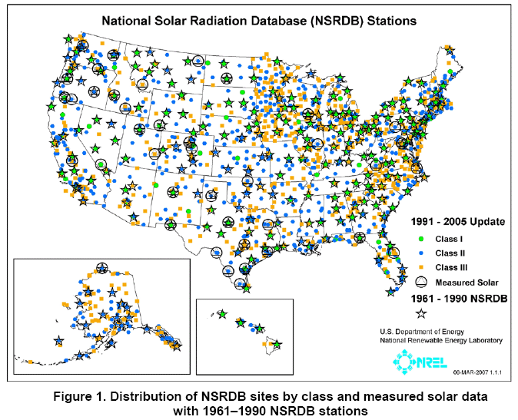
NREL’s insolation stations
NREL

Slide 11
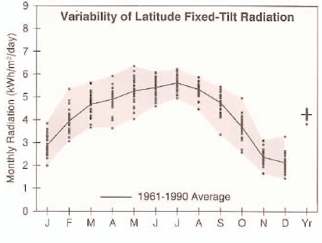
Solar data for Burlington, VT
NREL

Slide 12
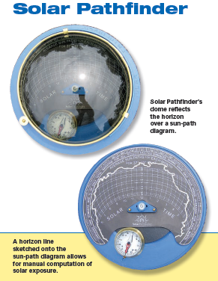
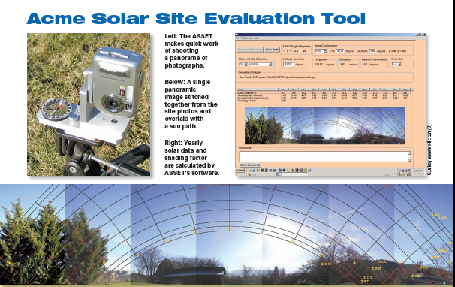
Solar citing analysis
Software tools, like PVmapper & GIS, can be used for 5,000-foot level mapping of solar resources. But location of arrays within a site are better assessed using solar pathfinder tools that look at shading from trees & buildings.
NREL

Slide 13
8. Solar energy
  8.3: History of our use of solar energy
Renewable Energy, 2/e, Chapter 2

Slide 14
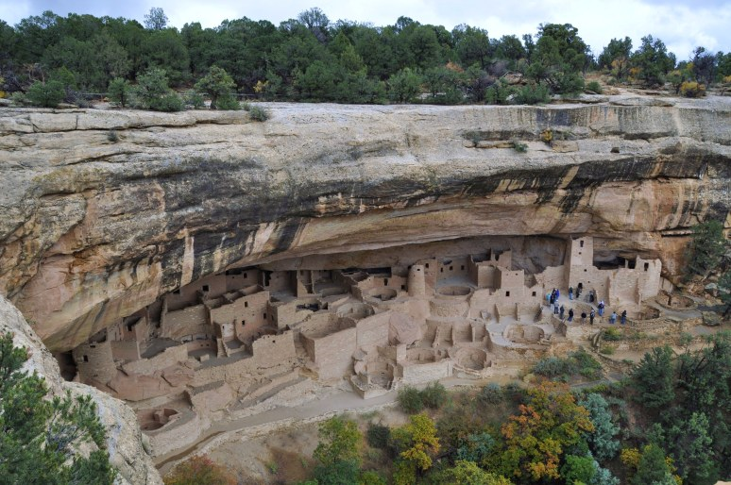
Ancient peoples
Anasazi people of the American southwest
“Some very sophisticated solar communities were built by the Pueblo Indian tribes of the American Southwest….south facing cliff dwellings and others on the open plateaus – that display a remarkable sensitivity to the suns daily and seasonal movements.”
Butti & Perlin, A Golden Thread – 2500 Years of Solar Architecture and Technology

Slide 15
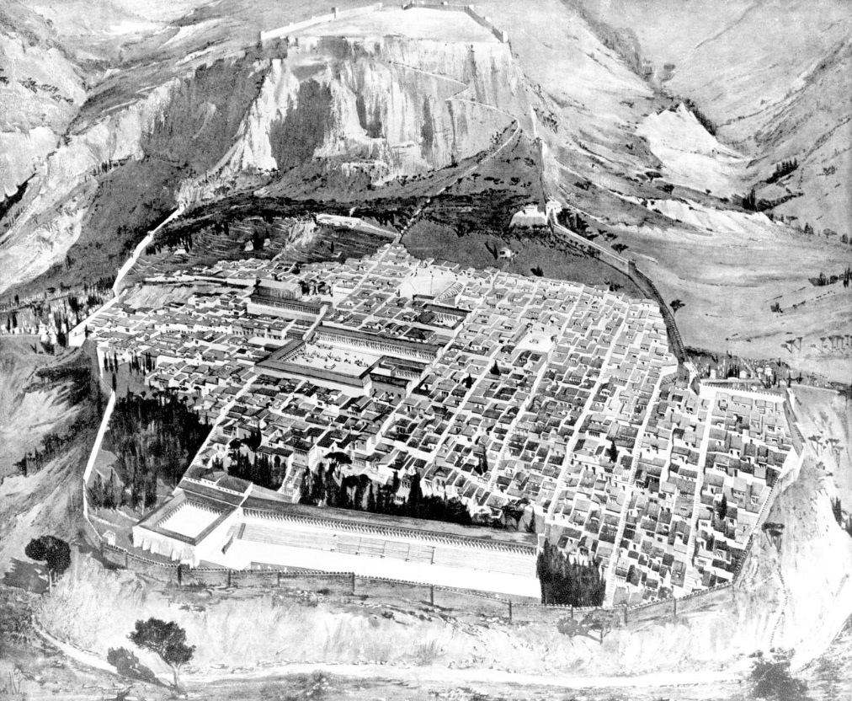
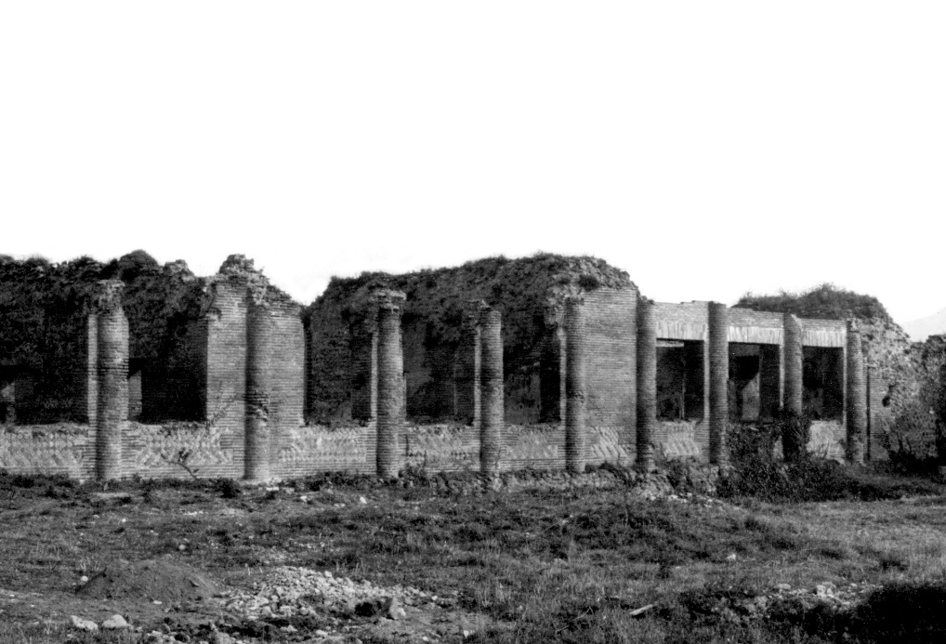
Ancient peoples
Romans oriented their cities towards the sun & used glass to let the sun in.
Butti & Perlin, A Golden Thread – 2500 Years of Solar Architecture and Technology

Slide 16
Enlightenment Europe
Scientists, like chemist Antoine Lavoisier experimented with sunlight & used it as a tool.
https://csirosolarthermal.wordpress.com/tag/solar-furnace/

Slide 17
Enlightenment Europe
In the mid-1860s, France ran short of cheap coal. Innovation with concentrated solar power flowered, producing solar powered printing presses, wine stills, cookers & refrigerators.
Concentrated solar energy was focuses on a steam boiler.
https://www.uh.edu/engines/epi2871.htm

Slide 18
Solar thermal: domestic hot water
Clarence Kemp’s ‘batch solar water heater’ from 1891
https://www.renewableenergyhub.co.uk/solar-thermal-information/the-history-of-solar-thermal-technology.html

Slide 19
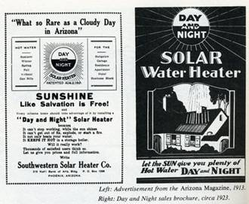
Solar thermal: domestic hot water
https://www.renewableenergyhub.co.uk/solar-thermal-information/the-history-of-solar-thermal-technology.html

Slide 20
California – always a solar leader
By 1900 there were 1600 solar water heaters in southern California.
The first modern flat-plate solar collector was invented by William Bailey in 1909. Sold by his ‘Day and Night’ company.
  Used a separate hot water storage tank

Slide 21
US solar milestones, 20th century
1920: cheap NG ends the solar boom in California
1950: low electrical costs in Florida end its solar boom
1970s: Arab oil embargoes lower oil supplies & increase oil prices
1970s: …so wood & solar heating make a comeback
    government incentives
1979: Jimmy Carter – White House solar thermal panels
1986: Ronald Regan removes those solar thermal panels
2000s: fossil fuel price volatility increases;solar makes a comeback
    PV booms
    PV driven air-to-air heat pumps become popular
https://www1.eere.energy.gov/solar/pdfs/solar_timeline.pdf

Slide 22
8. Solar energy
  8.4: Low-temperature solar thermal applications
Renewable Energy, 2/e, Chapter 2

Slide 23
The magic of glass
‘Certain inventions have come about within our own memory – the use of window panes which admit light through a transparent material.’
- Seneca, AD 65
Glass keeps wind & weather out but admits light from the visible to the short-wave infrared portion of the spectrum.
Glass does not let through long-wave infrared, lower energy heat that is re-radiated from solar collectors or buildings.
Material | Thickness (mm) | Solar transmittance | Long-wave infrared transmittance
Float glass | 3.9 | 0.83 | 0.02
Low-iron glass | 3.2 | 0.90 | 0.02
acrylic | 3.1 | 0.82 | 0.02
Polyvinyl fluoride | 0.1 | 0.92 | 0.22
Polyester (mylar) | 0.1 | 0.87 | 0.18
Renewable Energy, 2/e, Chapter 2

Slide 24
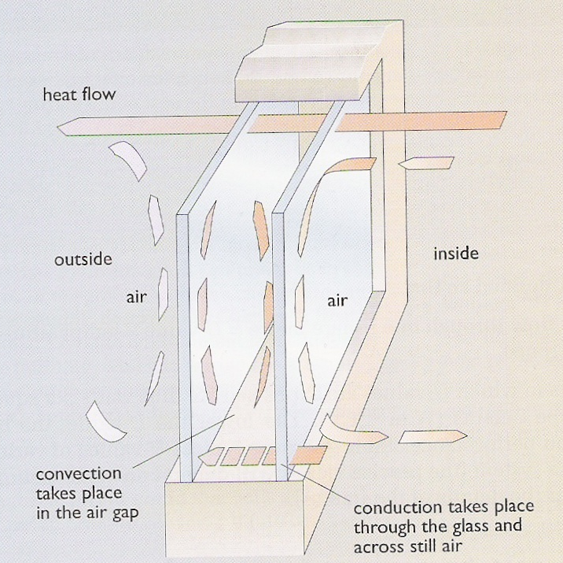
Heat loss & terms
The rate of heat flow through glass depends on three factors:
Difference in temperature on either side;
Total area; &
Insulating properties of the glazing.
Thermal conduction: flow of heat from hot to cold areas
Radiation: low-E (emission) coatings cut radiated heat loss across panes
Insulators: resist the flow of heat
Air is a good insulator.
Convection: warming air (or fluid) becomes less dense & rises; as it cools it sinks back down
Filling air spaces with denser, thus less mobile gases, reduces convection.
Reducing the size of the space reduces convection: triple glazing
Vacuum stops convection but is technically difficult
Renewable Energy, 2/e, Chapter 2

Slide 25
Heat loss characteristics, U-value
U-value is a practical measurement of the loss of energy through a material.
Lower U-value is better.
Heat loss can be calculated using U-value, square footage & the temperature differential.
Window type | U-value (W/m²/°C)
Single glazed | 6
Double glazed | 3
+ low-E coating | 1.8
+ heavy gas filling | 1.5
+ 3 plastic films & heavy gas | 0.35
+ evacuated with low-E coating | 1.0
10 cm opaque fiberglass | 0.4
A 2-square meter single-glazed window is used with indoor & outdoor temperatures of 20°C & 5°C.
Heat loss rate
= (6 W/m²/°C)(2 m²)(15°C)
= 180 W
Effect of more efficient windows
= (1 W/m²/°C)(2 m²)(15°C)
= 30 W
Renewable Energy, 2/e, Chapter 2

Slide 26
Providing low-temperature heat
In the UK (2003) most domestic end-of-use fuel was used for low-temperature heating.
  58% space heating
  24% water heating
Efficient means of providing this heat include:
  Solar;
  District heating systems using waste heat;
  Small-scale CHP;&
  Heat pumps.
Renewable Energy, 2/e, Chapter 2

Slide 27
Domestic space heating
In Northern latitudes, the need for space heating is out-of-phase with solar radiation.
Solar space heating works best in sunny regions
‘We must begin by taking note of the countries and climates in which homes are to be built if our designs for them are to be correct. One type of house seems appropriate for Egypt, another for Spain… ond still different for Rome, and so on with lands of varying characteristics. This is because one part of the earth is directly under the sun’s course, another is far away from it... It is obvious that designs for homes ought to conform to the diversities of climate.’
- Roman architect Vitruvius, 1st century BC
Renewable Energy, 2/e, Chapter 2

Slide 28
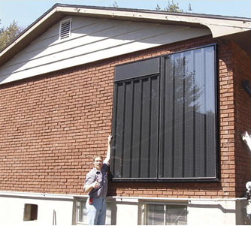
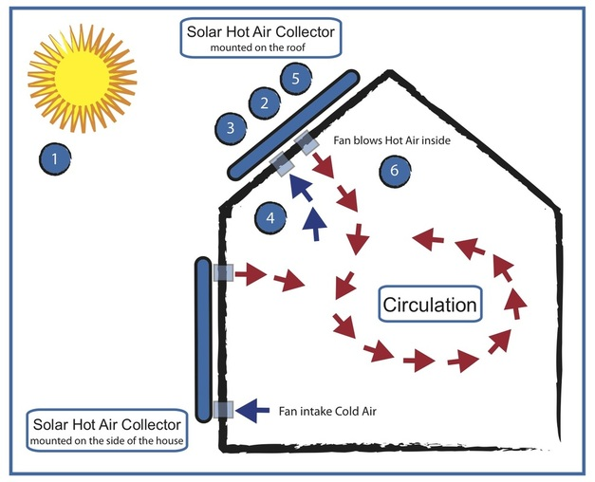
Solar hot air collector
Solar hot air collectors: are a modular, after-market Trombe wall.
Cold air flows into the bottom of the panel.
Solar energy is captured by an absorber & heats the air.
Rising hot air is blown into the house when the heated air is warmer than inside air.
Up to 50°C increase
Renewable Energy, 2/e, Chapter 2;
http://www.beach1electric.ca/solar-hot-air.html;
http://www.beebehavior.com/images/SolarCollector/air_solar_collector_2.jpg

Slide 29
8. Solar energy
  8.5: Active solar heating
Renewable Energy, 2/e, Chapter 2

Slide 30
Types of solar collectors
Unglazed panels
Flat plate water collectors
Flat plate air collectors
Evacuated tube collectors
Line focus collectors
Point focus collectors
Renewable Energy, 2/e, Chapter 2

Slide 31
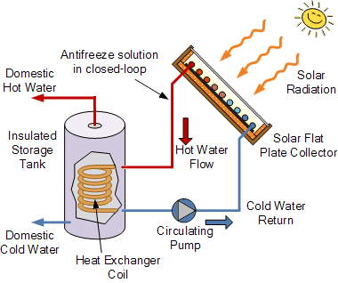
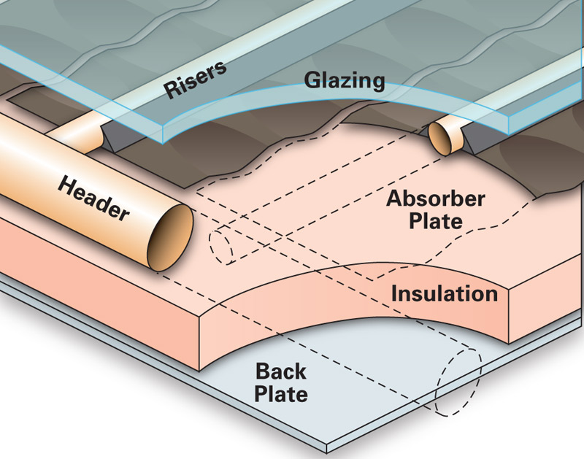
Unglazed, flat plate collectors
Unglazed panels: black boxes to run water through for low-level heating
  10°C increase
  Swimming pool heaters
Flat plate water collectors: box with single or double glazing
  Black absorber plate that collects > 90% of solar energy.
  High thermal conductivity to transfer heat to water pipes.
  Up to 50°C increase
homepower.com/articles/solar-water-heating/equipment
-products/flat-plate-evacuated-tube-solar-thermal-collectors
alternative-energy-tutorials.com/solar-hot-water/flat-plate-collector.html

Slide 32
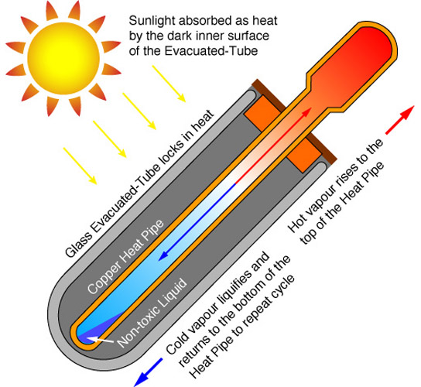
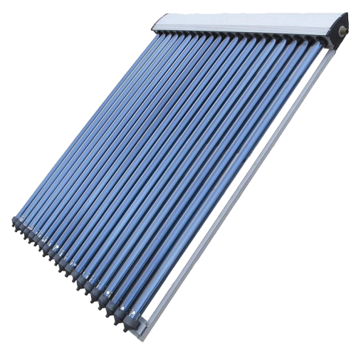
Evacuated tube collectors
Evacuated tube collectors: evacuated glass tubes are used as the collector box to prevent convective heat loss
Strip of absorber runs down each tube along with…
A closed copper tube containing alcohol.
Solar energy boils the alcohol, steam (vapor) rise to the top...
And transfers heat to a manifold heat exchanger.
10 – 150°C increase
http://www.siliconsolar.com/30-vacuum-tube-collector-p-18102.html

Slide 33
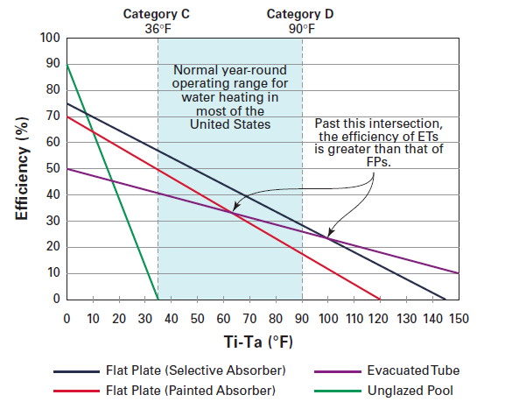
Collector efficiency
T_{i} : Temperature at collector inlet
T_{a}: Air temperature
NREL

Slide 34
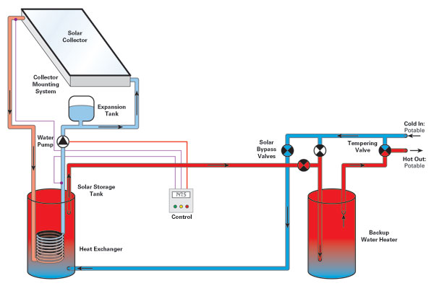
Pressurized heat transfer system
Pressurized glycol systems: best choice for very cold climates.
Active, closed-loop system
Incoming potable water is routed to the solar storage tank.
A water and antifreeze mixture circulates from the collectors through a coil of pipe in the solar tank, and then is pumped back through the collectors.
http://www.intermtnwindandsolar.com/pressurized-glycol-system/

Slide 35
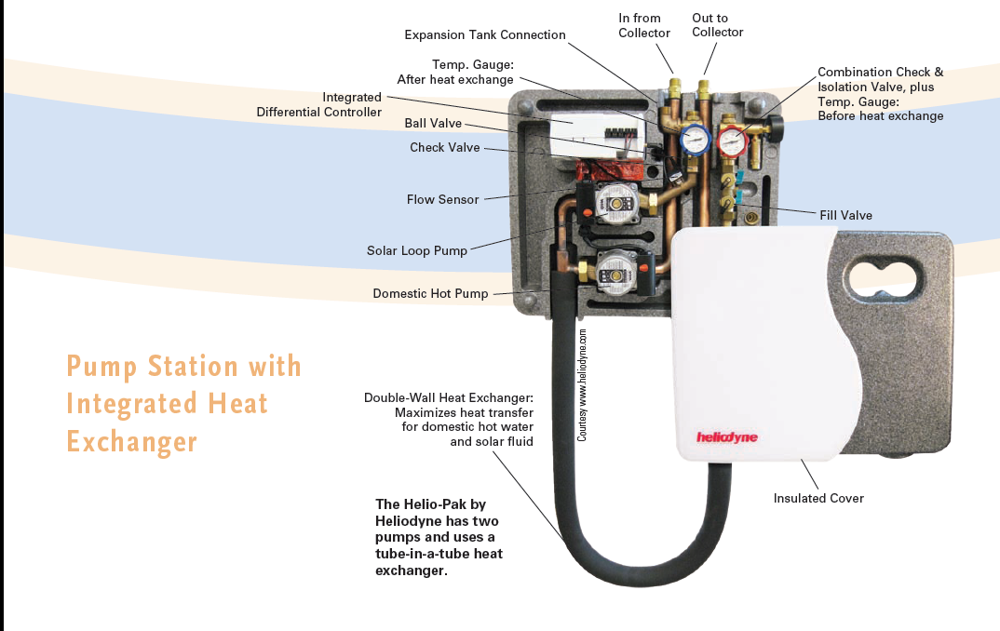
Thermal pump station control unit
https://www.homepower.com/articles/solar-water-heating/equipment-products/solar-hot-water-pump-stations

Slide 36
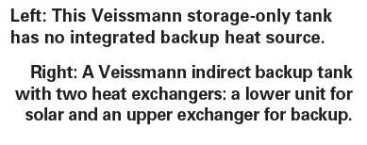
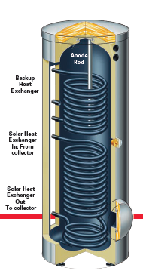
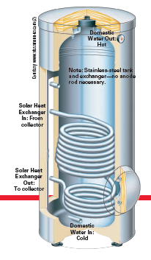
Thermal storage tanks
https://www.viessmann-us.com/en/residential/dhw-tanks/dhw-tanks/vitocell_300-v.html

Slide 37
Thermal storage as ‘grid’ storage
Large, insulated hot water tanks can be used to store water heated with solar energy.
Large storage tanks increase the effectiveness of the system by storing heat beyond sunlit hours.
Are efficient electric hot water heaters and storage tanks an alternative to the Tesla Powerwall?
When the sun is shining, use PV to make electricity.
No current need?
Use an electric hot water heater & store large volumes of hot water for later use when the sun is not shining or electricity demand rises.
https://www.popsci.com/need-high-power-home-battery-use-your-water-heater

Slide 38
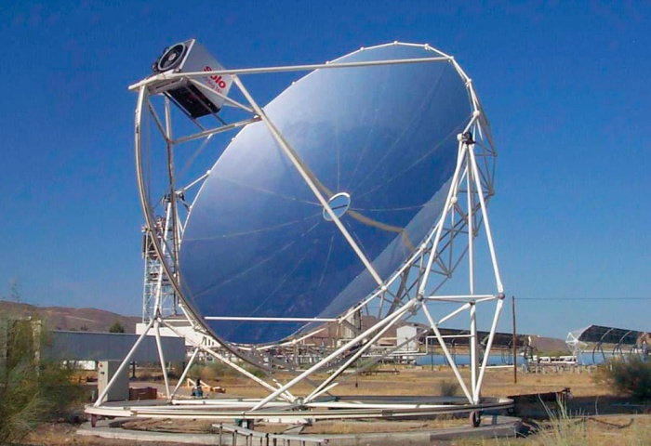
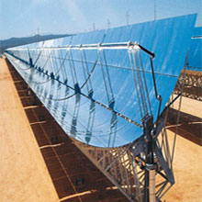
Line & point focus collectors
Line or point focus collectors: concentrate solar energy using parabolic mirrors and heat water to steam.
Use for generating electricity.
Mirrors may follow or track the sun.
100 – 150°C increase
http://www.ecosolenergy.com/images/services/Solar_Trough_01.jpg
https://www.homepower.com/articles/image/7353/3319?template=colorbox

Slide 39
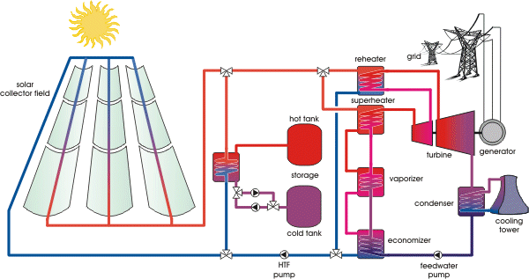
Line focus collectors → turbines
https://www.volker-quaschning.de/articles/fundamentals2/index_e.php

Slide 40
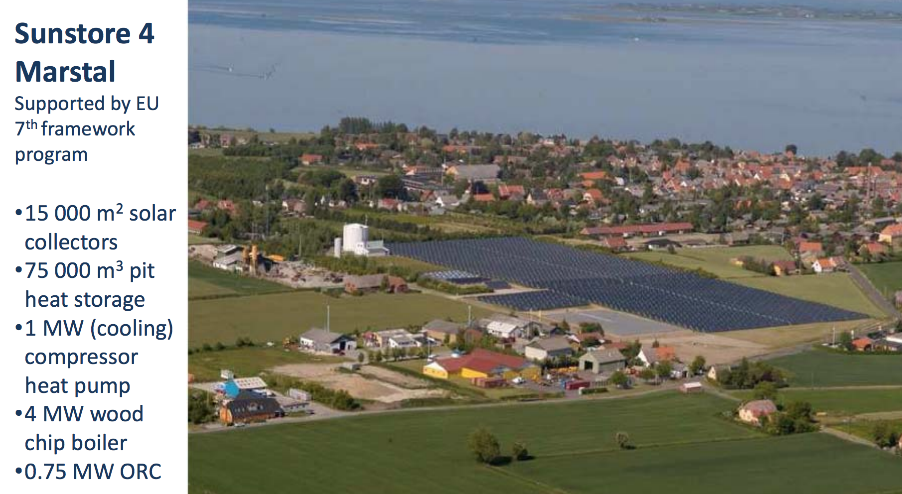
District solar heating
By 2002, 65 district solar heating systems in Denmark, Sweden & Germany had more than 500 m² of collector area each.
Total of 110,000 m²
Peak output of 50 MW of heat
Residential service
Marstal (DK) Sunstore 4:
18,365 m²
Covers 1/3 of district heating needs
Part of a larger district heating system
https://en.wikipedia.org/wiki/Central_solar_heating
https://cleanenergysolutions.org/sites/default/files/documents/June%205%20Per%20Alex%20Sorenson_MARSTAL_CHP%20DHC_05062014.pdf

Slide 41
Is solar thermal dead? (1)
“In northern states, a typical residential solar thermal system includes two 4' by 8' collectors and a 120-gallon solar storage tank; the installed cost for such a system is about $8,000 to $10,000. Instead of spending $10,000 on a solar thermal system, what would happen if you invested $3,000 in a heat-pump water heater and $7,000 in a 1.7-kW PV array?
The 1.7-kW PV system would produce 2,114 kWh per year in Boston or 2,093 kWh per year in Madison, Wisconsin. Let’s be conservative and use 2,000 kWh for our example. Assuming that the average COP of the heat-pump water heater is 2.0 — a fairly conservative assumption — it takes 0.0855 kWh to raise the temperature of a gallon of 50°F water to 120°F. So 2,000 kWh can produce 23,392 gallons of hot water a year, or 64 gallons a day — exactly equal to the amount of hot water that the U.S. Department of Energy assumes is used by the average American family. So, once you’ve paid for the system, you get “free” hot water.
That’s a much better deal than a solar thermal system that produces only 63% as much hot water — even if you do have to buy a new heat-pump water heater in 12 or 14 years. (Trust me — if you have a solar hot water system, you'll have to invest in maintenance and replace a few parts over time, too.)”
greenbuildingadvisor.com/blogs/dept/musings/solar-thermal-dead

Slide 42
Is solar thermal dead? (2)
“So I’ll list a few exceptions to my new rule:
Solar thermal systems still make sense for off-grid homes.
If you can get a two-collector solar thermal system installed for $5,000 or less — an attainable price in areas of the country where people don't have to worry about freeze protection — it may make sense to install one.
In a sunny, warm climate, where a solar hot water system will have a higher solar fraction than 63%, an investment in a solar thermal system makes more sense than it does in Wisconsin or Massachusetts. (On the other hand, a PV system produces more electricity in a sunny climate, too.)
If you are skeptical about the longevity of heat-pump water heaters, you may prefer to wait a few years before buying one, and to stick with a solar thermal system in the meantime.
Before taking the advice given in this article, compare the costs and energy production figures of a solar thermal system and a PV system in your area, using location-specific energy production figures and local equipment costs and installation costs.
greenbuildingadvisor.com/blogs/dept/musings/solar-thermal-dead

Slide 43
8. Solar energy
  8.6: Passive solar heating
Renewable Energy, 2/e, Chapter 2

Slide 44
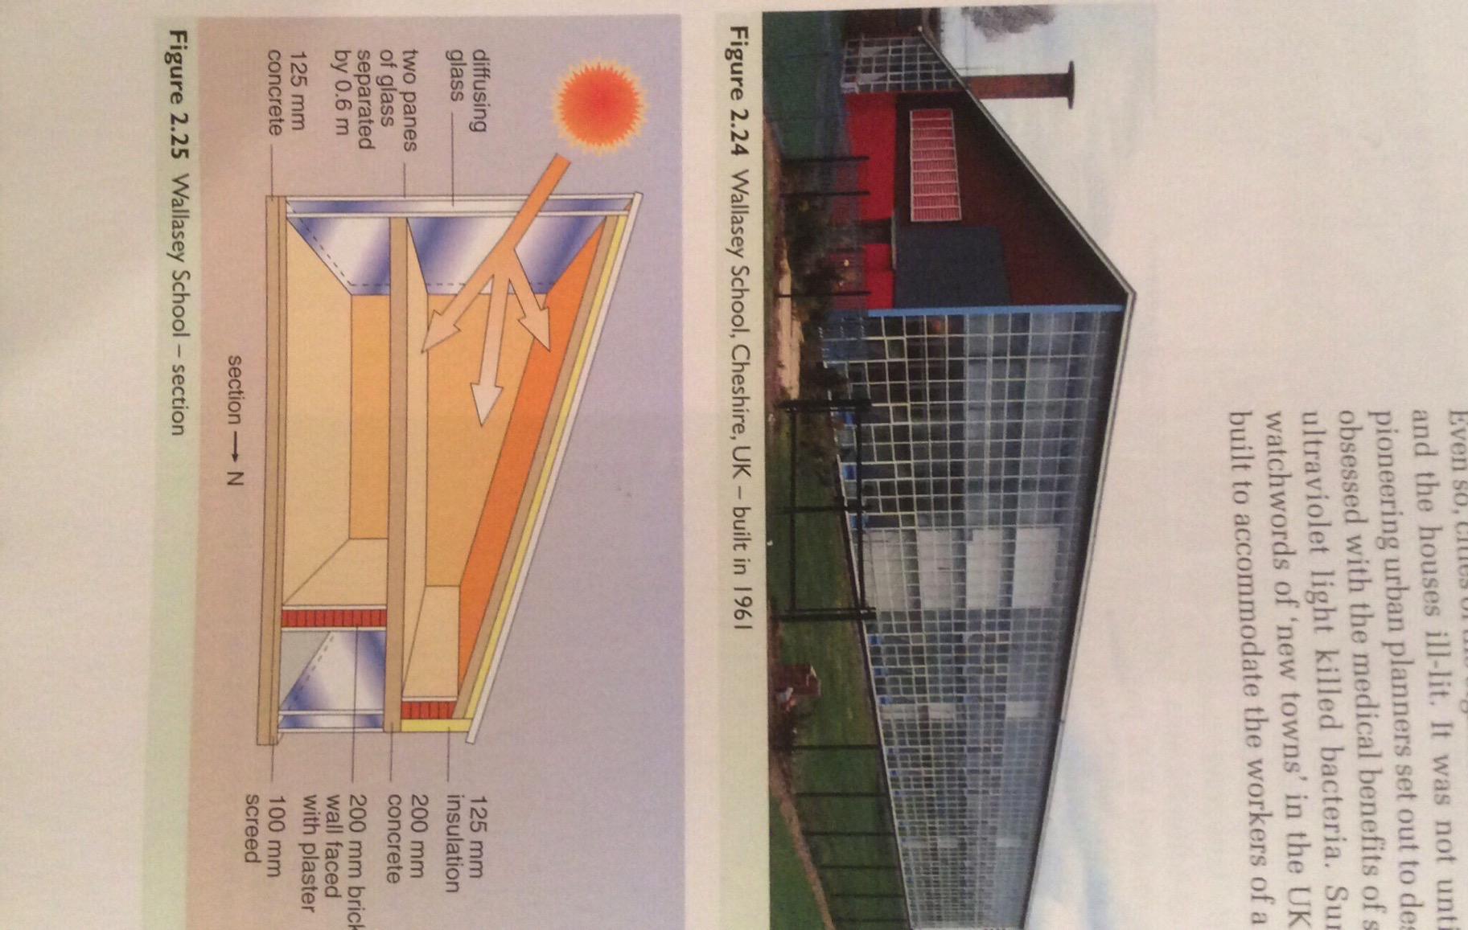
Passive solar heating: tied to glass
The Romans could make large glazed windows. After the fall of Rome this art disappeared and didn’t resurface until the late 1700s in France.
The push for sanitation & health made use of sunlight a priority in building in the late 1880s.
Direct gain design:
Large area of south-facing glazing;
Thermally heavy construction to store / retain heat until night;
Thick insulation to retain heat.
Renewable Energy, 2/e, Chapter 2

Slide 45
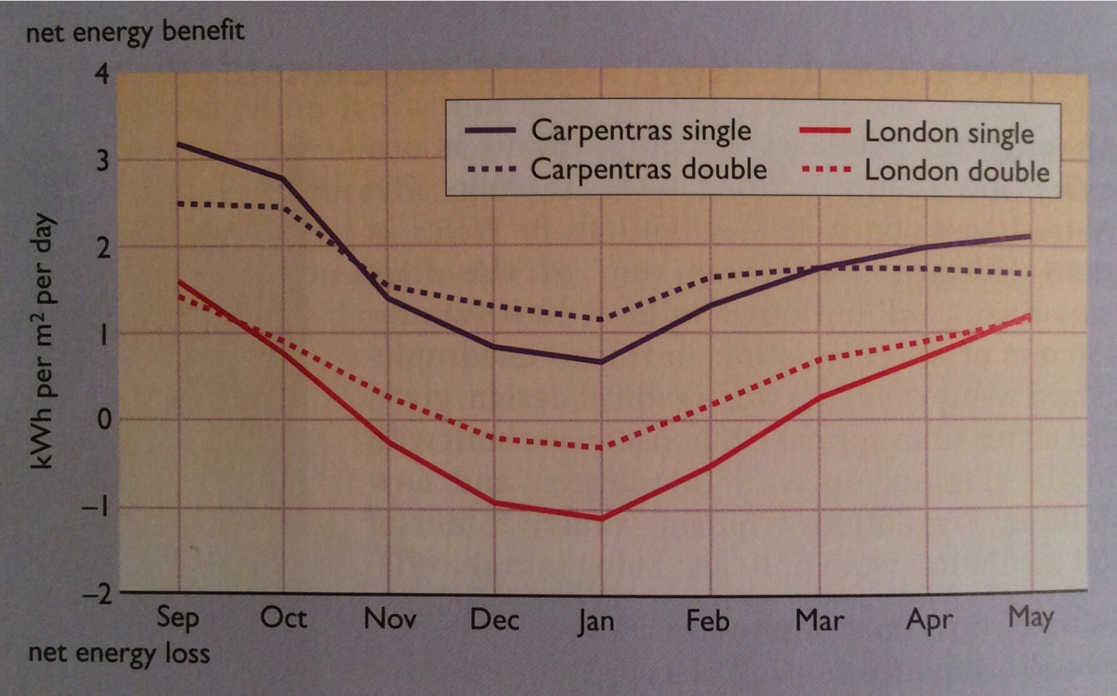
Window energy balance
Window energy balance looks at the possible thermal gain (net energy benefit) from placing a window in a south-facing wall.
Dependent on location
Shoulder seasons vs. total heating season
Renewable Energy, 2/e, Chapter 2

Slide 46
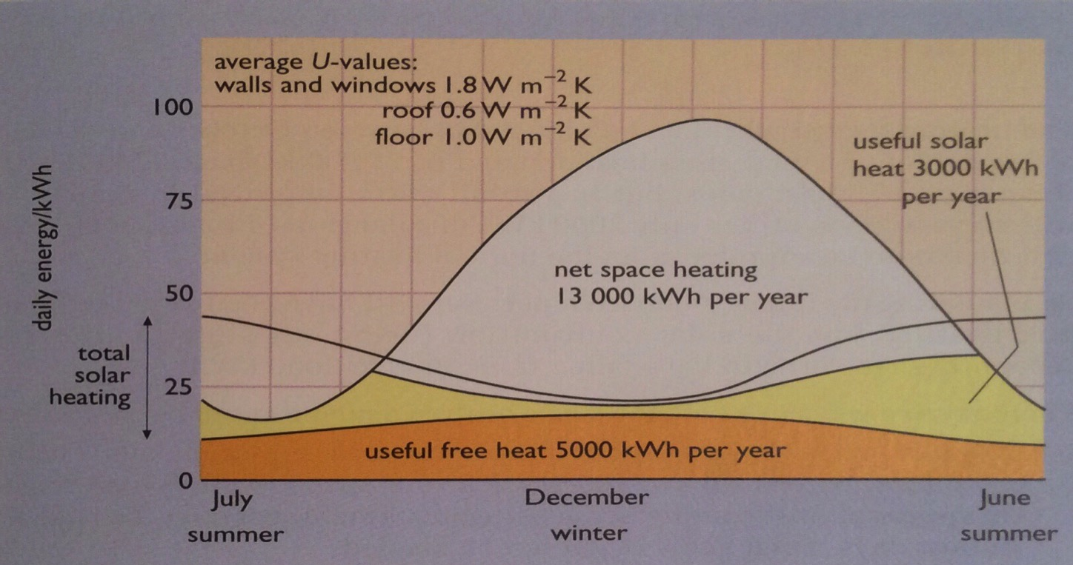
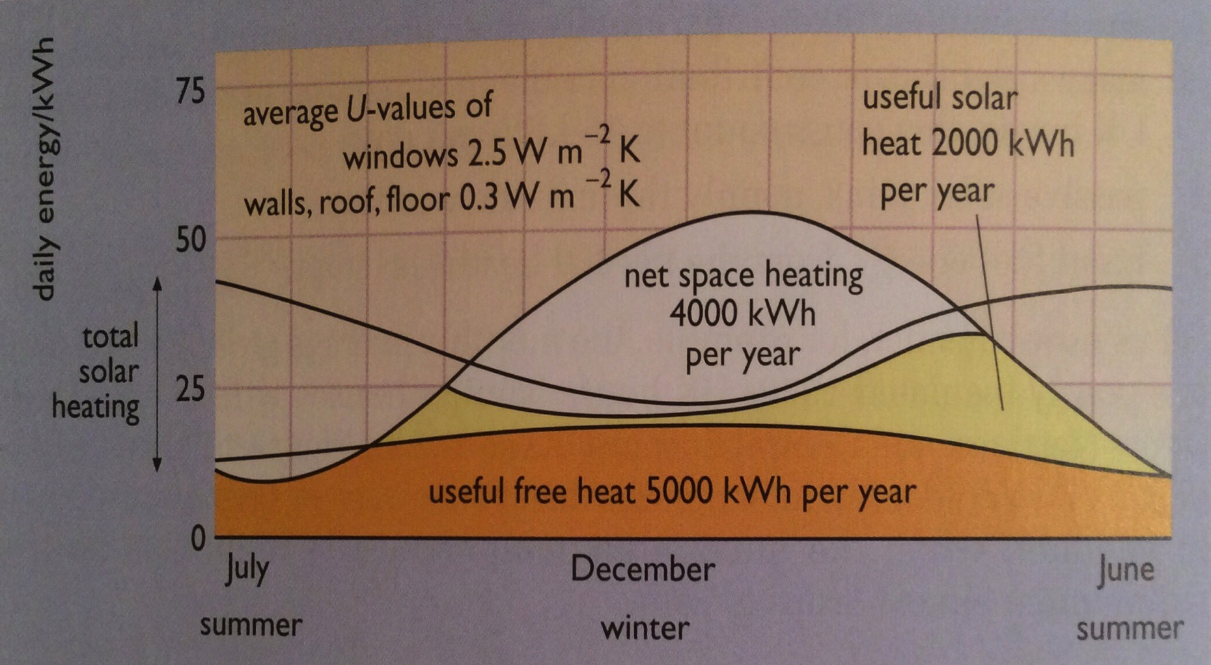
Contribution of solar gain?
The ability of solar gain to play a significant role in total building heating need depends on a number of factors:
Location
Design & insulation
14% passive solar
18% passive solar
& better insulation
Renewable Energy, 2/e, Chapter 2

Slide 47
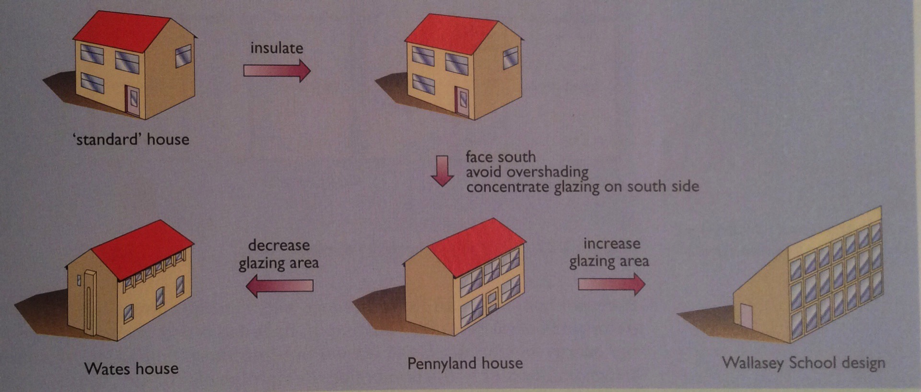
Passive solar heating techniques?
Buildings meant to use passive solar gain should:
Be well insulated;
Have responsive & efficient heating systems;
Face south with most-used rooms open to the south;
Avoid over-shading; &
Be thermally massive to hold heat and summer cool.
Extra cost = 2.5%; payback = 4 years
Renewable Energy, 2/e, Chapter 2

Slide 48
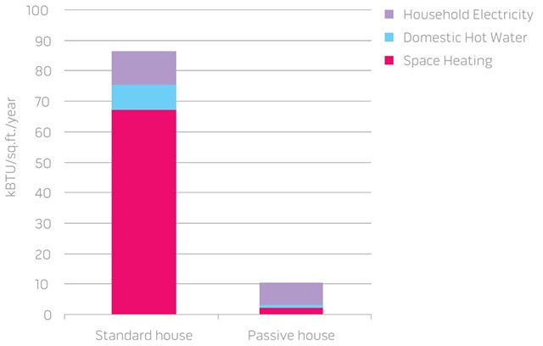
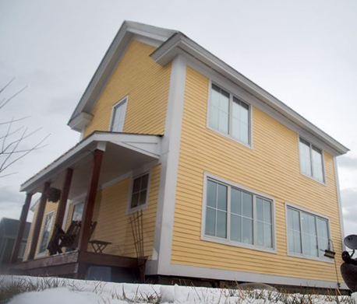
Vermont passive home
This passive home was built by Habitat for Humanity in Charlotte in 2011.
Super-insulated
Heated by the sun, appliances & occupants
All electricity is solar
Uses 90% less energy than an average home
Renewable Energy, 2/e, Chapter 2
https://www.sevendaysvt.com/vermont/does-the-ultra-efficient-passive-house-point-the-way-to-carbon-neutrality/Content?oid=2500123

Slide 49
8. Solar energy
  8.7: Daylighting
Renewable Energy, 2/e, Chapter 2

Slide 50
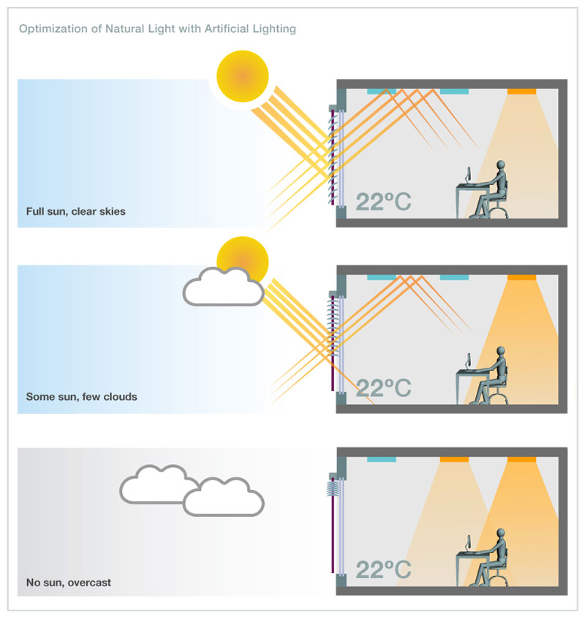
Daylighting
Daylighting is the design of a building to make maximal use of natural (sun)light & minimize use of electrical lighting.
Techniques:
Shallow-plan design for good light penetrance;
Light wells at the center of the building;
Roof lights;
Tall windows; &
Task lighting vs. room lighting.
Renewable Energy, 2/e, Chapter 2
sunproject.com/sustainable-design/energy-daylight-management

Slide 51
8. Solar energy
  8.8: Solar thermal engines & electricity
Renewable Energy, 2/e, Chapter 2

Slide 52
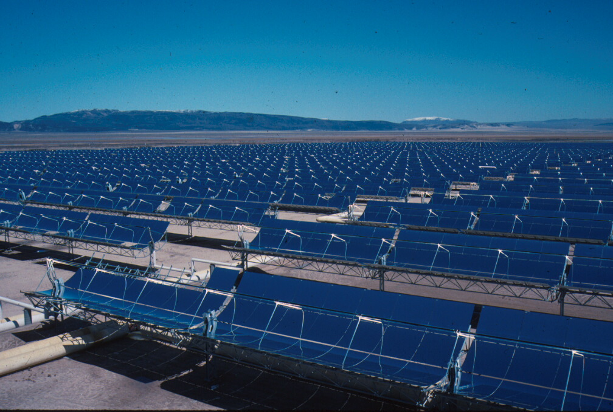
Solar thermal engines
Solar concentration is generally used to focus energy from large surface areas and boil water to steam.
Line focus → 50X concentration 200-400°C
Point focus → 1000X concentration 1500°C
Solar Electricity Generating Systems, CA (Mojave Desert)
Nine generating plants of 13 – 80MW each
  >936,000 mirrors on 1,600 acres
  Power 232,500 homes, displacing 3,800 tons of pollution
Fields of parabolic trough solar collectors focused on pipes carrying
synthetic oil to 390°C.
Produces high-temperature steam
to drive Rankin cycle steam turbines.
18 – 20% efficient
Competitive with old PV but not NG.
  NG runs the turbines at night.
Renewable Energy, 2/e, Chapter 2
https://en.wikipedia.org/wiki/Solar_Energy_Generating_Systems

Slide 53
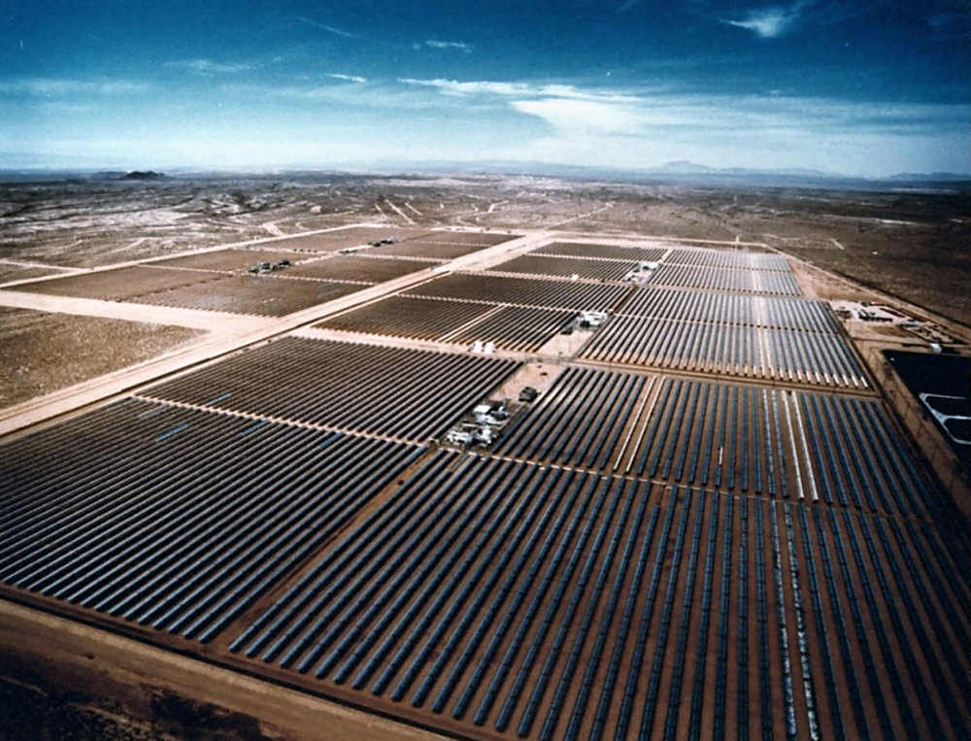
SEGS, Mojave Desert

Slide 54
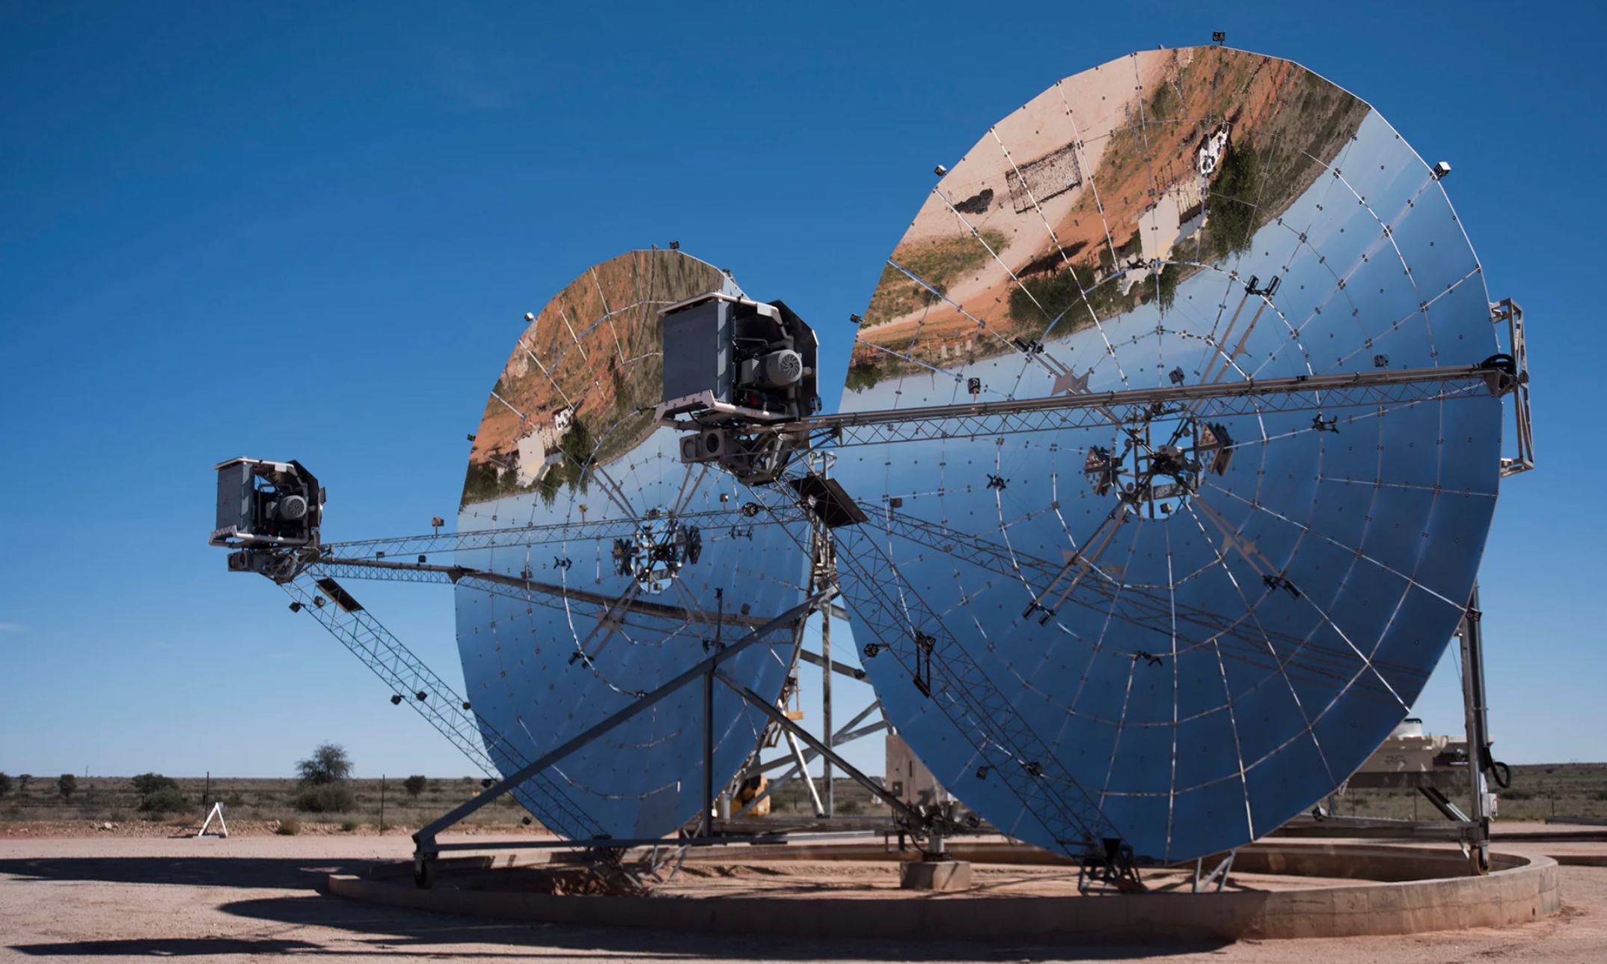
Parabolic solar → Stirling engines
https://www.theguardian.com/environment/2015/may/13/could-this-be-the-worlds-most-efficient-solar-electricity-system#img-1

Slide 55
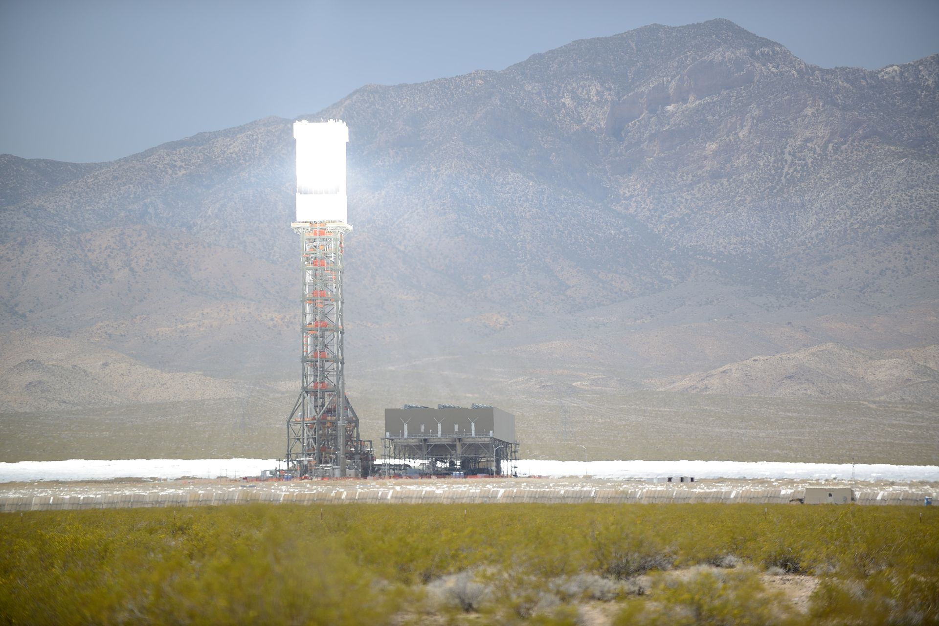
Solar tower power
Power towers (aka solar furnace) focus the solar energy from fields of heliostat mirrors upon a boiler located atop a central tower. Heat exchange produces high-temperature steam & thus electricity.
Heat transfer medium?
Synthetic oil was used in the 1980s.
Molten sodium metal allows heat storage as well as transfer.
Molten salts “ “ “
NREL predicted a price of $0.0547 / kWh by 2020.
Renewable Energy, 2/e, Chapter 2
https://en.wikipedia.org/wiki/Solar_power_tower#cite_note-Kraemer-4

Slide 56
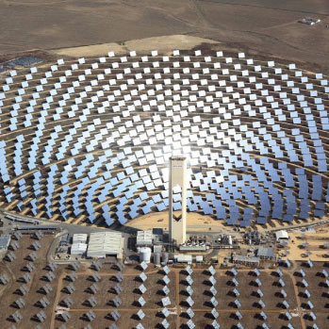
PS10 in Seville, Spain
Europe's first commercial concentrating PS10 solar power tower is operating near the sunny southern Spanish city of Seville.
The 11 MW solar power tower produces electricity with 624 large movable mirrors called heliostats.
https://en.wikipedia.org/wiki/PS10_solar_power_plant

Slide 57
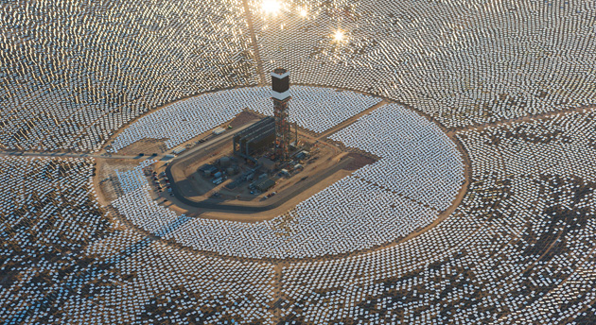
Ivanpah, California
2014 - The world's largest solar thermal plant, the Ivanpah Solar Electric Generating System in California. The array produces a total 392 MW of power through 173,500 multi-mirror units.
https://en.wikipedia.org/wiki/Ivanpah_Solar_Power_Facility

Slide 58
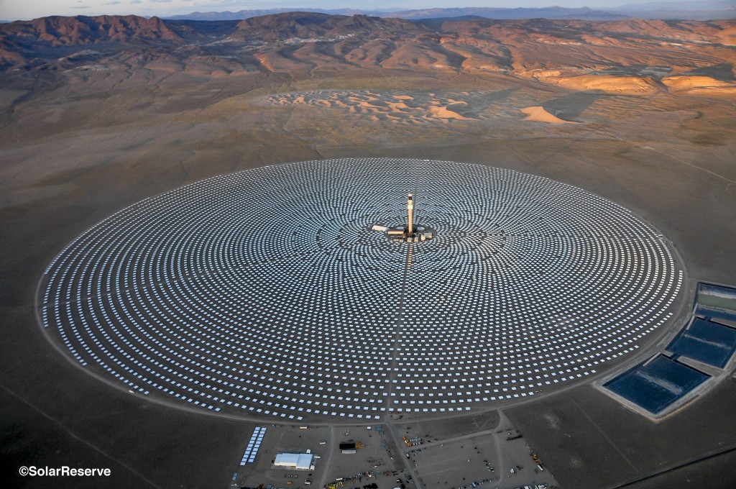
Crescent Dunes, NV
Power sold to NV Energy for $0.135 / kWh, 25-year agreement
500,000 MW output at capacity factor of 52% (110 MW plant)
640-foot tower with molten salt energy storage (1.1 GW)
$737 m loan guarantee from the Federal Government
Renewable Energy, 2/e, Chapter 2
breakingenergy.com/2015/02/10/solarreserve-crescent-dunes-solar-tower-will-power-up-in-march-without-ivanpahs-woes/

Slide 59
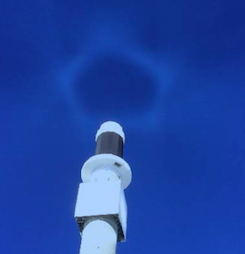
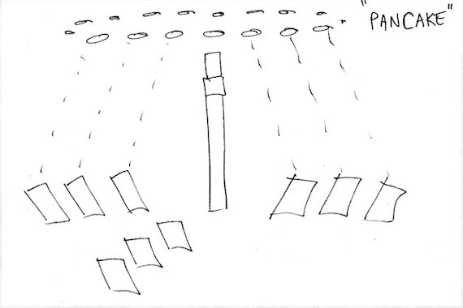
Reducing bird mortalities
In the first months of operation, a solar tower killed hundreds of birds that flew through its solar halo.
Reworking operations has lowered bird deaths.
Each spot in the pancake is equivalent to ‘only’ four suns.
Solar halo formed by heliostats
in standby position
Algorithms were used to reshape the ‘halo’ into a less dangerous ‘pancake’.
Renewable Energy, 2/e, Chapter 2
https://cleantechnica.com/2015/04/16/one-weird-trick-prevents-bird-deaths-solar-towers/

Slide 60
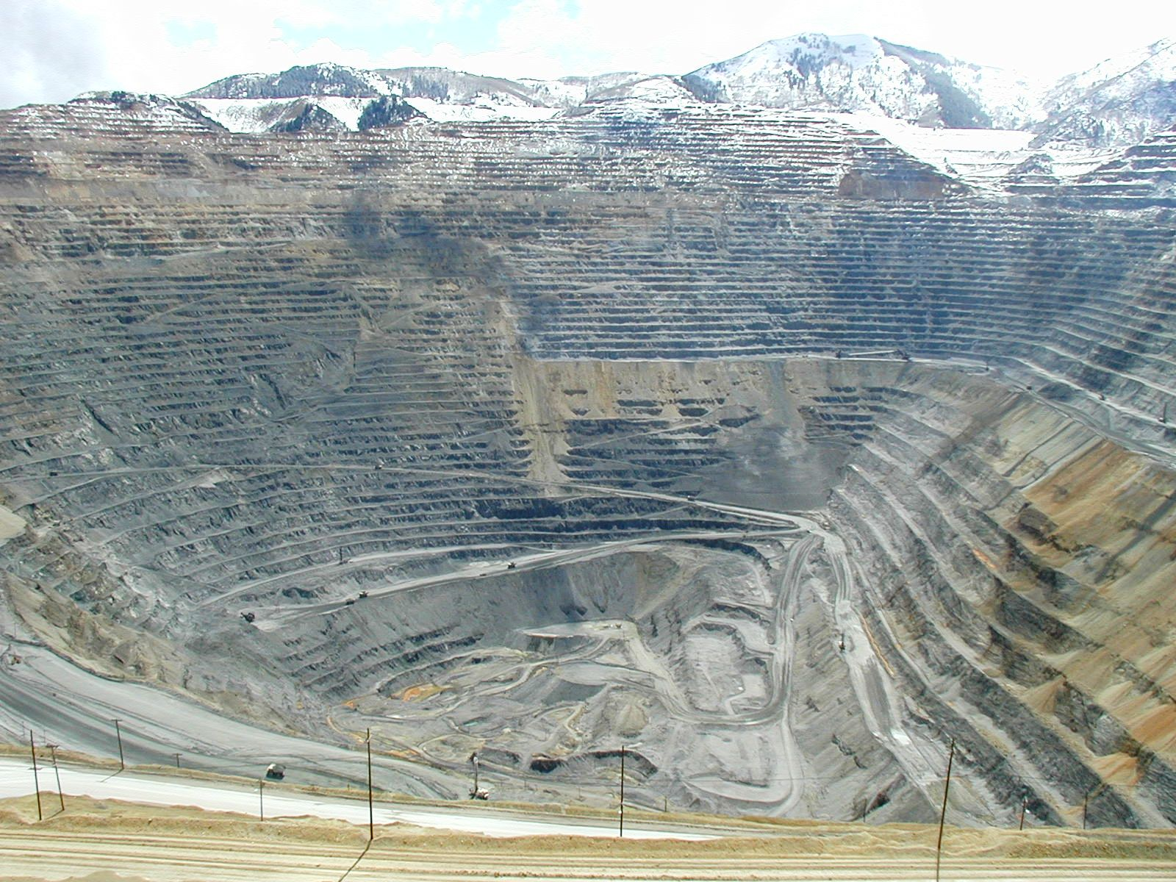
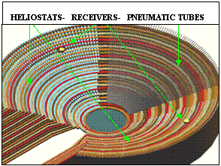
Pit power tower?
A young engineer from Northeastern University, Jonathan Gwiazda, has proposed using old pit mines to host solar power towers.
Advantages?
Brownfield to brightfield with existing roads & infrastructure
Abundant water for heat transfer & steam generation.
Shorter tower combining updraft & solar concentration
Bingham Canyon pit mine (Utah)
https://en.wikipedia.org/wiki/Solar_power_tower
https://en.wikipedia.org/wiki/Crescent_Dunes_Solar_Energy_Project

Slide 61
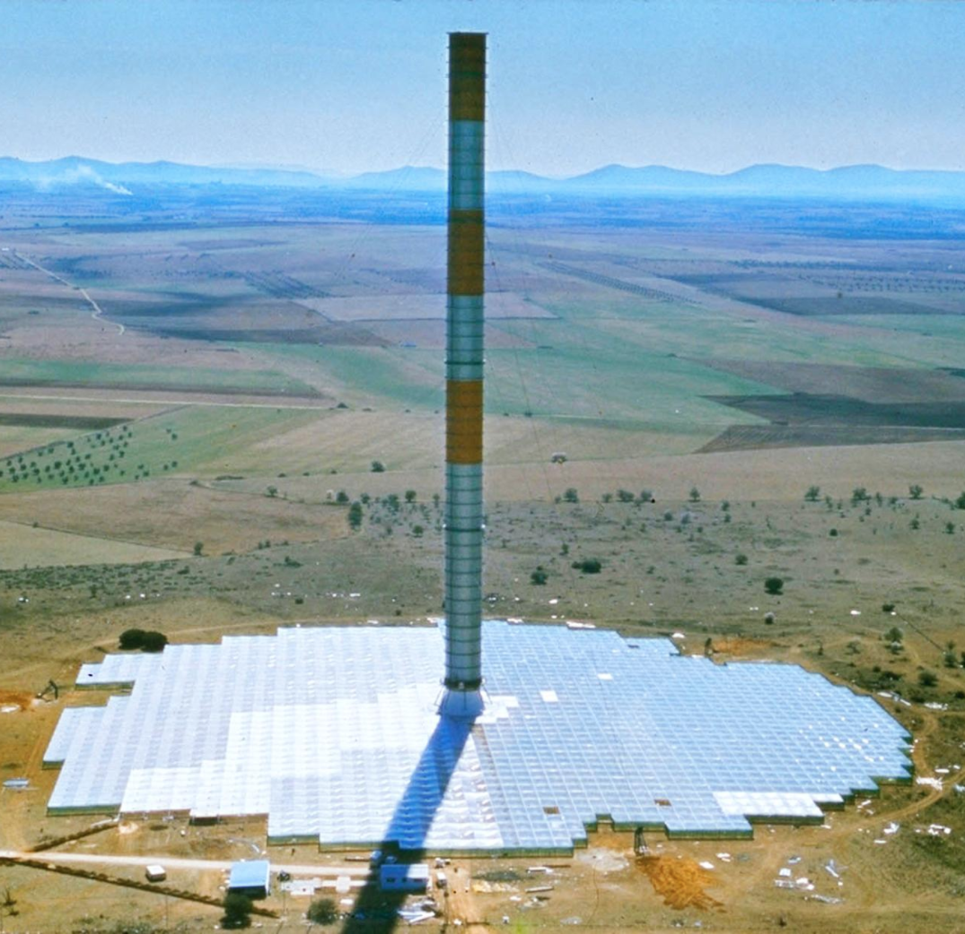
Solar chimneys
Solar updraft towers (aka solar chimneys) are powered by the heat generated when sunlight hits the earth.
Proposed 101 years ago by a Spaniard.
A transparent, insulate cover sits around the base of the tower & is raised 2 – 20 m off the ground.
Hot air forms under the cover,
is trapped & flows toward the
central chimney tower.
The hot earth continues to spin
turbine 24/7.
Flowing air spins (wind)
turbines that produce power.
Needs large area of flat land
with consistent sun. No water.
High capital costs.
  $1.6 b estimate for a
  200 MW plant
  in Western Australia.
A test solar updraft tower in Manzanares, Spain
news.nationalgeographic.com/news/energy/2014/04/140416-solar-updraft-towers-convert-hot-air-to-energy/

Slide 62
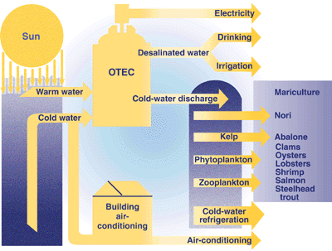
Ocean thermal energy conversion
Ocean thermal energy conversion (OTEC) is basically a heat exchanger that exploits the temperature differential between surface and deep ocean waters.
At depths of 1000 feet, there may be a 20°C difference.
The engineering challenges are huge.
10 MW station would need to pump 500 m²/second through heat exchangers while moored in 1000 feet of water.
Fig 2.48
Energy for
desalination?
https://en.wikipedia.org/wiki/Ocean_thermal_energy_conversion

Slide 63
8. Solar energy
  8.9: Silicon doping & how PV works
Renewable Energy, 2/e, Chapter 3

Slide 64
Photoelectric effect
In 1839, the French physicist Alexandre-Edmund Becquerel found that the voltage of a wet cell battery he was developing increased when its silver plates were exposed to sunlight.
In 1876, William Grylls Adams and his student, Richard Evans Day, discovered that an electrical current could be started in selenium solely by exposing it to light.
This pioneering work portended quantum mechanics long before most chemists and physicist had accepted the reality of atoms.
In 1883, Charles Edgar Fritts made a selenium solar cell with 1% efficiency.
In 1905, Albert Einstein discovered that the photoelectric effect was resulted from the quantum nature of matter at the subatomic scale.
In 1953, the team of Chapin-Fuller-Pearson at Bell Labs produced ‘doped’ silicon that had much better PV efficiency.
Renewable Energy, 2/e, Chapter 3

Slide 65

PV: current efficiency
http://news.energysage.com/solar-panel-efficiency-cost-over-time/

Slide 66

PV: current costs
http://news.energysage.com/solar-panel-efficiency-cost-over-time/

Slide 67


Silicon makes PV cells practical
1953: While researching silicon for its possible applications in electronics, Gerald Pearson, an empirical physicist at Bell Laboratories, inadvertently made a solar cell that was far more efficient than solar cells made from selenium. Two other Bell Labs scientists - Daryl Chapin and Calvin Fuller - refined this discovery and developed the first solar cell capable of converting enough of the sun's energy into power electrical equipment.
Renewable Energy, 2/e, Chapter 3

Slide 68

Semiconductors
Semiconductors: materials or elements whose ability to conduct electrons is intermediate between conductors (metals) and insulators (like glass).
Don’t have an abundance of electrons in the ‘conduction band’.
Group IV semiconductors
Group III-V semiconductors
Group II-V semiconductors

Slide 69

Conduction band electrons
Normally, electrons shared between atoms reside in an energy level called the valence band.
Addition of certain types of energy can bump the energy level of these electrons up to the conduction band.
The energy difference between the valence & conduction bands is called the energy gap, typically 1 to 1.5 eV
The p-n junction ‘warps’ the bands and the energy gap.
conduction band
energy gap
Renewable Energy, 2/e, Chapter 3
valence band

Slide 70

Semiconductors & doping
PV cells are a junction between two thin layers of silicon.
p layer (positive)
n layer (negative)
Doped with B (electron-deficient, so positive) = holes
Doped with P (surplus electrons so negative)
Renewable Energy, 2/e, Chapter 3
http://solarjourneyusa.com/bandgaps.php

Slide 71
Photons create ‘holes’
When photons hit electrons in the valence band they excite those electrons, boosting them into the conduction band & leaving ‘holes’ in the valence band.
Excited electrons roll downhill towards the n-layer.
‘Holes’ float uphill towards the p-layer.
Renewable Energy, 2/e, Chapter 3

Slide 72

How a PV cell works
www.homepower.com/articles/solar-electricity/equipment-products/peek-inside-pv

Slide 73

PV cell structure
http://www.pbs.org/wgbh/nova/solar/insi-nf.html

Slide 74

Doped silicon layers
Boron is added to the p-layer giving it a positive charge (lack of electrons).
Phosphorous is added to the n-layer giving it a negative charge (excess electrons).
p-layer
n-layer
http://www.pbs.org/wgbh/nova/solar/insi-nf.html

Slide 75

Electric field at p-n junction
The electric field that forms at the p-n junction forms a depletion zone: electrons are pulled into the p-layer, leaving ‘holes’ in the n-layer.
depletion
zone
p-layer
n-layer
http://www.pbs.org/wgbh/nova/solar/insi-nf.html
(-) charge
(+) charge

Slide 76

Electric field at p-n junction
Photons hitting the PV cell knock electrons loose.
Free electrons are pulled toward the p-layer…
Stopped by the electric field and...
Pushed to the metal strips on top of n-layer.
The current flows through the load &...
Back into the p-layer, filling holes.
http://www.pbs.org/wgbh/nova/solar/insi-nf.html

Slide 77

Power!
Notice that the solar panel forms a closed system.
Electrons are not added or removed, but merely flow from the PV cell, through the circuit & back into the PV panel.
http://www.pbs.org/wgbh/nova/solar/insi-nf.html
Photons simply get the electrons flowing or moving.

Slide 78
How do solar panels work?
https://www.youtube.com/watch?v=xKxrkht7CpY

Slide 79


Monocrystalline ingots via C
single silicon crystals or ingots
Single crystals, or ingots, of silicon can be formed using the Czochralski process, developed by accident when he dipped his pen nib in tin instead of ink and pulled a single crystal of tin out.
https://en.wikipedia.org/wiki/Czochralski_process

Slide 80

Monocrystalline
Renewable Energy, 2/e, Chapter 3

Slide 81


Less expensive forms of Si for PV
Pulling single crystals requires very pure silicon & is slow & painstaking. Less pure, & less expensive, forms of silicon can be used to make PV cells.
Polycrystalline silicon is made from many small grains of monocystalline silicon.
Formed into cubic ingots; sawn into wafers.
Ribbons & sheets of silicon can be drawn from multicrystalline silicon melt.
Pulled via dies, cut with lasers & formed into sheets.
Renewable Energy, 2/e, Chapter 3

Slide 82

Polycrystalline PV cells
http://www.newsouthernenergy.com/pv-solar-thin-film-vs-polycrystalline/

Slide 83
Amorphous silicon for PV
Even less expensive thin films of amorphous silicon can be used to create PV panels.
Special processes must be used to ‘quench’ dangling silicon bonds.
Hydrogen gas is used to create a hydrogen-silicon alloy.
Carbon-silicon alloys can also be used.
Thin films can be used for a wide variety of applications.
Lower efficiency is balanced by lower cost.
Renewable Energy, 2/e, Chapter 3

Slide 84

Multi-junction PV
Multi-junction PV cells essentially stack number of different n- & p-layers to create a cell that is responsive to photons of varying wavelengths, increasing the overall efficiency of the cell.
Overall efficiencies approach 50%.
Renewable Energy, 2/e, Chapter 3
https://en.wikipedia.org/wiki/Multi-junction_solar_cell

Slide 85

Evolution of PV technologies
While the efficiencies of newer technologies are low, they will likely increase as development continues. Printed panels offer some obvious advantages.
NREL

Slide 86

Concentrating PV systems
The efficiency of any PV cell can be increased by focusing (or concentrating) more sunlight on each cell.
Lenses can be used to capture & focus sunlight.
The must efficient cells should be used & must be cooled.
The array should track & be located where sunlight is abundant.
A head-to-head study at Penn State showed that tracking concentrating PV can produce 53% more energy than standard solar cells.
73% increase possible with cooling
Renewable Energy, 2/e, Chapter 3
.solaflect.com/faq-what-about-future-advances-in-solar-technology/

Slide 87

Silicon sphere PV
Spheres of doped silicon are placed in hexagonal reflective cups & mounted on a flexible foil surface: mini concentrators.
Uses less silicon (only 20%).
Cuts manufacturing costs by up to 50%.
P-doped spheres are coated with n-doped surface & anti-reflective coating.
Bonded to an electrode at cup’s bottom.
Efficiency needs to be improved.
Renewable Energy, 2/e, Chapter 3
technologyreview.com/s/409037/focusing-light-on-silicon-beads/

Slide 88

Solar thermophotovoltaic cells
Conventional PV panels loose much of incoming photon’s energy as heat. Researchers at MIT to capture most of the energy of incoming solar radiation, focus all of it to a narrower wavelength tuned to a particular PV cell, and emit it at that cell at will.
Current efficiencies are about 20%.
Promise? Storage of sunlight as heat with re-emission on demand.
http://bgr.com/2016/05/25/solar-panels-efficiency-doubled-mit/
https://s3tec.mit.edu/solar-thermophotovoltaics

Slide 89

Assembling cells into panels

Slide 90

Environmental costs of PV?
The processing of making silicon for PV panels uses hazardous & toxic chemicals like sulfuric acid, hydrofluoric acid, & heavy metals and creates hazardous waste like silicon tetrafluoride.
Serious effects on human health, and
Environmental health: compromised water quality & infertile soils
In 2008, there were reports of chemical dumping in China.
By 2014, a study of 37 PV manufacturers by Solar
Scorecard ranked one Chinese company as most
responsible, followed by a US firm.
As PV panels age out, they will need to be recycled to avoid releasing hazardous chemicals, like the toxic heavy metals in many panels.
PV panels are recycled in Europe.
Recycling hasn’t begun in the US; not sufficient
need.
http://www.washingtonpost.com/wp-dyn/content/article/2008/03/08/AR2008030802595.html
https://news.nationalgeographic.com/news/energy/2014/11/141111-solar-panel-manufacturing-sustainability-ranking/
http://2011.solarteam.org/news/recycling-methods-for-used-photovoltaic-panels

Slide 91
8. Solar energy
  8.10: Types of PV systems (mounting)
Renewable Energy, 2/e, Chapter 3

Slide 92



Fixed-mount rooftop PV arrays
Generally less expensive & a bit less efficient than pole-mount or
trackers.
Siting is never controversial.
Permitting is minimal.
Electrical service is present.

Slide 93
How many panels for a household?
The average Vermont household uses 569 kWh per month (2015),
or 6,828 kW per year.
A 2012 study looked at 5 kW rooftop-mounted residential PV systems in Vermont.
$25,000 total cost installed
10-year payback
$34,956 profit over a 25-year life
In Vermont, it’s estimated that distributed rooftop PV could generate 18% of electric consumption.
https://en.wikipedia.org/wiki/Solar_power_in_Vermont

Slide 94



Pole-mount PV arrays
Trackers follow the sun while pole-mount arrays do not.
Trackers generate more electricity, but…
  Are a bit more expensive & ...
  A bit more complex.
https://www.solarpowerworldonline.com/2016/05/advantages-disadvantages-solar-tracker-system/

Slide 95

Building-integrated PV
Integration could contribute to making new buildings self-sufficient.

Slide 96

Utility-scale PV
Utility scale-PV is large field of fixed-angle or tracking PV panels or solar tower powers.
In Vermont, the cap for net-metering is a 1-MW solar array.
http://fortune.com/2015/05/18/solar-power-ripasso

Slide 97
8. Solar energy
  8.11: Remote (off-grid) vs. grid-tied PV
Renewable Energy, 2/e, Chapter 3

Slide 98
Remote PV
Remote (or off-grid) PV is used to power devices in areas that don’t have access to the electrical grid.
Battery storage is sometimes included to allow power to extend beyond daylight hours.
Uses are limited only by human imagination, but are often prioritized by a community’s needs:
Pumping water;
Refrigerators;
  Keeping medicines & vaccines cold;
Power for homes & community centers; &
Telecommunications.
Renewable Energy, 2/e, Chapter 3

Slide 99

Who’s got power?
2012 data showing the percent of global & national populations without access to an electrical grid.

Slide 100

Access to electricity
2017 data showing the percent national populations without access to an electric power.

Slide 101




Stand-alone configurations

Slide 102

Grid-tied systems
Grid-tied PV systems are semi-autonomous systems that use the grid as a battery or electric storage system.
Net metered: electricity not used by generator is sold to grid.
  When the system is unable to make electricity, power is pulled from the grid.
Direct sale for arrays whose purpose is production of electricity for sale rather than use.
https://en.wikipedia.org/wiki/Grid-tied_electrical_system

Slide 103

Grid-tied components
Interconnecting components of grid-tied systems must be accessible to utility workers for safety reasons.
http://age.co.za/solar/Solutions/GridTieInSolution/tabid/847/language/en-US/Default.aspx

Slide 104

Adding PV to infrastructure
The Swiss have used PV in place of visual & noise barriers along roadways.
tnc.ch/en/power-instead-noise-photovoltaic-noise-barriers-1

Slide 105
8. Solar energy
  8.12: PV use stats & grid integration
Renewable Energy, 2/e, Chapter 3

Slide 106

Utility-scale solar: rapid growth
As of May 2017, utility-scale solar power accounted for 2% of all US electricity generation.
72% growth between 2010 to 2016
http://fortune.com/2015/05/18/solar-power-ripasso

Slide 107

PV is now common
Seia.org

Slide 108

Utility-scale solar capacity
Total US generating capacity for utility scale solar now >21.5 GW.
Several states have policies such as renewable portfolio standards or state renewable tax credits.
Since 2005, the federal government has provided a 30% tax credit, which is scheduled to phase down or expire by 2022.

Slide 109

Utility-scale solar plant locations
XXX

Slide 110

US PV: 1 m installations
1 million solar PV installations is 1% of total US electric generation.
Exhilarating and daunting!
Seia.org

Slide 111

US PV milestones: cost
Cost of installed PV is approaching $1.00/MW.
Seia.org

Slide 112

US PV milestones
Seia.org

Slide 113
Vermont’s solar electric capacity
Vermont’s first-in-the-nation feed-in tariff for renewable electricity jump-started installation of solar power.
2015: Vermont’s total solar electric capacity:107 MW.
2016: Vermont ranked 8th in per capita solar power
      (270 W/person)
https://www.seia.org/research-resources/top-10-solar-states

Slide 114

Global solar power
Global solar:
303 GW
Added 2016:
75 GW
Solar as % global consumption:
1.8%
https://en.wikipedia.org/wiki/Solar_power_by_country

Slide 115

Solar power is expanding globally

Slide 116
Integration of solar power
Because solar is an intermittent power source, integration of large amounts of solar power into the grid will require storage technologies.
More than 10-20% solar (or solar and wind) will require some form of storage.
See the energy storage material presented in upcoming module.
Renewable Energy, 2/e, Chapter 3

Slide 117
8. Solar power
  Out there?

Slide 118

PV in space?
Satellite solar power system (SSPS): would place PV arrays in geosynchronous orbit around the earth they would have access to 24/7 solar energy without absorbance by the atmosphere or any terrestrial shading. So, 1365 vs. 1000 W/m²
power.
30-year old concept
Huge 50 km² arrays, each producing GW
Electricity would be converted to
microwaves & beamed from 1 km-
diameter antennas to 10 km² receiving
dishes on earth.
  Laser transmission might be possible.
Hugely complex and expensive
https://energy.gov/articles/space-based-
solar-power
Renewable Energy, 2/e, Chapter 3

Slide 119

Artificial photosynthesis?
Plants capture 1% of the sun’s energy in photosynthesis to create sugars & carbon-based molecules. Let’s do that!
Researchers at Harvard have developed a ‘bionic leaf’ using a cobalt-phosphorous allow that can capture 10% of sunlight’s energy.
Energy is used to split water into H₂ and O₂.
Bacteria are then used to combine H₂ with
CO₂ to create hydrocarbons that could be
used as liquid fuels.
https://www.technologyreview.com/s/601692/the-road-to-solar-fuels-hits-a-speed-bump/; https://hms.harvard.edu/news/bionic-leaf
Researchers at Lawrence Berkeley National labs have developed a solar device that uses sunlight to convert CO₂ to formate, a carbon-based molecule that can be converted to liquid fuels.
Efficiency of 10%.

Slide 120
Solar energy summary
Solar energy can be captured by passive or active systems as heat.
Solar radiation can be converted into electricity through heat engines or photovoltaics.
Photovoltaic devices are semiconducting diodes that produce currents when irradiated with photons
Photovoltaic systems cover a wide range of sizes.
Solar PV systems connected to the grid are the largest part of the current market.
Huge growth in this sector is expected.

