Slide 1
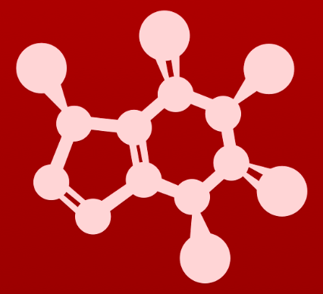
CHE 2060: Principles of Organic Chem
4. Overview of organic reactivity
Introduction: The $300 million reaction
4.1: A first look at some organic reaction mechanisms
4.1A: The acid-base reaction
4.1B: A one-step nucleophilic substitution mechanism
4.1C: A two-step nucleophilic substitution mechanism
4.2: A quick review of thermodynamics and kinetics
4.2A: Thermodynamics
4.2B: Kinetics
4.3: Catalysis
4.4: Comparing biological and laboratory reactions

Slide 2
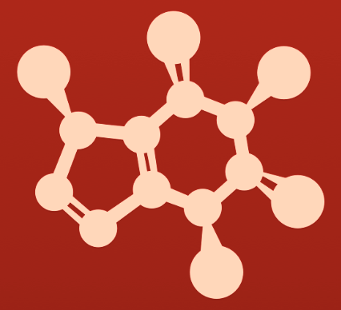
4. Animation of basic rxn mechanisms
Substitution Reactions
A new group, either Nu: or E+, is substituted for an existing group on the substrate.
No other changes are made to the substrate.
Alkanes remain alkanes & arenes remain arenes.
Generally:
Alkanes react via SN1 or SN2 mechanisms; but
Arenes react via E+ substitution mechanism.

Slide 3
Nucleophilic substitution mechanism (SN1)
..
H -- O
..
..
Br
O
..
..
:Br:-1
H+
..
substituted alkane
different
substituted alkane
SN1
2° or 3° substrate
Weak Nu:
2 steps:
Formation of carbocation by loss LG (rate-limiting).
Resolution of carbocation by Nu:
[ H polishing to stabilize the product]
If the product is chiral it is produced as a racemic mixture.

Slide 4
Nucleophilic substitution mechanism (SN1)
Substrate is a 2° or 3° alkyl halide or alcohol.
Here 1-bromo-1,1- dimethylethane.
Br is a good LG.
Reactant is a weak Nu:
This is ethanol.
..
H -- O
..
Br

Slide 5
Nucleophilic substitution mechanism (SN1)
carbocation intermediate
..
H -- O
..
Br
+
..
:Br:-1
..
STEP 1
The Br leaving group leaves….
[Bromine can leave because the bromide
anion is large & stable.]
…creating a carbocation.

Slide 6
protonated product
..
H -- O
..
..
Br
+
O
+
H
..
:Br:-1
..
STEP 2
Now ethanol acts as Nu: & quenches the carbocation E+ ….
…placing the nucleophile where the LG had been.

Slide 7
Nucleophilic substitution mechanism (SN1)
Substitution product
Here an ether.
..
H -- O
..
..
..
Br
+
O
O
+
H
..
..
:Br:-1
H+
..
STEP 3
Proton polishing: loss of proton stabilizes the oxygen.
Proton & LG form HBr byproduct.

Slide 8
Nucleophilic substitution mechanism (SN1)
Substrate is a 2° or 3° alkyl halide or alcohol.
Here 1-bromo-1,1- dimethylethane.
Br is a good LG.
Reactant is a weak Nu:
This is ethanol.
Substitution product
Here an ether.
carbocation intermediate
protonated product
..
H -- O
..
..
..
Br
+
O
O
+
H
..
..
:Br:-1
H+
..
STEP 1
The Br leaving group leaves….
[Bromine can leave because the bromide
anion is large & stable.]
STEP 2
Now ethanol acts as Nu: & quenches the carbocation E+ ….
…placing the nucleophile where the LG had been.
STEP 3
Proton polishing: loss of proton stabilizes the oxygen.
Proton & LG form HBr byproduct.
…creating a carbocation.

Slide 9
Nucleophilic substitution mechanism (SN2)
Na+
..
..
:Br:
- :O
..
..
:Br:-
:O
..
..
substituted alkane
different
substituted alkane
SN2
1° (or 2°) substrate
Strong Nu:-
1 step (concerted step):
Strong Nu:- pushes on, forming 5-bond intermediate, & pushing the old substituent off.
If the substrate is chiral, the product’s chirality will be inverted

Slide 10
Nucleophilic substitution mechanism (SN2)
Substrate is a 1° or 2° alkyl halide or alcohol.
Here 1-bromo ethane.
Br is a good LG.
Reactant is a strong Nu:-
Here sodium ethoxide
..
:Br:
Na+
..
- :O
..

Slide 11
Nucleophilic substitution mechanism (SN2)
untstable
(5 bond) intermediate
..
..
:Br:
Na+
:Br:
..
- :O
..
:O
..
STEP 1
The strong Nu:- attacks the E+, the carbon bonded to Br…
…creating an unstable intermediate….

Slide 12
Nucleophilic substitution mechanism (SN2)
NaBr is
formed as a byproduct.
Inverted substitution
product
Here an ether.
..
..
..
:Br:-
:Br:
Na+
:Br:
..
..
- :O
..
:O
:O
..
..
STEP 1 cont’d
…the unstable intermediate is resolved by pushing off of the LG, now substituted for by the Nu:
If chirality exists it is inverted.

Slide 13
Nucleophilic substitution mechanism (SN2)
Substrate is a 1° or 2° alkyl halide or alcohol.
Here 1-bromo ethane.
Br is a good LG.
Reactant is a strong Nu:-
Here sodium ethoxide
NaBr is
formed as a byproduct.
untstable
(5 bond) intermediate
Inverted substitution
product
Here an ether.
..
..
..
:Br:-
:Br:
Na+
:Br:
..
..
- :O
..
:O
:O
..
..
STEP 1
The strong Nu:- attacks the E+, the carbon bonded to Br…
STEP 1 cont’d
…the unstable intermediate is resolved by pushing off of the LG, now substituted for by the Nu:
If chirality exists it is inverted.
…creating an unstable intermediate….

Slide 14
Electrophilic substitution
H
..
..
:Br – Br:
Br:
..
..
..
..
HBr:
..
substituted
arene
arene
Electrophilic substitution: the substrate is the actor!
Substrate is an arene.
Arene π e- act as the Nu:
The reactant is polarized into an effective E+ by proximity to arene.
Intermediate is a stable carbocation (called a σ complex).
Both of theses steps are 1,3 electron pair displacements.
Why doesn’t the Br2 add across the double bond? Because the substrate is an arene and will not break resonance. Addition to an arene requires much stronger reactants!

Slide 15
Electrophilic substitution
Reactant is a non-polar halogen gas. Once polarized by proximity to the arene’s π e-s, closer
halogen serves as E+
Substrate is
an arene.
π e- are Nu:
H
E+
..
..
Nu:
:Br – Br:
..
..

Slide 16
Electrophilic substitution
Carbocation intermediate;
new E+.
H
..
H
Br:
E+
..
..
..
Nu:
:Br – Br:
..
..
..
+
:Br:-1
..
E+
STEP 1
Nu: attacks the E+, breaking π bond & adding a Br to ring.
The gas’s e- pair moves to the other Br atom, now an ion.
Loss of the π bond creates a ring carbocation intermediate

Slide 17
Electrophilic substitution
Substituted arene
product
H
..
..
H
Br:
Br:
E+
..
..
..
..
Nu:
:Br – Br:
..
..
..
+
H+
:Br:-1
..
E+
HBr
STEP 2
Resonance is restored by loss of proton polishing.
Loss of an H then forms HBr byproduct.

Slide 18
Electrophilic substitution
Reactant is a non-polar halogen gas. Once polarized by proximity to the arene’s π e-s, closer
halogen serves as E+
Substrate is
an arene.
π e- are Nu:
Carbocation intermediate;
new E+.
Substituted arene
product
H
..
..
H
Br:
Br:
E+
..
..
..
..
Nu:
:Br – Br:
..
..
..
+
H+
:Br:-1
..
E+
HBr
STEP 1
Nu: attacks the E+, breaking π bond & adding a Br to ring.
The gas’s e- pair moves to the other Br atom, now an ion.
STEP 2
Resonance is restored by loss of proton polishing.
Loss of an H then forms HBr byproduct.
Loss of the π bond creates a ring carbocation intermediate

