Slide 1
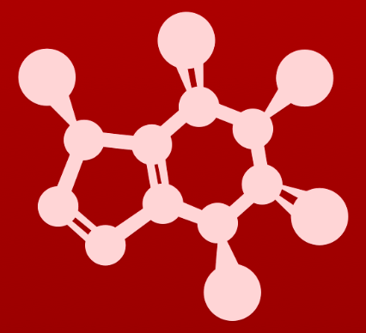
CHE 2060: Principles of Organic Chem
Introduction to organic structure & bonding, II
2.1: Covalent bonding in organic molecules
A. The σ bond in the H2 molecule
B. sp³ hybrid orbitals and tetrahedral bonding
C. sp² and sp hybrid orbitals and π bonds
2.2: Molecular orbital theory
A. Another look at the H2 molecule using MO theory
B. MO theory and conjugated π bonds
C. Aromaticity
2.3: Resonance
A. What is resonance?
B. Resonance contributors for the carboxylate group
C. Rules for drawing resonance structures
D. Major vs minor resonance contributors
2.4: Non-covalent interactions
A. Dipoles
B. Ion-ion, dipole-dipole, ion-dipole interactions
C. Van der Waals forces
D. Hydrogen bonds
E. Noncovalent interactions and protein structure
2.5: Physical properties of organic compounds
A. solubility
B. Boiling and melting points
C. Physical properties of lipids and proteins
VSEPR & molecular geometry

Slide 2
2. Intro to organic structure & bonding, II
Valence shell electron pair repulsion (VSEPR) and molecular geometry
This material is adapted from Flowers et al, ‘Chemistry’, OpenStax, 2018
Please note that Wikipedia has an excellent VSEPR page with clear models and explanations of each molecular and electron pair geometry:
https://en.wikipedia.org/wiki/VSEPR_theory

Slide 3
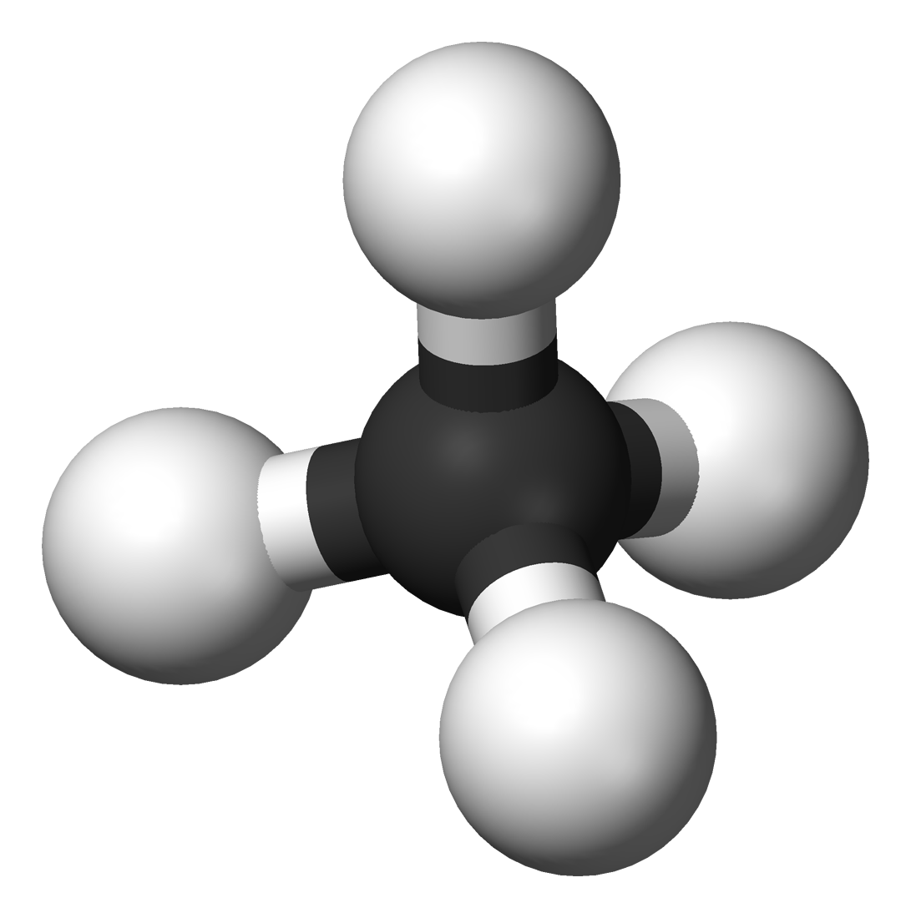
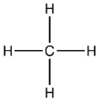
What is VSEPR?
Valence shell electron pair repulsion (VSEPR), allows for some prediction of molecular structure and geometry from the bonding patterns of the molecule’s central atom.
VSEPR is not a perfect predictor!
VSEPR uses the electrostatic repulsion of the pairs of electrons that make up both covalent bonds and lone pairs to assume that those pairs will repel one another, seek to maximize the inter-pair distance between one another and thus determine the molecule’s shape or geometry.
VSPER starts with Lewis dot structures and then counts:
The number of atoms bonded to the central atom; and
The number of lone electron pairs on the central atom.
4 atoms
0 free pairs
VSEPR
C is sp3 hybridized
tetrahedral molecular & electron pair geometry

Slide 4
VSEPR charts (1)
sp
sp²
sp³
sp³d
sp³d²

Slide 5
VSEPR charts (2)
# atoms
bonded to the central atom
sp
sp²
sp³
sp³d
sp³d²

Slide 6
VSEPR charts (3)
# lone e- pr | # atoms bonded | e- pair geometry |  | Molecular geometry | Bond Angle (°)
0 | 2 | linear |  | linear | 180
0 | 3 | trigonal planar |  | trigonal planar | 120
1 | 2 | trigonal planar |  | bent | < 120
0 | 4 | tetrahedral |  | tetrahedral | 109.5
1 | 3 | tetrahedral |  | trigonal pyramidal | < 109.5
2 | 2 | tetrahedral |  | bent | <109.5
0 | 5 | trigonal bipyramidal |  | trigonal bipyramidal | 90, 120, 180
1 | 4 | trigonal bipyramidal |  | seesaw | 90, 120, 180
2 | 3 | trigonal bipyramidal |  | T-shaped | 90, 180
3 | 2 | trigonal bipyramidal |  | linear | 180
0 | 6 | octahedral |  | octahedral | 90, 180
1 | 5 | octahedral |  | square pyramidal | 90, 180
2 | 4 | octahedral |  | square planar | 90, 180
sp
sp²
sp³
sp³d
sp³d²
http://intro.chem.okstate.edu

Slide 7
Here’s a simple example
Let’s look at the gas beryllium fluoride, BeF2.
The Lewis structure shows:
2 atoms bonded to the central (Be) atom; and
No lone pairs on the central atom.
Applying VSEPR, we can see that:
Be is sp hybridized.
The molecule has a linear electron pair and molecular geometry.
And this makes sense, because the two fluorines are electron rich – or areas of high electron density – and repel to get as far away from each other as they can.

Slide 8
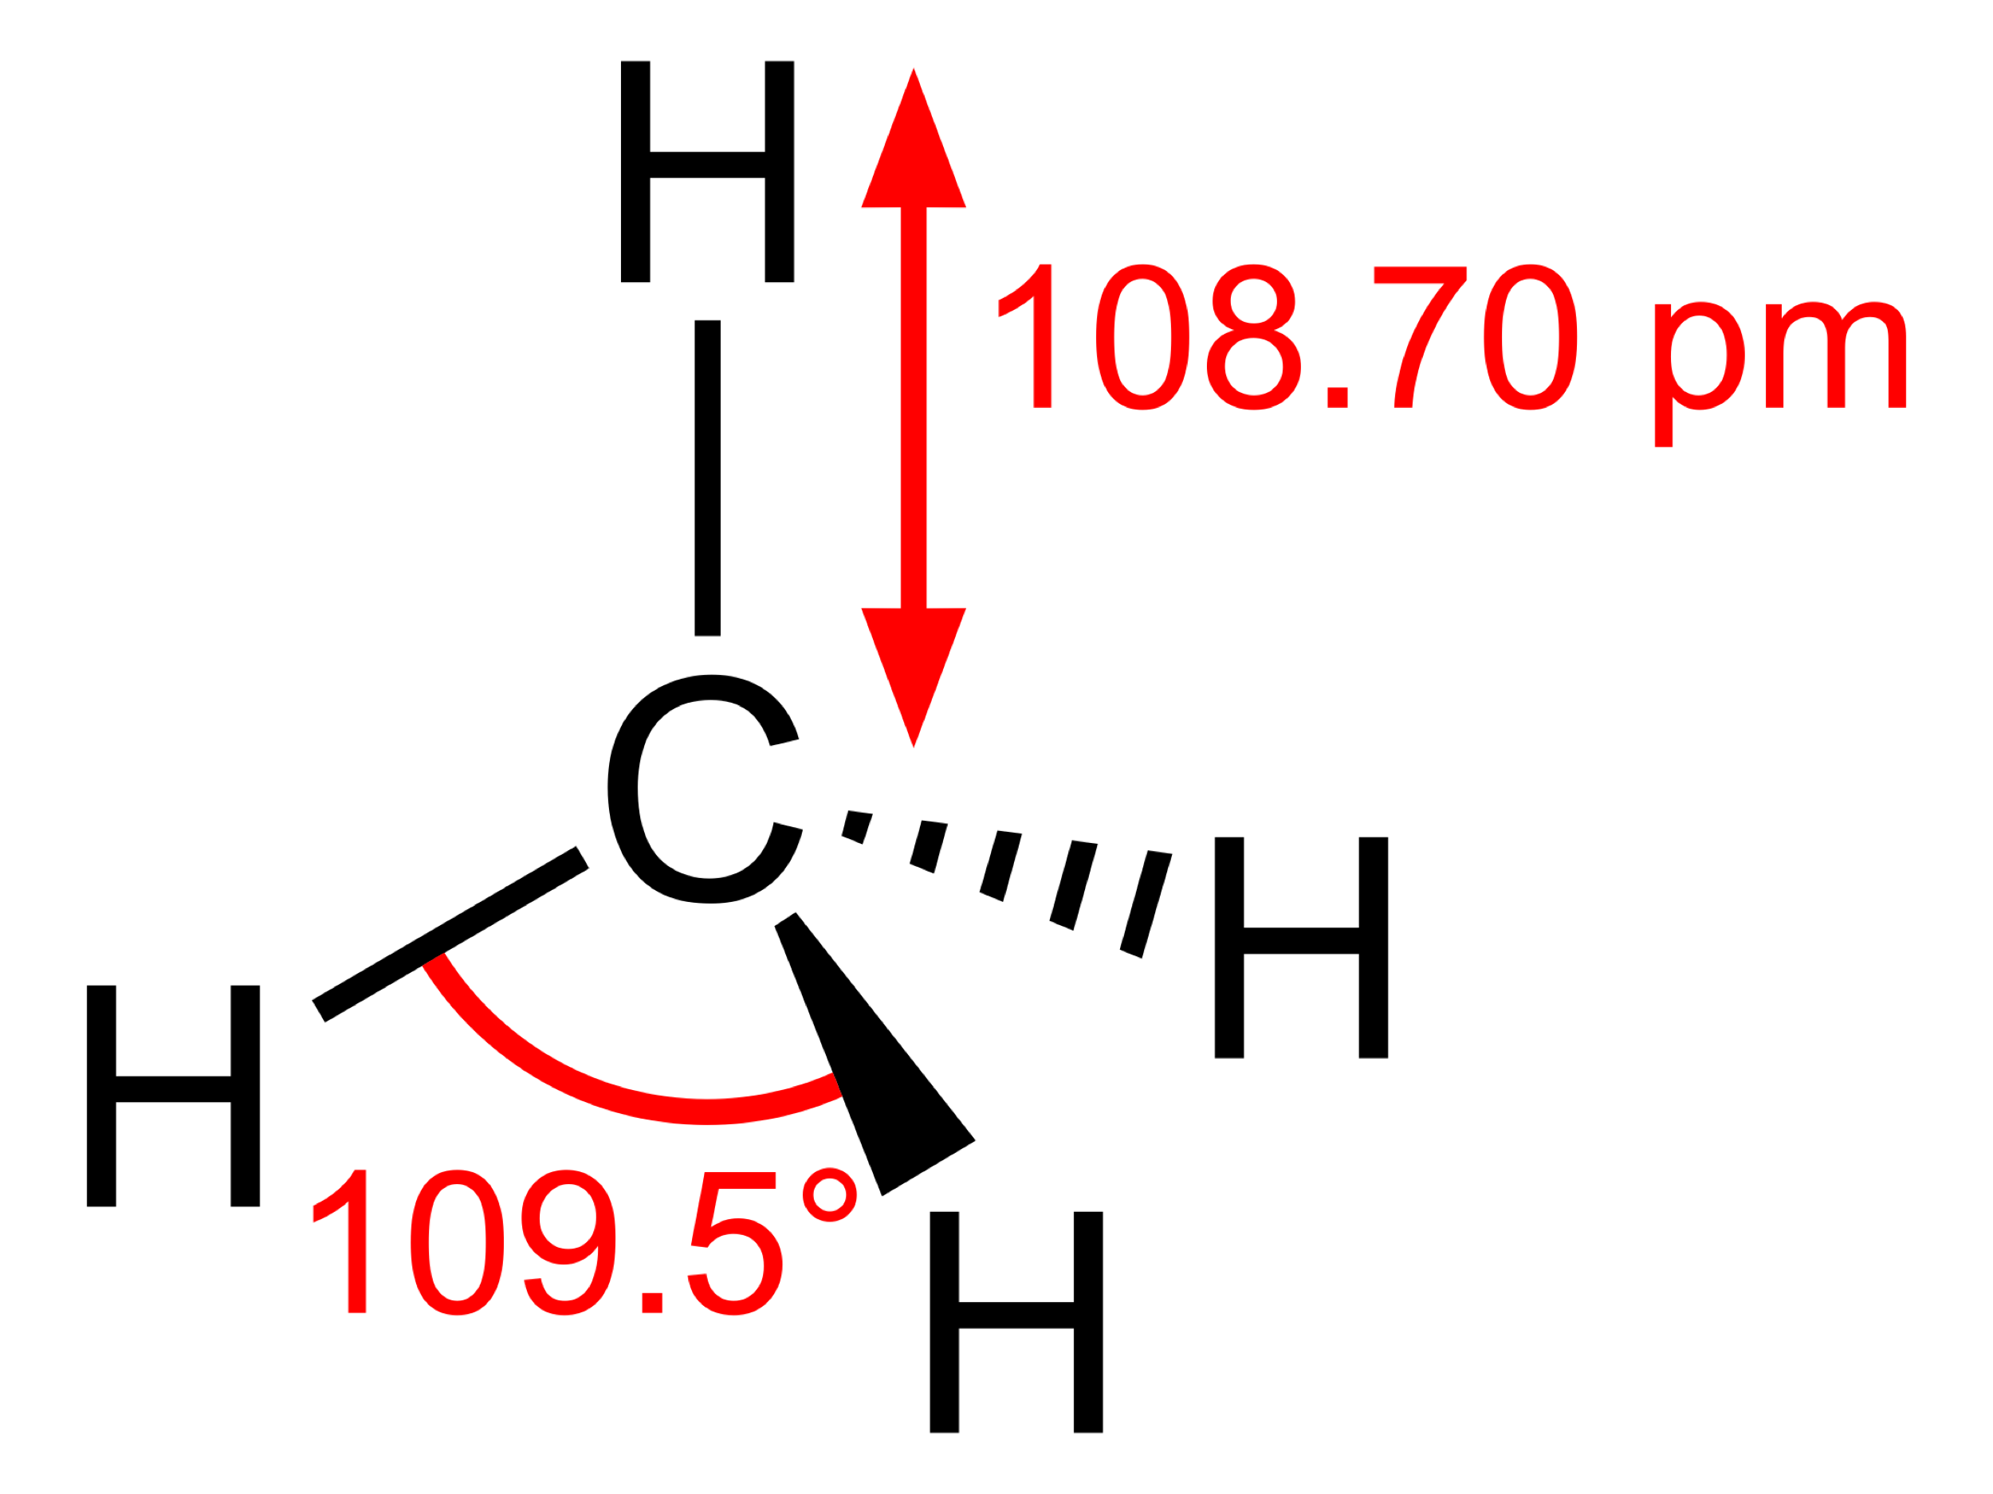
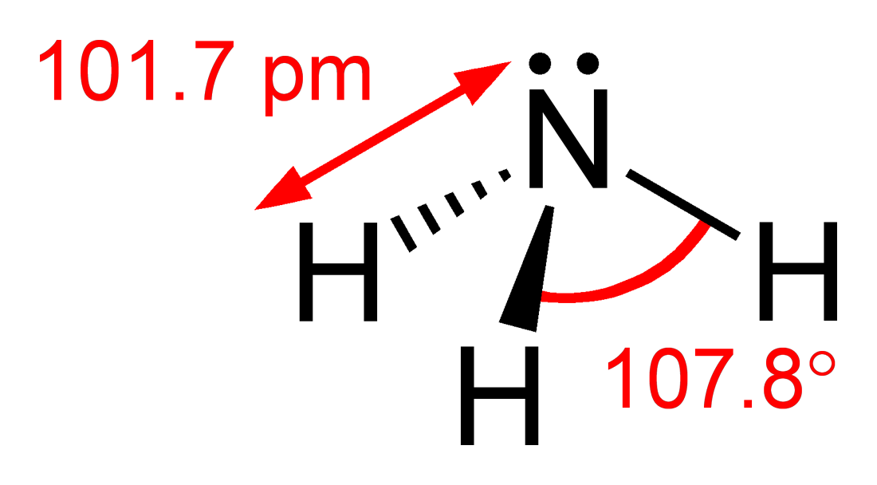
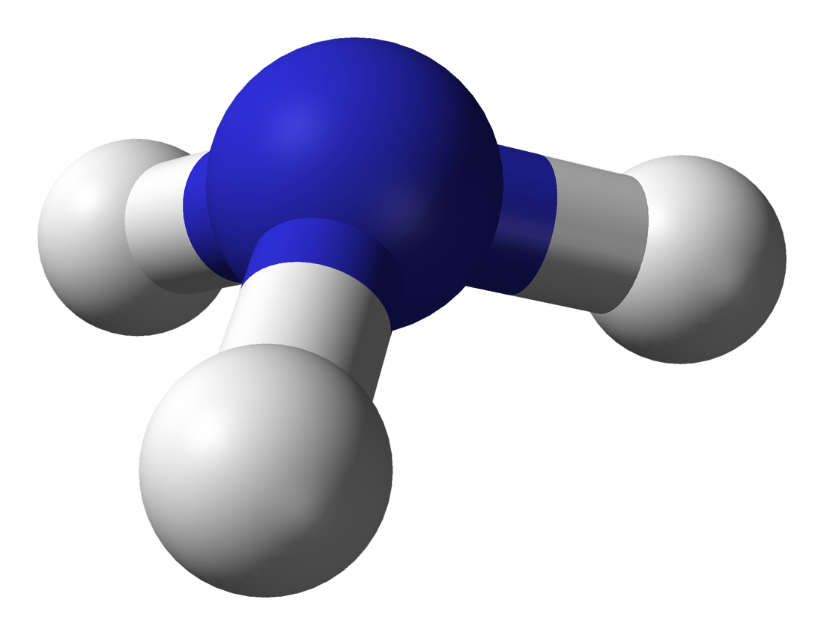
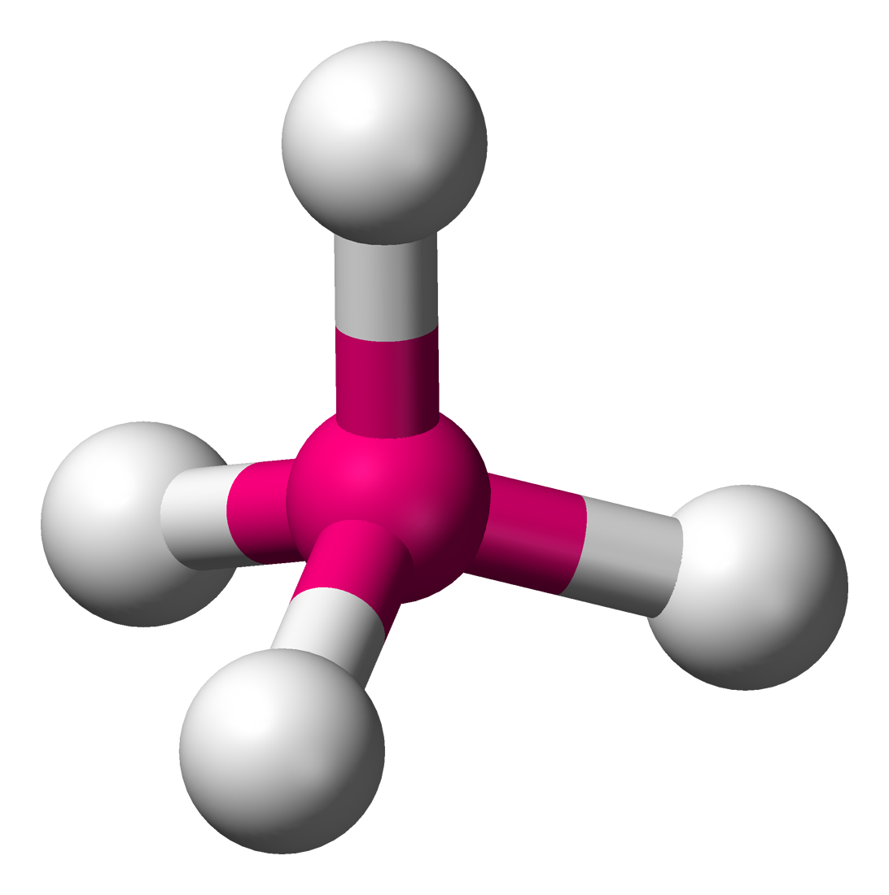
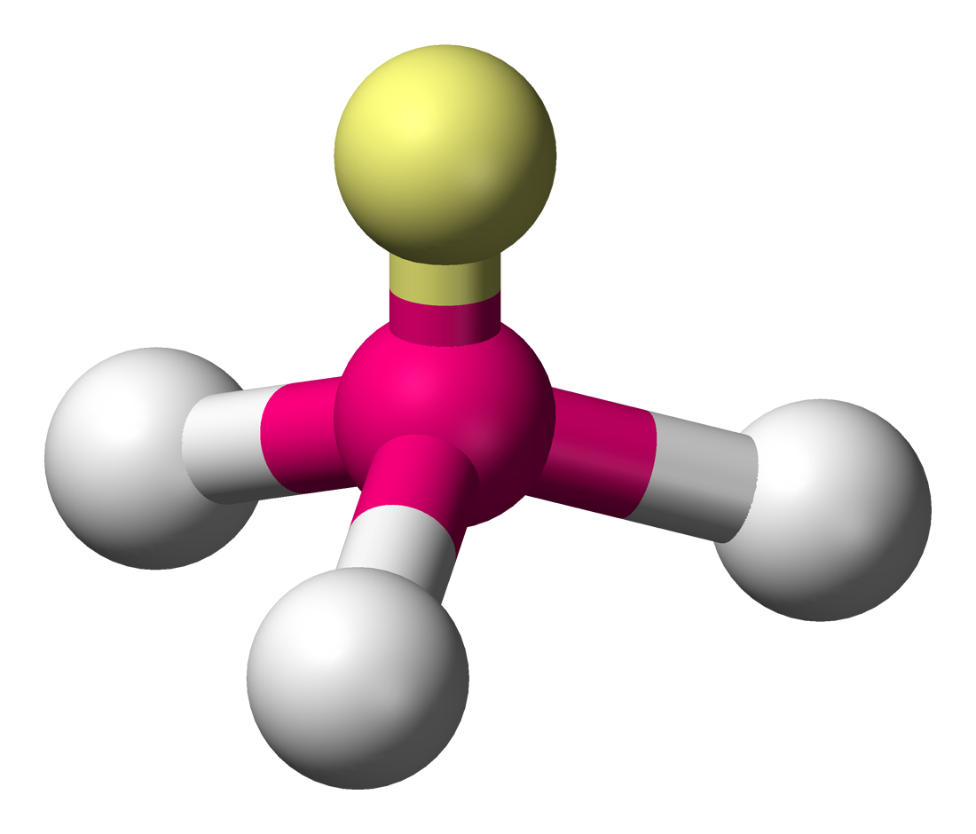
Electron pair vs molecular geometry?
Let’s compare methane (CH4) and ammonia NH3.
Begin with their Lewis structures.
CH4:
4 atoms bonded
0 lone pairs
NH3:
3 atoms bonded
1 lone pair
C is sp³ hybridized.
Tetrahedral electron pair
Tetrahedral molecular geometry
N is sp³ hybridized.
Tetrahedral electron pair
Trigonal pyramidal molecular geo.
..
..

Slide 9
Lone pairs distort geometry
Notice that methane has perfect tetrahedral angles of 109.5º.
But the inter-hydrogen angles of ammonia are closer, 107.8º.
Why?
The lone pair is more electronegative– more repulsive - than the covalent bonds and pushes the bonds further away and closing the angles to less than 109.5º.
Strength of repulsion:
lone pair – lone pair > lone pair – bond pair > bond pair - bond pair

Slide 10
Lone pairs occupy equatorial positions
The geometrical location of lone pairs isn’t random, but is determined by their greater repulsive power.
Lone pairs occupy more space than bonded atoms.
Equatorial positions offer more space than axial positions.
Notice that lone pairs always occupy equatorial positions here in trigonal bipyramidal geometries.
The number of lone pairs changes the apparent – or molecular geometries – of molecules even when the central atoms has a constant orbital hybridization.

Slide 11
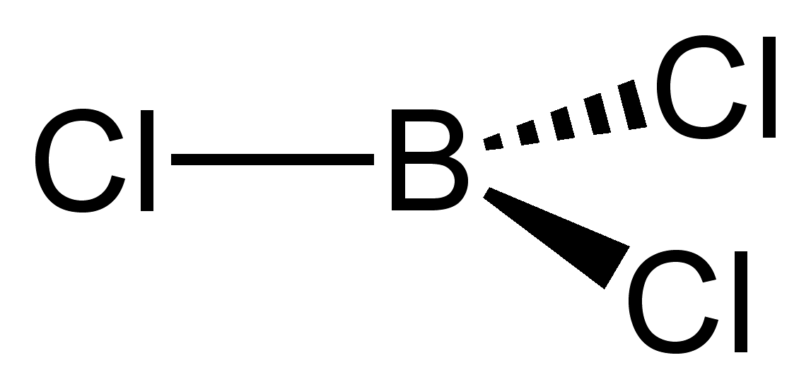
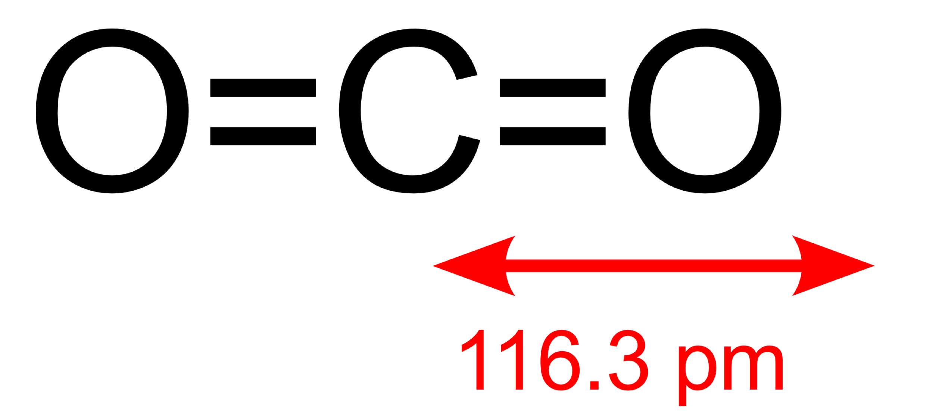
Try this:
Use VSEPR to predict: 1) electron pair geometry; and 2) molecular geometry of
CO2
BCl3
:
:
:
:
:
:
:
:
:
:
:
:
:
VSEPR analysis of CO2:
2 atoms bonded
0 lone pairs
C is sp hybridized
linear electron pair geometry
linear molecular geometry
VSEPR analysis of BCl3:
3 atoms bonded
0 lone pairs
B is sp² hybridized
trigonal planar electron pair geometry
trigonal planar molecular geometry

Slide 12
VSEPR exercises:
For each non-H atom of the amino acid glycine, use VSEPR to predict:
orbital hybridization;
electron pair geometry; and
molecular geometry
O = 1 bonds, 2 pairs
1) sp²
2) trigonal planar
3) linear
N = 3 bonds, 1 pair
1) sp³
2) tetrahedral
3) trigonal pyrimidal
O = 2 bonds, 2 pairs
1) sp³
2) tetrahedral
3) bent
C = 4 bonds, 0 pairs
1) sp³
2) tetrahedral
3) tetrahedral
C = 3 bonds, 0 pairs
1) sp²
2) trigonal planar
3) trigonal planar

Slide 13
VSEPR exercises:
Use VSEPR to predict: (1) electron pair geometry; & (2) molecular geometry of
CO3⁻² ion
NH4⁺¹ ion
PF5
H2O
H3O⁺¹ ion
SF4
XeF2
XeF4

Slide 14
Can you?
(1) Explain what VSEPR stands for?
(2) Explain why the concept of repulsion can determine molecular shape?
(3) Explain the steps required to use VSEPR to determine orbital hybridization,
electron pair geometry and molecular geometry?
(4) Apply VSEPR to predict orbital hybridization, electron pair and molecular
geometry?
(5) Describe why lone pairs have more ‘repulsive power’ than covalent
bonding pairs of electrons?
(6) Explain why the number of lone pairs can change molecular geometry?

