Slide 1
CHE 1020: Introduction to Chemistry
Module 7: Introduction to chemical reactions
7.1: Chemical equations must be balanced
7.2: Aqueous solutions and solubility
7.3: Precipitation reactions form solids; complete and net ionic
7.4: Acid-base reactions neutralize pH
7.5: Reduction-oxidation (redox) reactions transfer electrons
7.6: Combustion reactions are type of redox reaction
Resources on Canvas:
Periodic table
Solubility chart
Quick summary of Module 7
OpenStax Chemistry Atoms First 2/e p.10 – 14; 29 - 51

Slide 2
Module 7: Introduction to chemical reactions
7.1: Chemical reactions must be balanced
Derive chemical equations from narrative descriptions of chemical reactions
Write and balance chemical equations
Understand the units of balanced chemical equations
OpenStax Chemistry 2/e p.341 - 346

Slide 3
7. Introduction to chemical reactions
Big ideas?
Balanced chemical equations obey the law of conservation of mass.
Chemical reactions can be classified by type.

Slide 4
Visual signs of chemical reactions?
Not all chemical reactions produce visual change, but when they do, it’s spectacular.
https://www.youtube.com/watch?v=hUus48MnoI4

Slide 5
Chemical reactions we love
If we think about baking chocolate chip cookies, our reactants would be flour, butter, sugar, vanilla, some baking soda, salt, egg, and chocolate chips. What would be the products? Cookies! The reaction vessels would be our mixing bowl and oven.
flour + butter + sugar + vanilla + baking soda + eggs + chocolate chips → c.c. cookies
delicious reaction
Chemistry OpenStax

Slide 6
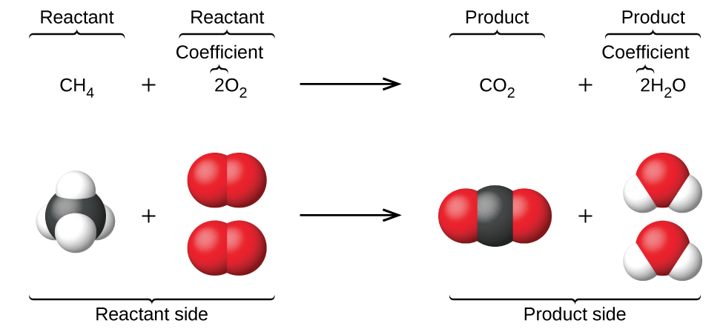
Chemical equations quantitate chemical change
Reaction: one methane molecule reacts with two oxygen gas molecules to yield one carbon dioxide molecules and two water molecules.
Or 1 mole + 2 moles becomes 1 mole + 2 moles
Note that mass is conserved.
change
combustion reaction
Chemistry OpenStax

Slide 7
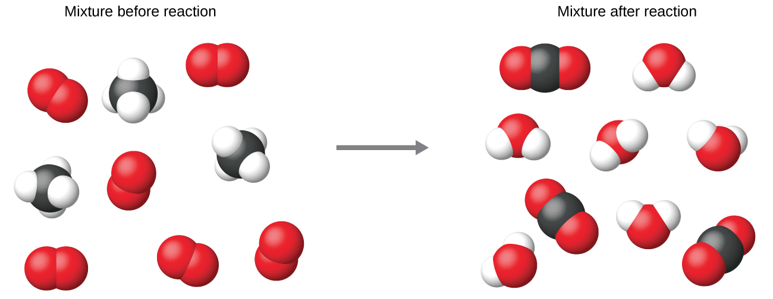
Mole ratios are constant even when amounts differ
Critical point: Coefficients of balanced equations are counting units NOT mass.
⌀
atoms
molecules
moles
g
Chemistry OpenStax

Slide 8
Balancing equation basics
Chemical equations are balanced because the same number and type of atoms are found on both sides of the equation.
Thus, equations obey the law of conservation of mass.
Stoichiometric coefficients (numbers before formulas) are used to balance equations.
Only coefficients may be changed to balance equations.
Subscripts cannot be changed because that would change chemical identity.
Electrolysis (addition of electricity) decomposes water into hydrogen and oxygen gases. Balance this equation:
H2O → H2 + O2
decomposition reaction
Chemistry OpenStax

Slide 9
Checking for balance
You may find it useful to do a systematic account of atoms when you see a chemical equation.
C3H8 + O2 → CO2 + H2O
combustion reaction
element | reactants | products | balanced?
C
H
O
To balance the equation you, increase coefficients but not subscripts.
Increase coefficients on the lower ‘side’.
Chemistry OpenStax

Slide 10
Try balancing these
Nitrogen and oxygen gas combine to form dinitrogen pentoxide.
Use formulas to create a chemical equation.
Add coefficients to balance the equation.
synthesis
(combination) reaction
Ammonium nitrate decomposes to form nitrogen and oxygen gases and water.
Use formulas to create a chemical equation.
Add coefficients to balance the equation.
decomposition reaction
Chemistry OpenStax

Slide 11
Add notation of physical state
Chemical reactions often include notation of the physical states or reactants or products:
(s) solid
(l) liquid (water, Hg)
(g) gas
(aq) aqueous solution
displacement
redox reaction
2Na(s) + 2H2O(l) → 2NaOH(aq) + H2(g)
CaCO3(s) → CaO(s) + CO2(g)
decomposition reaction
Δ
heat added
Can you see the patterns for displacement and decomposition reactions?
Chemistry OpenStax

Slide 12
Classifying chemical reactions
This summary of the general form of different types of chemical equations can is a useful reference guide when classifying reactions: identifying their type.
reaction name | general form
combination (synthesis) | A + B → C
decomposition | A → B + C
combustion | CxHy + O2 → XCO2 + y/2H2O
displacement | A + BX → AX + B
exchange | AB + CD → AD + CB
precipitation | CaCl2 + Na2(CO3) → 2NaCl + Ca(CO3)↓
acid-base (neutralization) | HCl + Na(OH) → H2O + NaCl
Chemistry OpenStax; ScienceSource

Slide 13
7.1: Can you?
(1) Recognize whether a chemical equation is balanced?
(2) Balance an unbalanced chemical equation?
(3) Write a chemical equation from a ‘narrative’ that uses the names of chemicals?
(4) Add notations to show the physical states of reactants and products?
(5) Begin to see that each type of chemical equation has a pattern?

Slide 14
7.1: Assignments
Canvas: Quick review questions quiz 7.1
Canvas: HW set 7, problems 1 - 5
Optional extras – great videos on this topic:
‘Signs of chemical reactions’ (Mireille Tannous) https://www.youtube.com/watch?v=hUus48MnoI4
'Balancing chemical equations' (Khan Academy) https://www.khanacademy.org/science/chemistry/chemical-reactions-stoichiome/balancing-chemical-equations/v/balancing-chemical-equations-introduction
'Balancing chemical equations practice problems' (DeWitt) https://www.youtube.com/watch?v=eNsVaUCzvLA
'A beginner's guide to balancing equations' (Bozeman) https://www.youtube.com/watch?v=_B735turDoM

Slide 15
Module 7: Introduction to chemical reactions
7.2: Aqueous solutions and solubility
Molecular compounds (with covalent bonds) dissolve
Ionic compounds dissociate
Water forms shells of hydration around ions
Ionic solutions are electrolytes: conduct electricity
Soluble or not? Consult the solubility chart!
OpenStax Chemistry 2/e p.600 - 607; 346 - 351

Slide 16
7. Introduction to chemical reactions
Big ideas?
Balanced chemical equations obey the law of conservation of mass.
Chemical reactions can be classified by type.

Slide 17
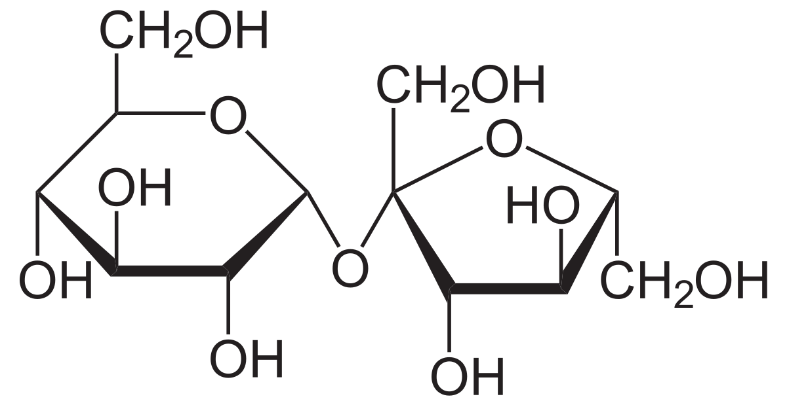
Molecular compounds usually dissolve in water
Sucrose, a molecular compound (C12H22O11), dissolves when stirred into water.
Dissolution: process in which the molecules of a solid form intermolecular interactions with a solvent and become equally distributed throughout that solvent.
Molecules and bonds remain intact when a substance dissolves.
Chemistry OpenStax; https://www.sciencesource.com/archive/Sugar-Dissolving-SS2870020.html

Slide 18
But ionic compounds dissociate in water
NaCl, an ionic compound dissociates when stirred into water.
Dissociation: process in which the molecules of a dipolar solvent create intermolecular interactions with an ionic compound, pulling ions off of the crystal and into the solvent;
Dipole-ion interactions
Chemistry OpenStax; https://www.youtube.com/watch?v=xdedxfhcpWo

Slide 19
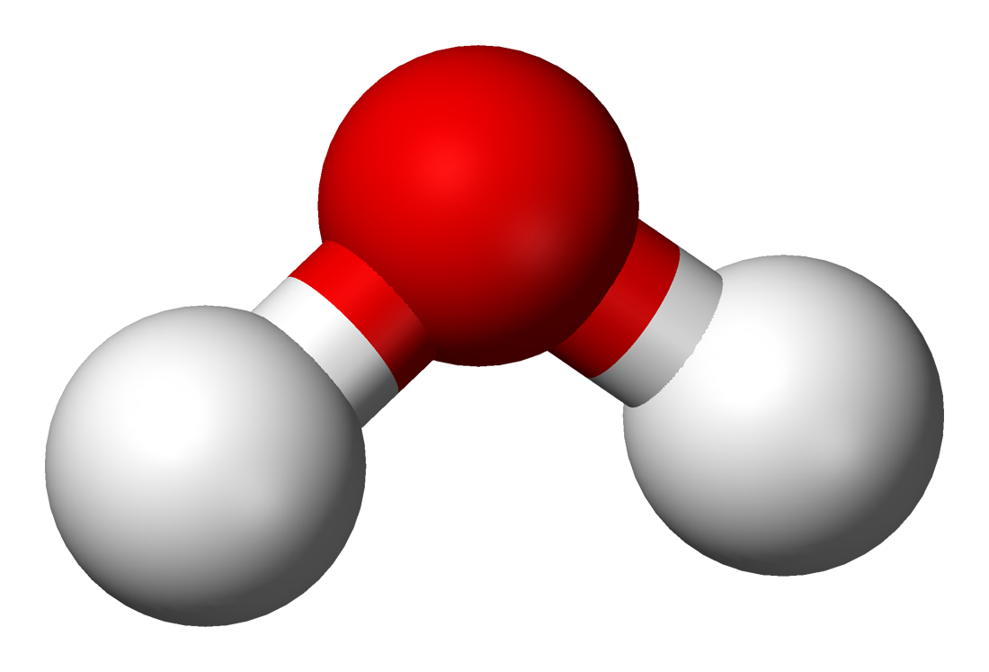
A look at why water causes ionic dissociation
Dissociation: ionic compounds fall apart into ions when water is added
Ion stoichiometry depends on the salt’s formula
Al⁺³
Cl⁻¹
δ-
δ+
δ+
AlCl3
Al⁺³
Cl⁻¹
Cl⁻¹
Cl⁻¹
Cl⁻¹
Cl⁻¹
Shells of hydration: water surrounds ions via ion-dipole bonding
Chemistry OpenStax

Slide 20
Dissociated salts are electrolytes
Electrolytes: an aqueous solution of ions that can conduct electricity
Salts in water are electrolytic.
Electrons added by electricity can jump from ion to ion through the solution.
bucket brigade
Conductivity increases with ionic strength; concentration of ions in solution.
Chemistry OpenStax

Slide 21
Try this
Complete the table. Consider whether each compound is linked by ionic or covalent bonds.
compound | dissolve or dissociate? | electrolyte?
CH3CH2OH
KBr
C6H12O6
HCl
Na(OH)
H2O2
compound | dissolve or dissociate? | electrolyte?
CH3CH2OH | dissolve | no
KBr | dissociate | yes
C6H12O6 | dissolve | no
HCl | dissociate | yes
Na(OH) | dissociate | yes
H2O2 | dissolve | no
Chemistry OpenStax

Slide 22
Solubility rules
While most ionic compounds dissociate readily in water, some are less water soluble.
Insoluble compounds form solids when the form and precipitate (fall out) of aqueous solutions, settling on the bottom
Organized by anion.
soluble in water | exceptions (form precipitates)
(NO3)⁻¹, (ClO3)⁻¹, (ClO4)⁻¹, (C2H3O2)⁻¹ | none
(SO4)⁻² | Ca, Ba, Sr, Pb
Cl⁻¹, Br⁻¹, I⁻¹ | Ag, Hg, Pb
barely soluble in water | exceptions (soluble in water)
(CO3)⁻², (PO4)⁻³ | alkali metals, NH4⁺¹
(OH)⁻¹ | alkali metals, NH4⁺¹, Ca, Ba, Sr
S⁻² | alkali, alkali earth metals, NH4⁺¹
(C2O4)⁻² | alkali metals, NH4⁺¹
Chemistry OpenStax; ScienceSource

Slide 23
Try this
Classify each compound as soluble or insoluble
(a) Zn(NO3)2
(b) PbBr2
(c) Sr3(PO4)2
soluble in water | exceptions (form precipitates)
alkali metals, NH4⁺¹ | none
(NO3)⁻¹, (ClO3)⁻¹, (ClO4)⁻¹, (C2H3O2)⁻¹ | none
(SO4)⁻² | Ca, Ba, Sr, Pb
Cl⁻¹, Br⁻¹, I⁻¹ | Ag, Hg, Pb
barely soluble in water | exceptions (soluble in water)
(CO3)⁻², (PO4)⁻³ | alkali metals, NH4⁺¹
(OH)⁻¹ | alkali metals, NH4⁺¹, Ca, Ba, Sr
S⁻² | alkali, alkali earth metals, NH4⁺¹
(C2O4)⁻² | alkali metals, NH4⁺¹
Chemistry OpenStax; ScienceSource

Slide 24
7.2: Can you?
(1) Explain the difference between dissolution and dissociation?
(2) Explain how and why ‘shells’ of water surround dissociated ions?
(3) Use a compound’s formula to determine whether it dissolves or dissociates?
(4) Define the term electrolyte and explain what types of compounds can act as electrolytes when in solution?
(5) Use the solubility chart to determine whether ionic compounds are soluble in water or precipitate from water as solids?

Slide 25
7.2: Assignments
Canvas: Quick review questions quiz 7.2
Canvas: HW set 7, problems 6 - 8
Optional extras – great videos on this topic:
‘How water dissolves salt’ (Canadian Museum of Nature) https://www.youtube.com/watch?v=xdedxfhcpWo
‘What happens when stuff dissolves’ (Tyler DeWitt) https://www.youtube.com/watch?v=0cPFx0wFuVs
‘Solubility’ (Bozeman Science) https://www.youtube.com/watch?v=KVZ_KS45rVg

Slide 26
Module 7: Introduction to chemical reactions
7.3: Precipitation and complete and net ionic equations
Exchange reactions swap cation and anion partners
Aqueous compounds dissociate into ions in complete and net net ionic equations
Precipitation reactions
OpenStax Chemistry 2/e p. 346 - 351

Slide 27
7. Introduction to chemical reactions
Big ideas?
Balanced chemical equations obey the law of conservation of mass.
Chemical reactions can be classified by type.

Slide 28
Exchange reactions
When two ionic compounds react an exchange reaction switches the ionic partnerships.
K2S (aq) + Mg3N2(aq) →
‘inner-inner, outer-outer’
Steps for an exchange reaction:
Predict new products (inner-inner, outer-outer).
Metal first in new formulas
Balance compounds for net charges of zero with subscripts.
Add coefficients to balance the equation.
exchange reaction
(double displacement)
Chemistry OpenStax

Slide 29
Try these
Write a balanced chemical equation for this reaction of ionic compounds.
Rb3N (aq) + (NH4)2S (aq) →
exchange reaction
(double displacement)
Write a balanced chemical equation for this reaction of ionic compounds.
AlCl3 (aq) + BaBr2 (aq) →
exchange reaction
(double displacement)
Chemistry OpenStax

Slide 30
Complete and net ionic equations
Since aqueous compounds dissociate in water it’s more accurate to show then as ions in solution.
Complete ionic equations: all aqueous compounds dissociate into ions
exchange reaction
(double displacement)
Coefficients multiply through…
…subscripts become coefficients
3K2S (aq) + Ca3N2(aq) → 2K3N (aq) + 3CaS (aq)
balanced (molecular)
complete ionic
Because all of the compounds are aqueous and mass is conserved, all of the ions are spectator ions: in the same form on both sides of the equation
Spectator ions simplify and cancel
Net ionic equation: show the actual chemical changes happening in the reaction
Net ionic is what’s left after spectator ions cancel out
net ionic
Chemistry OpenStax

Slide 31
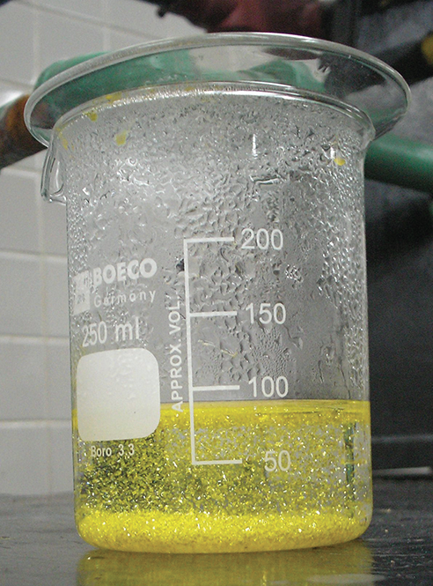
Try this
What makes this bright yellow precipitate when aqueous solutions of potassium iodide and lead (II) nitrate are mixed?
Write a balanced chemical equation.
Write complete and net ionic equations.
KI(aq) + Pb(NO3)2(aq) →
2KI(aq) + Pb(NO3)2(aq) → 2K(NO3)(aq) + PbI2(s; ppt)⬇
2K⁺¹ + 2I⁻¹ + Pb⁺² + 2(NO3)⁻¹ → 2K⁺¹ + 2(NO3)⁻¹ + PbI2(s; ppt)⬇
Chemistry OpenStax

Slide 32
Do these precipitate?
Which of these reactions will produce a precipitate?
Write complete ionic equations for those that do form ppt.
✔
potassium sulfate + barium nitrate →
lithium chloride + silver (I) acetate →
lead (II) nitrate + ammonium carbonate →
✔
✔
Chemistry OpenStax

Slide 33
7.3: Can you?
(1) Define and execute an exchange reaction?
(2) Define a precipitation reaction?
(3) Explain how to determine if a product precipitates?
(4) Define and write a complete ionic equation?
(5) Define and write a net ionic equation?

Slide 34
7.3: Assignments
Canvas: Quick review questions quiz 7.2
Canvas: HW set 7, problems 9 - 11
Optional extras – great videos on this topic:
‘Molecular, ionic, and net ionic equations’ (Bozeman Science) https://www.youtube.com/watch?v=wxvERNlUdBQ

Slide 35
Module 7: Introduction to chemical reactions
7.4: Acid-base reactions neutralize pH
Acids and bases can be recognized by their formulas
pH and acids and bases
Acid-base reactions generally produce water and a salt
Some neutralization reactions ‘evolve’ a gas
OpenStax Chemistry 2/e p.351 - 356

Slide 36
7. Introduction to chemical reactions
Big ideas?
Balanced chemical equations obey the law of conservation of mass.
Chemical reactions can be classified by type.

Slide 37
Acid-base reactions are called neutralization reactions
Acids and bases react to form water and a ‘salt’. And ‘salt’ means any ionic compound.
HCl (aq) + Na(OH) (aq) → H2O (l) + NaCl (aq)
pH is a measure of the acidity of a solution and depends on the concentration of hydrogen ions, [H⁺¹].
Acidic solutions have a pH of 0 – 7
Neutral (water) is pH = 7
Basic solutions have a pH of 7 - 14
pH is a log scale, meaning that a pH change of one unit is a ten-fold change in pH.
pH = - log [H⁺¹]
Chemistry OpenStax

Slide 38
Try these
Write a balanced chemical equation for the reaction of nitric acid (H(NO3) with the base calcium hydroxide (Ca(OH)2).
Write a balanced chemical equation for the reaction of sulfuric acid (H2(SO4) with the base aluminum hydroxide (Al(OH)3).
Chemistry OpenStax

Slide 39
Try these
Given the concentrations of hydrogen ions shown here, calculate pH values.
2H(NO3) (aq) + Ca(OH)2 (aq) → 2H2O (l) + Ca(NO3)2 (aq)
[H⁺¹]: 2.3 E-3 1 E-7
Chemistry OpenStax

Slide 40
Neutralization reactions as ionic equations
Like precipitates, water doesn’t dissociate in water. That just wouldn’t make sense!
And the chemical bonds of water are covalent, not ionic
HCl (aq) + Na(OH) (aq) → H2O (l) + NaCl (aq)
balanced (molecular)
H⁺¹ + Cl⁻¹ + Na⁺¹ + (OH)⁻¹ → H2O (l) + Na⁺¹ + Cl⁻¹
complete ionic
H⁺¹ + (OH)⁻¹ → H2O (l)
net ionic
For most neutralization reactions, the net ionic equation produces water.
Easy to remember, since water is neutral.
Chemistry OpenStax

Slide 41
Some neutralization reactions ‘evolve’ gas
When the base has a carbonate (CO3⁻²), reaction with acid will make a gas not water.
H(C2H3O2) (aq) + Na(HCO3) (aq) → H2(CO3) (aq) + Na(C2H3O2) (aq)
Like precipitates and water, gases don’t dissociate.
Gases have molecular bonds
net ionic:
H⁺¹ + H(CO3)⁻¹ → H2O (l) + CO2 (g)
Chemistry OpenStax; https://www.youtube.com/watch?v=GRMFTgGmN5c

Slide 42
Base anions that produce gases when reacted with acid
When the base has a carbonate (CO3⁻²), reaction with acid will make a gas not water.
H(C2H3O2) (aq) + Na(HCO3) (aq) → H2(CO3) (aq) + Na(C2H3O2) (aq)
H2(CO3) (aq) → H2O (l) + CO2 (g)
Intermediate products are unstable in water and decompose to gases.
base anion | intermediate product | final product (g)
sulfide (S⁻²) | none | H2S
carbonate (CO3⁻²) | H2(CO3) | CO2
bicarbonate (HCO3⁻¹) | H2(CO3) | CO2
sulfite (SO3⁻²) | H2(SO3) | SO2
bisulfite (HSO3⁻¹) | H2(SO3) | SO2
ammonia (NH3) | (NH4)(OH) | NH3
Chemistry OpenStax; https://www.youtube.com/watch?v=GRMFTgGmN5c

Slide 43
Try these
Sodium bisulfate (Na(HSO3) reacts with nitric acid (H(NO3)) to make a gas rather than water. Write balanced, complete and net ionic equations and identify the gas.
Sodium sulfate (NaS) reacts with sulfuric acid (H2(SO4)) to make a gas rather than water. Write balanced, complete and net ionic equations and identify the gas.
Chemistry OpenStax

Slide 44
7.4: Can you?
(1) Recognize acids and bases by their formulas?
(2) Understand the function of the pH scale and calculation of pH values?
(3) Understand that most neutralization reactions have the same net ionic equation?
(4) Understand that some neutralization reactions produce a gas after forming an unstable intermediate product?

Slide 45
7.4: Assignments
Canvas: Quick review questions quiz 7.4
Canvas: HW set 7, problems 12 - 14
Optional extras – great videos on this topic:
‘Simple experiment: A foaming volcano from baking soda and vinegar’ (MEL Science) https://www.youtube.com/watch?v=GRMFTgGmN5c
‘Neutralization reaction’ (Bozeman Science) https://www.youtube.com/watch?v=HdmCagtasYg

Slide 46
Module 7: Introduction to chemical reactions
7.5: Reduction-oxidation reactions transfer electrons
Redox reactions transfer electrons and can be understood as half-equations
Definitions of oxidation vs. reduction
Assigning oxidation numbers
OpenStax Chemistry 2/e p.356 - 360

Slide 47
7. Introduction to chemical reactions
Big ideas?
Balanced chemical equations obey the law of conservation of mass.
Chemical reactions can be classified by type.

Slide 48
Reduction-oxidation (redox) reactions
Earth’s atmosphere is 21% oxygen gas (O2) and this gas is vital for life on earth. Many reactions involve O2, and the term oxidation was originally used to describe these reactions.
Oxidation and reduction: now are used to describe chemical reactions involving the transfer of electrons.
Notice both elements go from uncharged (elemental) to charged ions.
2Na(s) + Cl2(g) → 2NaCl(s)
Half-reactions show us what’s happening to each reactant.
2Na(s) → 2Na⁺¹ + 2e-
Each Na(s) loses one e-.
Cl2(g) + 2e- → 2Cl⁻¹
Each atom in Cl2(g) gains one e-.
Chemistry OpenStax

Slide 49
Oxidation vs. reduction?
Oxidation and reduction are linked and must occur simultaneously.
Oxidation: loss of electron(s)
Metals are oxidized
‘t’ mimics + sign
Become positively charged cations.
Oxidation numbers increase.
Oxidized elements are the reducing agent.
OIL RIG
‘oxidation is loss’
Reduction: gain of electron(s)
V
Nonmetals are reduced.
‘reduction is gain’
Become negatively charged anions.
Oxidation numbers are reduced.
an: a negative ion
Reduced elements are the oxidizing agent.
Chemistry OpenStax

Slide 50
How to assign oxidation numbers
So, how do you know which is oxidized and which is reduced?
Oxidation numbers (aka oxidation state): the charge an atom would possess if the compound were ionic
assigned on a per atom basis
Guidelines:
Elemental atoms or molecules = 0
Monoatomic ions = ionic charge
Common nonmetals:
H = +1 with nonmetals or = -1 with metals
O = -2 (except -1 in peroxide; + when with F)
halogens = -1
Oxidation numbers of ions sum to ionic charge and oxidation numbers of molecules sum to zero.
Chemistry OpenStax

Slide 51
Applying oxidation numbers
Assign oxidation numbers to all elements in these:
H2S
SO3⁻²
Na2(SO4)
Note that S and N have to most variable oxidation numbers.
Chemistry OpenStax

Slide 52
Try these
Assign oxidation numbers to all elements:
K(NO3)
AlH3
NH4⁺¹
H2(PO4)⁻¹
Note that S and N have to most variable oxidation numbers.
Chemistry OpenStax

Slide 53
Redox reactions change oxidation numbers
If a chemical reaction is a redox reaction, the oxidation numbers of at least two elements change from reactants to products.
2Na(s) + Cl2(g) → 2NaCl(s)
0 0 +1/-1
⬆ so ox
⬇ so red
Solid rocket fuel is combusted by this reaction. Assign oxidation numbers to see which element is oxidized and which reduced?
10Al(s) + 6(NH4)(ClO4)(s) → 4Al2O3(s) + 2AlCl3(s) + 12H2O(g) + 3N2(g)
Chemistry OpenStax

Slide 54
The activity series shows easy of oxidation
The ‘activity series’ is a chart that shows how easily metals are oxidized.
metal | oxidized by...
Li | cold water
K
Ba
Sr
Ca
Na
Mg | steam
Al
Zn
Cr
Fe
Cd
Metals can be oxidized by the ions of the any metal below them on the activity series.
most easily oxidized
metal | oxidized by…
Co | acids
Ni
Sn
Pb
H2 | ------ ACID----------
Cu | not oxidized
Hg
Ag
Pt
Au
Li⁺¹ batteries:
Light (7 amu)
Easy to oxidize; gives up e-s
‘precious metals’: not because they are rare, but because they endure time, weather and change generally
least easily oxidized
Chemistry OpenStax

Slide 55
Try this
Which of these chemical reactions will occur (or ‘go forward’)?
(a) Al (s) + Zn(NO3)2 (aq) → ?
(b) Ag (s) + HCl (aq) → ?
(c) FeCl2 (aq) + Zn (s) → ?
(d) H(NO3) (aq) + Au (s) → ?
Chemistry OpenStax

Slide 56
7.5: Can you?
(1) Understand that redox reactions require the transfer of electrons?
(2) Define the terms oxidation and reduction and distinguish between them?
(3) Assign oxidation numbers to every atom in a chemical reactions?
(4) Use oxidation numbers to determine which elements are oxidized and which are reduced in a chemical reaction?
(5) Use the activity series to determine whether a proposed redox reaction will occur or ‘go forward’?

Slide 57
7.5: Assignments
Canvas: Quick review questions quiz 7.5
Canvas: HW set 7, problems 15 - 16
Optional extras – great videos on this topic:
'Introduction to oxidation-reduction (redox) reactions' (DeWitt) https://www.youtube.com/watch?v=5rtJdjas-mY
'Redox reactions' (Bozeman) https://www.youtube.com/watch?v=RX6rh-eeflM
'How to calculate oxidation numbers introduction' (DeWitt) https://www.youtube.com/watch?v=-a2ckxhfDjQ
'How to calculate oxidation numbers practice problems' (DeWitt) https://www.youtube.com/watch?v=zpCy7KwqDO8

Slide 58
Module 7: Introduction to chemical reactions
7.6: Combustion reactions are a type of redox reaction
Combustion fuels are carbon based (hydrocarbons)
Combustion of fuels in oxygen produces carbon dioxide and water
Oxygen can have fractional coefficients
OpenStax Chemistry 2/e p.359 - 361

Slide 59
7. Introduction to chemical reactions
Big ideas?
Balanced chemical equations obey the law of conservation of mass.
Chemical reactions can be classified by type.

Slide 60
Combustion reactions: fuels ‘burn’ in the presence of O2
In combustion reactions, carbon-based fuels react with oxygen gas to produce two products, carbon dioxide and water.
The fuel is often a hydrocarbon: a molecule made of carbon and hydrogen.
When balancing combustion reactions start with C, then H and save O for last.
We combust propane (C3H8) to heat houses. Write a balanced chemical equation.
combustion reaction
C3H8 + O2 → CO2 + H2O
C3H8 + 5O2 → 3CO2 + 4H2O
Chemistry OpenStax

Slide 61
Fractional coefficients may be used for combustion
Ethane (C2H6) is combusted. Write a balanced chemical equation.
7/2
2
3
combustion reaction
C2H6 + O2 → CO2 + H2O
7 O atoms
7 O atoms
Multiply through by 2 to remove the fraction.
2C2H6 + 7O2 → 4CO2 + 6H2O
Hexane (C6H14) is combusted. Write a balanced chemical equation.
Chemistry OpenStax

Slide 62
Try this
Combust ethanol, C2H5OH, and write a balanced chemical equation.
combustion reaction
Combust diethylether, C4H10O, and write a balanced chemical equation.
Chemistry OpenStax

Slide 63
7.6: Can you?
(1) Explain the pattern of combustion reactions?
(2) Use oxidation numbers to show that combustion reactions are redox reactions?
(3) Use fractional coefficients to balance combustion reactions?

Slide 64
7.6: Assignments
Canvas: Quick review questions quiz 7.6
Canvas: HW set 7, problems 17 - 19
Optional extras – great videos on this topic:
‘Types of chemical reactions’ (Tyler DeWitt) https://www.youtube.com/watch?v=aMU1RaRulSo

