Slide 1
1. Essential ideas
Instructions:
Click through this short presentation.
Answer these questions on engineering graph paper or in a Word document.
How old is the science of chemistry?
Give examples of three common items or products made with ancient chemistry.
How many elements did the ancient Greeks think made up our world?
What were the big goals of alchemists?
What society preserved scientific knowledge during the dark ages and developed experimentation?
What two critical elements of science did the West rediscover during the Enlightenment?
Is chemistry really the central science?
What do you think is the most significant difference between science and engineering?

Slide 2
CHE 1031: General Chemistry I
Essential ideas
1.1: Chemistry in context
Outline historical development of chemistry
Provide examples of chemistry in everyday life
Describe the scientific method
Differentiate between hypotheses, theories & laws
Provide examples of macroscopic, microscopic & symbolic domains
1.2: Phases & classification of matter
1.3: Physical & chemical properties
1.4: Measurements
1.5: Measurement uncertainty, accuracy & precision
1.6: Mathematical treatment of measurement results

Slide 3
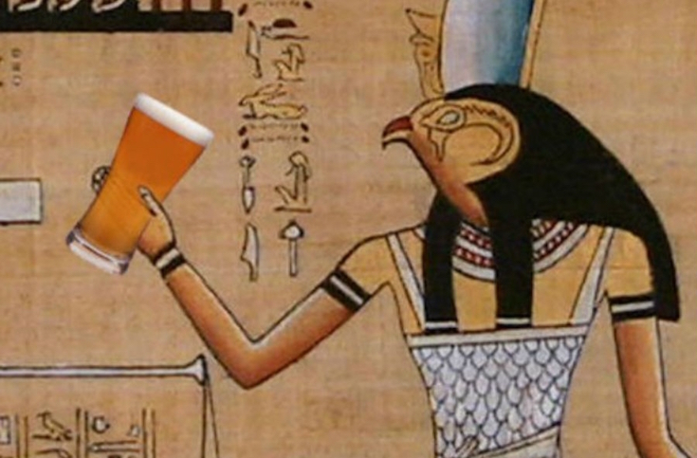
Earliest chemists?
The ancients harnessed food chemistry to make cheese, bread, beer and other delights. They were early chemists.
Tanning of hides to make leather;
Smelting of copper ore;
Isolation of myrrh & opium from plants;
Creation of dyes like indigo & Tyrian purple;
Creating soap by reacting fats & lye;
Creating alloys like bronze from tin & copper
http://www.cairoscene.com/ArtsAndCulture/The-History-of-Beer-In-Ancient-Egypt

Slide 4
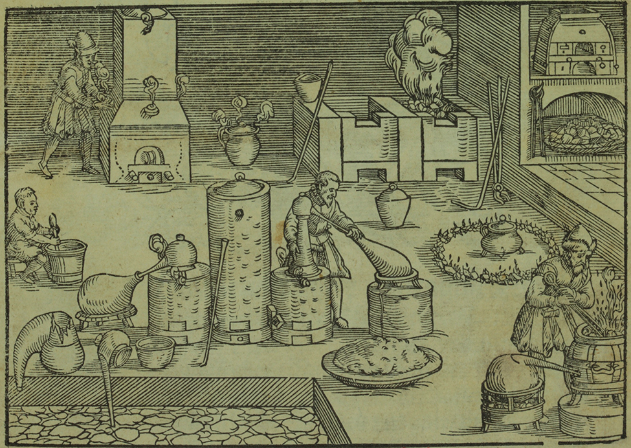
Elements & alchemy
600 B.C. the Greeks, trying to understand the fundamental nature of the world, hypothesized that all matter was a combination of four elements:
Earth, wind, fire and water (water as the basis of life)
Alchemists combined early chemical knowledge with philosophy in an attempt to transform ‘base metals’ into gold and to cure disease and extend life.
While alchemy was a bit of a stretch, the work of alchemists advanced our knowledge of the world and became the basis of scientific experimentation.
Alchemist’s laboratory (Chemical Heritage Foundation)

Slide 5
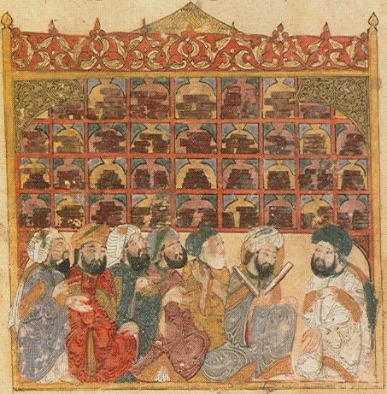
Dark ages shifted centers of learning
During the Dark Ages (5th – 10th centuries) knowledge developed by the Greeks and Romans was lost in Europe, but preserved by Arab and Asian societies.
An 8th-century Arab alchemist, Jābir ibn Hayyān, added lab experimentation to alchemy and may be the father of modern chemistry.
The House of Wisdom library in Bagdad, Maqamat of al-Hariri Illustration by Yahyá al-Wasiti, 1237 (Wikipedia)

Slide 6
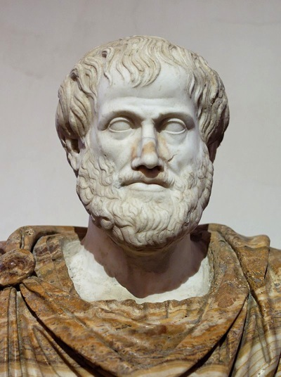
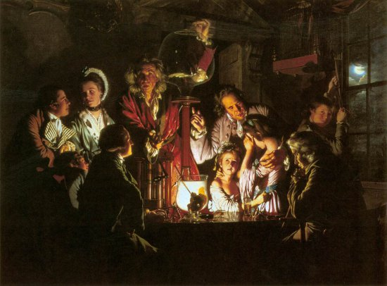
The Enlightenment
During the Enlightenment (1600s to 1800) the Western world rediscovered the works of philosophers of the ancient world (Greek, Arabic, Asian) who had developed logic and experimentation.
Aristotle
Scientists like Bacon, Newton, Hooke, Boyle, Faraday, Wright, Lavoisier and others married logic with experimentation to ask and answer questions about the ‘invisible’ forces of the natural world.
Wright’s gas pump experiments

Slide 7
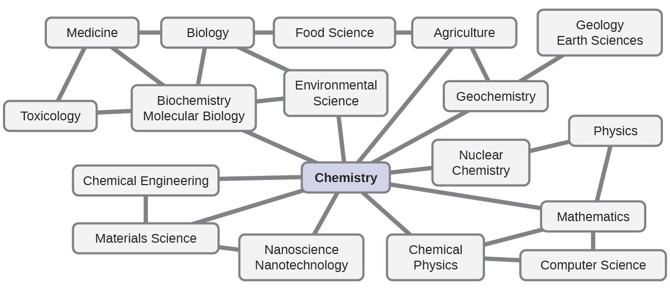
The central science?
Some refer to chemistry as the central science because it is interconnected with many other fields of scientific & STEM study.
STEM: science, technology, engineering & medicine
Chemistry Openstax

Slide 8
Science vs. engineering?
sci·ence (n)
The study of the physical world & its manifestations, especially by using systematic observation & experimentation
A branch of science of a particular area of study
The knowledge gained by study of the physical world
Any systematically organized body of knowledge about a specific subject
Any activity that is the object of careful study or that is carried out according to an accepted method
en·gi·neer·ing (n)
The art or science of making practical application of the knowledge of pure sciences, as physics or chemistry, as in the construction of engines, bridges, buildings, mines, ships, and chemical plants
2. The action, work, or profession of an engineer
3. Skillful or artful contrivance; maneuvering
Chemistry Openstax

Slide 9
CHE 1031: General Chemistry I
… end …

