Slide 1
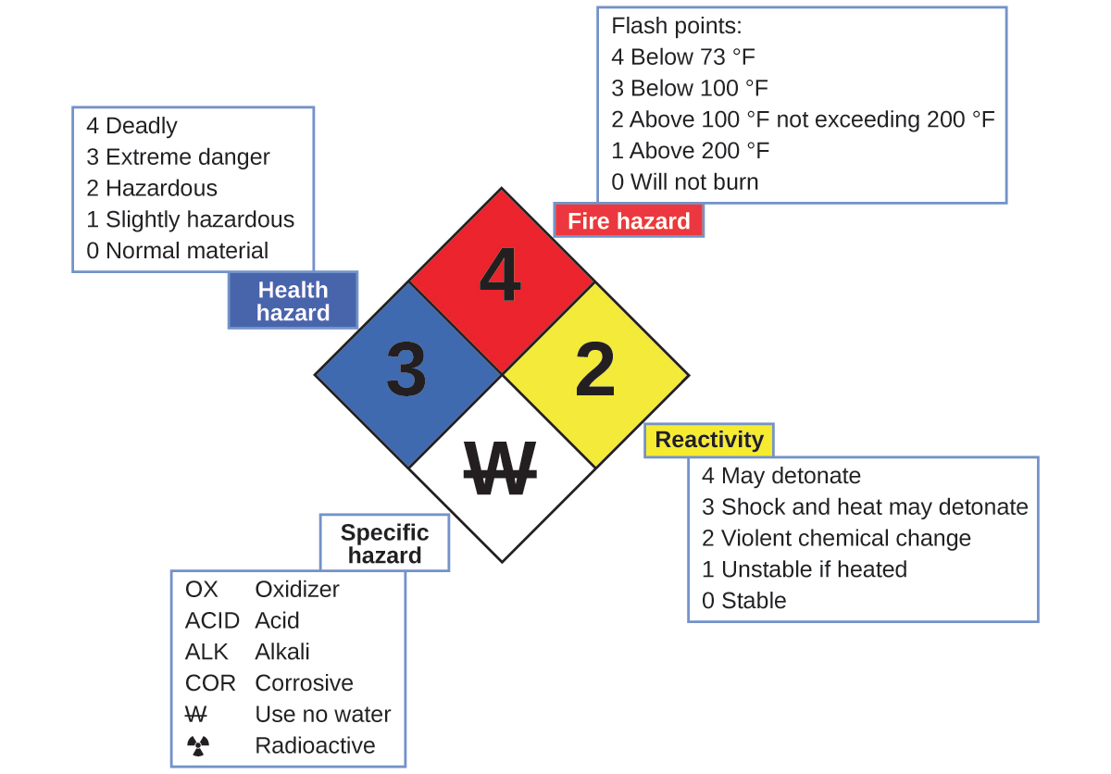
Chemical reactivity
The ‘diamond’ hazard symbol is a quick, visual guide to chemical reactivity.
Chemistry Openstax

Slide 2
CHE 1031: General Chemistry I
… end …

