Slide 1
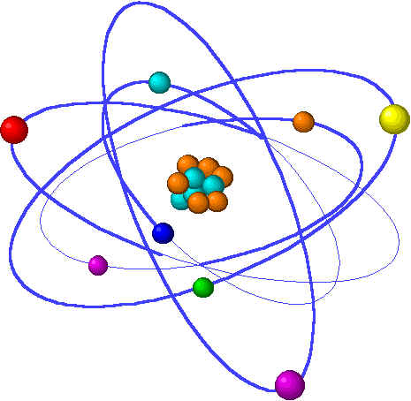
CHE1031 Lecture 10: Reaction kinetics
Lecture 10 topics Brown chapter 14
1. Reaction rates
Factors that effect reaction rates 14.1
Visualizing rates & units 14.2
Average reaction rates
Instantaneous reaction rates
Stoichiometry & reaction rates
2. Concentration & reaction rates 14.3
Rate laws
Reaction orders
3. Change in concentration with time 14.4
First- & second-order reactions
Half-life
4. Temperature & reaction rate 14.5
Collision, orientation & Ea
5. Reaction mechanisms 14.6
Elementary
Multistep
6. Catalysis ` 14.7

Slide 2
Temperature & kinetics
Rates ~double with 10C increase.
How temperature increases rate
Activation energy & transition states
Notes:
The general process of advancing scientific knowledge by making experimental observations and by formulating hypotheses, theories, and laws.
It’s a systematic problems solving process AND it’s hands-on….. Experiments must be done, data generated, conclusions made.
This method is “iterative”; it requires looping back and starting over if needed. [Why do you think they call it REsearch?] Often years, decades or more of experiments are required to prove a theory.
While it’s possible to prove a hypothesis wrong, it’s actually NOT possible to absolutely prove a hypothesis correct as the outcome may have had a cause that the scientist hasn’t considered.

Slide 3
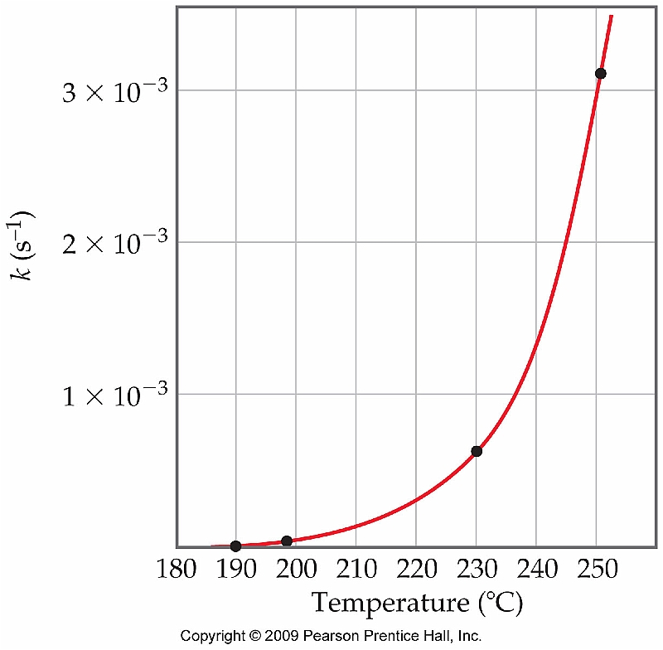
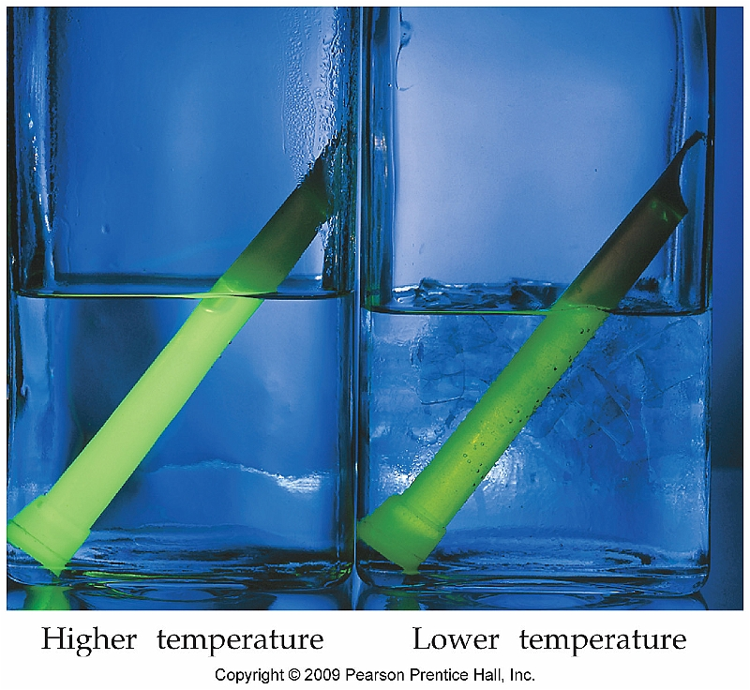
Temperature & rate
Generally, temperature increases the rate of chemical reactions.
A rough estimate is that rate doubles for every 10°C increase in temperature.
p. 575 – 6

Slide 4
How does temperature increase rate?
There are three ways in which temperature can increase kinetics:
Collision
Orientation
3. Activation Energy
Molecules must collide in order to react; temperature speeds motion & increases chances of constructive collision. At room temp gas molecules collide 10¹⁰ s; however, only one of every
10¹³ collisions results in reaction.
- Molecules be oriented so that atoms fated to form new bonds contact each other during collisions.
Energy barrier that must be overcome in order for a chemical reaction to occur.
p. 576 - 7

Slide 5
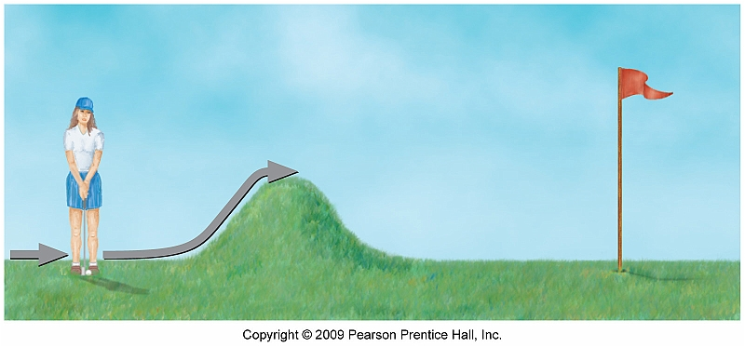
Activation energy
Energy (Ea) must be input in order to change the conformation of the reactant from its original state, through an intermediate transition state.
The final reaction can then occur.
p. 577

Slide 6
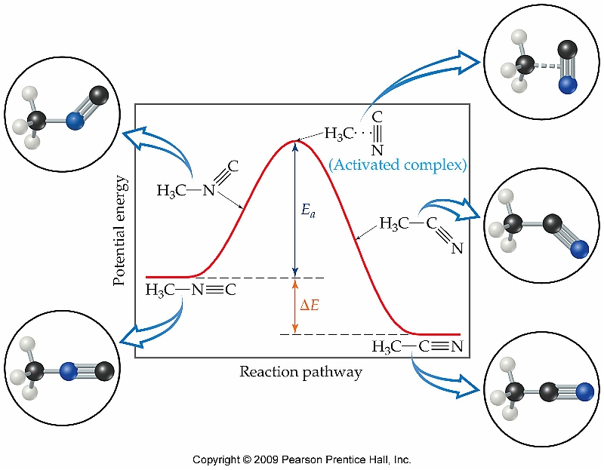
Transition states
Note that temperature is able to cause changes in molecular shape (aka conformation).
p. 577 - 80

