Slide 1
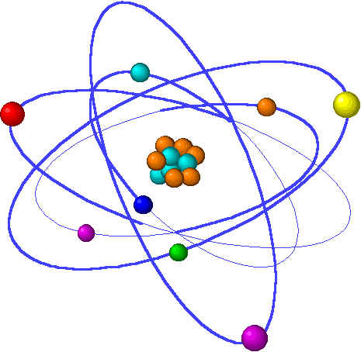
CHE1031 Lecture 10: Reaction kinetics
Lecture 10 topics Brown chapter 14
1. Reaction rates
Factors that effect reaction rates 14.1
Visualizing rates & units 14.2
Average reaction rates
Instantaneous reaction rates
Stoichiometry & reaction rates
2. Concentration & reaction rates 14.3
Rate laws
Reaction orders
3. Change in concentration with time 14.4
First- & second-order reactions
Half-life
4. Temperature & reaction rate 14.5
Collision, orientation & Ea
5. Reaction mechanisms 14.6
Elementary
Multistep
6. Catalysis ` 14.7

Slide 2
Catalysts speed reactions
Homogeneous vs. heterogeneous
Catalysts lower activation energy.
Enzymes are nature’s catalysts.
Notes:
The general process of advancing scientific knowledge by making experimental observations and by formulating hypotheses, theories, and laws.
It’s a systematic problems solving process AND it’s hands-on….. Experiments must be done, data generated, conclusions made.
This method is “iterative”; it requires looping back and starting over if needed. [Why do you think they call it REsearch?] Often years, decades or more of experiments are required to prove a theory.
While it’s possible to prove a hypothesis wrong, it’s actually NOT possible to absolutely prove a hypothesis correct as the outcome may have had a cause that the scientist hasn’t considered.

Slide 3
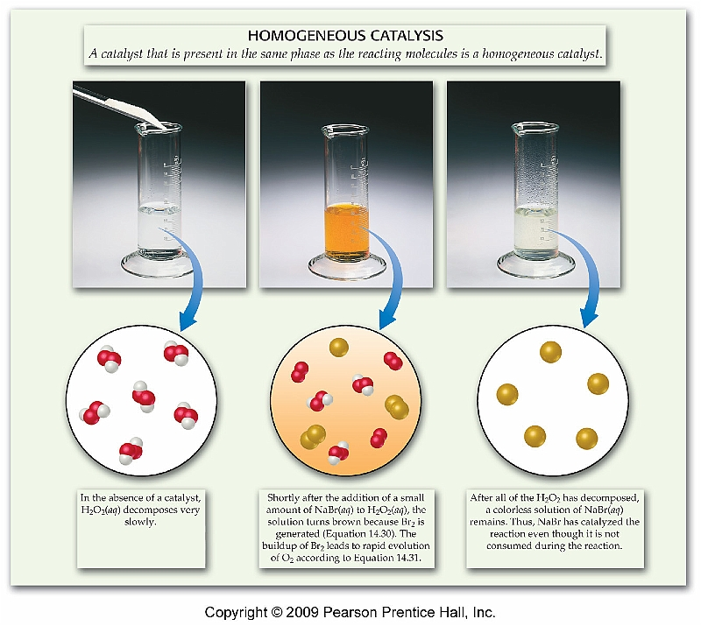
Catalysts
Catalyst – a substance that increases the speed of a chemical reaction without undergoing any permanent change itself.
Catalysts are common in biochemistry (living organisms) & chem in general.
Here the salt, NaBr, dissociates, becoming part of the solution & is therefore a homogeneous catalyst.
p. 589 - 93

Slide 4
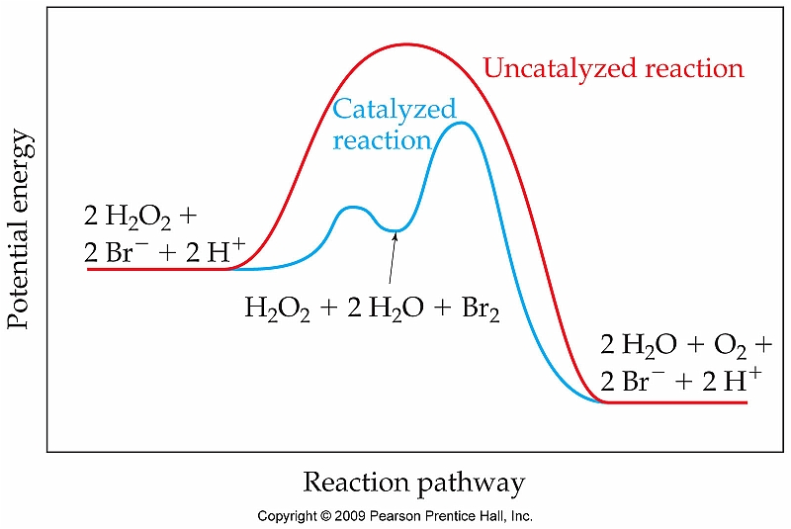
How do catalysts work?
In general, catalysts decrease the Ea, activation energy, needed to cause a reaction to happen.
Catalysts can do this in a number of ways:
Supplies a very reactive intermediate (like Br2).
Makes a reactant more “reactive”.
Brings reactants into contact.
Br ion forms the Br2 intermediate -very reactive – which then oxidizes H2O2 into water & O2.
p. 589 - 93

Slide 5
Heterogeneous catalyst: increases reactivity
Heterogeneous catalysts – exist in a different phase than the reactants.
Here a layer of metal atoms (Ni, Pt, Pd) helps to separate the two H atoms of H2 gas, causing the H atoms to become more reactive. The H’s then add to the organic molecule ethylene, reducing it to ethane.
C2H4 + H2 → C2H6
Note that the metal surface also “concentrates” the gas-phase reactants by “pulling” them down to the metal’s surface. This brings reactants into close proximity &
also increases the speed of rxn.
Note that Pt is the catalyst here & does not appear in the equation.
p. 589 - 93

Slide 6
Enzymes: nature’s catalysts
Enzymes – biological molecules, mainly proteins, that lower reaction Ea & therefore increase reaction rate.
Enzymes work by a “lock & key” mechanism which can have several aspects:
Brings reactants into close physical proximity.
Provides chemically reactive groups
Flexes and provides motion to potentiate rxn.
enzyme
reactant
Some toxins & poisons (like mercury & nerve gas) kill by inhibiting enzymes & preventing our body from doing necessary chemistry.
p. 589 - 93

