Slide 1
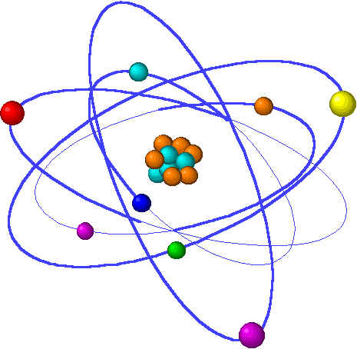
CHE1031 Lecture 10: Reaction kinetics
Lecture 10 topics Brown chapter 14
1. Reaction rates
Factors that effect reaction rates 14.1
Visualizing rates & units 14.2
Average reaction rates
Instantaneous reaction rates
Stoichiometry & reaction rates
2. Concentration & reaction rates 14.3
Rate laws
Reaction orders
3. Change in concentration with time 14.4
First- & second-order reactions
Half-life
4. Temperature & reaction rate 14.5
Collision, orientation & Ea
5. Reaction mechanisms 14.6
Elementary
Multistep
6. Catalysis ` 14.7

Slide 2
Lecture 10: Terms to know
Kinetics
Rate
Average rate
Instantaneous rate
Tangent
Rate law
Rate constant
Orders of reaction
Overall order of reaction
First vs. second order reactions
Half-life
Collision
Orientation
Activation energy
Transition state
Reaction pathway
Reaction mechanisms (elementary vs. multistep)
Rate-limiting step
Catalyst (homogeneous vs. heterogenous)
Enzymes
Notes:
PLEASE note that the formula calculates a weighted average, so there’s not need to add and then divide the sum by the number of isotopes in the problem. This is an incredibly common student error so don’t get caught!

