Slide 1
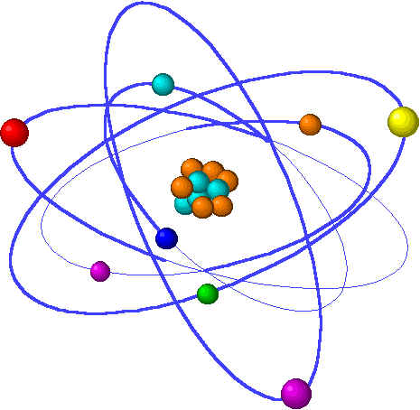
CHE1031 Lecture 11: Chemical equilibrium
Lecture 11 topics Brown chapter 1
1. Concept of equilibrium 15.1
Equilibrium reactions are reversible
2. The equilibrium constant 15.2
Law of mass action
Equilibrium constant expressions
3. Working with equilibrium expressions 15.3
What does Kc tell us?
Kc & direction of reaction
4. Le Chatelier’s Principle 15.7
Application to Haber reaction
Changes of concentration
Changes in volume & pressure
Changes in temperature
5. Catalysts & equilibrium

Slide 2
Le Châtelier’s principle
Equilibrium reactions respond to disturbances:
Concentration
Temperature
Pressure
Notes:
The general process of advancing scientific knowledge by making experimental observations and by formulating hypotheses, theories, and laws.
It’s a systematic problems solving process AND it’s hands-on….. Experiments must be done, data generated, conclusions made.
This method is “iterative”; it requires looping back and starting over if needed. [Why do you think they call it REsearch?] Often years, decades or more of experiments are required to prove a theory.
While it’s possible to prove a hypothesis wrong, it’s actually NOT possible to absolutely prove a hypothesis correct as the outcome may have had a cause that the scientist hasn’t considered.

Slide 3
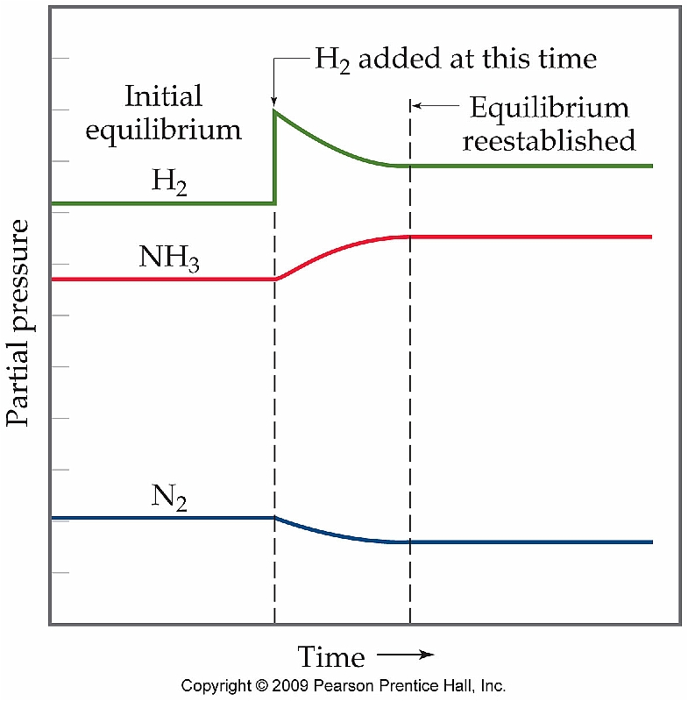
Le Châtelier’s principle
Le Chatelier’s Principle – If a system at equilibrium is disturbed by a change in temperature, pressure or concentration, the system will shift to a new equilibrium position to counteract the disturbance.
Disturbance?
Adding product or reactant
Removing product or reactant
Changing volume, thus pressure
Changing temperature
N2 + 3H2 2NH3
Typically, we say that the equilibrium:
Shifts to the right (towards products)
Shifts to the left (toward reactants)
What does adding H2 do?
How could you shift the reaction left?
Shifts rxn right – makes NH3
Add NH3
Remove N2
Remove H2
p. 635-7

Slide 4
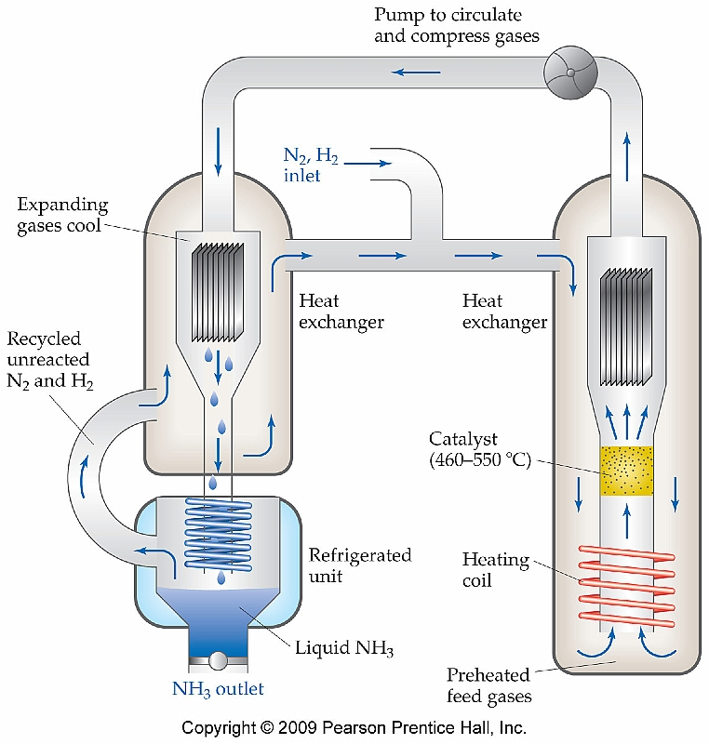
Applying Le Châtelier’s to the Haber rxn
N2 + 3H2 2NH3
How is Le Chatelier’s Principle employed here to increase production of NH3?
NH3 is cooled, condensed and collected.
When it’s removed from the system it’s loss shifts equilibrium to the right…
…causing more NH3 product to be made.
p. 649-50

Slide 5
Changes in volume & pressure
Changes in volume tend to cause changes in pressure that “disturb” the system.
Reducing volume increases pressure and that shifts equilibrium in whichever direction reduces moles of gas….and vice versa.
N2O4 2NO2
1. Initial equilibrium
2. Plunger decreases
volume & increases
pressure &
concentration,
particularly of NO2.
3. Equilibrium has shifted
left in order to decrease
the moles of gas in
cylinder.
p. 649-51

Slide 6
Le Châtelier’s example
What happens to the equilibrium of this reaction if the volume of the system is increased?
2SO2 + O2 2SO3
When the volume is increased, pressure on the system decreases.
So to stay as close as possible to the original equilibrium position, the reaction needs to produce MORE molecules; more volume so need more molecules to maintain the original density of gases.
So to get more molecules the reaction shifts to the left (3 moles) away from the right (2 moles).
p. 649-51

Slide 7
Effects of temperature changes
The direction of shift depends on whether the reaction in question is exothermic or endothermic via Le Châtelier’s Principle.
Endothermic: reactants + heat products
Exothermic: reactants products + heat
Co(H2O)6 + 4Cl⁻¹ CoCl4⁻² + 6H2O ΔH = +
pink blue
1. Room temp
2. Heating bath Favors products since the endothermic rxn uses heat as a reactant.
3. Cooling bath
Favors reactant since lack of heat doesn’t allow product to be produced. It reduces [reactant].
p. 649-51

Slide 8
Another Le Châtelier’s example
Consider this equilibrium reaction:
N2O4 2NO2 ΔH = + 58 kJ
In which direction does the reaction shift when:
N2O4 is added
NO2 is removed
Pressure Is increased by addition of N2
Volume is increased
Temperature is decreased
Shifts right towards product, driven by added reactant.
Shifts right towards the now depleted product
c) Shifts left since there are only half as many moles of reactant as product
d) Shifts right since the larger volume can accommodate more moles
Shifts left since the reaction is endothermic and requires heat as
reactant. Reducing the heat is like reducing [reactant].
p. 649-53

