Slide 1
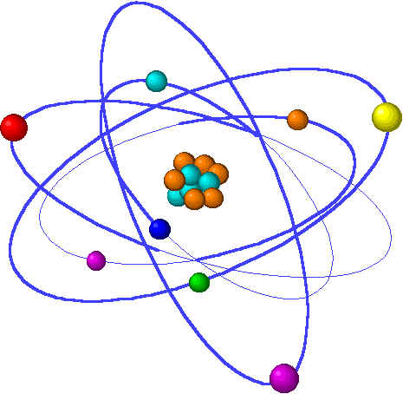
CHE1031 Lecture 11: Chemical equilibrium
Lecture 11 topics Brown chapter 1
1. Concept of equilibrium 15.1
Equilibrium reactions are reversible
2. The equilibrium constant 15.2
Law of mass action
Equilibrium constant expressions
3. Working with equilibrium expressions 15.3
What does Kc tell us?
Kc & direction of reaction
4. Le Chatelier’s Principle 15.7
Application to Haber reaction
Changes of concentration
Changes in volume & pressure
Changes in temperature
5. Catalysts & equilibrium

Slide 2
Catalysts do not affect equilibrium
Notes:
The general process of advancing scientific knowledge by making experimental observations and by formulating hypotheses, theories, and laws.
It’s a systematic problems solving process AND it’s hands-on….. Experiments must be done, data generated, conclusions made.
This method is “iterative”; it requires looping back and starting over if needed. [Why do you think they call it REsearch?] Often years, decades or more of experiments are required to prove a theory.
While it’s possible to prove a hypothesis wrong, it’s actually NOT possible to absolutely prove a hypothesis correct as the outcome may have had a cause that the scientist hasn’t considered.

Slide 3
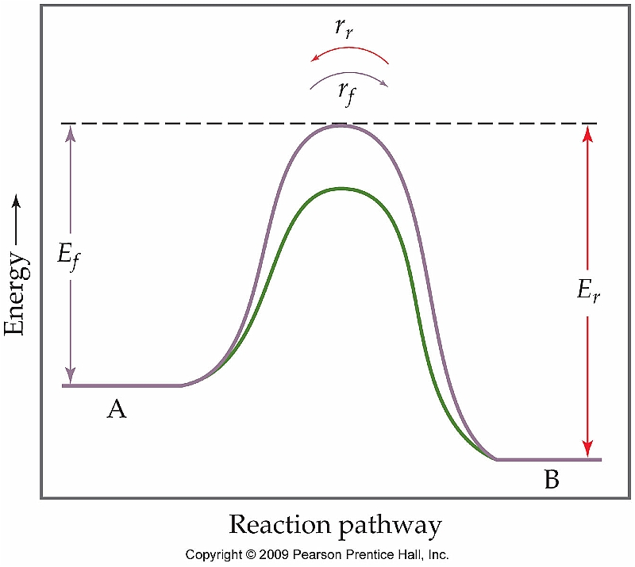
Do catalysts affect equilibrium?
Nope! Catalysts get reactions to equilibrium more quickly, but they don’t change equilibrium.
Note that the catalyst lowers Ea (green line) for both the forward & reverse reactions.
So the catalyst makes it easier for reactant to become product, and vice versa. But it does not change the relative proportions of reactant & product.
Therefore the catalyst does not affect equilibrium.
p. 654-6

