Slide 1
7. Chemical bonding
7.1: Ionic bonding
Explain the formation of cations, anions and ionic compounds
Predict the charge of common metallic and nonmetallic elements and write their electron configuration
Before this section, please check for a Flip exercise!
(Posted on the Module 7 page)

Slide 2
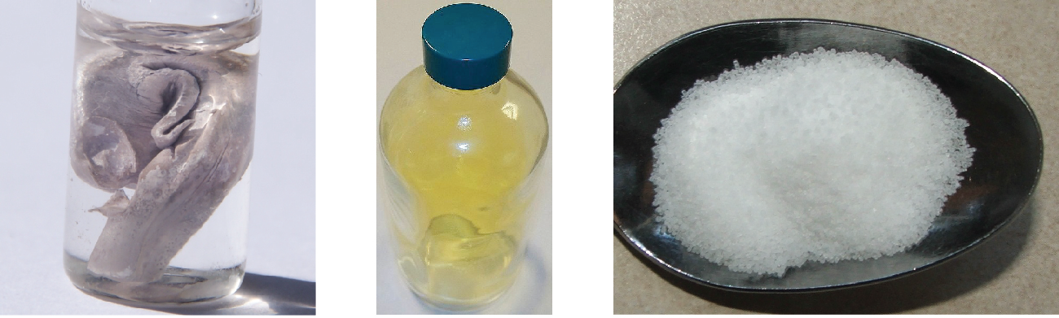
What are ionic compounds?
Ionic compounds (aka salts): compounds formed by cations and anions held together by ionic bonds
Ionic bonds: electrostatic forces of attraction between oppositely charged ions (cations and anions)
Crystalline structure; rigid & brittle; high melting & boiling points Ionic bonds are strong but water soluble
Ionic solutions are good conductors of electricity
poisonous
essential for life
violent rxn with water
sodium (Na)
chlorine (Cl₂)
sodium chloride (NaCl)
Chemistry Openstax

Slide 3
Formation of ionic compounds
Ionic compounds form when atoms ionize in order to create full valence shells.
V
Na
Cl

Slide 4
Formation of ionic compounds
Ionic compounds form when atoms ionize in order to create full valence shells.
Simultaneous redox reactions.
Metals have low-ish ionization energies.
Non-metals have high electron affinities.
Ionic compounds have neutral charges: equal number of positive and negative charges.
V
Na⁺¹
Cl⁻¹

Slide 5
Net zero charge
Ionic compounds must have overall, or net, zero charges.
Combine aluminum and oxygen to create an ionic compound.
1
Al⁺³ O⁻²
2 3
→ Al2O3
+6 -6
Remember that the formulas of ionic compounds are always empirical formulas.
In reality, the number of ions in a crystal of ionic compound varies, but the ratio of cations to anions is constant and defined by the salt’s formula.

Slide 6
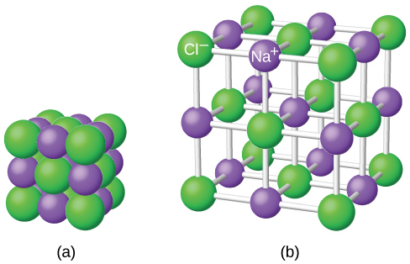
Crystal lattice
Ionic compounds form crystals (aka crystal lattice), as structure in which cations and anions alternate and surround each other.
Ions are held together by electrostatic force (opposite charge).
Size of crystals varies with the number of ions in the crystal & conditions under which the crystal is ‘grown’.

Slide 7
Electronic structure of cations
Cations lose electrons to get down to a full valence shell.
Groups 1A & 2A: (electropositive) lose all valence shell e-
Isoelectronic with previous noble gas
Charge = group number
Groups 12A & 17A: lose all valence shell e-
Charge = group # - 10
Transition / inner transition metals: usually +2 or +3 charge from losing their outermost s electrons first, followed by an electron or two from the next-to-outermost shell

Slide 8
Try this:
Write the electron configurations of the Cr⁺³ and Zn⁺² cations.
2
Zn: [Ar] 3d¹⁰4s²
Cr: [Ar] 3d⁵4s¹
remove e-
Zn⁺²: [Ar] 3d¹⁰4s⁰
Cr⁺³: [Ar] 3d³4s⁰
Write the electron configurations of the K and Mg cations.
3
K: [Ar] 4s¹
Mg: [Ne] 3s²
remove e-
K⁺¹: [Ar] 4s⁰
Mg⁺²: [Ne] 3s⁰

Slide 9
Electronic structures of anions
Most monoatomic anions form when atoms fill s & p orbitals and become isoelectronic with the next noble gas.
Write the electron configurations of the Se and I anions.
4
Se: [Ar] 3d104s²4p⁴
I: [Kr] 4d¹⁰5s²5d⁵
add e-
Se: [Ar] 3d104s²4p⁶
I: [Kr] 4d¹⁰5s²5d⁶
Write the electron configurations of the P atom and anion.
5
add e-
P: [Ne] 3s²3p³
P: [Ne] 3s²3p⁶

Slide 10
Can you?
Describe ionic compounds and their properties?
(2) Explain how formation of ionic compounds is redox chemistry?
(3) Explain why the formulae of ionic compounds are always empirical formulae?
(4) Write the electron configuration of ions of main group metals, transition metals and main-group nonmetals.

