Slide 1
CHE 1031: General Chemistry I
7. Chemical bonding
7.1: Ionic bonding [sidebar]
7.2: Covalent bonding
7.3: Lewis symbols & structures
7.4: Formal charges & resonance
7.5: Strengths of ionic & covalent bonds
7.6: Molecular structure & polarity [sidebar]

Slide 2
7. Chemical bonding
7.3: Lewis symbols & structures
Write Lewis symbols for neutral atoms & ions
Draw Lewis structures depicting the bonds in simple molecules.

Slide 3
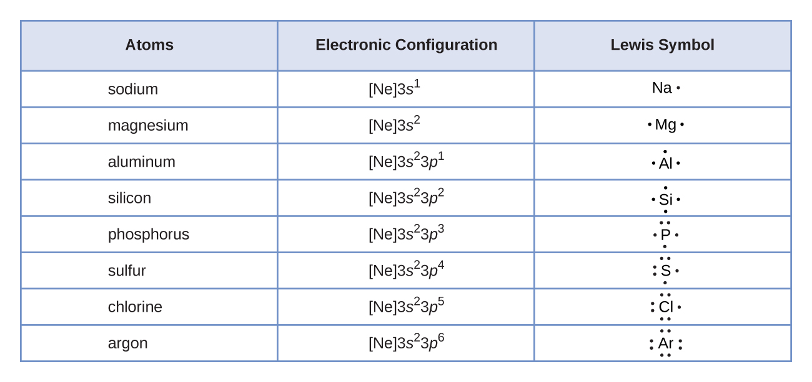
Lewis symbols
Lewis symbols show the number of valence electrons in an atom using a dot for each valence electron.
Calcium is in column 2A, so has 2 valence electrons:
.Ca.

Slide 4
Lewis symbols in redox reactions
Lewis symbols show that:
metals empty their valence shell when they become cations;
while nonmetals fill their shells to become anions.
Na. Na⁺¹ + e-
.Ca. Ca⁺² + 2e-
..
..
:Cl. + e- :Cl:⁻¹
..
..
..
..
.S. + 2e- :S:⁻²
..
..

Slide 5
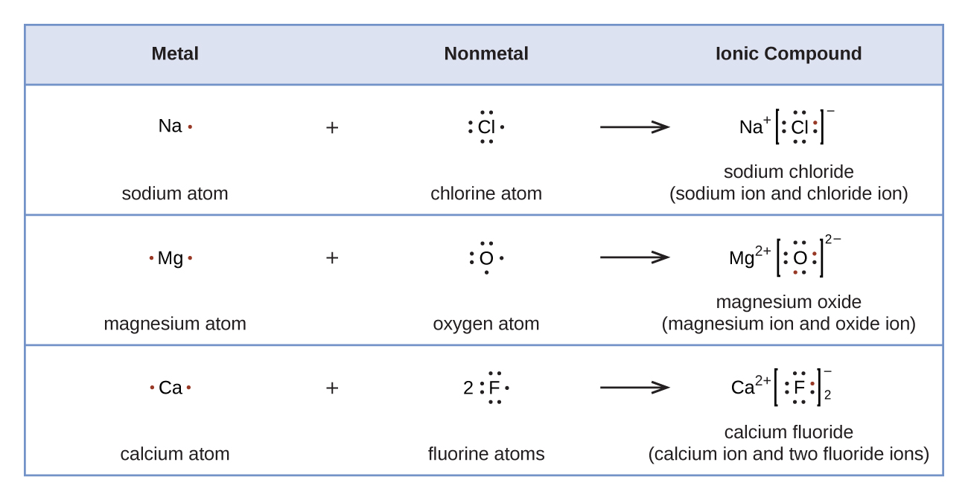
Lewis symbols formation of salts
Lewis symbols show that spontaneous redox (transfer 0f electrons) occurs when salts form.

Slide 6
Try this
Use Lewis symbols and arrows to diagram out the formation of aluminum fluoride from aluminum and chlorine atoms.
8
Al⁺³ Cl⁻¹ → AlCl3
..
..
-1
.Cl:
:Cl:
..
..
Cl⁻¹
Cl⁻¹
Al⁺³
..
..
-1
.Al:
.Cl:
Al⁺³
:Cl:
..
..
Cl⁻¹
..
..
-1
.Cl:
:Cl:
..
..

Slide 7
Lewis structures
Lewis structures are used to show the structure and bonding patterns of covalent molecules.
A pair of shared e- = : = ---
Remember to show the unbonded electron pairs
9
Each H atom has access to the 2 shared ve-; the duet H wants.
H.
+
H.
H:H
H - H
..
..
..
..
..
..
.Cl:
+
.Cl:
:Cl:
Cl:
:Cl -
Cl:
Each Cl atom has access to its 6 ve-& the shared pair; so the octet each wants.
..
..
..
..
..
..

Slide 8
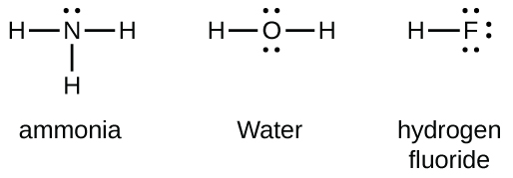
The octet rule
Octet rule: all atoms ionize of bond to achieve a full valence shell.
Most atoms want 8 valence electrons (an octet).
H & He want only 2 valence electrons (a duet).
Count to confirm that each atom has it’s octet or duet.

Slide 9
Double & triple bonds
Multiple bonds are used when there is no other way to give ‘central atoms’ a full valence shell.
Double bond: 2 shared pairs of valence electrons ::
Triple bond: 3 shared pairs of valence electrons :::

Slide 10
Writing Lewis structures
Steps:
Count total number of valence electrons (including charge).
Draw symbols for each atom, placing the least electronegative atom (or carbon, or the unique atom) in the center.
(3) Connect each atom with a single bond at a cost of 2 ve- each.
(4) Distribute remaining ve- as lone pairs around the outermost
atoms to give each an octet.
(5) Place any remaining ve- on the central atom.
(6) If the central atom doesn’t have an octet, create multiple
bonds to it using ve- from the outer atoms.
H |
1.90
2.20
SiH4
H – Si – H
#ve- = 4 + (4x1) = 8
| H

Slide 11
Try these
Draw Lewis structures for these:
CHO2⁻¹
NO⁺¹
OF2
10
..
O
..
2.5
3.5
2.20
H C
CHO2⁻¹
..
#ve- = 4 + 1 + (2x6) + 1 = 18
O
:
..
3.0
3.5
NO⁺¹
#ve- = 5 + 6 - 1 = 10
:
:
N O
3.5
4.0
..
..
..
:
F O F
OF2
:
..
..
..
#ve- = 6 + (2x7) = 20

Slide 12
Try these
NASA’s Cassini-Huygens mission detected a cloud of toxic hydrogen cyanide (HCN) on Titan, one of Saturn’s moons. Titan’s atmosphere also includes ethane (H3CCH3), acetylene (HCCH) and ammonia (NH3). Draw their Lewis structures!
11
NH3
2.2
2.5
#ve- = 5+ (3x1) = 8
3.o
HCN
:
H C N
#ve- = 1+ 4 + 5 = 10
..
N
H |
H |
H
H
H3CCH3
H
#ve- = (6x1) + (2x4) = 14
H C C H
|
H
|
H
HCCH
H C C H
#ve- = (2x1) + (2x4) = 10

Slide 13
One more
Both carbon monoxide and carbon dioxide are produced by combustion of fossil fuels. Draw their Lewis structures.
12
2.5
3.5
..
CO
:
:
C O
..
#ve- = 4 + 6 = 10
CO2
..
..
#ve- = 4 + (2x6) = 16
:
:
O C O
..
..

Slide 14
Exceptions to the octet rule
Chemistry is a field full of exceptions. There are three types of exceptions to the octet rule.
Molecules with an odd number of valence electrons (an unpaired electron).
(2) Molecules whose central atom has less than an octet.
(3) Hypervalent molecules whose central atom has more than an octet.

Slide 15
(1) Odd-electron molecules
Molecules with an odd number of electrons are called free radicals.
Example: nitric oxide (NO)
13
.
..
NO
#ve- = 5 + 6 = 11
:
N O
..

Slide 16
(2) e- deficient molecules
Electron deficient molecules generally have central atoms from groups 2A and 12A, outer hydrogen or other atoms that don’t form double bonds.
Example: berylium dihydride (BeH2)
14
BeH2
#ve- = 2 + 2 = 4
H Be H
Example: boron trifluoride (BF3)
15
..
:
:
F
BF3
#ve- = 3 + (3x7) = 24
B
:
F
:
:
:
F
..
..

Slide 17
(3) Hypervalent molecules
Elements below the second row of the periodic table can accommodate more than an octet using d orbitals.
Example: phosphorus pentachloride (PCl5)
16
..
:
:
Cl
PCl5
#ve- = 5 + (5x7) = 40
..
..
:
:
Cl P Cl
..
..
..
:
Cl
:
Cl
..
:
..
Example: sulfur hexafluoride (SF6)
..
17
..
:
..
:
F
:
:
SF6
#ve- = 6 + (6x7) = 48
F
F
..
..
S
:
F
:
:
:
F
..
:
..
:
F
..

Slide 18
Try this
Write the Lewis structures for XeF2, XeF4, XeF6 identify any exceptions to the octet rule.
18
XeF2
#ve- = 8 + (2x7) = 22
..
..
..
..
:
:
F Xe F
..
..
..
..
:
:
F |
XeF4
#ve- = 8 + (4x7) = 36
..
..
..
:
:
F Xe F
..
..
..
|
F
:
:
..
..
:
..
:
..
F
:
:
XeF6
#ve- = 8 + (6x7) = 50
F
F
..
..
Xe
..
:
F
:
:
:
F
..
:
..
:
F
..

Slide 19
Can you?
Define the term ‘Lewis symbol’.
(2) Use Lewis symbols to diagram out formation of an ionic
compound?
(3) List the steps required to draw the Lewis structure of a covalently bonded compound?
(4) Draw Lewis structures for a wide variety of covalently bonded compounds from their molecular formulas?
(5) List and explain the three types of exceptions to the octet rule?

