Slide 1
CHE 1031: General Chemistry I
Electrochemistry
5.1: Galvanic cells (aka voltaic cells)
5.2: Standard reduction potentials
5.3: Batteries & fuel cells
5.4: Corrosion

Slide 2
5. Electrochemistry
5.2: Standard reduction potentials
Use standard reduction potentials to determine the better oxidizing or reducing agent from among choices.

Slide 3
Using standard reduction potentials
When standard reduction potentials of both half-reactions are known, the cell potential of a galvanic cell can be calculated rather than experimentally determined.
A positive cell potential indicates that a galvanic cell reacts spontaneously and will produce an electric current.
Calculate the cell potential of this galvanic cell:
Cu(s) | Cu+2(1 M) || Ag⁺¹ (1 M) | Ag(s)
4
anode
cathode
3
E°cell = E°cathode - E°anode
E°cell = E°Ag+1/Ag – E°Cu+2/Cu
= (+0.80 V) – (+ 0.34 V) = +0.46 V

Slide 4
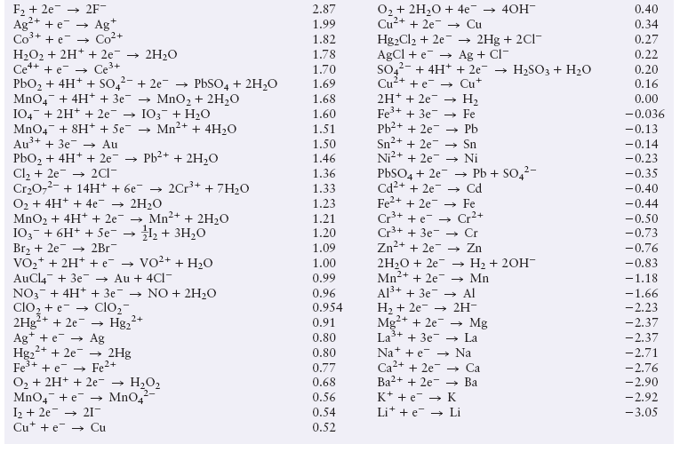
Standard reduction potentials
least easily oxidized
most easily oxidized

Slide 5
Try this
A galvanic cell is made with Au⁺³/Au and Ni⁺²/Ni half-cells.
Identify the oxidizing & reducing agents.
Calculate the cell potential.
5
(a) Au⁺³ + 3e- → Au(s) E° = + 1.498 V
← cathode
Ni⁺² + 2e- → Ni(s) E° = - 0.257 V
← anode (smaller SRP)
So, Ni is oxidized; the reducing agent.
And Au is reduced; the oxidizing agent.
3
(b) E°cell = E°cathode - E°anode
E°cell = E°Au+3/Au – E°Ni+2/Ni
= (+1.498) – (- 0.257 V) = +1.755 V

Slide 6
One more
A galvanic cell is made with Mg electrode in a 1 M solution of Mg(NO3)2 and a Ag electrode and a 1 M Ag(NO3) solution.
Identify the oxidizing & reducing agents.
Calculate the cell potential.
6
(a) Mg⁺² + 2e- → Mg(s) E° = - 2.37 V
← anode
Ag⁺¹ + e- → Ag(s) E° = +0.80V
← cathode
So, Mg is oxidized; the reducing agent.
And Ag is reduced; the oxidizing agent.
3
(b) E°cell = E°cathode - E°anode
E°cell = E°Ag+1/Ag – E°Mg+2/Mg
= (+0.80) – (- 2.37 V) = +3.17 V

Slide 7
Can you?
(1) Find both the appropriate SRP for both anode and cathode using a table of SRP values?
(2) Calculate cell potential given a galvanic cell diagram?
(3) Determine if a redox reaction is spontaneous?

