Slide 1
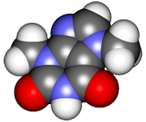
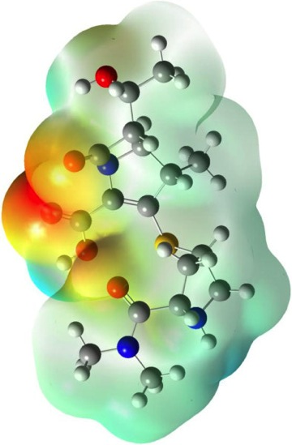
CHE2060 Lecture 5: Acid-base chemistry
5.1 Acids & bases: overview & basics
5.2 Acid & base strength
5.3 Equilibrium acid-base reactions
5.4 The leveling effect of solvents
5.5 Estimation of acidity by conceptual knowledge
5.6 Classes of organic acids & bases
5.7 Functional groups: acid-base nature
Daley & Daley
Chapter 5:
Acid-base theory

Slide 2
Key concepts from Lecture 5
According to the Brønsted-Lowry definition of acids and bases, an acid is a proton donor and a base is a proton acceptor.
Acid strength is related to the stability of the acid’s conjugate base. The stronger the acid, the more stable is its conjugate base.
A measure of acid strength is the value of the acid dissociation constant, Ka. Higher Ka = stronger acid
According to the Lewis definition of acids and bases, an acid is an electron-pair acceptor and a base is an electron-pair donor.
The character of the acidic or basic functional group, as well as the inductive effect of any adjacent functional group, affects acid or base strength.
Notes:
M

