Slide 1
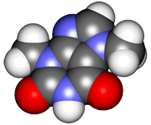
CHE2060 Topic 1: Atoms, orbitals & bonding
1.10: Free electron pairs & radicals
affect structure, polarity & reactivity

Slide 2
Effects of charge & unpaired e- on polarity
A radical is a molecule carrying a single unpaired e-.
sp3
Bruice (2007)

