Slide 1
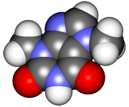
CHE2060 Topic 1: Atoms, orbitals & bonding
1.3: All about orbitals
‘God never saw an orbital.’
- Walter Kauzmann

Slide 2
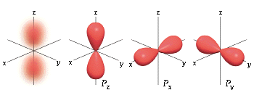
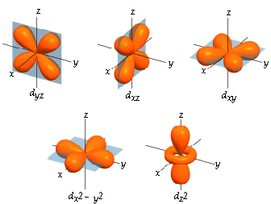
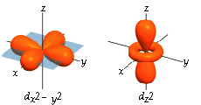
The first three orbitals
s orbital
p orbital
d orbital
Brown, chapter 6

Slide 3
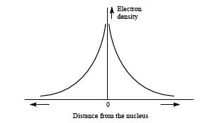
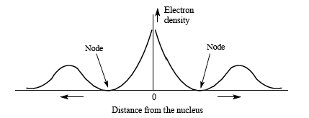
The “s” orbital
nucleus
Orbitals are really probability plots that describe the 3D location of electrons in space. They have:
shapes
sizes |_ energy!
distances from the nucleus |
1s
1s
Orbitals are centered on the nucleus
e- density highest @ nucleus
Energy increases as you move away from the nucleus
Each orbital holds zero, 1 or 2 e-
2s
2s
“s” orbitals are spherical
D&D p.24
Notes:
Analogy: You could describe the “orbital” of an individual who carries a cell phone with a GPS chip. If the cell phone reported the person’s location every 10 minutes and you plotted those locations on a map you’d have a “Fred” density plot – the likely location of Fred is in that area at any point in time – with something like 95% certainty.
Heisenberg’s uncertainty principle says that we can’t know both the exact momentum and position of the e-. Therefore, the orbital is as close as we can get to knowing where any e- is.

Slide 4
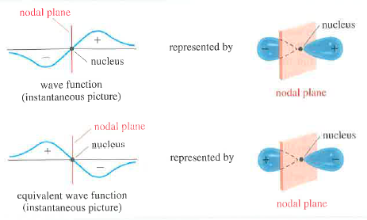
Effect of wave function on orbitals
Because waves have both positive and negative aspects, so do orbitals. Nodes: Areas of an orbital with no probability; where e- are never found
Orbitals other than s (p, d, f) have both positive & negative ‘lobes’.
Wade p.40
Notes:
Analogy: You could describe the “orbital” of an individual who carries a cell phone with a GPS chip. If the cell phone reported the person’s location every 10 minutes and you plotted those locations on a map you’d have a “Fred” density plot – the likely location of Fred is in that area at any point in time – with something like 95% certainty.
Heisenberg’s uncertainty principle says that we can’t know both the exact momentum and position of the e-. Therefore, the orbital is as close as we can get to knowing where any e- is.

Slide 5
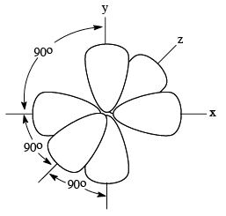
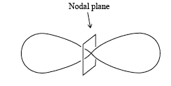
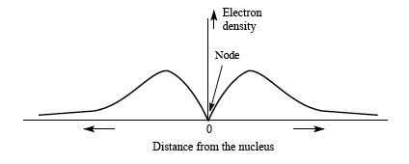
A closer look at “p” orbitals
The p orbital demonstrates the “waveicle” nature of e-s.
Waves “flow” above & below the x axis.
We say that waves have + and – areas.
Similarly, p & d orbitals have + and – “lobes”.
An e- can exist in one lobe or the other, never @ the node (0% at the nucleus)
y
z
x
x
+ -
z
y
nucleus
Each p is “dumbell shaped”.
This diagram represents 3 p orbitals – one along each axis, x, y & z.
So how many e- can this complex hold?
D&D p.25-6

Slide 6
“d” orbitals are like “doubled” p’s
Each of these d shapes holds 0, 1 or 2 electrons.
So how many e- can a complete set of d orbitals hold?
What would that set of orbitals look like?

Slide 7
Can you?
Describe s, p & d orbitals? Shapes, number & orientation?
Define the term ‘orbital’?
Draw graphs of the change in electron density as a function of distance from the nucleus for each type of orbital?
Define the term node and locate nodes in each type of orbital?
Explain why nodes occur in orbitals?
Aristotle
1700’s gas pump experiment

