Slide 1
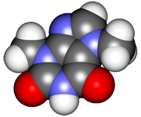
1.6: Lewis dot structures of molecules & ions

Slide 2
Building Lewis dot structures
Simple steps allow us to create organic structures with the
proper number & placement of covalent bonds:
Sum all valence electrons in the compound.
Draw atomic symbols (The single atom is the central atom. C is central.)
Connect atoms with single lines. (line = 2 e-)
Fill in valence electrons, starting with peripheral atoms.
If needed, use multiple bonds to satisfy all octets.
No more than 4 bonds each for C, N, or O.
C2H6
H
H
:
:
ethane + heat
H : C : C : H
:
:
H
H
H
H
C2H4
:
:
C :: C
ethene + heat
:
:
H
H
C2H2
H : C ::: C : H
ethyne + heat
CH3OH
H
:
methanol + heat
formaldehyde + heat
H : C : O : H
:
H
H : C :: O
CH2O
:
H
D&D p.48-52

Slide 3
‘Typical’ bonding for common atoms?
When drawing Lewis dot structures it helps to know how many bonds atoms typically form; most atoms have a common pattern.
What about H?
Carbon usually forms 4 bonds:
|
C C C C
|
Nitrogen often forms 3 bonds & carries a free e- pair:
..
N :N
|
Oxygen likes to form 2 bond & to carries 2 free e- pairs:
O O
..
..
Note: S & P can accommodate up
to 10 ve-; more
than an octet.
..
..

Slide 4
Which atom is in the center?
When you look at a formula like SOF2 (really :SOF2) how do you know which atom is found in the center of the small molecule?
The lone (single, unrepeated) or first atom is placed in the center.
..
..
..
26 ve-
O
S
F:
..
..
:F:
..
What about long molecular formulas with carbon?
Start with a chain of carbons running right to left and “decorate” with Hs.
And think symmetry!
C3H7Br
C4H10O
C3H6F2
26 ve-
..
..
Br:
O - H
32 ve-
..
..
32 ve-
Notes:
C & H don’t usually have free pairs
These aren’t the only solutions!
..
F:
..
:F:
..
D&D p.48-52

Slide 5
Exercise: single bonds
Draw Lewis dot structures for the each of these. Be sure to show all unbonded electrons (aka free electron pairs).
..
..
..
10 ve-
H
:Cl – P – Cl:
|
:Cl:
H2O
PCl3
I2
CH3Br
NH3
:O:
..
..
26 ve-
H
14 ve-
..
14 ve-
8 ve-
H
|
H – C – Br:
|
H
..
..
..
:I – I:
..
..
..
H
|
H – N:
|
H
D&D p.48-52

Slide 6
Exercise: multiple bonds
Draw Lewis dot structures for the each of these. Be sure to show all unbonded electrons.
..
..
16 ve-
CO2
HCN
N2
H2S
SiO2
CH2NH
O = C = O
H – C N:
..
..
10 ve-
10 ve-
..
8 ve-
:N N:
H – S – H
..
16 ve-
12 ve-
..
..
O = Si = O
H
|
H – C = N – H
..
..
..
D&D p.48-52

Slide 7
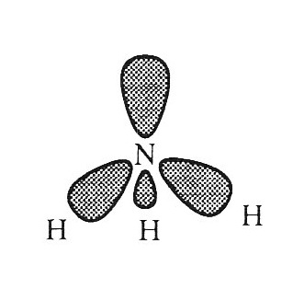
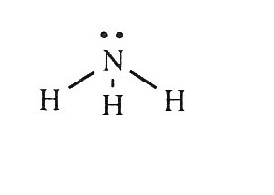
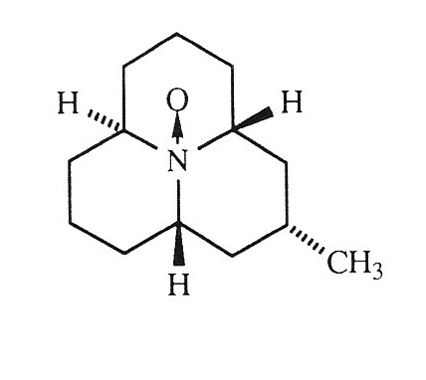
Unbonded electron pairs of are reactive
Unbonded electron pairs are reactive and can form dative covalent bonds with other atoms or molecules.
In a dative bond, one atom supplies both e- of the covalent bond.
Coccinellin is a defensive compound secreted by ladybug beetles when
attacked. The unbonded pair of the central N has formed a dative bond with an oxygen atom.
H&P p.10

Slide 8
Can you?
List the steps required to draw Lewis dot structures for molecules?
Explain how you know when multiple bonds are required?
Draw the ‘usual’ bonding patterns for most non-metals?
Define the term ‘dative bond’?
Aristotle
1700’s gas pump experiment

