Slide 1
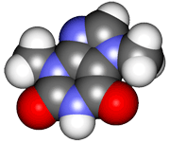
CHE2060 Topic 1: Atoms, orbitals & bonding
Models of the atom:
nuclear to quantum mechanical

Slide 2
History of atomic thinking
fire earth water air
Electrons orbit the nucleus at specific levels, or orbits.
Orbitals are wave -functions.
Quantum theory: electrons occupy ‘ortitals’ with specific shapes & energies.
‘A-tomos’
Bohr (1913)
Schrödinger (1926)
Greeks (~500 B.C.)
Dalton (1803)
Rutherford Thompson Millikan (1897-1911)
Pauli (1924)
‘exclusion principle’
No more than 2 electrons may occupy the same orbital.
Molecules
Atoms
Nuclei & electrons
Matter consists of particles called atoms.
Atoms consist of subatomic particles: electrons, neutrons protons.
2 electrons in the same orbital have opposite ‘spin’.

Slide 3
Nuclear model of the atom
-
-
-
-
+
-
+
+
+
+
-
+
+
-
-
-
-
-
-
Atoms have a small central nucleus made up of the two “heavy” subatomic particles, protons (+1) & neutrons (uncharged). Electrons are much smaller (-1) particles that form a diffuse cloud surrounding the nucleus.
D&D p.22-23

Slide 4
B0hr’s “planetary model” of the atom
shells subshells #e- e- pairs
3d
1 s 2 1
3p
2 s 2 1 p 6 3
2p
orbiting
vs. orbital
3s
3 s 2 1 p 6 3 d 10 5
1s
2s
p/n
How many electrons in an atom?
atomic #
Which is the valance shell?
The valence shell is chemically active (exposed, available & vulnerable) while inner shells are inert.
What causes chemical bonding?
Atoms strive to obtain and maintain stable valence shells. Stable mean full: 8 ve- for all atoms except H or He.
Bohr model
D&D p.23

Slide 5
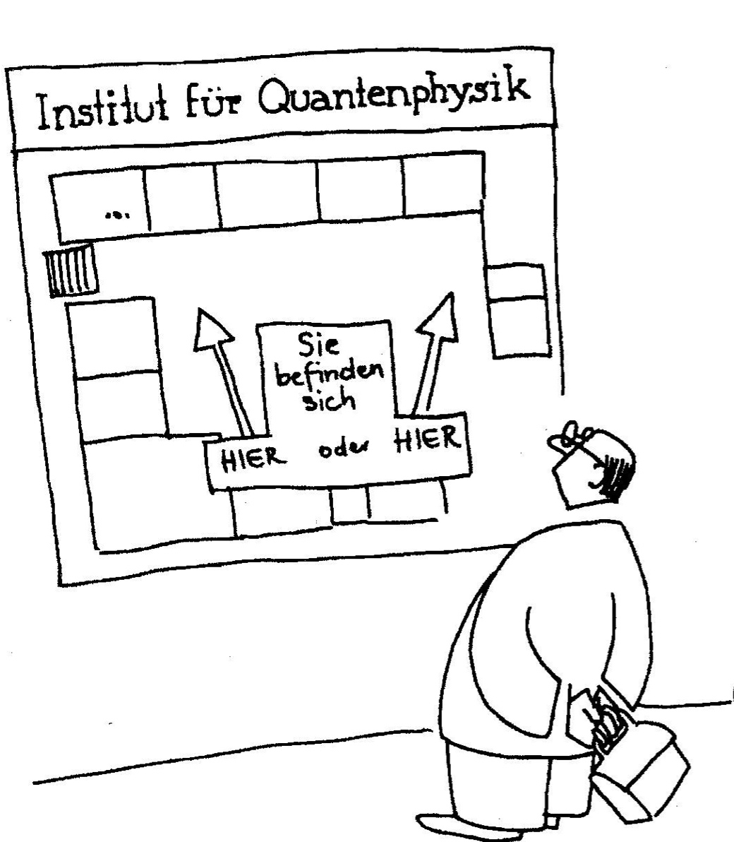
The surprising subatomic world
This slide-set introduces you to the idea that the physics – and thus behavior – of the subatomic world are different from the physics of our “macro world”.
Institute of Quantum Physics
The development and concepts of this quantum world are introduced without the complex mathematics used in its development.
The goal of this module is to introduce the general concepts in a very descriptive way in order to support some of the atom’s non-intuitive behavior.
You are HERE or HERE
Notes:
Welcome to the surprising subatomic world of quantum mechanics! This aspect of atomic structure is pretty intimidating for most introductory students. The goal of this slide set is not to intimidate you or to overwhelm you with complicated mathematics. Rather, I hope to introduce you to a bit of the history of the discovery of atomic structure, and to a very conceptual and basic understanding of how the quantum physics of the atom differs from the physics of our everyday (macro) world. If I succeed, this brief introduction will help you accept that the behavior of matter at the atomic level is different than the behavior we typically experience in our macro world, and this should improve your understanding of atomic chemistry.

Slide 6
Newtonian physics just doesn’t cut it
The behavior of our everyday world can be described by classical, Newtonian, physics.
However, at the end of the 1800s it was clear that Newtonian physics didn’t accurately describe the behavior of light and matter at the atomic scale.
For example: Why atoms don’t collapse? Give that some thought…
Three phenomena that could not be understood with Newtonian physics were investigated and explained by radical new ideas that would lead to a new type of physics, the field that would become quantum mechanics.
Blackbody radiation Max Planck 1900
Photoelectric effect Albert Einsetein 1905
Line spectra of elements Niels Bohr 1913
Notes:
For atoms and molecules plain old classical Newtonian physics just doesn't cut it. What do I mean by Newtonian physics? That's the classical physics we first learn in high school and college. Objects are subject to the force of gravity. Force equals mass times acceleration. Friction slows the velocity of objects in contact with the Earth. Newtonian physics explains the behavior of objects in our macro world, but by the end of the 1800s it was clear that Newtonian physics couldn't adequately describe the behavior of light or of matter at atomic and subatomic scale.
To see the failure of Newtonian physics, take a minute and think about this question, “Why don't atom collapse?” Think about your knowledge of atomic structure. Ernest Rutherford developed the nuclear model of the atom: a tiny dense positively charged nucleus surrounded by a cloud of negatively charged electrons. Why doesn't electrostatic force pull the negatively charged electrons into the nucleus, causing the collapse of atomic structure? Newtonian physics can't explain that.
At the turn of the 20th century, three phenomena that could not be explained with Newtonian physics were investigated by a group of very bright European physicists. Their radical explanations led to the development of a new type of physics, a field that would be called quantum mechanics. Not mechanics like the guys who fix cars, but the mechanism by which the world works.
These three phenomena are blackbody radiation, the photoelectric effect, and the line spectra produced by pure elements. I’ll tackle these one at a time.

Slide 7
Blackbody radiation
Hot objects emit energy as both heat and color. The color of hot objects correlates with their temperature.
In turn of the century Germany, this was of great economic interest, as the newly unified country wanted to dominate the lighting industry. They wanted to find the best filament for light bulbs.
The relationship between color & temperature was not continuous.
In 1900, Max Planck found that the energy emitted or radiated from the object was in discrete energy bundles that he called quanta.
E = nhν
E = energy (J)
n = integer
h = Planck’s constant (J-s)
ν = frequency (1/s)
Notice that all values of E are multiples of Planck’s constant and are therefore not continuous, but discrete.
Notes:
Most of us have observed this phenomenon: as objects are heated, particularly metal objects, their color changes. A bar of iron is black when it's cool, but as it's heated it turns red, then orange, then yellow, then white, and finally a bluish white when extremely hot. In turn-of-the-century Germany, this phenomenon was of great interest to men who wanted to dominate the lighting industry. They hoped to identify a metal that would glow with a brilliant white color at a relatively low temperature and to understand the relationship between the energy used to heat the metal and the energy emitted as light. However, the relationship between temperature and color could not be explained by classical physics. In 1900, Max Planck found that the blackbody spectrum could be predicted if the energy absorbed or emitted from an object took the form of discrete energy bundles, integral multiples of a constant multiplied by energy’s frequency. Plank's blackbody radiation equation is shown here. You can see that energy can only exist in discontinuous ‘steps’. So energy values are discrete. Planck called these discrete energy bundles quanta.

Slide 8
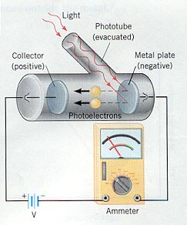
Photoelectric effect
In 1839 it was observed that when visible or uv light is aimed at a clean metal surface, electrons are ejected from the metal, causing an electrical current.
Unexpectedly, a light energy threshold was required before electrons would be emitted.
In 1905, Albert Einstein applied Planck’s idea of quanta to explain the effect.
Einstein called these quantum bundles of light photons.
Einstein’s work bolstered the quantum concept.
E = hν
E = energy (J)
h = Planck’s constant (J-s)
ν = frequency (1/s)
Notes:
The second phenomenon that cannot be explained with Newtonian physics is the photoelectric effect. In 1893, it was observed that when visible or UV light is aimed at a clean metal surface electrons are rejected from that metal surface causing an electric current. Unexpectedly, investigators found that a threshold frequency of light energy was required before electrons could be produced. In 1905, Albert Einstein applied Planck’s idea of quantum to explain the photoelectric effect. Notice that Einstein's equation is almost identical to Planck’s. Einstein called the quantum bundles of light energy that hit the metal surface photons. His equation for the energy of photons is almost identical to Planck’s equation for blackbody radiation. The energy is proportional to a constant, Planck’s constant again, multiplied by the frequency of the light. Today, the photoelectric effect is being used to produce energy from sunlight via photovoltaic panels. Einstein's work confirmed the importance of Planck’s finding of quanta. How do we define quanta? Quanta are discrete amounts of energy proportional in magnitude to the frequency of the radiation they produce.

Slide 9
Elemental line spectra
When gases are heated to incandescence, they emit light at a series of
characteristic wavelengths due to the atomic composition of the gas.
These ‘line spectra’ are discrete rather than continuous. Why?
In 1913, Niels Bohr built on the work of Planck and Einstein and hypothesized that atomic energies are discrete rather than continuous.
The lines of elemental spectra correspond to the possible energy states of the atom’s electrons.
So Bohr applied the concept of quanta to matter and to the atom in particular.
Notes:
The third phenomenon is elemental line spectra. When pure gases are heated to incandescence (until they glow), they emit light at a series of wavelengths characteristic of their atomic identity. These line spectra differ from the continuous spectrum of electromagnetic radiation (seen when light hits a prism) because they are discrete. In other words, only a few wavelengths of light are seen for each element. Why? The lines produced from a gas result from the energy levels of electrons in that gas. In 1913, Niels Bohr hypothesized that the energy states of electrons in atoms were discrete or quantized. In other words, he built on the work of Planck and Einstein but applied the quantum idea to atoms rather than to light. So, electrons exist at quantum energy levels.

Slide 10
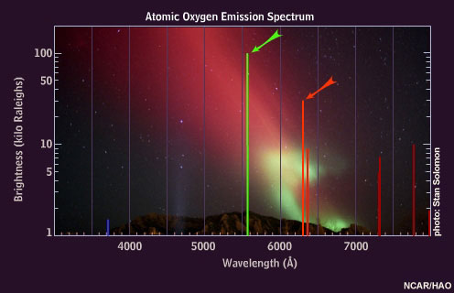
Line spectra of deep winter
The aurora borealis occurs when solar wind and magnetospheric plasma lose energy, hit Earth’s atmosphere and excite atmospheric molecules. The energy lost upon return to ground state produces the colors of the aurora.
windows2universe.org
Notes:
Those of us who live near the poles of our planet can actually see atomic line spectra on deep winter nights. Solar flares produce solar wind and plasma energy that travel through space, hit the Earth's atmosphere, and excite atmospheric gases. This added energy boosts the ground state energy levels of electrons in those atmospheric gases. When the excited electrons return to their ground states, they emit light at the wavelengths found in their line spectra. We call this atmospheric phenomenon the aurora borealis, or northern lights. This image shows you the line spectrum of atomic oxygen. You can see that the predominant colors are green and red and you can see those colors in the photograph of the aurora borealis seen in the background. Why? Earth’s atmosphere is 21% oxygen gas.

Slide 11
Yea, but is this quantum stuff really relevant?
Does all this quantum stuff really matter outside of the classroom and lab?
Yep, we’re about to look at the development of the quantum mechanical behavior of the atom, a theoretical framework that expresses the behavior of matter at the atomic scale.
Quantum mechanics now plays critical roles in science, medicine, engineering and technology. This model has correctly predicted the behavior of matter at the atomic level across disciplines.
It’s estimated that quantum mechanics is involved in 30% of the US gross domestic product.
Notes:
So, I’ve shown you three interesting phenomena, and three interesting new explanations; quantum explanations. But does all this really matter? Is it really relevant? Well, yep it is. First, understanding some basic quantum concepts will really help you understand chemistry: changes matter undergoes at the atomic and subatomic level. Second, quantum mechanics now play a critical role in science, medicine, engineering, and a host of technologies like electronics, electromechanical engineering and computer technologies. Quantum mechanics drives each of these fields forward. In fact, it's estimated that quantum mechanics is now involved in over 30% of the US gross domestic product. And that's important.

Slide 12
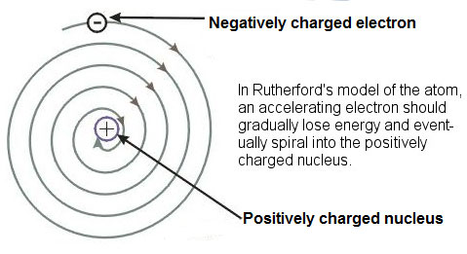
Back to the atom!
We left off at the planetary model of the atom developed by Hantaro Nagaoka in 1903 and was considered in Rutherford’s nuclear model paper.
But the planetary model already had problems:
Electrons orbiting the nucleus would be accelerating and therefore emitting energy like radio signals; &
As energy is emitted it is lost, and the electron would spiral in and crash.
the nuclear “death spiral”
Notes:
So, let's get back to our discussion of the atom. Earlier in the course, I discussed JJ Thomson's discovery of the electron and Rutherford's experiments that led to the development of the nuclear model of the atom. In 1903, Hantaro Nagaoka developed the so-called planetary model of the atom; Rutherford actually mentioned it in his paper describing the nuclear model. In this planetary model, electrons orbited the nucleus. But, the planetary model quickly showed some weaknesses. First, if electrons orbit the nucleus they must be accelerating, and accelerating objects emit energy as radiation. Under normal circumstances, atoms aren’t seen to emit energy. Second, emitted energy is lost, and if electrons lose energy they will spiral into the nucleus and crash, collapsing the atom. And we don’t observe this ‘nuclear death spiral’.

Slide 13
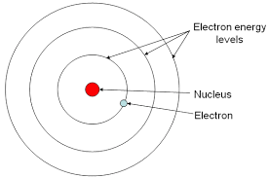
Bohr (temporarily) to the rescue!
In 1913, Bohr applied what he’d learned about the quantum nature of elemental line spectra to the atom.
Bohr’s modified planetary model assigned quantum energy levels to electrons.
Since these levels had to be maintained, electrons could not lose energy,
..would not emit energy, and
..would not spiral in and crash.
And, this quantum planetary model would explain the existence of elemental line spectra.
Alas, this rescue of the planetary model was only temporary because:
The model worked only for atoms with one electron (H).
Doesn’t explain why electrons don’t lose energy.
Notes:
In 1913, Bohr applied what he learned about the quantum nature of electrons to the planetary model of the atom. In his modified model, Bohr assigned quantum energy levels to the electrons orbiting the nucleus. Because their energy levels were quantum, electrons were not allowed to lose energy. Therefore they would not emit energy, and they would not spiral in and crash. And even more importantly, Bohr’s quantum model explained the existence of elemental line spectra so it was consistent with existing atomic data. Unfortunately Bohr’s model also had problems. His model only worked for atoms with one electron, like hydrogen. And there was no simple explanation for electrons’ unchanging energy.

Slide 14
Applying a new quantum physics to the atom
In fact, creating a model of the atom consistent with line spectrum data would require a more complete understanding of the implications of quantum energy.
Through the 1920s, the work of a number of physicists fleshed out and developed the quantum mechanical model of the atom.
In addition to the concept of quantized energy, a number of other ideas were critical to this work:
Light behaves as a wave.
Light behaves as a particle.
Matter can behave as a wave.
Wave functions can describe the energy levels of atoms.
At the atomic level two properties of a particle cannot be determined exactly at the same time: uncertainty (undeterminant).
Landé suggests the term ‘waveicle’.
Notes:
In fact, to create a model of the atom that overcame these problems would require a more complete understanding of the implications of quantum physics. Throughout the 1920s, work by a number of physicists fleshed out and developed the quantum mechanical model of the atom. In addition to the concept of quantized energy, a number of other ideas were critical to this work. And we will look at those ideas in the next few slides after clarifying a few simple definitions.

Slide 15
Let’s start with some clear definitions
Particle
A minute portion of matter.
The least possible amount.
Mass
Size (diameter)
Wave
An oscillation that moves outward from a disturbance.
A periodic disturbance of the particles of a substance that may be propagated without net movement of the particles, such as in the passage of undulating motion, heat, or sound.
A variation of an electromagnetic field in the propagation of light or other radiation through a medium or vacuum.
Wavelength (λ) distance from peak to peak or trough to trough (nm)
Frequency (ν) the number of peaks that pass a point over time (1/s)
Amplitude the height of the wave (nm)
Notes:
We're going to be talking about the dualistic nature of the electron: its dual behavior as both a wave and a particle. So, what's a particle? A particle can be defined as a minute portion of matter, or the least possible amount of something. This should sound pretty familiar because it's much like our earlier definition of an atom. A particle has mass and particle has size; size is often described as diameter or radius. What's a wave? Waves can be described as oscillations that move outwards from a disturbance; ripples caused by throwing a pebble into a pond. Or more formally, a wave is a periodic disturbance of particles of a substance that can be propagated without net movement of the particles. For example, you're at the beach watching the waves come in to shore. Imagine swimming into the ocean and stopping to bob up and down in the waves. You, the particle, are not being moved in to shore, but the periodic disturbance (or wave of water) passes beneath you and travels to the beach. Waves are characterized by three properties. Wavelength describes the distance from one peak to the next, or the distance from one trough to the next. Frequency describes the number of peaks that pass a certain point in a given amount of time. Amplitude describes the height of a wave from its horizontal axis.

Slide 16
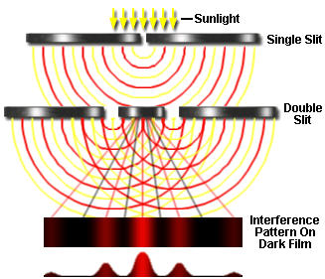
Light behaves as a wave
In 1801,Thomas Young’s double-slit experiment demonstrated that light is a wave.
Waves of light passing through the two slits meet and interfere.
Where waves meet out of phase, addition of waves of opposite signs yields little light.
Where waves meet in-phase, addition produces strong light.
Stripes of strong light are separated by darker stripes of little light.
Notes:
So, let's get back to ideas that contributed to the development of quantum mechanics. In 1801, Thomas Young’s double-slit experiment demonstrated that light behaves as a wave. Let me walk you through the diagram shown here. Young started with a single slit in order to collate, or focus, a beam of sunlight. You can see that when sunlight passed through this slit it formed a semi-circular wave. Young then propagated (passed) this first wave through a pair of slits, a.k.a. a double slit. This produced two new waves that collided with one another. Their collision produced additive and subtractive interference. Where two waves collided out of phase, their magnitudes canceled each other. But where two waves collided in phase, their magnitudes were added together, increasing the size of the wave. Interference becomes obvious when the waves of light are visualized on film: positive interference produces bright stripes of light, and negative interference leaves the film dark. The most light is produced where the strongest waves collide in phase. So, the bands of light, an interference pattern strongest in the center and weakest at the edges, prove that light behaves as a wave.

Slide 17
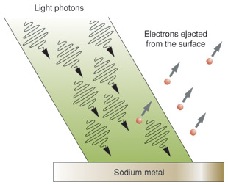
Light behaves as particles
In 1905, Einstein’s explanation of the photoelectric effect showed that light could behave as a particle, a photon.
In this view, photons act as ‘bullets’, hitting the surface of the metal and knocking electrons free.
http://www.daviddarling.info/images/photoelectric_effect.jpg
Notes:
While light clearly behaves as a wave, we've already seen proof that light also behaves as particles. That proof was provided by Einstein's 1905 explanation of the photoelectric effect. This diagram should remind you of that earlier explanation. Here, we can visualize the photons as little bullets or BBs impacting a metal surface. As the photon ‘bullets’ impact the surface, the force of their impact ejects electrons from the surface of the metal producing the current that is evidence of the photoelectric

Slide 18
Electrons behave like waves
In 1924, Louis de Broglie showed that electrons (a form of matter) could behave like waves. He described e- wavelength as:
λ = h/mν
This work implied that the behavior of electrons in an atom could be described mathematically by a wave function (equation).
De Broglie shot a beam of electrons at a metal surface and observed a diffraction pattern typically produced by waves.
Examples of electron diffraction patterns from graphene & variants.
Notes:
What about electrons? Well, electrons were assumed to be particles from the first. JJ Thompson's plum pudding model envisioned particulate electrons as the fruit in a fruitcake. Could electrons also behave as waves? In 1924, French physicist Louis de Broglie showed that electrons (a form of matter) could act as waves. De Broglie's experiment involved shooting a beam of electrons at a metal surface. He found that the metal surface diffracted the beam of electrons producing a pattern very much like the interference pattern produced by waves. The figure on my slide is actually the electron diffraction pattern produced by graphene, a very thin film of pure carbon that capable of conducting electricity. You can see that the structure of graphene is a series of perfect interlocking hexagons, and the diffraction pattern suggests this molecular structure. De Broglie found that the wavelength of electrons is proportional to the product of their momentum and their frequency.

Slide 19
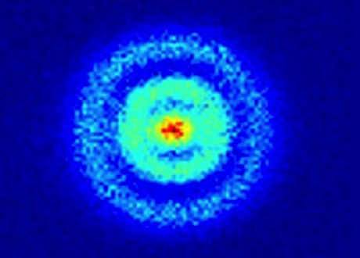
Wave functions describe atomic energies
In 1926, Erwin Schrödinger showed that the energy levels of electrons in atoms – shown by elemental line spectra - could be described by mathematical wave functions, confirming the wave nature of electrons.
-
δ .
δt
ih ψ = Ĥψ
Schrödinger’s work confirmed the wave behavior of electrons and allowed scientists to calculate, or predict, the likely location of an atom’s electrons.
The square of the wave function, ψ², represents the probability that the e- will be found at that location: probability density or electron density.
Orbital of H atom imaged by a quantum microscope (Stodolna, 2013)
This concept of electron density plots led to the development of electron orbitals.
Schrödinger is sometimes called the ‘father of quantum mechanics’.
Notes:
So, the behavior of atoms is due largely to their electrons. Electrons can behave like waves. If this is the case, mathematical models of waves should be able to describe the behavior of atoms. In 1926, Erwin Schrödinger showed that the energy levels of electrons in atoms could be described by mathematical wave functions. And these energy levels were consistent with the energy levels observed in elemental line spectra, so Schrödinger's model was consistent with earlier data. Schrödinger is sometimes called the father of quantum mechanics because his work pulled together existing data, the work of other researchers, and produced mathematical equations that could describe the behavior of electrons in atoms. And this changed our concept of the structure of atoms in a fundamental way. No longer would electrons orbit the nucleus. The square of the wave function (ψ²) represents the probability that an electron will be found at a specific location. So Schrödinger’s wave functions demonstrate an uncertain location for electrons. They show us where electrons are most likely, or most probably, found. This probability led to the development of the orbital: the likely, or probable, spatial location of the electron relative to the nucleus of the atom. This slide shows the first actual visualization of the spherical orbital of one hydrogen atom using a quantum microscope. The result is consistent with the energy predicted by Schrödinger's wave functions.

Slide 20
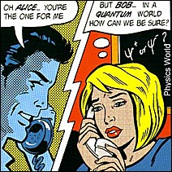
Particle behavior is also uncertain
In 1927, Werner Heisenberg found that pairs of properties of particles cannot have exact values at the same time when the particles are of subatomic scale. He called this ‘indeterminant’ behavior.
For example, if you know a subatomic particle’s speed or momentum exactly, you cannot know its location exactly at the same moment.
So, the location and movement of electrons cannot be known precisely at any particular moment.
Heisenberg’s work supported that of Schrödinger.
We don’t see this uncertainty in our “macro” world because the size of the uncertainty is many, many times smaller than the size of the object.
Uncertainty ‘works’ in the subatomic world because the size of the uncertainty and the size of the object are similar.
Notes:
In 1965, Richard Feynman proposed a thought experiment: repeat Young's double-slit experiment with a beam of electrons rather than a beam of light. It took a while to make this thought experiment a reality, but several groups have now done so. Let's look at an animated recap of the electron double-slit experiment featuring Dr. Quantum (https://www.youtube.com/watch?v=DfPeprQ7oGc). This animation clearly shows that a beam of electrons behaves like a wave. But when electrons are shot through the double-slit one at a time, they appear to behave like particles. However, after many, many individual electrons pass through both slits, the pattern produced begins to look more like a wave interference pattern than a pattern produced by particles. And, most strangely, if we attempt to observe the behavior of a single electron it appears to go back to behaving like a particle. We have to conclude that electrons behave like particles and like waves. And that the quantum world is strange.

Slide 21
Best proof of the electron’s dualist nature
In 1965, Richard Feynman proposed a thought experiment: repeat Young’s double-slit experiment with electrons.
A number of groups have now done it!
Pozzi et al. (1974)
Tonomura et al. (1982)
Batelaan et al. (2013)
Let’s look at Dr. Quantum’s great video recap!
https://www.youtube.com/watch?v=DfPeprQ7oGc
Roger Bach, Damian Pope, Sy-Hwang Liou, Herman Batelaan. Controlled double-slit electron diffraction. New Journal of Physics, 2013; 15 (3): 033018 DOI: 10.1088/1367-2630/15/3/03301
Notes:
In 1965, Richard Feynman proposed a thought experiment: repeat Young's double-slit experiment with a beam of electrons rather than a beam of light. It took a while to make this thought experiment a reality, but several groups have now done so. Let's look at an animated recap of the electron double-slit experiment featuring Dr. Quantum (https://www.youtube.com/watch?v=DfPeprQ7oGc). This animation clearly shows that a beam of electrons behaves like a wave. But when electrons are shot through the double-slit one at a time, they appear to behave like particles. However, after many, many individual electrons pass through both slits, the pattern produced begins to look more like a wave interference pattern than a pattern produced by particles. And, most strangely, if we attempt to observe the behavior of a single electron it appears to go back to behaving like a particle. We have to conclude that electrons behave like particles and like waves. And that the quantum world is strange.

Slide 22
So, why don’t atoms collapse?
In our macro world atoms would collapse when the negatively charged electrons were pulled into the nucleus by electrostatic attraction. Unless we constantly added energy to the electrons, their velocity would slow, and they would spiral into the nucleus and collapse the atom.
But, in the subatomic quantum world, atoms are subject to quantum mechanics rather than the Newtonian laws of motion.
Electrons have quantum energy and that level of energy can only be changed transiently.
Uncertainty says that if an electron did approach the nucleus the uncertainty of its location would be greatly decreased. To compensate, the uncertainty of its speed or momentum would have to increase. That increased speed would push the electron away from the nucleus.
Notes:
Now that we've explored the quantum subatomic world in a simple conceptual way, let's look back at that earlier question, “Why don't atoms collapse?”. Well, it's clear that Newtonian physics doesn't govern the world of atoms. In the subatomic world, electrons have quantum energy and that quantum energy can only be changed transiently by an energy boost. So the quantum energy level cannot decay. And, uncertainty dictates that if an electron did approach the nucleus of an atom the uncertainty of the electrons position would be dramatically decreased. To compensate and maintain the uncertainty that's part of the quantum world, the speed or momentum of that electron would have to increase and would likely push the electron away from the nucleus, preventing collapse of the atom.

