Slide 1
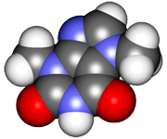
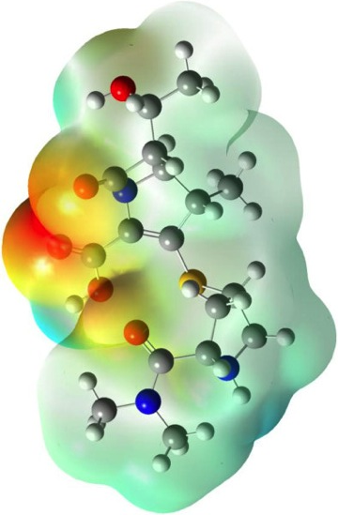
CHE2060 2: Simple structures, functional groups
Topics
Drawing molecular structures
Arrow formalism & molecular framework
Introduction to alkanes
Isomers
IUPAC naming of alkanes
Alkyl halides & cycloalkanes
Functional groups: where the action is
Alkenes: hydrocarbons with > one double bond
Alkynes: hydrocarbons with > one triple bond
Alkene isomers: who’s across that double bond?
Arenes
Organohalogens
Using molecular formulas
Daley & Daley, Chapter 2
Organic Nomenclature & Functional Groups

Slide 2
Isomers

Slide 3
Types of isomers
Same formula
Different in some way
isomers
Same connectivity?
no
yes
constitutional isomers
stereoisomers
Different single bond rotation?
no
yes
configurational isomers
conformational isomers
mirror images?
no
yes
diastereomers
enantiomers
& cis-trans or E-Z
Karty p.177

Slide 4
Isomers
Constitutional or structural isomers: molecules that have the same types & numbers of atoms, but with different arrangement, bonding or connectivity.
molecular formulas are identical
structures are distinct
physical properties differ
Stereoisomers are a different & distinct type of isomer discussed later.
C4H8?
(one C=C bond or one ring is needed)
H H H
| | |
H - C = C - C - C - H
| | | H H H
H H
\ /
C - H
/
H - C = C | \
H C - H
/ \
H H
H H
\ /
H C
| / |
H - C - C | | | \ |
H H C
/ \
H H
H H
| |
H - C -- C - H
| |
H - C -- C - H
| |
H H
H H H
| | |
H - C - C = C - C - H
| | | H H H
D&D p.78

Slide 5
Isomers can be straight or branched.
Draw a chain of the proper number of carbons & then fill in with Hs.
Chains can be ‘straight’ or branched.
Make isomers of C5H12:
H H H H H
| | | | |
H - C - C - C - C - C - H
| | | | |
H H H H H
n-pentane
C - C - C - C - C straight chain
H H H
\ | /
H C H
\ | /
H - C - C - C - H
/ | \
H C H
/ | \
H H H
C - C - C same
|
C
|
C
C
|
C - C - C
|
cruciform C
So there are just 3 isomers of C5H12.
C
|
C - C - C - C branched chain
H H H
\ | /
H C H H
| | | |
H - C - C - C - C - H
| | | |
H H H H
2,2-dimethylpropane
C
|
C - C - C - C same
2-methylbutane

Slide 6
Isomers have distinct physical properties.
Of course, the chemical properties of isomers may differ, but physical properties are also distinct.
Make isomers of C2H6O:
H H
| |
H - C - C - O - H
| | H H
H H
| |
H - C - O - C - H
| | H H
..
..
..
..
Ethanol
b.p. 78°C
Diethyl ether
b.p. -24°C
What do you know of their chemical properties?

Slide 7
Example: How many isomers?
Draw all structural isomers of C6H14!

