Slide 1
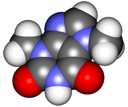
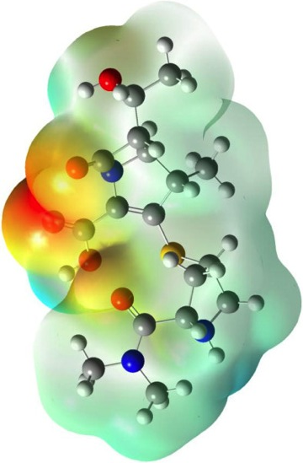
CHE2060 Lecture 5: Acid-base chemistry
5.1 Acids & bases: overview & basics
5.2 Acid & base strength
5.3 Equilibrium acid-base reactions
5.4 The leveling effect of solvents
5.5 Estimation of acidity by conceptual knowledge
5.6 Classes of organic acids & bases
5.7 Functional groups: acid-base nature
Daley & Daley
Chapter 5:
Acid-base theory

Slide 2
Equilibrium reactions
Using pKa to predict whether reactants or products predominate

Slide 3
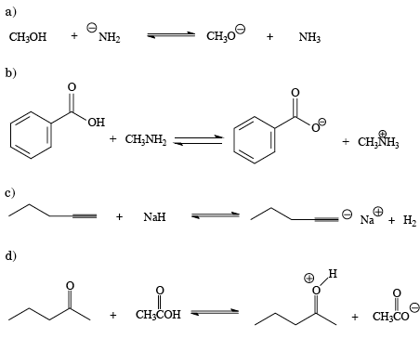
Equilibrium of conjugate acid-base pairs
When a reaction is reversible, the “side” with the weaker conjugate acid (higher pka) is favored. Are reactants or products are favored here?
pKa = 15.1
pKa = 36
pKa = 10.66
pKa ~ 4.76
pKa = 35
pKa ~ 26
pKa = 4.76
pKa ~ - 7.5
D&D, p.218
Notes:
M

Slide 4
Why is the weaker conjugate acid favored?
It’s as if the two acids, on the reactant & product sides, of the reaction are in competition with one another.
In essence, the stronger acid wins and acts like an acid, accepting an electron pair, and driving the reaction to producing the weaker acid and the conjugate base of the stronger acid.
B: - + H – A B – H + :A-
base acid conjugate conjugate
acid base
Karty p.302
Notes:
M

Slide 5
A more detailed look the driving acid
Let’s look at a specific example with numbers.
The strong acid pushes equilibrium to the right
acetic acid methyl acetate methyl
amine ion ammonium
pKa 4.76 pKa 10.63
stronger
equilibrium
We can see how strongly the reaction favors products by calculating Δ pKa.
Δ pKa = 10.63 – 4.75 = 5.88
So the equilibrium constant for this reaction can be calculated:
Keq = 10^{5.88} = 7.6E10⁵
In other words, products are favored by a factor of 760,000.
Karty p.302
Notes:
M

Slide 6
Example: quantitate the push
Predict which side is favored and by how much.
2-methyl- 2-propoxide
propanone
2-methyl- 2-propanol
propanone anion
pKa 20
pKa 19
equilibrium
We can see how strongly the reaction favors reactants by calculating Δ pKa.
Δ pKa = 20 – 19 = 1
So the equilibrium constant for this reaction can be calculated:
Keq = 10¹ = 1o
In other words, reactants are favored by a factor of 10. Barely pushed.
Karty p.302
Notes:
M

