Slide 1
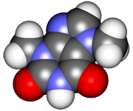
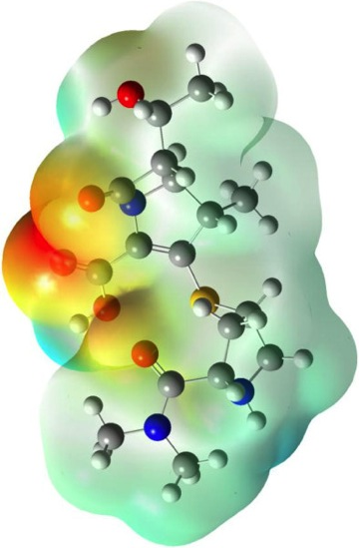
CHE2060 Lecture 6: Chirality
6.1: Symmetry & asymmetry
6.2: Nomenclature of stereocenters
6.3: Properties of asymmetric molecules
6.4: Optical isomerism
6.5: Fisher projections
6.6: Molecules with two stereocenters
6.7: Resolution of enantiomers
6.8: Stereocenters other than carbon
Daley & Daley, Chapter 11
Chirality

Slide 2
Non-carbon stereocenters

Slide 3
Non-carbon stereocenters (chiral atoms)
Like carbon, silicon (Si) forms four bonds to other atoms.
Nitrogen (N), phosphorous (P), and sulfur (S) can also form stereocenters.
However, these two N enatiomers cannot be separated because they interconvert rapidly.
Other N enantiomers are separable.
CIP system assigns : the lowest priority; lower than H.
D&D, p.563 -
Notes:
M

Slide 4
Non-C stereocenter example
What type of isomers are these:
Rotate 180°
Diastereomers, ??? NEED TO MODEL IT………
D&D, p.565 -
Notes:
M

