Slide 1
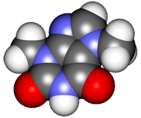
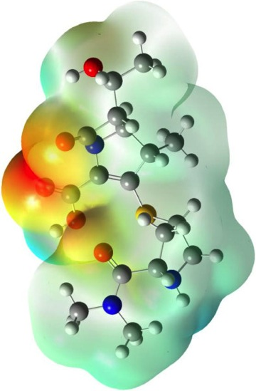
CHE2060 Lecture 6: Chirality
6.1: Symmetry & asymmetry
6.2: Nomenclature of stereocenters
6.3: Properties of asymmetric molecules
6.4: Optical isomerism
6.5: Fisher projections
6.6: Molecules with two stereocenters
6.7: Resolution of enantiomers
6.8: Stereocenters other than carbon
Daley & Daley, Chapter 11
Chirality

Slide 2
CHE2060 Lecture 6: Chirality
6.1: Symmetry & asymmetry
6.2: Nomenclature of stereocenters
6.3: Properties of asymmetric molecules
6.4: Optical isomerism
6.5: Fisher projections
6.6: Molecules with two stereocenters
6.7: Resolution of enantiomers
6.8: Stereocenters other than carbon
Daley & Daley, Chapter 11
Chirality

Slide 3
Symmetry & asymmetry

Slide 4
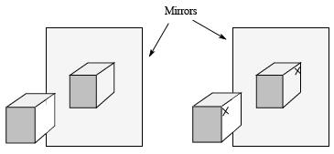
Symmetry & asymmetry
All 3D objects are either symmetrical or asymmetrical. A common test for symmetry uses mirrors to compare and object with its reflection.
Test: Can an object be superimposed upon it’s mirror image?
If the object is superimposible, then it’s symmetrical.
If the object is not superimposible, then it’s asymmetrical.
D&D, p.534
Notes:
M

Slide 5
Chirality: property of asymmetrical molecules
Chiral: means hand or “handedness”, or asymmetrical
Chiral objects cannot be superimposed upon their mirror images.
Give some other chiral and achiral examples?
Chiral:
Golf clubs
CFLs
Shoes
Books
D&D, p.535
Notes:
M

Slide 6
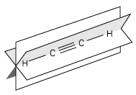
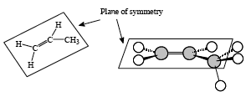
Planes of symmetry
If molecules have an internal plane of symmetry then they are achiral.
Bisects the molecule into mirror-image halves.
Chiral molecules do not have internal planes of symmetry.
Acetylene has an infinite number of planes of symmetry.
Three are shown here.
Can you identify a fourth?
Any molecule containing a C = C or C = O bond has at least one plane of symmetry. However, the rest of the molecule could negate that symmetry.
D&D, p.536
Notes:
M

Slide 7
Center of symmetry
Molecules without planes of symmetry may still be symmetrical if they have points or centers of symmetry.
To look for a point of symmetry, draw a line from a substituent through the center of the molecule and across to the other side. If the line “finds” an identical substituent or group then you’ve found a point of symmetry.
This example, trans-1,3-dibromo-trans-2,4-dimethylcyclobutane has a point of symmetry. Lines through this center can connect the two hydrogens, two bromines or two methyl groups.
D&D, p.536
Notes:
M

Slide 8
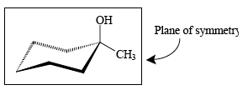
Examples
Are these molecules symmetrical or asymmetrical?
cis-1,2-dimethylcyclopropane
1-methylcyclohexanol
Plane of symmetry passing between C1 & C2 and through C3
At least 1 plane of symmetry through the ring at C1 & C4, and through both functional groups: OH and CH3
D&D, p.537
Notes:
M

Slide 9
Asymmetric molecules are optical isomers.
All asymmetric molecules are chiral. The two forms (non-superimposible mirror images) come in “right-handed” and “left-handed” pairs.
Enantiomers: the handed pairs in which an asymmetric molecule exists.
Draw (or build) the two enantiomers of 2,3-pentadiene.
This molecule has no chiral carbons, so it does not have an enantiomer.
How could you change the molecule so that it is chiral and has an enantiomer?
D&D, p.537 - 8
Notes:
M

Slide 10
Stereogenic carbons have 4 Δ substituents.
A good and simple characteristic of chiral (or stereogenic) carbons is that they are bonded to four different atoms or substitutents.
And have no planes or centers of symmetry.
Mirror-images
So the central carbon of both molecules is a sterocenter.
Non-superimposible, so enantiomers
D&D, p.538
Notes:
M

Slide 11
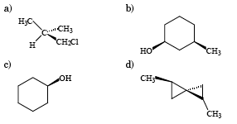
Are these molecules chiral or achiral?
Use any and all tests to find what works best for you.
The two sides of the ring are not identical.
Does not have 4 Δ substituents.
achiral
chiral
*
*
achiral
achiral
Does not have 4 Δ substituents. And has a mirror plane of symmetry.
The ring has a plane of symmetry.
5/6 ring carbons have two Hs, so don’t have 4 Δ substituents.
D&D, p.538
Notes:
M

Slide 12
Types of isomers
Same formula
Different in some way
isomers
Same connectivity?
no
yes
constitututional isomers
stereoisomers
Different single bond rotation?
no
yes
configurational isomers
conformational isomers
mirror images?
no
yes
diastereomers
enantiomers
Karty p.177

Slide 13
CHE2060 Lecture 6: Chirality
6.1: Symmetry & asymmetry
6.2: Nomenclature of stereocenters
6.3: Properties of asymmetric molecules
6.4: Optical isomerism
6.5: Fisher projections
6.6: Molecules with two stereocenters
6.7: Resolution of enantiomers
6.8: Stereocenters other than carbon
Daley & Daley, Chapter 11
Chirality

Slide 14
Nomenclature of stereocenters

Slide 15
The Cahn-Ingold-Prelog convention
The Cahn-Ingold-Prelog method can be used to differentiate between and name enantiomeric pairs as (R) or (S).
I think it’s easier with models, but some can do CIP on paper.
Steps:
Assign a priority numbers to the four atoms or substituent groups. Priority numbers are based on atomic number: highest = 1; lowest =4.
Place the lowest priority number (4) facing away from you, or into the paper.
Move from the first to the third priority group to determine (R) or (S):
Clockwise = (R)
Counterclockwise = (S)
So this is S-3-hydroxy -3-methylcyclohexene
Multiple bonds?
Double counts as two C
C = O counts as two O
Triple counts as three C
*
D&D, p.538
Notes:
M

Slide 16
Example
Label natural and synthetic serines as either (R) or (S)
1
1
4
4
3
3
2
2
(S) serine (R) serine
COOH > CH2OH > NH3 > H
D&D, p.543
Notes:
M

Slide 17
Example
Look at the molecule shown below:
Mark any stereogenic centers.
R 0r S?
1
H 4
1
*
3
*
3
2
2
4
3
H 4
2
*
1
(R,R,R)-3-(1-chloroethyl)cyclohexanol
D&D, p.543
Notes:
M

Slide 18
CHE2060 Lecture 6: Chirality
6.1: Symmetry & asymmetry
6.2: Nomenclature of stereocenters
6.3: Properties of asymmetric molecules
6.4: Optical isomerism
6.5: Fisher projections
6.6: Molecules with two stereocenters
6.7: Resolution of enantiomers
6.8: Stereocenters other than carbon
Daley & Daley, Chapter 11
Chirality

Slide 19
Properties of asymmetric (chiral) molecules

Slide 20
Properties of chiral molecules
Most physical properties of enantiomers are identical.
However, there are two critical ways in which enantiomers differ:
Each of the two enantiomers rotates plane-polarized light in different directions. Both rotate light to the same degree, just in different directions.
Each reacts differently to other chiral molecules, in biological environments.
All molecules produced biologically are chiral. So all molecules in biological organisms have only one chiral form.
So only one enantiomer of each hormone or drug will bind to and activate that hormone’s or that drug’s receptor.
The same goes for all other biomolecules.
Natural amino acids are the (L) chiral form while natural sugars are the (D) chiral form.
(L) is levorotary (to the left) while (D) is dextrorotary (to the right).
D&D, p.546
Notes:
M

Slide 21
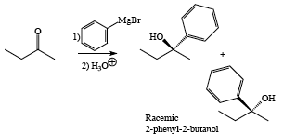
Biological vs. chemical synthesis
Biological synthesis of molecules always produces a single enantiomer; just one chiral form.
And that (biological) enantiomer is always biologically active.
But chemical synthesis creates a racemic (50:50) mixture of both enantiomers.
One enantiomer will have the expected biological activity.
The other enantiomer will have either no biological activity, or a very different biological activity.
Chemical synthesis of
2-phenyl-2-butanol produces a
racemic mixture.
D&D, p.546
Notes:
M

Slide 22
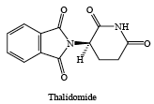
Examples of differential chiral recognition
Carvone is the organic molecule responsible for the smell & taste of both spearmint and caraway. How can it be these very different things?
(R)-carvone enantiomer “is” spearmint
(S)-carvone enantiomer “is” caraway
Each enantiomer binds only to one specific odor receptor in the nose.
*
*
Thalidomide was used in the 1960s as a mild sedative & hypnotic (mainly Europe).
Given to women for morning sickness
When given in the first trimester it caused birth defects like phocomelia (seal limbs)
(R ) enantiomer is therapeutic
However, in production temps were increased to speed production & this increased amount of (S) enantiomer that is a tetratogen.
*
D&D, p.547 - 8
Notes:
M

Slide 23
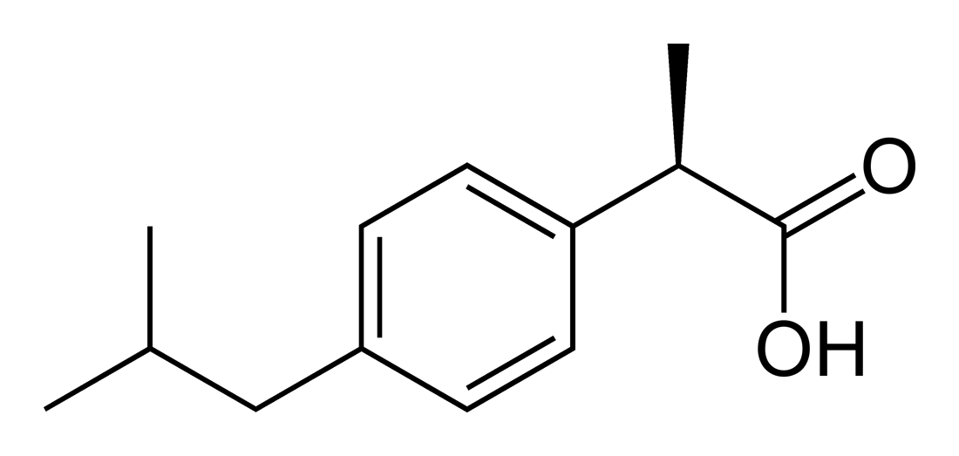
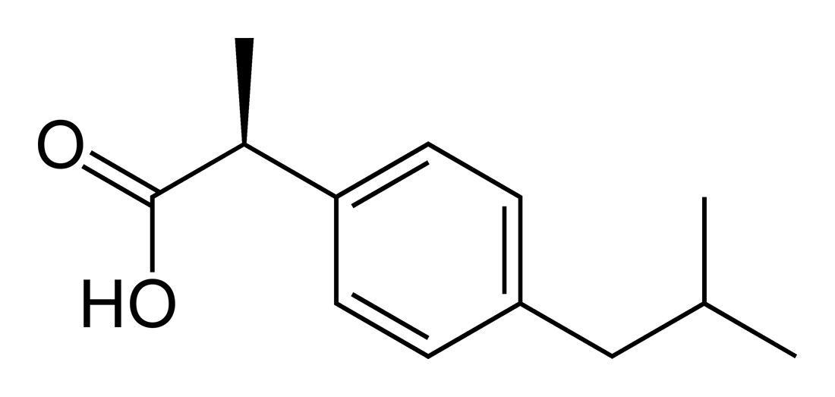
Example: ibuprofen
Ibuprofen (isobutylphenylpropanoic acid) is a non-steroidal anti-inflammatory drug (NSAID) available over the counter for inflammation and pain.
The S form is biologically active.
Should it be separated from the R-form to make a better drug?
No need!
The body has an isomerase enzyme (alpha-methylacyl-CoA-racemase) that converts the R-form to the S-form.
R-enantionmer
S-enantionmer
https://en.wikipedia.org/wiki/Ibuprofen
Notes:
M

Slide 24
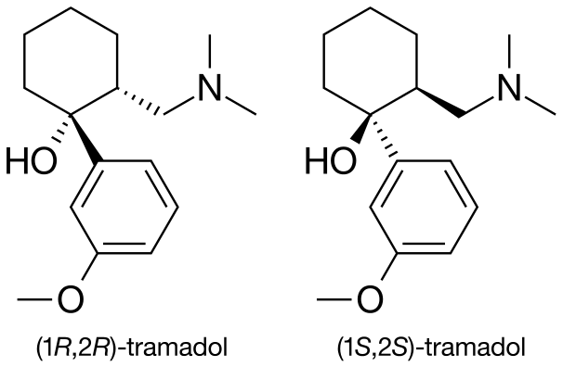
Example: tramadol
Tramadol is an opioid pan medication with 2 different mechanisms of action:
Binds to μ-opioid receptor; and
Inhibits reuptake of serotonin & norepinephrine
Tramadol is administered as a racemic mixture, because that mixture is more efficacious: the two enatiomers complement each other’s effects.
Tramadol is metabolized to O-desmethyltramadol, which is more potent than the parent compound, tramadol.
Tramadol is more effective when given in combination with acetaminophen.
https://en.wikipedia.org/wiki/Tramadol#/media/File:R-tramadol3Dan2.gif
Notes:
M

Slide 25
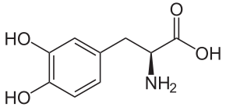
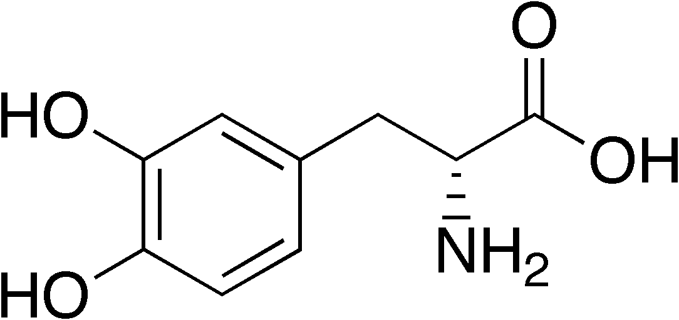
Example: DOPA
Dopamine (3,4-dihydroxylphenylalanine) is a precursor to neurotransmitters and a molecule that affects brain chemistry.
Absence of dopamine results in Parkinson’s disease.
L-DOPA is used to treat Parkinson’s disease.
D-DOPA is biologically inactive.
L-DOPA
D-DOPA
https://en.wikipedia.org/wiki/L-DOPA
https://en.wikipedia.org/wiki/D-DOPA
Notes:
M

Slide 26
CHE2060 Lecture 6: Chirality
6.1: Symmetry & asymmetry
6.2: Nomenclature of stereocenters
6.3: Properties of asymmetric molecules
6.4: Optical isomerism
6.5: Fisher projections
6.6: Molecules with two stereocenters
6.7: Resolution of enantiomers
6.8: Stereocenters other than carbon
Daley & Daley, Chapter 11
Chirality

Slide 27
Optical isomerism

Slide 28
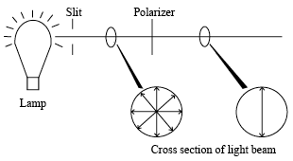
Optical isomers
Chiral molecules rotate plane polarized light.
incoming plane
enantiomer
1
enantiomer
2
Dextrorotary (D) or (+): rotates light to the right
Levorotary (L) or (-): rotates light to the left
Unfortunately D & L don’t have fixed associations with either R or S
Angle of rotation is a characteristic of the molecule.
Amount of rotation depends on concentration.
So what sort of rotation is seen with a racemic mixture?
D&D, p.548 - 51
Notes:
M

Slide 29
CHE2060 Lecture 6: Chirality
6.1: Symmetry & asymmetry
6.2: Nomenclature of stereocenters
6.3: Properties of asymmetric molecules
6.4: Optical isomerism
6.5: Fisher projections
6.6: Molecules with two stereocenters
6.7: Resolution of enantiomers
6.8: Stereocenters other than carbon
Daley & Daley, Chapter 11
Chirality

Slide 30
Fisher projections

Slide 31
Fisher projections
Fisher projections are a systematic way of showing 3D structure on the 2D page.
Projections use dash-wedge symbolism and are “coded” by vertical & horizontal axes:
Groups shown on the horizontal axis come out of the paper toward us.
Groups shown on the vertical axis recede into the paper away from us.
4
1
2
Is this R or S?
3
The molecule’s long chain should be shown on the vertical axis.
D&D, p.552 -
Notes:
M

Slide 32
Rotating Fisher projections
Rotating Fisher projections 180° does not change them.
However, they are altered by 90° rotation or by flipping them over.
D&D, p.552 -
Notes:
M

Slide 33
Fisher examples
Can you tell whether these Fisher pairs are identical molecules, enantiomers, or different molecules altogether?
Rotate 90° & now the (R) enantiomer.
When you aren’t sure, build models of both & try to overlap them as an identity test.
Rotate 180° & so identical.
D&D, p.554 -
Notes:
M

Slide 34
Fisher examples
How does the first Fisher relate to the other 3?
Identical?
Enantiomer?
Different molecule?
When you aren’t sure, build models of both & try to overlap them as an identity test.
enantiomer
identical
enantiomer
enantiomer
enantiomer
enantiomer
D&D, p.554 -
Notes:
M

Slide 35
CHE2060 Lecture 6: Chirality
6.1: Symmetry & asymmetry
6.2: Nomenclature of stereocenters
6.3: Properties of asymmetric molecules
6.4: Optical isomerism
6.5: Fisher projections
6.6: Molecules with two stereocenters
6.7: Resolution of enantiomers
6.8: Stereocenters other than carbon
Daley & Daley, Chapter 11
Chirality

Slide 36
More than one stereocenter

Slide 37
Multiple chiral carbons & diastereomers
Not all pairs of stereoisomers are enantiomers or mirror images. These are both 3-chloro-2-butanol, and they are diastereomers.
Diastereomers: stereoisomers that are not enationmers.
S
S
R
S
Conformation @ C3
has been switched.
Each of these diastereomers has a mirror image enantiomer. Draw them!
How many stereoisomers can a molecule have? Well, if it has n chiral carbons, there can be 2^{n} stereoisomers.
D&D, p.556 -
Notes:
M

Slide 38
Meso isomers
Meso compounds: another form of stereoisomer defined by an internal plane of symmetry (internal reflection).
Meso compounds have no optical activity.
In meso compounds the groups at C2 & C3 are the same…
…but the conformations at C2 & C3 are opposite.
D&D, p.557 -
Notes:
M

Slide 39
Meso examples
For each compound shown here:
Mark chiral carbons
Determine whether they are R or S
Are any meso?
Which are optically active?
R
*
*
R
meso
S
S
*
*
S
*
R
*
*
S
*
S
*
S
*
S
All but the cyclohexane are optically active.
D&D, p.557 -
Notes:
M

Slide 40
CHE2060 Lecture 6: Chirality
6.1: Symmetry & asymmetry
6.2: Nomenclature of stereocenters
6.3: Properties of asymmetric molecules
6.4: Optical isomerism
6.5: Fisher projections
6.6: Molecules with two stereocenters
6.7: Resolution of enantiomers
6.8: Stereocenters other than carbon
Daley & Daley, Chapter 11
Chirality

Slide 41
Resolution of enantiomers

Slide 42
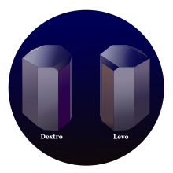
Resolving enatiomers (1)
Resolution: the separation of enantiomers from a racemic mixture
Challenges?
Both enatiomers have the same physical & chemical properties, so traditional separation techniques like distillation, filtration and recrystallization won’t work.
In 1848, Louis Pasteur separated the enantiomers of tartaric acid the old fashioned way: with a microscope and a pair of tweezers. When separated and dissolved his two forms of tartaric acid rotated plane-polarized light.
D&D, p.560 - 2
Notes:
M

Slide 43
Resolving enatiomers (2)
The most common method involves adding the same chiral molecule, either R or S to both enantiomers. [Fusion partner is usually made biologically.]
The two “fusion” projects have different properties.
Fusions can therefore be separated by usual physical means.
After separation they are “defused”.
The butanol is separated from the tartaric acid by reaction with the base hydroxide.
D&D, p.560 - 2
Notes:
M

Slide 44
CHE2060 Lecture 6: Chirality
6.1: Symmetry & asymmetry
6.2: Nomenclature of stereocenters
6.3: Properties of asymmetric molecules
6.4: Optical isomerism
6.5: Fisher projections
6.6: Molecules with two stereocenters
6.7: Resolution of enantiomers
6.8: Stereocenters other than carbon
Daley & Daley, Chapter 11
Chirality

Slide 45
Non-carbon stereocenters

Slide 46
Non-carbon stereocenters (chiral atoms)
Like carbon, silicon (Si) forms four bonds to other atoms.
Nitrogen (N), phosphorous (P), and sulfur (S) can also form stereocenters.
However, these two N enatiomers cannot be separated because they interconvert rapidly.
Other N enantiomers are separable.
CIP system assigns : the lowest priority; lower than H.
D&D, p.563 -
Notes:
M

Slide 47
Non-C stereocenter example
What type of isomers are these:
Rotate 180°
Diastereomers, ??? NEED TO MODEL IT………
D&D, p.565 -
Notes:
M

Slide 48
CHE2060 Lecture 6: Chirality
6.1: Symmetry & asymmetry
6.2: Nomenclature of stereocenters
6.3: Properties of asymmetric molecules
6.4: Optical isomerism
6.5: Fisher projections
6.6: Molecules with two stereocenters
6.7: Resolution of enantiomers
6.8: Stereocenters other than carbon
Daley & Daley, Chapter 11
Chirality

Slide 49
Key ideas about chirality (1)
All three-dimensional objects are either symmetric or asymmetric. You can superimpose a symmetric object onto its mirror image, but you cannot superimpose an asymmetric object onto its mirror image.
Stereoisomers are molecules that have the same sequence of bonds, but have a different arrangement of the atoms in space.
There are two types of stereoisomers.
1. Enantiomers: Compounds that have a mirror image relationship.
2. Diastereomers: Stereoisomers that are not enantiomers.
A carbon atom bonded to four different groups is stereogenic center. A molecule with a single stereogenic center is asymmetric. Molecules with more than one stereocenter may be chiral molecules or they may be meso molecules.
Meso molecules are symmetrical molecules with even numbers of stereogenic center. Meso isomers occur with molecules that have an internal plane of symmetry.
D&D, p.566 -
Notes:
M

Slide 50
Key ideas about chirality (2)
The pure components of an enantiomeric pair have the same melting points, boiling points, and other physical properties, but they rotate the plane of polarized light in equal but opposite directions.
Diastereomers, in general, differ in their physical properties. That is, they have different melting points, boiling points, etc.
A chemical reaction capable of producing an asymmetric product from a symmetric substrate produces both enantiomers equally with symmetric reagents. Asymmetric reagents usually prefer one enantiomer rather than the other.
Atoms other than carbon (e.g. nitrogen, phosphorus, and sulfur) can also be stereocenters. The four different groups can include a non-bonding pair of electrons as one of the groups.
D&D, p.566 -
Notes:
M

