Slide 1
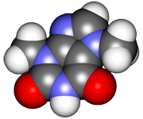
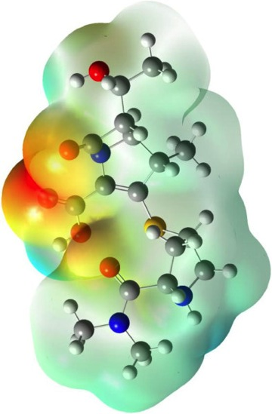
CHE2060 Lecture 7: Brief Overview of Reactions
7.1 Reaction energies & transition states
7.2 Review of acid-base reaction mechanisms
7.3 Writing reactions as transformations
7.4 Substitution reactions
7.5 Addition reactions
7.6 Elimination reactions
7.7 Competition between substitution, addition & elimination reactions
7.8 Diagnostic chart to identify reactions
Daley & Daley, Chapter 6
Reaction Mechanisms: an
Overview of Organic Chemistry

Slide 2
Addition reactions
Notes:
In the early 1800s chemists found the chemistry of living things to be amazing and a bit intimidating:
“ Organic chemistry nowadays drives me mad. To me it appears like a primeval tropical forest full of the most remarkable things, a dreadful endless jungle into which one does not dare enter for there seems to be no way out.” – Friedrich Wohler, 1835

Slide 3
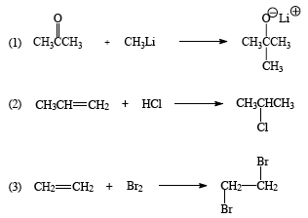
Addition reactions
In addition reactions the substrate gains atoms (or groups) from the reactant but doesn’t lose any.
Substrate is unsaturated
Occur easily & quickly because σ-bonds are more stable than the π bonds they replace
(Has multiple bond(s))
nucleophilic addition
electrophilic additions
D&D, p.279 - 81
Notes:
M

Slide 4
Nucleophilic addition
Nucleophilic addition: a Nu:- attacks the electrophilic carbonyl carbon of the substrate and adds to the substrate.
counter-ion
E+
Nu:-
final product
D&D, p.279 - 81
Notes:
M

Slide 5
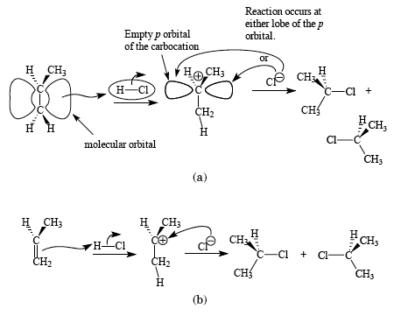
Electrophilic addition
Electrophilic addition: an alkene or alkyne serves as the Nu: and donates : to the electropositive atom of a molecule, typically an acid
Substrate is unsaturated
Reactant is often an acid
The two halves (electropositive & electronegative) are both added “across” the double bond
Nu:-
carbocation
final products
E+
Nu:-
E+
Nu:-
Nu:-
carbocation
D&D, p.279 - 81
Notes:
M

Slide 6
Which part of the reactant goes where?
In electrophilic addition, the reactant is ‘added across’ the double bond. But which ‘half’ of the reactant adds to which carbon?
Is there a difference and does it matter?
Yep!
Substrate is an alkene & acts as the Nu:
Reactant provides the E+
..
Cl:
..
Nu:
..
E+
H – Cl:
..
..
Cl:
..
D&D, p.717
Notes:
M

Slide 7
Markovnikov’s rule
Markovnikov’s rule (of regioselectivity): in the addition of HX across a double bond the H (the E+) adds to the C with the most hydrogens & the X (the Nu:) adds to the most substituted carbon.
- Vladimir V. Markovnikov, Russian, 1870
Substrate is an alkene & acts as the Nu:
Reactant provides the E+
..
Cl:
..
Nu:
..
E+
H – Cl:
..
This methyl group makes this end of the π bond more substituted.
..
Cl:
..
D&D, p.717
Notes:
M

Slide 8
Why?
The first step of electrophilic addition forms a carbocation, and formation favors the more stable carbocation.
To stabilize the carbocation, maximize the amount of charge delocalization.
More stable carbocations exist for longer periods of time, making it more likely that reactions will occur.
+
+
+
1°
2°
3°
Increasing charge delocalization & stability
So, adding the H+ (E+) to the less substituted C places the + on the more substituted carbon, creates the most stable carbocation.
Sometimes the substituted carbocation is also stabilized by resonance.
H+
..
..
..
v
Br:
H
Br:
H
Br:
+
..
..
+
D&D, p.717-8
Notes:
M

Slide 9
Thus, electrophilic addition prefers 2° & 3°
As a result of Markovniko’vs rule, electrophilic addition prefers 2° or 3° substrates.
So, imagine that you are a chemist who wants to produce alcohols from alkenes using electrophilic addition.
..
..
..
O - H
O - H
O - H
..
..
..
So, tertbutyl alcohol & isopropanol are easy …
…but ethanol, not s0 much!
H
..
H
v
O
H+
..
H
v
..
H
+
O
+
..
O - H
H
H
..
v
H+
regenerates
acid catalyst
D&D, p.717-8
Notes:
M

Slide 10
Hydroboration-oxidation for 1° alcohols
This method was developed by Professor Herbert Brown of Purdue, who won the 1979 Nobel Prize in chemistry for this useful reaction.
Sometimes said to make ‘anti-Markovnikov’ additions.
Workhorse reaction for making primary alcohols.
H
H
The boron (E+) adds to the less substituted C.
v
δ-
H
H
B
H
B
δ+
H
H
B
H
δ-
δ-
H
(Fiona transition state arrow)
borane (BH3)
2 more
1st step stoichiometry of 3 alkenes per BH3.
3 H2O2
3 NaOH
v
..
B
3
O - H
..
3 H2O
3 Na3BO3
sodium borate
D&D, p.717-8
Notes:
M

Slide 11
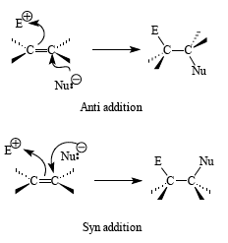
Anti addition is more common than syn
In electrophilic addition, the E+ and Nu: can add to either side, or face, of the trigonal planar alkene’s π bond.
Anti: groups add on opposite faces of the double bond
top and bottom
more common
Syn: groups add to the same face of the double bond
Both on top;
or both on the bottom
D&D, p.717-8
Notes:
M

Slide 12
Why anti?
Why is anti addition more common than syn addition?
A pre-carbocation intermediate could explain the preference for anti.
So consider the bromination of an alkene. The first
..
v
v
..
:Br – Br:
..
+
The brominium ion blocks addition of the Nu: from above (same side), so it preferentially adds from below causing anti addition.
..
..
..
Br
E+
Nu:
brominium ion
D&D, p.717-8
Notes:
M

