Slide 1
MEC3040 Module 11: Feedstock
11.1: Organics & organic waste (or residuals)
11.2: The ideal AD feedstock?
11.3: Vermont: farm vs. off-farm feedstock materials
11.4: Feedstock values of manures
11.5: Off-farm feedstock energy values
11.6: Inhibitors: the dark side of feedstock
11.7: Predicting feedstock energy content from labels?
11.8: Goal: consistent diet and homeostasis
This curriculum is adapted from: eXtension Course 3: AD, University of Wisconsin

Slide 2
11.1: Organics & organic waste (aka residuals or resources)

Slide 3
What is ‘feedstock’?
Organic materials that are fed to an anaerobic digester and are degraded by anaerobic digestion to methane.
Organic material is carbon-based. While natural biomolecules are most frequently thought of as biogas feedstock, many synthetic or man-made molecules can also be degraded by AD.
However, organic molecules that are bacteriocidal (toxic to bacteria) should not be included in AD feedstock. And bacteriocides can be either natural and synthetic.
Many types of organic material can be used as feedstock, but typical feedstock materials include:
Manure
Crop residues / energy crops
Food processing residuals
Food residuals

Slide 4
What’s been used as feedstock?
Manure
(Energy) crops
Food waste, pre- & post-consumer (aka food scraps; food residuals)
Food processing residuals:
Chicken processing
Juice processing
Brewing
Dairy production
Aquicultural wastewater
Seafood processing waste
Municipal solid waste – organic fraction (separated from MSW)
Paper & processing pulp
Shredded cardboard
Yard waste (for dry AD)
Wastewater sludge, human (aka biosolids)
Himansen (2011); Nakasaki (2009); Richards, 1994; Sezum (2011)

Slide 5
Danger of non-biodegradables?
Non-biodegradable materials fall into two classes:
Organic but refractory, like non-digestable fiber has organic origin & structure, but would require a much longer HRT or a different biological process for digestion. This material remains (somewhat) intact captured in separated solids
Non-organic / non-biodegradable
Himansen (2011); Nakasaki (2009); Richards, 1994; Sezum (2011)

Slide 6
Feedstock may be regulated
Some states allow AD of animal mortalities or slaughterhouse waste but some don’t. AD operators must check to be sure that they are complying with federal and state regulations.
Some states regulate the amounts of high-strength organics like ethanol syrup or FOG to a maximum amount.
Other cautions:
Don’t overload with high-energy feedstock like food waste.
Don’t feed known toxins like fossil fuel derivatives, ammonia or sulfides at high pH.
Recalcitrant (or poorly degradable) material requires long retention times in order to degrade most of the VS.
Inert materials yield headaches rather than biogas.

Slide 7
Tools to estimate biogas yield
These tools can be downloaded at no charge:
AgSTAR
AgSTAR Handbook
FarmWare
University of Minnesota Extension
Anaerobic Digester Economics Excel spreadsheet
This module will focus on using biogas yield values (energy values) and similar values to predict the biogas and energy yields of feedstock mixtures.

Slide 8
11.2: The ideal AD feedstock

Slide 9
The ideal feedstock?
Organic materials that are fed to an anaerobic digester and are degraded by anaerobic digestion to methane.
C:N ratio of 20:1 to 30:1
High energy content
High volatile solids (VS) content
High calorific content
Largely degradable [Materials like lignin are refractory to AD.]
Low sulfur / sulfate content
Low toxins content
(Maishanu et al., 1991)

Slide 10
Volatile solids (VS)
Volatile solids: solid material that can be ‘volatilized’ or combusted. Only VS can be made into methane.
The best feedstock materials have high levels of volatile solids.
Test for VS by combusting total solids at high temperatures.
The mass lost in combustion represents volatile solids
The mass of ash that remains are the ‘unvolatile’ solids.
Not all volatile solids will be destroyed, or converted, to biogas. The extent of VS conversion depends on:
The nature of the feedstock; and
The efficiency & operation of the AD process.
Typically, 10-40% of VS are not available to biological processes:
Non-degradable fiber (NDF)
Lignin
Biogas production estimated as 0.75 – 1.00 m³ /kg VS destroyed.

Slide 11
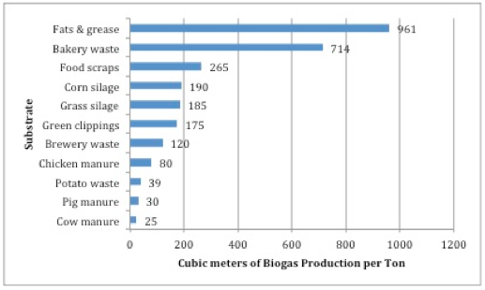
Volatile solids
Volatile solids: the organic compounds that can be made into methane. The best feedstock materials have high levels of volatile solids.

Slide 12
BOD & COD
BOD (biological oxygen demand): the amount of oxygen required for biological destruction of organic molecules
Amount of oxygen required by the bacteria that degrade organics
Measured in a week-long assay (BOD₅ or BOD₇)
[aka DR4 = dynamic respiration rate over 4 days]
COD (chemical oxygen demand): amount of oxygen required for chemical destruction of organic molecules by oxidative reactions
COD levels should be higher than BOD levels because material that cannot be degraded by bacteria can be chemically destroyed
Typically, COD = 1.5X BOD
The COD assay is faster, requiring hours rather than days
BOD can underestimate the amount of destruction that occurs in anaerobic systems, so COD may be a more useful measure of the ‘strength’ of feedstock materials.

Slide 13
VFAs are critical indicators
The most common volatile fatty acids (VFAs) are:
Acetate (2 C) = 64% of methane
Propionate (3 C) = 30% of methane
Butyrate (4 C)
Acetate is converted directly to methane; concentration predicts success.
Propionate must be broken down by a specific population of bacteria that produce acetate & formic acid:
C₂H₅COO⁻¹ + 3H₂O → CH₃COO⁻¹ + HCO₃⁻¹ + 3H₂ + H⁺¹
C₂H₅COO⁻¹ + 2HCO₃⁻¹ → CH₃COO⁻¹ + 3HCOO⁻¹ + H⁺¹
propionate acetate formate
Some methanogens can convert formate to methane. If this population is not robust and does not have sufficient trace minerals:
formate accumulates
high concentrations of formate inhibit propionate oxidizing bacteria
Banks & Zhang (2010); Batstone (2002); Jens & McCarty (1965); McCarty & Smith (1986)

Slide 14
Production of volatile acids
In a stable AD system, VFAs are used by methanogens as quickly as they are made and the concentration of acetic acid in the slurry should be 50 – 300 mg/L.
If the loading rate is increased or feedstock rich in volatile solid is suddenly added, production of VFAs will surge and pH will drop because methane production won’t be able to keep up. This is referred to as the AD going ‘sour’.
Sufficient buffering (alkalinity) will prevent this from happening.

Slide 15
VFA levels at each AD step

Slide 16
VFA:TA ratio
The ratio of volatile fatty acids : total alkalinity is a useful diagnostic test.
For manure, the VFA:TA should be no higher than 2:1
Since the ratio can reach 7.5:1 before pH changes, the Ripley ratio is a better predictor of AD stability than pH values.
AD systems with low concentrations (< 3% TS) are more sensitive to changes in acidity, so use lower VFA:TA ratios.

Slide 17
Trace elements?
A 2010 study tested a variety of feedstock mixtures in bench-scale digesters for nearly a year.
Digesters were inoculated with sewage sludge but then feed other materials.
After prolonged operation of nearly one year, digestion became unstable and failed.
Failure was associated with increased concentrations of propionate.
Further study found a drop of concentrations of essential trace elements had dropped below 1 mg/kg TS as the levels of propionate increased:
Cobalt
Selenium
Tungsten
These trace elements are co-factors for enzymes, like formate dehydrogenase, required for conversion of propionate to methane.
Banks & Zhang (2010)

Slide 18
C:N ratio
Anaerobic bacteria use C for energy and N for building cells.
Carbon is used 30-times faster than nitrogen so a 30:1 ratio is optimal for AD.
At higher C:N ratios the N is used up first & gas production then slows.
At lower C:N ratios the C is used up and fermentation stops.
Lack of acetate then stops biogas production.
And excess N becomes excess ammonia.

Slide 19
C:N ratios (1)
Why do want want high levels of carbon?
Carbon is converted to methane by reduction (addition of H atoms).
The AD process also converts carbon into CO₂.
When CO₂ dissolves (partitions) into the digestate it reacts with water to form carbonic acid (H₂CO₃). Carbonic acid is unstable and immediately breaks down to release hydrogen ions (H⁺¹) and hydrogen carbonate ions (HCO₃⁻¹). Increased [H⁺¹] decreases the pH of the digestate.
And what’s the problem with nitrogen?
High levels of nitrogen (N) are problematic because protein nitrogen can be converted to ammonia (NH₃).
Ammonia is toxic to methanogens.
And ammonia absorbs H⁺¹ to form ammonium ions (NH₄⁺¹), raising the pH of digestate.
Feedstock with high TS tend to produce more ammonia, likely because of higher protein content.
Dioha et al., (2013)

Slide 20
C:N ratios (2)
C:N ratios are even more critical if AD is operated at thermophilic rather than mesophilic temperatures.
Mesophilic = 30-40°C (usually 35-37°C)
Thermophilic = 50-60°C (usually 55°C)
As temperature is increased ammonia production also increases.
While thermophilic temperatures often increase methane production, that increase won’t be seen if ammonia levels rise and inhibit methanogenesis.
Fortunately, increasing C:N ratios reduce the risk of ammonia production.
Wang et al. (2014) showed that increasing C:N ratios could overcome ammonia inhibition when ratios were raised from:
15 to 25 for mesophilic temperatures
20 to 30 for thermophilic temperatures
Wang et al., (2014)

Slide 21
Feedstock C:N ratios
Material | C:N
Dairy cow manure | 6:1 – 20:1
Straw | 90:1
Corn stalks | 75:1
Leaves | 30:1 – 80:1
Garden waste | 30:1 – 150:1
Fruit waste | 35:1
Weeds | 30:1
Hay | 25:1
Grass | 12:1 – 25:1
Grass silage | 10:1 – 25:1
Clover | 23:1
Grass clippings | 20:1
Alfalfa | 12:1
Material | C:N
Cardboard | 350:1
Newspaper | 175:1
Vegetable scraps | 25:1
Coffee grounds | 20:1
Food waste | 20:1
Grease trap waste | 9:1 - 15:1
Brewery sludge/yeast | 1.5 – 5:1
AD liquid effluent | < 10:1
Many use color to get a quick sense of nitrogen content in feedstock:
Many high C materials are brown
Many high-N materials are green
Biocycle (2006) 47(8): 27 / Steffen (1998) / Thomas (2006)

Slide 22
Estimating C:N of mixtures
C:N ratios are actually a ratio of parts.
Example: 20:1 C:N
Consider a total of 21 parts:
20 of those parts are C
1 of those parts is N
It’s useful to convert these ratios to percentages.
For the 20:1 example:
C = (20/21)(100) = 95.24%
N = (1/21)(100) = 4.76%
These values can then be used to calculate volume or mass of C & N in the dry weight of any feedstock and any mixture. The combined masses of C & N can then be used to calculate the overall C:N ration of an AD diet.

Slide 23
Estimating C:N of mixtures
Excel spreadsheets can be used to analyze or design AD diets.
C:N ratios are a critical factor for this analysis.

Slide 24
Calculating C:N from analysis
C:N ratios can be estimated from some rudimentary biochemical data.
Volatile solids (VS; aka organic matter, OM) are that portion of feedstock that can be removed (volatilized) by combustion at high temperature. The amount of biogas that can be produced from feedstock is determined by its percent VS. Since most biological compounds have a carbon content of 45 to 60%, we can use a 55% carbon content to estimate % total carbon from % VS
Estimate C:N ratios from VS (or OM) and total nitrogen (TKN):
Divide % VS (OM) by 1.8 to estimate % carbon content. OR multiply % VS by 0.55 to estimate % carbon content.
Convert % total carbon to mass of total carbon by multiplying mass by % total carbon.
Divide the mass of total carbon by the mass of total nitrogen (TKN) for an estimate of C:N ratio.
http://compost.css.cornell.edu/calc/carbon.html Adams etal (1951)

Slide 25
Co-digestion: manure & food
A 2010 study using a GHD plug-flow digester with 30-day HRT combined scraped dairy manure with 16% (v/v) food residuals:
 | C:N | alkalinity CaCO3 g/L | pH | N:P:K | micro-nutrients
manure | 11:1 | 9.63 | 6.94 | 6:1:6 | Fe, Mn, S, Mg, Ca, Ni
residuals | 56:1 | 3.39 | 5.19 | 10:1:1 | Se, Ni
combination | 28:1 | 8.96 | 6.87 | 8:1:4.5 | sum
Biogas and methane production exceeded theoretical values calculated with Bushwell’s equation by 33% suggesting that co-digestion of manure and food residuals had a synergistic effect.
 | % destruction |  |  | % destruction
TS | 40.6 |  | COD | 67.7
VS | 55.3 |  | VFA | 99.9
Frear et al. (2009)

Slide 26
Optimal AD conditions
Parameter | Optimal Range | Reference
C:N ratio | 20:1 – 30:1 | Liu et al. (2009)
C:N:P ratio | 115:4:1 | Liu et al. (2009)
Moisture content | design dependent
TS | design dependent
VS (organic loading rate) | 0.0012 – 0.2248 kg/gallon
pH | 6.8 – 7.2
alkalinity | 2 – 5 g/L | Metcalf & Eddy (2003)
VFA/alkalinity (Ripley ratio) | 0.2 – 0.4 (0.25 optimal) | Ripley et al. (1986)
TAN (total NH₃ nitrogen) | < 1.7 g/L | Koster & Lettinga (1984)
effluent VFA | 90% destruction
Optimal HRT, %TS and temperature are dictated by AD design.

Slide 27
Feedstock loading
AD operators monitor and control AD feeding, aka loading.
Critical factors include:
Concentration of feedstock (solids/volume)
Volatile solids content of feedstock
Inorganic (or inert) content of feedstock
Volatile solids / AD volume
Hydraulic retention time

Slide 28
Calculating organic loading rate
Example: complete mixed AD (50’ dia x 20’ deep w/ 5’ cone depth)
Fed 5,000 gallons manure/day @ 100F
6.5% TS, 69% VS, density =1
Calculating manure volume
cylinder = (π)(r²)(h) = (π)(25²)(20) = 39,250 ft³
cone = (1/3)(r²)(h) = (1/3)(25²)(5) = 3,217 ft³
total = 42,521 ft³
Calculating loading rate
pounds TS/day = (gallons/day)(8.34 lb/gallon)(%TS)
= (5000)(8.34)(0.065) = 2,710 lb TS/day
pounds VS/day = (lb TS/day)(%VS) = (2,710 lb TS/day)(0.69) = 1,869 lb VS/day
loading rate = (lb VS/day) / volume of manure = 1,869 lb/day / 45,521 ft³
= 0.04 lb / day / ft³
Average loading rates are 0.02 – 0.37 lb VS / ft³ volume

Slide 29
11.3: Vermont on-farm vs. off-farm feedstock

Slide 30
Vermont: farm vs. biomass AD
On-farm AD:
Located on a farm.
At least 51% of AD feedstock must come from the farm.
SPEED contract electric revenue is around $0.014.
Biomass AD:
Can be located anywhere.
No restrictions on % of feedstock from a farm.
May use on-farm feedstock.
May not use any on-farm feedstock.
SPEED contract electric revenue is around $0.021.
For VTCAD, this requirement is part of our SPEED contract and is mentioned in our Certificate of Public Good.

Slide 31
What’s what?
On-farm AD:
Manure
Crops (fresh or ensiled)
Crop waste
Food processing residuals
Effluent (?)
Biomass AD:
Anything else that is permitted or regulated…
By ANR’s Wastewater Division via an indirect discharge permit; or
By ANR’s Solid Waste Division as the organic fraction of municipal solid waste.
Of course, the material should be organic, biodegradable and energetic.

Slide 32
11.4: Feedstock value of manures

Slide 33
Manure: it’s not energy content
Manure: has low energy since the feed has already been digested. But manure has other properties that make it a valuable feedstock material.
Manure has a neutral pH & high buffering capacity (alkalinity).
Has all the microbes needed for AD.
Has all the macro- & micronutrients needed for AD.
Manure is abundant & pumpable.

Slide 34
Buffers
The stability of AD depends on pH, and pH is dependent on…
Buffering capacity: the ability of the slurry to resist changes of pH when chemical composition changes.
Alkaline buffers have two sources:
Buffers present in feedstock (manure is a great buffer)
Buffers created by methanogens: carbonates, bicarbonates, ammonia
Feedstock with low levels of alkalinity may need to be augmented with sodium bicarbonate (the ‘Tums’ for AD).
When pH begins to drop:
The buffering capacity is nearly depleted.
The rate of fermentation > than the rate of methanogenesis.
Bacteria may be growing slowly or have been washed out.
Toxins may be present.

Slide 35
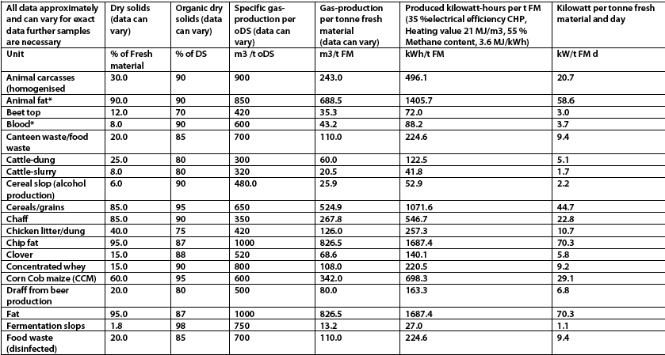
Energy values (1)
Sustainable Energy Authority of Ireland

Slide 36
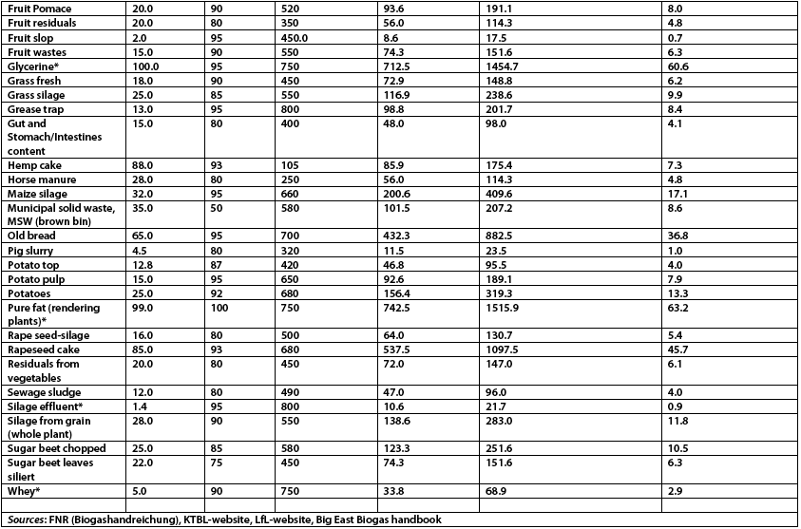
Energy values (2)

Slide 37
11.5: Off-farm feedstock energy values

Slide 38
Off-farm feedstock adds energy
Off-farm feedstock materials have more energy content (thus energy value) than manures because they have not been digested.
They add energy.
The added energy boots biogas production and revenue.
Off-farm feedstock also adds nutrients.
Disadvantages?
Off-farm materials will require: 1) more permitting; 2) communication & coordination; 3) attentive operation; and 4) may require storage.
Permitting through Vermont Agency of Natural Resources.
Communication & coordination with generators & haulers.
Added nutrients must be properly managed.
Large amounts of energetic off-farm feedstock may overload AD, causing chemical imbalance.
High energy off-farm feedstock should be fed in small amounts.
So, either deliver frequently, or store on-site and pump in daily.

Slide 39
Energy values (1)
Sustainable Energy Authority of Ireland

Slide 40
Energy values (2)

Slide 41
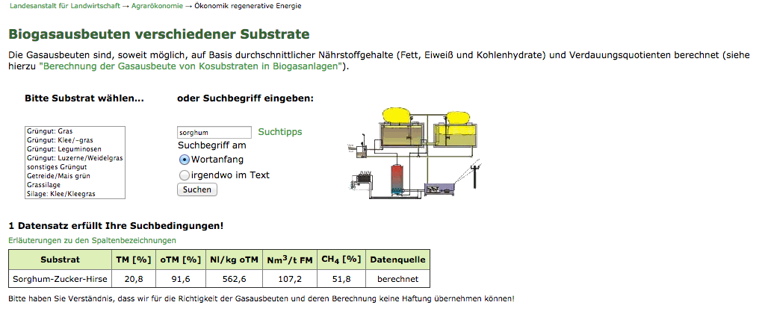
Databases for energy values
There are a number of good sources for feedstock energy values and the most extensive are from Europe.
One of the best is from the Bayerische Landesanstalt für Landwirtschaft:
http://www.lfl-design3.bayern.de/ilb/technik/10225/?sel_list=14%2Cb&strsearch=sorghum&pos=left&button=Suchen
Other sources are linked in Module 5 materials at
Richmond-hall.weebly.com

Slide 42
11.6: Inhibitors: the dark side of feedstock

Slide 43
Inhibitors
Challenge: critical elements & molecules are required for, and enhance, AD at optimal concentrations, but inhibit AD at other concentrations:
VFAs: high concentrations of VFAs cause pH to drop and inhibit AD
NH₃ (ammonia) from degradation of nitrogenous (protein-rich) feedstock
Free NH₃ is more toxic than NH₄⁺¹
NH₃ toxic at levels > 150 mg/L
NH₄⁺¹ toxic at levels > 3000 mg/L
pH can shift the equilibrium and lower toxicity
At pH 7.2 NH₄⁺¹ predominates
Metal ions from food feedstock or bases used to increase alkalinity
Acclimatization is slow
Heavy metals are more of a problem & must be avoided in feedstock
Sulfides are produced from the sulfur in protein-rich feedstock
Precipitation of sulfides by iron prevents toxicity; only soluble S⁻² is toxic

Slide 44
Toxins
Toxins (or toxicants): component of feedstock that causes an adverse effect on microbial metabolism.
Fossil fuels and their derivatives
High levels of ammonia
Insecticides
Fungicides
Antibiotics (like ionophores)
High levels of sulfides
Copper sulfate
Treatment with buffers won’t cure toxin problems.

Slide 45
Alkali & alkaline earth toxicity
These salts are needed for AD but are toxic at high levels. High soil levels will also inhibit crop growth.
cation (mg/L) | stimulatory | moderate Inhibition | strong inhibition
Na | 100 - 200 | 3,500 – 5,550 | 8,000
K | 200 - 400 | 2,500 – 4,500 | 12,000
Ca | 100 – 200 | 2,500 – 4,500 | 8,000
Mg | 75 - 150 | 1,000 – 1,500 | 3,000

Slide 46
Heavy metal toxicity
Like salts, trace amounts of heavy metals (particularly Cu, Zn, Ni) are needed for AD. But higher levels are toxic.
Addition of sulfates or hydroxides will precipitate many heavy metals at AD pH values.

Slide 47
Sulfide toxicity
Some soluble sulfides are needed for the growth of fermenting bacteria at levels of 50 – 100 mg / L. But > 200 mg/L sulfides are toxic.
Sulfides are dervived from sulfates in the feedstock
Or from proteins
Addition of iron salts can precipitate sulfides in the feedstock, preventing toxicity.
In the long run, diluting high-sulfur feedstock or reducing its use is a better solution to sulfide toxicity.

Slide 48
Ammonia toxicity
Livestock manures usually contain ammonium ion (NH₄⁺) or proteins that can be degrade to ammonia. Ammonia easily accumulates to toxic levels within feedstock.
When AD pH is greater than 7.4, 1500 – 3000 mg/L of ammonia can inhibit AD. But, under these conditions acetogenesis will occur and will lower pH.
Treatment: hydrochloric acid (HCl) can be added to reduce pH to 7.0
When the concentration of ammonia rises above 3000 mg/L it’s toxic at any pH. The best treatment is to withdraw high-nitrogen feedstock and switch to feedstock with lower ammonia potential.

Slide 49
11.6: Predicting energy from food labels?

Slide 50
Bushwell: theoretical yield
Bushwell’s formula predicts the methane productivity of a feedstock material or mixture:
Bu = CnHaOb + n – a – b H₂O → n – a + b CO₂ + n + a – b CH₄
4 2 2 8 4 2 8 4
Bu is m³ CH₄/kg VSDESTROYED at STP
Where:
VSLIPID = C57H104O6
VSPROTEIN = C5H7O2N
VSCARBOHYDRATE = C6H10O5
VSVFA = C2H4O2

Slide 51
11.7: Feedstock goal =
predictable homeostasis!

Slide 52
Homeostasis: critical concept
Homeostasis: a stable state (aka steady-state) in which many biological and chemical processes are happening, but no change is apparent to the observer.
Stability at chemical & biological levels
All biological systems strive to maintain homeostasis.
Example: Our bodies strive to maintain a constant body temperature of 98.6°F. Many chemical, biological and behavioral changes are used to maintain stable body temperature.

Slide 53
Homeostasis for AD?
In AD systems, homeostasis allows stable and predictable operation at high rates of energy production.
How do we get to homeostasis and stay there?
Find optimal operational parameters and maintain them.
Temperature, feeding, mixing
Find optimal feedstock mixtures and maintain them.
Make any changes slowly.
Changes must maintain consistent energy & biochemical inputs.
Monitor critical operational parameters like Ripley ratio, pH, C:N ratios.

Slide 54
Feedstock references:
Dioha, I.J., Ikeme, C.H., Nafi’u, T., Soba, N.I., Yusuf, M.B.S. (2013) Effect of carbon to nitrogen ratio on biogas production, International Research Journal of Natural Sciences, 1(3): 1-10.
Himansen, M & Hänninen, K. (2011) Composting of bio-waste, aerobic and anaerobic sludges. Effect of feedstock on the process and quality of compost. BioresourceTechnology, 102(3): 2842-52.
Hoffman, R.M., Wilson, J.A., Kronfeld, D.S., Cooper, W.L., Lawrence, L.A., Sklan, D., Harris, P.A. (2001) Hydrolyzable carbohydrates in pasture, hay and horse feeds: direct assay and seasonal variation. Journal of Animal Science, 79: 500 -506.
Martin, A.D. (2007) Understanding Anaerobic Digestion, Presentation to Environmental Services Association, 16.10.07, esauk.org.
Wang, X., Lu, X., Li, F., Yange, G. (2014) Effects of temperature and carbon-nitrogen (C/N) ratios on the performance of anaerobic co-digestion of dairy manure, chicken manure and rice straw: focusing on ammonia inhibition. PLOS One, 9(5): e97265
Anaerobic Digestion <http://www.rpi.edu/dept/chem-eng/Biotech-Environ/Biocontrol/AnaerobicDigestion.html>

Slide 55
Feedstock references:
Liu, Y., Miller, S.A., Safferman, S.I. (2009) Screening co-digestion of food waste water with manure for biogas production, Biofuels, Bioproducts & Biorefining, 3: 11-19.
Frear, C. Liao, W., Ewing,, T., Chen, S. (2010) Baseline Performance Monitoring of Commercial Dairy Anaerobic Digester, CSANR Research Report 2010-001, Climate Friendly Farming
Ripley, L.E., Boyle, W.C., Converse, J.C. (1986) Improved alkalimetric monitoring for anaerobic digestion of high-strength wastes, Journal – Water Pollution Control Federation, 58: 406-11
Kostner, I.W. and Lettinga, G. (1984) The influence of ammonia-nitrogen on the specific activity of pelletized sludge, Agricultural Wastes, 9: 205-16
Metcalf, Eddy (2003) Wastewater engineering treatment and reuse, 4/e, McGraw Hill, Boston, MA
Callaghan, F.J., Wase, D.A.J., Thayanithy, K., Forster, C.F. (2002) Continuous co-digestion of cattle slurry with fruit and vegetable wastes and chicken manure, Biomass and Bioenergy, 22: 71-77

Slide 56
Forage testing
Forage testing gives us insight into the total energy value and ease of availability of feedstock.
The most available fractions will cause rapid rises in volatile fatty acid concentrations & consequent drops in pH.
To create a balanced diet, match quickly available sources of N (protein) with quickly available sources of C (carbohydrates & lipids)… and so on.
Forage testing terms can be grouped by the class of biomolecule:
Overall: DM
NEI
TDN
RFV
DE
Protein: CP
ADICP
AV CP
SOL PRO
Carbohydrates: ADF
NSC
WSC
NDF
NFC
NDICP
Lignin
Wang et al., (2014)

Slide 57
Forage protein
Crude Protein (CP) = total protein content
Calculated as CP = (total N)(6.25)
Acid Detergent Insoluble Crude Protein (ADICP) (aka ‘bound protein)
Heat damaged protein, bound to acid detergent fiber, unavailable
Neutral Detergent Insoluble Crude Protein (NDICP) = available ADICP
Available Protein (AV CP) = protein available to the animal
Calculated as: AV CP = CP - ADICP
Soluble Protein (SP) = fraction of protein rapidly broken down in rumen
Degradable Protein (RDP) = SP + those intermediately degradable in rumen
Undegradable Protein (RUP) = (aka escape, bypass protein)
Degraded in lower GI rather than the rumen
Urea & Ammonia = non-protein nitrogen immediately available to microbes
Often expressed as % CPE (crude protein equivalent)

Slide 58
Forage carbohydrates
Acid Detergent Fiber (ADF) = cell wall cellulose & lignin
As ADF increases, digestability & energy decrease (particularly high lignin)
Neutral Detergent Fiber (NDF) = total cell wall = ADF + hemicellulose
As NDF increases, digestability & energy decrease
Non-Fiber Carbohydrates (NFC) = total carbohydates - NDF
Calculated as: NFC = 100 – ((CP + (NDF – NDICP) + fat + ash)
Non-Structural Carbohydrates (NSC) = starch + WSC
A fraction of NFC (ranges from a small to a very significant fraction)
Monosaccarides, disaccharides, oligosaccharides + starch
Water-Soluble Carbohydates (WSC) = soluble in water or GI tract
Monosaccharides, disaccharides, oligosaccharides, fructans
Ethanol Soluble Carbohydrates (ESC) = soluble in 80% ethanol
Mono- & disaccharides
Wang et al., (2014)

Slide 59
Better view of forage carbs?
This system classifies carbohydrates by ease of digestion
Hydrolyzable Carbohydrates = those digested in the small intestine
Hexoses
Disaccharides
Some oliogosaccharides
Non-resistant starches (starches broken down by stomach enzymes)
Rapidly Fermented Carbohydrates
= digested by microbes in the large intestine
Pectin
Fructan
Oligosaccharides not digested in small intestine
Slowly Fermentable Carbohydrates
= slowly digested by large intestine microbes
Cellulose
Hemicellulose
Major sources of acetate
Hofffman et al., (2001)

Slide 60
Carbohydrate analysis
WSC (water-soluble carbohydrates) = simple, sugar & starch, quick energy
NSC (nonstructural carbohydrates) = most easily digested Measured in the lab
Sugars
Starches
Organic acids
NFC (non-fibrous carbohydrates) = same + pectin
Measured by calculating difference….
Sugars
Starches
Organic acids
Pectin
NDF (non-digestable carbohydrates) = recalcitrant; pass through in solids

Slide 61
Feedstock planning
 | 7/28 | 8/3
manure | 5,800 | 5,800
heifer | as | as
grass | as | as
silage | as | as
effluent | as | as
beer | as | as
glycerol | 100 | 200
GTW | 0 | 0
FeCl3 | 40 | 40
CaCO3 | 50 lb | 50 lb
TOTAL | 12,000 | 12,000
Ripley | 0.42
Volume in gallons
“as” indicates as delivered, provided volumes are relatively steady

